Slide 1
CLEFT LIP AND PALATE

Slide 2

 The dictionary meaning of cleft is a crack, fissure,split or gap.
 Cleft lip and palate is a congenital birth defect which is characterized by complete or partial cleft of lip and/or palate
 Not life threatening unless associated with other syndrome

Slide 3

 The approximate incidence is 1 in 700 live births,

 Cleft lip is more common among males and cleft palate is more commoly among females.
 Unilateral clefts accounting for 80% of incidence and bilateral for remaining 20%.
 Among unilateral clefts, clefts involving left side are seen in 70% of cases.

Slide 4
 Face is formed by fusion of number of embryonic processes.
 Around the 4th week of intrauterine life, five brachial arches develop at the site of future neck.

Slide 5

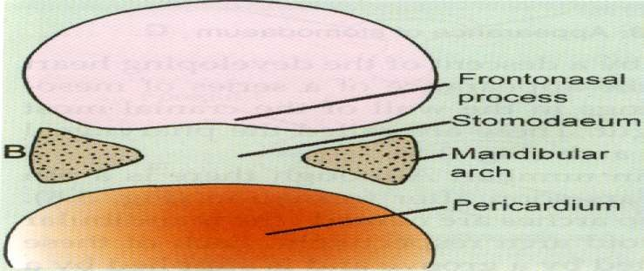
 The first arch, mandibular arch plays a role in
development of nasomaxillary complex.

Slide 6
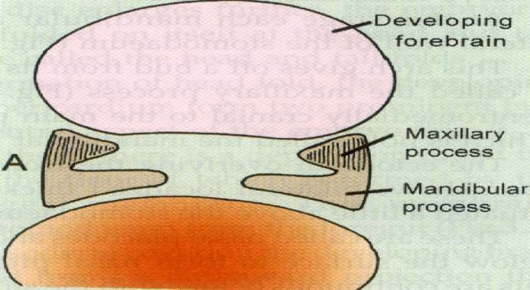
 Mandibular arch gives rise to maxillary process from the dorsal end.

Slide 7
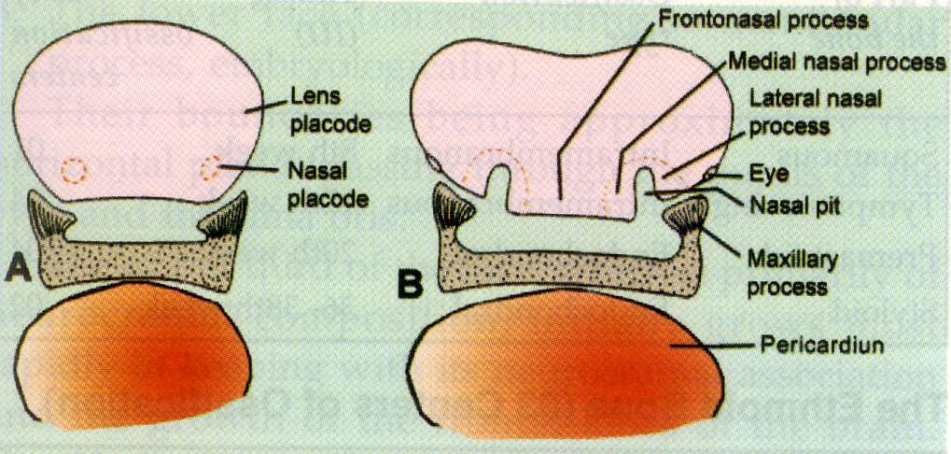
5-6th week
 With the formation of nasal pits, frontonasal process gets divided into a medial nasal process and two lateral nasal processes.

Slide 8

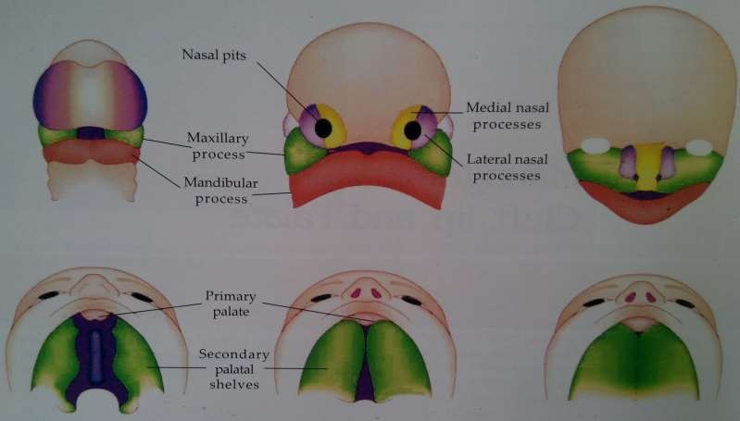
 Maxillary process fuse with medial and lateral nasal processes to form upper lip and primary palate respectively

Slide 9
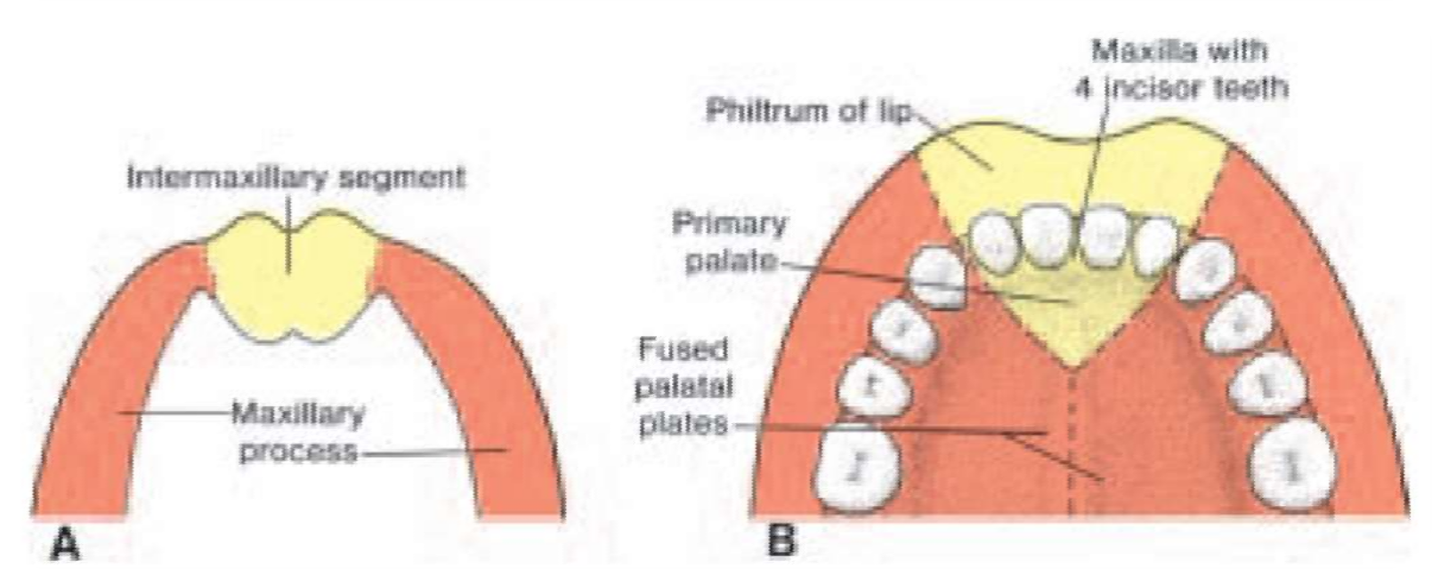
Development of palate
Development begins in 6th
week
Develops from-
1.Primary palate(from medial nasal process) 2.Secondary palate(from maxillary process)

Slide 10
 Fusion of palatal shelves begin at 8th week which continues till 12/17th week.
 Initially the palatal shelves are covered by an epithelial lining.
 As they join epithelial cells degenerate.
 The connective tissue of the palatal shelves intermingle with each other resulting in their fusion.

Slide 11

 Lower Lip is formed by the fusion of mandibular process of two sides.
 Upper Lip is derived from medial nasal and maxillary processes.
 Failure of merging between the medial nasal and maxillary processes at 5 weeks’gestation,on one or both sides,results in cleft lip.

Slide 12
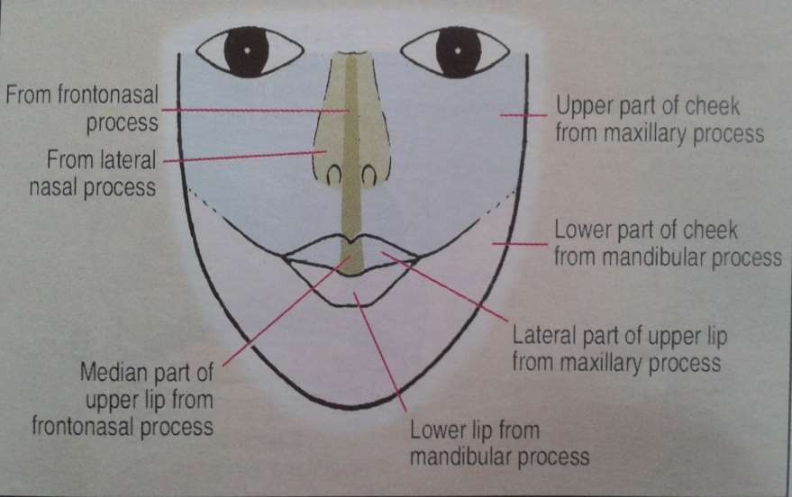

Slide 13
 If cleft of lip extends deep into primary palate, it
results in cleft of alveolus too.


Slide 14
 Cleft of palate occurs in number of ways:
Defective growth of palatal shelves
Delayed or total failure of shelves to elevate and attain a horizontal position
Lack of contact between shelves
Post fusion rupture of shelves
Failure of mesenchyme consolidation.
Failure of epithelial rupture

Slide 15

 Many workers are of view that clefts occur due to
a number of causes and no single etiology can be pinpointed.
Heredity: Drilien reported that 1 in 3 children with clefts had some relatives with similar congenital defects.
Family history is available in about 12- 20% of cases.
Tranforming growth factor alpha(TGFA)
Tranforming growth factor beta 3(TGFB3)
AP2 and MSX1
are the genes that have been identified as major role in the development of cleft lip and cleft palate.

Slide 16
o Environment: can be divided into 4 categories
i) Infections: Infections like rubella, syphilis and toxoplasmosis
ii)
Nutrition- micronutrient and folic acid
deficiencies
iv) Drugs
Certain drugs acts as teratogen that cause birth defects like
-Anti emetics
-Antiepilectic drugs( phenytoin, valproic acid)
-Thalidomide
- Dioxin, retinoic acid, maternal alcohol use, and maternal cigarette smoking

Slide 17
o Multifactorial etiology:
Recent studies show that etiology of cleft lip and palate cannot be attributed solely to either genetic or environmental factors.
IT seems to involve more than one factor.
They argue that unless a person is genetically susceptible, the environment factors may not by themselves cause clefts.

Slide 18

Increased maternal age: women who conceive late have increased risk of having offsprings with clefts
Racial: Mongoloids have greatest incidence of clefts
Blood supply: Any factor that reduces blood supply to nasomaxillary areas during embryological development predisposes to clefts

Slide 19
Cleft lip may be associated with the following syndromes:
Down’s syndrome
Wardenburg’s syndrome (abnormities of pigmentation of hair,iris and skin,deafness)
Vander Woude’s syndrome(lips pits)
Orofacial digital syndrome
Treacher collins syndrome
Pierre Robin syndrome
Klippel-Feil syndrome

Slide 20
1. Davis and Ritchie classification
Morphological classification based on the location of cleft relative to alveolar process
Group I- prealveolar clefts involving only lips and are subclassified as
Unilateral
bilateral
Group II- post alveolar clefts that comprises hard and soft palate clefts upto the alveolar ridge
Group III- alveolar clefts. Complete clefts involving the palate, alveolar ridge and lips.can be subdivided into-

Slide 21
 can be subdivided into
Unilateral
Bilateral
2) Veau’s classification
Group 1 – cleft involving soft palate only
Group 2 - cleft of hard and soft palate extending upto incisive foramen
Group 3 – complete unilateral clefts involving soft palate, hard palate, lips and alveolar ridge
Group 4 - complete bilateral clefts affecting the soft palate, hard palate, lips and alveolar ridge

Slide 22
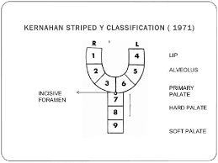
Kernahan’s stripped ‘Y’ classification
Symbolic classification
Uses a stripped ‘Y’ having numbered blocks
Each block represents a specific area on the oral cavity
 Block 1 and 4 – lip
 Block 2 and 5 – alveolus
 Block 3 and 6 - hard palate anterior to incisive foramen
 Block 7 and 8 – hard palate
posterior to incisive foramen
 Block 9 – soft palate

Slide 23
Dental problems
Aesthetic problems
Hearing and speech problems
Psychological problems

Slide 24
1) Dental problems
Congenitally missing teeth( mostly upper lateral
incisors)
Presence of supernumerary, neonatal and natal teeth
Ectopically erupted tooth
Enamel hypoplasia
Microdontia, macrodontia
Fused teeth
Gemination, dilaceration

Slide 25
Tendency towards class III skeletal pattern
Posterior and anterior cross bite
Deep bite
Spacing/ crowding
Protruding premaxilla
2) Esthetic problems
Facial disfigurement
Orofacial structures can be malformed and congenitally missing
Deformities of nose can also occur

Slide 26
3) Hearing and speech problems
-Children with cleft often have associated speech and
language disorder.
Patient with delayed development of speech may have receptive language problems that arise because of the collection of fluid in middle ear
Hearing loss may also occur due to ossicular malformation

Slide 27
Speech problems are more severe if surgery is delayed
4)Psychological problems
Patients are under a lot of psychological stress.

Slide 28
Multidisciplinary approach
Gynecologist
Pediatrician
Neurologist
Plastic surgeon
Oral surgeon
Pedodontist
Orthodontist
Speech therapist
Prosthodontist
Audiologist
Otolaryngologist
Psychologist

Slide 29
Birth to 1 month Initial assessment
Presurgical orthopaedics
3 months
Primary lip repair 9 to 18 months
Palate repair 2 years
Speech assessment
3-5 years
Lip revision surgery 8-9 years
Initial interventional orthodontics in preparaton for alveolar bone grafting
Continuing speech therapy

Slide 30
10 years
Alveolar bone grafts 12-14 years
Definitive orthodontics 16 years
Nasal revisional surgery
17-20 years Orthognathic surgery
Advanced conservative treatment

Slide 31
Parents are usually not prepared to face this problem.
Sometimes, they have a feeling of guilt that they had done something wrong during pregnancy.
They should be informed that there is nothing known which they could have done earlier to prevent its occurrence.
The management regarding surgery,dentistry and speech therapy should be explained properly along with possible outcomes.

Slide 32
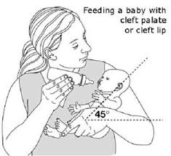
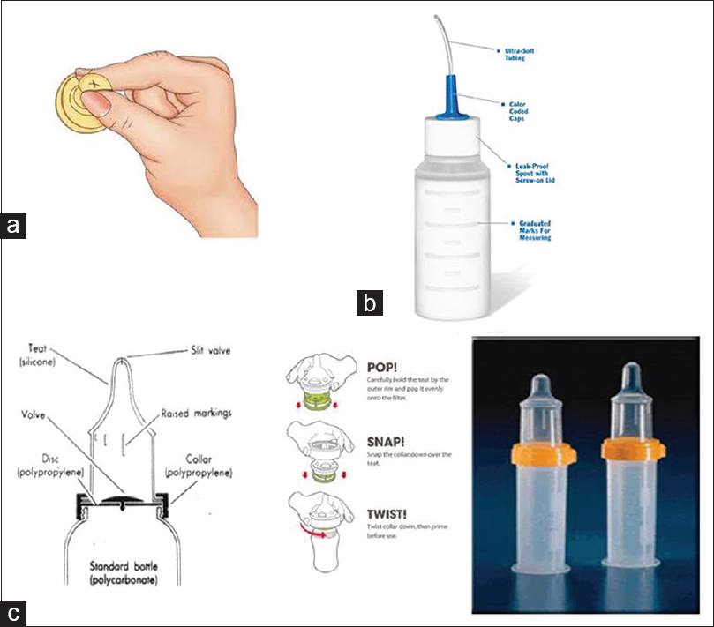
Parent counselling after birth

Slide 33
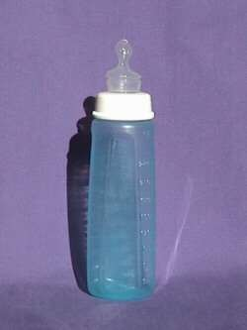
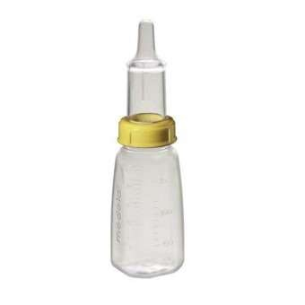
 Feeding dificulties are common, so specialized feeding bottles such as haberman feeder and Mead Johnson bottle are helpful.
Haberman feeder
Mead Johnson bottle

Slide 34
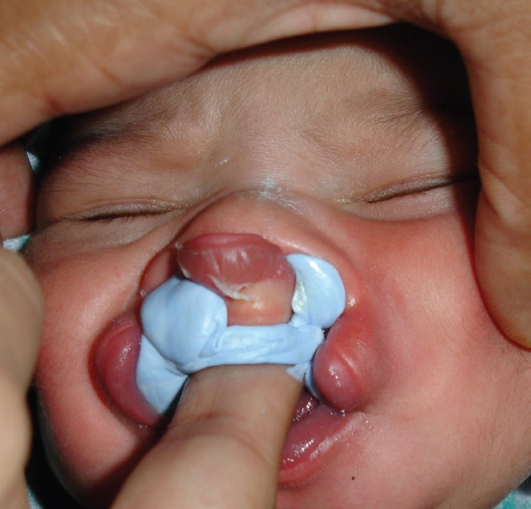
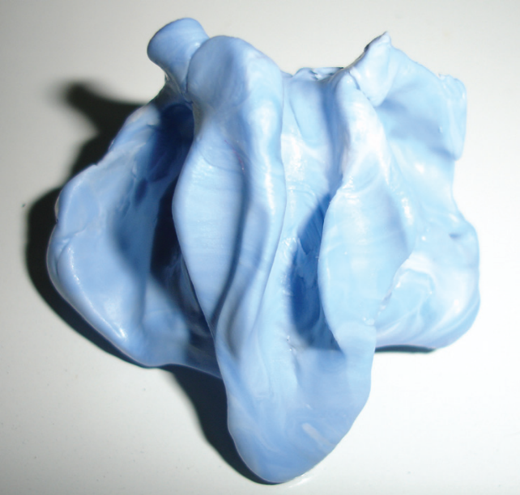
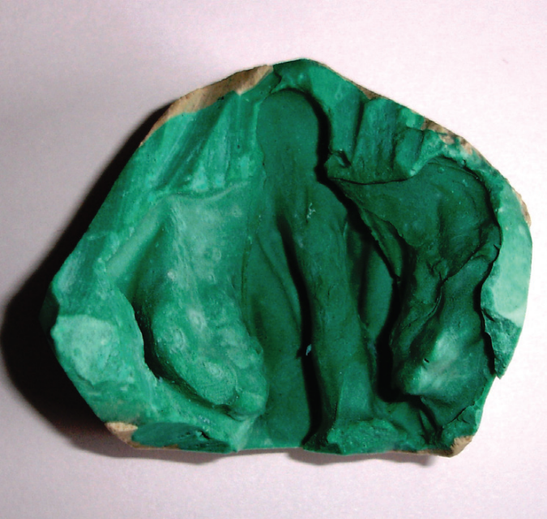
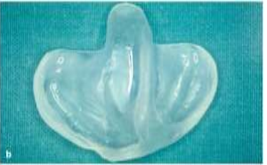
Feeding Plate or Obturator

Slide 35
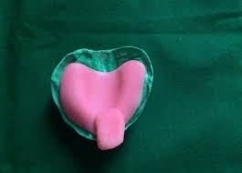
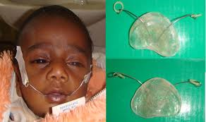
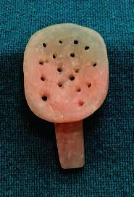
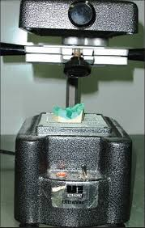
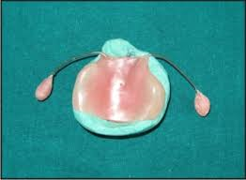
Special tray
Obturator

Slide 36
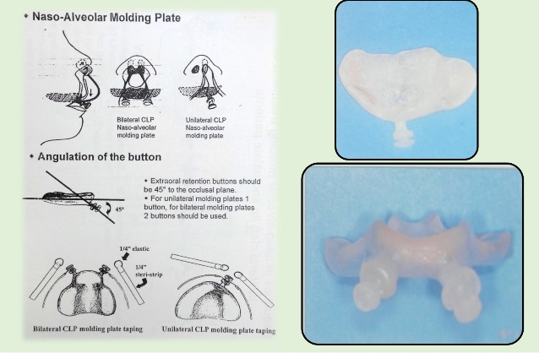
Nasoalveolar moulding (NAM)

Slide 37
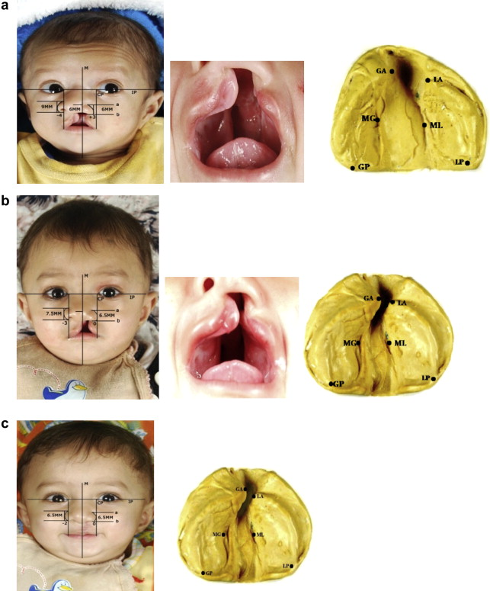

Slide 38
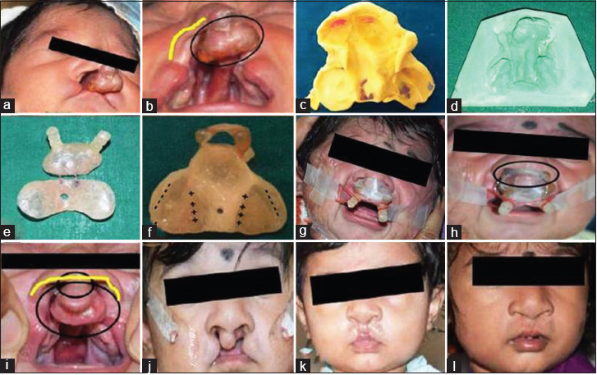

Slide 39
Primary Surgical Repair
Isolated Cleft Lip
3-4 months
Cleft Lip and Palate 3-4 months
Soft palate
8-9 months
Isolated Cleft Palate Hard +/or Soft Palate
8-9 months

Slide 40
Secondary Surgery
Speech surgery - (Pre school)
Velopharyngeal insufficiency
Alveolar bone graft - (8-10 years)
Boney union of alveolus
Orthognathic surgery - (Adult)
Malocclusion / aesthetic

Slide 41
















Surgical Management
Staging and Timing of Surgery
Different institutions = different practice
Cleft Lip
Rule of 10’s
Hb = 10g Weight of 10lbs Age 10wks
6-8 weeks
Cleft Palate
9-12 months of age

Slide 42
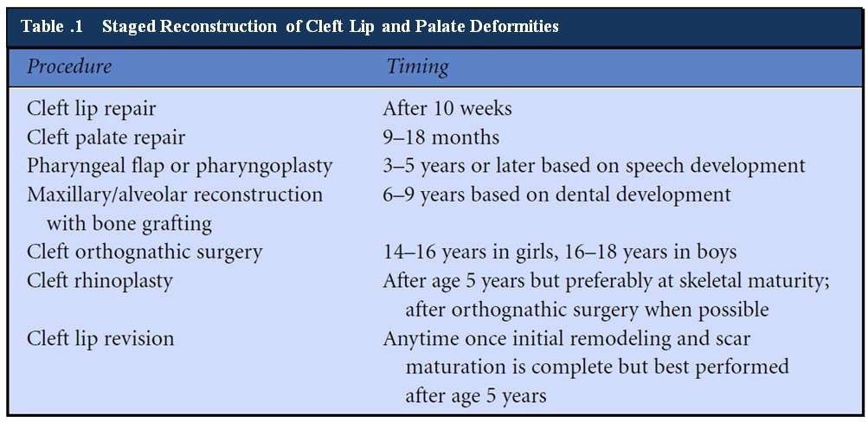

Slide 43

 Recurrent chest and throat infections: care by the neonatologist/ and paediatrician.
First few months
 Primary surgery of lip and anterior palate: done by a cleft surgeon who could be an oral surgeon/plastic surgeon/ paediatric surgeon.

Slide 44
Management of cleft lip and palate can be divided into
following stages:
Stage I- treatment done from birth to 18 month of age
Stage II- from 18 th month to 5th year of life( primary dentition stage)
Stage III- treatment carried out during mixed dentition stage from 6th to 11th year of life
Stage IV - treatment done during permanent dentition stage ( 12-18 years)

