Slide 1
Infrabulge clasp and rpi concept
Dr. Chetan Luniyal

Slide 2
Direct retainer is that component of a partial removable dental prosthesis used to retain and prevent dislodgment, consisting of a clasp assembly or precision attachment
GPT-9
A direct retainer is any unit of a removable dental prosthesis that engages an abutment tooth to resist displacement of the prosthesis away from basal seat tissue
Mccracken

Slide 3
The component that engages an abutment tooth and in so doing resist dislodging forces applied to a removable partial denture is called direct retainer.
-stewart

Slide 4
CLASP is the component of the clasp assembly that engages a portion of the tooth surface and either enters an undercut for retention or remains entirely above the height of contour to act as a reciprocating element. Generally it is used to stabilize and retain a removable dental prosthesis .
GPT 8th ed

Slide 5
CLASP ASSEMBLY is the part of a removable dental prosthesis that acts as a direct retainer and/or stabilizer for a prosthesis by partially encompassing or contacting an abutment tooth : components of the clasp assembly include the clasp, the reciprocal clasp, the cingulum, incisal or occlusal rest, and the minor connector
GUIDING PLANES
Vertically parallel surfaces on abutment teeth or/and dental implant abutments oriented so as to contribute to the direction of the path of placement and removal of a removable dental prosthesis
GPT 8th ed

Slide 6
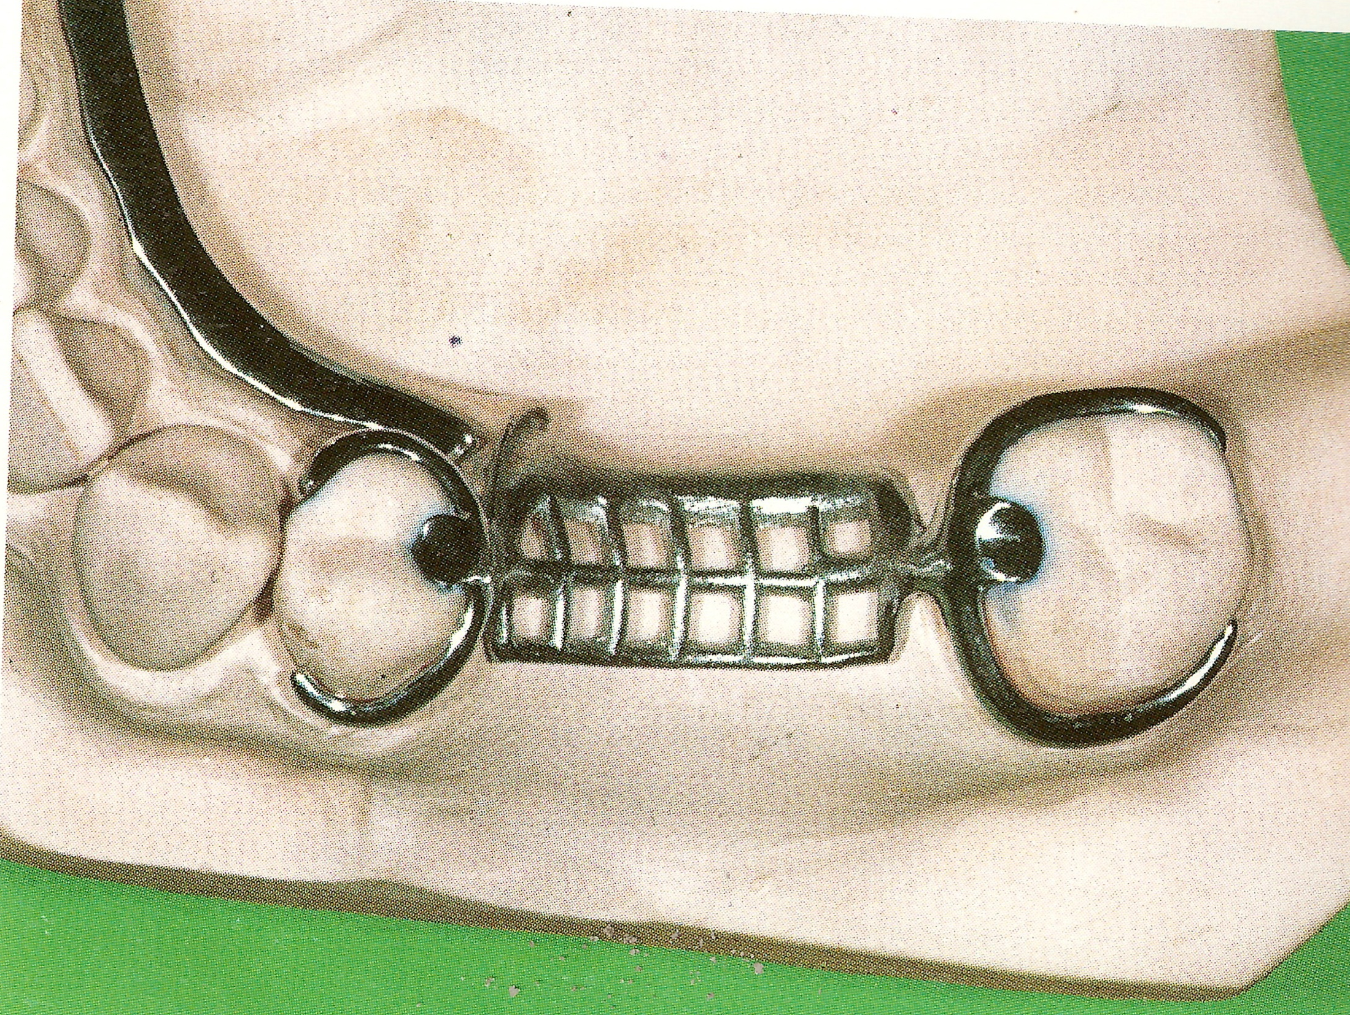
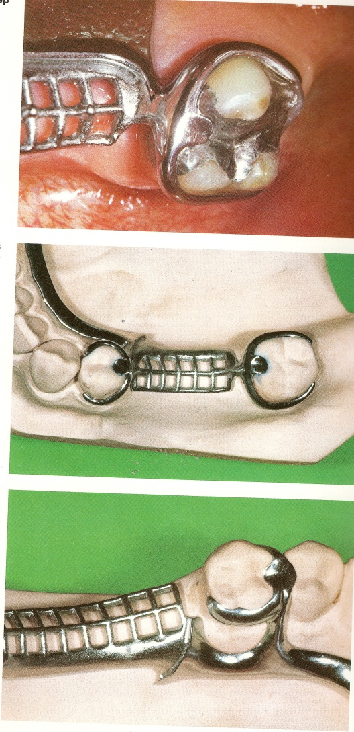
CLASSIFICATION
DIRECT RETAINERS
Intracoronal
Extracoronal
Retentive clasp assembly
Attachments
Precision
SemiPrecision
Suprabulge
Infrabulge

Slide 7
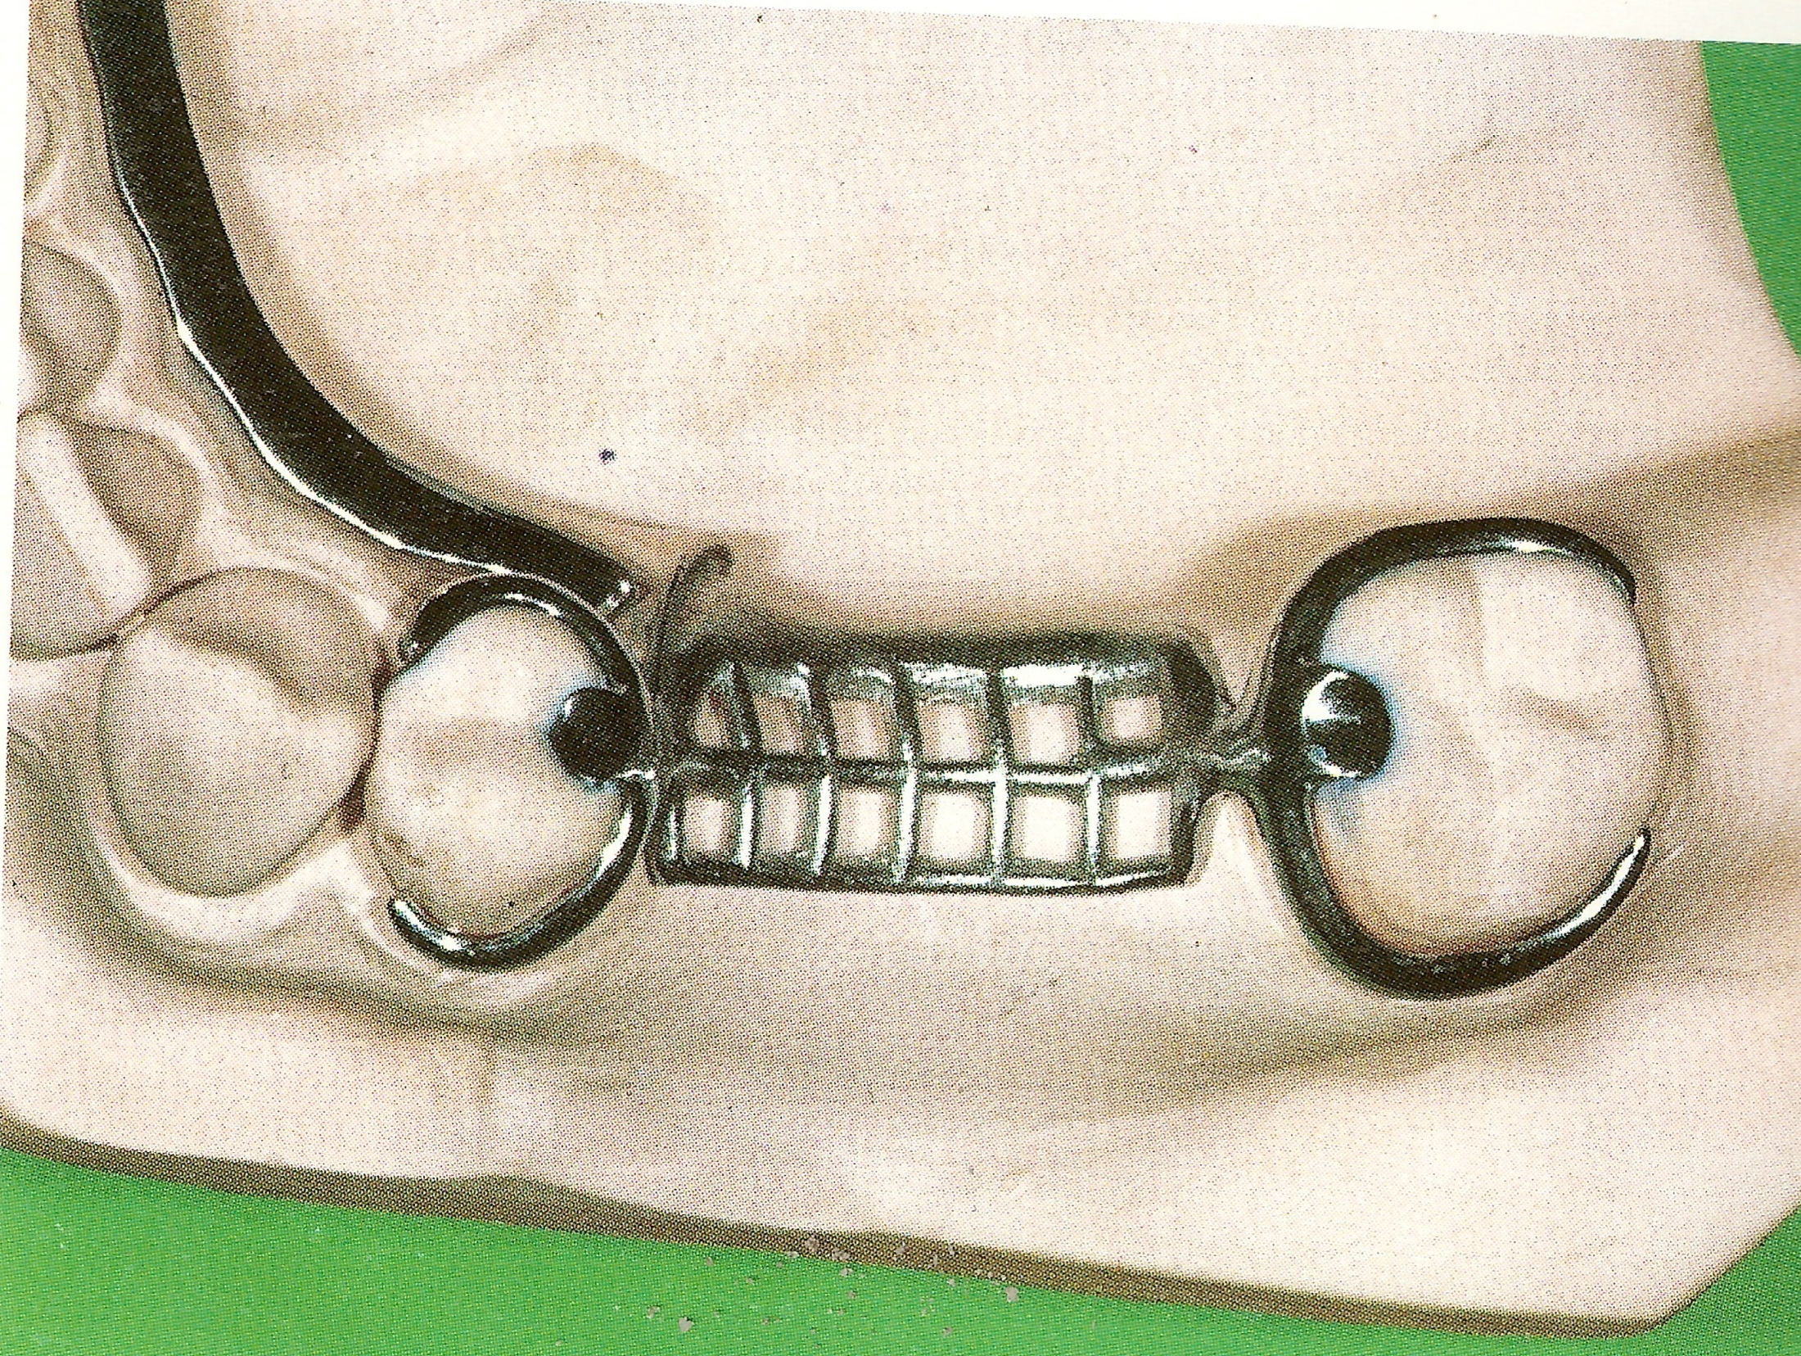
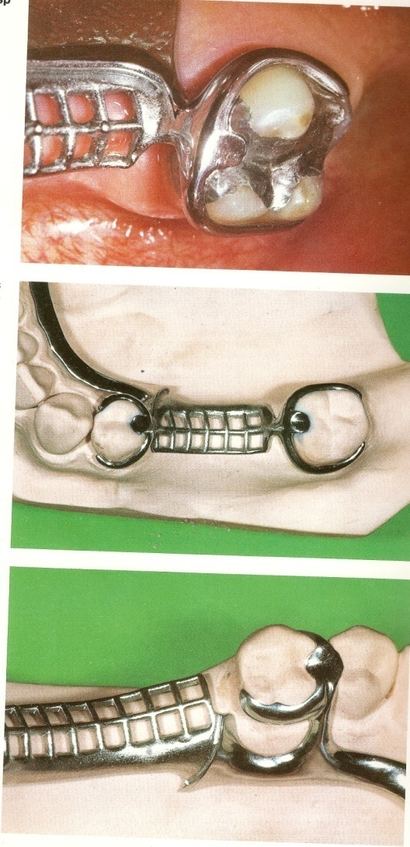
EXTRA CORONAL
Circumferential Clasp T Clasp
Reverse clasp Modified T
Multiple Circlet Clasp Y Clasp
Embrasure Clasp I Clasp / I Bar
Ring Clasp
C Clasp
Onlay Clasp
Half and Half clasp
Back action
Circumferential / Aker’s Clasp / Suprabulge
Vertical/ Bar /Roach / Infrabulge

Slide 8
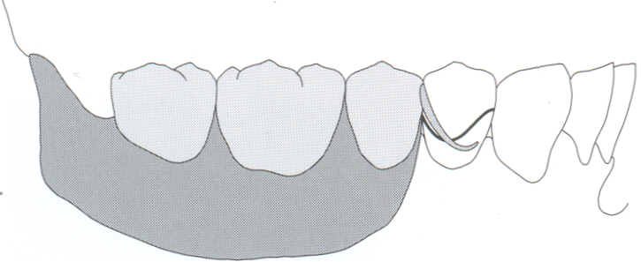
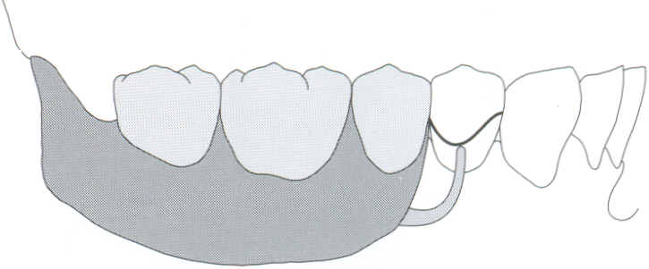
Suprabulge & Infrabulge
It was coined by Devan ( 1955)
It refers to the surface of a tooth that is occlusal to the height of contour and the surface may be said to be infrabulge when it is inclines cervically
(a) A supra­bulge retentive clasp arm originates from the removable partial denture occlusal to the height of contour
(b) In contrast, an infrabulge retentive clasp arm originates from a position apical to the height of contour.
suprabulge
infrabulge

Slide 9
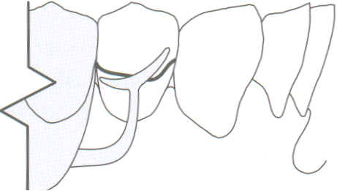
INFRABULGE CLASP ARMS
An infrabulge clasp arm consists of two distinct segments:
  the approach arm and
  the terminus ( Fig )
The approach arm is a minor connector that originates from the framework, travels horizontally along the surface of the mucosa, and then turns vertically to cross the free gingival margin at 90 degrees
The terminus arises from the vertical portion of the approach arm and engages a measured undercut on the surface of the abutment.

Slide 10
INFRABULGE CLASP
The infrabulge clasp design was introduced during the early 1900s, but did not receive widespread attention until 1930
At that time, Dr F. Ewing Roach presented his "bar-type" or "Roach" clasp
An infrabulge clasp approaches the undercut region of an abutment from an apical direction
Therefore, an infrabulge clasp exhibits a "push" type of retention
Flexibility of the infrabulge clasp is controlled primarily by the length of the approach arm. The greater the length and the more marked the taper, the more flexible the clasp

Slide 11

INFRABULGE CLASP
Vertical/ Bar /Roach / Infrabulge
Described by their geometric shape
T Clasp
Modified T
Y Clasp
I Clasp / I Bar

Slide 12
Design rules
The approach arm of an infrabulge clasp must not impinge on the soft tissues adjacent to the abutment. It is not desirable to provide relief under the approach arm, but the tissue surface of the approach arm should be smooth and well polished
The approach arm should cross perpendicular to the free gingival margin
The approach arm should never be designed to "bridge" an area of soft tissue undercut since this will produce an increased risk of food entrapment and may result in irritation of the associated soft tissues

Slide 13
To optimize flexibility, the approach arm should be uniformly tapered from its origin to the clasp terminus
The clasp terminus should be positioned as far apically on the abutment as is practical. Proper placement of the clasp terminus yields a decrease in leverage induced stresses resulting from movement of the prosthesis
The minor connector that attaches the occlusal rest to the framework should be rigid and should contribute to the overall bracing and stabilization characteristics of the prosthesis
Bar retentive clasp is used only when the retentive undercut is adjacent to the edentulous area

Slide 14
BAR OR VERTICAL PROJECTION CLASP
Vertical projection clasp approach retentive undercut from a gingival direction
Advantage
Effective retention
Less difficulty in inserting
Increased esthetics
Disadvantage
Poor oral hygiene maintenance
Less bracing & stabilization.

Slide 15
Specific Indications
When a small degree of undercut (0.01 inch) exists in the cervical third of the abutment tooth, which may be approached from a gingival direction;
On abutment teeth for tooth-supported partial dentures or tooth-supported modification areas
In distal extension base situations
in situations in which esthetic considerations must be accommodated and a cast clasp is contraindicated

Slide 16
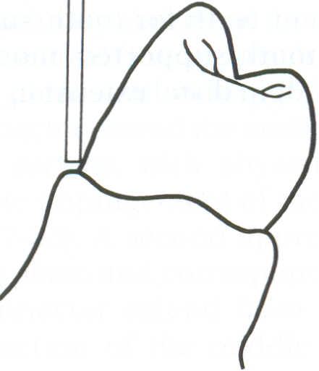
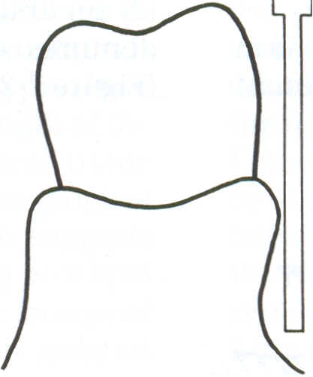
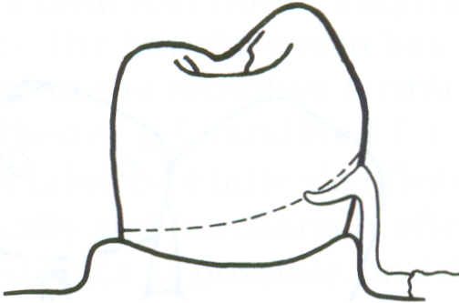
Contraindications
Severe buccal or lingual tilts of abutment teeth
Severe tissue undercuts
Shallow buccal or labial vestibules
Severe tooth undercut

Slide 17
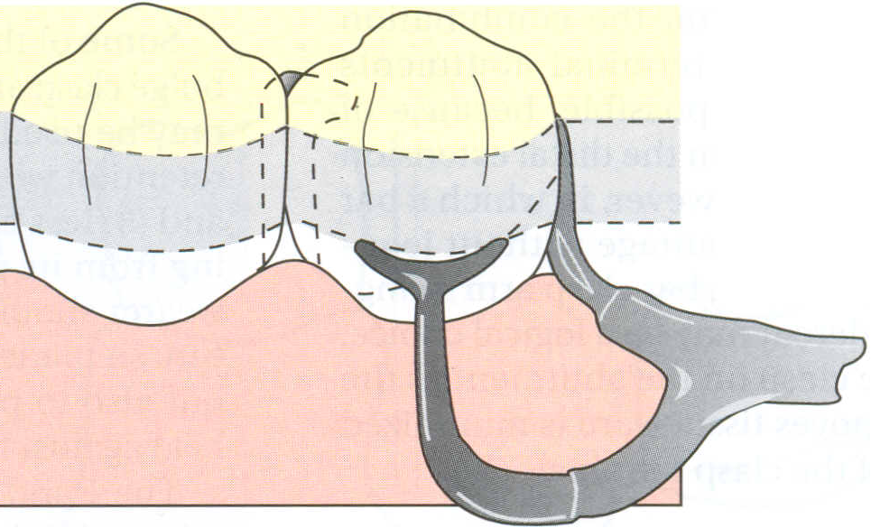
TYPES
T CLASP
. The T- clasp derives its name from the shape created where the retentive clasp arm joins the vertical aspect of the approach arm
The approach arm originates from minor connector components located in the edentulous area and projects horizontally across the soft tissues
The approach arm then turns vertically to cross the free gingival margin at 90 degrees and contact the abutment at the height of contour

Slide 18
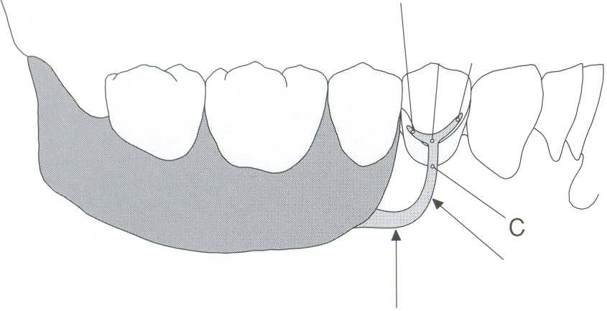
From this point, two horizontal projections arise. One projection extends toward the edentulous area This projection passes over the height of contour and enters a 0.01 a-inch undercut
The second projection extends in the opposite direction and remains occlusal/incisal to the height of contour
This projection improves bracing and stabilization provided by the clasp assembly
Both projections display a gentle curvature and point slightly toward the occlusal plane

Slide 19
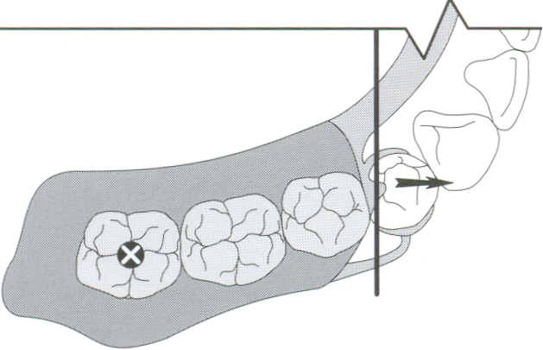
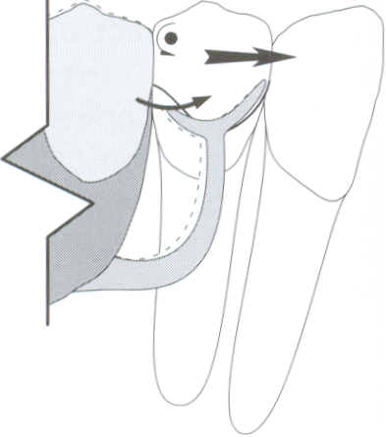
Upon loading of the extension base, the distal rest serves as a center of rotation
The tip of the retentive clasp moves apically and mesially
This minimizes potentially harmful torquing forces while transmitting a relatively small, mesially directed force to the abutment
The mesially directed force is well tolerated as a result of sound contact with the adjacent natural tooth undercut is located on the mesiofacial aspect

Slide 20
Indication
Kennedy Class I or Class II partially edentulous situations when an undercut is located adjacent to the edentulous area
Disadvantages
Causes food retention.
Less bracing compared to circumferential clasp

Slide 21
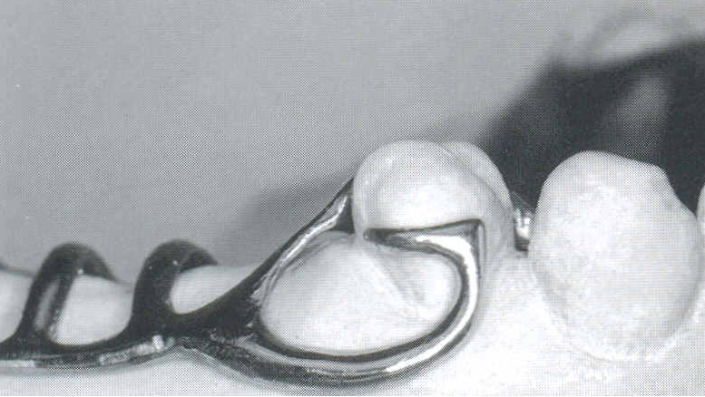
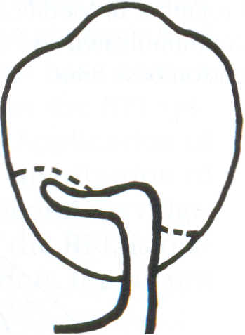
MODIFIED T CLASP
  Modified t clasp is essentially a “ T “ clasp that lacks the non retentive, horizontal projection
  The retentive component of the clasp is located apical to the height of contour and engages the specified undercut

Slide 22
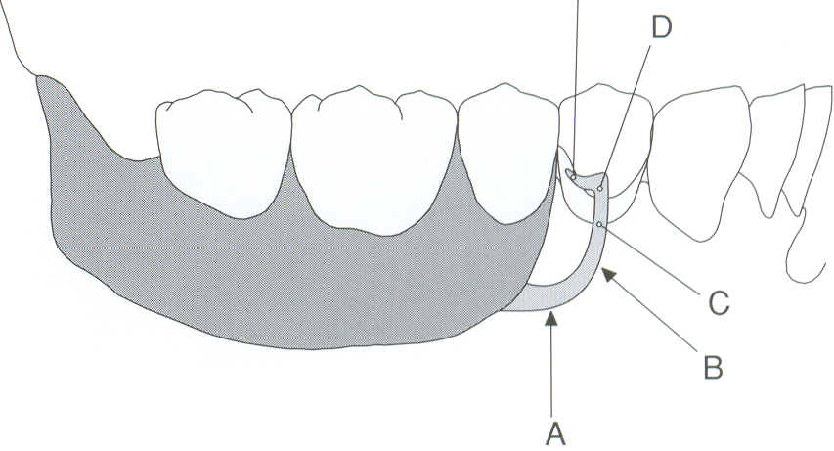
  The retentive projection is gently curved and should point slightly toward the occlusal plane E
Horizontal projection portion of the approach arm (A), vertical projection aspect of the approach arm (B),
location where the approach arm crosses perpendicular to the free gingival margin (C), point of first tooth contact at or occlusal to the height of abut­ment contour (D), terminus of the retentive clasp contacting the abutment apical to the height of contour (E)

Slide 23
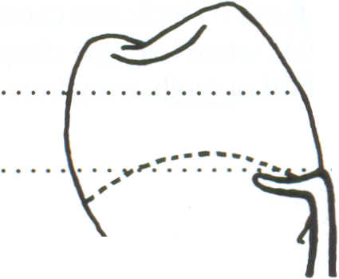
The mechanics of a modified T-clasp are nearly identical to those of a conventional T-clasp
Indications
Used in Kennedy Class I and Class applications when retentive undercuts are located adjacent to the edentulous area( s)
Used when canines or premolars will serve as abutments
Advantage
As, non retentive projection is absent, the modified T-clasp provides improved esthetics in most applications
Disadvantage
Encirclement is compromised for the esthetics

Slide 24
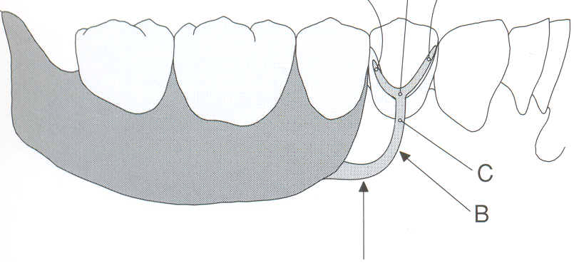
Y – CLASP
It is basically a T clasp
A Y clasp is formed when the approach arm terminates in the cervical third of the abutment while the mesial and distal projections are positioned near the occlusal / incisal surface
The mechanics of a Y-clasp are similar to those of a T-clasp

Slide 25
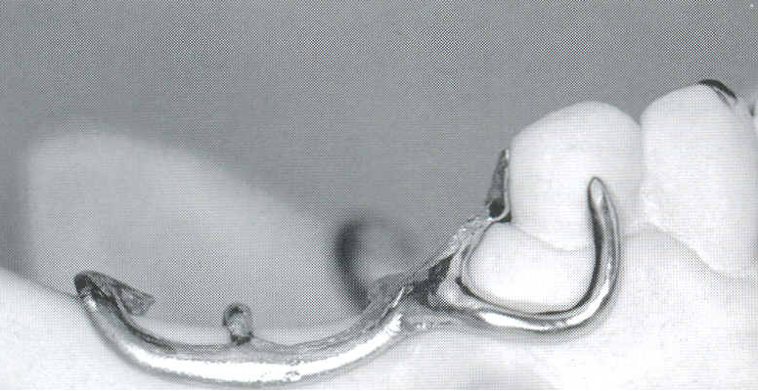
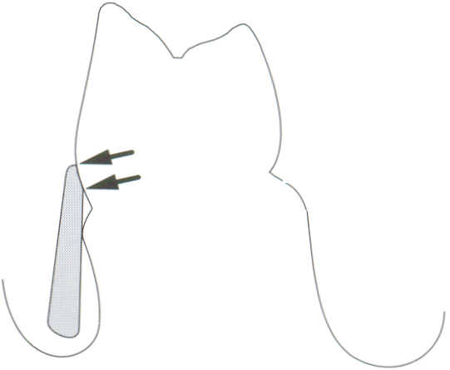
The I-clasp, or I-bar, direct retainer derives its name from the linear configuration of the vertical approach arm
The clasp arm contacts the abutment surface over an area that extends from the measured undercut to the height of contour
Typically, the contact area between the clasp and the abutment is 2.0 to 3.0 mm in height and 1.5 to 2.0 mm in width
As the I-clasp approaches the abutment from an apical direction, the clasp termi­nus makes first contact with the abutment surface at the measured undercut (bottom arrow). Contact is then maintained to the height of contour of the abutment (top arrow

Slide 26
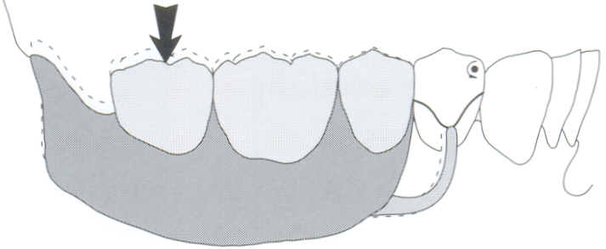
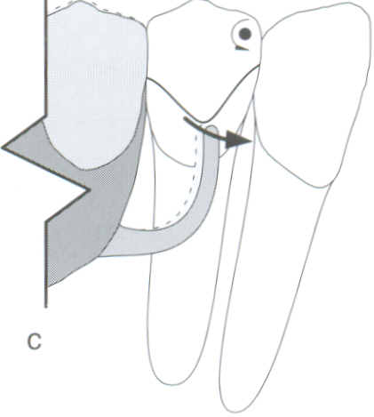
The approach arm has a half­round, cross-sectional geometry and is characterized by a gradual and uniform taper throughout its length
The clasp terminus is placed at or mesial the midfacial prominence of the abutment

Slide 27
Upon loading, the extension base is displaced toward the underlying tissues, causing the removable partial denture to rotate around a fulcrum line passing through the distal rest
This rest serves as the center of rotation and the clasp terminus moves into an area of greater undercut disengaging from the abutment, and torquing forces are minimized
This design is commonly used in the treatment of Kennedy Class I and Class II partially edentulous arches
As prosthesis rotation occurs, the retentive terminus of the I-clasp moves mesially, disengaging from the abutment. (e) Since the clasp disengages from the abutment surface, it induces no stress to the abutment, thus minimiz­ing harmful force transference
As the I-clasp approaches the abut­ment from an apical direction, the clasp termi­nus makes first contact with the abutment sur­face at the measured undercut (bottom arrow). Contact is then maintained to the height of contour of the abutment (top arrow

Slide 28
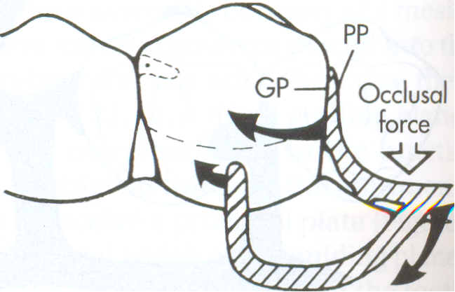
Rpi concept
The I-clasp is an integral retentive component in distinct design philosophies: the RPI concept
Dr. Kratchovil(1963, 1968) and krol (1972, 1973) developed RPI concept in an attempt to deal with the stresses that are induced by the distal extension base partial denture

Slide 29
The RPI is a current concept of bar clasp design, and refers to the rest, proximal plate, and I -bar component parts of the clasp assembly
Rationale
Design minimizes torquing forces and direct occlusal loads parallel to the long axes of abutments during rotational movement of the removable partial denture

Slide 30
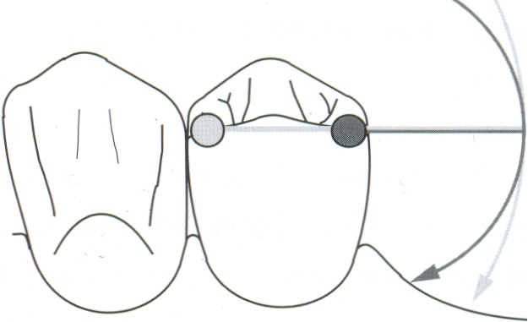
Basically, this clasp assembly consists of a mesioocclusal rest with the minor connector placed into the mesio­lingual embrasure, but not contacting the adjacent tooth
A distal guiding plane, extending from the marginal ridge to the junction of the middle and gingival thirds of the abutment tooth, is prepared to receive a proximal plate
The buccolingual width of the guiding plane is determined by the proximal contour of the tooth
The proximal plate, in conjunction with the minor connector supporting the rest, provides the stabilizing and reciprocal aspects of the clasp assembly

Slide 31
The I-bar should be located in the gingival third of the buccal or labial surface of the abutment in a 0.01-inch undercut
The whole arm of the I-bar should be tapered to its terminus, with no more than 2 mm of its tip contacting the abutment
The retentive tip contacts the tooth from the undercut to the height of contour
This area of contact along with the rest and proximal plate contact provides stabilization through encirclement
The horizontal portion of the approach arm must be located at least 4 mm from the gingival margin and even farther if possible

Slide 32
There are three basic approaches to the application of the RPI system depending on variations in these factors
The location of the rest,
the design of the minor connector (proximal plate) as it relates to the guiding plane, &
the location of the retentive arm

Slide 33
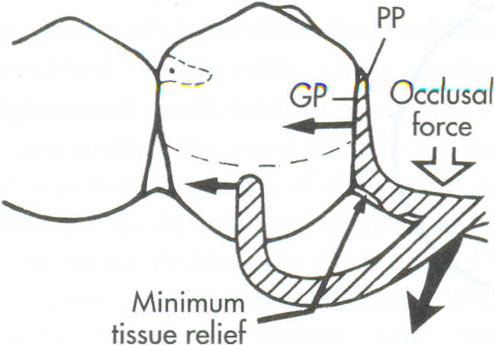
All advocate the use of a rest located mesially on the primary abutment tooth adjacent to the extension base area.
One approach recommends that the guiding plane and corresponding proximal plate minor connector extend the entire length of the proximal tooth surface, with physiological tissue relief to eliminate impingement of the free gingival margin
A second approach suggests that the guiding plane and corresponding proximal plate minor connector extend from the marginal ridge to the junction of the middle and gingival thirds of the proximal tooth surface

Slide 34
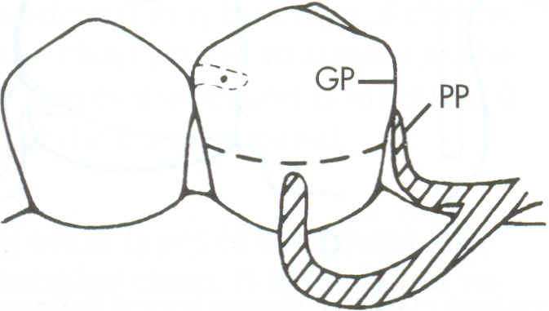
The third approach favors a proximal plate minor connector that contacts approximately I mm of the gingival portion of the guiding plane
If the abutment teeth demonstrate contraindications for a bar-type clasp, a modification should be considered for the RPI system (the RPA clasp) i.e., Rest, Proximal plate and Akers clasp

Slide 35
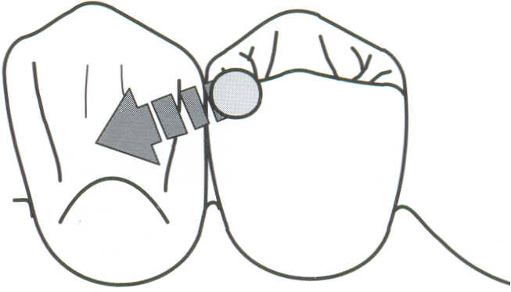
In RPI concept, mesial rest is advised in place of distal rest for 2 reasons
Anterior placement of rest helps the forces more vertically onto the tissues under the denture base extension
Mesial rest directs tipping forces on abutment mesially and move the abutment tooth into firm contact with anterior teeth

Slide 36
Proximal Plates
Parallel guide planes are prepared on all proximal tooth surfaces adjacent to edentulous spaces
Proximal plate covers the guide plane from marginal ridge to the tooth tissue junction and extends on to the attached gingiva for 2mm
This configuration provides
Stabilization of the prosthesis
Increased retention as dislodgement is limited to path of insertion
Protects tooth tissue junction
Provides reciprocation
Distributes occlusion force throughout the arch
Reunites and stabilizes remaining teeth within the arch

Slide 37
Minor Connector
Connect rests, Proximal plates and retainers to major connector
Provide horizontal stability and are located usually in buccal or lingual embrasures.
Designed such that they cross tooth tissue junction at right angles to eliminate food impaction.
Advantages
Better esthetics
I Bar is passive in its relationships to the abutment tooth except against the vertical displacement forces
Good resistance to occlusal displacement
Shows less metal in comparison to other clasps

Slide 38
Disadvantages
If design concepts are not fully developed it provides less horizontal stability
Less retention
Contra indications
Insufficient vestibular depth
Presence of tissue undercuts
Patients with high smile line
When extensive mouth preparation is required

Slide 39
THANK YOU

