Slide 1
Indirect retainers in RPD

Slide 2
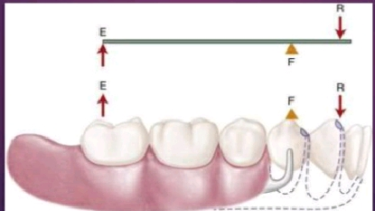
Definition
A part of a RPD which assists the direct retainers in preventing the displacement of distal extension denture bases by functioning through lever action on the opposite side of fulcrum line. ( GPT 8)

Slide 3
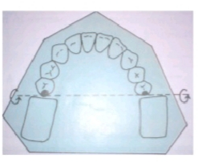
Fulcrum Lines:
An imaginary line around which a partial denture tends to rotate

Slide 4


Slide 5


Slide 6
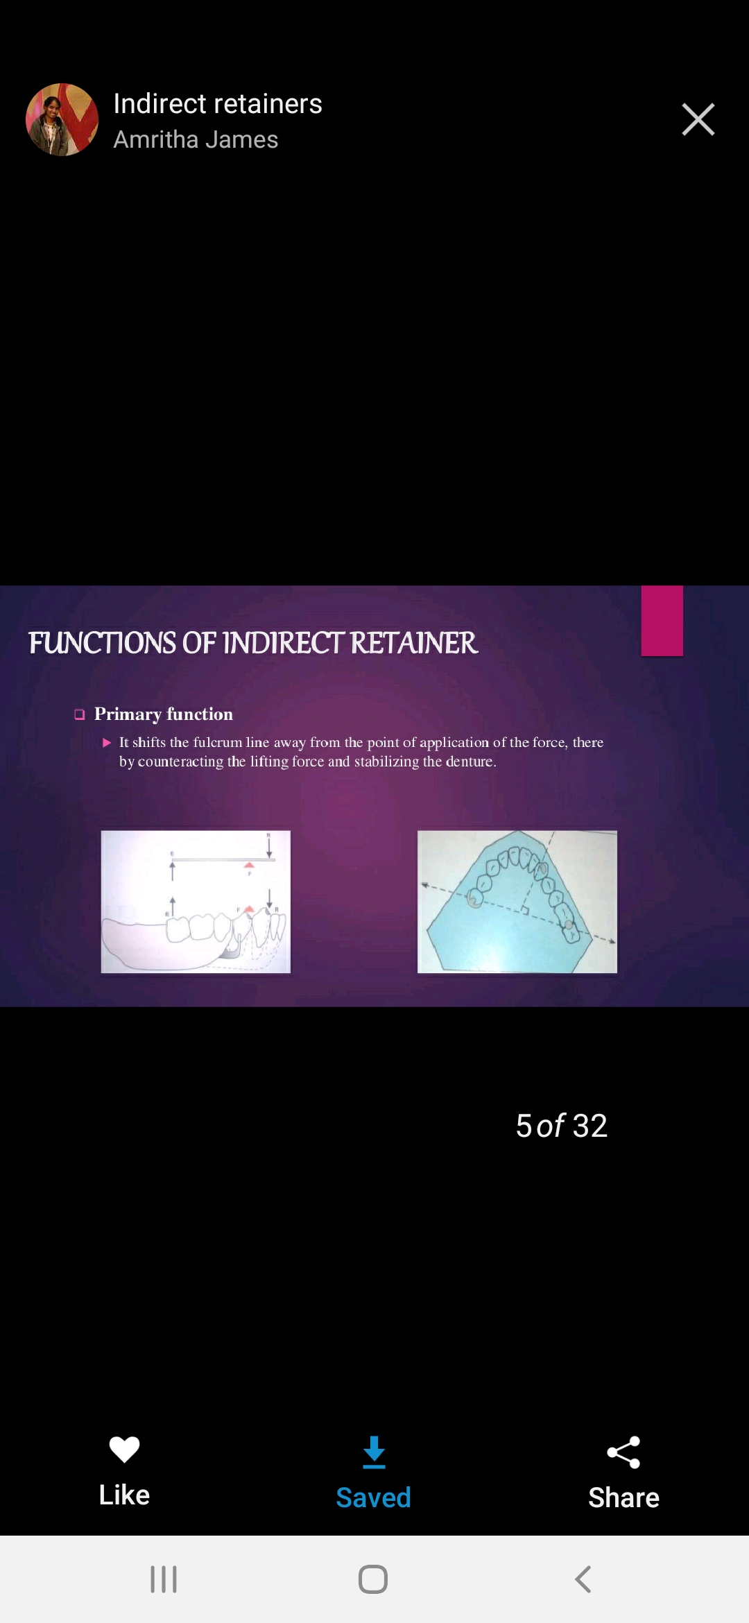

Slide 7
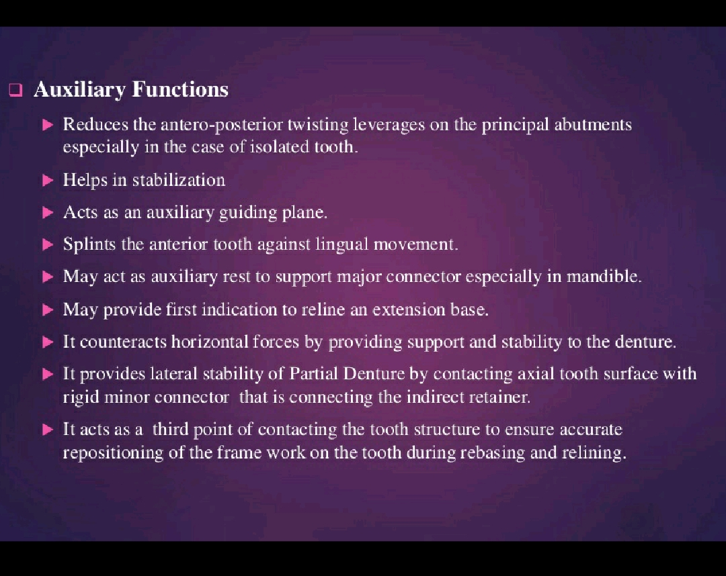

Slide 8
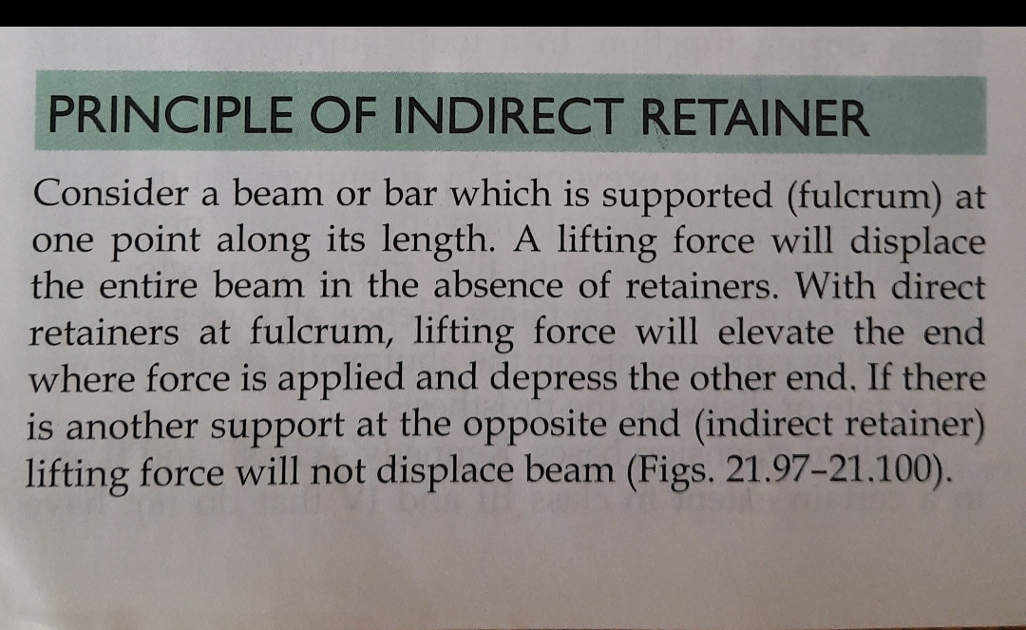

Slide 9
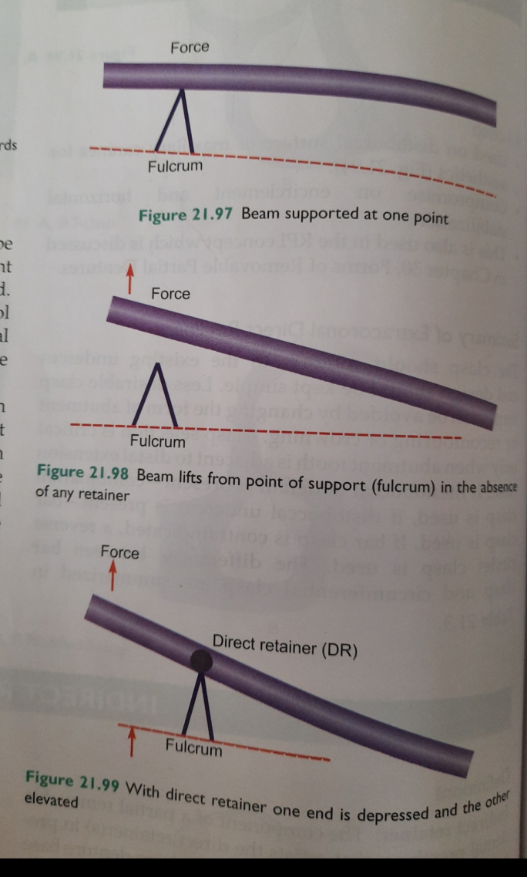
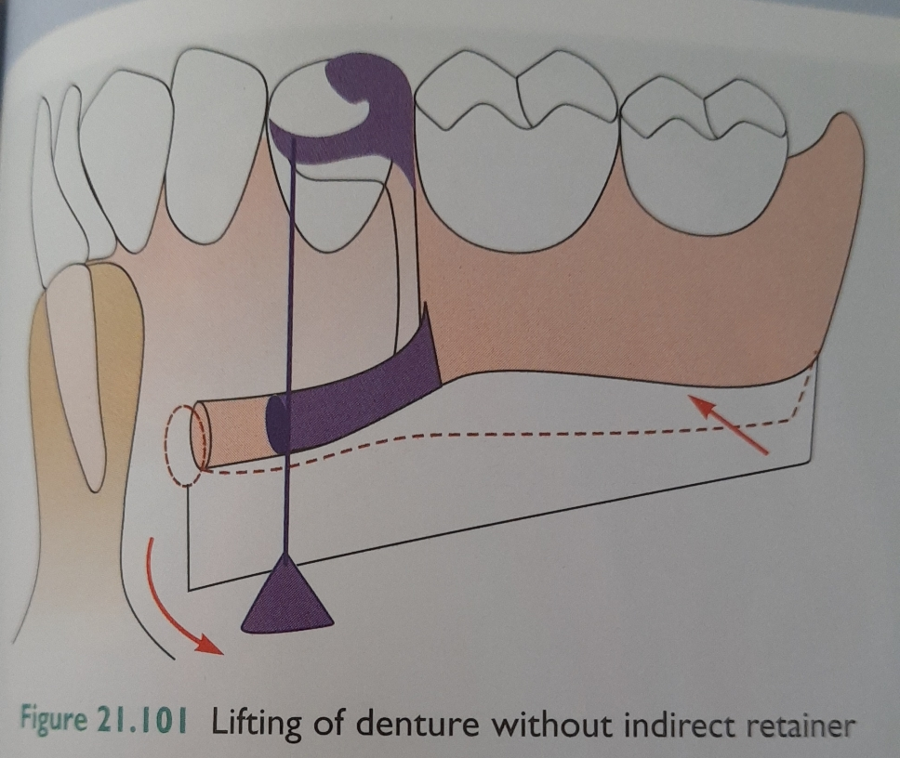

Slide 10
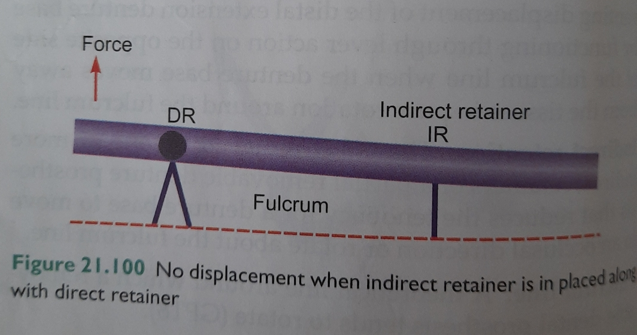
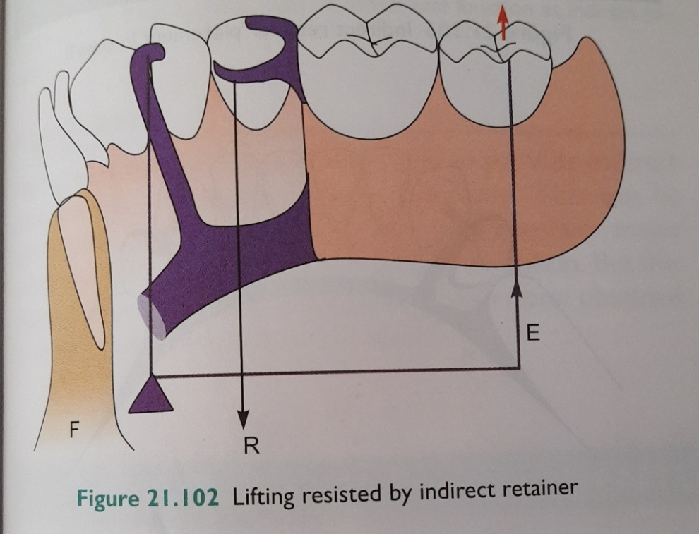

Slide 11


Slide 12
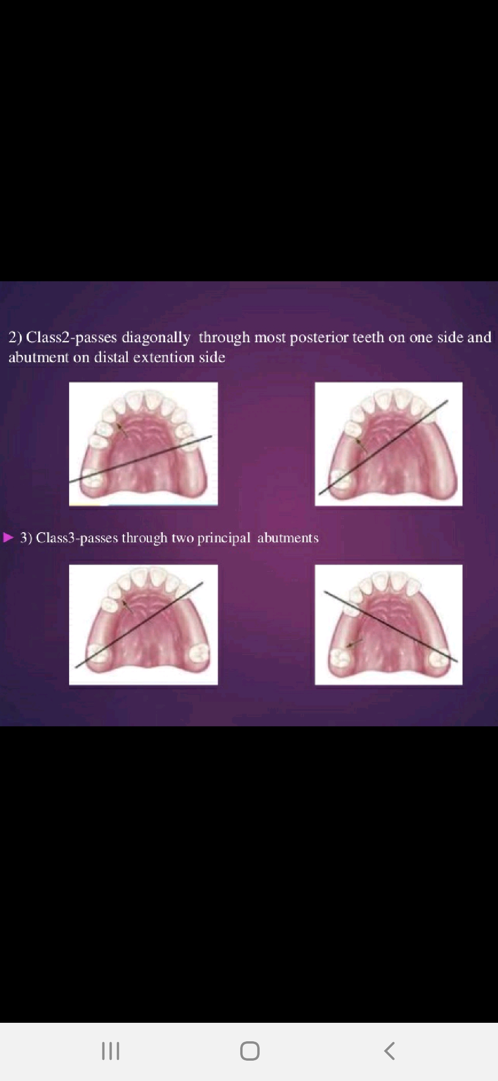

Slide 13
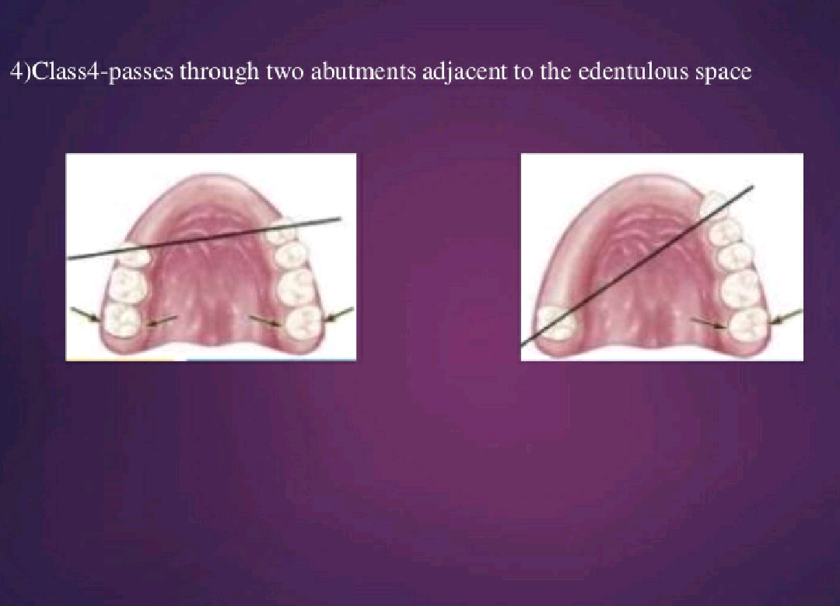

Slide 14


Slide 15
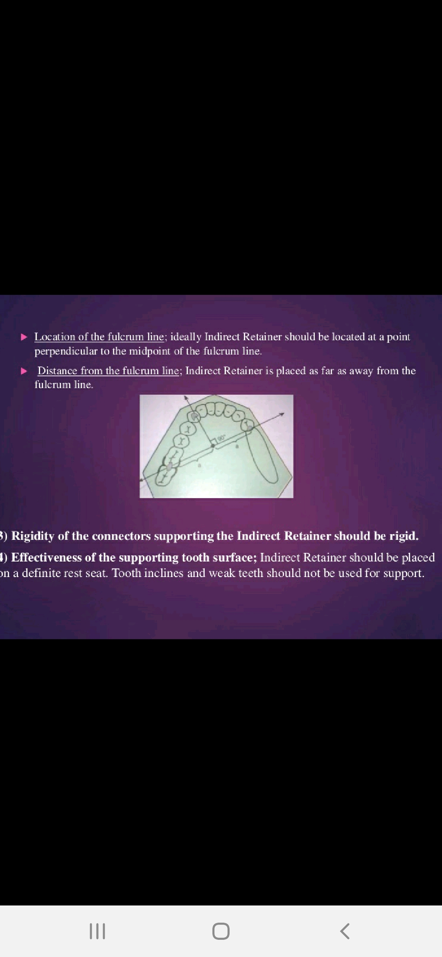

Slide 16
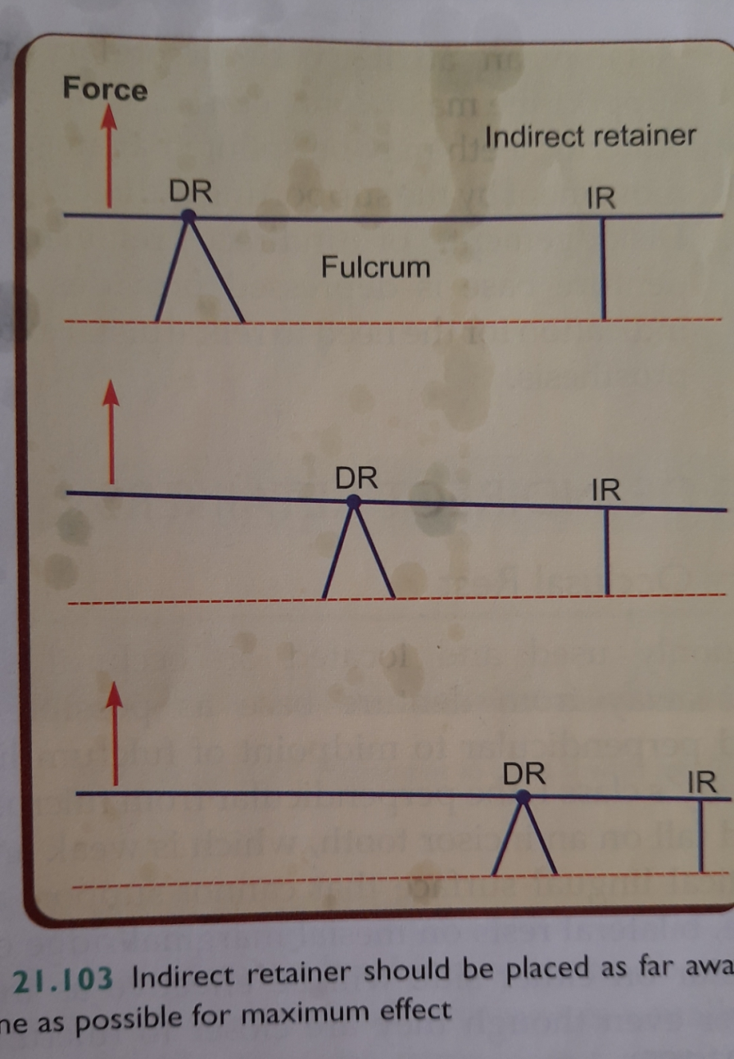

Slide 17
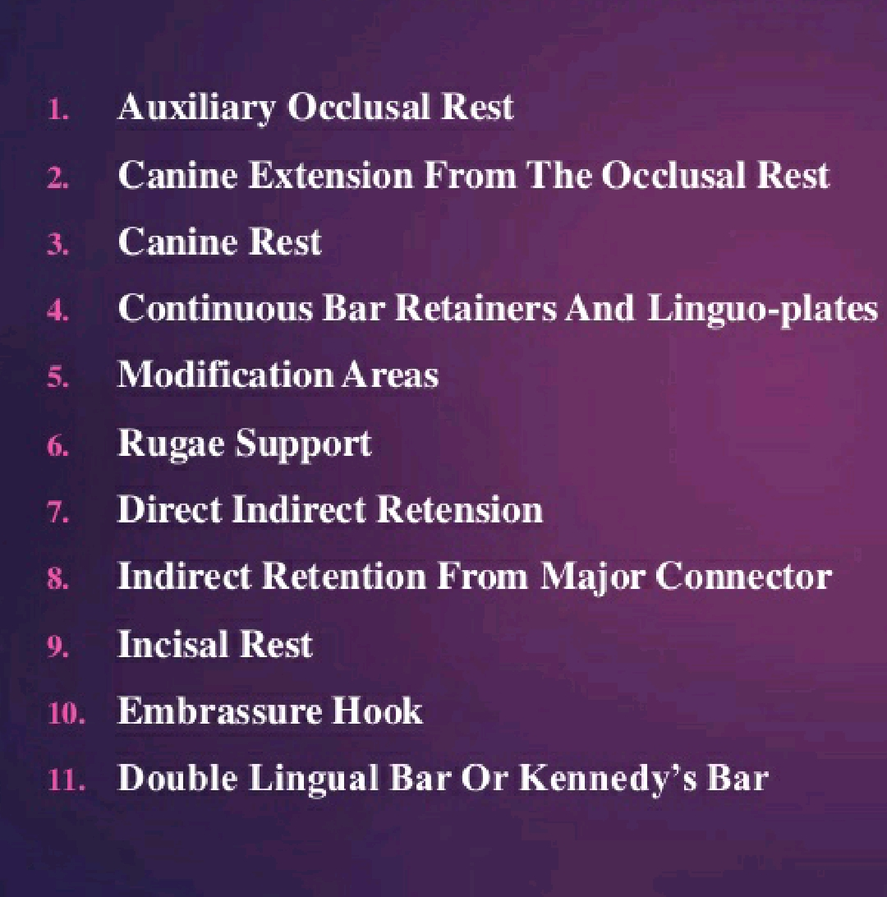
TYPES OF INDIRECT RETAINERS

Slide 18
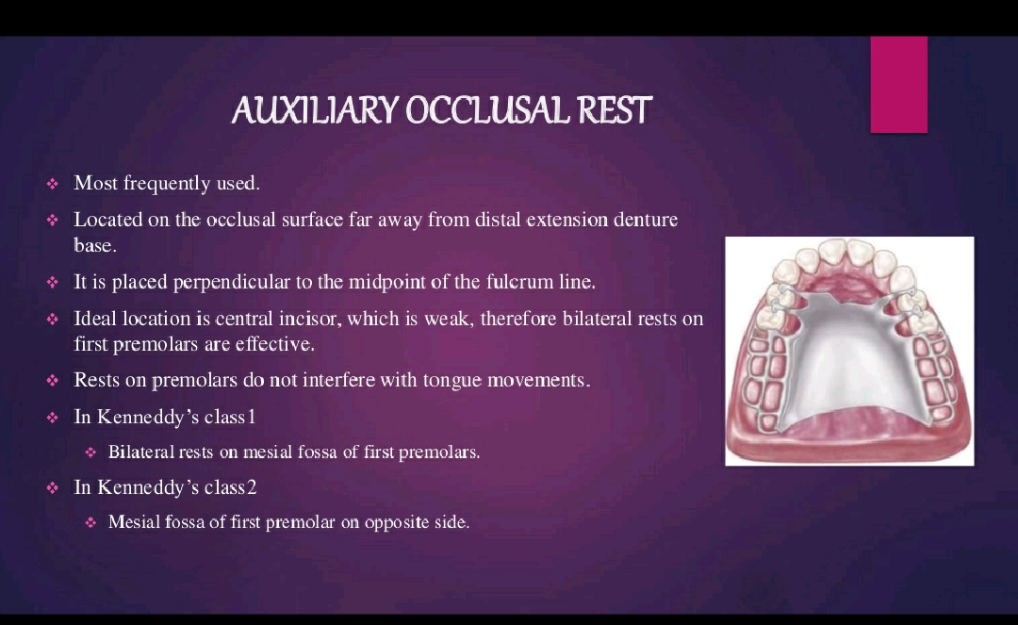

Slide 19
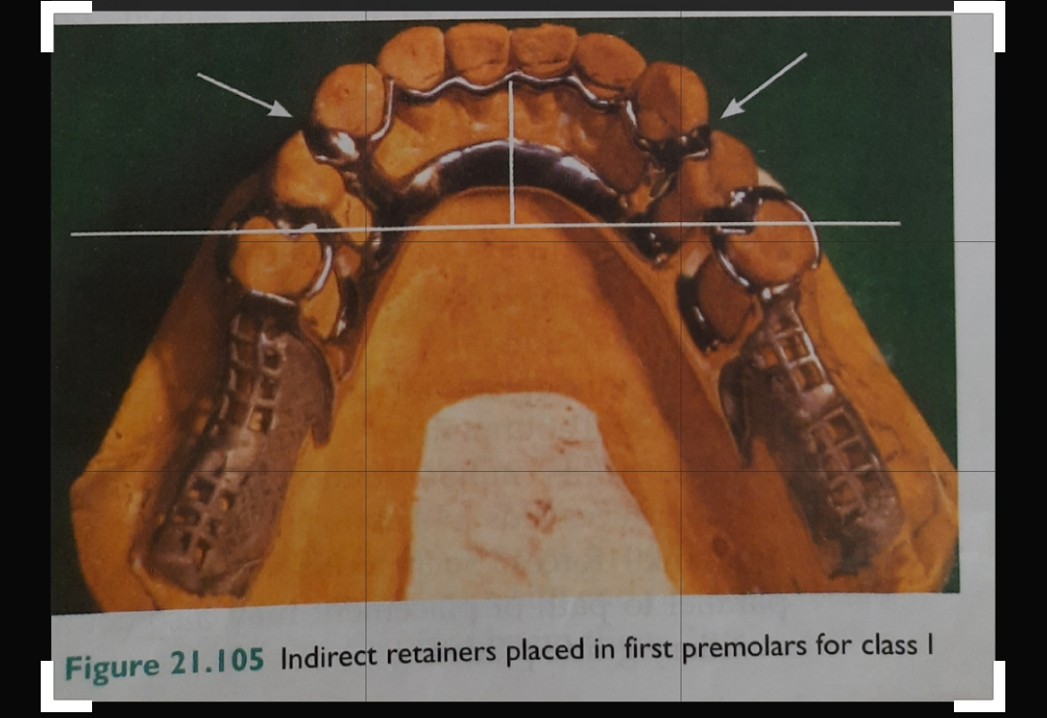
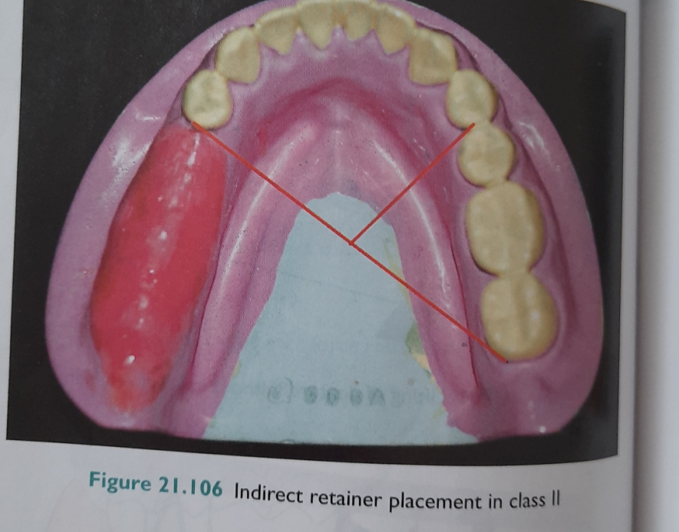

Slide 20


Slide 21


Slide 22
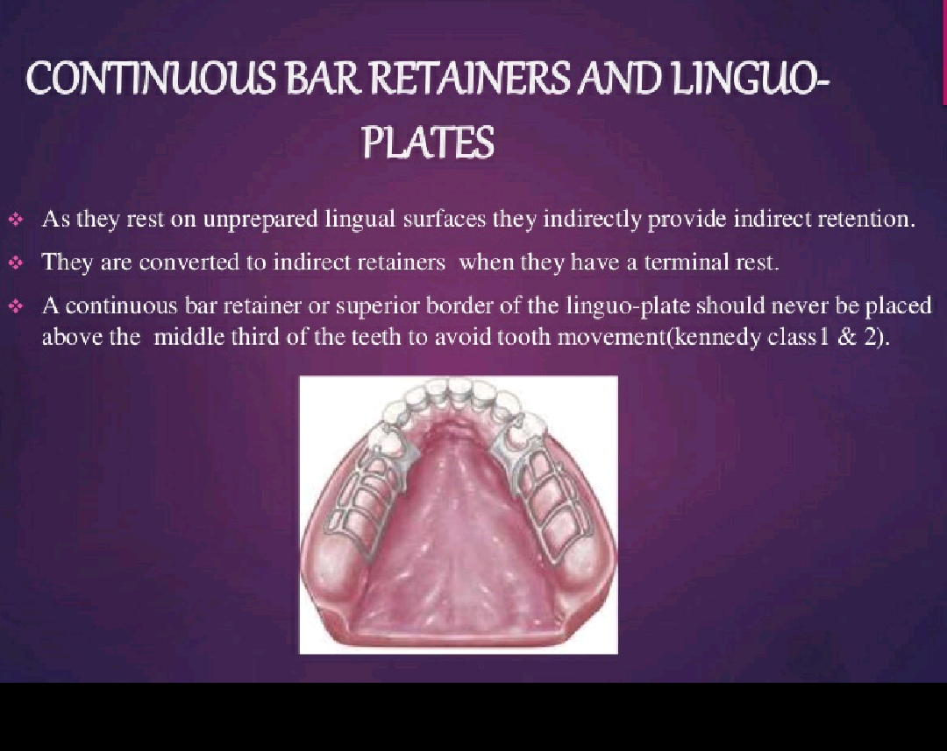

Slide 23


Slide 24


Slide 25
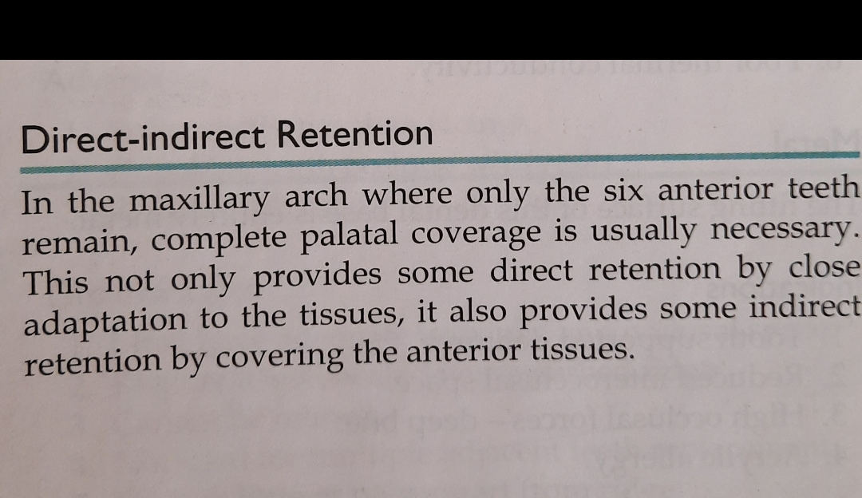

Slide 26
THANK YOU

