Slide 1
FUNCTIONAL IMPRESSIONS IN RPD

Slide 2
Introduction
Paramount in the function of a partial denture is the presentation of the remaining natural teeth and the residual alveolar ridge.
RPD are considered to cause trauma to the tooth and underlying soft tissue mainly due to little consideration given to stress tolerance of supporting anatomic structures.
Support for a distal extension RPD is derived from a combination of hard and soft tissues alongwith underlying bone

Slide 3
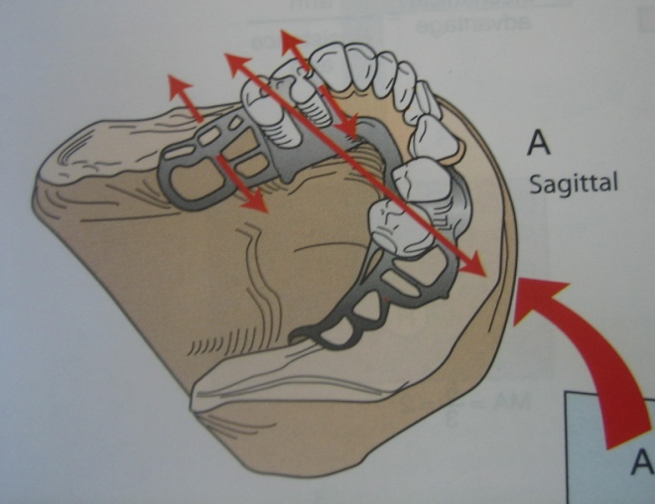
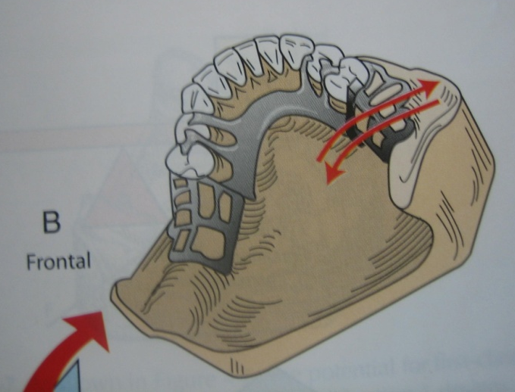
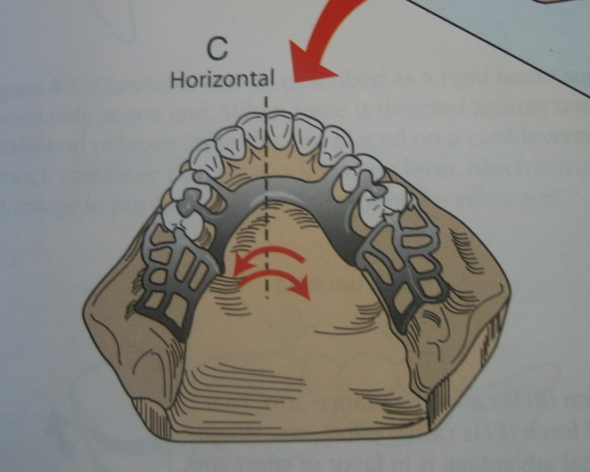
MOVEMENTS OF REMOVABLE PARTIAL DENTURE

Slide 4
FACTORS INFLUENCING SUPPORT OF D.E
1.Quality of soft tissue covering edentulous ridge.
2. Type of bone making up the denture bearing area.
3.Design of partial denture.
4.Amount of tissue coverage of denture base.
5.Amount of occlusal force.
6. Denture bearing area.
7. Fit of denture base.

Slide 5
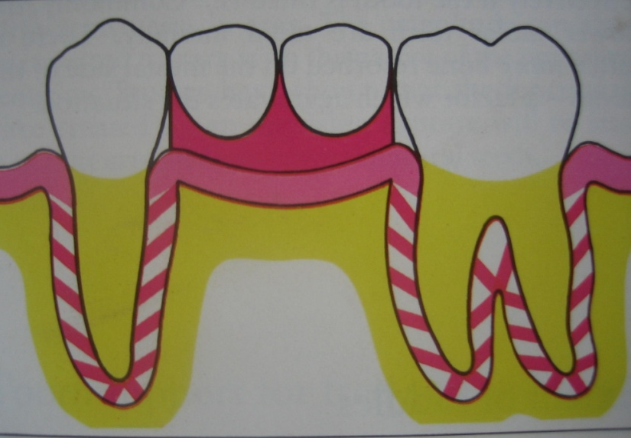
CLASSIFICATION OF PARTIALLY EDENTULOUS ARCHES DEPENDING UPON MECHANISM OF SUPPORT
Tooth supported:
• Forces are directed through rest of the
abutment tooth
• Edentulous ridge do not contribute to
the support of RPD
• Underlying mucosa and bone are not
subjected to functional forces
• Single impression of anatomic form is
acceptable
• Movement occurs towards tissue is
prevented by occlusal rest and
movements away from tissue is
prevented by direct retainers.

Slide 6
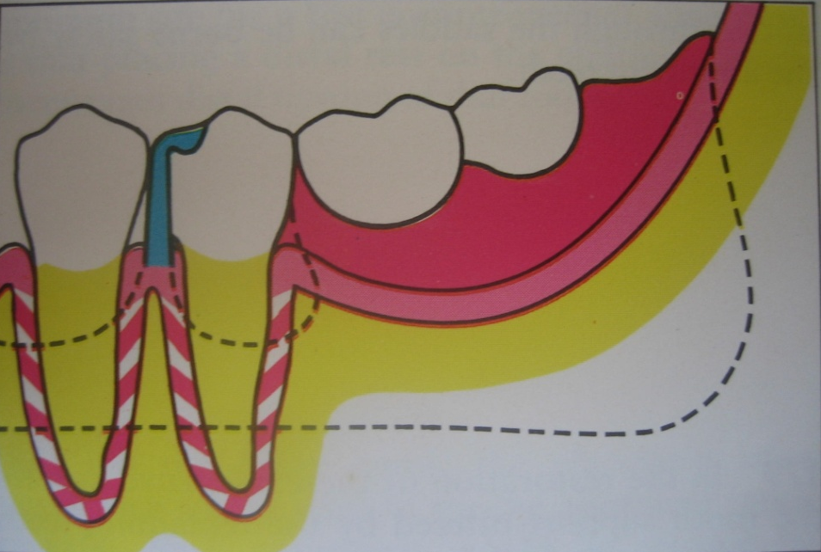
Tooth tissue supported:
• When forces are applied to
the tooth tissue supported RPD,
it should be distributed uniformly
• Stress bearing area and relieving
should be considered during
impression procedure
• Single impression of anatomic
form is not acceptable. An
impression, which can record
tissue in its functional form &
related it to the remaining natural
teeth, is essential.
• Movement towards tissue is
resisted by occlusal rest and
movement away from tissue is not
well controlled

Slide 7
INDICATIONS
Acrylic resin bases are added to framework, placed in the mouth and finger pressure applied.If the base can be depressed enough that indirect retainers lifts away from the teeth
Mandibular distal extension
Long span anterior edentulous ridge

Slide 8
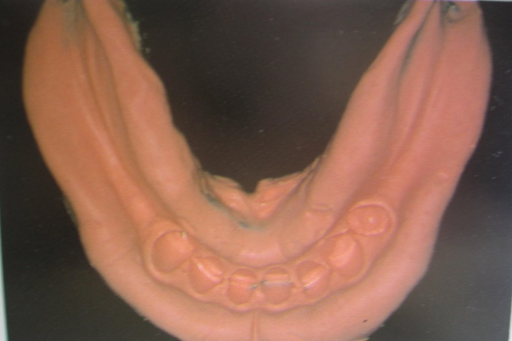
TYPE OF IMPRESSION REGISTRATION IN REMOVABLE PARTIAL DENTURES
Anatomical impression:
Anatomical impression
Anatomic form of the ridge is the static relationship of teeth and ridge when there is absolutely no load applied on them a single pressure free impression that records the teeth and the edentulous ridge in their anatomic form.

Slide 9
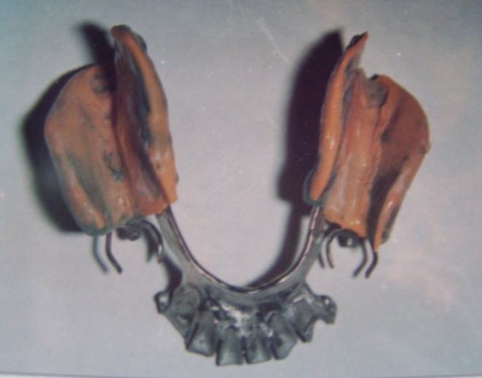
Functional impression
Functional impression:
The impression, which records the form of the residual alveolar ridge under some loading to simulate occlusal loading The term "functional," as it is used to describe the form of the sub-basal structures, is meant to refer to the state of these structures when they function to give support to an occlusal load.

Slide 10
IMPRESSION METHODS
1. Physiologic or functional impression technique
Mclean’s and Hindel’s method
Functional relining method
Fluid wax method

Slide 11
2. Selected pressure impression technique
Fluid wax impression Altered
Selected pressure Cast technique

Slide 12
FUNCTIONAL IMPRESSION
DEFINATION
The impression, which records the form of the residual alveolar ridge under some loading whether by occlusal loading, finger loading, in a specially designed individual tray or consistency of recording medium.

Slide 13
The one piece impression will produce a cast, which cannot possibly represent a functional relationship between various supporting structures of mouth. All that may be obtained from such an impression is a cast of the hard and soft tissues at rest. With the partial denture in position on a dental arch, the occlusal rest will fit the rest seat of the abutment tooth, while the denture base will fit the mucosa at rest.
When masticatory load is applied to the extension saddle, the rest will act as a stop, which will prevent the part of the saddle near the abutment tooth from transmitting the load to the underlying tissues. The distal end of the saddle however being able to move freely will transmit the full masticatory load. In a partial denture constructed from one-piece impression, only the abutment teeth and that part of the bone, which under lies the distal of the free end of saddle, will carry the masticatory load. The results will be traumatic load to the bone underlying the distal end of the saddle and to the abutment tooth, which in turn will result in a bone loss and loosening of abutment tooth.

Slide 14
WHETHER FUNCTIONAL IMPRESSION IS NEEDED IN ALL DISTAL EXTENSION CASES?
The decision as to whether a dual impression is necessary in a given case maybe determined by the following tests –
- Add acrylic resin bases to the metal framework,
- Then place framework in the mouth with attached bases
- Apply finger pressure.
- If the base can be depressed enough that the indirect retainer or lingual plate lifts away from the teeth, a dual impression is advised.
Other method is to measure the displaceability of the tissues with ball burnisher

Slide 15
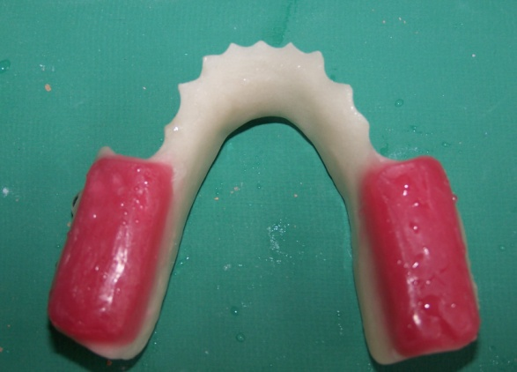
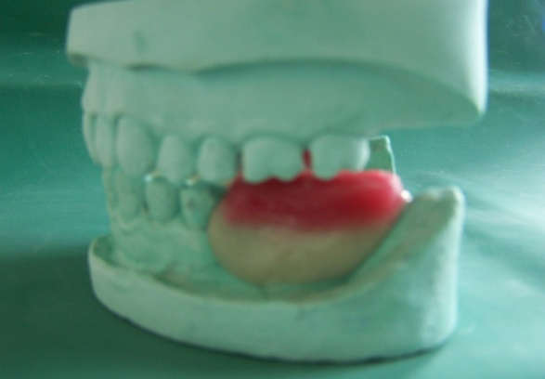
MCLEAN’S TECHNIQUE
Custom impression tray is constructed over preliminary cast.
Functional impression of DE made
Hydrocolloid impression made with first impression held in functional position with finger pressure.
Custom impression tray with modeling compound occlusal rim was constructed over a preliminary cast
Functional impression of edentulous ridge is made. Patient bites on occlusal rim while recording impression

Slide 16
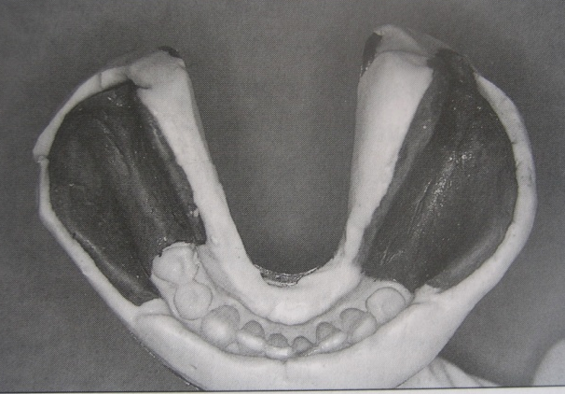
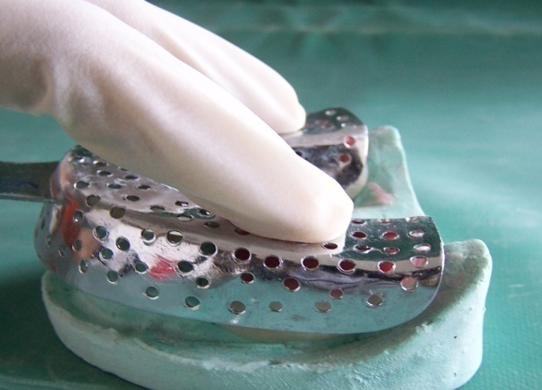
Over impression is made using irreversible hydrocolloid impression material by keeping the first impression in position and holding it under finger pressure.

Slide 17
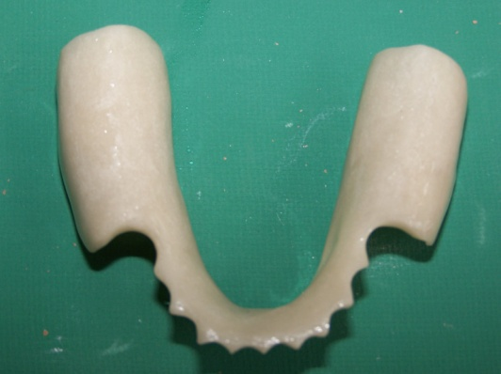
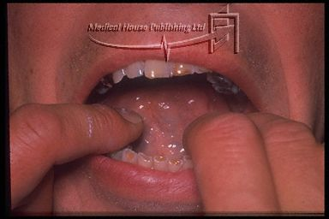
HINDEL’S TECHNIQUE
Impression of the edentulous ridge was made at rest.(anatomic)

Slide 18
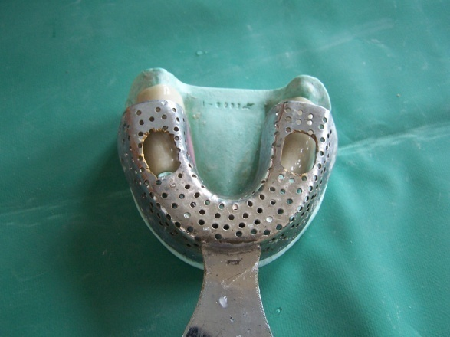
Hydrocolloid trays had holes.
During second impression finger pressure was applied thro the holes in tray to the anatomic impression
Purpose – to relate the edentulous ridge to the teeth under functional loading

Slide 19
1. Retentive clasps are active- denture base would be in functional form – interruption of blood supply
2. If retentive clasps are passive – at rest, the partial denture would be occlusal to the position it would assume when occlusal forces act.

Slide 20
FUNCTIONAL RELINING METHOD
Adding new surface to the tissue side of denture either before insertion of partial denture or at a later date.
Partial denture constructed on cast made with irreversible hydrocolloid- anatomic impression.
Making of reline – border molding & impression with ZnOE or elastomeric.

Slide 21
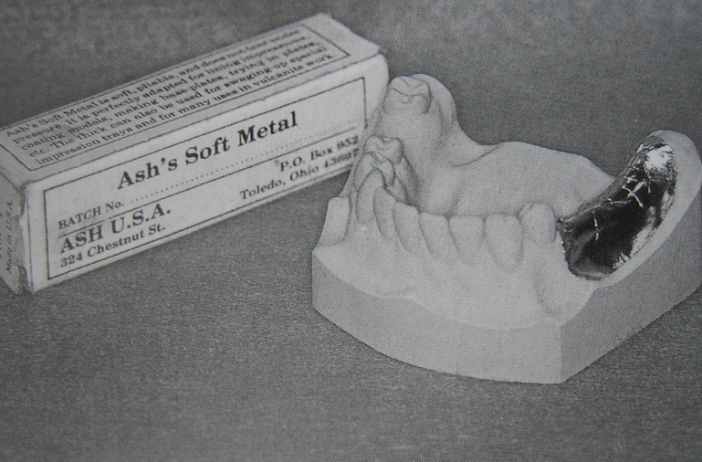
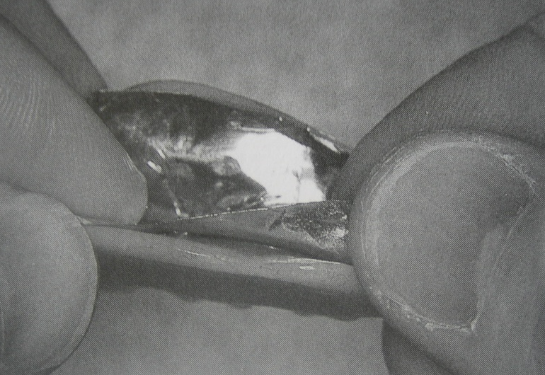
PROCEDURE:
1.Diagnostic cast prepared from an alginate impression. (Anatomical impression)
2.Soft metal spacer (ash’s no : 7 metal) is adapted over edentulous area before processing the denture base
3.Spacer is removed from the processed base

Slide 22
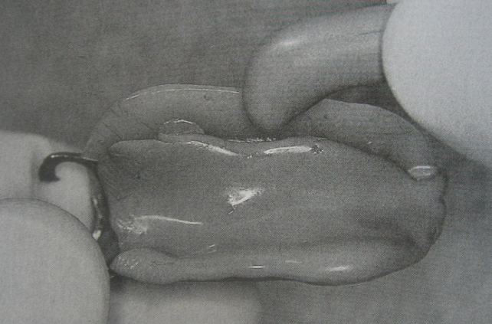
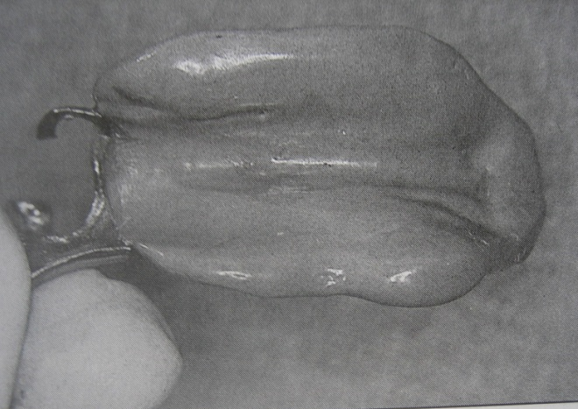
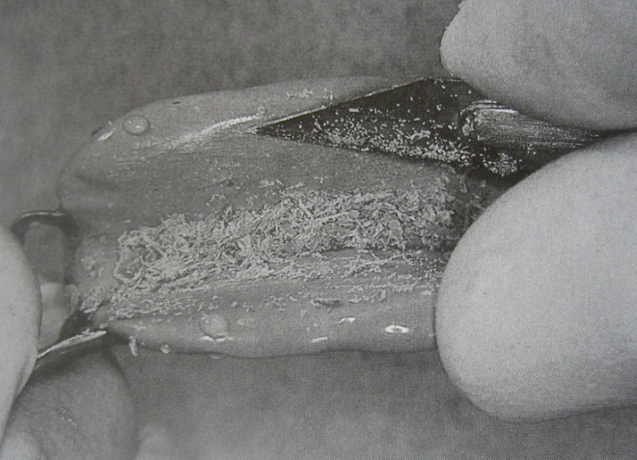
4. Low fusing compound applied to the denture base, mouth kept partly open, Border molding completed.
5. 1mm of material is scraped out from the surface
6.Impression made with free flowing ZnOE /light body elastomer.
7.Relined denture processed

Slide 23
Advantage
Adaptation of denture base is superior to other technique.
Soft tissue displacement is controlled by the amount of relief given.
Disadvantage
Difficult to maintain the correct relationship of the framework and abutment teeth during impression procedure
Occlusal discrepancy occurs because relining is done with open mouth technique

Slide 24
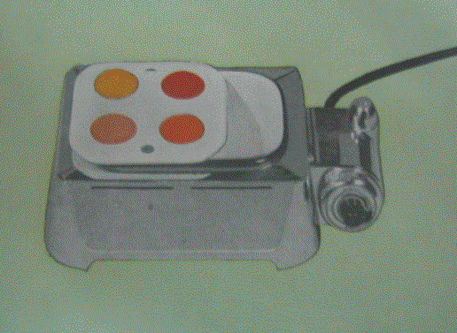
FLUID WAX FUNCTIONAL IMPRESSION
Fluid waxes – firm at R.T. and flow at mouth temperature.
( Iowa wax, Korrecta wax no.4,)
Relief between tray and ridge – 1 to 2mm
Water bath maintained at 51-54⁰C. Wax container placed in water bath.

Slide 25
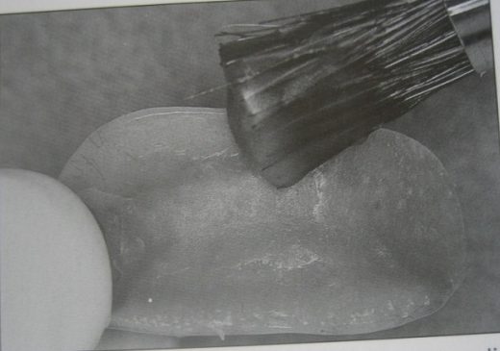
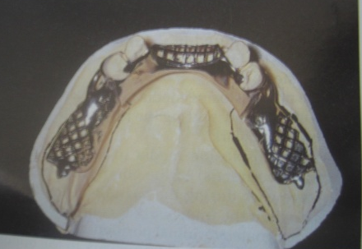
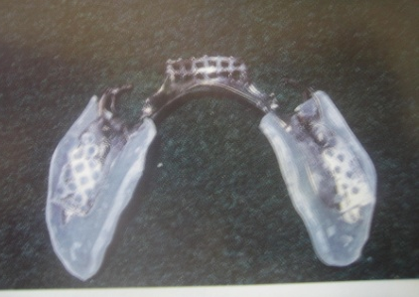
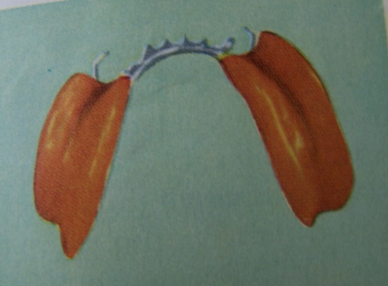
FLUID WAX FUNCTIONAL IMPRESSION
3. Wax painted to a depth slightly more than the relief provided.
Trays remains in mouth for 5-7min.
1. Metal framework constructed
4. Where tissue contact is present, surface is glossy, no contact- surface dull
Impression should be left in the mouth for 12min.
2. Special tray is fabricated with self cured resin . 1mm short of borders

Slide 26
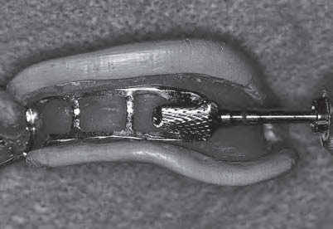
SELECTED PRESSURE TECHNIQUE
The selected pressure impression attempts to direct more force to those portions of the ridge able to absorb stress and to protect the areas of the ridge least able to absorb stress
To accomplish this, the intaglio surface of the
tray is selectively relieved.

Slide 27
For the mandibular posterior region, the crest of the ridge is not considered to be a pressure-bearing area.
As the impression is made, the material over the crest
of the ridge is not closely confined and will exert minimal
tissue ward force. This will result in minimal tissue displacement.
The impression material over the buccal shelf, being
somewhat more confined, will exert somewhat greater tissueward force, and a slightly greater amount of tissue displacement will occur.
Materials used
(i) ZnOE (ii) Elastomeric impression material (light body consistency)

Slide 28

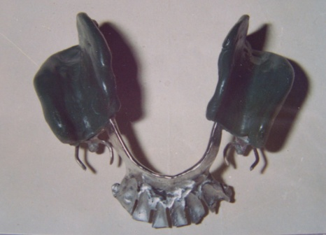
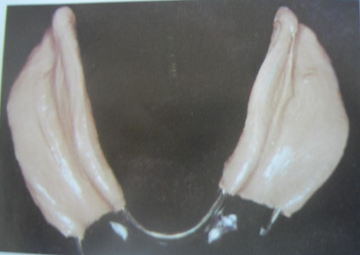
Procedure :
1. Framework is constructed on a master cast
2. Acrylic resin tray is prepared with relief
Thin layer of modeling compound is
painted on tissue sides of impression trays.
The tray is stabilized by tissue contact and
borders are perfected.
3. Compound is removed from holes of the tray.
4. ZnOE Material is loaded in free flowing
consistency
5. Pressure applied only through the occlusal
rests. Impression is made.
6. Altered cast prepared

Slide 29
Corrected cast technique
Metal framework constructed.
Fit is checked in the mouth
Acrylic resin trays are added to the minor connector of denture base.
Border molding done.
Final impression taken

Slide 30
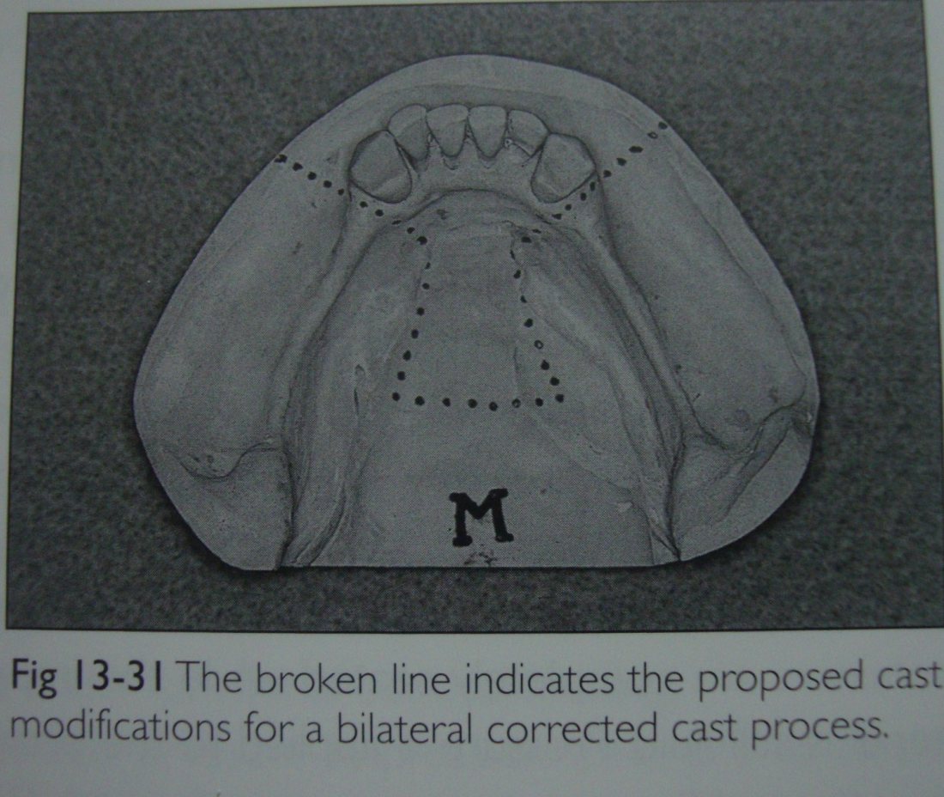
PREPARING ALTERED CAST

Slide 31
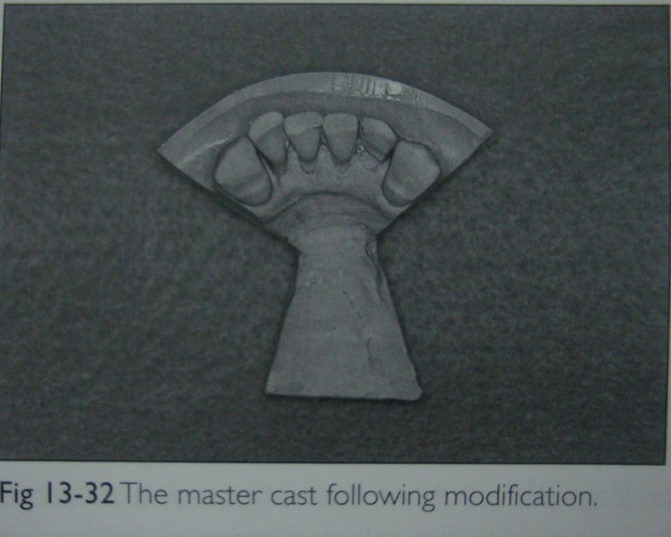
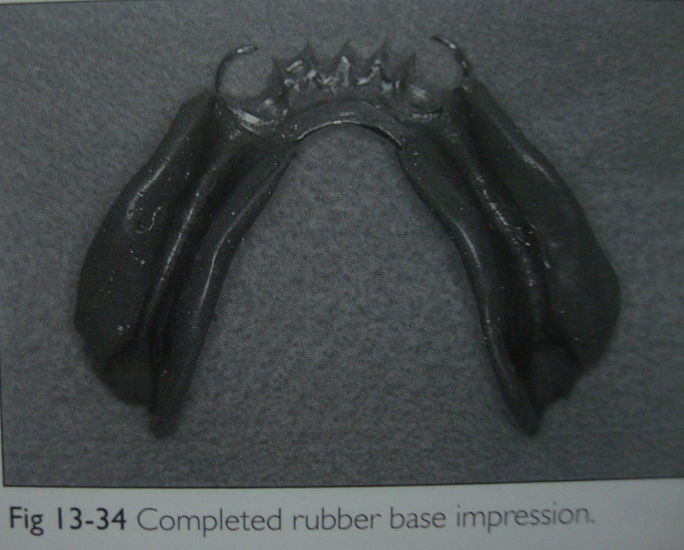

Slide 32
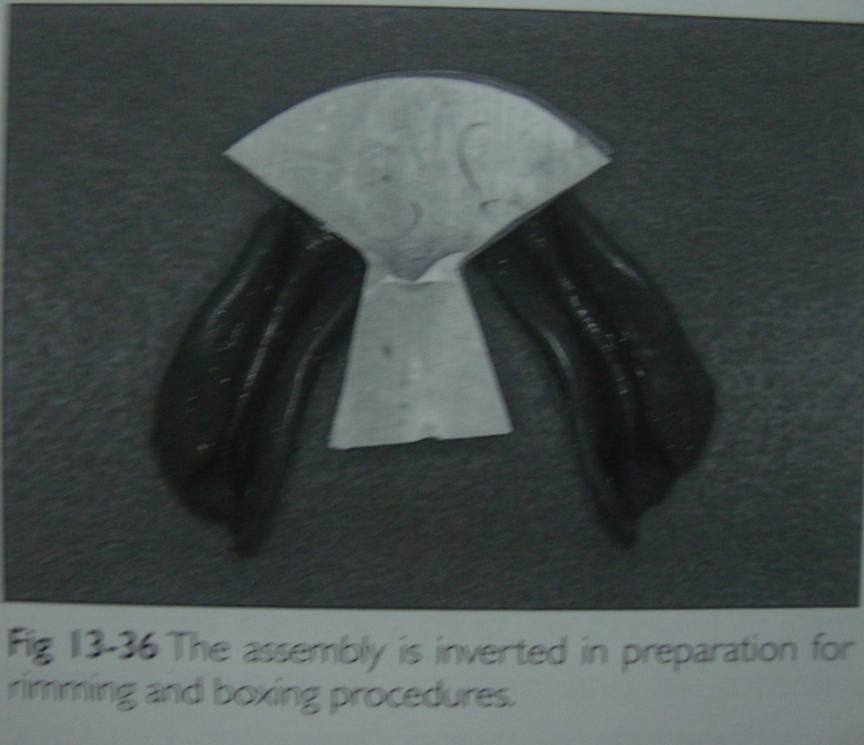

Slide 33
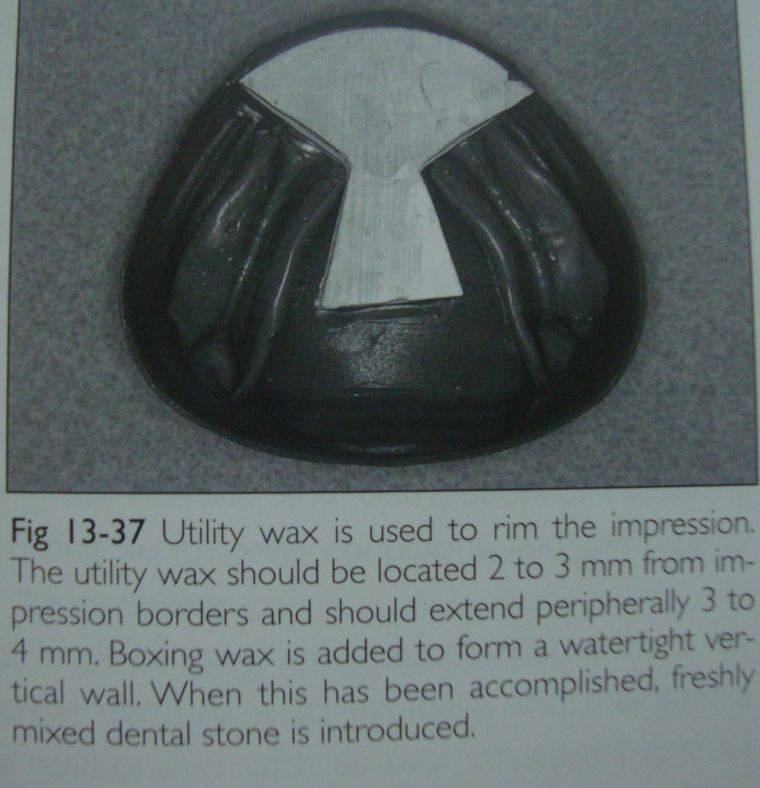

Slide 34
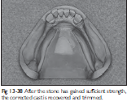

Slide 35
Conclusion
Various techniques have been discussed which are used in the construction of distal extension RPD. They are based on the theories related to character and behaviour of soft tissue. In order to understand the role of the soft tissues, we should understand that it has both mechanical and physiological function.
Before proceeding with fabrication a sound knowledge of the anatomy, condition of tissues in function will help us provide a better foundation for the restoration.

