Slide 1
infection control

Slide 2
The goal of a health care practitioner should be to ensure compliance with standard precautions and other methods to minimize infection risks.

Slide 3
Air-borne Contamination
A high-speed handpiece can create air-borne contaminants from bacterial residents in the dental unit water spray system and from microbial contaminants from saliva, tissues, blood, plaque etc. With respect to size, these air-borne contaminants exist in the following forms-

Slide 4
Aerosols
Invisible particles (5-50 µm)
Mists
Droplets (50µm)
May carry agents of respiratory infections
Spatter
May carry agents of respiratory infections
Remain suspended for hours
Settle gradually after 5-15 min
Particles >50mm or visible splashes.
Has a distinct trajectory falling within 3 ft.
considered a potential route of infection for dental personnel by blood-borne pathogens.

Slide 5
Direct contamination
occurs during direct contact with bodily ﬂuids,
Indirect contamination
occurs due to saliva-contaminated hands
major exposure concern for dental personnel

Slide 6
Personal Barrier Protection
Instructions for Handwashing-
remove the wristwatch, jewelry, rings etc
Hands should be lathered for at least 15 seconds, rubbing all surfaces, and rinsed.
Hand cleansers containing a mild antiseptic, such as 3% parachlorometaxylenol (PCMX) or chlorhexidine are preferable
Hand cleansers with 4% chlorhexidine may have broader activity for special cleansing, e.g. for surgery when a glove leaks, or when a clinician experiences an injury.

Slide 7
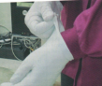
Gloves-
Wear treatment gloves during all treatment procedures.
After each appointment, or whenevera leakage is detected replace them.
Gloves should never be washed.
To remove a contaminated glove (fig ) pinch the side of the outer cuff surface with the gloved fingers of the other hand.
Pull off the glove, inverting it. Both gloves should be removed simultaneously in this manner.

Slide 8
Protective Eyewear; Masks, and Hair Protection
Protective eyewear - They may consist of goggles or glasses with solid side-shields. When eyewear or shields are removed, they should be cleaned and disinfected.
Masks - A mask should be worn to protect against aerosols. Face shields are appropriate for protection against heavy spatter, but a mask still is required to protect against aerosols that drift behind the shield.
Touching masks and eyewear during treatments should be avoided to prevent cross-contamination.

Slide 9
Hair protection- Hair can trap heavy contamination and must be protected with a surgical cap.
Protective Overgarments - Operatory clothing is heavily spattered with invisible saliva and traces of blood throughout the day. HBV and many other microbes can live on dry materials for 1 or more days. An overgarment must protect clothing as well as skin.

Slide 10
Overview of Aseptic Techniques
The concept of asepsis is to prevent cross-contamination—all items that are touched with saliva-coated hands must be rendered free of contamination before beginning treatment on the next patient.
A few simple rules that help avoid wasting costly time and effort between patient appointments are-

Slide 11
Do:
Wear protective puncture-resistant gloves to handle used instruments.
Keep instruments wet in an antibacterial solution before cleaning.
Use an ultrasonic cleaning device.
Use good-quality sterilizer equipment. Have sterilizers annually inspected regarding gaskets, timer, valves, and temperature and press gauges.
Use proper water or chemicals to operate, clean, maintain sterilizer.
Place only dry instruments in the sterilizer.
Use a wrap that will be penetrated by the steam orgas used.
Load the sterilizer loosely; leave air space between large packs.
Read the sterilizer temperature and pressure gauges daily.
Keep a record of daily indicators and spore tests

Slide 12
Don’t-
Place wet instruments into sterilizer.
Use impermeable wraps.
Use non- perforated trays or sealed containers in gas or steam sterilizers.
Overload or cram packs together in a sterilizer.
Decrease the time required for sterilization.

Slide 13
Disinfectants
Regarding disinfection, two principles should be remembered:
1. Disinfection cannot occur until fresh disinfectant is reapplied to a thoroughly cleaned surface.”'“
2. Disinfection does not sterilize
Disinfectants containing 70-79% ethyl alcohol are
considered the most effective disinfectants on cleaned
Surfaces.
Sterilants used for high-level disinfection of items for reuse are glutaraldehyde at 2-3% concentrations.

Slide 14
Procedures, Materials, and Devices for Cleaning Instruments before Sterilization
Ultrasonic Cleaners and Solutions -
Ultrasonic cleaning is the safest and most efﬁcient way to clean sharp instruments
It is the safest and most efﬁcient way to clean sharp instruments.
Nine times more effective than hand cleaning.
Procedures for ultrasonic cleaning are as follows-
Observe operating precautions.
Operate the tank at one half to three fourth of cleaning solution at all times.

Slide 15
An antimicrobial cleaning solution is preferable.
Operate the ultrasonic cleaner for 5 minutes or longer, as directed by the manufacturer, to achieve optimal cleaning, possibly 1 minute per instrument.
Remove coatings such as plaster, wax, cement, and impression material with an appropriate solvent cleaner, and place the instruments and/or impression trays in a beaker in the ultrasonic device.

Slide 16
Rules to prevent cross-contamination
1. Remember, whatever is touched is contaminated
2. Directly touch only what has to be touched (anticipate your needs) '
3. Use one of the following to control contamination:
i. Clean and sterilize dental instruments.
ii. Protect surfaces and equipment that are not sterilized with disposable, single-use covers (barriers). Discard them after every appointment.
lll. Use a paper towel, tongs, or plastic bag over gloves to handle equipment brieﬂy or to open cabinets and drawers to get things that were not anticipated during setup
iv. Scrub and disinfect noncritical surfaces as well as possible. These include any countertops or things that may be accidentally touched, such as room door handles and light switches.

Slide 17
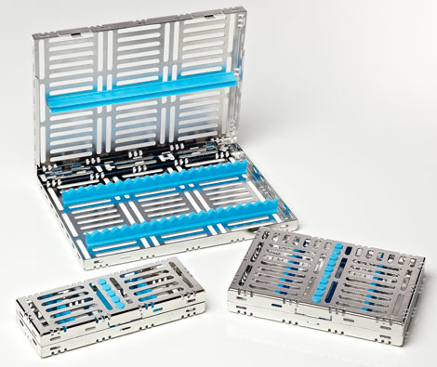
Instrument Containment
Various kinds of instrument trays and cassettes are manufactured to contain the instruments at chairside, and they can be placed in an ultrasonic cleaner, rinsed, and packaged ready for sterilization.
Cassettes provide convenience, safety in handling and cleaning batches of instruments and maintenance of instrument organization for efﬁcient use.

Slide 18
Sterilization
Sterilization is deﬁned as killing all forms of life, including the most heat-resistant forms, that is, bacterial spores. Since most instruments contact mucosa or penetrate oral tissues, it is essential that contaminated reusable instruments be cleaned and sterilized thoroughly by using accepted methods that can be tested and monitored routinely.
The four accepted methods of sterilization are as follows:
1. Steam pressure sterilization (autoclave)
2. Chemical vapor pressure sterilization (chemiclave)
3. Dry heat sterilization (dryclave)
4. Ethylene oxide (ETOX) sterilization.

Slide 19
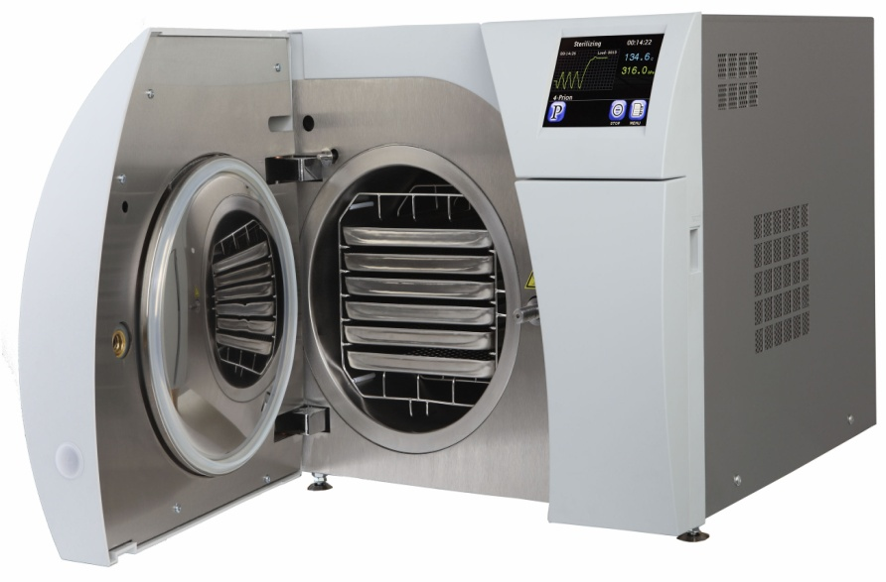
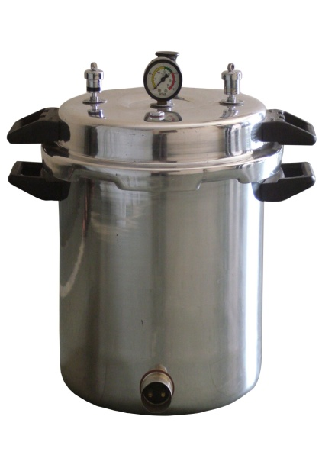
1. Steam Pressure Sterilization (Autoclaving)
Sterilization with steam under pressure is performed in a steam autoclave.
Time required at 250°F (121°C) is a minimum of 15 minutes at 15 lb of pressure
Time for wrapped instruments can be reduced to 7 minutes if the temperature is increased to approx. 273°F (134°C) at 30 lb pressure.
For autoclave sterilization, burs can be protected by keeping them submerged in a small amount of 2% sodium nitrite solution.

Slide 20
Advantages of Autoclaving
Autoclaving is the most rapid and effective method for sterilizing cloth surgical packs and towel packs [other methods are not suitable for processing cloth packs).
Automated models are also available.
Disadvantages of Autoclaving
Steam seems to corrode the steel neck and shank portions of some diamond instruments and carbide burs.
Items sensitive to elevated temperatures cannot be autoclaved.

Slide 21
2. Chemical Vapor Pressure Sterilization (Chemiclaving)
It is performed in a chemiclave
Chemical vapor pressure sterilizers operate at 270°F [131°C) and 20 lb of pressure and have a cycle time of approximately 30 minutes.
They must be used with a prescribed chemical.
Advantage
Carbon steel and other corrosion-sensitive burs, instruments, and pliers are said to be sterilized without rust or corrosion.

Slide 22
Disadvantages-
Items sensitive to the elevated temperature can be damaged.
Instruments must be lightly packaged in bags
Towels and heavy cloth wrappings of surgical instruments may not be penetrated well.
Only ﬂuid purchased from the sterilizer manufacturer can be used.

Slide 23
3. Dry Heat Sterilization
Conventional Dry Heat Ovens-
Dry heat sterilization can be achieved at temperatures greater than 320°F (>160°C).
Packs of instruments must be placed at least 1cm apart to allow heated air to circulate for at least 30 min.
Increasing the total time by 50% as a safety factor is recommended.
Total time required also depends on the efﬁciency of the oven based on its size, the size of the load, and how instruments are packaged.
Approximately 60-90 minutes may be required to sterilize a medium load of lightly wrapped instruments in
an oven set at a range of 335°F [168°C) to 345°F (174°C).

Slide 24
Short-Cycle, High- Temperature Dry Heat Ovens-
It invloves a rapid high-temperature process that uses a forced draft sterilization chamber i.e a mechanical convection sterilization chamber that circulates heated air with a fan or blower.
These short-cycle, high-temperature dry heat sterilizers operate at 375°F [190°C).
It reduces total sterilization time to 6 minutes for unwrapped instruments and 12 minutes for wrapped instruments.

Slide 25
Advantages of dry heat sterilization
Carbon steel instruments and burs do not rust, corrode, or lose their cutting edges if they are well dried before processing.
Industrial forced-draft hot air ovens provide a larger capacity at a reasonable price.
Rapid cycles are possible at high temperatures.
Disadvantages of dry heat sterilization
High temperatures may damage more heat-sensitive items such as rubber or plastic goods.
Sterilization cycles are prolonged at lower temperatures.
Heavy loads of instruments, crowding of packs, and heavy wrapping easily prevent sterilization.

Slide 26
3. Ethylene Oxide (ETOX) Sterilization
ETOX sterilization is the best method for sterilizing complex instruments and delicate materials.
ETOX gas is the best way to sterilize rotary handpieces.
Automatic devices sterilize items in several hours and operate at elevated temperatures well below 100°C
Some devices operate overnight to produce sterilization at room temperature
Porous and plastic materials absorb gas and require aeration for 24 hours or more before it is safe for them to contact skin or tissues.

Slide 27
5. Boiling Water
Boiling instruments in water does not kill spores and cannot sterilize instruments.
Boiling is a method of high level disinfection that has been used when actual sterilization cannot be achieved (e g in case of a sterilizer breakdown)
Well cleaned items must be completely submerged and allowed to boil at 98-100⁰ C for 10 minutes.

Slide 28
Monitors of Sterilization
Effective instrument sterilization is ensured by routine
monitoring of instrument sterilization, which has become a standard of care. Sterilization monitoring has ﬁve components:
Mechanical monitoring
Chemical indicator strip in each pack
External sterilization indicator on the outside of each pack
Weekly biologic spore test
Documentation log.

Slide 29
1. Mechanical Monitoring
Each sterilized load must be mechanically monitored to document time, temperature, and pressure. Otherwise, the clinician manually observes the maximum temperature and pressure and documents the data in a log.
2. Chemical Indicator Strips
Chemical indicator strips provide an inexpensive, qualitative monitor of sterilizer function, operation, and heat penetration into packs.
The clinician places one of the inexpensive color-change indicator strips into every pack. Chemicals on the strip change color slowly, relative to the temperature reached in the pack.

Slide 30
3. External Sterilization Indicators
External sterilization indicators, including tapes and bags, are marked with heat-sensitive dyes that change color easily on exposure to heat, pressure, or sterilization chemicals. Such heat-sensitive markers are important distinguish the packs that have been in the sterilizer from those that have not.

Slide 31
4. Biologic Monitoring Strips
A biologic monitoring spore test strip is the accepted weekly monitor of adequate time and temperature exposure.
Spores dried on absorbent paper strips are calibrated to be killed when sterilization conditions are reached and maintained for the time necessary to kill all pathogenic microorganisms.
By sending the strip to a licensed reference laboratory for testing, the dentist obtains independent documentation of monitoring frequency and sterilization effectiveness.

Slide 32
5. Documentation Log
In a log, a single, dated, initialed indicator strip is attached to a sheet or calendar for each workday, followed by a weekly spore strip report. The log provides valuable sterilization documentation.

Slide 33
Dental Control Unit Water System
Oral fluid contamination problems of rotary equipment, especially the high-speed handpiece, involve
Contamination of handpiece external surfaces and crevices
Turbine chamber contamination that enters the mouth
Water spray retraction and aspiration of oral ﬂuids into the water lines of older dental units
Growth of environmental aquatic bacteria in water lines
Exposure of personnel to spatter and aerosols generated by intraoral use of rotary equipment.

Slide 34
Bacterial growth in bioﬁlms on the inner walls of den- tal unit water lines is a universal occurrence unless steps are taken to control it.
Counts of bacteria that are shed from the bioﬁlms into water of the dental unit may range from thousands to hundreds of thousands of bacteria per milliliter.
It is recommended that dental unit treatment water contain less than 500 colony-forming units (cfu] per milliliter of bacteria.
Disinfectants such as an iodophor or diluted sodium hypochlorite are recommended to clean the system. These disinfectants must be flushed out with clean, boiled, or sterile water before using the system.

Slide 35
Conclusion
With proper knowledge of the available barriers, standard operating procedures, sterilization methods and equipments a clinician can prevent risk of infections to a large extent.

