Slide 1
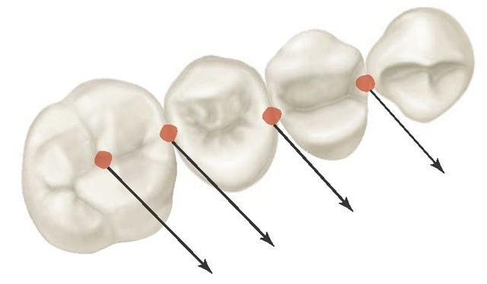
CLINICAL SIGNIFICANCE OF DENTAL ANATOMY, HISTOLOGY, PHYSIOLOGY AND OCCLUSION

Slide 2
“Success in life is founded upon attention to the smallest of things…. rather than to the largest of thing…”
A thorough understanding of the histology, physiology and occlusal intractions of the dentition and supporting tissues is essential for the restorative dentist.
The relationships of form to function are specially noteworthy when considering the shape of the dental arch, proximal contacts, occlusal contacts and mandibular movements.

Slide 3
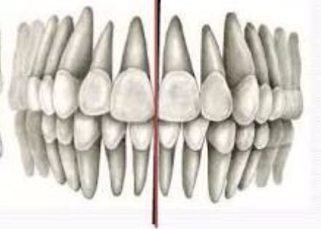
DENTITION
HUMAN DENTITION
PRIMARY DENTITION (20)
PERMANENT DENTITION (32)
CLASSES OF HUMAN TEETH
Incisors - For shearing of food
Canine – For piercing, tearing and cutting of food
Premolars – Similar to canine in – tearing of food
Similar to molars in – grinding of food
Molars – Major role in crushing, grinding and chewing of food.

Slide 4
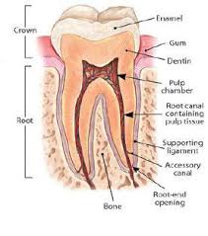
STRUCTURE OF TEETH
Enamel
Pulp-Dentin complex
Cementum

Slide 5
ENAMEL
Hardest substance of human body.
Ectodermal in origin
Secreted by ameloblasts - amelogenesis
PHYSICAL PROPERTIES
Color - Light yellow to gray white
Thickness - thick at the incisal edge and cusp tip of molars and premolars (2-2.5 mm) and ends cervically as knife edge
Hardness - It is the hardest calcified tissue in the human body because of its high calcification & crystal orientation.
It is greater at the cusp tip or incisal edge & decrease at the cervical line.
Specific gravity - The specific gravity of enamel is 2.8
COMPOSITION
It is the most highly mineralized extracellular matrix, consisting of
96% inorganic material
4% organic material & water

Slide 6
ENAMEL IS FORMED OF
1) Enamel Crystallites
2) Enamel Rod
3) Rod Sheath (packaging of rods)
4) Interrod Substance
DIRECTION OF ENAMEL ROD
The enamel rod is perpendicular to the dentin surface
  In deciduous teeth - vertical at the cusp tip or incisal edge then become oblique toward the occlusal surface at the middle part and become horizontal at the cervical area.
  In permanent teeth - the direction of the enamel rods are similar to that of the deciduous teeth at the occlusal 2/3 but at the cervical region are directed towards the root.
HYPOCALCIFIED AREAS
Enamel lamellae
Enamel tufts
Strai of retzius
DEJ
Pit & Fissure

Slide 7
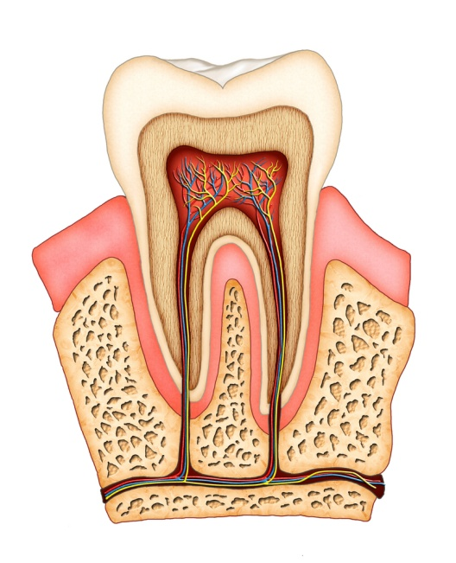
PULP-DENTIN COMPLEX
PULP
Coronal pulp
Radicular pulp
COMPLEX
Common embryonic origin – Ectomesenchyme - Dental Papilla
Anything that affects dentin will affect pulp and vice-versa
Physiologic and pathologic reactions in one of the tissues will also affect the other
Interstitial fluid of pulp and dentinal tubules forms a continuum
FUNCTIONS OF PULP
Formative
Nutritive
Sensory
Defensive/ Reparative

Slide 8
DENTIN
Physical Properties
Color - Yellowish, becoming darker with age.
Hardness Unlike enamel i.e. hard and brittle dentin is viscoelastic and subjected to slight deformation.
Harder – central part than periphery.
Dentine of primary teeth is slightly less hard than that of permanent teeth.
Chemical Properties
Inorganic material - 70% by wt. 45% by volume
Organic material - 20% by wt. ,33% by volume
Water - 10% by wt. 22% by volume

Slide 9
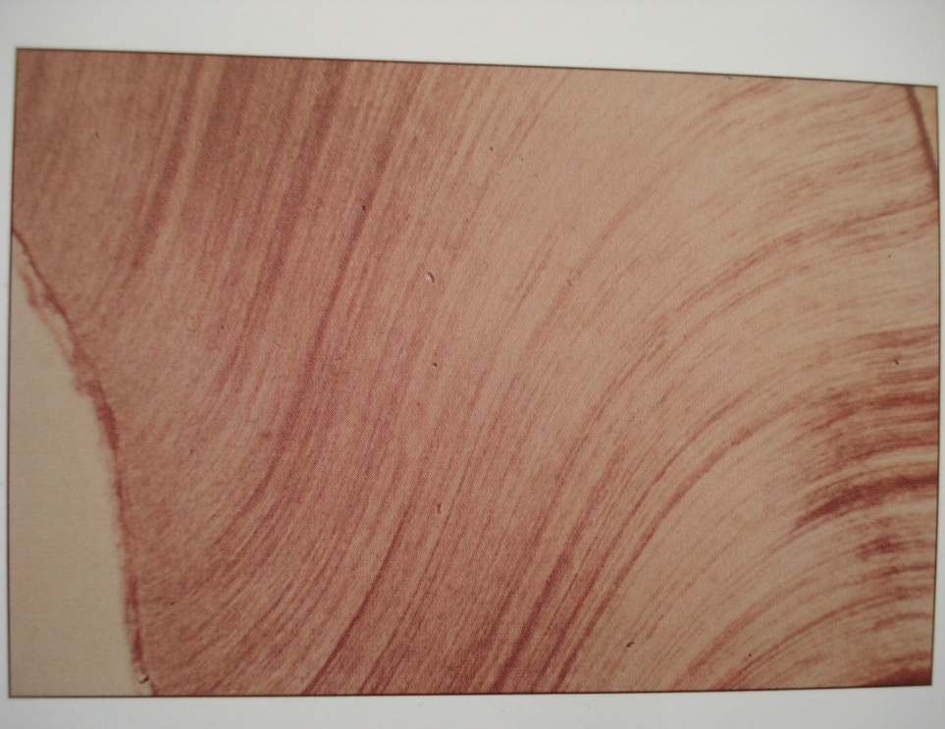
DENTINAL TUBULES
Extend through the entire thickness of the dentine from the DEJ to the pulp and form a network for the diffusion of nutrients throughout dentine.
The tubules follow an S shaped path from the outer surface of the dentine to the perimeter of pulp in coronal dentine.
Perpendicular – DEJ & CDJ, straight - incisal edges and root tip.
Tubules are farther apart in the peripheral layers and more closely packed near the pulp
No. of tubules /unit area surface of dentin - 50,000-90,000 per sq. mm on pulpal surface of dentin.
THEORIES OF PAIN TRANSMISSION
1- Direct Neural stimulation Theory
2- Hydro dynamic Theory
3- Transduction Theory

Slide 10
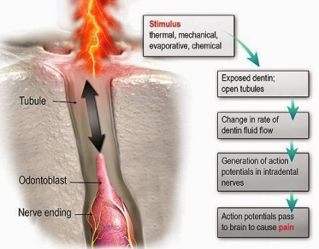

Slide 11
PHYSIOLOGY OF TOOTH FORM
Teeth serves four main functions
Mastication
Esthetics
Speech
Protection of supporting tissues

Slide 12
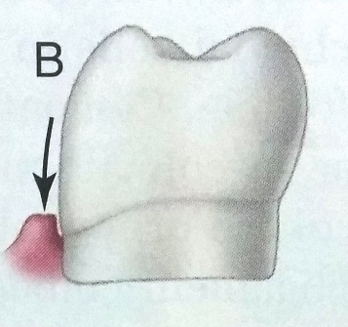
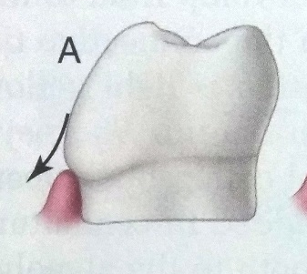
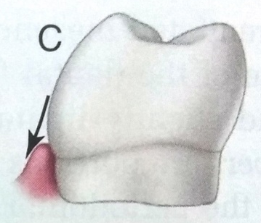
CONTOURS
Facial and lingual surface posses a degree of convexity that affords protection and stimulation of supporting tissues during mastication
The convexities are generally located at
  Cervical III of crown on facial surfaces of all the teeth
  Cervical III of the lingual surfaces of incisors and canine
  Middle III of lingual surfaces of posterior teeth
Normal contour – act in deflecting food only to the extent that the passing food stimulates and does not irritate supporting tissues.
Little contour – trauma to attachment apparatus
Over contour – deflect food from gingiva resulting in decreased stimulation – plaque accumulation – chronic gingival inflammation.

Slide 13
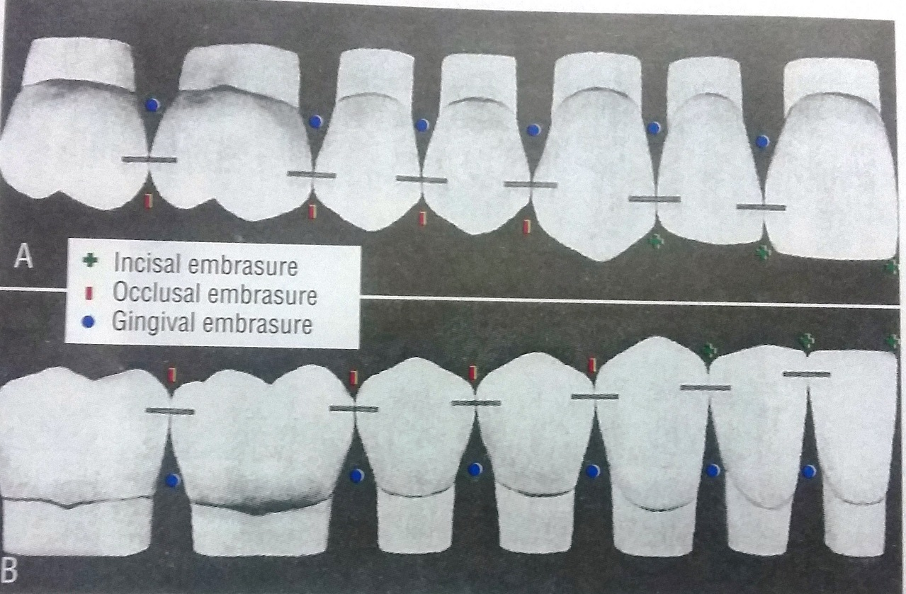
Proximal contact areas
When teeth erupt to make proximal contact with previously erupted teeth initially a contact point is present. The contact point increases in size to become the proximal contact area as the adjacent teeth abrade each other during physiologic tooth movement
Larger in the molar region helping food impaction during mastication.
Location -
Incisal III of approximating surfaces of max and mand. central incisors.
Proceeding posteriorly from incisal region through all the teeth it is located at the junction of incisal and middle III or in the middle III.

Slide 14
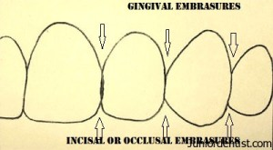
Embrasures
V shaped spaces originating at the proximal contact areas between the adjacent teeth.
These are – Facial, Lingual, Incisal/ Occlusal and Gingival
Lingual embrasure – larger allowing more food to be displaced lingually
Correct relationship of embrasure, cusp to sulci, marginal ridges and grooves of adjacent and opposing teeth provide for the escape of food from occlusal surface during mastication
Decreased embrasure/ absent – additional stress created on teeth and supporting structure during mastication
Too large embrasure – food is forced into interproximal spaces – little protection to the supporting structure.

Slide 15
Periodontium
PERIODONTIUM
GINGIVAL
UNIT
FREE GINGIVA
ATTACHED
GINGIVA
ATTACHMENT
APPARATUS
PERIODONTAL
LIGAMENT
ALVEOLAR MUCOSA
ALVEOLAR PROCESS

Slide 16
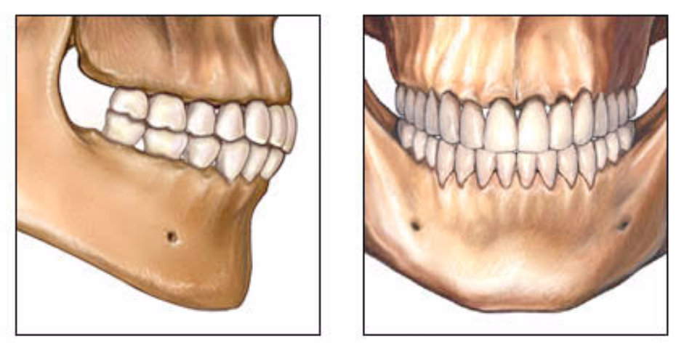
Occlusion
Contact of teeth in opposing dental arches when the jaws are closed (static occlusal relationship) and during various jaw movements (dynamic occlusal relationship).

Slide 17
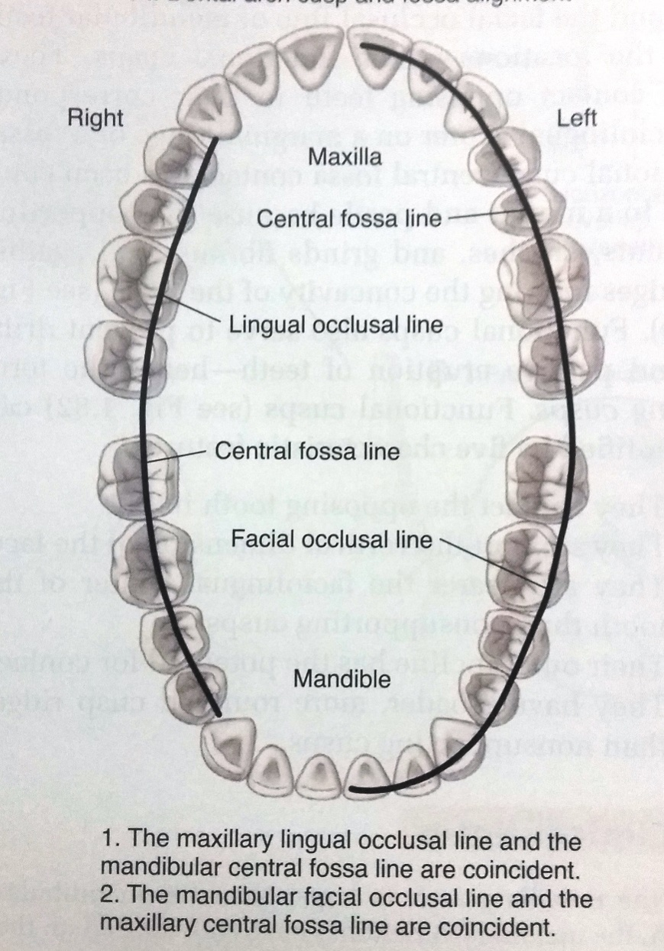
Tooth alignment and dental arch
Facial occlusal line -
Central fossa occlusal line – An imaginary line connecting the maxillary central fossae.
Maximum intercuspation – Refers to the position of the mandible when teeth are brought into full interdigitation with the maximum number of teeth contacting

Slide 18
Anteroposterior Interarch Relationship
Class I - Maxillary mesiofacial cusp located in the mesiofacial developmental groove of the mandibular first molar
Most common molar relationship.
Class II – Mesiofacial cusp of maxillary molar settling into facial embrasure between mandibular first molar and mandibular second premolar.
Class III - Mesiofacial cusp of maxillary first molar fits into distofacial groove of mandibular first molar.
Least common

Slide 19
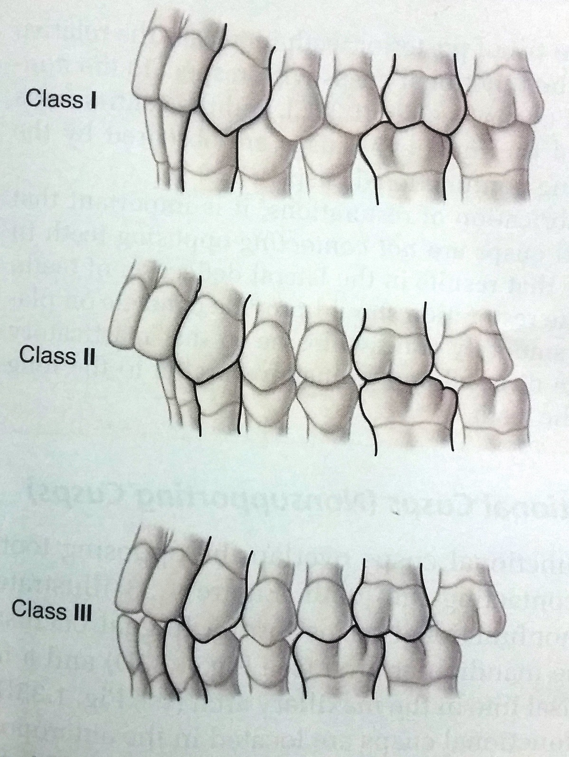

Slide 20
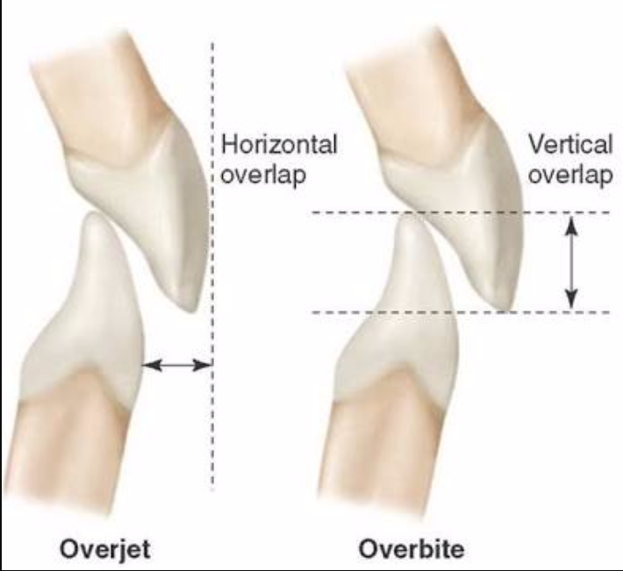
Interarch Tooth Relationship
Overjet – Horizontal overlap
Overbite – Vertical overlap
Differences in size of mandible & maxilla
Variations in incisal relationshiop
Mandibular deficiency, Excessive eruption of posterior teeth
Mandibular growth excess
Open bite
Cross bite

Slide 21
Posterior Cusp Characteristics
Outer incline ridge – The outer inclines of cusp faces the facial surface of the tooth and is named for its respective surface.
Inner incline ridge - The inner inclines of cusp faces the central fossa or the central groove of the tooth. These are widest at the base and become narrower as they approach the cusp tip.
Mesial and distal cusp ridge – The mesial and distal cusp ridges extend from the cusp tip mesially and distally and are named for their directions.

Slide 22
Types of Cusps
Functional cusps -
These cusp contact the opposing teeth in their corresponding faciolingual center on a marginal ridge or fossa.
Maxillary function cusp – located in maxillary lingual occlusal line
Mandibular functional cusp – Located on mandibular facial occlusal line
Non functional cusp -
Overlap the opposing tooth without contacting the tooth

Slide 23
CLINICAL TIPS
The primary motive during operative procedure must be the preservation of the health of the pulp.
For optimum strength in tooth preparation, all enamel rods should be supported by dentin.
Unsupported enamel rods should be removed.
Over, under contoured restorations results in gingival irritation
Properly formed and located proximal contacts and associated embrasures promote normal healthy interdental papilla.
During restoration functional cusps should not contact opposing teeth in a manner that result in the lateral deflection of the food.

Slide 24
CONCLUSUION
An intimate knowledge of the anatomy and the physiology of dental tissues is important for a clinician to use various dental material optimally
A thorough understanding of the tooth anatomy and their occlusal relationship is crucial for a restorative dentist in being able to perform adequate restorative rehabilitation.

