Slide 1
TOXICITY OF HEAVY METALS AND CHELATING AGENTS
Presented by:
Dr. Arun Sharma

Slide 2
Contents
Introduction
Properties of heavy metals
Toxicity of trace heavy metals
Mercury
Lead
Cadmium
Arsenic
Copper
Chelation therapy
Antidotes In ayurveda

Slide 3
Introduction
Heavy metals are toxic to human health
Most common heavy metals are lead(Pb), mercury(Hg), cadmium(Cd) and arsenic(As). Other examples include manganese, chromium, cobalt, nickel, copper, zinc, selenium, silver, antimony and thallium
They are mainly produced by industrial activities, and deposit slowly in the surrounding water and soil

Slide 4
World Health Organisation's list of 10 chemicals of major public concern which includes Toxic Heavy metal particular applicable to arsenic, asbestos,benzene,cadmium, mercury and lead.
WHO, recommended Permissible Limits of Heavy Metals-
Heavy metal | Permissible limits
Lead | 10 ppm
Arsenic | 3 ppm
Cadmium | 0.3 ppm
Mercury | 1 ppm

Slide 5
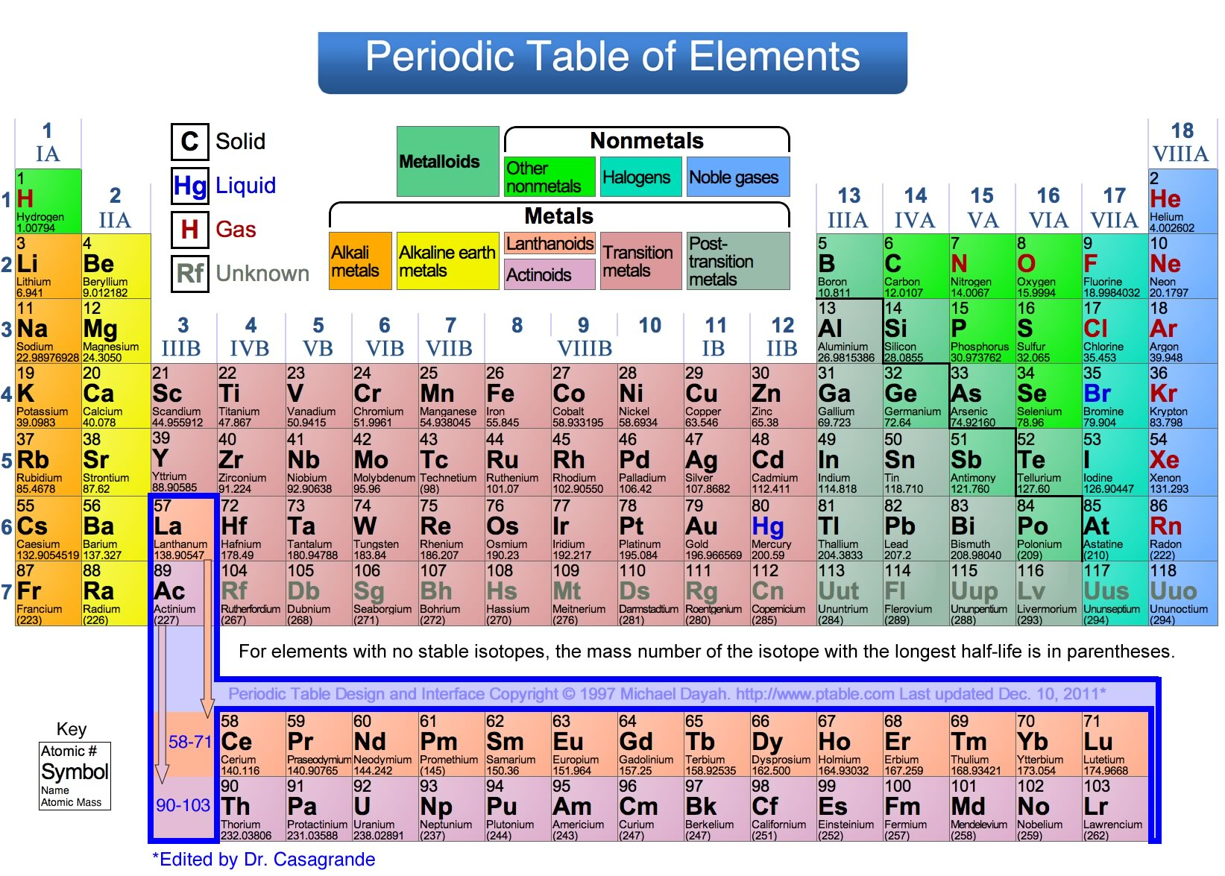

Slide 6
Properties of heavy metals
The Mendeleev’s periodic table illustrated heavy metals in the bottom(high atomic num);
Metal with high atomic weight> sodium
Have high densities i.e >3.5-5 g/cu cm
Toxic in nature
Can damage living things at low concentrations
Nondegradable i.e tend to accumulate in the food chain
Note: Arsenic is not actually a metal but is a semimetal i.e. its properties are intermediate between those of metals and nonmetals.

Slide 7
The pathophysiology of the heavy metals :
For the most part, heavy metals bind to oxygen, nitrogen, and sulfhydryl groups in proteins, to denature them.resulting in alterations of enzymatic activity.
Metals in our body
Iron is present in hemoglobin, myoglobin
Cobalt in coenzyme
Copper as co-factor in enzymes
Zinc, selenium, chromium in enzymes

Slide 8
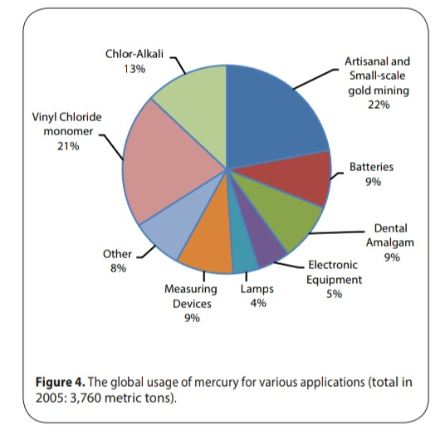
Sources and uses of heavy metals
  Mercury: Used in electrical switches, fluorescent light bulbs and mercury lamps, Unregulated burning of coal and fuel oil , batteries, thermometers, dental fillings
  Cadmium: By-product from smelting of lead & zinc ores, Solders containing cadmium, Welding, Food: grains, cereals , leafy veg- only 5% is absorbed, smoking>90% is absorbed(cigarette smoke contains about 0.5-2.0 Ùg and about 10% of cadmium content is inhaled when cigarette is smoked – WHO 1992)

Slide 9
Lead: in the building industry for roofing and for soundproofing, pipes, used in electronics, in ammunition, in batteries and sinkers in fishing, Mining/Smelting, Cutting and welding lead-painted structure, lead storage batteries, paints and lipsticks.
  Arsenic: Semiconductor manufacturing (gallium arsenide), Fossil fuel, Wood treated with arsenic preservatives, Smelting (copper, zinc, lead) and refining of metals and ores, Glass manufacturing, Wood preservatives, Pesticides, Feed additive (poultry and swine), Drugs (for leukemia), Homeopathic medicines may contain
  Copper:inhaled particulates in mining, metal fumes in smelting operations, welding, or related activities, Insecticides and fungicides, Copper wire

Slide 10
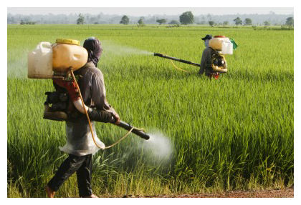
General sources of heavy metals in residential houses
Infiltration from outside, along with the dust carried on shoes and clothes
Indoor sources include old-lead and latex based paints, domestic water supply, burning of wood, and tobacco smoke
Pesticides and fungicides are major sources of arsenic and mercury indoors

Slide 11
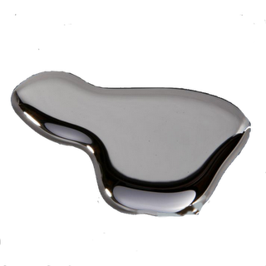
Mercury (Hg)
At num 80

Slide 12
Mercury in its elemental state is the only metal that occurs as liquid in room temp,
Mercury is highly toxic in vapor form but lead, cadmium and arsenic are more toxic in their cationic form
has low viscocity,
high density
high electrical conductance

Slide 13
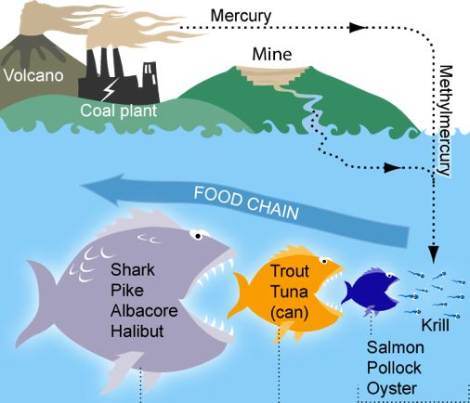
Toxic forms:
    Elemental (Hg liquid/vapor) and Compounds of
    mercury
    Inorganic salts –less soluble and less toxic eg. mercuric nitrate, Hg(NO3)2
    Organometallic –more toxic eg. Methylmercury elemental mercury is biotransformed by bacteria into methylmercury-thus enters the food chain and remains unchanged

Slide 14
Compounds of Mercury in Ayurveda
Mercury is ranked 3rd on the Top Hazardous substances.
Metabolism – Three form-
Elemental – Hgº – non toxic (orally), highly toxic(inhalation)
Inorganic :( Hg⁺ and Hg ²⁺ ) – Hg⁺ Less soluble & less toxic and Hg ²⁺ More soluble and more toxic
Organic – more toxic
Most volatile of all metals
Highly toxic in vapor form
Liquid mercury itself is not highly toxic, and most of that ingested is excreted
Compoud | English Name | Name | Properties | Dose
HgO | Mercuric Oxide : Red Oxide of Mercury | Giri sindur, | Red & Shining powder | 4 – 15mg
HgCl₂ | Mercuric Chloride : Perchloride of Mercury / Corrosive Sublimate | - | White crystalline powder Antiseptic Property, Violent poison | 2 – 4 mg
Hg₂Cl₂ | Mercurous Chloride : Subchloride of mercury / Calomel | Rasakarpoor | White / Tasteless / Insoluble water | 30 – 180mg
HgS | Mercuric Sulphide : Cinnabar | Hingula, Rasasindur | Pigment Vermilion, Non – poisnous , Vapours poisnous | 125mg

Slide 15
Mechanism of toxicity
Absorption
  Hgº via respiratory tract (80% retained)
  Inorganic Hg⁺ and Hg ²⁺ about 7% retained
  Organic Hg about 70% retained
Distribution and Metabolism
  Oxidation finally to Hg²⁺
  Affinity for kidney
Excretion (half life 70 days for organic, 35-90 days for elemental)
  Mainly via urine
  Organic Hg mainly faecal
Cross placenta

Slide 16
(1) Elemental mercury effects
    Tremors;
    Emotional changes (e.g., mood swings, irritability, nervousness, etc.);
    Insomnia;
    Neuromuscular changes (such as weakness, muscle atrophy, twitching);
    Headaches;
    Disturbances in sensations; changes in nerve responses; performance deficits on tests of cognitive function.
    At higher exposures there may be:
        Kidney damage,
        Respiratory failure, and Death

Slide 17
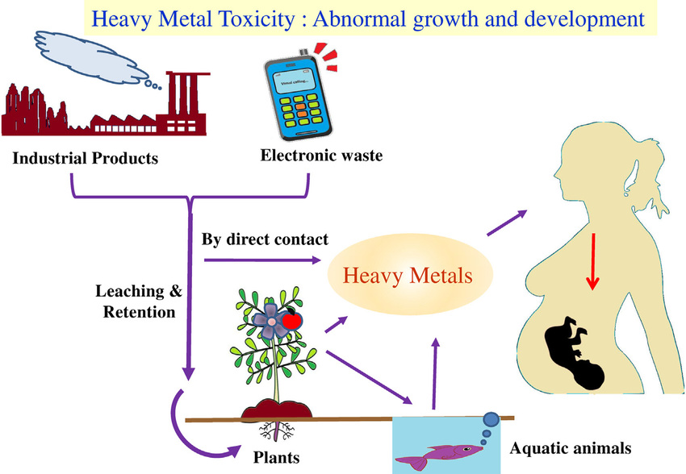
Mode of entry:
    Elemental Hg through inhalation
    Ingestion
    Transdermal: Hg (e.g. Organomercury) can also enter the body by absorption through the skin
    Systemic: Once in the body, it is carried by the bloodstream to the brain

Slide 18
(2) Organomercury effects – Ex. Methylmercury
Exposure in the womb (which can result from a mother's consumption of fish and shellfish that contain methylmercury), can adversely affect a baby's growing brain and nervous system.
Impacts on cognitive thinking, memory, attention, language and fine motor and visual spatial skills have been seen in children exposed to methylmercury in the womb. High exposures to inorganic mercury may result in damage to:
    Gastrointestinal tract,
    Nervous system, and
    Kidneys

Slide 19
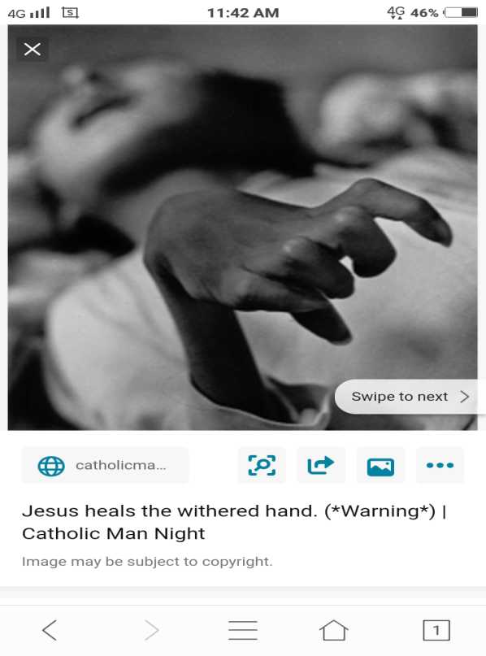
Mercury poisoning
Due to mercury exposure. It can be acute in which the amount of exposed mercury is high
Can be chronic, over time. Spl- factory workers
H: HYDRAGYRISM(chronic mercury poisoning): Hatters shake
G: Glassblower shake
M: MINAMATA DISEASE: MERCURIA LENTIS
BATTLE(mnemonic)
B: BROWN MALT REFLEX
A:acrodynia- pink disease
T: Tremor(danburry)
T: Tonicity of muscles(hypotonia)
L:Lens affected
E:erithism(neurological disorder)

Slide 20
Fatal Dose –
Metallic Hg:0.06gm (Smallest dose recorded)
HgO: 2gm (Repeated)
HgCl2: Av. 1 gm (Smallest recorded- 120mg)
Hg(CN)2: Av. 0.6gm-1.3gm
Mercury Vapour: 0.5mg/cu.mt.

Slide 21
Fatal Period - Death may occur within a few hours, but is usually delayed for 3-5 days. Delayed deaths are usually due to renal failure (uraemia).
DIAGNOSIS -
    (1) History of exposure
    (2) Blood mercury
    (3) Excretion of 500μg of Hg in urine in a day suggest poisoning.

Slide 22
Treatment of Acute Poisoning
Gastric & Colonic lavage- Stomach should be washed out with 250 ml of a 5% solution of sodium formaldehyde sulphoxylate. (Beneficial only if given within the first half hour of poison intake)
Egg Albumin/ Vegetable gluten/ Skimmed milk may be administered, which forms mercury albuminate (which is insoluble). Removed by administration of emetic or a lavage.
Medicinal Charcoal – Mercury adsorbs with charcoal’s surface, and hence gets removed without being absorbed by enterocytes.

Slide 23
Treatment of Chronic Poisoning
Patient should be removed from surrounding.
Drink milk/ Gargle mouth with Potassium Chlorate / Borax
I.V- Sodium Thiosulfate (0.45- 0.6gm in 5 ml of water)
Deep I.M – BAL3-4 mg/Kg bd.wt. –per 4 hr – 1st & 2nd Day
3-4 mg/Kg bd.wt. –per 6 hr – 3rd Day
Oral Pencillamine: 250mg to 2 g / day
Children 20mg/Kg bd .wt.

Slide 24
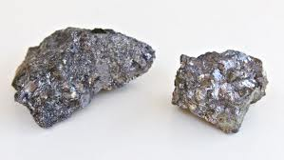
Lead (Pb)
At num 82

Slide 25
Lead
Lead is ranked 2nd on “the Top Hazardous Substances”
Types of lead
  Inorganic – PbO2
  Organic – Tetraethyl lead, tetramethyl lead
Has a very low melting point of 327 degrees C
Used as a structural metal in ancient times and for weather proofing buildings

Slide 26
Compounds of lead
Pb(C₂H₃O₂)_{2 .}3H₂O | PbS | PbO | Pb₃O₄ | PbCO₃ | PbCrO₄
Lead Acetate | Lead Sulphide | Lead Monoxide | Lead Tetraoxide | Lead Carbonate | Lead Chromate
Sugar of Lead | Galena, Nilaanjan | Litharge, Mriddarsring | Red Lead, Sindur | White Lead | Chrome Yellow
Most Common Cause – Acute Poisoning, Used to sweeten wine in olden days | Used- Collyrium for eyes | Constituent of hair dye, Remedy for Syphilis | Insoluble in water | Children who sucks toys, showi Pb poisoning symptoms, Ointment | Major cause- Chronic Poisoning Artificial pigmentation on food product

Slide 27
Mechanism of toxicity
Absorption
  Inorganic lead is poorly absorbed from GI tract
2. Transport &storage :
  Pb is transported to all organs and tissue of body by blood
  95% of Pb in blood is associated with the erythrocytes and remain with plasma protein
  Lead accumulates in bone throughout life
  90% of body burden of lead is found in bone and most remaining 10% in kidneys and liver

Slide 28
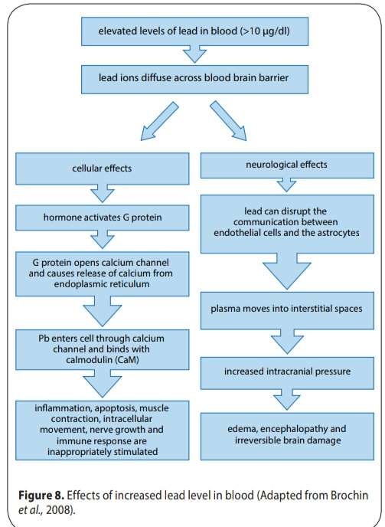

Slide 29
Health effects
At high levels, inorganic lead is a general metabolic poison
Lead poisoning effects the neurological and reproductive systems
Lead breaks the blood-brain barrier and interferes with the normal development of brain in infants
Exposure to high levels of lead can permanently affect the brain, bones, kidneys, and the heart.

Slide 30
Diagnosis
(1) History of exposure
(2) Whole blood lead level
  Children: >25μg/dl treatments
  Adults: >50 μg/dl candidates for treatment;
(3) Protoporphyrin levels in erythrocytes are usually elevated with lead levels > 40 μg/dl
(4) Urinary lead excretion >80 μg/dl
(5) Lead mobilization test (redistribution toxicity)

Slide 31
Symptoms of lead poisoning(aka plumbism or saturnism)
A: Anaemia, Amenorrhea
B: basophilic stippling(blue gums), burtonian line
C: constipation, colic
D:Drop(wrist/foot)
E: encephalopathy(m/c in children)
P: paleness of face(earliest and consistent)
S: sterility

Slide 32
Facts about lead poisoning
The human groups most at risk of lead poisoning are fetuses and children under the age of seven
Episodes of lead poisoning were recorded through the middle ages and even until recent times
A recent study in Mexico indicated that pregnant women can decrease the lead levels in their blood and presumably in the blood of their developing fetus by taking calcium supplements.

Slide 33
Fatal Dose –
-Absorbed Lead – 0.5 gm
-Acetate – 20 gm
-Carbonate – 4 gm
Fatal Period – 2nd – 3rd day
  Biological half-life of lead in bone is 10-20 years, while half life of lead in soft tissues is several months

Slide 34
Treatment
Remove from exposure
Stomach Wash- 1% Mg2(SO4)3/ Na2(SO4)
Milk/Egg White/ Barley Water
CaNa2EDTA
2,3-dimercaptopropanol (Dimercaprol, BAL)
2,3-dimercaptosuccinic acid (Succimer)
High dose of Vit. D

Slide 35
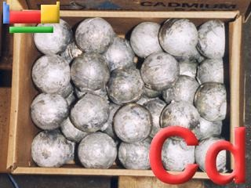
Cadmium
At num 48

Slide 36
Cadmium
Cadmium lies in the same subgroup of the periodic table as zinc and mercury, but is more similar to zinc
Cadmium is a soft, bluish-white metal and is easily cut with a knife. It is similar in many respects to zinc.
Coal burning is the main source of environmental cadmium
Incineration of wastes containing cadmium is an important source of the metal in the environment
Cadmium is most toxic in its ionic form unlike mercury
Note: Mercury is most toxic in vapor form and lead, cadmium and arsenic are most toxic in their ionic forms.

Slide 37
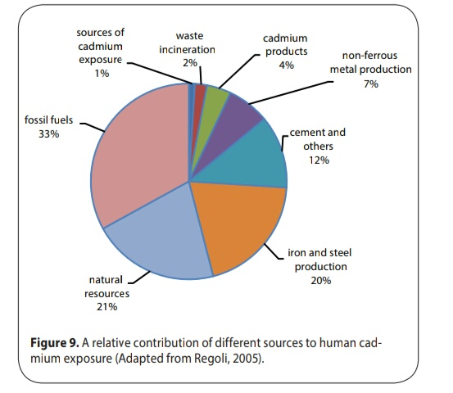
Cadmium and its compounds are highly toxic.
Cd is acutely toxic (lethal dose ~ 1 g)
Itai itai disease (cadmium contamination + diet low in calcium and vitamin D)

Slide 38
Mechanism of toxicity
1. Absorption
      (1) Inhalation 10 to 40%
      (2) GI 1.5 to 5%
2. Distribution: initially bound to albumin and blood cells; subsequently bound to metallothionnin in liver and kidney tissue.
Metabolism and excretion: it is transported in the blood bound to metallothionein, inhibits zinc metabolism
greatest conc in kidneys , Decreases copper in liver and plasma
Binds to ferritin, decreases Hb
Deposits in bones, Urinary excretion is slow

Slide 39
Diagnosis
History of exposure
  whole blood cadmium level >80 μg/dl
  Reduce pulmonary function
  Impaired renal tubular function (proteinuria)

Slide 40
Symptoms
a. Acute
  oral: vomiting, diarrhea, abdominal cramps
  inhalation: chest pains, nausea, dizziness, diarrhea,
  pulmonary edema
b. Chronic
  oral: nephrotoxicity
  inhalation: emphysema like syndrome and nephrotoxicity

Slide 41
Health effects
Severe pain in joints
Bone diseases
Kidney problems
Its lifetime in the body is several years
Areas of greatest risk are Japan and central Europe
In very high levels it poses serious health problems related to bones, liver and kidneys and can eventually cause death.

Slide 42
Fatal Dose-
      Not certain
      10 mg is enough to cause symptoms
Fatal Period – 5-7 days
Half life 10-20 years
Biological half life 25-30 years

Slide 43
Treatment
    Remove from exposure
    Stomach Wash with Tannin or egg albumin
    Na2SO4 should be given as Purgative
    BAL is contraindicated
    CaNa2EDTA may be effective
    Chelation is ineffective due to high affinity of cadmium to metallothionione

Slide 44
Arsenic (As)
At num 33

Slide 45
Arsenic
Arsenic is the most common cause of acute heavy metal poisoning in adults and is number 1 on the Top Hazardous Substances.
Arsenic oxides were the common poisons used for murder and suicide
Arsenic compounds were used widely as pesticides before the organic chemicals era
Elemental As is a naturally occuring silver-gray solid metalloid

Slide 46
WHO guideline value of arsenic in water – 0.01 mg/L or 10ppb
Metallic Arsenic -Not Poisnous ; Insoluble in Water
Non-adsorable from Alimentary Canal
Oxides form - Poisnous
As (3+) is more toxic than As (5+) – presumably due to stronger binding with S-containing proteins.
The toxicity of arsenic depends on its chemical composition and valency., arsine gas AsH3 being the most toxic , a potent hemolytic agent.( immediate death occurs at 150 ppm or 30 min from 25-5- ppm)

Slide 47
Compounds of Arsenic
Arsenic Trioxide | Potassium Arsenite & Sodium Arsenite |  | Potassium Arsenate & Sodium Arsenate |  | Arsenic Sulphides
As₂O₃ – White Arsenic / Sankhiya | K₃AsO₃ | Na₃AsO₃ | K₃AsO₄ | Na₃AsO₄ | Manashila (Real gar = Red Arsenic) As₂S₂ | Hartal (Orpiment = Yellow Arsenic) As₂S₃
Vapours- Garlic Odour & faint sweet taste Pharmaceutical Dose= 1 to 5 mg | Poisnous/ Used as weed Killers, Rodenticides, Fungicides |  | Poisnous/ Used for Homicidal Purpose & for destroying Catteles |  | Sulphides being insoluble in water & in its pure form are Nonpoisnous.

Slide 48
Mechanism of toxicity
Absorption
  inorganic: trivalent and pentavalent salts >90% from intestine
  organic: also bound as tri and pentavalent >90% poorly absorbed
  Inhalation: arsine gas; uptake is dependent upon particle size
  Skin : As3+ high absorption( lipid soluble)
2. Distribution: bound to rbcs and globulin; redistribution in lung, liver, and spleen. Concentrates in skin, nails and hair. (mees’ line)
3. Metabolism : undergoes transformation in body from pentavelent(less toxic) which is well absorbed to trivalent (more toxic)

Slide 49
the main effect is through induction of oxidative stress and impairment of the antioxidant defense mechanism, leading to apoptosis and cell death
4) excretion: mainly by kidneys, renal tubules can convert arsenate As5+ to the more toxic arsenite As3+
Placental transfer can cause marked damage to the fetus.

Slide 50
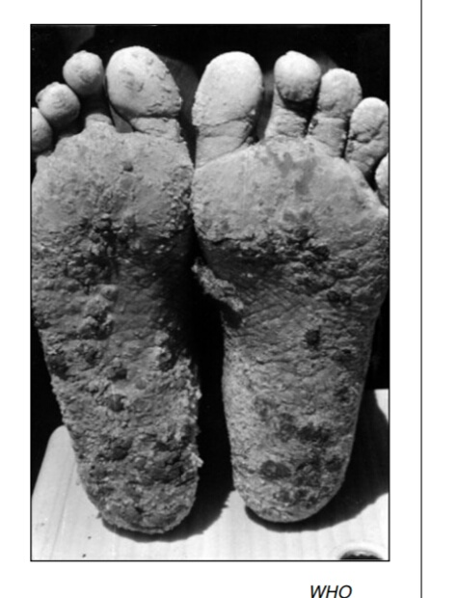
Symptoms
a. Acute
Damage to LIVER,mucosa, sloughing, hypovolemic shock, fever, GI discomfort /pain, anorexia
b. Chronic: main source : drinking water
hepatomegaly (jaundice > cirrhosis), melanosis, arrhythmias, peripheral neuropathy, peripheral vascular disease (black foot disease)
c. Carcinogenicity
  epidemiologic evidence; liver angiosarcoma, skin
  and Lung cancer results from the inhalation of arsenic and probably also from its ingestion and perhaps cancers of the
  bladder and kidneys.

Slide 51
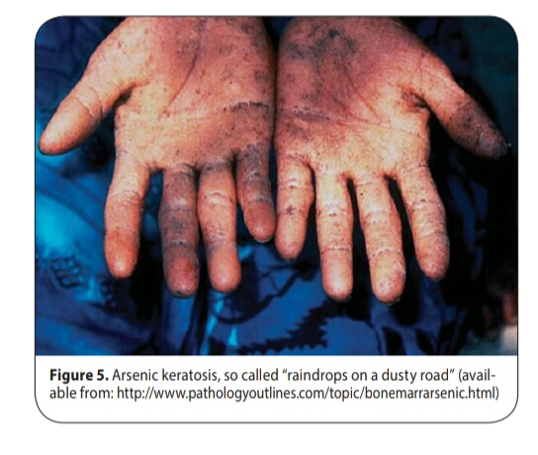
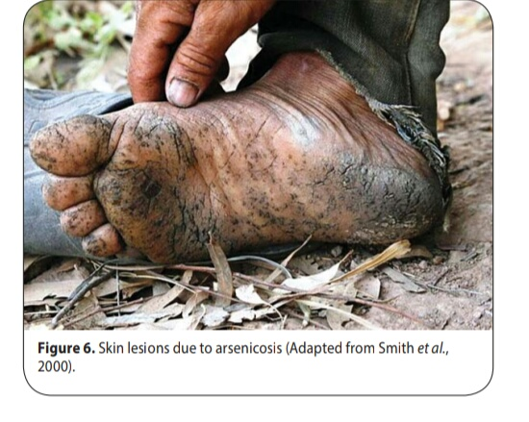
Mnemonic for arsenic poisoning
A: Aldrich- Mees line(white line on nails)
R: rain drop pigmentation, red velvety mucosa of stomach,rash, reinsch test
S: subendocardial haemorrhage
E: excessive pigmentation of palm & soles
N: neuritis
I: iron oxide is antidote
C: cholera like disease
G: garlicky smell, golden hair

Slide 52
Fatal Dose – Average = 180 mg (0.1- o.2 gms)
Fatal Period – 12 – 48 hr (Frequently 2-3 hr)
Half life is 7 to 10 hours.
    Diagnosis-History of exposure
    Blood and urinary levels (acute)
    Hair or fingernail (chronic)
    Barium like radio-opaque shadow on X- ray of Abdomen (As₂O₃)
    Arsenic detected on Chemical Analysis

Slide 53
Treatment
Remove from exposure
  Forced emesis, Stomach wash with warm H2O or milk.
  Administration of freshly prepared Ferric Oxide – Conversion of Arsenious acid into Ferric Arsenate.
  BAL =
      (2.5- 5 mg/Kg body wt.) - Deep I.M.*4 hourly for 2 days
      2.5 mg/Kg body wt.- Twice daily- on 3rd day
  BAL is not effective on Haemolysis due to Arsenic inhalation.

Slide 54
Demulsent- Ghee/Albumen/Barley water
Castor oil or MgSO4- Diminish intestinal absorption
  Acute: supportive therapy: fluid, electrolyte replacement, blood pressure support (dopamine)
  Chronic: penicillamine w/o dialysis
      Supportive therapy: transfusion; (chelators have not been shown to be beneficial)

Slide 55
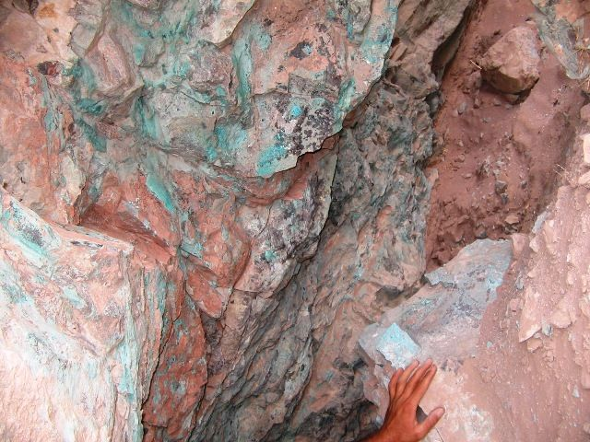
Copper

Slide 56
Copper is a reddish brown ductile and malleable metal
Daily intake of copper in adults varies between 0.9 and 2.2 mg, and in children between 0.6 to 0.8 mg (WHO, 1998).
It varies according to age, pregnancy and lactation.
It is an integral part of enzymes- ferrooxidase, cytochrome c coxidase, superoxide dismutase and other organs like liver, brain, heart, spleean and kidneys.
Adult body contains 50-120 mg of copper
Absorption: in diet-1.2 – 5 mg/day (50% absorbed)

Slide 57
Compounds of copper
  CuSO₄.5H₂O – Copper Sulphate (Blue Vitrol - Tutha) –
  Blue/ Water soluble Crystal
  Become anhydrous when heated 220° - 240°C – White Hygroscopic
  Emetic in 0.3-0.6 gm dose.
  Large dose it acts as an irritant poison.

Slide 58
Diagnosis
The hair copper level is a very unreliable indicator for copper toxicity. So is serum copper, serum ceruloplasmin, and many other tests because the copper can hide deep in the brain and the liver.
A liver biopsy is a good indicator
Hb Level Examination.
LFTs (AST, Lactate Dehydrgenase, Arginase, Sorbitol Dehydrogenase).
Serum or whole blood copper level.

Slide 59
Fatal dose-
Uncertain
CuSO₄.5H₂O taken in small amount is much more fatal then that taken in large amount, as large amount cause vomiting
Fatal Period- 1-3 days

Slide 60
Treatment-
Stomach wash with 1% K4Fe(CN)6 – Insoluble Cupric Ferrocyanide
Administration of White of an egg or milk as an Antidote- Albuminate of Copper(Insoluble)
Calcium EDTA- Antidote
I.M. BAL
Clinical improvement can be achieved by Chelation of copper with d-Penicillamine, Zinc acetate and Tetra thio-molybdate.
The combination of tetrathiomolybdate and zinc acetate is more effective.

Slide 61
Mechanism of toxicity of heavy metals
1. Absorption
Intestinal absorption/membrane translocation mediated by specific transporters
Inhalation- dust fumes in industrial setting
2. Distribution:
Copper circulates bound to ceruloplasmin
Relative tissue distribution of copper reflects levels of cuproenzymes
Excretion occurs via transport of copper into bile and elimination in feces

Slide 62
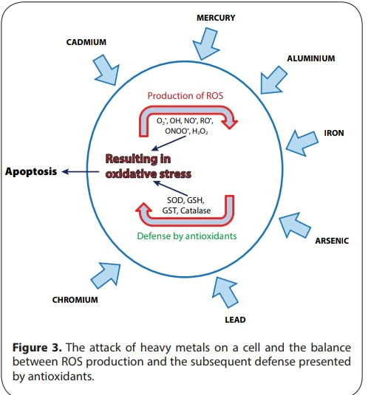

Slide 63
Toxicity of trace heavy metals
Metal | Route of Entry | Toxicity Effect | TWA by ACGIH (mg / m³) | Carcinogen
Arsenic | Inhalation and ingestion | Irritation of respiratory system, Liver and Kidney damage, Loss of appetite, nausea and vomiting etc | 0.20 | Yes
Cadmium | Inhalation and ingestion | Lung, liver and kidney damage; Irritation of respiratory system | 0.05 | Yes
Chromium | Inhalation, ingestion, and absorption through skin | Lung damage and Irritation or respiratory system | 0.5 | Yes

Slide 64
Toxicity of trace heavy metals
Metal | Route of entry | Toxicity Effect | TWA by ACGIH (mg / m³) | Carcinogen (suspected by NIOSH)
Mercury | Inhalation,ingestion and absorption through skin | Irritation of respiratory system; lung, liver and kidney damage | 0.05 (vapor) | Yes
Lead | Inhalation and ingestion | Lung and liver damage; loss of appetite, nausea etc | 0.15 | No
Nickel | Inhalation | Lung, liver and kidney damage | 1.00 | Yes

Slide 65
Basic principles of metal toxicity management :
Decontamination
Removal of the patient from the source of exposure is critical to limiting dose.
Elimination of metal from the circulation:gastric lavage and adm of emetic(except copper)
Prevention of further metal absorption into the system: use of albumin or demulscents to protect stomach wall
2. Resuscitation
Good supportive care is critical.
3. antidotes: chelators+toxins=soluble stable complex
Inactivation of metal bioavailable in the system
4.symptomatic treatment

Slide 66
Methods for measurement of trace metals
Most common method of collecting particulate matter is through filters
Identification and concentration of individual trace metals like lead,cadmium, arsenic, mercury and chromium is determined by
→ X-ray fluorescence
→ Atomic absorption spectrophotometry
→ X-ray fluorescence

Slide 67
                In ayurveda

Slide 68
Rasa Bhasma | Adverse effects (if improperly processed) | Reference
Rasa (Mercury) | Burning sensation, Skin lesions, vomiting, Stiffness and even death | Ayurveda Prakash 1/366
Swarna (Gold) | Ojas nash, cause diseases and even death | Rasa Ratna Samuchaya 5/20
Rajat (Silver) | Pyrexia, constipation Impotency, lowering body resistance power | Ayurveda Prakash 9/92

Slide 69
Tamra (Copper) | murcha, bhram, chitta santap,aruchi, Vomiting | Ayurveda Prakash 3/115
Naga (Lead) | Prameha, kshaya, kamlaa | Ayurveda Prakash 3/188
Manhashila (As2S2) | ashmari, mutraavrodh, mutrakriccha, mandaagni,mandbal | Ayurveda Prakash 2/219
Hartala (As2S3) | Diabetes, Pyrexia, kushtha, and even death | Ayurveda Prakash 2/179

Slide 70
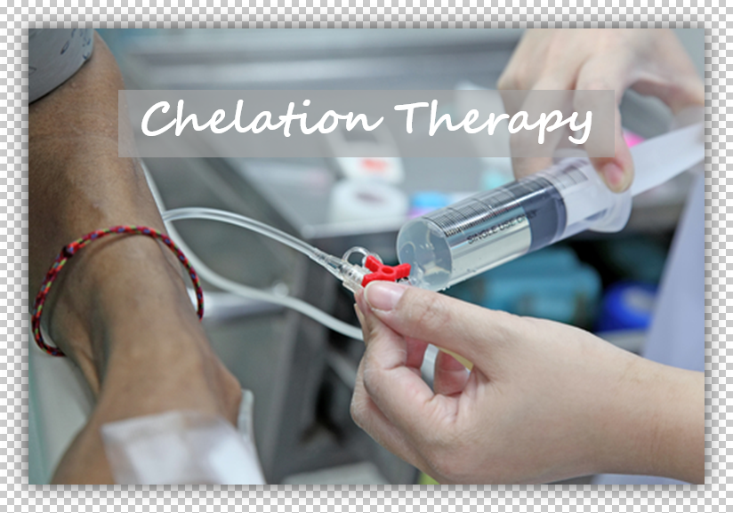
Chelating agents
Medicinal treatment for heavy metal poisoning is done by chelation therapy by administering compounds known as chelates
Example : British Anti-Lewisite(BAL), ethylene diamine tetra acetic acid(EDTA).
Usually these ligands are organic compounds, and are called chelants, chelators, chelating agents, or sequestering agents.
These drugs supply sulfhydryl groups for the heavy metals to attach and subsequently, may be eliminated from the body.

Slide 71
Chelation
The process by which these organic compounds combine with the metals to form relatively stable nonionised ring complexes (chele-claw).
Chelation therapy is a Process to remove toxic metals and minerals from the body using chelating agents.
Chelating agents are capable of binding to toxic metal ions to form complex structures which are easily excreted from the body removing them from intracellular or extracellular spaces. So these drugs used to prevent heavy metal poisoning.[EDTA]

Slide 72
Properties
Greater Affinity, Low Toxicity
High water solubility
Ability to compete with natural chelators
Ability to penetrate cell membranes
Same distribution as the metal
Capacity to form non-toxic complexes
Rapid elimination of the toxic metal

Slide 73
S .no | Metals/Mineral | Chelating agent/antidote | Reference
1 | Rasa/Parad (Mercury) | Gandhaka (Sulphur) with Nagvalli (piper betel) | Rasa Raj Sundar
2 | Swarna (Gold) | Haritaki (Termenelia chebula) with sita (sugar) | Rasa Raj Sundar
3 | Tamra (Copper) | Dhaniyaka (Coriander) with sita (Sugar) | Brihad Rasa Rajsindur
4 | Naga (Lead) | Swarnabhasma (Gold ash) mix with Haritaki (Termenila chebula) and sita (Sugar) | Rasa Raj Sundar

Slide 74
5 | Vanga (Tin) | Meshringi (Gymnema sylvestre) with sita (Sugar) | Rasa Rajsundar
6 | Hartala (As2S3) | Jeerak (Carum carvi) with sita (Sugar) | Rasa Rajsundar
7 | Manhashila (As2S2) | Cow’s milk with Honey | Rasa Taringini
8 | Abhrak (Biotite) | Atisi Beej | Rasa Jalnidhi
9 | Vimal (Iron Pyrite) | Meshringi (Gymnemasylvestre) wih sita | Brihad Rasa Rajsundar
10 | Makshik (Copper Pyrite) | Kullatha kwatha (Dolichus biflorus) and Dadima Kwatha (Punica granatum) | Brihad Rasa Rajsundar

Slide 75
11 | Sasayak (Blue Vitroil) | Jambiri nimbu | Brihad Rasa Rajsundar
12 | Rasak (Zinc Oxide) | Gomutra (Cow’s urine) | Brihad Rasa Rajsundar
13 | Gandhak (Sulphur) | Godudha (Cow’s milk) with Goghrita (Cow’s Ghee) | Brihad Rasa Rajsundar
14 | Gauripashana (White arsenic) | Tankan (Borax) Godudha (Cow’s milk) with Goghrita | Ayurvedic Rasashastra
15 | Loha (Iron) | Agastya swarasa with Vidang (Embelia ribes) | Ayuveda Prakash
16 | Yashad (Zinc) | Bala (Sida cordifolia) mixed with Haritaki (Termenelia chebula) and sugar | Rasa Rajsundar

Slide 76
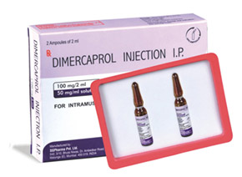
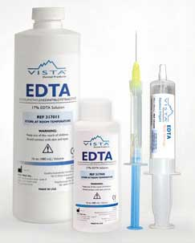
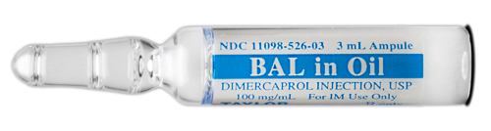
The antidote drugs in Schedule “I” of D&C act are
non specific- activated charcoal
CHELATING AGENTS (DRUGS)
Lead
Ethylenediamine-tetraacetic acid (EDTA)
2,3-dimercaptosuccinic Acid (Succimer)
2,3-dimercaptopropanol (BAL, Dimercaprol)
Penicillamine
Cadmium
Ethylenediamine-tetraacetic Acid (EDTA)
Mercury
N-acetyl-penicillamine (NAP)
Penicillamine
2,3-dimercaptopropanol (BAL, Dimercaprol)
2,3-dimercaptosuccinic Acid (Succimer)
Arsenic
N-acetyl-penicillamine (NAP)
BAL

Slide 77
Natural antidotes may consider as chelating agents of Ayurveda
Ex: Tankan (borax),
Gandhak (sulphur),
Saindhav Lavana (rocksalt),
Churnodaka (lime water),
Triphala Kwath,
ginger juice,
turmeric,
coriander,
honey,
cow’s urine, etc.,

Slide 78
OTHER antidotes are
Mechanical antidote viz fats(cow’s milk, goat’s milk, cow’s ghee, castor oil and egg albumen : forms a coating in stomach
Chemical antidotes viz lemon juice: for caustic alkali
Borax and turmeric were also known to have a powerful anti-dote effect
If purified aresnious oxide (Gauripasan) caused some toxicity then borax (Tankan) with cow’s milk used as antidote for it
If prepared medicine made from lead (Naag) cause some toxicity, then medicine prepared from gold (Swarna Bhasma) with Termenelia chebula powder used as antidote
If purified copper (Tamra) cause some toxicity, then aresnious oxide (Gauripasan) with sugar recommended as antidote.
Raw sulfur gets purified with the treatment of cow’s milk and ghee and to remove its toxicity from the human body cow’s ghee and milk are recommended
Raw Hartala (Arsenic trioxide; As2S3) gets purified with Kushmand Swarasa (Benincasa hispida) and to remove its toxicity Kushmand Swarasa is recommended with Jeerak (Carum carvi) and Madhu (Honey)
Raw Gauripasan (arsenious oxide; As2O3) gets purified with Tankan (borax) and cow’s milk and to remove its toxicity from body same is recommended.

Slide 79
1Dietary fibres from various food products, including bran from grains as well as fruit, have been evaluated as an alternative or adjunct to chelation therapy with the aim to interrupt enterohepatic recirculation and to modulate intestinal flora ,
2toxic metals have great affinity for sulphur-containing peptides, diets rich in sulphur-containing foods such as alliums (e.g. garlic and brassicas (e.g., broccoli have been suggested for effects on glutathione, with hopes for symptomatic improvement and enhanced excretion. Garlic prevented cadmium-induced kidney damage and decreased the oxidative damage due to lead in rats
3. leaves of Coriandrum sativum), a popular culinary and medicinal herb, gained attention when a soup was reported to enhance mercury excretion following dental amalgam removal and remains popular despite limited evidence

Slide 80
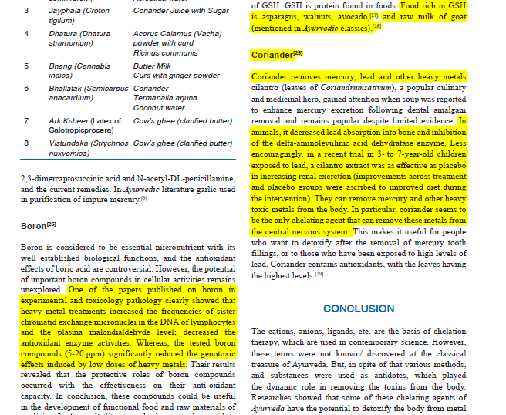

Slide 81
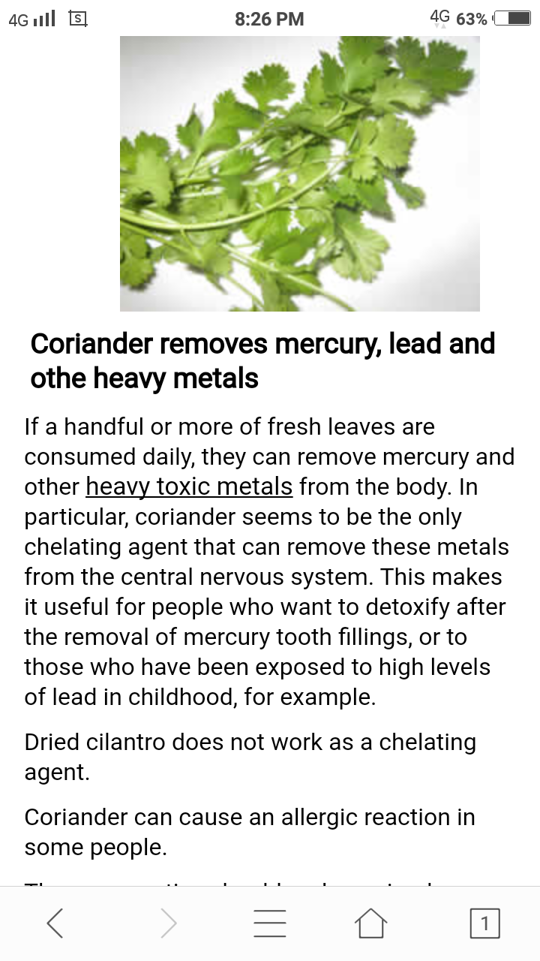
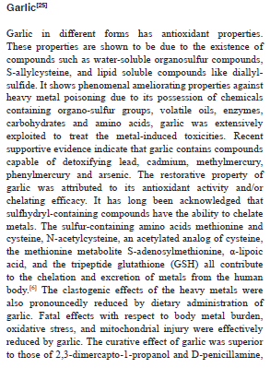

Slide 82
Conclusion
Some of the risks while using chelating agents :
1. Chelators bind to heavy metal or metal particles, but they can also bind to important minerals in body, such as calcium and iron, which are essentials for human body.
2. Sometimes chelating agents can also be dangerous. The use of disodium EDTA instead of calcium EDTA has resulted in fatalities due to hypocalcemia
3.Side effects of chelation therapy include dehydration, low blood calcium, harm to kidneys, increased enzymes as would be detected in liver function tests, allergic reactions, and lowered levels of dietary elements
4. Ayurvedic antidotes donot pose such complications

Slide 83
references
www.who.int/ipcs/features/10chemicals_en.pdf
Krishnamurthy, S. 1992. Biomethylation and environmental transport of metals. Journal of Chemical Education 69
Colin Baird.2000. Environmental Chemistry, W.H. Freeman and Company, New York.
Ou S, Gao K, Li Y. An in vitro study of wheat bran binding capacity for Hg, Cd, and Pb. Journal of Agricultural and Food Chemistry. 1999;47(11):4714–4717. [PubMed]
. Callegaro M, Milbradt BG, Diettrich T, et al. Influence of cereal bran supplement on cadmium effects in growing rats. Human & Experimental Toxicology. 2010;29(6):467–476. [PubMed]
Berglund M, Akesson A, Nermell B, Vahter M. Intestinal absorption of dietary cadmium in women depends on body iron stores and fiber intake. Environmental Health Perspectives. 1994;102(12):1058–1066. [PMC free article] [PubMed]
Rowland IR, Mallett AK, Flynn J, Hargreaves RJ. The effect of various dietary fibres on tissue concentration of chemical form of mercury after methylmercury exposure in mice. Archives of Toxicology. 1986;59(2):94–98. [PubMed]

Slide 84
. Abdalla FH, Bellé LP, de Bona KS, Bitencourt PER, Pigatto AS, Moretto MB. Allium sativum L. extract prevents methyl mercury-induced cytotoxicity in peripheral blood leukocytes (LS) Food and Chemical Toxicology. 2010;48(1):417–421. [PubMed]
Lampe JW, Peterson S. Brassica, biotransformation and cancer risk: genetic polymorphisms alter the preventive effects of cruciferous vegetables. Journal of Nutrition. 2002;132(10):2991–2994. [PubMed]
. Suru SM. Onion and garlic extracts lessen cadmium-induced nephrotoxicity in rats. BioMetals. 2008;21(6):623–633. [PubMed]
. Senapati SK, Dey S, Dwivedi SK, Swarup D. Effect of garlic (Allium sativum L.) extract on tissue lead level in rats. Journal of Ethnopharmacology. 2001;76(3):229–232. [PubMed]
. Abascal K, Yarnell E. Cilantro-culinary herb or miracle medicinal plant? Alternative and Complementary Therapies. 2012;18:259–264.

