Slide 1
TKDL, DHARA & INFORMATION AVAILABLE AT AYUSH WEBSITE
Dr Arun Sharma

Slide 2
CONTENTS
Introduction
What is TKDL?
How is it evolved?
Importance of TKDL?
How does it work?
History of TKDL?
DHARA
Inclusion criteria in DHARA
Indexing in DHARA
Information at AYUSH Website

Slide 3
iNTRODUCTION
India possesses a rich traditional knowledge which is generally being passed down by word of mouth from one generation to another.
Most part of this traditional knowledge is inaccessible to common since it is described in ancient classical and other literature.
There is also a threat of misuse of such knowledge through obtaining patents on non-original innovations which is a great loss to the country.
TKDL addresses these issues.

Slide 4
WHAT IS TKDL?
Traditional Knowledge Digital Library
Managed by the CSIR , TKDL is a computerised database of documented information available in Indian texts , relating to Indian systems of medicine.
Over 10 years, more than 2 lakh formulations of ayurveda, siddha, unani and yoga have been documented under the TKDL.
TKDL
Country India
Type Digital Library
Scope Traditional Knowledge
Established 2001
Website www.tkdl.res.in

Slide 5
HOW IS IT EVOLVED ?
Vinod Kumar Gupta, who set up TKDL, devised a modern clasification based on the structure of International Patent Classification (IPC) for India’s traditional systems: Ayurveda, Unani, Siddha & Yoga.
Set up in 2001, as a collaboration between the Council of Scientific and Industrial Research (CSIR) and the Department of Ayurveda, Yoga and Naturopathy, Unani, Siddha, and Homeopathy (Dept. of AYUSH), Ministry of Health & Family Welfare, Government of India.

Slide 6
As of 2010, it had transcribed 148 books on Ayurveda, Unani , Siddha & Yoga in public domain, into 34 million A4 size pages of information, translated into five languages –
English
German
French
Spanish
Japanese
Data on 80,000 formulations in Ayurveda, 1,000,000 in Unani and 12,000 in Siddha had already been put in the TKDL.

Slide 7
IMPORTANCE OF TKDL
The Objective of the library is to protect the ancient and traditional knowledge of the country from exploitation.
TKDL provides information on traditional knowledge existing in the country, in languages and format understandable by patent examiners at International Patent Offices(IPOs), so as to prevent the grant of wrong patents.
TKDL thus acts as a bridge between the traditional knowledge information existing in local languages and the Patent Examiners at IPOs.

Slide 8
HOW DOES IT WORK?
The knowledge obtained from ancient Indian texts is not a transliteration; rather it is a knowledge- based conversion, where data abstracted once is converted into several languages by using Unicode, Metadata methodology.
This ensures near-fool proof security for our invaluable bio resources against piracy. All of this required not just high-end technology but also skills of a high technical order.

Slide 9


Slide 10
The issue of bio piracy & unethical patent.
India’s vast traditional medicine knowledge existed in limited languages.
Reports of a large number of false gurus and yoga masters, who attempted to patent this ancient knowledge in their own countries.

Slide 11
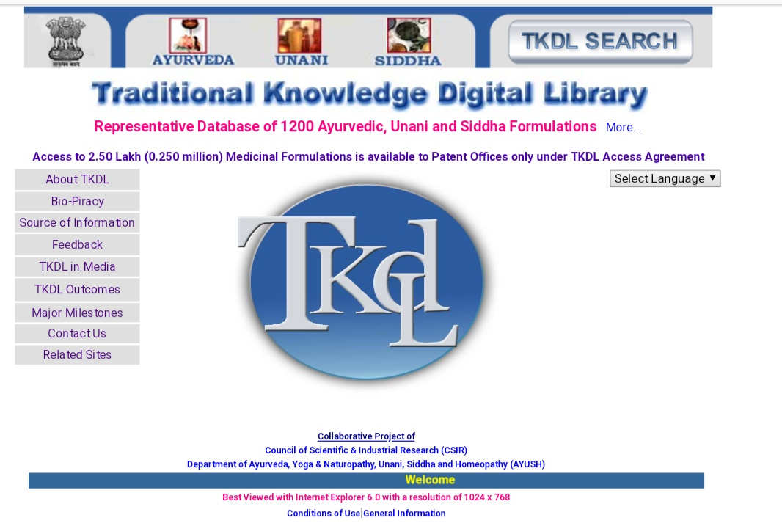
HOMEPAGE OF TKDL

Slide 12
DHARA
DHARA is the acronym for Digital Helpline for Ayurveda Research Articles. It is the first comprehensive online indexing service exclusively for research articles published in the field of Ayurveda.
DHARA is accessible online at www.dharaonline.org

Slide 13
Cont.…….
DHARA in Sanskrit means flow. It symbolizes the facilitation of the free flow of information on research in Ayurveda.
A collaborative initiative between Central Council for Research in Ayurvedic Sciences(CCRAS), New Delhi, The Ayurvedic Trust (AVT), Coimbatore, & Swiss Ayurveda Medical Academy (SAMA), Switzerland.

Slide 14
CONT..
A comprehensive database that will allow systematic access to published research on Ayurveda was taken up by AVT Institute for Advanced Research (AVTAR), the research wing of the Ayurvedic Trust with financial assistance from CCRAS.
The scope for the tripartite initiative between CCRAS, AVT, & SAMA to generate meta-analysis & systematic reviews on published research in Ayurveda will be explored in the future.

Slide 15
CONTD..
Nearly 1 million articles were indexed in PubMed in the year 2010.
About 50,000 articles were indexed from the field of Complementary & Alternative Medicine (CAM).
About 1500 articles on Acupuncture were indexed in PubMed.

Slide 16
CONTD..
DHARA has indexed 4123 artiles on Ayurveda in 2010 compared with the 3780 indexed in PubMed, out of which only 240 are identified as related to Ayurveda.
More than providing access to published research on Ayurveda, DHARA also makes it possible to do a comprehensive gap analysis with reference to the current status of research in Ayurveda.

Slide 17
CRITERIA FOR INCLUSION OF ARTICLES IN DHARA
For indexing, DHARA includes any research article published on Ayurveda in research journals that meet basic editorial standards.
In other words, the journal should have an independent editorial board and accept articles for publication only after internal editorial review & external peer review.
Articles published in magazines and unpublished theses & dissertations are not included for indexing in DHARA.

Slide 18
CONTD..
Research articles dealing directly or indirectly with research findings related to Ayurveda are accepted.
Relevant articles from other systems of complementary and alternative medicine are also included after scrutiny, if they refer to Ayurveda in the content or deal with a drug, therapy, instrument, or any procedure which is also used in ayurveda.

Slide 19
INDEXING OF RESEARCH ARTICLE
Articles titles and abstracts are indexed in separate fields.
DHARA does not deposit the full version of the articles directly.
DHARA provides link to the full text wherever available. This link can be seen below the abstracts.
Access to the full article may be free or against payment depending on the policy of the research journal.

Slide 20
CONTD…
In some cases, even abstracts are copyrighted and hence not displayed if not provided by the journal.
Every entry is given a unique identification number known as DHARA ID.
If the article is also indexed in PubMed, then the PubMed ID is also included.

Slide 21
FEATURES
1. Wild Keyword Search Option
2. Advanced Search with Boolean Operators
3. Search Field Tags
4. Limiting Search with Controlled Vocabulary
5. Journals Areas for listing journals by keyword search or in alphabetical order to access basic information on journals

Slide 22
CONTD..
6. Authors area for listing authors by keywords search or in
alphabetical order to search articles by author name.
7. Building Uniform Resource Locators (URLs) that can be stored
for future use
8. Options for sorting search results
9. Exporting the search result as text file.

Slide 23
SUMMARY INFORMATION
The home page of DHARA displays summary information of the total number of articles indexed and also gives break up of articles titles, abstracts, and full text access, free or paid.
Year wise index to published articles is also provided.
The home page also lists the number of authors as well as the number of first and last authors.
These numbers are not accurate as the names of same authors are indexed in different format and get indexed as independent names.

Slide 24
CONTD..
The number of journals indexed in DHARA is also displayed with a breakup of the category of journals belonging to Ayurveda, CAM, & other disciplines.
In addition, the link to the journals area and authors area are also provided and the five latest articles indexed in DHARA are listed on the homepage.
The homepage provides a snapshot of the information available in the database.

Slide 25
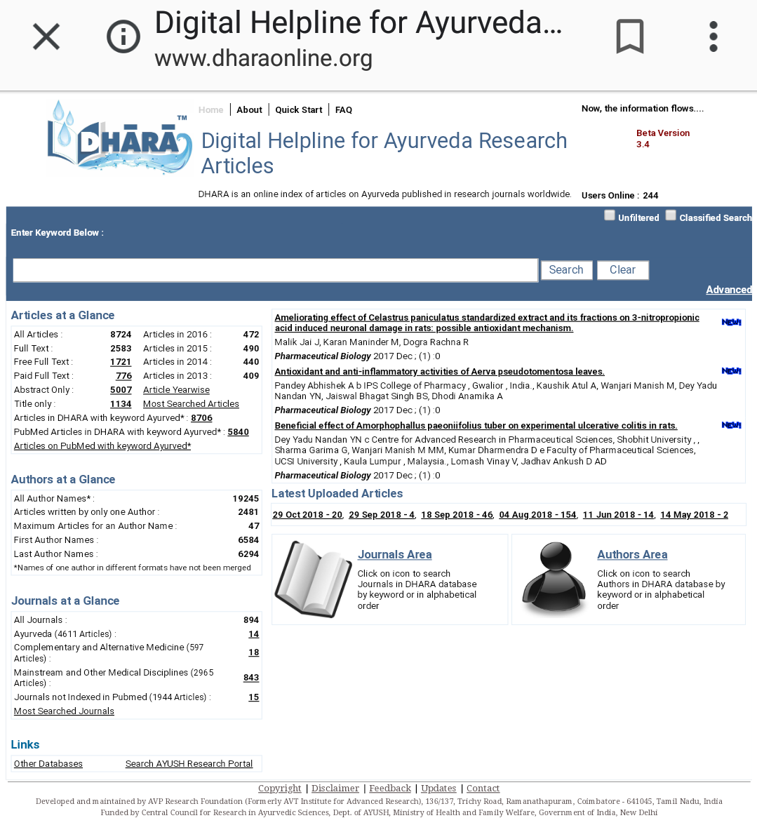

Slide 26
FUNDINGS
The DHARA project was financially supported by CCRAS, Dept. of Ayush Gvt. Of India, for a period of 1 year from August 2010 to july 2011.
Further development and maintenance of the database is being continued by the Ayurvedic Trust.

Slide 27
AYUSH WEBSITE
This Ministry of AYUSH was formed on 9th November 2014 to ensure the optimal development and propagation of AYUSH systems of health care.
Earlier it was known as the department of Indian System of Medicine and Homeopathy (ISM&H) which was created in March 1995 and renamed as Department of Ayurveda, Yoga and Naturopathy, Unani, Siddha and Homeopathy(AYUSH) in November 2003, with focused attention for development of Education & Research in same.

Slide 28
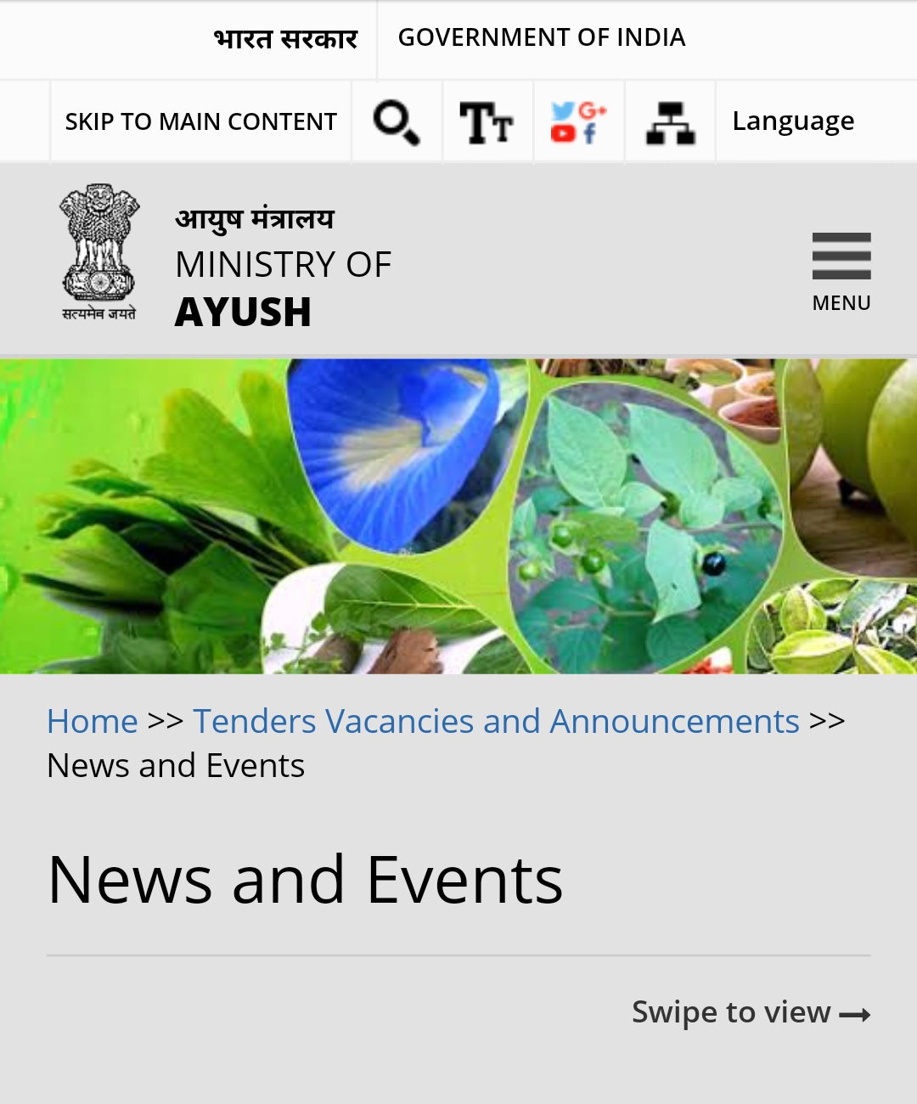

Slide 29


Slide 30
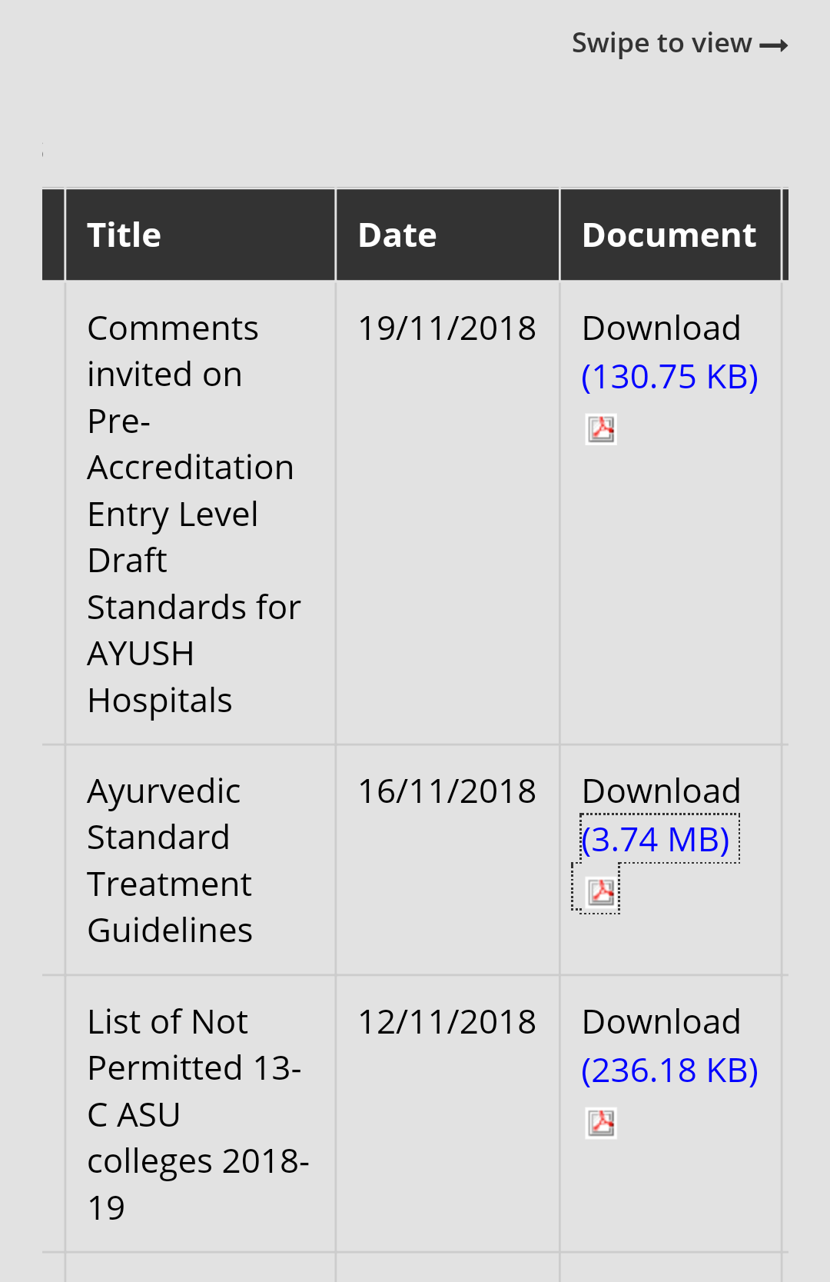

Slide 31
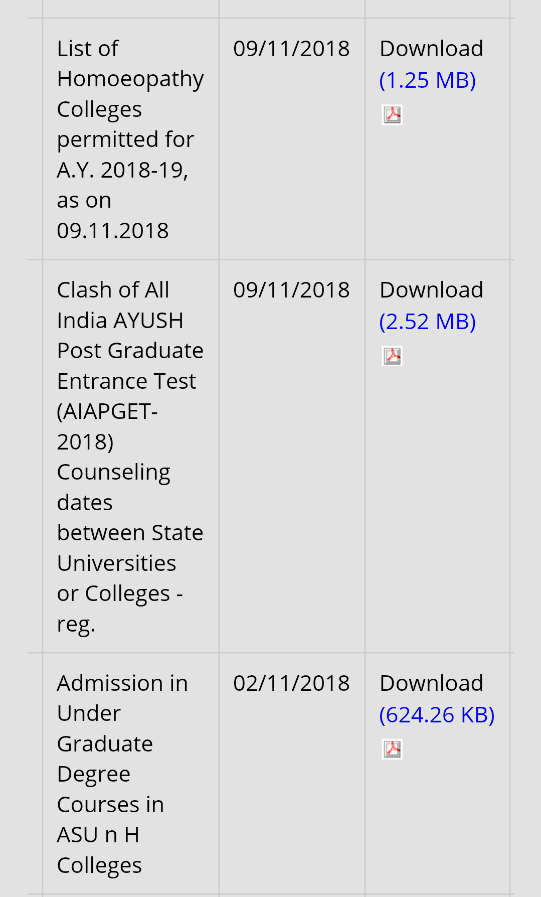

Slide 32
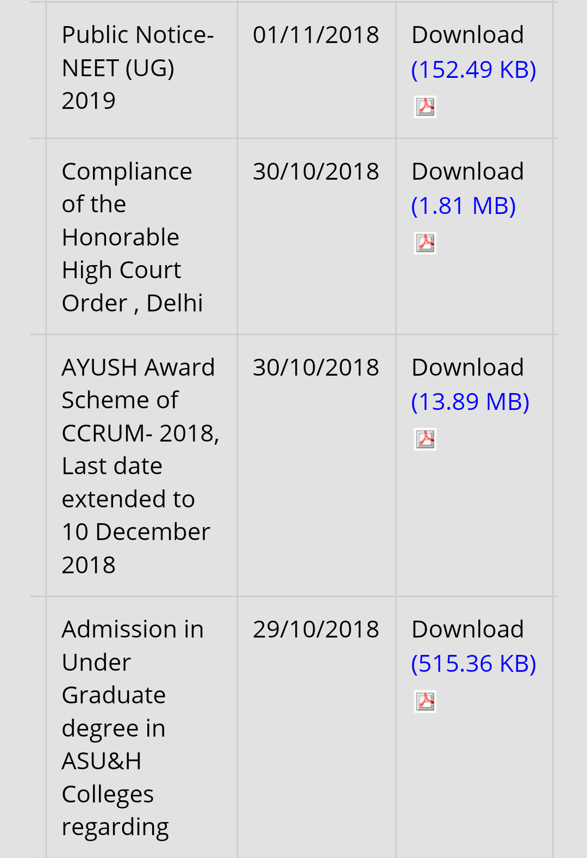

Slide 33


