Slide 1
PROF H S RAI ROHILKHAND AYURVEDOC MEDICAL COLLEGE BAREILLY

Slide 2
BLOOD PRESSURE is actually arterial pressure which is defined as lateral pressure on the arterial wall exerted by blood flowing across
BP cardiac output (stoke volume*heart rate

Slide 3
Physiological Types-of Blood PRESSURE
TYPES-
Physiologically there are 4 types of blood pressure =
1 systolic ,the maximum pressure recorded during systole ranges 100 -140 mm of Hg
Significance –mainly depends on stroke volume or cardiac output the elasticity of blood vessels has got a prime role ;
a rigid and stiff vessel affect the lateral pressure .

Slide 4
Diastolic
- Diastolic the minimum pressure recorded during diastolic phase of cardiac cycle,
it ranges from 60- 90 mm of Hg,
it depends on peripheral resistance ie
- diameter of lumen of artery
  viscosity of blood.

Slide 5
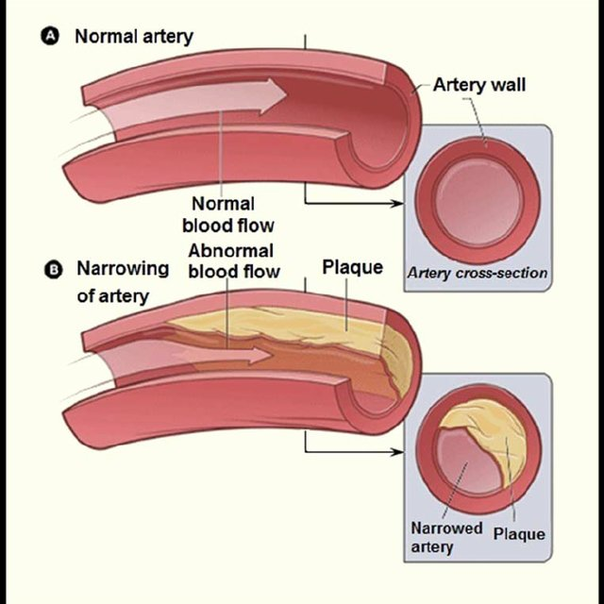
Atherosclerosis

Slide 6
. Pulse Pressure
3- Pulse pressure (PP)- Pulse pressure is the difference between the systolic and diastolic blood pressures.
Pulse Pressure = Systolic Blood Pressure – Diastolic Blood Pressure
.
Normal pulse pressure is, approximately 40 mm Hg.
A change in pulse pressure (Delta Pp) is proportional to blood volume change ( Stroke volume] (Delta V) but inversely proportional to arterial compliance (C):
Delta Pp = Delta V/C

Slide 7
Continued
SV =Because the change in volume is due to the stroke volume of blood being ejected from the left ventricle we can approximate pulse pressure as:
Pp = SV/C
A normal young adult at rest has a stroke volume of approximately 80 mL.
Arterial compliance is approximately 2 mL/mm Hg, which confirms that normal pulse pressure is approximately 40 mm Hg.

Slide 8
Arterial compliance is equal to the change in volume (Delta V) over a given change in pressure (Delta P):
C = Delta V/Delta P
Because the aorta is the most compliant portion of the human arterial system, pulse pressure is the lowest.
Compliance progressively decreases until it reaches a minimum in the femoral and saphenous arteries,
and then it begins to increase again.
Ar

Slide 9
A, a pulse pressure , that is less than 25% of the systolic pressure is inappropriately low or “narrowed,” whereas of greater than 100 is high or “widened.
Normally it ranges from 20-50 mm of Hg.

Slide 10
Significance
Significance –For adults older than age 60, a pulse pressure greater than 60 can be a useful predictor of heart attacks or other cardiovascular disease; this is especially true for men.
In some cases a low pulse pressure (less than 40) may indicate poor heart function. A higher pulse pressure (greater than 60) may reflect leaky heart valves (valve regurgitation),
often due to age-related ,losses in aortic elasticity.

Slide 11
Continued
However, systolic and diastolic pressure should also be considered alongside pulse pressure values. Higher systolic and diastolic pairs imply higher risk than lower pairs with the same pulse pressure: 160/120 millimeters of mercury (mm Hg) indicates a higher risk than 110/70 mm Hg even though the pulse pressure in each pair is 40.

Slide 12
Cause of elevated PP
Stiffness of the aorta, the largest artery in the body.
The stiffness may be due to high blood pressure or fatty deposits damaging the walls of the arteries, leaving them less elastic (atherosclerosis).
The greater your pulse pressure, the stiffer and more damaged the vessels are thought to be.

Slide 13
OTHER CONDITIONS
Severe iron deficiency (anemia)
Thyrotoxicosis
Athlete - conditioned runner (increased cardiac out and decreased peripheral resistance
AGING – Due to atherosclerosis and loss of elasticity of wall i.e increased stiffness of arterial wall that predisposes the left ventricular hypertrophy.
Aortic regurgitation -Valvular disease like Aortic regurgitation result in changes in pulse pressure. In aortic regurgitation, the aortic valve insufficiency results in a backward, or regurgitant, flow of blood from the aorta back into the left ventricle, so that blood that was ejected during systole returns during diastole. This leads to an increase in the systolic pressure and a decrease in the diastolic pressure, which results in an increase in pulse pressure .
Aortic stenosis, there is a narrowing

Slide 14
Aortic stenosis
Aortic stenosis, there is a narrowing of the aortic valve which interferes with the ejection of blood from the left ventricle into the aorta, which results in a decrease in stroke volume and subsequent decrease in pulse pressure
HAEMORRHAGE---due to decrease in strok volume

Slide 15
HIGHER RANG
Higher systolic and diastolic pairs imply higher risk than lower pairs with the same pulse pressure: 160/120 millimeters of mercury (mm Hg) indicates a higher risk than 110/70 mm Hg even though the pulse pressure in each pair is 40.

Slide 16
The most important cause of elevated pulse pressure is 1-stiffness of the aorta, the largest artery in the body. The stiffness may be due to high blood pressure or fatty deposits damaging the walls of the arteries, leaving them less elastic (atherosclerosis). The greater your pulse pressure, the stiffer and more damaged the vessels are thought to be.
Severe iron deficiency (anemia)
Thyrotoxicosis
Athlete - conditioned runner (increased cardiac out and decreased peripheral resistance
AGING – Due to atherosclerosis and loss of elasticity of wall i.e increased stiffness of arterial wall that predisposes the left ventricular hypertrophy.
AORTIC REGURGITATION
AORTIC STENOSIS

Slide 17
Risk factor.
In fact, as little as a 10-mm Hg increase in the pulse pressure increases the cardiovascular risk by as much as 20%.

Slide 18
Treatment –Aerobic exercise
Use of ACE inhibitor
Estrogen in menopausal women
Use of n-3 fatty acid
Decrease salt intake

Slide 19
Mean pressure
Mean pressure -The mean arterial pressure (MAP) is the average arterial pressure throughout one cardiac cycle, systole, and diastole.
MAP is influenced by cardiac output and systemic vascular resistance, each of which is under the influence of several variables.
A common method used to estimate the MAP is the following formula:
MAP = DP + 1/3(SP – DP) or MAP = DP + 1/3(PP)

Slide 20
Continued.
In general, most people need a MAP of at least 60 mmHg (millimeters of mercury) or greater to ensure enough blood flow to vital organs, such as the heart, brain, and kidneys. Doctors usually consider anything between 70 and 100 mmHg to be normal
.A MAP in this range indicates that there’s enough consistent pressure in your arteries to deliver blood throughout your body.
A high MAP is anything over 100 mmHg, which indicates that there’s a lot of pressure in the arteries. This can eventually lead to blood clots or damage to the heart muscle, which has to work a lot harder.

Slide 21
Many things that cause very high blood pressure can also cause a high MAP, including:
heart attack
kidney failure
heart failure
Anything under 60 mmHg is usually considered a low MAP. It indicates that your blood may not be reaching your major organs. Without blood and nutrients, the tissue of these organs begins to die, leading to permanent organ damage.

Slide 22
Continued
Anything under 60 mmHg is usually considered a low MAP. It indicates that your blood may not be reaching your major organs. Without blood and nutrients, the tissue of these organs begins to die, leading to permanent organ damage.
Doctors usually consider a low MAP to be a possible sign of:
Sepsis
Stroke
Internal bleeding

Slide 23
Once blood pressure is under control, the doctor can begin treating the underlying cause. This might involve:
breaking up a stroke-causing blood clot
inserting a stent into a coronary artery to keep it open
      SIGNIFICANS - In order to perfuse vital organs requires the maintenance of a minimum MAP of 60 mmHg. If MAP drops below this point for an extended period, end-organ manifestations such as ischemia and infarction can occur. If the MAP drops significantly, blood will not be able to perfuse cerebral tissues, there will be a loss of consciousness, and neuronal death will quickly ensue.The body has several protective mechanisms to regulate MAP and ensure that a sufficient level of perfusion is maintained for the function of all organs.

Slide 24
SIGNIFICANS
      In order to perfuse vital organs requires the maintenance of a minimum MAP of 60 mmHg.
      If MAP drops below this point for an extended period, end-organ manifestations such as ischemia and infarction can occur.
      If the MAP drops significantly, blood will not be able to perfuse cerebral tissues, there will be a loss of consciousness, and neuronal death will quickly ensue.
      The body has several protective mechanisms to regulate MAP and ensure that a sufficient level of perfusion is maintained for the function of all organs.

Slide 25
The CARDIAC OUT PUT and the diameter of lumen are under the influence of several variables affected by many factors not being discussed here

Slide 26
Clinical types of Hypertension
Isolated systolic hypertension
Isolated diastolic hypertension
Sustained hypertension
Accelerated hypertension
Labile hypertension or paraoxismal
Malignant hypertension
White coat or Mask hypertension

Slide 27
Isolated systolic hypertension-
Isolated systolic hypertension- Isolated systolic hypertension (ISH) [systolic blood pressure (SBP) > or = l60mm Hg with diastolic blood pressure (DBP) <90mm Hg] is the commonest form of hypertension in the elderly, and accounts for about 70% of all hypertensive conditions in the population aged over 60 years. The cause is not well understood but decrease in arterial compliance is supposed to be the important factor.
It is associated with a significantly increased risk of cardiovascular and cerebrovascular morbidity and mortality.

