Slide 1
POWDERS
BY
Dr. Arun Sharma

Slide 2
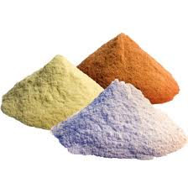
POWDERS
Homogeneous mixture of drugs and chemicals in a finely divided state
Particle size from 0.1 to 10000 micron

Slide 3
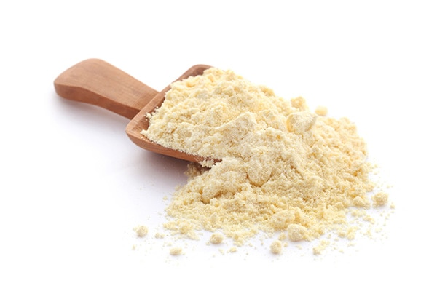
characters
Finest state of subdivision
Homogeneous
Small particle size
Large surface area
High absorptive capacity

Slide 4
CLASSIFICATION
POWDERS
INTERNAL
DIVIDED
BULK
EXTERNAL
BULK
PARENTRAL
Antacid
Laxative
Dietary
Effervecent
Simple
Compound
Closed In Sachet
Tablet Tarturatess
Dusting
Snuff
Insufflations
Dentrifices

Slide 5
cont
GRADE OF POWDER | SIEVE THROUGH WHICH ALL PARTICLES MUST PASS | SIEVE THROUGH WHICH NOT MORE THAN 40 % OF PARTICLES PASS
COARSE | 10 | 44
MODERATELY COARSE | 22 | 60
MODERATELY FINE | 44 | 85
FINE | 85 | NOT SPECIFIED
VERY FINE | 120 | NOT SPECIFIED

Slide 6
ADVANTAGES and DISADVANTAGES
ADVANTAGES
DISADVANTAGES
Flexibility
Ease of administration
Rapid therapeutic effect
Stability
Time consuming
Dose inaccuracy
Deteriorate on exposure to atmosphere
Unpleasant taste

Slide 7
SPECIAL PROBLEMS AND REMEDIES
PROBLEMS
REMEDIES
Hygroscopic and deliquescent ingredients
Eg ammonium bromide
Iron
Calcium chloride
Dispense in granular form
Don’t reduce to a very fine powder
Use double wrapped or cellophane envelopes
Mag. Oxide as absorbent

Slide 8
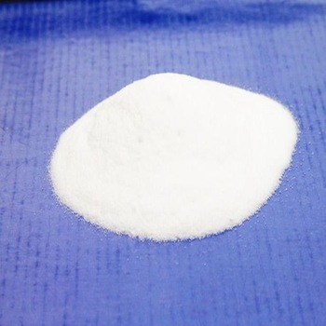
CONT
2. Efflorescent ingredients (liberate water of crystillisation)
Eg Citric acid
Sodium acetate
Codeine
Use anhydrous salt and double wrapped to prevent moisture

Slide 9
cont
3. Eutectic mixtures
( may liquefy at room temperature)
Eg Acetyl salicylic acid
menthol
Phenol
Salol
Liquefiable substance
Triturated
Forming eutectic
Add fine powder
2. Dilute with absorbent

Slide 10
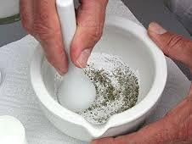
cont
4. Incorporation of liquids
Small liquid proportion
Triturated with equal amount of powder
Add remaining powder
Add absorbent

Slide 11
Cont.
5. Incorporation of extracts/tinctures
Eg belladonna tincture
Nitroglycerine spirit
6. Containing volatile substances
Eg menthol
camphor
5.Replace liquid extract with dry extract
Evaporate liquid to dry state
6.Double wrapped and inner paper being paraffined

Slide 12
cont
7. Containing explosive mixtures
Oxidzing agent (pot.
Chlorate,pot. Nitrate)
triturated with a reducing
Agent (charcoal,sulphur) a
violent explosion may occur
Minimum pressure while triturating. Use tumbling
Powder seperately and then mix
Powder seperately and dispense them in separate powder papers

Slide 13
cont
8. Powders containing potent drug
Take minimum
weighable quantity add
diluent and mix

Slide 14
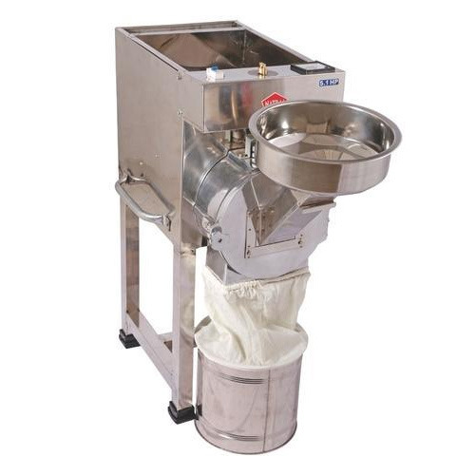
DIVIDED POWDERS
Preparation of divided powders
Size reduction
    Trituration
    Pulverization by intervention
    Levigation (wet grinding)
    EQUIPMENTS: mortar pestle
    pulvelizer

Slide 15
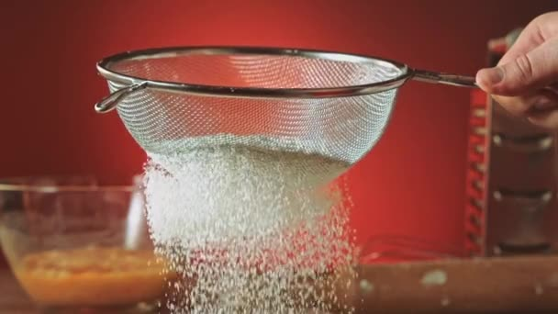
Cont.
MIXING OF POWDERS
Spatulation
Trituration
Sifting
Tumbling
DIVIDING POWDER MIXTURES
Estimation
Blocking and dividing
Powder measures
weighing each powder

Slide 16
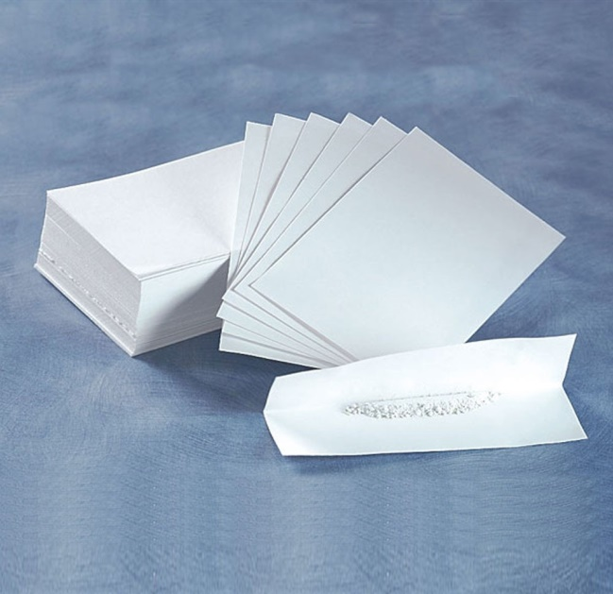
CONT.
PACKING
  Powder papers
  vegetable parchment
  paraffined paper
  light weight bond paper
  Folding the powders
  Envelopes
  Powder boxes

Slide 17
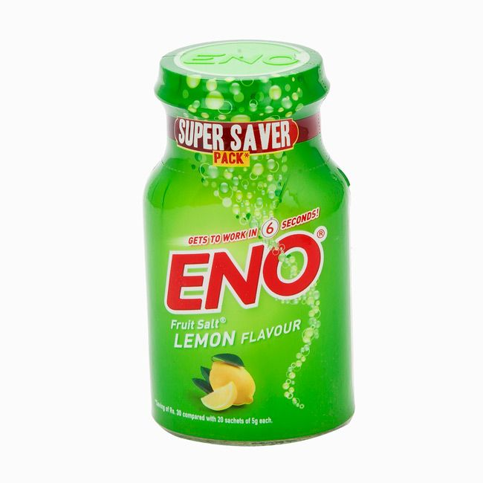
BULK POWDERS
Powders taken in large doses.
eg Antacids
Laxatives
Powders for douches
EFFERVESCENT POWDERS
Citric acid + Tartaric acid + Sodium biphosphate/Bicarbonate + Medicinal agent

Slide 18
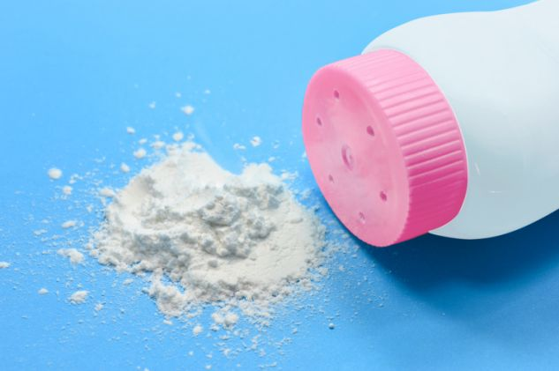
CONT
DUSTING POWDERS
Homogeneous
No local irritation
Flow easily
Spread uniformly
Cling to skin
Good covering capability
Good adsorptive and absorptive capacity
Fine state of division

Slide 19
CONT
INGREDIENTS
Starch
Talcum
Kaolin
Boric acid
Aluminium stearate, zinc oxide, zinc stearate

Slide 20
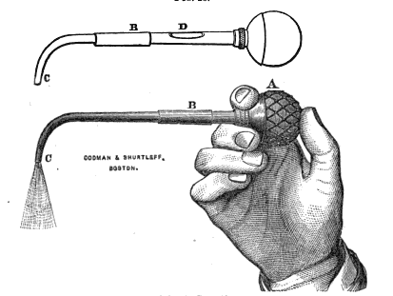
cont
INSUFFLATIONS
finely divided dusting powders introduced into body cavities. Eg tooth sockets, ears, nose , vagina, throat.

Slide 21
cont
DISADVANTAGES
Non uniform dosage
Particles stick to each other and to wall of the insufflator.
SNUFFS
These are sent out in flat metal boxes with hinged lid

Slide 22
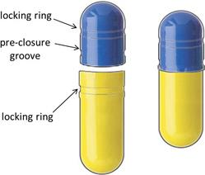
Enclosed powders
KONSEALS
Formed by sealing two concave disks of wafer sheet.
For administering nauseating and unpleasant taste drug
TYPES :
Wet seal
Dry seal

Slide 23
MOULDED SOLID DOSAGE FORMS
TABLET TRITURATES
Made of fine powders moulded into shape while in a moist condition . Contains only medicament and diluent e.g morphine, atropine
HYPODERMIC TABLETS
Dissolved in water for injection

Slide 24
THANK YOU

