Slide 1
POTTALI KALPANA
Presented by :- Arun Sharma

Slide 2
CLASSIFICATION OF RASA KALPA
On the basis of Method Of Preparation
RASA KALPA
Kharaliya
Koopipakwa
Parpati
Pottali
Notes:
पोटली कल्पना एक प्रकार की रस कल्पना है
रस कल्पों का आधार द्रव्य पारद है
अर्थात रस के योग से जो भी औषधें बनायीं जाती हैं वे सभी रासौशाधि कहलाती है
जरा रोग और मृत्यु को नष्ट करने में समर्थ होने के कारण रस कहा गया है।
शुद्ध हुआ पारद अमृत के तुल्य है व् गंद्धक जारण करने पर १००० गुना फल देने वाला हो जाता है
1) Kharaleeya = It is the basic processing techniques. Here all the processing of parada is done with the help of khalva yantra. Here shuddha parada or parada bhasma is triturated with herbs/ rasa substances. Ex: Kajjali, Arogyavardhini vati etc.
2) Kupipakva = This term is composed of four words:- kupi, pakva, ras and ayana. A rasayana product from parada, gandhaka etc. is prepared in a glass bottle by applying mild, moderate and intense heat. Based on preparation method it classified into:- Antardhooma and Bahirdhoom. The colour of the finished product depends on the ingredients used. Ex. Rasashindoor, Makardhawaja etc.
3) Parpati = Kajjali is melted and poured over leaf of banana or palash. Kept over cow dung cake and pressed with another plate to get a thin cake like formulations called Parpati. Ex: Ras parpati etc.
4) Pottali Kalpana = Kajjali and other substances are triturated with kumari swarasa to get a bolus. it is given a shape of a betel nut, wrapped with silk cloth and one tola shuddha gandhaka. This mass is taken in a pot and subjected to intence heat to get pottali. Ex:- Rasagarbha pottali etc.

Slide 3
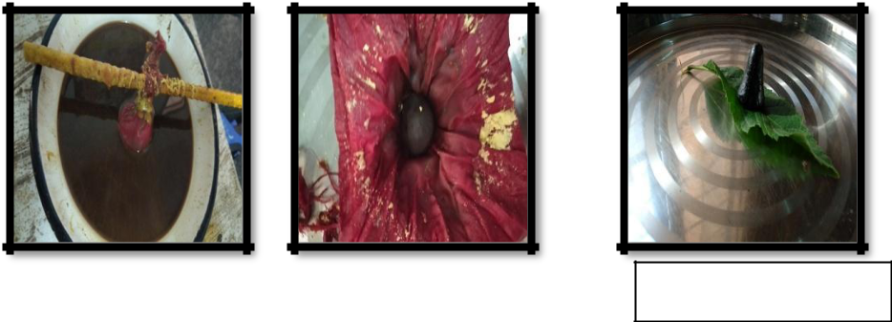
पोट्टली
पुट पोट पोट्टली = संश्लेष = To Adhere,
To Give Support
To Keep Intact
पोट्टली “ पोटेन संश्लेषेण लीयते इति ”
विस्तारितस्य वस्तुन: अल्पो भवनं पोट्टम् ।
पोट्टलाति गृह्याती इति पोट्टली॥
DEFINITION: Pottali can be defined as to collect scattered material in to a compact dosage form to ensure long shelf life and usability.
Notes:
पोटली शब्द की उत्पत्ति पोट शब्द से हुई है और पॉट शब्द की उत्पत्ति पुट शब्द से हुई है जिसका अर्थ होता है है संस्लेश अर्थात जोड़ना या बंधन करना

Slide 4

Vedic Literature = No Referance
Brihatrayee = POTTALI = swedana, avapeedana nasya, etc.
But no reference for POTTALI Kalpana preparations.
First Reference = 12th century in Rasa Ratnakara and explained under PUTAPAKA VIDHI
13th century = Rasa Prakasa Sudhakara = Preparation of pottali kalpana by Gandhaka Drava Paka in the context of VAJRA POTTALI.
Notes:
But from the point of Rasa shastra, Pottali kalpana should be considered as separate kalpana of metallo-mineral drugs evolved in order to keep multiple components like Bhasma, Dhatu, Ratna etc., into a compactly processed one.

Slide 5
18th centuary = Yogaratnakara = Gandhaka drava in an iron vessel.
Maximum number of Pottali Yogas = Rasa yoga Sagara under the chapter ‘Pottali Rahasyam’.
Rasamritam contains Hemagarbha Pottali Kalpana, procedure in this pottali kalpana is considered to be the best one.

Slide 6

Necessicity of Pottali Kalpana
Kupi sangrahane dukham, dukhen bharat dawye param,
Dukhenah bhangate dalikah, oushad kshayam mahat
(Rasayansar, Chikitsa prakaran, 113)
Unavailability or Scarcity of glass (kupi) bottles in 13th century A.D.
Mud pots are heavy to carry and cause havoc in transportation.
There was always a risk of breakage of mud pots by the roaming physicians, if it happened; it causes a great loss of medicaments.
Pottali kalpana are the drugs of high potency with compact size, hence they were easy to carry by the travelling physicians.
Notes:
पोटली कल्पना की importance बाकि रस कल्पों के drawback पर based है,
ग्लास बोतल की कमी के कारण Kupipakwa formulation बनाने में दिक्कत आती थी
मध्यकालीन समय में वैद्य अपनी औषध खुद लेकर रोगी के पास जाता करते थे ,और उन्हें अलग अलग स्थानों पर जाना होता था .

Slide 7
CLASSIFICATION OF POTTALI
1. Based on Appearance
2. Based on Ingredients
  Parada
  Gandhaka
3. Based on Agni Samskara
4. Based on Gandhaka Paka
5. Based on Methods Of Preparation

Slide 8
1. BASED ON APPEARANCE
POTTALI
Choorna Form Bhasma Conical Solid Form
Eg. Mriganka Pottali Rasa Eg. Hamsa Pottali Rasa
Gandhakadi Pottali Rasa Shanka Garbha Pottali
Lokanath Pottali Rasa
Shaped Before Gandhaka Paka Shaped On Its Own During Paka
Eg. Ratna Garbha Pottali Eg. Hema Garbha Pottali (S.B.M.)
Tamra Garbha Pottali

Slide 9
2. BASED ON INGREDIENTS
Parada
POTTALI
With Parada Without Parada
Eg. Ratna Garbha Pottali Eg. Gandhakadi Pottali
Hema Garbha Pottali
Gandhaka
POTTALI
With Gandhaka Without Gandhaka
Eg. Ratna Garbha Pottali Eg. Vajra Pottali (R.P.S.)
Hema Garbha Pottali

Slide 10
3. Based on Agni Samskara
POTTALI
Without Agni Samskara With Agni Samskara
Eg. Hamsa Pottali Rasa
Gandhakadi Pottali Rasa
PUTA PAKA YANTRA PAKA
Gaja Puta Lavana Yantra
Eg. Lokanath Pottali Eg. Kaparda Pottali
Bhudara Puta Valuka Yantra
Eg. Rasa Pottali Eg. Shila Garbha Pottali
Vitasti Pramana Pit Dola Yantra
Eg.Hema Garbha Pottali (3) Eg. Hema Garbha Pottali
Bhanda Puta
Eg. Vaishvanara Pottali

Slide 11
4. BASED ON GANDHAKA PAKA
POTTALI PAKA
By Dola Yantra
Eg. Hema Garbha Pottali (RSM)
Without Dola Yantra
Eg. Hema Garbha Pottali (2) (Y.R)
Initially Swedana By Krusara, Follwed By Sulphur Bath
Eg. Hema Garbha Pottali (11) (R.Y.S)
Gandhaka Taila
Eg. Hema Garbha Pottali (S.B.M.)

Slide 12
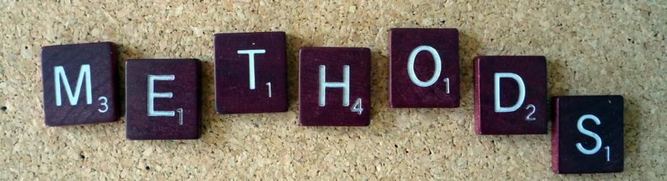
5. Based on Methods Of Preparation
POTTALI PREPARATION methods
Bhavana (09)
Putpaka (60)
Varatika Purana (19)
Gandhaka Drava Paka (31)
Other Preparatory Methods (10)

Slide 13
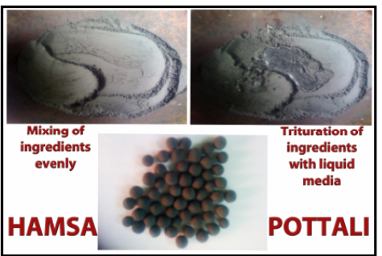
Bhavana Method
Khalwa yantra = Ingredients = Triturate with the prescribed liquid media.
Duration = Till the final product attains viscous and semi-solid state.
Liquid Media for Triturition (Juices or decoctions) = Depends on the indication
Media is not mentioned = Pulp of Kumari
Final product is rolled into pills of recommended dose
Dried and stored in powder form.
This method of preparation is equal to other khalwiya rasayanas.

Slide 14
Pottali Kalpa Prepared Through Bhavana Method
S. No. POTTALI KALPA REFERENCE PERIOD
  Hemagarbha Pottali Rasendra sar Sangraha 13 th Cent.
  Hansa Pottali Rasendra sar Sangraha 13 th Cent.
  Gandhaka marda Pottali – 1 Rasa Ratna Samucchaya 14 th Cent.
  Gandhaka marda Pottali – 2 Rasa Ratna Samucchaya 14 th Cent.
  Hamsa Pottali Rasendra Chudamani 14 th Cent.
  Hansa Pottali Rasayana Sangraha 19 th Cent.
  Hansa Pottali Rasayoga saagara 20 th Cent.
  Gandhakadi Pottali rasa Rasayoga saagara 20 th Cent.
  Rasagarbha Pottali - 3 Rasayoga saagara 20 th Cent.

Slide 15
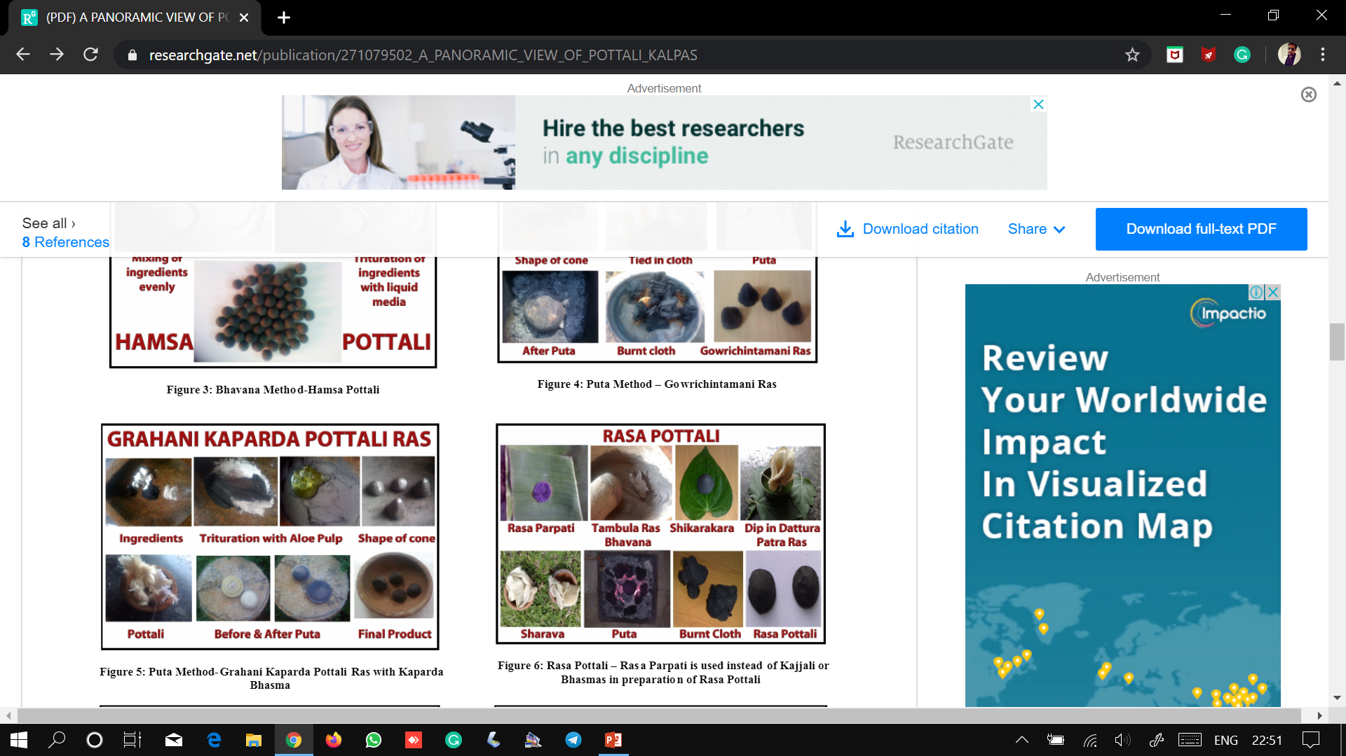
Putapaka Method
Popular method
The ingredients are triturated with fresh juices of Nagavalli, Dattura, Kumari, Nimbu, Nirgundi, Jayanti or Chitrak mula decoction and subjected incineration.
Final product is usually in the form of Bhasma
Rasayoga Sagara = Divya Jal as bhavana dravya to make the pottali very hard and glossy.
Siddha Sampradaya = White Portion 0f Krishna-kukkutanda (increase the potency)
Type of Puta = from Kukkuta Puta to Gaja Puta
Duration = from One Yama (3 hrs.) to 03 days ( nature of the ingredients used as raw material.)
Notes:
It is a specialized technique in Rasa Shastra where the drugs of metallic, mineral and animal origin are reduced to fine ashes through oxidation by subjecting them to appropriate quantum of heat repeatedly so that the substance loses its original shape, colour, texture and luster etc.

Slide 16
POTTALI KALPA PREPARED THROUGH PUTAPAKA METHOD
S. No. POTTALI KALPA REFERENCE PERIOD
Ratnagarbha Pottali Rasa Ratnakara 12 th Cent.
Sankhagarbha Pottali Rasa Ratnakara 12 th Cent.
Taaragarbha Pottali (vartika) Rasendra Sangraha 13 th Cent.
Lokeshwera Pottali Rasendra Sangraha 13 th Cent.
Grahani kapharda Pottali Rasendra Sangraha 13 th Cent.
Mrigaanka Pottali Rasa Prakaasa Sudhakara 13 th Cent.
Raja Mrigaanka Pottali Rasa Prakaasa Sudhakara 13 th Cent.
Hemagarbha Pottali-1 (Bhudara) Rasa Prakaasa Sudhakara 13 th Cent.
Hemagarbha Pottali-2 (Gaja Puta) Rasa Prakaasa Sudhakara 13 th Cent.
Mrigaanka Pottali Rasa Ratna Samucchaya 14 th Cent.
Pottali Rasa Rasa Ratna Samucchaya 14 th Cent.
Visesha Varna Pottali Rasa Ratna Samucchaya 14 th Cent.
Hemagarbha Pottali Rasa Ratna Samucchaya 14 th Cent.
Ratnagarbha Pottali Rasendra Chudamani 14 th Cent.
Lokesh Pottali Rasa Chintamani 14 th Cent.
Laghu Pottali Rasa Chintamani 14 th Cent.
Kanchana Pottali Rasa Chintamani 14 th Cent.
Shankha Pottali Rasa Chintamani 14 th Cent.
Hiranyagarbha Pottali Rasa Chintamani 14 th Cent.
Kanka Pottali Rasa Rasa Kankaliya 14 th Cent.

Slide 17
Contd..
S. No. POTTALI KALPA REFERENCE PERIOD
Mrigaanka Pottali Rasa Kankaliya 14 th Cent
Lokanatha Pottali Rasa Kankaliya 14 th Cent.
Shankhagarbha Pottali Rasa Kankaliya 14 th Cent.
Hiranyagarbha Pottali Rasa Kankaliya 14 th Cent
Mrigaanka Pottali Rasaavataara 14 th Cent.
Ratnagarbha Pottali Rasaavataara 14 th Cent.
Lokanatha Pottali Rasaavataara 14 th Cent.
Mrigaanka Pottali Sarngadhara Samhitha 14 th Cent.
Ratnagarbha Pottali Rasa Kaumudi 16 th Cent.
Shankhagarbha Pottali Rasa Kaumudi 16 th Cent.
Ratnagarbha Pottali Rasa Kamadhenu 17 th Cent.
Mrigaanka Pottali Rasa Kamadhenu 17 th Cent.
Hiranyagarbha Pottali Rasa Kamadhenu 17 th Cent.
Hemagarbha – 1 Rasa Kamadhenu 17 th Cent
Hemagarbha – 2 Rasa Kamadhenu 17 th Cent.
Lokeshwera Pottali Rasa Kamadhenu 17 th Cent.
Lokanath Pottali Rasa Kamadhenu 17 th Cent.
Shankhagarbha Pottali Rasa Kamadhenu 17 th Cent.

Slide 18
Contd..
S. No. Pottali Kalpa Reference Period
39 Ratnagarbha Pottali (Gaja Puta) Yoga Ratnakara 18 Th Cent.
Lokeshwer Pottali (Varaha Puta) Yoga Ratnakara 18 Th Cent.
Hemagarbha – 1 (Gaja Puta) Yoga Ratnakara 18 Th Cent.
Hamsagarbha Pottali Bhaishajya Ratnavali 18 Th Cent.
Hiranyagarbha Pottali Bhaishajya Ratnavali 18 Th Cent.
Ratnagarbha Pottali Bihatyoga Tarangini 18 Th Cent.
Mrigaanka Pottali Nighantu Ratnakara 19 Th Cent.
Ratnagarbha Pottali Nighantu Ratnakara 19 Th Cent.
Mrigaanka Pottali Rasaayana Sangraha 19 Th Cent
Shankhagarbha Pottali Rasayoga Saagara 20 Th Cent.
Lokanath Pottali Rasayoga Saagara 20 Th Cent.
Lokeshwer Pottali Rasayoga Saagara 20 Th Cent.
Rasagarbha Pottali - 1 Rasayoga Saagara 20 Th Cent.
Rasagarbha Pottali – 2 Rasayoga Saagara 20 Th Cent.
Rasagarbha Pottali – 3 Rasayoga Saagara 20 Th Cent.
Rasagarbha Pottali - 4 Rasayoga Saagara 20 Th Cent.
Hemagarbha Pottali – 1(bhudara Puta) Rasayoga Saagara 20 Th Cent.
Hemagarbha Pottali – 6 Rasayoga Saagara 20 Th Cent.
Hemagarbha Pottali – 10 Rasayoga Saagara 20 Th Cent.
Hiranyagarbha Pottali (Gaja Puta) Rasayoga Saagara 20 Th Cent.
Shankhagarbha Pottali (Bhudara Puta) rasayoga Saagara 20 Th Cent.
Panchamrita Pottali (Laghu Puta) Rasayoga Saagara 20 Th Cent.

Slide 19
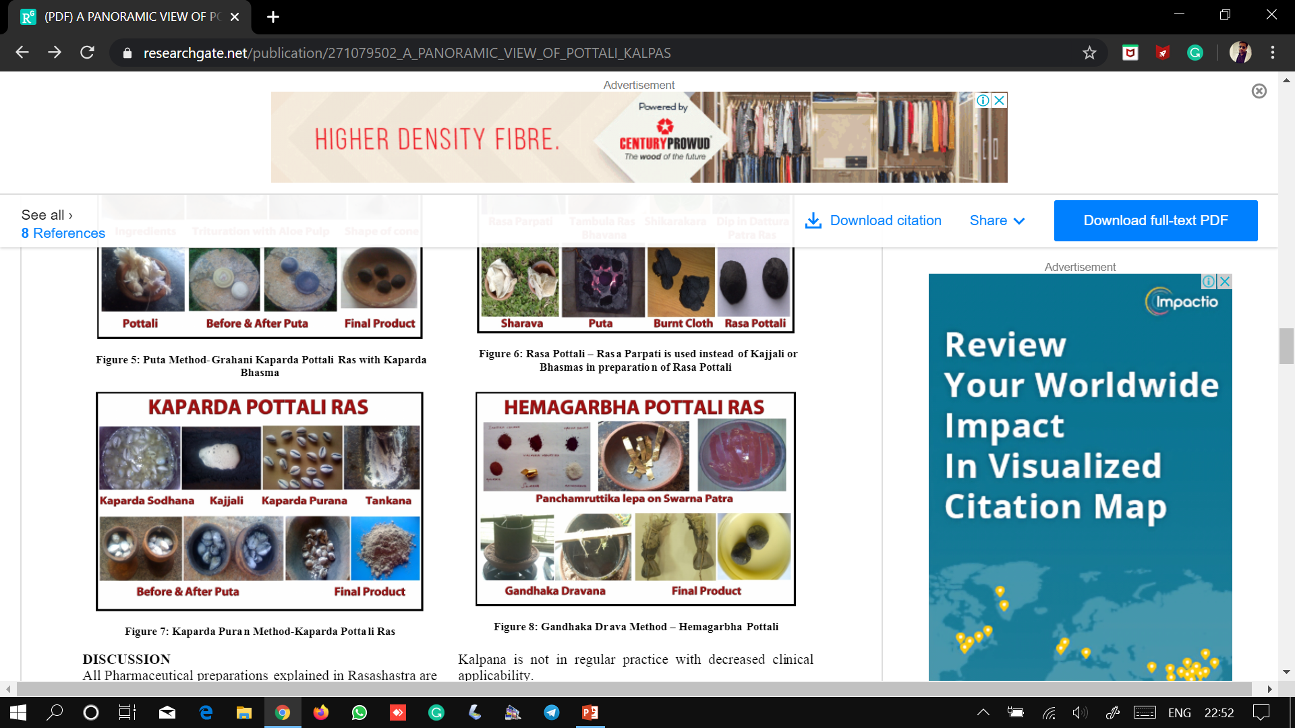
VARATIKA / SANKHA PURANA METHOD
All the ingredients after thorough processing, are filled into a Varatika (cowry – shell) or Shankha (conch – shell).
The groove or opening of the shell is closed and sealed with the paste made up of mixing Tankana (borax) in either Go Mutra / Go Dugdha
The filled in shells are subjected to Puta.
On cooling, the final product is Finely Powdered and Stored.

Slide 20
POTTALI KALPA PREPARED THROUGH VARATIKA / SANKHA PURANA METHOD
S. No. Pottali Kalpa Reference Period
Hemagarbha Pottali - 1 Sarngadhara Samhitha 14 Th Cent.
Hemagarbha Pottali - 2 Sarngadhara Samhitha 14 Th Cent.
Ratnagarbha Pottali Bhaishajya Ratnaavali 18 Th Cent.
Likeshwera Pottali Bhaishajya Ratnaavali 18 Th Cent.
Hemagarbha Pottali Bhaishajya Ratnaavali 18 Th Cent.
Lokeshwer Pottali Brihatyoga Tarangini 18 Th Cent.
Lokanath Pottali Nighantu Ratnakara 19 Th Cent.
Shankhagarbha Pottali – 1 Nighantu Ratnakara 19 Th Cent.
Shankhagarbha Pottali - 2 Nighantu Ratnakara 19 Th Cent.
Hemagarbha Pottali - 1 Nighantu Ratnakara 19 Th Cent.
Hemagarbha Pottali – 2 Nighantu Ratnakara 19 Th Cent.
Ratnagarbha Pottali Rasaayana Sangraha 19 Th Cent.
Hemagarbha Pottali Rasayoga Saagara 20 Th Cent.
Ratnagarbha Pottali Rasayoga Saagara 20 Th Cent.
Narasimha Pottali Rasa Rasayoga Saagara 20 Th Cent.
Kanka Pottali Rasayoga Saagara 20 Th Cent.
Kashyapa Pottali Rasa Rasayoga Saagara 20 Th Cent.
Muktagarbha Pottali Rasayoga Saagara 20 Th Cent.
Vajragarbha Pottali Rasayoga Saagara 20 Th Cent.

Slide 21
GANDHAKA DRAVA PAKA METHOD
First introduced in Rasa Prakasa Sudhakara (13th century) by Yashodhara in the context of Vajra Pottali.
Not that popular as compared to that of Putapaka method.
Gandhaka Drav Paka method is considered to be the best one in the preparation of Pottali Kalpa due to its high therapeutic efficacy.

Slide 22
PROCEDURE
POORVA KARMA
PRADHANA KARMA
PASCHAT KARMA

Slide 23
Poorva Karma
Identification and collection of raw materials
Shodhana of Raw Materials
Preparation of Kajjali
Arrangement of Valuka Yantra
Collection of thread and Silk cloth, Mud pot
Firing Apparatus
Notes:
Identification of correct and collection of best

Slide 24
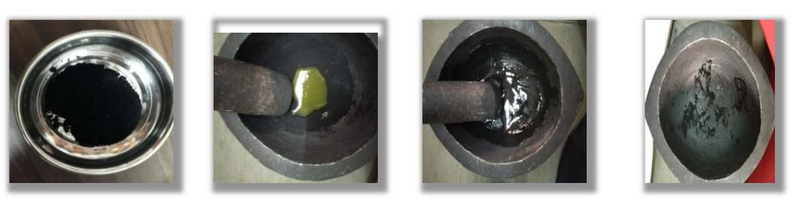
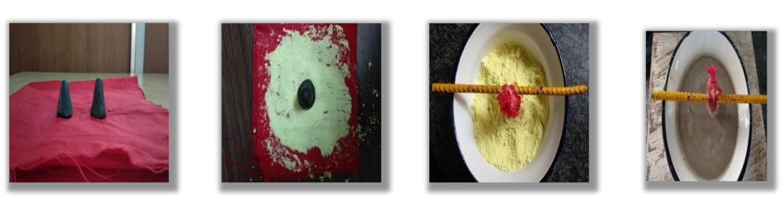
PRADHANA KARMA
POTTALI NIRMAAN
Medicinal drugs are taken into khalwa.
Triturated with binding agent
Shikharakara matras were prepared from this mixture and dried.
Prepared matra is tied in four fold silk cloth.
Notes:
like kumari swarasa, babbul niryasa, chitraka swarasa. As per siddha pranali, egg yolk used as a binding agent.

Slide 25
Shape of Pottali
“shikhara-arambhika akara” = The base being wide with narrowly pointed towards the top resembling the shape of the pyramid (rasayana sara)
“pugakara” = The pottali should look like puga phala (fruit of araca catechu nut) in shape and size.
“karsya manasca vartika” = The pottali should be in the shape of varti and approximately weighing of one karsha (12grams).
Notes:
Regarding the shape of the pottali different opinions are encountered in rasa shastra text.

Slide 26
POTTALI PAAKA
Valuka yantra is kept on gas and heat is to be given.
An Iron vessel or Musha containing Gandhak powder is kept on valuka.
After heating Gandhak melts and Pottalis are placed in melted Gandhak.
This procedure is done for 3-4 hours till Pottali siddhi lakshana attains.

Slide 27
Contd…
Gandhaka should be in molten state throughout the procedure.
Level of gandhaka should be maintained throughout the procedure
Valuka yantra is used to maintain uniform and sustained heat to pottali and to prevent catching of fire by gandhaka in musha.
After pakwa lakshnas are observed, pottalis are taken out from Gandhaka.

Slide 28
Quantity of sulphur
The quantity of sulphur to be equal with the weight of pottali taken (Y.R.)
2 to 6 times to the weight of the pottali, gandhaka should be taken (R.S.)
2 inches of gandhaka as base and 1 inch of gandhaka after placing the pottali. (Vasudev mulashankar dvivedi)

Slide 29
Paka kala
Different views are mentioned in rasa shastra text regarding the duration of paka of pottali.
They are yamardha, yama, ghatika, dwitayam, ghatadwaya, dwiyamam which indicated the duration of paka from 1hr to 8hrs.
But yoga ratnakara, rasamritam mentions the paka kala up to the attainment of vyoma varna of gandhaka.

Slide 30
Pakwa Lakshnas
On the basis of colour of gandhak
    Vyoma varna (sky color) in Yog Ratnakara & Rasamrutha.
    Neelashyama (bluish black) by V.M.Dwivedi.
Gandhaka become more viscous
Pottalies become stony hard
Produces metallic sound
Burning of silk cloth should be observed.
Notes:
Vasudev mulashankar dvivedi

Slide 31
PASCHAT KARMA
After Swangasheeta Pottali is removed.
Gandhaka adhered to that pottali is scraped out.
Remove the silk cloth.
Polished with silk cloth.

Slide 32

EXAMINATION OF FINAL PRODUCT
Metallic sound
Hard
Lustre
Colour – Shyama Varna

Slide 33
WHY GANDHAK AS MEDIA FOR PAKA
Because other media e.g. Taila, kwath, relatively evaporates fast.
Other liquid media = temp 90-100⁰C (Not Sufficient / Upto 250⁰ C)
Impure Gandhak (outside) = More Melting Point & less sensitive to fire
Pure Gandhak (inside) = Keeps parad intact inside Potali
Gandhak forms protective coat on ingredients and protects it from atmospheric attack thus preserving properties of a drug for a long time.
Gandhak has been mentioned as the reducer of the toxic effects of mercury and useful for Moorchana of parada.
Gandhak enhances drug properties in kalpas.

Slide 34

^{PRECAUTIONS}
Use Enamel Vessel or Iron Vessel (ref. Yogaratnakara)
Shade dry pottali to avoid evoparation of Mercury.
Dry it for atleast 1 week to avoid bubbles during paka.
Care should be taken in giving heat
Regarding time for Pottali paka.
The exact time period was not mentioned in the texts but avg. time for paka is 2.5 to 4.5 Hours.
Praval garbha pottali = less time
Tamra garbh pottali = more time
Notes:
2. Because gandhaka is been used as a liquid part in dola yantra. By overheating, flames may arise. So heat should be maintained in between 120 –185 degree celsius.
3. it should be subjected to heat till Gandhaka turns to sky blue colour.
4. So heat is allowed till a hard sound is heard when the pot is tapped by pottali. In the beginning of the procedure, a dull sound is heard when tapped.

Slide 35
POTTALI KALPA PREPARED THROUGH GANDHAKA DRAVA PAKA METHOD
S. No. Pottali Kalpa Reference Period
1. Vajra Pottali Rasa Prakaasa Sudhaakara 13 Th Cent.
2 Hiranyagarbha Pottali Rasendra Chintamani 16 Th Cent.
3. Hemagarbha – 4 Yoga Ratnaakara 18 Th Cent.
4. Hemagarbah Pottali – IV Yoga Ratnaakara 18 Th Cent.
5. Hemagarbha Pottali Siddha Bheshaja Manimala 19 Th Cent.
6. Hemagarbha Pottali - III Rasa Chandamshu 19 Th Cent.
7 Swarnagarbha Pottali Rasaayana Saara 20 Th Cent.
8. Vaikranta Pottali Rasa Rasayoga Saagara 20 Th Cent.
9. Hemagarbha Pottali – 2 Rasayoga Saagara 20 Th Cent.
10. Hemagarbha Pottali – 3 Rasayoga Saagara 20 Th Cent.
11 Hemagarbha Pottali – 4 Rasayoga Saagara 20 Th Cent.
12. Hemagarbha Pottali – 5 Rasayoga Saagara 20 Th Cent.
13. Hemagarbha Pottali – 7 Rasayoga Saagara 20 Th Cent.
14. Hemagarbha Pottali – 8 Rasayoga Saagara 20 Th Cent.
15. Hemagarbha Pottali – 9 Rasayoga Saagara 20 Th Cent.
16. Hemagarbha Pottali – 11 Rasayoga Saagara 20 Th Cent.
17. Hemagarbha Pottali – 12 Rasayoga Saagara 20 Th Cent.

Slide 36
Contd..
S. No. Pottali Kalpa Reference Period
Hemagarbha Pottali – 13 Rasayoga Saagara 20 Th Cent.
Taraagarbha Pottali Rasayoga Saagara 20 Th Cent.
Tamragarbha Pottali Rasayoga Saagara 20 Th Cent.
Lohagarbha Pottali - 1 Rasayoga Saagara 20 Th Cent.
Lohagarbha Pottali – 2 Rasayoga Saagara 20 Th Cent.
Mallagarbha Pottali Rasayoga Saagara 20 Th Cent.
Talaagarbha Pottali Rasayoga Saagara 20 Th Cent.
Shilagarbha Pottali Rasayoga Saagara 20 Th Cent.
Vishagarbha Pottali Rasayoga Saagara 20 Th Cent.
Tridhatugarbha Pottali Rasayoga Saagara 20 Th Cent.
Ratnagarbha Pottali Rasayoga Saagara 20 Th Cent.
Abhragarbha Pottali Rasayoga Saagara 20 Th Cent.
Makshikagarbha Pottali Rasayoga Saagara 20 Th Cent.
Pravalagarbha Pottali Rasayoga Saagara 20 Th Cent.

Slide 37
POTTALI KALPA PREPARED THROUGH OTHER METHODS
S. No POTTALI KALPA METHOD REFERENCE PERIOD
Loknath Pottali Only Hg & Sulphur Rasa Prakasa Sudhakara 13 Th Cent.
Rasa Pottali Only Hg & Sulphur Rasa Prakasa Sudhakara 13 Th Cent.
Hemagarbha – 2 Sikatha Yantra Paka Yoga Ratnakara 18 Th Cent.
Hemagarbha – 3 Paka In Bhugarta Yoga Ratnakara 18 Th Cent.
Reto Rodhana Pottali Swedana In Dugdha Siddha Bheshaja Manimala 19 Th Cent.
Netra Pottali Powdered & Tied Into Pottali Siddha Bheshaja Manimala 19 Th Cent.
Reto Rodhana Pottali Swedana In Dugdha Rasayoga Sara 20 Th Cent.
Kapharda Pottali Ras Lavana Yantra Paka Rasayoga Sara 20 Th Cent.
Mriganka Pottali Lavana Yantra Paka Rasayoga Sara 20 Th Cent.
Hemagarbha Pottali - 14 Gandhaka Taila Paka Rasayoga Sara 20 Th Cent.

Slide 38
Retorodhana Pottali
Procedure-
Specified Medicinal dravyas are taken.
Pottali is made.
It is tied in cloth and heated in milk or it is cooked in moong dal or Rice.
These cooked Rice are also used as medicine.

Slide 39

CONCLUSION
  In all these four methods, final product differs in shape, consistency etc. but they all are included in pottali kalpana.
  Maximum number of references found in classics belongs to Putpaka method.
Gandhaka Drav Paka method is more popular because of its
  Increased efficacy
  Compact shape
  Easy method of administration
  Provide quick absorption of medicine
  Less dose and more potent due to agni sanskar & gandhak jaaran process.

Slide 40

EXCEPTIONS
There are certain formulations mentioned in rasa shastra which defy the definition of Pottali.
The method of preparation for these preparations resembles that of pottali kalpana but they are not considered and placed under pottali group of drugs.
Hansa Pottali Ras and Agnikumara Ras.
Hemagarbha Pottali and Maha Hemagarbha Ras.
Karsha Pottali and Lokanath Ras.
Notes:
Definition : the Pottali is the drug that is prepared by giving compactness to the scattered material through a specialized pharmaceutical technique.
Both Hansa Pottali Ras and Agnikumara Ras are prepared in similar lines but Agnikumara Ras is not included under Pottali group.
Hemagarbha Pottali and Maha Hemagarbha Ras resemble each other in terms of ingredients and preparation method. But, Maha Hemagarbha Ras is not included under pottali group of drugs
Karsha Pottali and Lokanath Ras also have similar composition and share same pharmaceutical technique. But lokanath ras is not considered as a pottali kalpa

Slide 41

COMPARISON
Preparation of Pottali Kalpana is similar with Guda kalpana of charaka sampradaya in samhitakala
In Guda Kalpana powder is coated with guda, similarly in pottali kalpana Ras Dravyas are coated with Gandhak and covered with cloth and then processed.
In this way during Rasakala to increase shelf life of Ras Kalpas, Gandhaka was used which leads to invention of Pottali Kalpana
Notes:
to increase shelf life of churnas, jagery and sugar were used which leads to invention of gutivati kalpana or guda kalpana.
A

Slide 42

Dosage
The exact dosage of Pottali is not mentioned in any of the rasa shastra literature. It differs from ½ to 4 Ratties from one Pottali yoga to other.

Slide 43

Method of Administration
  It is usually administered by rubbing over stone for desired number of rotations with the juices of Ginger, Nagavalli, Honey or Ghee and paste is administerd orally.
  Hiranyagarbha pottali is also administered in the form of Pradhamana Nasya.
  Rub pottali with Adrak & Nagvelli swaras in Sannipataj conditions (Rasamrit)
The number of rotations are to be decided by the physician according
  Nature
  Severity of the disease
  Age of the patient.

Slide 44
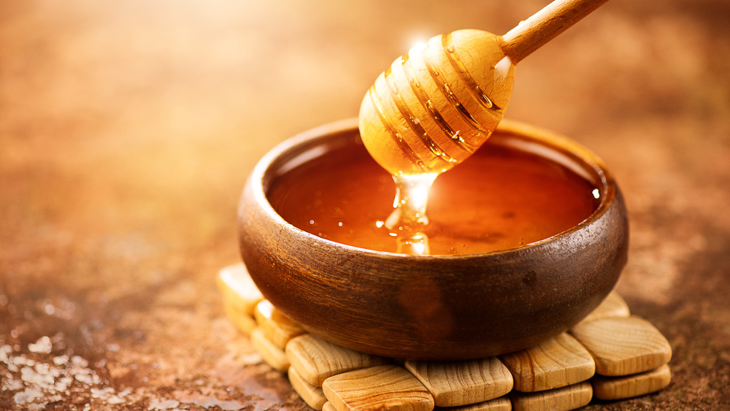
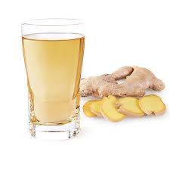
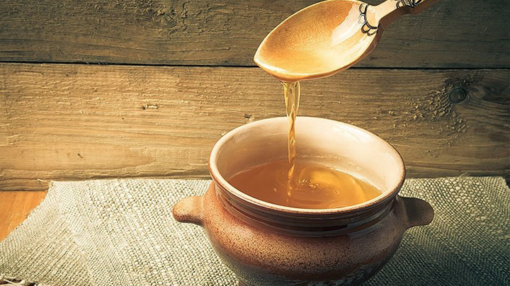
ANUPANA
  Honey
  Jeeraka
  Poogaphala twak churna
  Ardraka swarasa
  Dronapushpi swarasa or kwatha
  Breast milk
  Bhunimba kwatha
  Laaja

Slide 45

INDICATIONS
  Kasa
  Shwasa
  Prameha
  Shukra dushti
  Pradara
  Rajayakshma
  Grahani
  Mootrakrichra
  Mootradaha
  Jwara

Slide 46
PATHYA AND APATHYA
PATHYA
Ghrita, Dadhi, Sali Rice, Shaka Sevana Without Adding Hingu, etc.
APATHYA
Amladravyas, Taila, Bilva, Vrintaka, Hingu, Kanji, Kakarashtaka Gana Dravyas, Ratrijagrana, Strisevana, Krodha, etc.
(Rasa Kamdhenu)

Slide 47
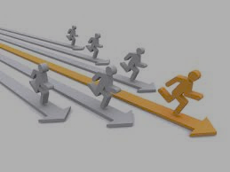
Advantages of Pottali
In practice it is observed that Bhasmas tend to degrade & become toxic if not preserved properly.
Pottali contains ability to preserve the therapeutic efficacy of bhasmas for a long time, with out compromising its basic quality parameters.
Pottali kalpana should be looked at as advanced rasashastra (pharmaceutical ) technique to increase the shelf life, therapeutic effects and low dose requirement.

Slide 48
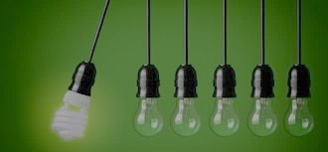
SIGNIFICANCE
Compactness
Portability
Palatability
Easy to dispense
Minimum dosing amount
Longer shelf-life
Quicker therapeutic effect
Easy administration to all categories of patients from paediatrics to geriatrics and also in patients with terminal illness.

Slide 49

Negetive aspects
  Scarcity of classical reference or research data.
  Occult preparation method
  Administration method is also not revealed.
  Market is not demanding hence not using often.

Slide 50
THANK
YOU

