Slide 1
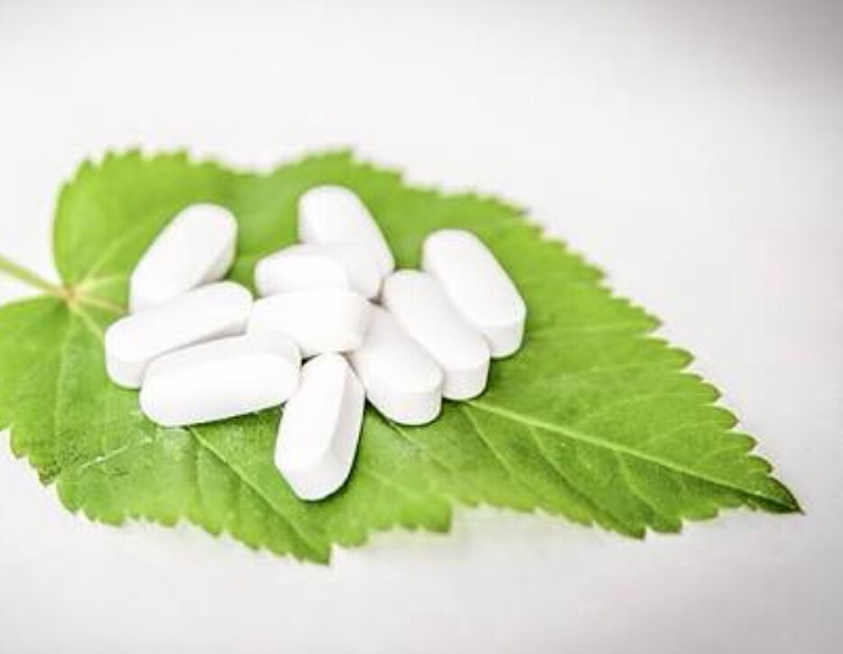
0
pharmacodynamics
Dr. Arun Sharma

Slide 2
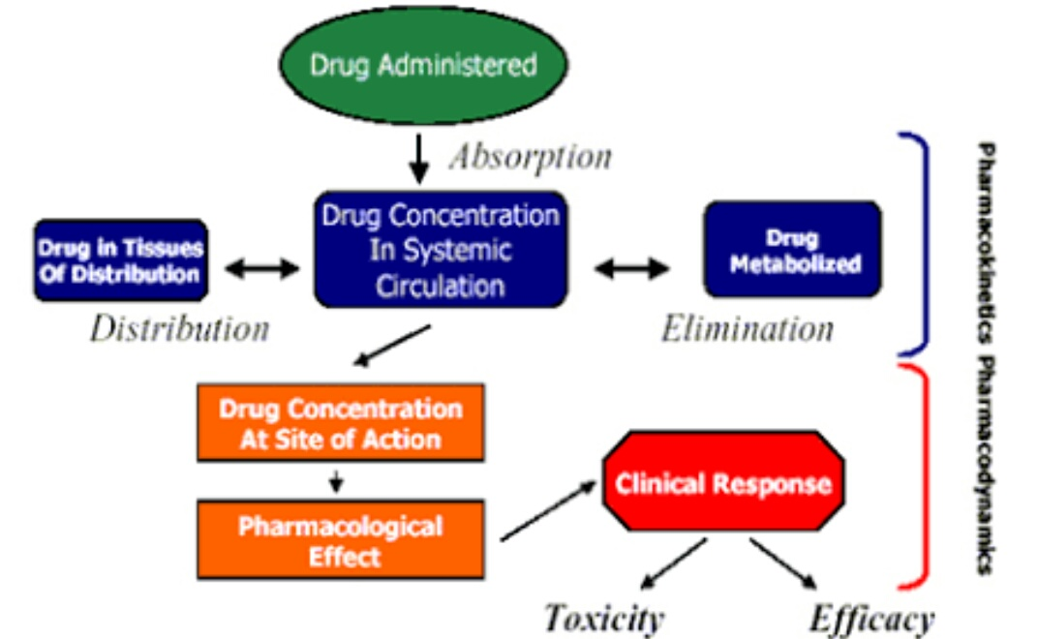
pharmacokinetics
pharmacodynamics

Slide 3
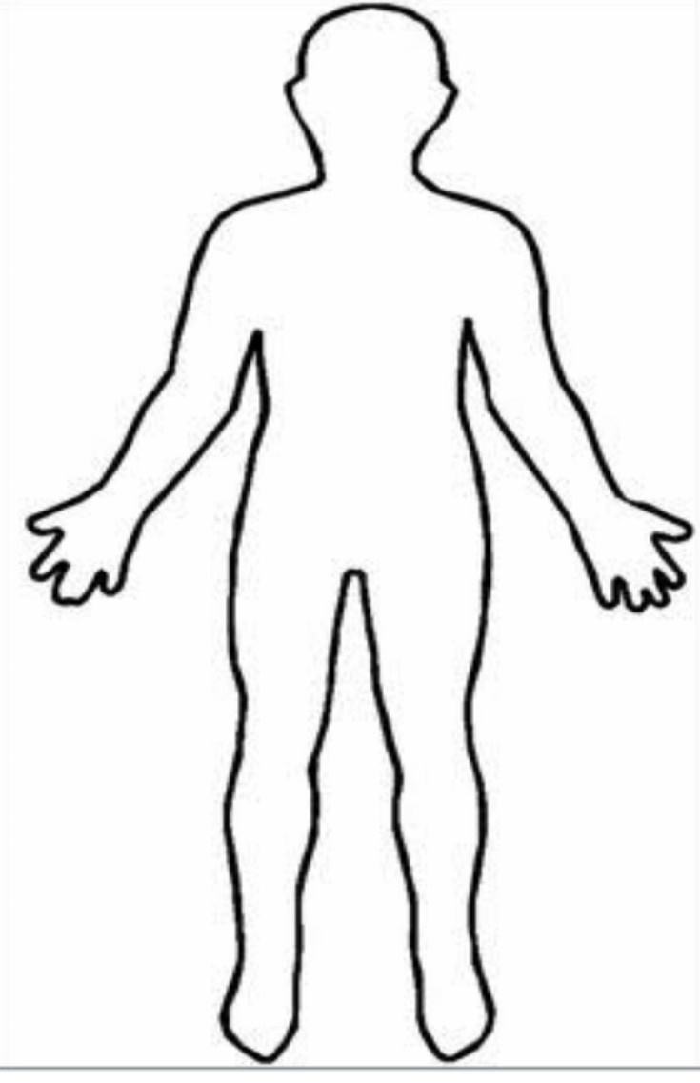
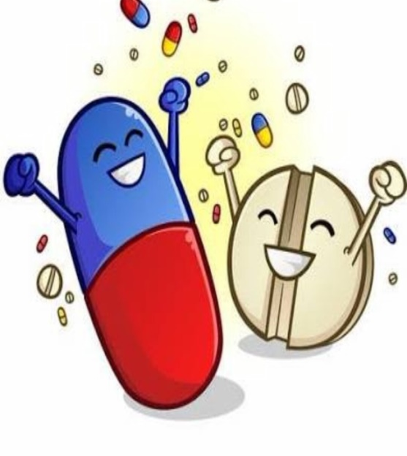
Pharmacodynamics

Slide 4
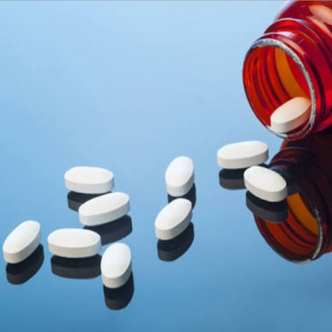
Pharmacodynamics
Pharmacon + dynamis
pharmacon = drug, dynamis = power/action
What the drug does to the body?
Ayurveda
refers to Rasa, guna, virya, vipaka and prabhav

Slide 5
Pharmacodynamics
Definition
The branch of pharmacology deals with
The biochemical and physiological effects of drugs on body
Mechanism of drug action
Dose-effect relationship

Slide 6
Pharmacodynamics
Adverse drug reaction
(ADR)
Mechanism of action
(MOA)
Pharmacological action

Slide 7
Mechanism of drug action

Slide 8
Action of Drug
Drug binds with protein biological target
Biomolecule (protein)- modified activity - specific drug
specific effect
desirable therapeutic unwanted adverse
effect effect
Enzymes
Ion –channel
Transporters
receptors

Slide 9
Types Of Drug Action
(What drugs do??)
Drugs do not impart new function in body
except for gene therapy
1. Stimulation
2. depression
Adrenaline
pilocarpine
Picrotoxin – respiratory depression coma
quinidine
omeprazole
Ach. stimulates GIT & depresses the heart

Slide 10
3. Irritation
4. Replacement
5. Cytotoxic
counter-irritants
insulin, vitamins
antibiotics, anticancer

Slide 11
Mechanism of action
How the drugs act??
Physical action
Chemical action
Through enzymes
Through receptors
Isabgol - bulk laxative
Antacids neutralises acid
Pyridoxine + , Aspirin -
Adrenaline stim. heart
Most drugs act through the receptors

Slide 12
Drug - target interaction
Enzymes & receptors

Slide 13
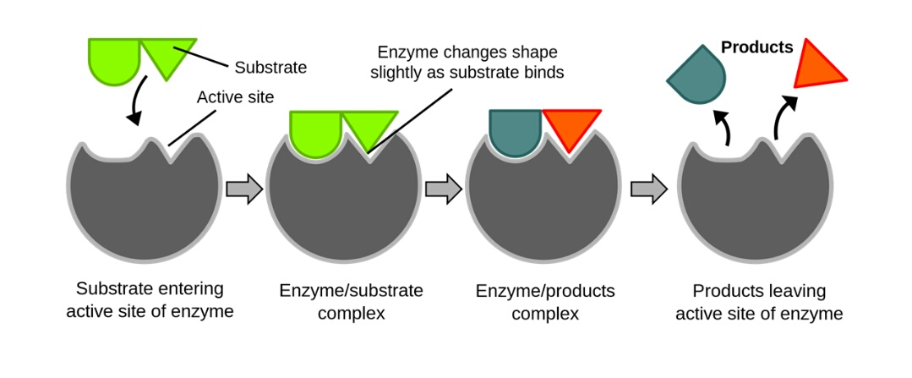
Drug-enzyme interaction
Enzymes as target
protein biomolecule acts as biological catalysts
regulate the rate of chemical reaction
no external energy or being changed with themselves
Mol. Interacts with enzymes are called substrate

Slide 14
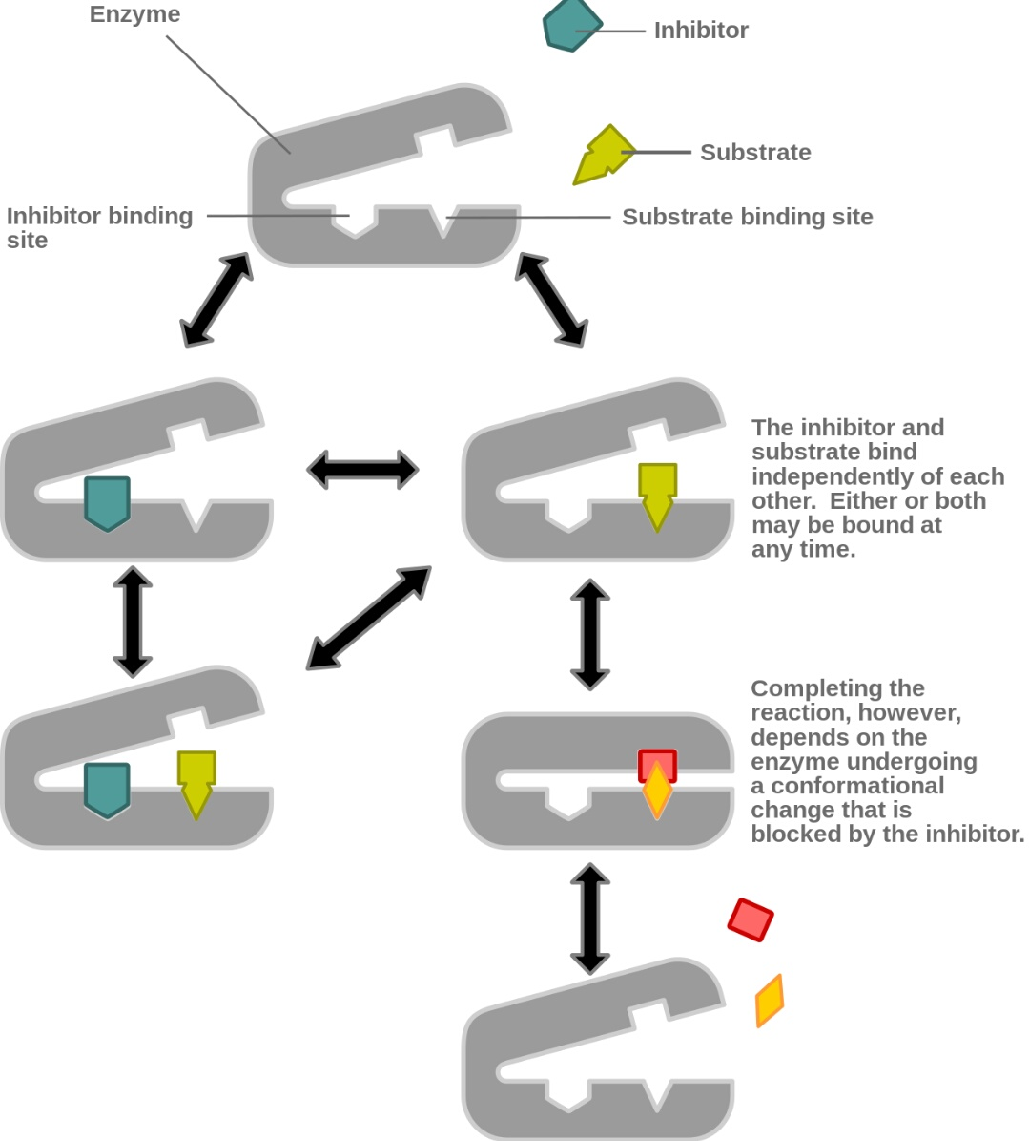
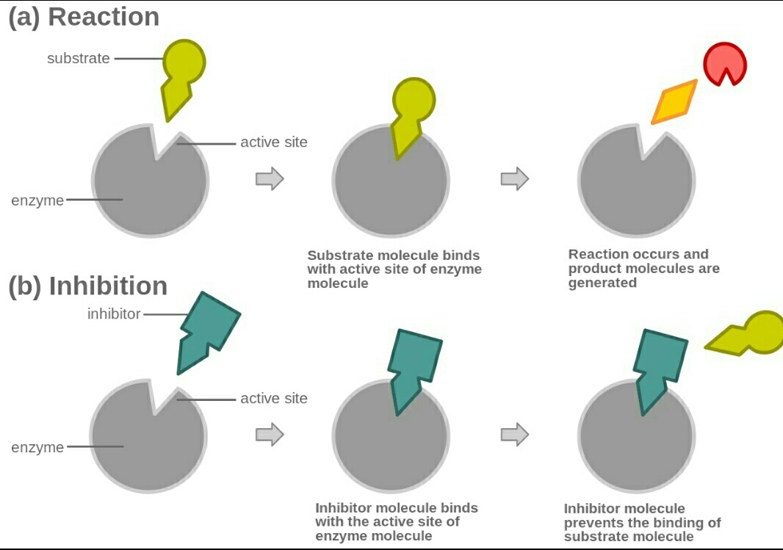
mechanism
Competitive inhibition
Non-competitive inhibition

Slide 15
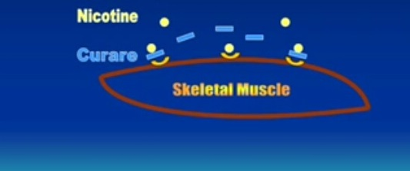
Drug–receptor interaction
Receptors as targets
macromolecule with which drug combines to produce an effect.
Recieves the chemical signal from outside a cell
Proposed by John Langley.
Mol. Interacts with receptor are called ligand

Slide 16
Types of receptors
cell-surface receptor
Found attached to the cell membrane
Ligands do not directly enter the cell.
performs signal transduction.

Slide 17
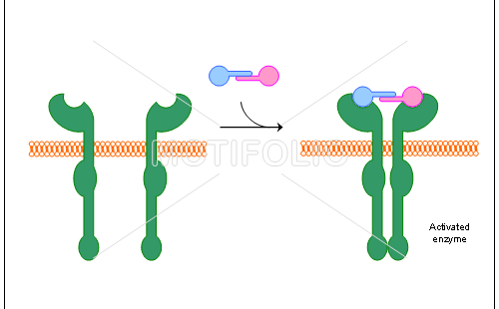
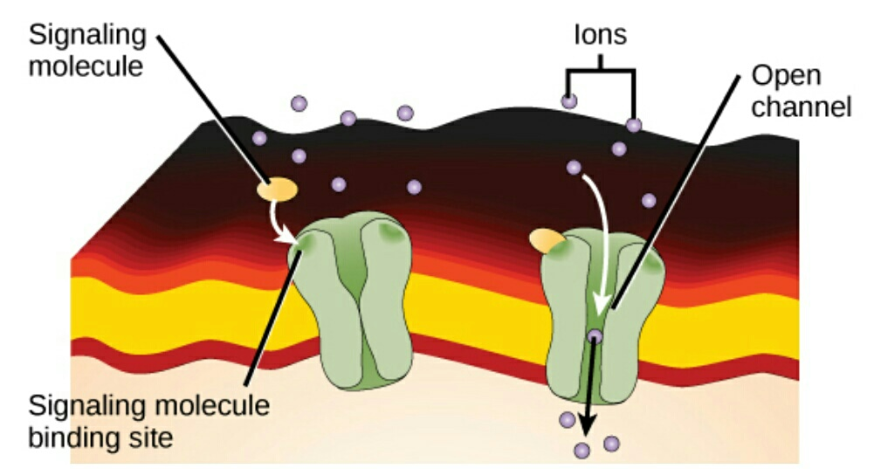
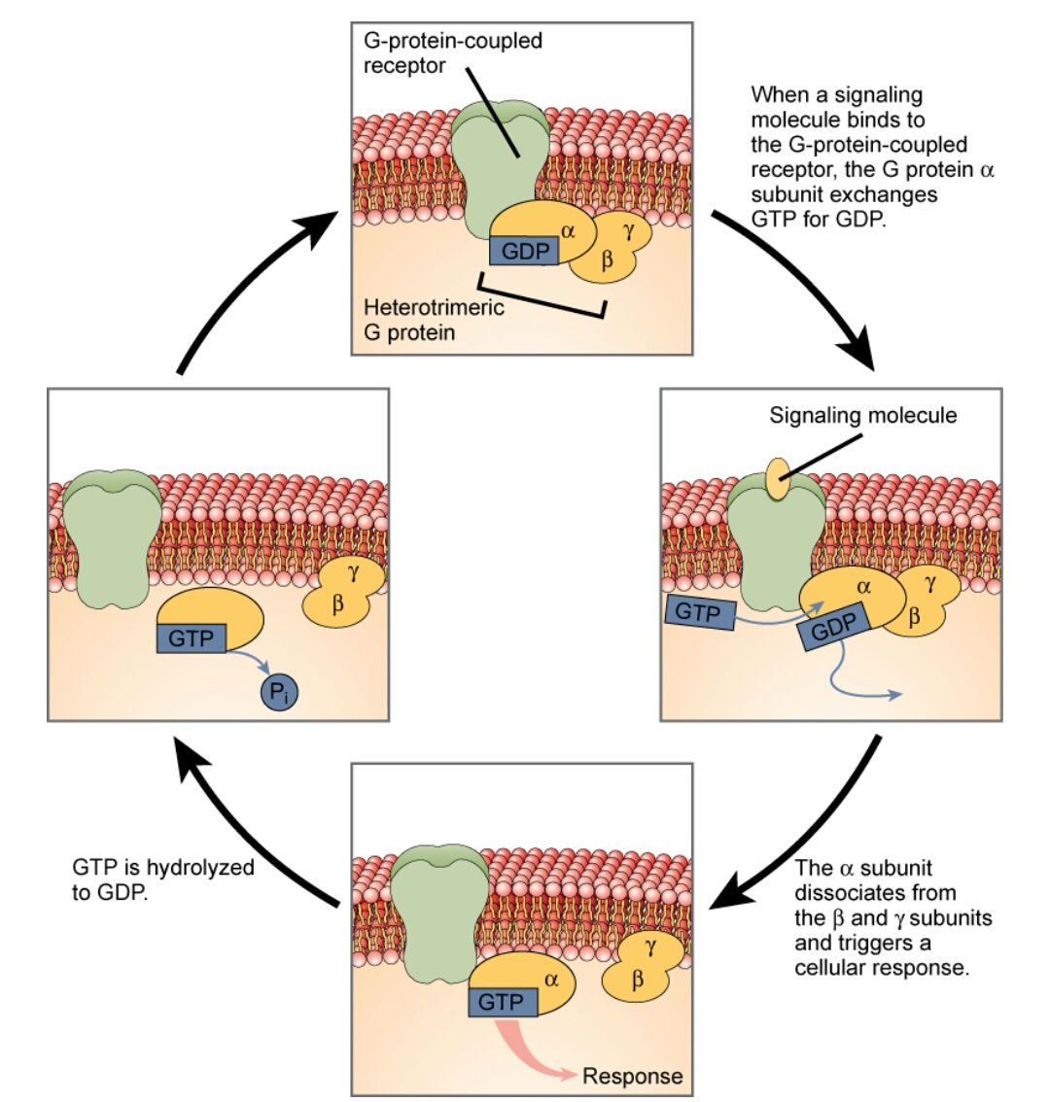
Categories of cell surface receptors
G - protein coupled receptors-
Ion-channel linked receptors
Enzyme linked receptors

Slide 18
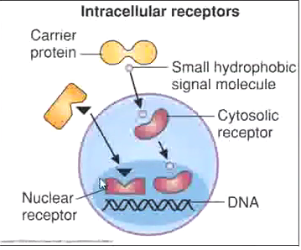
Intra-cellular receptor
Found inside the cytoplasm of cell
Respond to hydrophobic ligand
Nuclear receptors / Gene regulating receptors

Slide 19
ligands
endogenous
exogenous
Ligands are the substance that binds with receptor to produce an effect.
Agonist
Antagonist
Partial agonist
Inverse agonist
Lipophillic
2.Hydrophillic
Affinity - ability of ligand to bind with receptor
Intrinsic activity- ability of drug to produce the effect

Slide 20
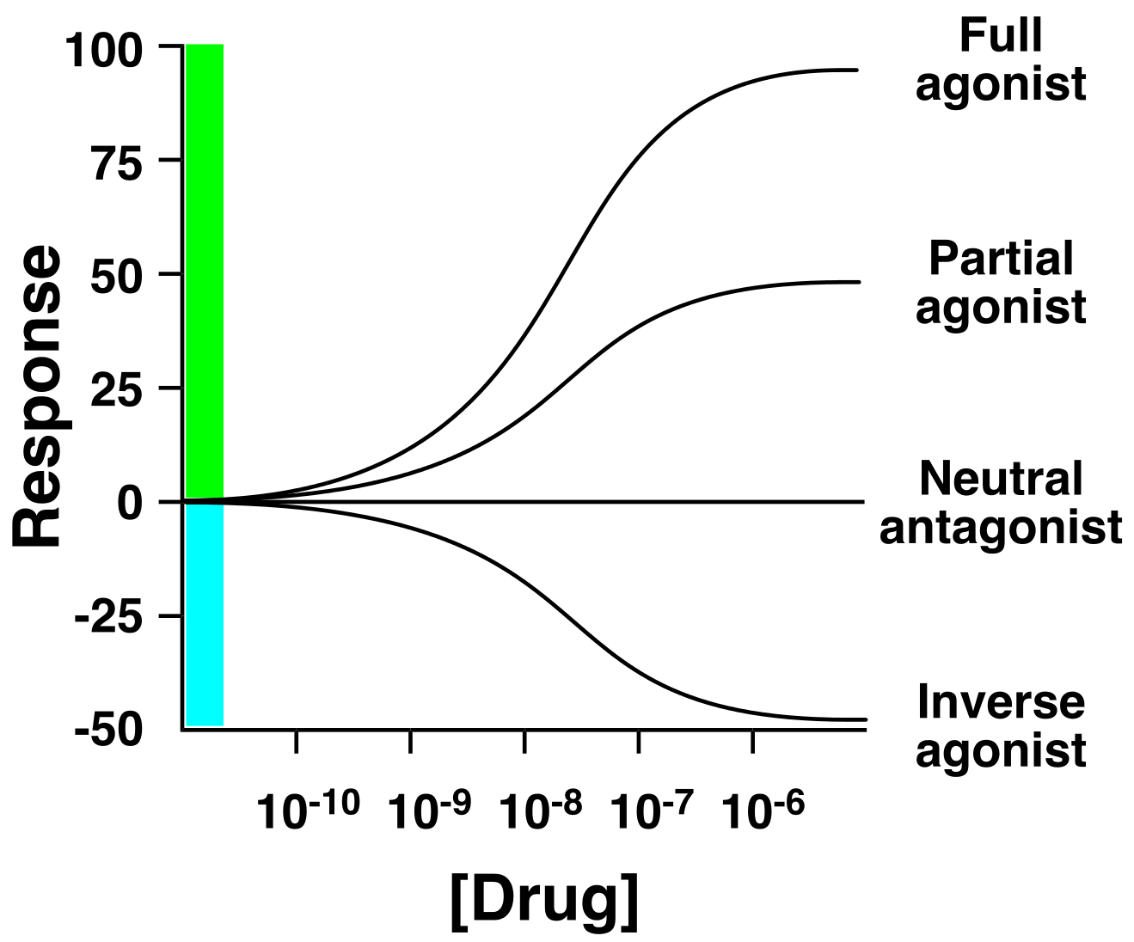

Slide 21

mechanism
Drug combines with particular receptor
change in the shape of receptor
Sequence of events in the cell
(signal transduction)
drug action

Slide 22
Signal transduction
(cell signalling)
Transmission of physical–chemical signals through cell
series of molecular events (protein phosphorylation)
to ensure appropriate cellular response
Response - transcription of genes
conformational changes in proteins

Slide 23
Drug dose
Amount required for certain effects
Standard dose- same for most patients
Regulated dose- regulated as per the response
Target level dose- adjust as per target levels
Titrated dose- max. tolerated dose is given by
(i) upward titration
(ii) downward titration

Slide 24
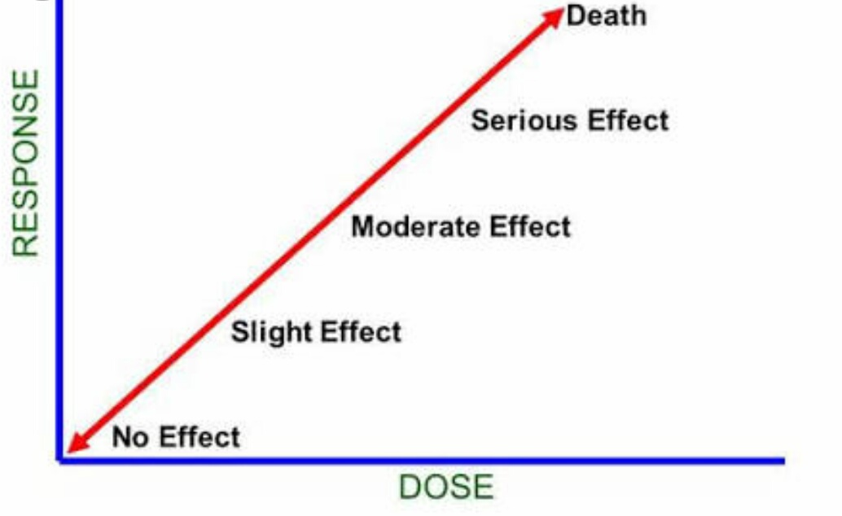
Dose-response relation
Effect of the drug depends on the dose

Slide 25
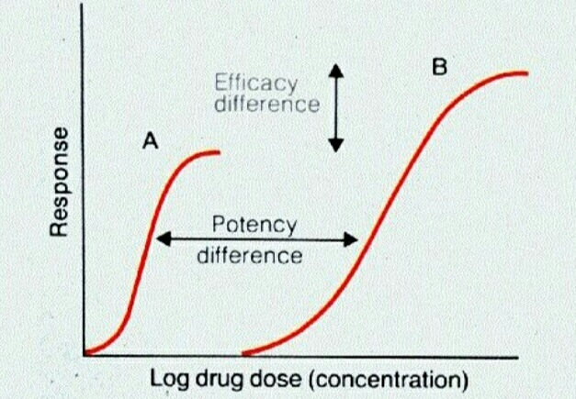
Efficacy and potency
Efficacy- maximum effect of a drug can produce
Potency- amount of drug required to produce 50% of the maximal effect

Slide 26
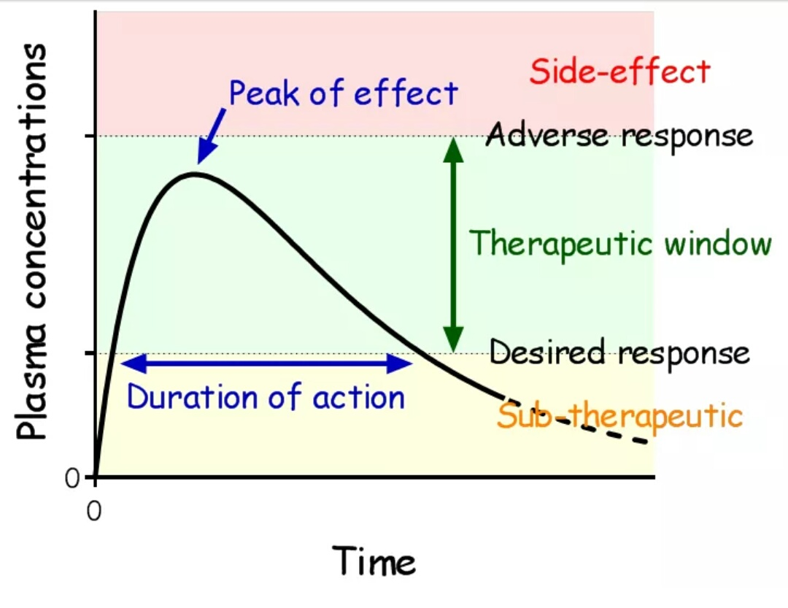
Therapeutic window
Range of dose that produces therapeutic response without causing any significant adverse effects
Ratio b/w Min. effective concentration To the Max.effective concentration
Quantified by therapeutic index

Slide 27
Therapeutic index
The ratio of the dose that produces toxicity to the dose that produces a clinically desired response in half of the population
Indicator For drug safety
Drug with low TI- narrow margin b/w TD & ED
Drug with high TI- wide margin b/w TD & ED
TI =TD50 / ED50

Slide 28
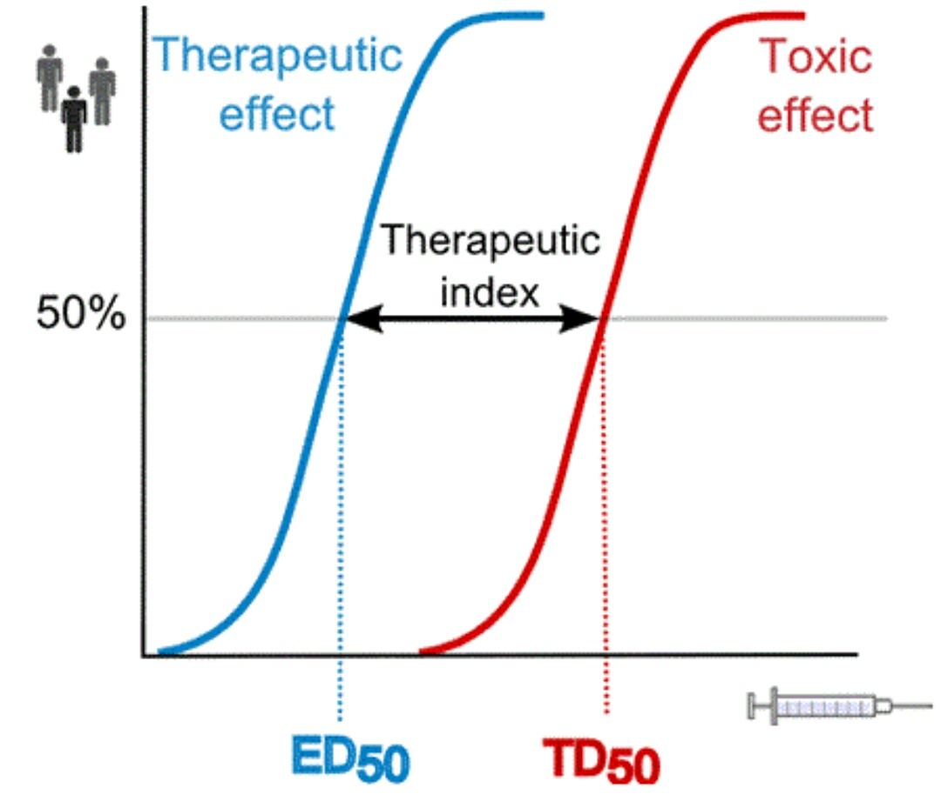

Slide 29
Factors modifying the effects of drugs
Physiological factors
Body size
Age
Sex
Species and race
Food

Slide 30
Pathological factors
G.I disorders
Liver disorders
Kidney disorders
Thyroid disorders
Other disorders
Psychological factors
Patients belief and expectation
placebo effect

Slide 31
Drug factors
Route of administration : magnesium sulphate
Time of administration : corticosteroids, NSAIDs
Other drugs administered concurrently
(i) synergism (ii) antagonism

Slide 32
Synergism
Additive effect
Sum total of effects of two drugs
Supra-additive effect (potentiation)
more than sum total of effects of two drugs

Slide 33
antagonism
Physical antagonism- charcoal tablets
Chemical antagonism - protamine
Functional antagonism- adrenaline
Receptor antagonism
(i) competitive antagonism
(ii) non- competitive antagonism

Slide 34
Pharmacological action

Slide 35
Pharmacological Action of aspirin
Aspirin – acetyl salicyclic acid
(i) Aspirin prevents the production of prostaglandins
prostaglandins
fever
pain
inflammation
(ii) Aspirin inhibits the platelets aggregation

Slide 36
Pharmacological Action of aspirin
Analgesic - pain relief
2.Antipyretic - reduce fever
3.Anti-inflammmatory - prevents & bring down swelling
4. Anticoagulant

Slide 37
Structure - activity relation
Composition and spatial arrangement of chemical functional group determines
the type of pharmacological effect
Physiochemical properties of drug molecule

Slide 38
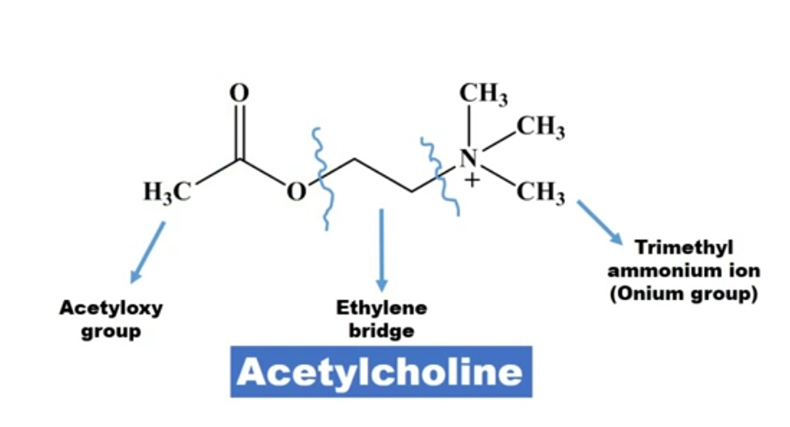
SAR of Acetylcholine

Slide 39
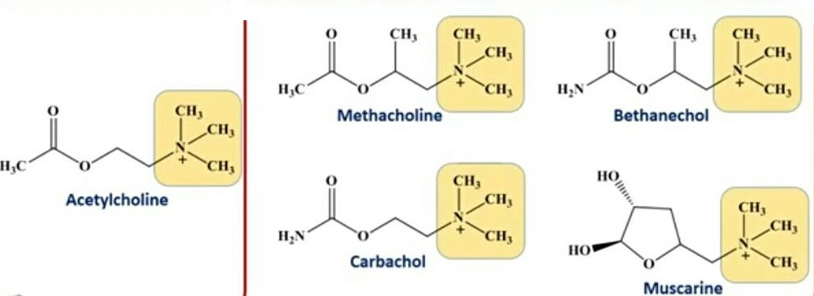
Ammonium group
For optimum activity group must be quaternary
Substituiton of one of 3 methyl gr with ethyl or propyl gr.- less active

Slide 40
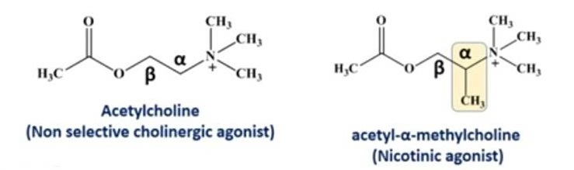
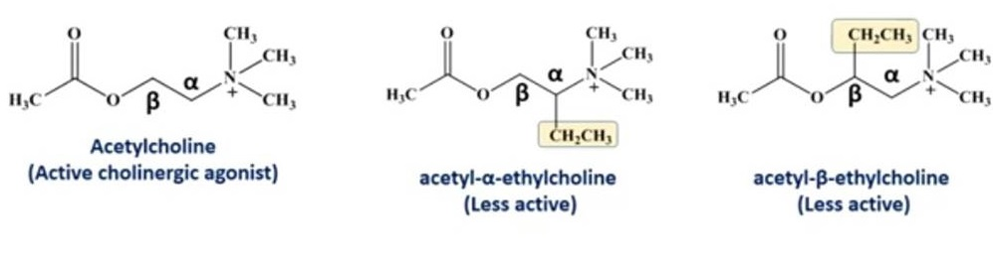
Ethylene chain
Addition of methyl gr. At alpha position - selectivity towards nicotinic receptor
Alkyl gr. other than methyl at alpha or beta position – decreases cholinergic activity

Slide 41
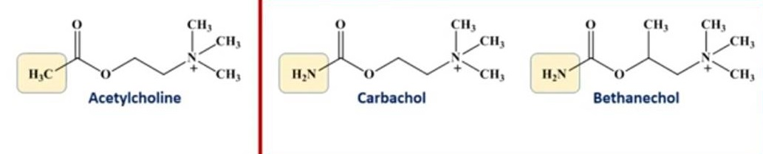
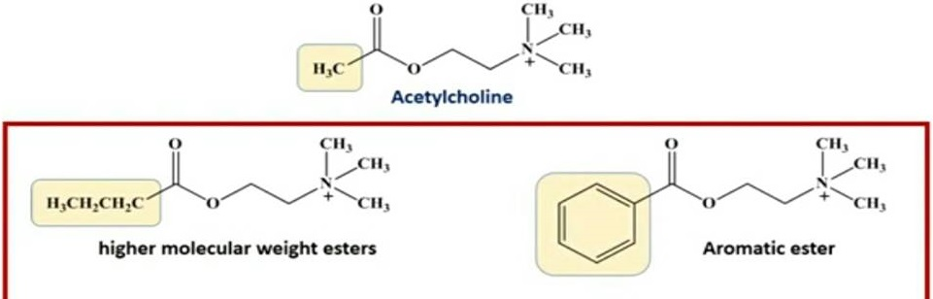
Acetyloxy group
Methyl group is replaced with amino group – increases cholinergic activity
Methyl group is replaced with aromatic ester & higher mol.wt esters - antagonist

Slide 42
Adverse drug reaction

Slide 43
Adverse drug reaction
Definition
noxious and unintended
Normal dose
Types
Type A (augmented)
Type B (bizzare)
Type C (chronic)
Type D (delayed)
TYpe E (end of dose)
Type F ( failure of therapy)

Slide 44
Pharmacodynamics in Ayurveda
1. Principles of drug action
(panchbhoutik siddhanta)
(Samanya-vishesha siddhanta)
सर्वं द्रव्यं पञ्चभौतिकमस्मिन्नर्थे | (च. सू)
सर्वदा सर्व भावानां सामान्यं वृद्धिकारणं |
ह्यसहेतुः विशेषश्चा प्रवृत्ति च उभयस्य तु || (च.सू)

Slide 45
2. Mechanism of drug action
(Ras,Guna,Virya,Vipaka,Prabhav)
“द्रव्ये रसो गुणो वीर्यं विपाकः शक्तिरेव च |
पदार्थाः पञ्च तिष्टंत स्व स्व कुर्वन्ति कर्म च ” ||
(भा.प्र. 6/169)

Slide 46
3. Pharmacological action
(aushadh karma)
Deepan - appetisers
Pachana - digestives
Samsrana - laxative
Hridya - cardiac tonics
Krimighna - anti-helminthic
Vishaghna - anti–toxic/antibiotic
Vedanasthapana - analgesics
Shool-prashman - antispasmodic

Slide 47
4. Importance of dose
(Mana Concept)
ना मानेन विना युक्ति द्रव्याणां जायते क्वचित्
अतः प्रयोग कार्यार्थ मानमात्रोच्यते मया ||”
(शा.सं.पू.1\14)

Slide 48
5. Synergism & antagonism
(samanya - vishesha concept)
Synergism - samanya
Antagonism - Vishesha
सर्वदा सर्व भावानां सामान्यं वृद्धिकारणं |
ह्यसहेतुः विशेषश्चा प्रवृत्ति च उभयस्य तु || (च.सू)

Slide 49
6. Factors affecting drug action
Aushadh marga - route of administration
Aushadh sevan kaal- time of administration
Manasik prabhav – psychological factors

Slide 50
7. ADR / SIDE EFFECTS
(ashuddha - apakwa dosha)
RASA DRAVYA | TOXIC EFFECT
Abhraka | Chidrodra, Mrityu
Makshika | Kustha, Halimaka, VaatVikar
Shilajatu | Daha, Murcha, Bhrma, Raktta Pitta, Shosh, Manda Agni
Tuttha | Vaman, Bhrma
Rasaka | Vaman, Bhrma
Manashila | Malabandha, Mutrakrach, Krimi Rog, Mutra Roga

Slide 51
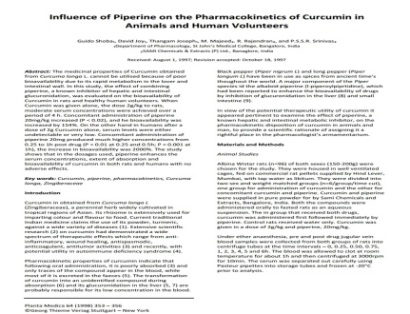
Current scenario
1.Influence on piperine on the pharmacokinetics of Curcumine
Curcumine
poor bioavailability
rapid metabolism (glucoronidation) in liver & intestinal wall
Piperine – mechanism of action
By inhibition of glucuronidation in liver & intestine

Slide 52
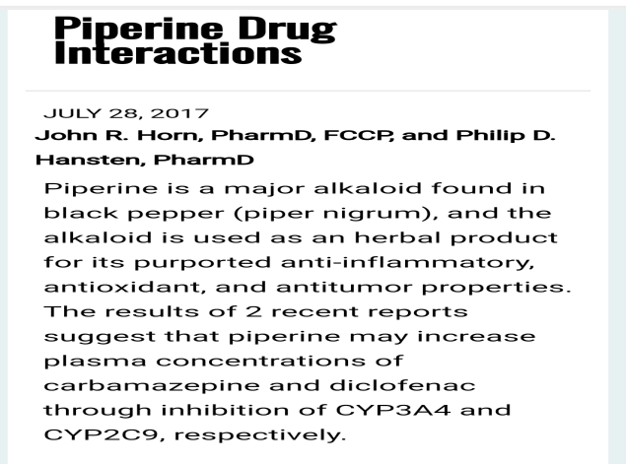
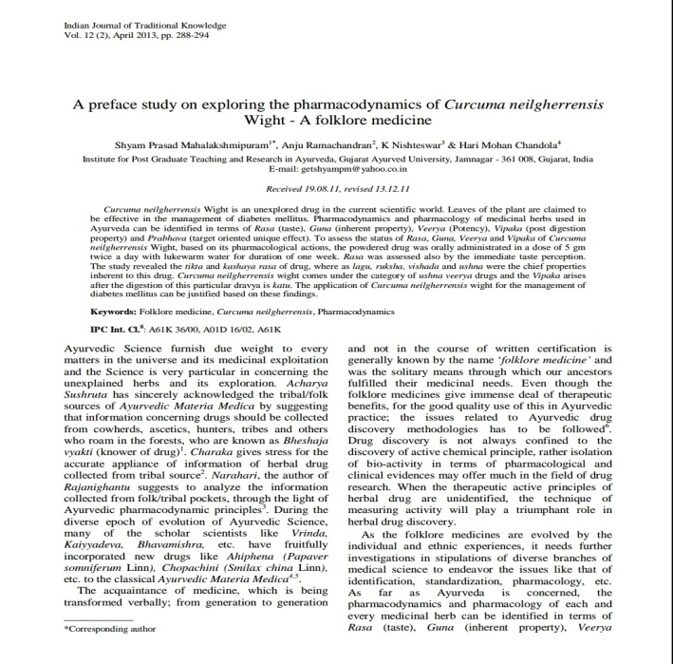
2.Piperine drug interaction
piperine may increase plasma concentration of diclofenac
Through inhibition oF CYP2C9
3.A preface study on exploring the pharmacodynamics of curcuma neilgherrensis
ras- tikta ,kashaya rasa
Guna -laghu ruksha vishada ushna
Veerya- ushna
Vipaka-katu

Slide 53
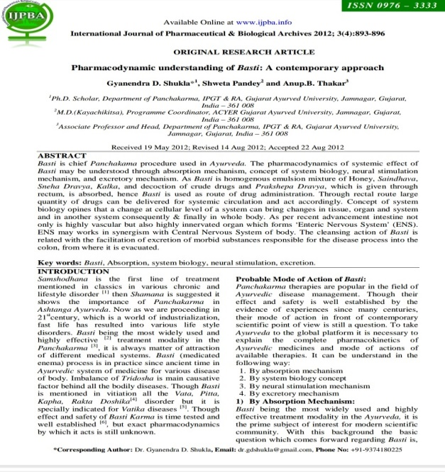
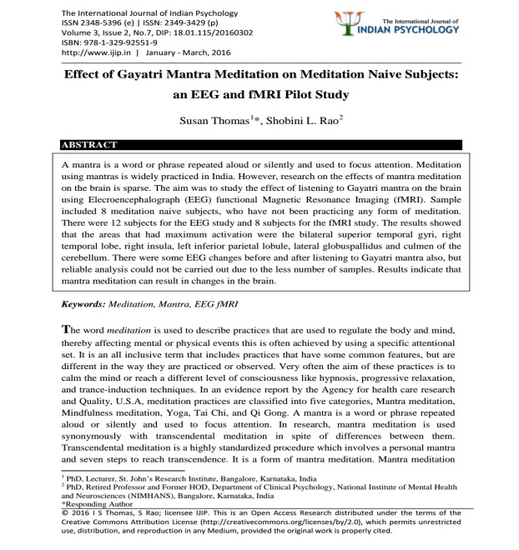
4.Pharmacodynamics understanding of basti – a contemporary approach
By absorption mechanism
By system biology concept
By neural stimulation mechanism
By excretory mechanism
5.Effect of gayatri mantra:-EEG &
fMRI pilot study
Mantra meditation can results in changes in the brain

Slide 54
Thank you

