Slide 1
Intellectual property rights & patents
Presented by : - arun sharma

Slide 2
PROPERTY
Those things that are commonly recognized as the Possessions of an individual or a group.
Tangible property Things physically present
Intangible property Things physically absent

Slide 3

Intellectual property is a property that arises from the Human Intellect.
It is a product of Human Creation.
Intellectual property comprises 2 distinct forms:
Literary & Artistic works
Industrial Property

Slide 4
“Literary & Artistic Works”
These are Books, Paintings, Musical Compositions, Plays, Movies, Radio/Tv Programs, Performances, & other Artistic works.
How are they protected?
Protected by “copyright”

Slide 5
“Industrial Property”
Physical matter that is the product of an Idea Or Concept for commercial purposes.
How are they protected?
By Patents
By Trademarks
By Industrial Designs
By Geographical Indications

Slide 6
Intellectual property rights
The LEGAL RIGHTS given by the state to the inventor/creator to protect his invention/creation for a certain period of time.
These restricts the imitation or copying of invention without the consent of owner

Slide 7
Cont….
Every nation has framed their own IPR’S and laws but on international level WIPO governs it.
These rights are outlined in article 27 of the UNIVERSAL DECLARATION OF HUMAN RIGHTS.

Slide 8


Established in 1967
Specialized agency of the UNITED NATIONS.
It promote the protection of IP throughout the world.
Its headquarters are in Geneva, switzerland

Slide 9
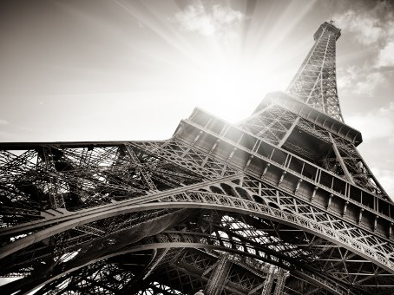
Ipr organisations
The importance of IPR was first recognized in–
PARIS CONVENTION for the protection of industrial property (1883) and
BERNE CONVENTION for the protection of literary and artistic works (1886).
Both treaties are administered by the WIPO

Slide 10

Need of ipr
PROVIDES SAFETY against any misappropriation without consent of the owner.
ENCOURAGE & INDUCE CREATORS to share or disclose their knowledge.
Gives BENEFIT to the owner from property they have invented
Fair trading also contributes to SOCIO-ECONOMIC GROWTH.

Slide 11
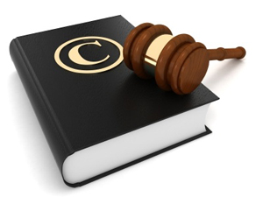
Law relating ipr
Patent – 1. The Patents Act, 1970 (Amended By The Patents Act, 2005)
2. The Patents Rules, 2003, (Amended By The Patents Rules 2006)
Trademark – 1. The Trade Marks Act, 1999
2. The Trade Marks Rules, 2002
ID – 1. The Designs Act, 2000
2. The Designs Rules, 2001
GI – 1. Geographical Indications Of Goods (Registration And Protection) Act, 1999
2. The Geographical Indications Of Goods (Registration And Protection) Rules, 2002
Copyright – 1. The Copyright Act Of 1957
2. The Copyright Rules, 1958 (Amended In 1983, 1984, 1992, 1994 and 1999)

Slide 12

Duration of ipr
PATENT - 20 YEARS*
TRADEMARK - 10 YEARS*
ID - 15 YEARS*
GI - 10 YEARS*
COPYRIGHTS - 60 YEARS*
*from date of filing of application

Slide 13

Industrial property
PATENT
TRADEMARKS
INDUSTRIAL DESIGNS
GEOGRAPHICAL INDICATIONS

Slide 14

1. patent
An invention for which the inventor claims the exclusive right.
Invention patentable if.....
New (novel)
Useful
Not obvious
Pertains to patentable subject matter

Slide 15
Contd….
Patent protection means an invention cannot be commercially Made, Used, Distributed or Sold without the patent OWNER’S CONSENT.
Court can also declare a patent invalid upon a successful challenge by a third party.
These incentives ENCOURAGE INNOVATION, which in turn enhances the quality of human life.

Slide 16

invention
A new Product or Process involving an inventive step and capable of “INDUSTRIAL APPLICATION”
Invention must be-
Related to a process/product or both
Involves an inventive step
Capable of industrial application
Must be of practical use
Invention must not be-
Published in india or elsewhere
In prior public knowledge or prior public use with in india
Claimed before in any specification in india

Slide 17

Patent is for
For INVENTIONS and not for DISCOVERIES.
Can be for Process, Product Or Process Cum Product.
For UNIQUE COMBINATIONS involving specific ingredients, specific proportions or specific processing method.
For UNIQUE FORMULATIONS & Formulations showing better activity, better self-life and better absorption.

Slide 18

Patent is not for….
According to section 3(d) of the patents act 1970)-
An invention which claims anything obviously contrary to well established natural laws
An invention which causes serious hazard to human/animal/plant life/ environment. ( e.g. Process of making brown sugar )
Mere discovery of any living thing /non-living substances occurring in nature.
Mere discovery of a new form of a known substance which does not result in the enhancement of the known efficacy of that substance
A substance obtained by a mere admixture resulting only in the aggregation of the properties of the components

Slide 19

Mere arrangement or re-arrangement or duplication of known devices each functioning independently of one another in a known way.
A method of agriculture or horticulture
Any process for the medicinal, surgical or other treatment of human beings
Mere scheme /rule/method of performing mental act/method of playing game
Aggregation or duplication of known properties of traditionally known components.

Slide 20
Rights to patent owner
Right to decide who may – or may not – use the patented invention for the period during which it is protected.
Right to give permission /license to other parties to use their inventions on mutually agreed terms.
Right to sell their invention rights to someone else, who then becomes the new owner of the patent.

Slide 21
offpatent
Once a patent expires, protection ends and the invention enters the public domain. This is also known as becoming off patent
For public it is freely available after expiry of patent and cheaper and better products become available.

Slide 22
Patent registration
Filing a patent application, containing title of invention & indication of its technical field.
Background and description of invention must be given in easy language with enough detail so that an individual with an average understanding of the field could USE OR REPRODUCE the invention.

Slide 23



Patent granting
Patents are granted by –
National patent offices or by regional offices that carry out examination work for a group of countries.
Examples-
European Patent Office (EPO)
African Region Intellectual Property Organization.
WIPO

Slide 24
Branches of patent offices
Mumbai : - States of Maharashtra, Gujarat, M.P., Goa Chhattisgarh, Union Territories of Daman and Diu & Dadra and Nagar Haveli
Chennai : - States of Andhra Pradesh, Karnataka, Kerala, Tamil Nadu and the Union Territories of Pondicherry and Lakshadweep.
New Delhi : - States of Haryana, Himachal Pradesh, Jammu and Kashmir, Punjab, Rajasthan, Uttar Pradesh, Uttarakhand, Delhi and the Union Territory of Chandigarh.
Kolkata : - Rest of India

Slide 25
Term & duration
Term of the patent is 20 years from the date of filling for all types of inventions.
The date of patent is the date of filing the application for patent.

Slide 26
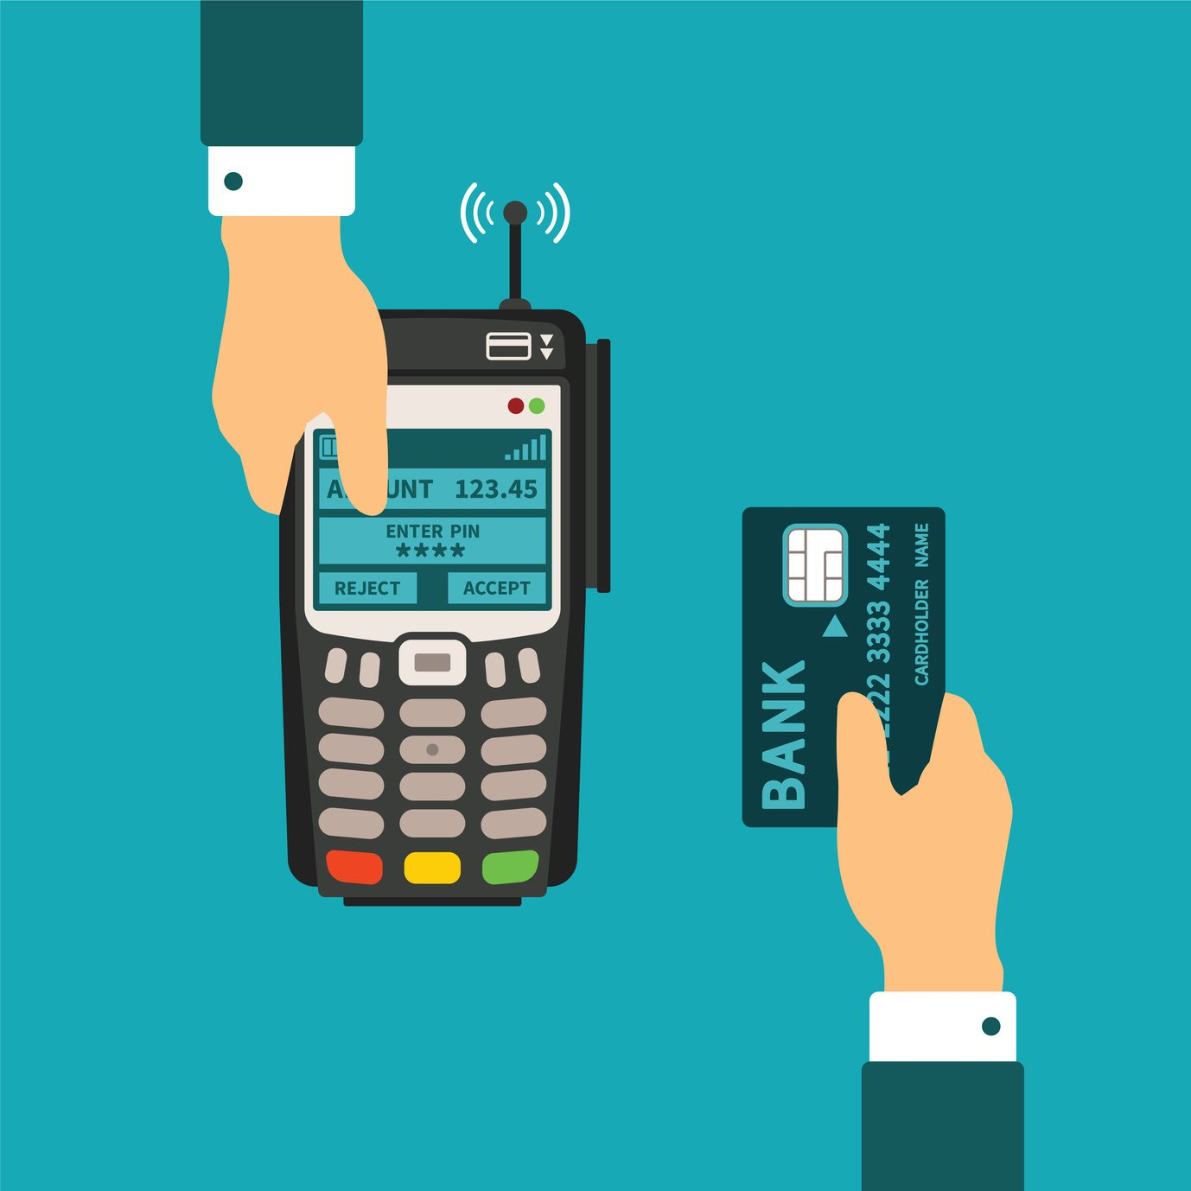
Fees for filing patent
The government fee for filing a patent application in India is ₹. 750/- for individuals and ₹.3,000/- for legal entities.
No fee for 1st and 2nd year
Renewal fee, on yearly basis, is required to be paid for 3rd to 20th for keeping the patent in force.
Patent lapses if renewal fee is not paid within the prescribed period.

Slide 27

Patent holders in india
The list of top 10 patents holders in India comprises only pharmaceutical and bio-tech companies.
In India, 184 patents are held by the C.S.I.R., followed by “Ranbaxy’’
While the top 10 patents holders across the world are IT companies.

Slide 28
Infringement & remedies
Infringement means unauthorized Making, Importing, Using, Offering For Sale Or Selling any patented invention.
Remedies –
Interlocutory injunction (court order by which an individual is required to perform/restrained from performing a particular act)
Relief of damages (compensation to the patentee and not punishment to the infringer)
Account of profits (focuses on the profits made by the
Defendant, without reference to the damage suffered by the claimant)

Slide 29
Penalties of infringements
Falsification of entries- imprisonment = 2 years or fine or both.
Unauthorized claim- fine upto ₹ 1,00,000
Wrong information about business place- imprisonment = 6 months or fine, or both.
Practice by non-registered patent agents- fine of ₹ 1,00,000/- in the first offence and rs.5,00,000/- for subsequent offence.

Slide 30


example
Apple sued phone maker HTC and has filed a complaint with THE U.S. INTERNATIONAL TRADE COMMISSION, alleging that the Taiwanese company is Infringing 20 Apple Patents Related To The Iphone .

Slide 31
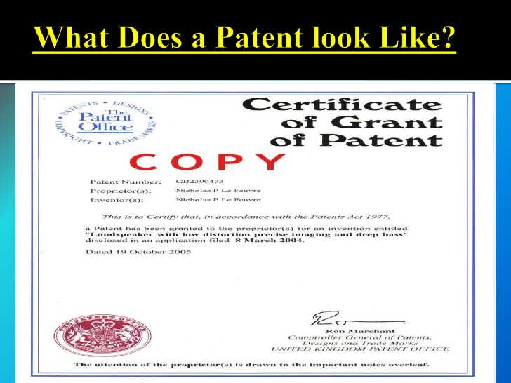
How it looks like…

Slide 32

2. trademarks
It is covered under the act called the TRADE MARKS ACT, 1999.
The act came into effect on September 15, 2003.
It replaces THE TRADE AND MERCHANDISE MARKS ACT, 1958.

Slide 33
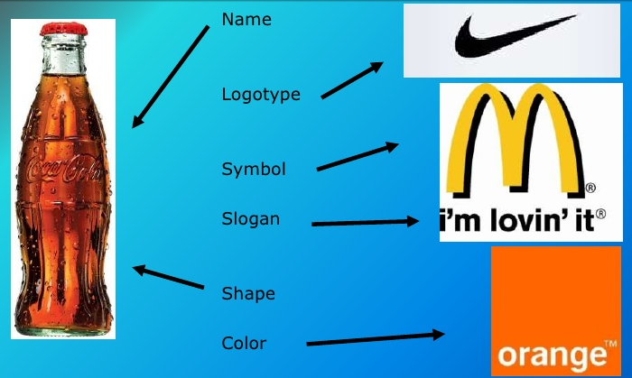
Trademark
A Symbol, Logo, Word, Sound, Color, Design, Or Other Device that are used to identify a business or a product in commerce.
Types-
Trademark- TM Used To File Application For Products
Service Mark- SM Used To File Application For Services
® Registered Trademark

Slide 34
A. Set apart from surrounding text
CORRECT USE:
Raymond textile is India's leading producer of worsted suiting fabric with over 60% market share
“ Raymond textile ’’ is India's leading producer of worsted suiting fabric with over 60% market share.
INCORRECT USE:
Raymond textile is India's leading producer of worsted suiting fabric with over 60% market share.

Slide 35
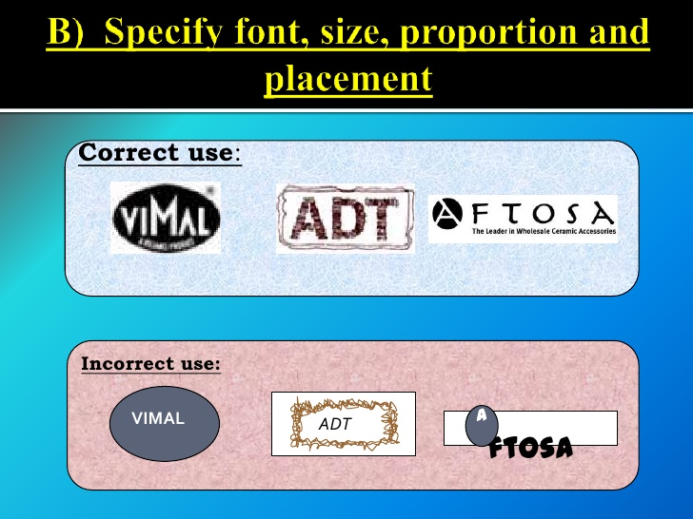
B. Specify font size, proportion and placement
Correct use
Incorrect use

Slide 36

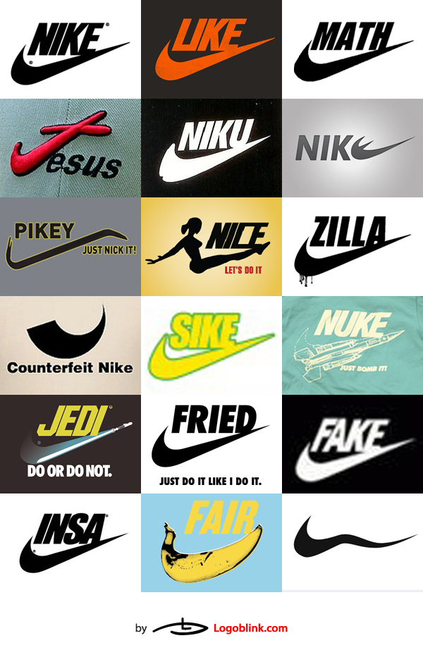
C. Do not change spelling
Correct use:
Calvin Klein
Tommy Hilfiger
MPC POTTERIES GWALIOR
Incorrect use:
Kalvin Klein
Tommy-Hilfiger
MPC P/G

Slide 37
Functions of trademark
Trademark performs four functions –
It IDENTIFIES the goods / services and its origin.
It GUARANTEES its unchanged quality.
It ADVERTISES the goods/services.
It CREATES AN IMAGE for the goods/ services.

Slide 38

Trademark registration
Application should be filed with-
Graphical representation of trademark
Five additional representations corresponding to each other
In case of trademark containing words other than hindi or english translation of each word in english or in hindi should be given.

Slide 39
Duration & fees
TRADEMARK is valid for 10 years from the date of application which may be RENEWED for further period of 10 years on payment of prescribed fees.
SERVICE MARK RIGHTS are reserved exclusively for owners for 17 year & it can also be renewed.
The govt. Fees is ₹ 2,500 for each class of goods or services.

Slide 40
Branches of trademark offices
Mumbai (Head Office) - State of Maharashtra, M.P .& Goa.
Delhi - State of J& K, Punjab, Haryana, U.P., H.P., Union Territory of Delhi & Chandigarh
Kolkata - State of A.P., Assam, Bihar, Orissa, West Bengal, Manipur, Mizoram, Meghalaya, Sikkim , Tripura & Union Territory of Nagaland, Andaman & Nicobar.
Ahmedabad - State of Gujarat, Rajasthan & Union Territory of Daman, Diu, Dadra and Nagar Haveli
Chennai - State of A.P., Kerala, Tamil Nadu, Karnataka & Union Territory of Pondicherry & Lakshadweep

Slide 41
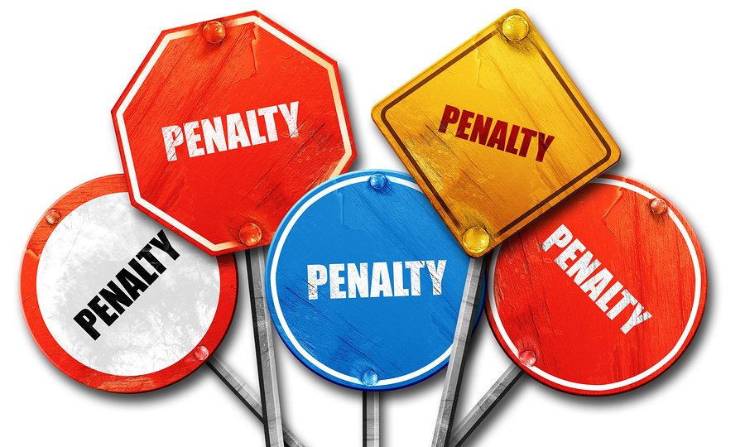
Offences & penalties
There are mainly two classes of offences relating to trademarks –
Falsification of trademark
Falsely applying the trademark to goods or services
Punishment = 6 months to three years imprisonment
Fine = ₹ 50,000/- to ₹ 2,00,000 /-

Slide 42


example
3 suits filed by adidas company in the Delhi high court against counterfeiters
At the initial stage, infringing goods were seized by the local commissioner
Cases were decreed recently & damages of ₹ 15 lakhs was awarded to adidas

Slide 43
3. Industrial designs
ID means development of CONCEPTS AND DESIGNS for MANUFACTURING products.
The features of shape, configuration, pattern, ornamentation or composition of lines or colors applied to any product, whether in 2d or 3d(or both) forms.

Slide 44
Applicable to….
IDs are applied to a wide variety of industrial products and handicrafts:
From technical and medical instruments to watches, jewelry/other luxury items/electrical appliances to vehicles/architectural structures/textile designs.

Slide 45
Requirements of id
New or original
Not be disclosed to the public anywhere by publication in tangible form or by use or in any other way prior to the filling application for registration.
Be significantly distinguishable from known designs
Not comprise or contain obscene matter.
Applied to an article and should appeal to the eye.
An ID is primarily of an aesthetic nature, and any technical features of the article to which it is applied are not protected by the design registration.

Slide 46
Need of id protection
Industrial designs make an article attractive and appealing; hence, they add on the commercial value of a product and increase its marketability.
Provides protection to provide FAIR RETURN ON INVESTMENT.
By promoting fair competition and honest trade practices
Encourage creativity
Designs contribute to the expansion of commercial activity and the export of national products.

Slide 47

Exclusion from scope of design
Books, Certificates, Forms-and Other Documents, Maps ,Stamps, Labels.
Any Principle Or Mode Of Construction Of An Article.
Buildings And Structures.
Parts Of Articles Not Manufactured And Sold Separately.
Mere Change In Size Of Article.
Flags Or Signs Of Any Country.

Slide 48

Registration of id
Related documents are submitted to the DESIGN WING of the patent office at "INTELLECTUAL PROPERTY OFFICE", KOLKATA, DELHI, MUMBAI AND CHENNAI on the prescribed form (FORM-I) along with the prescribed fees

Slide 49
4. Geographical indications
GI refers to a country or a place of origin of that product.
It originates from a definite geographical territory.
It is used to identify agricultural, natural or manufactured goods
The manufactured goods should be produced or processed or prepared in that territory.
It should have a special quality or reputation or other characteristics

Slide 50

Examples of gi
Basmati rice
Darjeeling tea
Kanchipuram silk saree
Alphonso mango
Nagpur orange etc.

Slide 51
Need to protect gi
Geographical indications are understood by consumers to denote the ORIGIN AND QUALITY OF PRODUCTS.
Many of them have acquired valuable reputations which, if not adequately protected, may be misrepresented by commercial operators.
False claim to any product may cause damage to the established reputation of original products.

Slide 52
Registration of gi
The registration of a geographical indication is not compulsory
FORM (GI-1A TO ID)
FEE (₹.5,000).

Slide 53

Gi infringement & remedies
Imprisonment = 3 years
fine ₹. 50,000/- to ₹. 10.0 lakh
or both.

Slide 54

copyrights
Set of exclusive rights granted to the AUTHOR OR CREATOR of an ORIGINAL WORK in the field of art, literature, music etc .
It provides the right to Use, Copy, Distribute And Sell the work FOR LIMITED TIME PERIOD.

Slide 55
Rights protected under copyrights
1. Literary work 2. Paintings
3. Musical works 4. Dramatics works
5. Audiovisual works 6. Sound recordings
7. Photographic works 8. Broadcast
9. Drawings 10. Architectural works

Slide 56
Terms of copyright
Literary/Dramatic/Musical/Artistic Work- lifetime of the author + 60 years after his death
CINEMATOGRAPHIC FILMS/ SOUND RECORDINGS /PHOTOGRAPHS- for 60 years from date of publication
WORKS OF PUBLIC UNDERTAKING/ INTERNATIONAL ORGANIZATIONS- 60 years from the date of publication.

Slide 57

Aim of copyright
To PROTECT the expression of an idea & not the idea itself.
To ENCOURAGE composers to create original work for public benefit .
To REWARD them with exclusive rights to reproduce their work.
To provide FINANCIAL HELP as well.
Helps in SOCIO-ECONOMIC GROWTH OF COUNTRY also.

Slide 58

Ownership of copyright
For Literary, Artistic & Dramatic Work- Author or Creator.
For any Public Speech- Person Who Has Delivered Speech.
  (If speech was delivered on behalf of other person- That Other Person)
For government work- Government.
For work made under any public undertaking- such Public Undertaking.
For work made under any international organization - such International Organization will be the 1st owner.

Slide 59
Penelties against infringement
Imprisonment = 06 Months to 01 Year
Fine = ₹ 50,000- ₹ 01 lakh
Both
Seizing of pirated copies
Ban in importation of infringing copies into india

Slide 60
conclusion
Technological advancement made the job of the CREATOR easy it also made the job of the COPY-ER easy.
Create yourself, rather than using other’s creations.
Don’t use competitor’s mark in such way that it harms competitor in unfair way.

Slide 61


