Slide 1
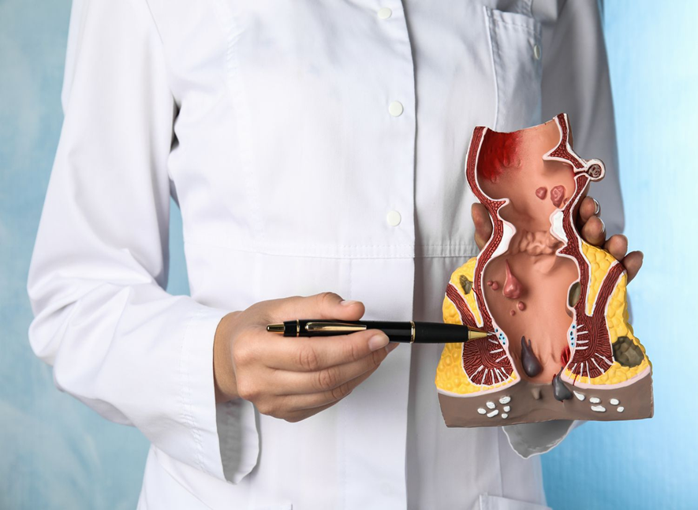
Managements of (Arsha) Hemorrhoids/Piles
Dr. Vishal Agarwal
Associate Professor
Department of Rog Nidan Evam Vikruti Vigyan
Rohilkhand Ayurvedic Medical College and Hospital,
Bareilly, U.P.

Slide 2
Why anorectal diseases so serious-
Most people experience some form of anorectal disorder during their lifetime.
Hemorrhoidal disease is one of the most common anorectal conditions encountered in daily practice in India.
It has been projected that about 50% of the population would have hemorrhoids at some point in their life probably by the time they reach the age 50. (NIH)
Hemorrhoids are an extremely common condition, affecting approximately 10 million persons per year. (Sanchez C, Chinn BT. Hemorrhoids. Clin Colon Rectal Surg. 2011 Mar;24(1):5-13. doi: 10.1055/s-0031-1272818. PMID: 22379400; PMCID: PMC3140328.)

Slide 3

Summary-
Anatomy of anal canal
Haemorrhoids in modern point of view
Haemorrhoids in ayurvedic point of view

Slide 4
Common Ano-rectal diseases- Haemorrhoids
Fistula in ano
Fissure in ano
Rectal prolapse
Anorectal abscess
PNS
Sentinal tag
Carcinoma

Slide 5
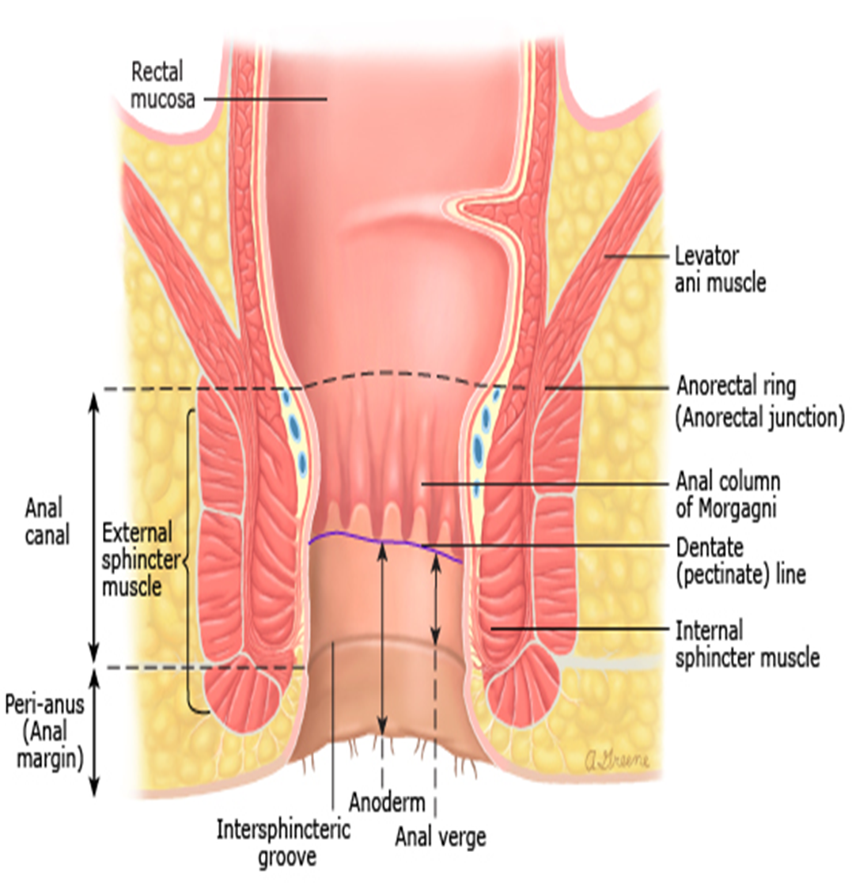
Anatomy of anal canal

Slide 6
‘Haemorrhoids’ / Piles-
‘Haemorrhoids’ (Greek word)
↓
Haima (bleed) + Rhoos (flowering)
↓
Bleeding
The pile is derived from the Latin word ‘Pila’ means Ball.

Slide 7
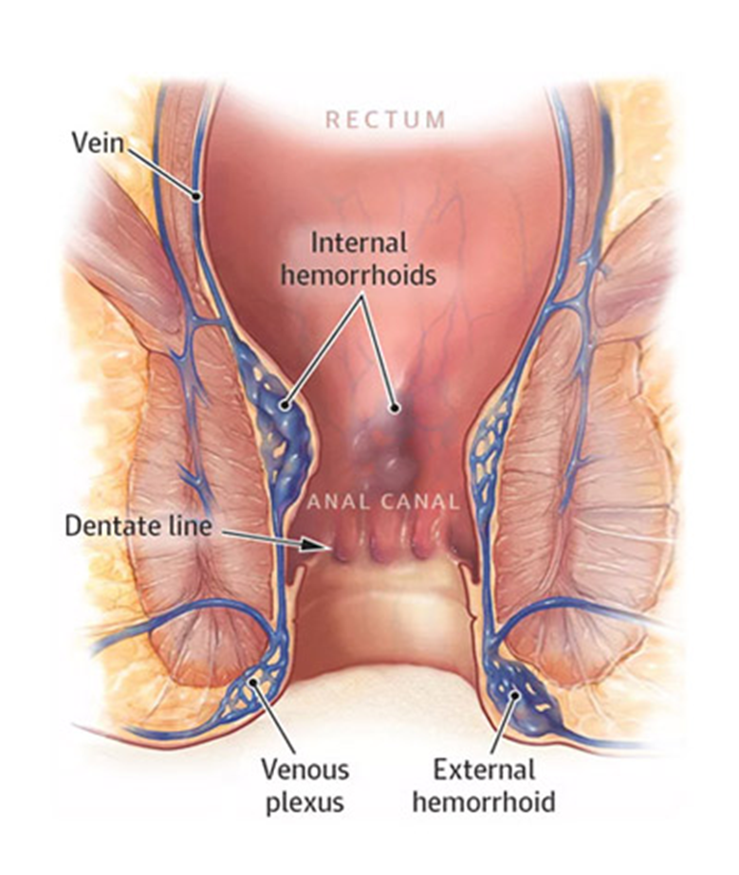
Hemorrhoids is downward sliding of anal cushions abnormally due to straining or other causes.
Anal cushions (Thomson, 1975) are aggregation of blood vessels (arterioles, venules), smooth muscles and elastic connective tissue in the submucosa that normally reside in left lateral, right posterolateral and right anterolateral anal canal.

Slide 8
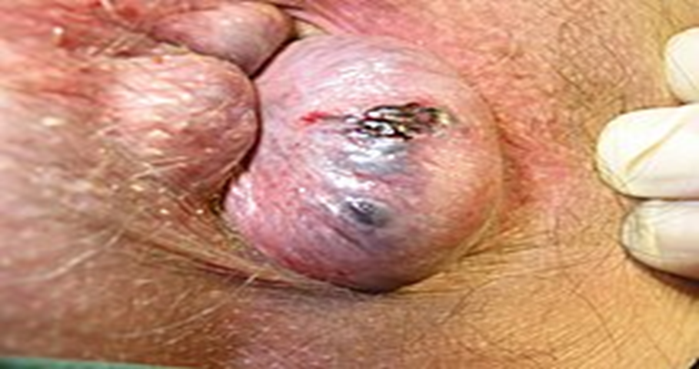

Slide 9
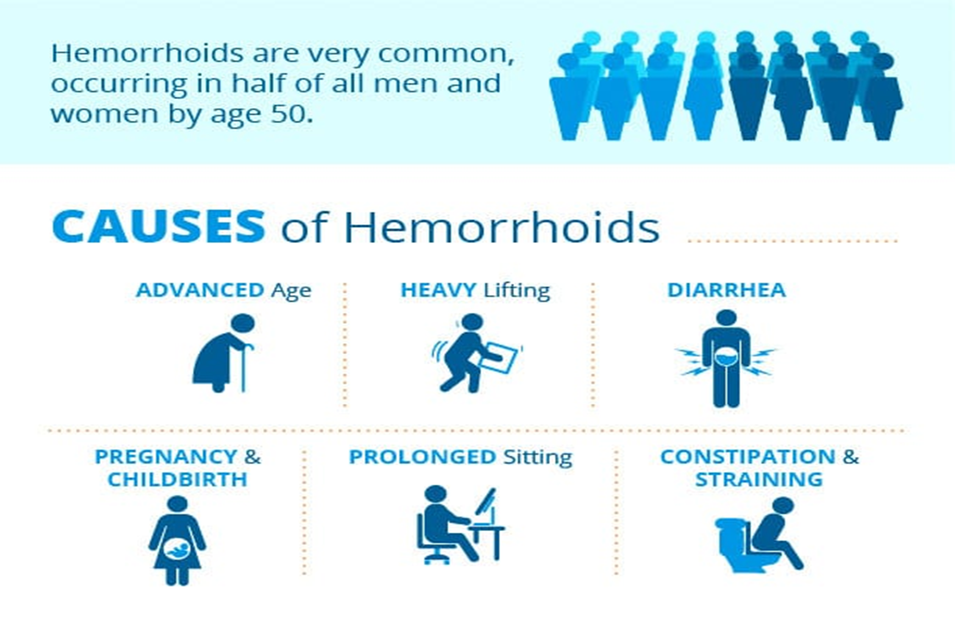

Slide 10
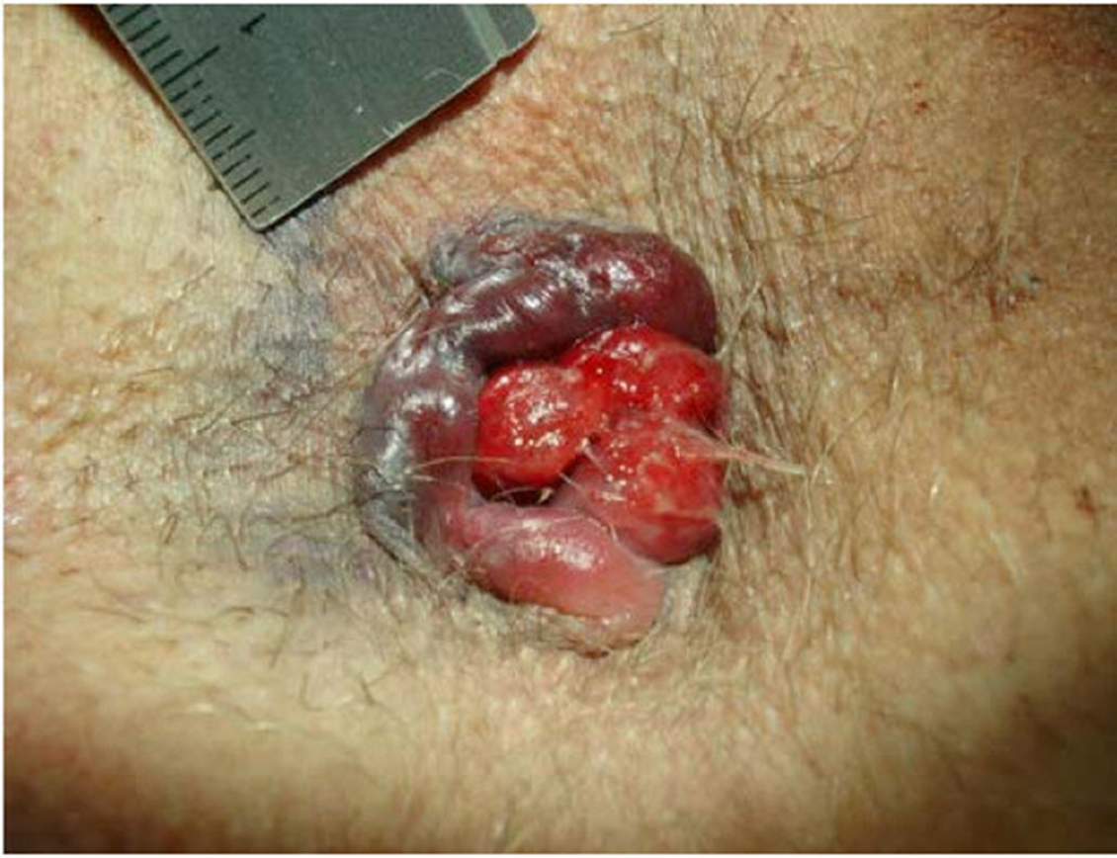
Classification 1
Internal—above the dentate line, covered with mucous membrane.
External—below the dentate line, covered with skin.
Inerno-external—together occurs

Slide 11
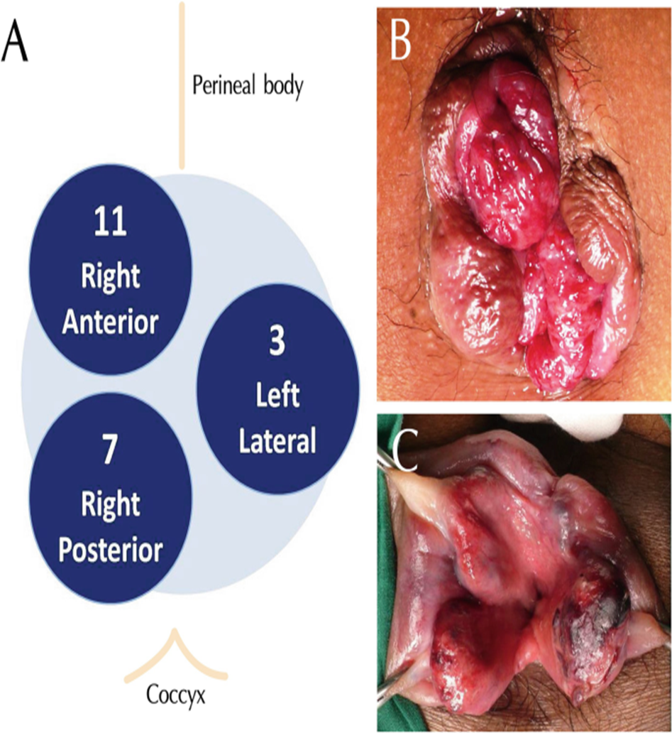
Classification -2
Primary haemorrhoids:-Located at 3, 7, 11 o’clock positions, related to the branches of the superior hemorrhoidal vessel which divides on the right side into two; left side it continues as one.
Secondary haemorrhoids:- One which occurs between the primary sites(eg. 4,5 or 6 o’clock positions)

Slide 12
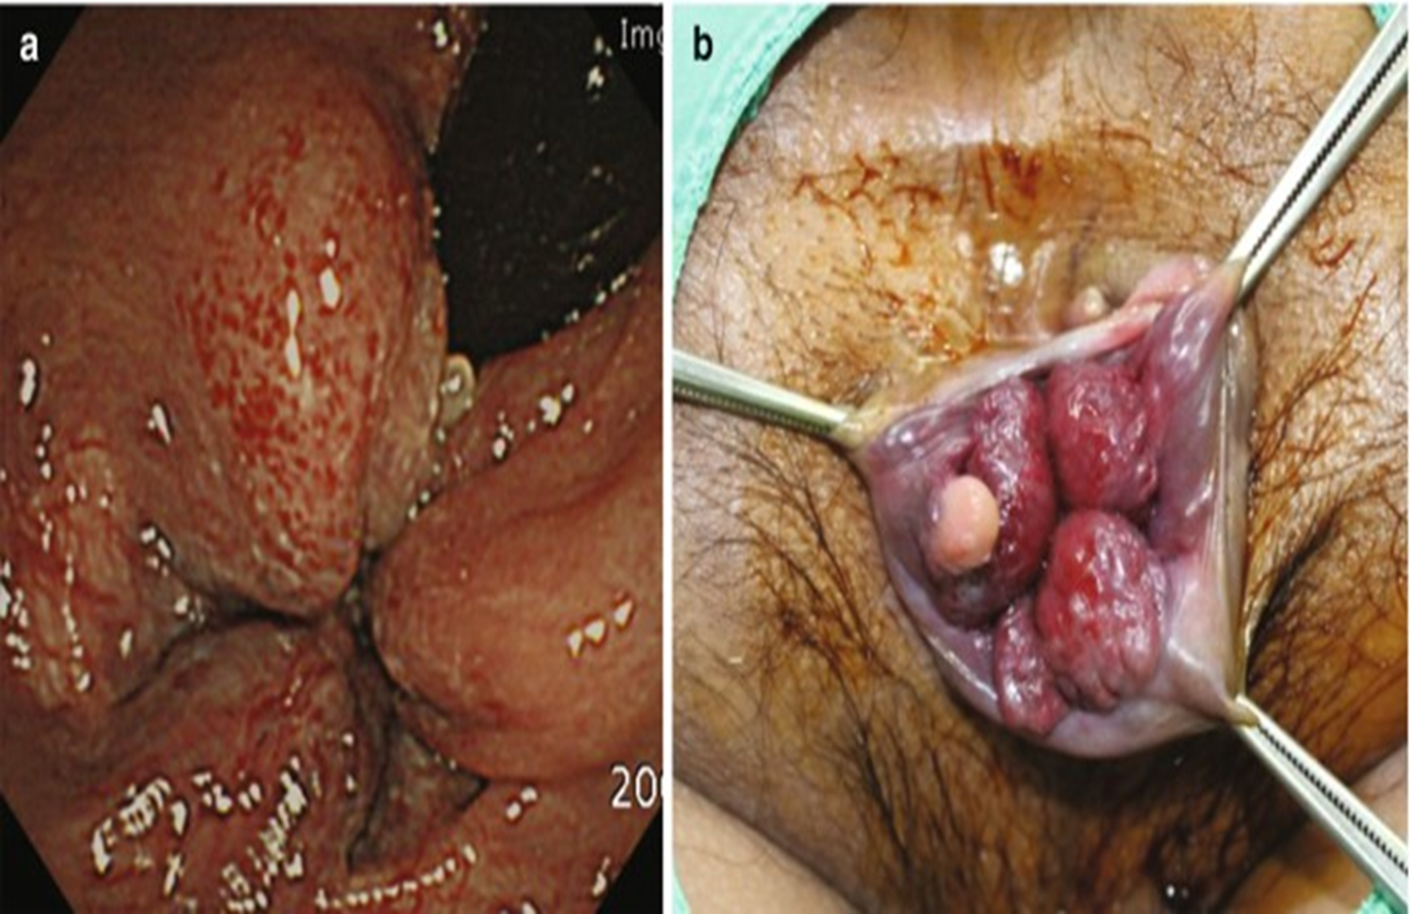

Slide 13
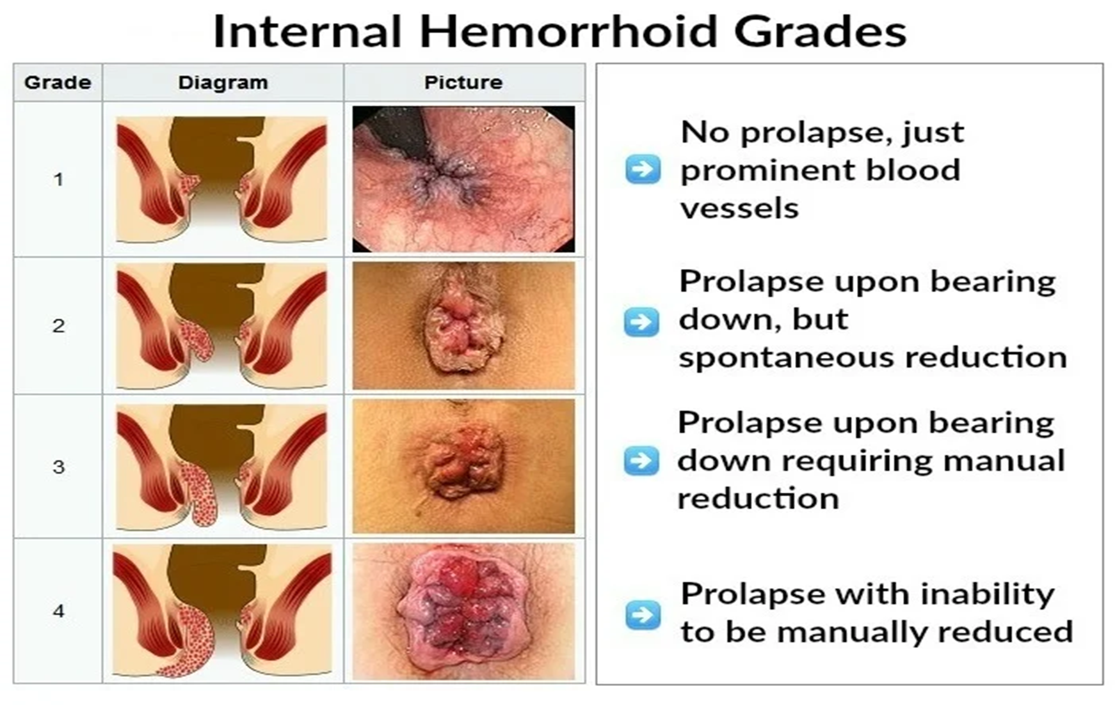

Slide 14
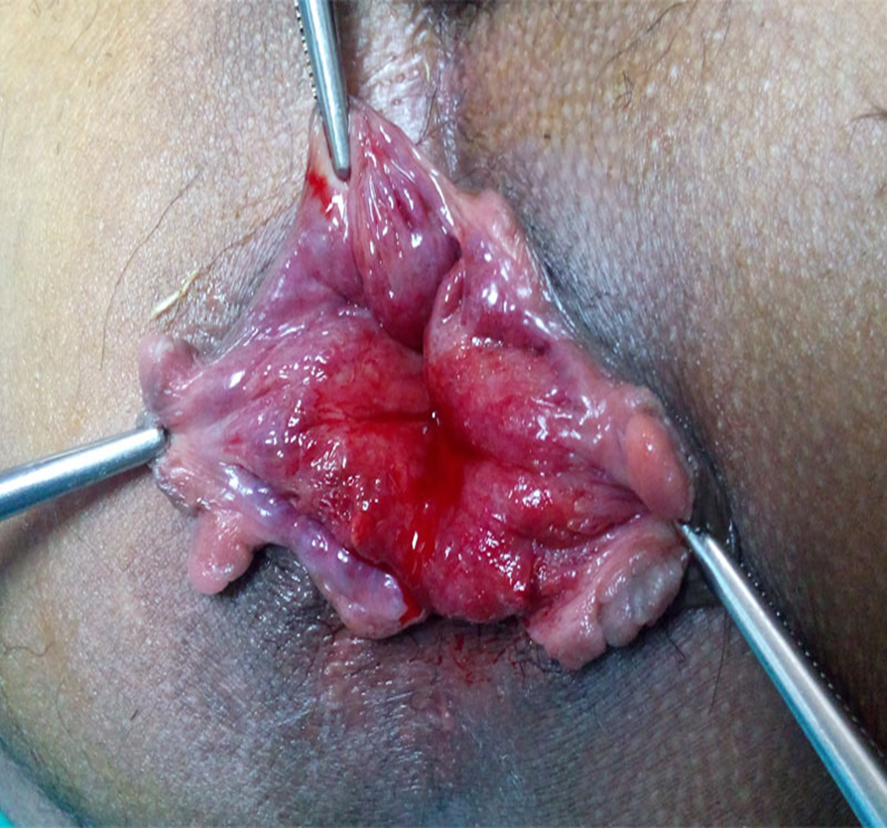
Symptoms-
Bleeding—1st symptom- bright red and fresh blood—occurs during defecation.
Mass per anum.
Pain—may be due to prolapse, infection or spasm.
Anaemia—secondary.
On inspection, prolapsed piles will be visualized.
On P/R examination, only thrombosed piles can be felt.
Through proctoscopy, exact position can be made out as a bulge into the proctoscope

Slide 15
Treatment-
Medical- local applications, sitz bath, diet, laxatives, drugs—analgesics
Para surgical- • Sclerotherapy • Banding • Cryotherapy • Infrared coagulation (IRC) • Laser therapy • Doppler-guided haemorrhoidal artery ligation (DGHAL)
Surgical- • Open haemorrhoidectomy • Closed haemorrhoidectomy • Stapled haemorrhoidopexy • Anal stretching

Slide 16
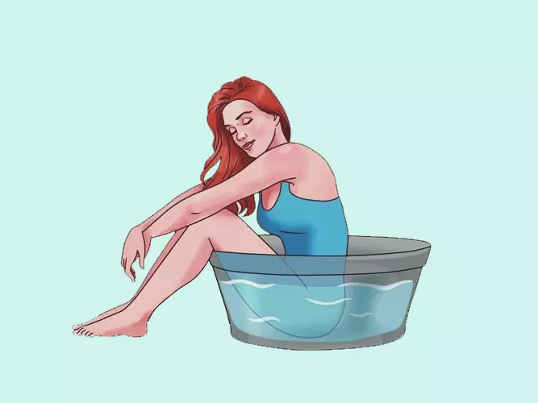
Medical Management-
Sitz bath—means the patient has to sit in warm water with the anal region dipped in water for 20 minutes, 2–3 times a day. This reduces the oedema, pain and promotes healing.
localized topical treatments- (creams or ointments) combining, to varying degrees, locally applied corticosteroids, anesthetics, lubricants, and veinotonics;
Antibiotics, laxatives, anti-inflammatory drugs are beneficial.
Fibre diet 35 g/day,
plenty of water.

Slide 17
Medical Management-
Fibre alternatives (bulk-forming agents, e.g. ispaghula husk, sterculia, methylcellulose) can be used to supplement a high-fibre diet;
Laxatives such as lactulose solution which soften bowel motions and relieve the constipation.
Phlebotonics including diosmin, troxerutin, derivatives of Ginkgo biloba, and hydroxy-ethylrutosides.
Non-steroidal anti-inflammatory drugs (NSAIDs) that act on pain and inflammation, peripheral and central analgesics for pain and corticosteroids for the inflammation.

Slide 18
Arsha-
‘अरिवत् प्राणान् शृणाति हिनस्तीत्यर्शः’
अरिवत्प्राणिनो मांसकीलका विशसन्ति यत्|
अर्शांसि तस्मादुच्यन्ते गुदमार्गनिरोधतः||१||
दोषास्त्वङ्मांसमेदांसि सन्दूष्य विविधाकृतीन्|
मांसाङ्कुरानपानादौ कुर्वन्त्यर्शांसि तान् जगुः||२|| A.H. Ni.7/1-2

Slide 19
Samprapti (Pathogenesis)
Virruddhahara, Adhyasana, irregular diet habits, over riding etc.
↓
suppression of Apana Vayu, Mandagni and constipation.
↓
Vitiation of Doshas and involvement of Rakta travels
through pradhana dhamani and affects Gudavali .
↓
Involves Meda, Mamsa, and Twak representing anal cushions.
↓
Fleshy mass i.e. Haemorrhoids.

Slide 20
Classification of Piles (Arsha)-
(There are different opinions of Acharya regarding the classification of Arsha)
On the basis of the predominance of dosha-
1. Vataj
2. Pittaj
3. Kaphaj
4. Raktaj
5. Sannipataj
6. Sahaj
According to origin 2 types of Arsha-
1. Sahaj
2. Kalaja
The classication on the basis of prognosis-
1. Sadhya (Curable), 2.Yapya (Palliative)
3. Asadhya (Incurable).
On the basis of the character of Bleeding Ardra (Sravi)--
शुष्क अर्श
स्रावी अर्श

Slide 21
Treatment of Arsha-
चतुर्विधोऽर्शसां साधनोपायः-
तद्यथा- भेषजं क्षारोऽग्निः शस्त्रमिति |
1) भेषज चिकित्सा -अचिरकालजातान्यल्पदोषलिङ्गोपद्रवाणि भेषजसाध्यानि,
२) क्षार चिकित्सा- मृदुप्रसृतावगाढान्युच्छ्रितानि क्षारेण,
३) अग्नि चिकित्सा- कर्कशस्थिरपृथुकठिनान्यग्निना,
४) शस्त्र चिकित्सा- तनुमूलान्युच्छ्रितानि क्लेदवन्ति च शस्त्रेण |
तत्र भेषजसाध्यानामर्शसामदृश्यानां च भेषजं भवति, || Su. Chi.6/3

Slide 22
1. Bheshaj Chikitsa-

Slide 23
अर्श चिकित्सा-
अर्श
∕ \
शुष्क अर्श आर्द्र अर्श / स्रावी अर्श
↓ ↓
V/K or VK R/P or RP

Slide 24
शुष्क अर्श- V/K or VK
Shushka Arsha with Bhinnavarchas-
Swedan karma (स्वेदन कर्म)-
Avagaha sweda ( अवगाह स्वेद )
Dhuma (धूम)
Lepa (लेप)
Raktamokshana(रक्तमोक्षण)

Slide 25
1)स्वेदन कर्म-
तेल मालिश गुदा – चित्रकक्षारबिल्वानां तैलेनाभ्यज्य बुद्धिमान् |
पोटली स्वेदन - यवमाषकुलत्थानां पुलाकानां च पोट्टलैः |

Slide 26
2) Avagaha sweda ( अवगाह स्वेद ) -
Avagaha sweda is a drava sweda, the drugs like mulaka, triphala, arka, shigru, badara etc.
These drugs are used for preparation of kwatha, the patient is made to sit in the tub containing kwatha, this helps in relieving the pain of Shushka Arsha.

Slide 27
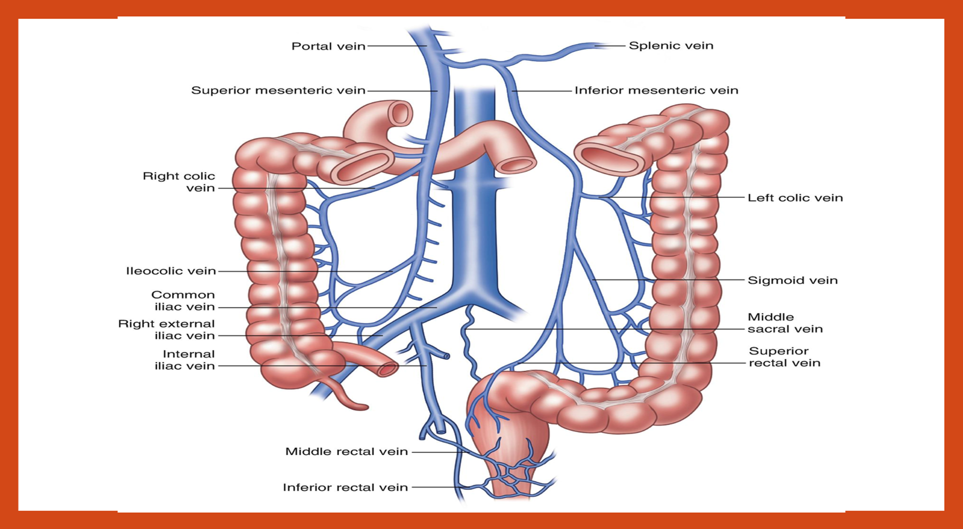

Slide 28
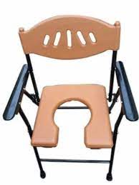
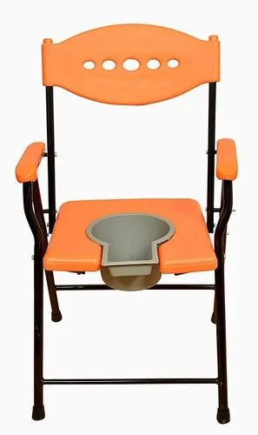
3) Dhuma(धूम)-
Before administration of Dhooma, Abhyanga is done on anal region with using vasa of Krishna sarpa or varaha or ushtra followed by Dhuma prayoga.
Dhuma with human hair or exoskeleton of snake or Arkamula or Shameepatra and fumes made to get in contact with anal region. This procedure helps in relieving pain of Arsha.

Slide 29
4) Lepa(लेप)-
Haridra churna mixed with sudha ksheera etc. The drugs used in lepa are having shothahara, shulahara and arshohara properties.
Local application helps to relieve local symptoms.

Slide 30
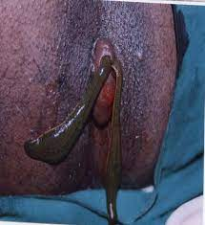
5) Raktamokshana(रक्तमोक्षण)
शीतोष्णास्निग्धरूक्षैर्हि न व्याधिरुपशाम्यति|
रक्ते दुष्टे भिषक् तस्माद्रक्तमेवावसेचयेत्||६०||
जलौकोभिस्तथा शस्त्रैः सूचीभिर्वा पुनः पुनः|
अवर्तमानं रुधिरं रक्तार्शोभ्यः प्रवाहयेत्||६१||

Slide 31
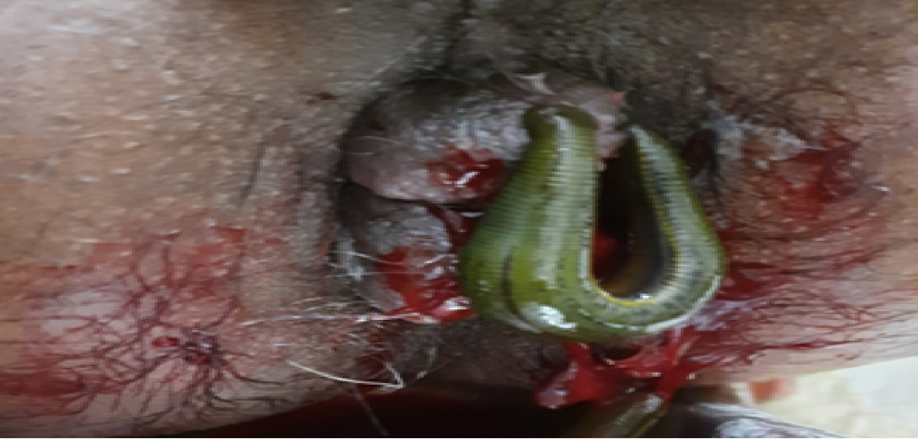
This helps to reduce local congestion of blood and relieve the pain.

Slide 32
Management of Shushka Arsha with Baddha Shakrat-
Anulomana
Yavani, Nagara, Patha, Dadima swarasa, Guda, Takra, Lavana etc drugs advised orally to relieve constipation.
Niruha Basti
Dashamula kwatha, Godugda, Goghrita, Sneha, Saindhava lavana, madanaphala kalka are used in Niruha basti.
Anvasana Basti
Nagaradi ghrita, Pippalayadi ghrita etc are given in Guda shopha, Picha srava.
Guda Prakshalana
Bhangodaka with a tolerable hot decoction is used for washing Guda. Bhanga is mohakara, madakara, therefore it helps in relieving pain immediately.

Slide 33
Takraprayoga in Arshas -
वातश्लेष्मार्शसां तक्रात् परं नास्तीह भेषजम् |
तत् प्रयोज्यं यथादोषं सस्नेहं रूक्षमेव वा ||
सप्ताहं वा दशाहं वा पक्षं मासमथापि वा |
बलकालविशेषज्ञो भिषक् तक्रं प्रयोजयेत् ||
वातश्लेष्मविकाराणां शतं चापि निवर्तते |
नास्ति तक्रात् परं किञ्चिदौषधं कफवातजे ||
रूक्षमर्धोद्धृतस्नेहं यतश्चानुद्धृतं घृतम्
रूक्ष तक्र
अर्धोद्धृतस्नेहं
अनुद्धृतं घृतम्

Slide 34
Rakta Arshas/ Sravi Arshas –R / P or RP
सम्बन्ध- K or V
पञ्चात्मा मारुतः पित्तं कफो गुदवलित्रयम् |
सर्व एव प्रकुप्यन्ति गुदजानां समुद्भवे ||
स्निग्धशीतं हितं वाते रूक्षशीतं कफानुगे |
चिकित्सितमिदं तस्मात् सम्प्रधार्य प्रयोजयेत् ||
K अनुबन्ध- शीत + रुक्ष चिकित्सा
V अनुबन्ध- शीत + स्निग्ध चिकित्सा

Slide 35
Langhana and Shodhana in Raktarsha-
If Pitta and Kapha both are involved in Raktarshas,
पित्तश्लेष्माधिकं मत्वा शोधनेनोपपादयेत् |
स्रवणं चाप्युपेक्षेत लङ्घनैर्वा समाचरेत् ||
प्रवृत्तमादावर्शोभ्यो यो निगृह्णात्यबुद्धिमान् |
शोणितं दोषमनिलं तद्रोगाञ्जनयेद्बहून् ||

Slide 36
Raktastambaka -
तस्मात् स्रुते दुष्टरक्ते रक्तसङ्ग्रहणं हितम् |
कालं तावदुपेक्षेत यावन्नात्ययमाप्नुयात् ||
अग्निसन्दीपनार्थं च रक्तसङ्ग्रहणाय च |
दोषाणां पाचनार्थं च परं तिक्तैरुपाचरेत् ||
Raktastambaka Dravyas
Kutaja twak, Nagara, Dadima phalatwak, Raktachandana, Kiratatikta, Dhanvayasa, Daruharidra twak, Nimba twak, Ushira are used for Raktastambanartha.

Slide 37
Avagaha Sweda-
रक्तेऽतिवर्तमाने दाहे क्लेदेऽवगाहयेच्चापि|
मधुकमृणालपद्मकचन्दनकुशकाशनिष्क्वाथे||

Slide 38
Picha Basti- प्रवाहिकागुदभ्रंशरक्तस्रावज्वरापहः||
In predominance of vata with ati Raktasrava Pichabasti should be administered.
Roots of yavāsa (durālabhā), kusha and kaasha, flowers of Salmali, leaf buds of Nyagrodha, Udumbara, and Asvattha each two Palas should be boiled with three Prastha water and one Prastha milk until only milk is left.
This should be filtered and mixed with pastes of Shalmali-niryāsa, Samangā, Candana, Utpala, seed of Vatsaka, Priyangu and Padmakesara.
At the end Ghṛta, Honey and sugar should also be mixed. This Piccha Basti eliminates Pravahika, Arshas, Gudabhramsha, Raktasrava, Jwara.

Slide 39
Vyatyasa Chikits in Arshas-
व्यत्यासान्मधुराम्लानि शीतोष्णानि च योजयेत्|
नित्यमग्निबलापेक्षी जयत्यर्शःकृतान् गदान्||
सन्निपातो दुश्चिकित्स्यानाम्.
पञ्चात्मा मारुतः पित्तं कफो गुदवलित्रयम्|
महागद

Slide 40
Role of Agni in Arshas
त्रयो विकाराः प्रायेण ये परस्परहेतवः|
अर्शांसि चातिसारश्च ग्रहणीदोष एव च||
एषामग्निबले हीने वृद्धिर्वृद्धे परिक्षयः|
तस्मादग्निबलं रक्ष्यमेषु त्रिषु विशेषतः||

Slide 41
Pathya in Arshas-
यद्वायोरानुलोम्याय यदग्निबलवृद्धये|
अन्नपानौषधद्रव्यं तत् सेव्यं नित्यमर्शसैः||
वात का अनुलोमन
अग्नि वर्धन

Slide 42
क्षार चिकित्सा-
Indication-
मृदुप्रसृतावगाढान्युच्छ्रितानि क्षारेण,
तत्र वातश्लेष्मनिमित्तान्यग्निक्षाराभ्यां साधयेत्, क्षारेणैव मृदुना पित्तरक्तनिमित्तानि ||

Slide 43
Procedure-
Purva karma (Pre-operative)
Written consent
Injection Tetanus toxoid (0.5ml) I/M was given
Xylocain sensitivity test

Slide 44
Pradhan Karma (Operative procedure)
After the patient was position in lithotomy on the operation table, local anaesthesia was given.
The part was painted with antiseptic solution.
The diseased part is exposed by special slit proctoscope and examined carefully.
The adjoining healthy region of these organs was covered with gauze piece to prevent the spread of Kshara on healthy tissue exposed.
The kshara is applied on proposed lesion by probe.
Generally the kshara is applied up to the counting 100, but this depends on the nature of tissue so we should take 1-3 min.
The mucosal covered part of the lesion take shorter time than hard skin covered parts..

Slide 45
Paschat Karma (Post-Operative)
As soon as the sign of Samyak dagdha (proper cauterization) appears, the Kshara is rapidly neutralised by acidic fluid like lemon water.
Later, on the cauterised part is washed out with distilled water. Jatyadhi tail/ghrit is applied on the cauterised lesion and dressing is done.
It should be neutralized and washed out completely and carefully, otherwise it produces severe complications rather than cure.

Slide 46
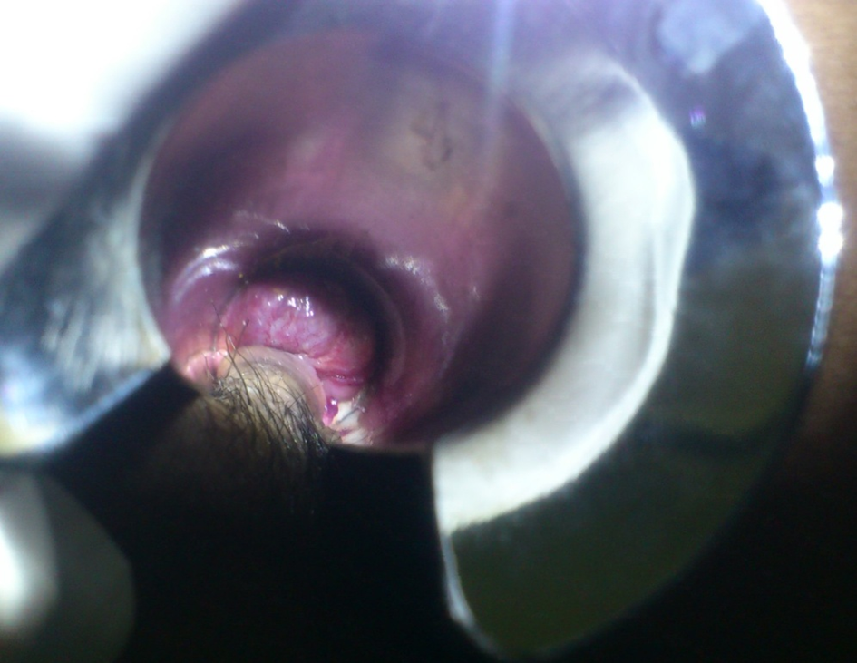
Before Ksharkarma-

Slide 47
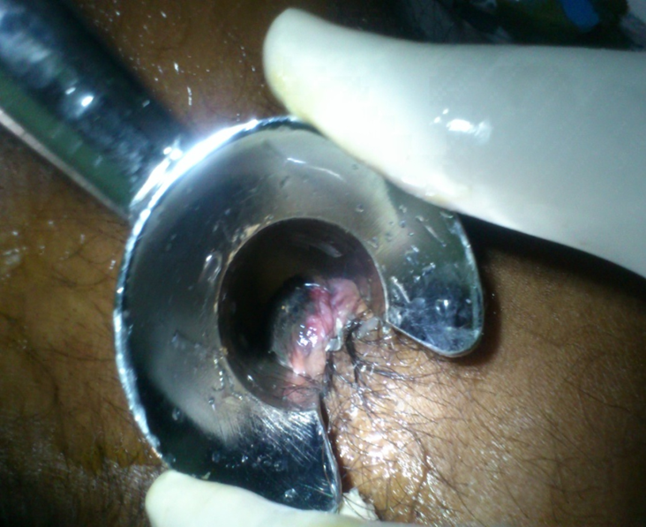
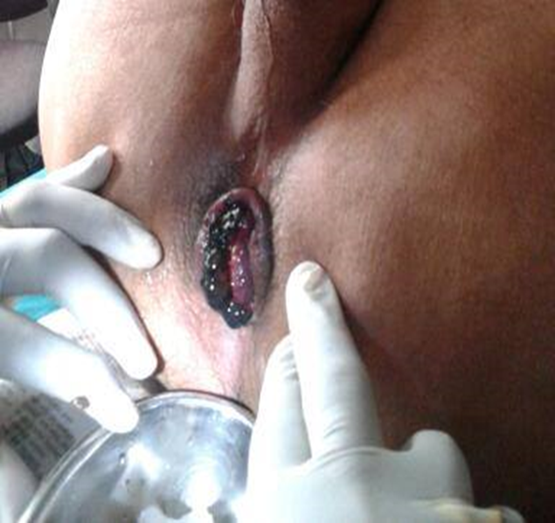
During Ksharkarma-

Slide 48
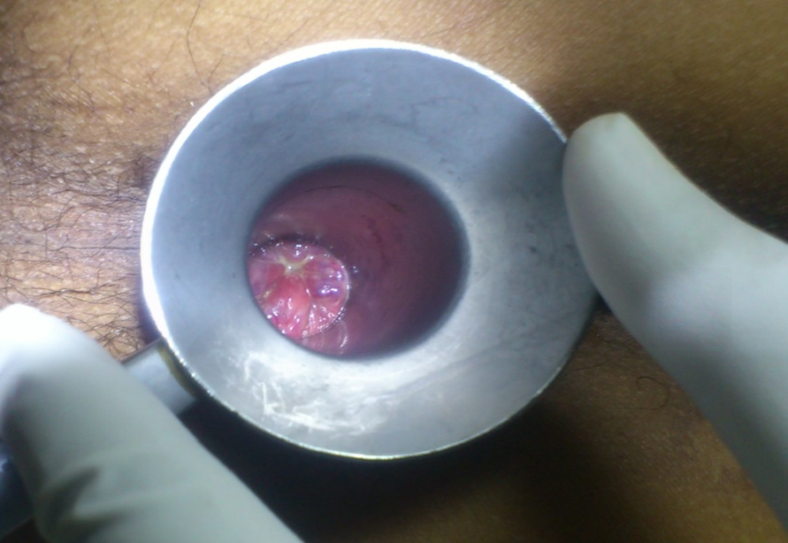
After Ksharkarma-

Slide 49
Sign of Samyak dagdha (Proper cauterization)
पक्वजाम्बवप्रतीकाशमवसन्नमीषन्
Within 1-3min after Kshara application the tissue of the diseased part becomes purple or dark black in colour and cauterised lesion is shrinked, pain and discharge relieved.
The patient feels easiness with relief of prominent symptoms.

Slide 50


