Slide 1
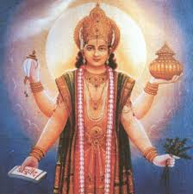
DEDICATED TO BHAGWAN DHANVANTARI
,DIVINE PHYSICIAN
Notes:
THE LORD DIVINE PHYSICIAN

Slide 2
AN AYURVEDIC APPROACH TO MANAGEMENT OF TYPE -2 DIABETES
(Prof. H S RAI)
BSc,BAMMS.MD(Ay),LKO
PROFESSOR KAYACHIKITSA
ROHILKHAND AYURVEDIC MEDICAL COLLEGE BAREILLY

Slide 3
CRITERIA OF DIAGNOSIS OF DM
Symptoms of diabetes plus random blood glucose concentration--- (200 mg/dL) or
Fasting plasma glucose- (126 mg/dL) or
Two-hour plasma glucose- (200 mg/dL) during an oral glucose tolerance test

Slide 4
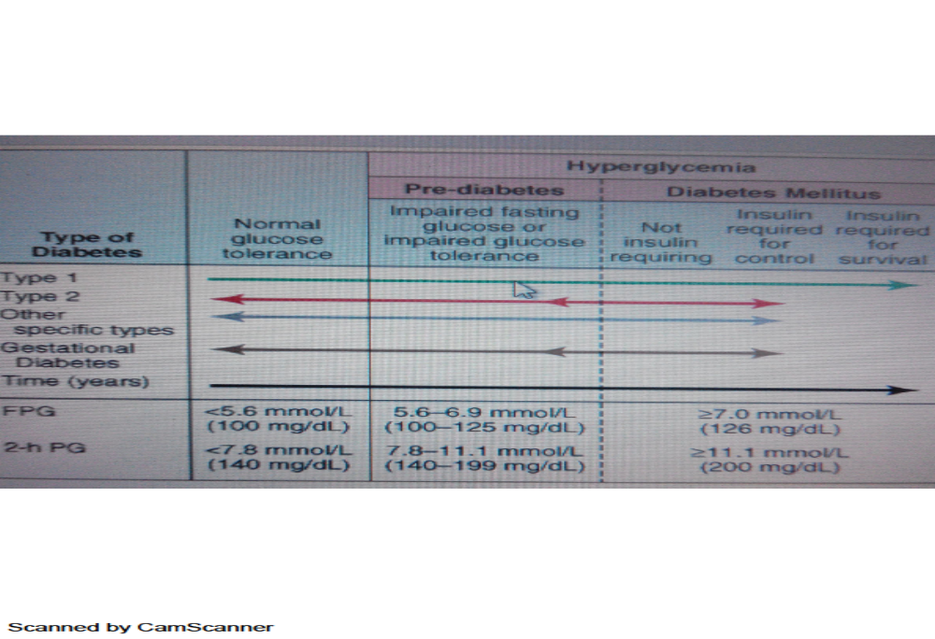

Slide 5
CAUSES OF IGT OTHER THAN DM
ENDOCRINE DISTURBANCE
PITUITARY CONDITIONS,ACROMEGALY.CUSHING SYNDROME
HYPERTHYOIDISM
ADRENAL CODITIONS – EMOTINAL GLYCOSURIA increase adrenaline-In emotions and in pheochromocytoma
Cerebral conditions –hyperglycemia and ranal glycosuria-due to skull fracture cerebral hemorrhage mistaken as diabetic coma
Disease of liver – gross liver disease
Gastro intestinal disease-post prandal glycosuria( dumping syndrome )
Fevers and infections- any acute infection may cause temporary IGTT-GLYCOSURIA

Slide 6
GOALS OF TREATMENT IN DM
Glycemic control^{b}
A1C | <7.0^{c}
Preprandial capillary plasma glucose | 5.0–7.2 mmol/L (90–130 mg/dL)
Peak postprandial capillary plasma glucose | <10.0 mmol/L (<180 mg/dL)^{d}
Blood pressure | <130/80e
Lipids^{f}
Low-density lipoprotein | <2.6 mmol/L (<100 mg/dL)
High-density lipoprotein | >1.1 mmol/L (>40 mg/dL)^{g}
Triglycerides | <1.7 mmol/L (<150 mg/dL

Slide 7
MANAGEMENT OF PATIENT WITH DIFFERENT LEVEL OF BLOOD SUGAR/COMPLICATIONS IN DM TYPE- 2
FIRST DIAGNOSE BY YOU- PP 200mg/l TO 250mg/dL
CHRONC PATIENT-- BSL 251mg to 350mg/dl
PATIENT DEVELOPING COMPLICATION- OTHER SYSTEM /organs ENTREPTMENT
PATIENT DEVELOPING DKA(DIABETIC KETO ACIDOSIS
DIABETIC COMA

Slide 8
FIRST DIAGNOSE BY YOU- PP 200MG TO 250MG/L
EDUCATE THE PATIENT ABOUT DM AND ITS COMPLICATION AND IMPORTANCE OF TREATMENT
DIET COUNCILING(PATHYA - APTHYA )
HERBOMINERAL DRUGS
EXERCISES AND YOGA
RGULAR CHECK UP

Slide 9
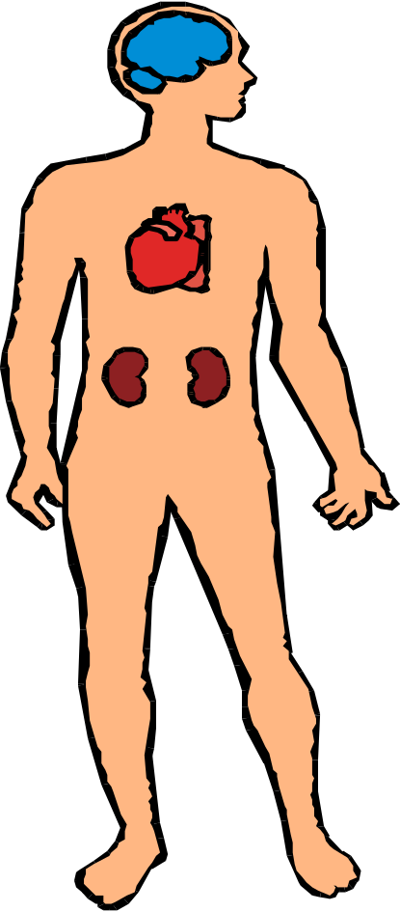
Diabetes:Complications
Microvascular
Diabeteic retinopathy and cataracts
Nephropathy/CRF
Erectile dysfunction
Peripheral Neuropathy
Macrovascular
Stroke
Heart Disease
Hypertension with2.4 X increased risk of MI
Peripheral Vascular Disease
Foot Ulcers

Slide 10
Principles of Treatment
Principles of Treatment for Prameha (Madhumeha)
Sthula (Balwan Rogi) Krśha (Durbala Rogi)
Samsodhana therapy Samsamana therapy
Vamana Virechana Santarpana
Àsthāpana (Niruha vasti) or Anuvāsana
Vasti (Sushruta and Vagbhata)
Santarpana Apatarpana

Slide 11
HERBO- MINERAL CHIKITSA
Rasa
Bhasma
Basanta Kusmakar (B.R.),
Prameha Chintamani (B.R.)
. Prameha Kulantak (B.R.)
Vangeswar (B.R.),
Vasantatilak Ras (B.R.)
Mahakuntarkesari Rasa
Mehantak Ras,
Chandrakala Ras.
Trivnga Bhasma
Loha Bhasma
Roupya Bhasma.

Slide 12
CHURNA AND VATI
Churna
VATI
1 Triphala Churna (Y.R.)
2-Sphatika Churna (B.R.),
3-Ailadi Churna (B.R)
4 Karkati Veejadi Churna (Y.R.).
4. Vati : Gokshuradi Vati (Y.R.),
Chandraprabha Vati (Y.R.), Arogya Vardhini Vati.

Slide 13
KWATH AND SWARAS
Kwath / Swaras :
0
Darvyadi Kwath (Ch.)
, Phalatrikadi Kwath (Ch.), Vidangadi Kwath (Y.P.), Triphaladi Kwath (B.R., Brinda),
Manjisthadi Kwath (B.R.), Palash Pushpa Kwath (Y.R.), Amrita Swaras (Sarangadhar),
Dhatri Swaras (Chakradutta), Satavari Swaras (B.R.).
. Guducchayadi Yoga (Vrinda),
Nisha Triphala Yoga (Y.R),
Triphalakalka (Y.R.).

Slide 14
Asava / Arista
Madhyasav (Ch.),
Lodhraasava,
Deodarvarista (B.R.),
Dantyarishta (Ch.).

Slide 15
PATTHYA APATHYA
PATHYA :
Yava, Godhuma, Shali,
Kulattha, , Masura, Chana, Arhara
Tila, Laja, Purana Madya
Madhu, Manda, Takra,
Shigru, Parval, Karela, Lasuna, unripe banana, Guduchi, Triphala, Kapittha, Khajur
Jambu fruit, water melon,
Strenuous physical exercises
All kashaya, tikta, dravyas, exposure to sun’s heat etc

Slide 16
CONTINUED
APATHYA :
Suppression of urges, Dhumapana, Day sleep,
New cereals, , curd and other dairy products.
Kusmanda, Sugarcane. (Cheese, butter etc.)
All foods that have excess sweet, sour and salt properties.
All heavy and oil foods (Abhisyandi)
Day sleep prolonged rest (Sadasana)
Foods like katu tumbi, Tala, , Ikshu, etc.

Slide 17
Risk Factors for Type 2 Diabetes Mellitus
Family history of diabetes (i.e., parent or sibling with type 2 diabetes)
Obesity (BMI 25 kg/m²)
Habitual physical inactivity
Race/ethnicity (e.g., African American, Latino, Native American, Asian American, Pacific Islander)
Previously identified IFG or IGT
History of GDM or delivery of baby >4 kg (>9 lb)
Hypertension (blood pressure 140/90 mmHg)
HDL cholesterol level <35 mg/dL (0.90 mmol/L) and/or a triglyceride level >250 mg/dL (2.82 mmol/L)
Polycystic ovary syndrome or acanthosis nigricans
History of vascular disease

Slide 18


Slide 19
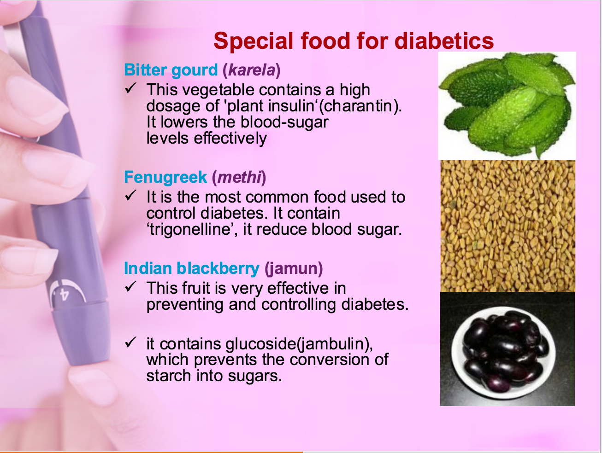

Slide 20
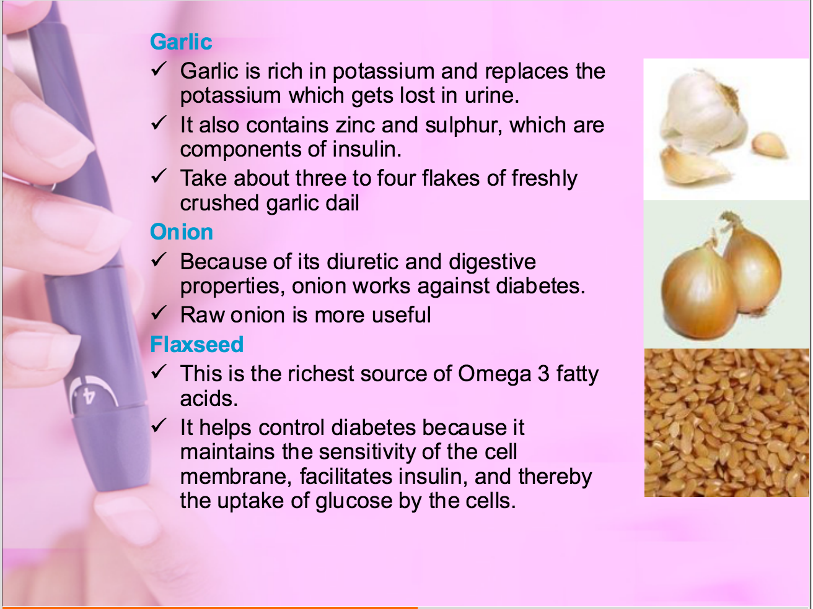

Slide 21
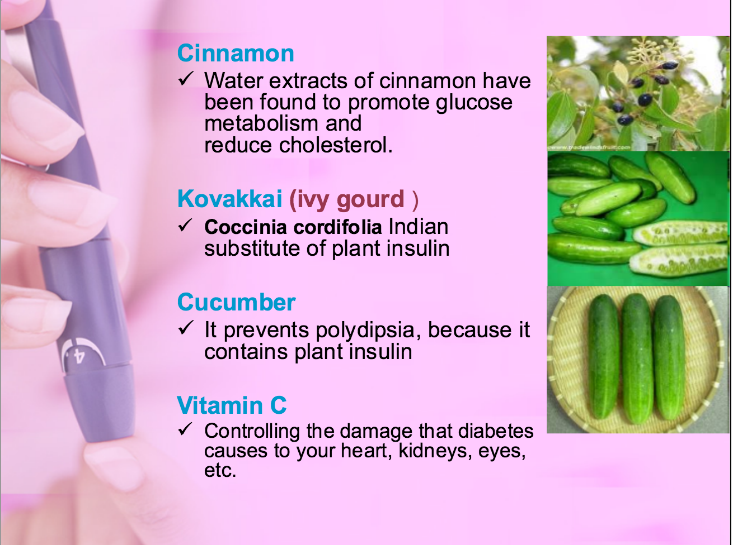

Slide 22
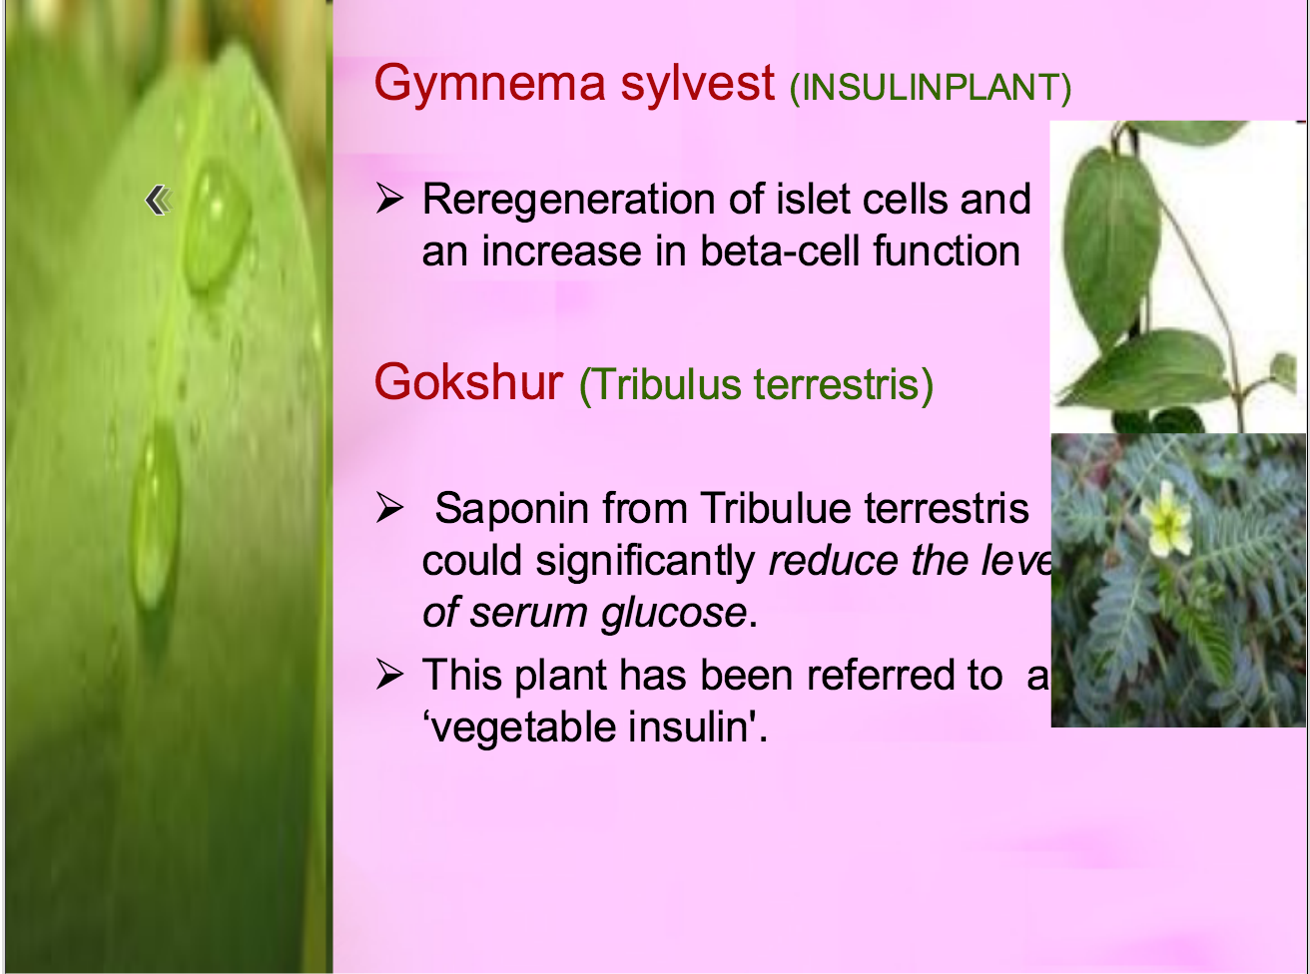

Slide 23
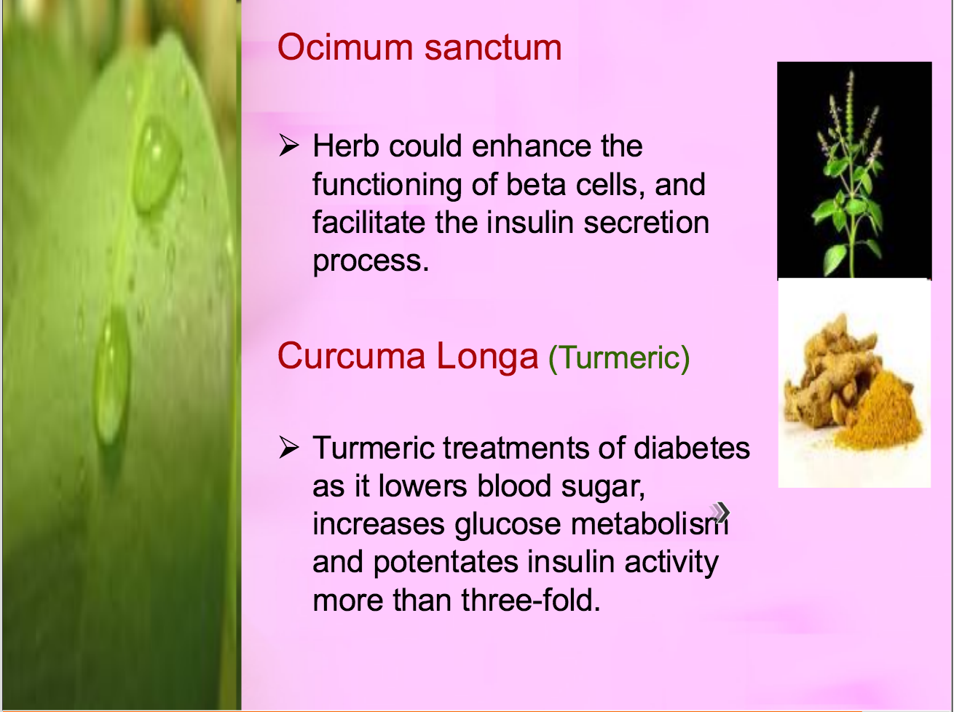

Slide 24

GUD MAAR

Slide 25
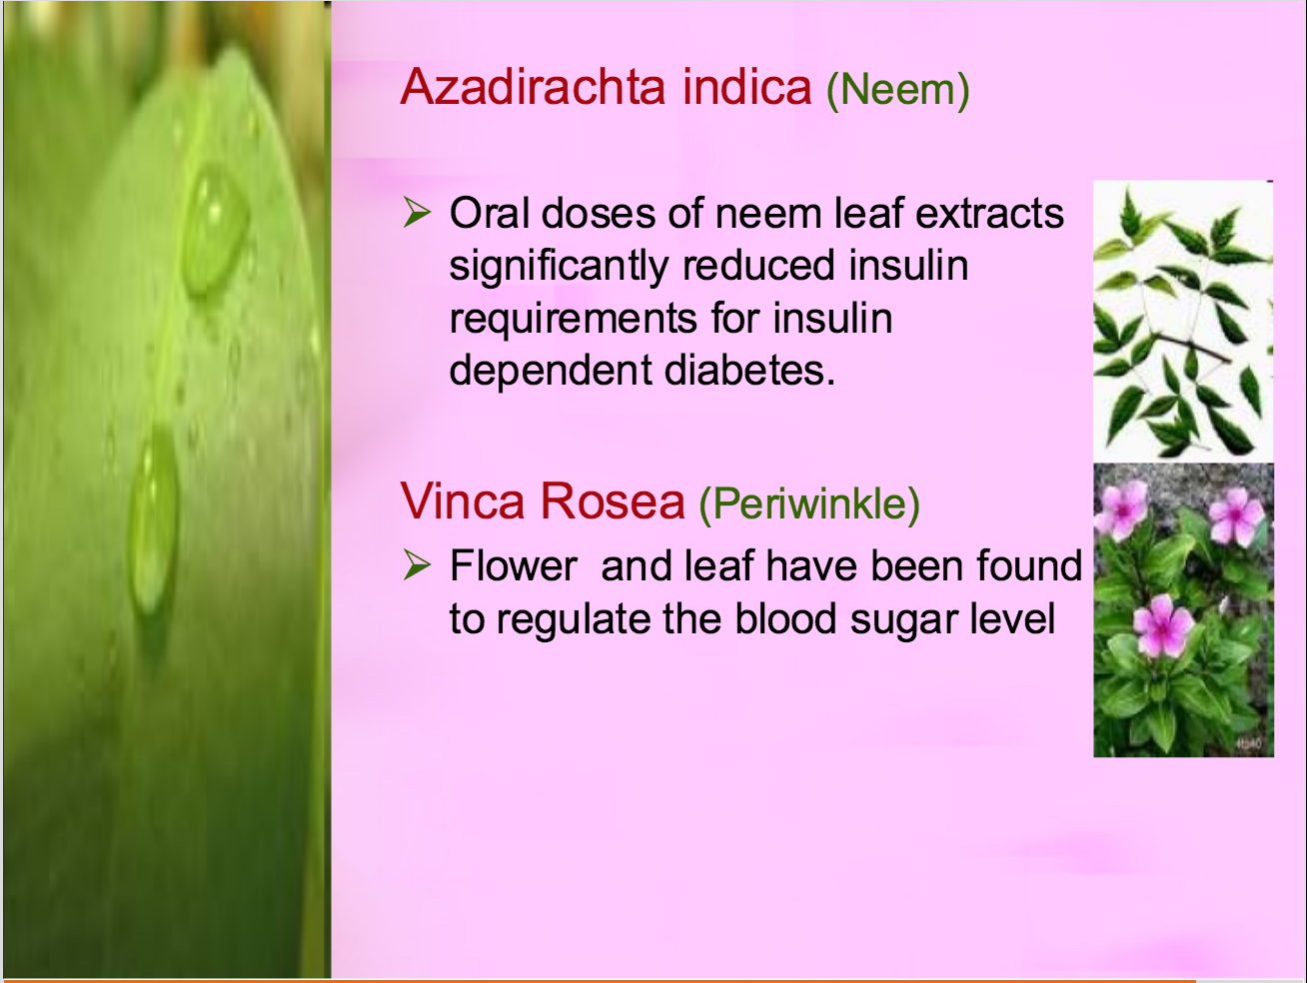

Slide 26
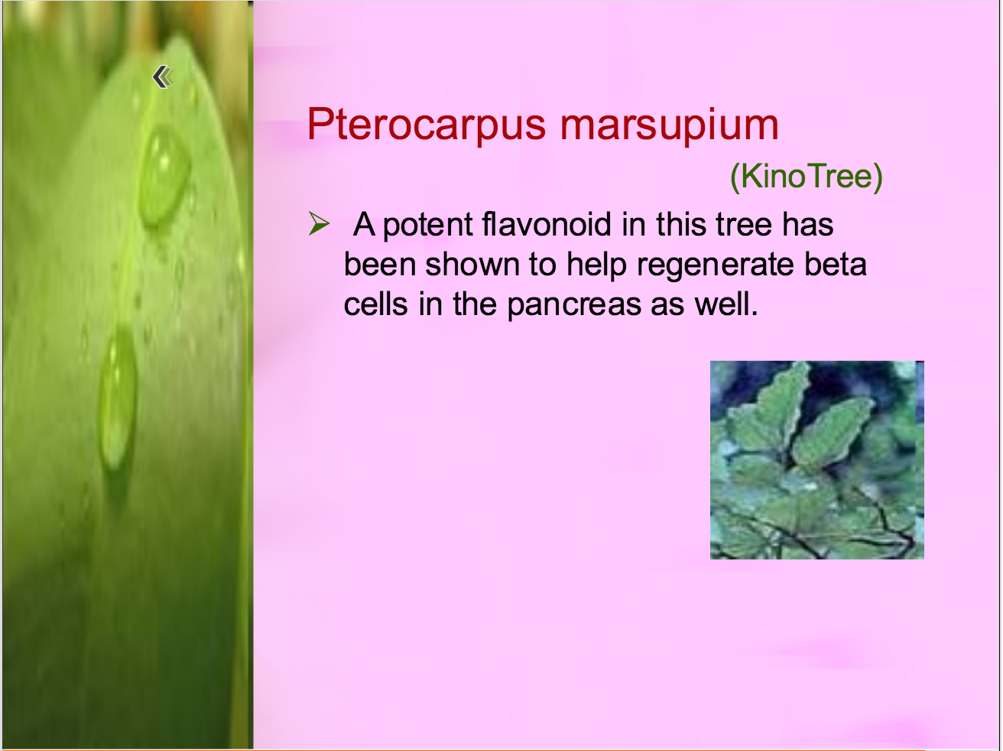

Slide 27
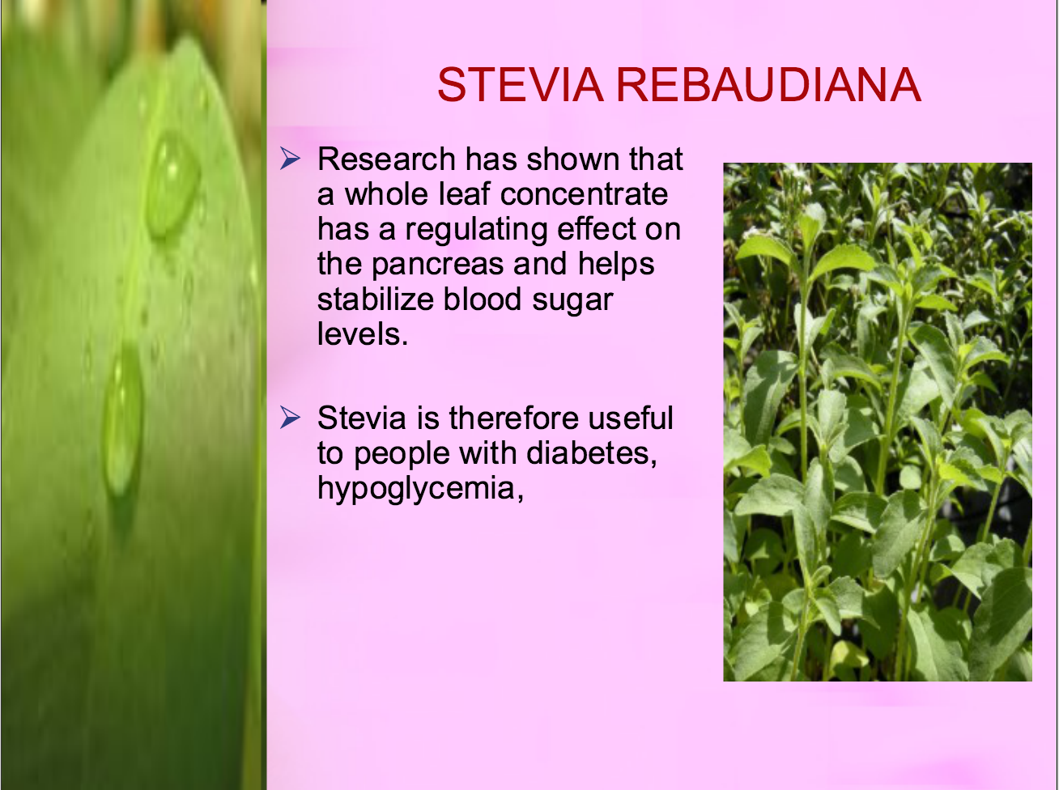
Its glucoside ) Stevioside(10%-20%) and 2.) Rebaudioside-A(1-3%). T .it is also used in obesity and hypertension

Slide 28


Slide 29
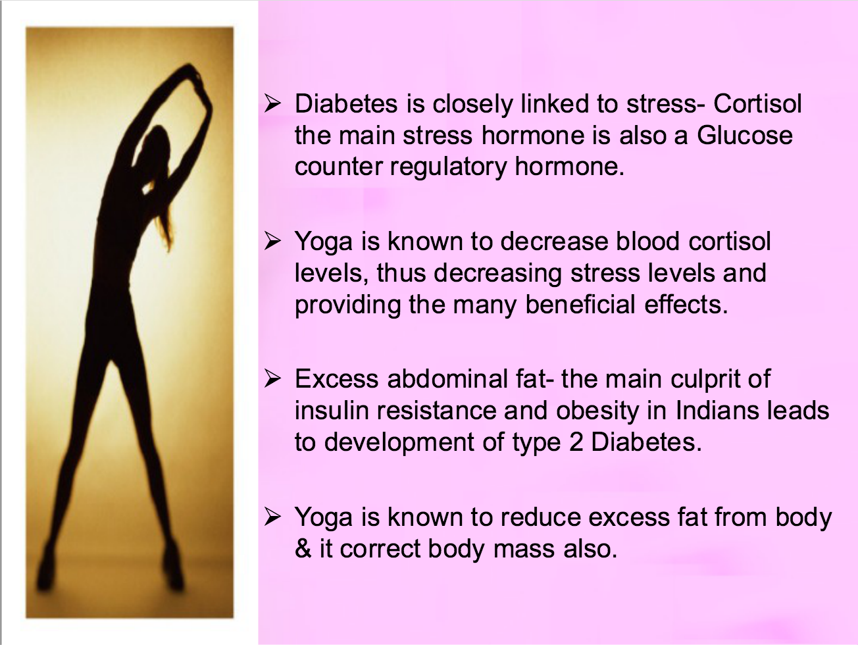
YOGA AND DIABETES

Slide 30
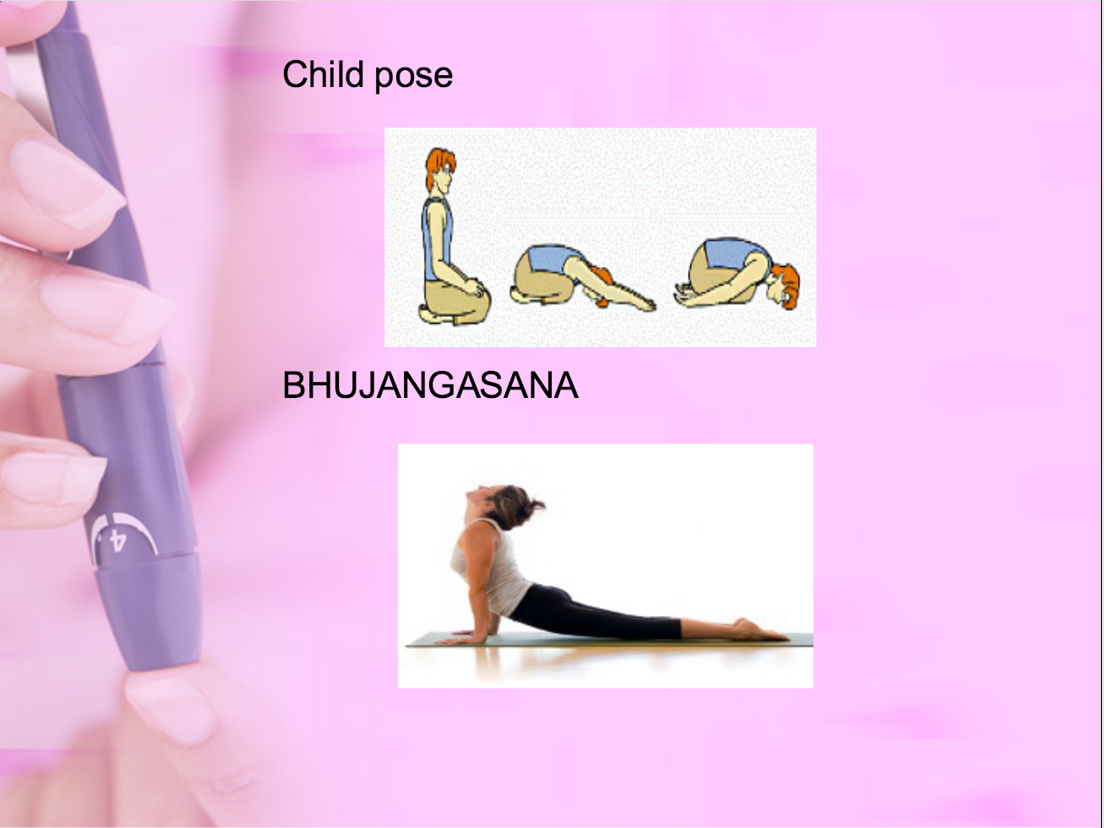

Slide 31
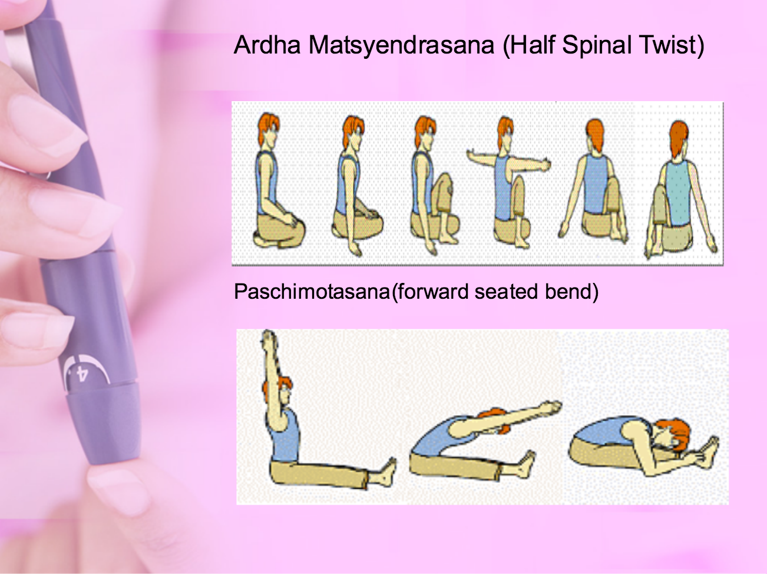

Slide 32
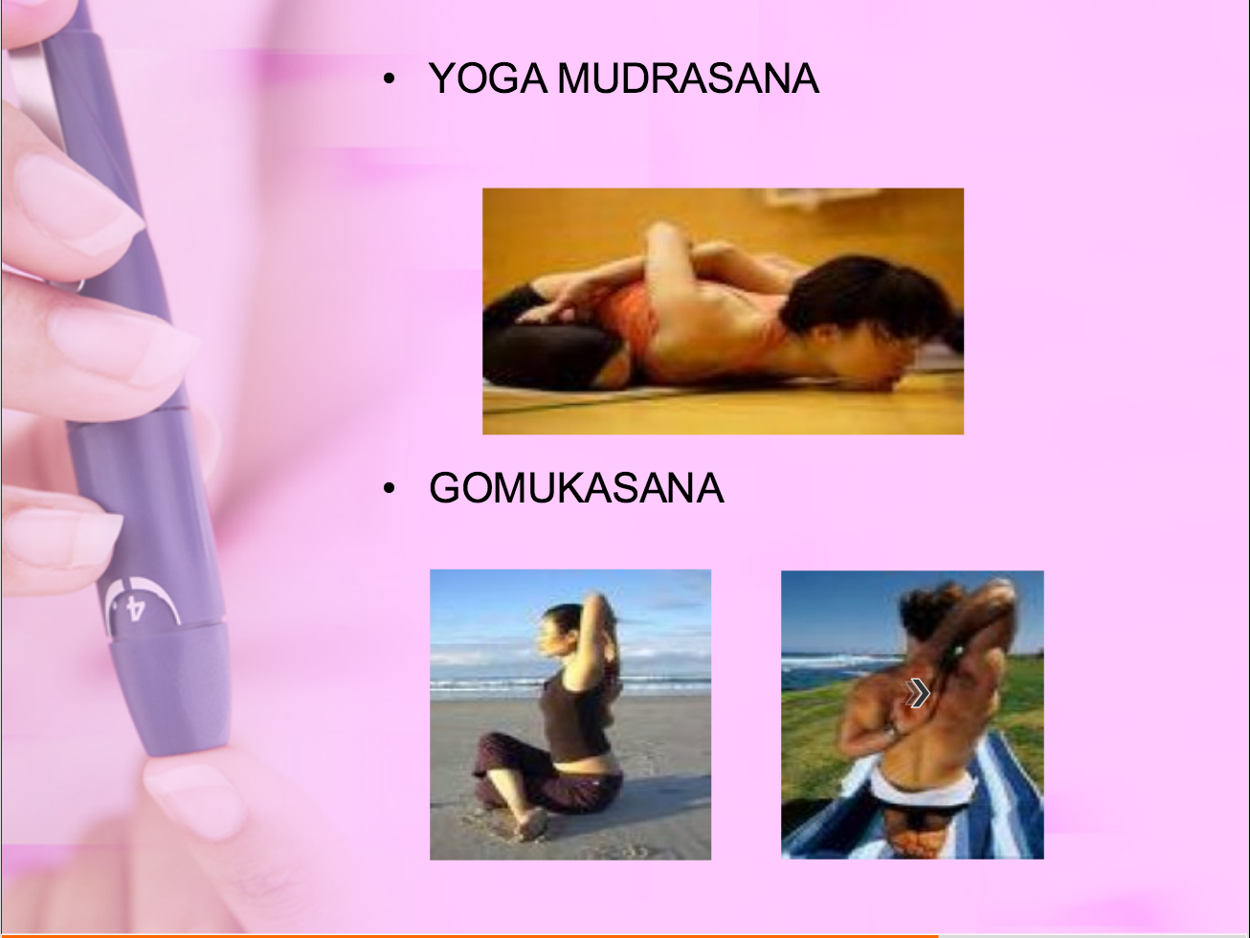

Slide 33


Slide 34
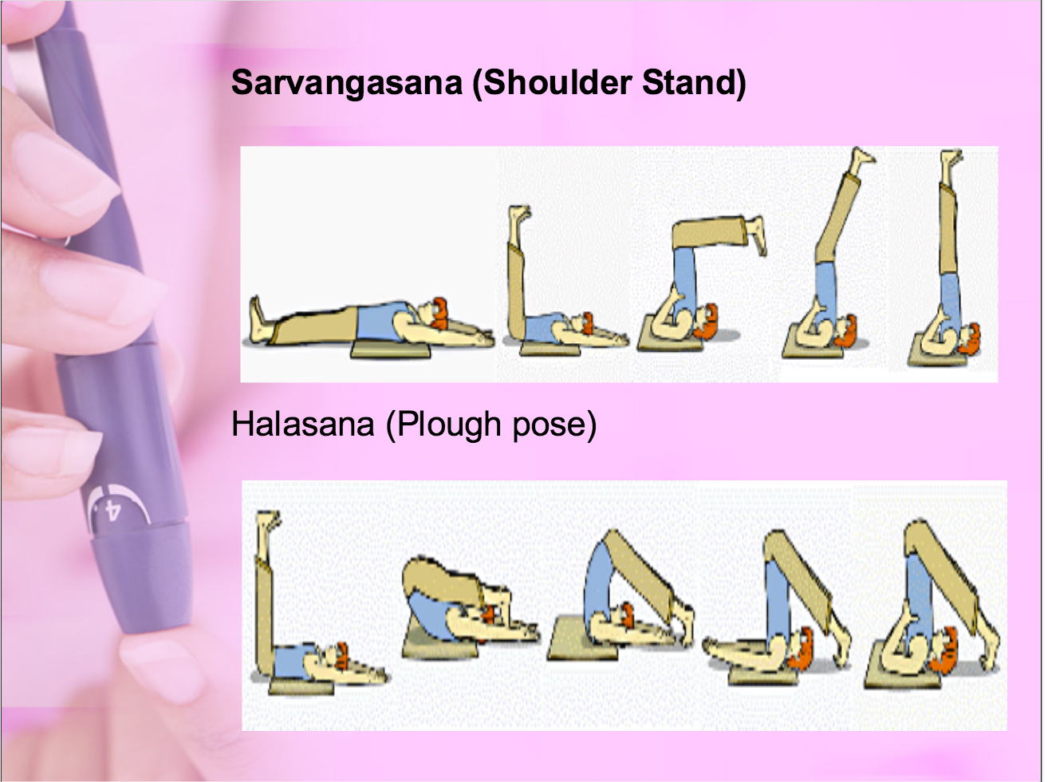

Slide 35
ORAL HYPOGLYCEMIC AGENT
oral | Examples | Mechanism of action | A1C Reduction (%)ª | Agent-Specific Advantages | Agent-Specific Disadvantages | Contraindications/Relative Contraindications
Biguainides | Metformin | Decrease hepatic glucose production ,weight loss,glucose utilization and insulin resistance | 1-2 | Weight loss | Lactic acidosis,diarrhea,nausea | Serum creatinine >1.5 mg/dL (men) >1.4 mg/dL (women), CHF, radiographic contrast studies, seriously ill patients, acidosis
Alfa Glucosidase inhibitors | Acarbose | Glucose absorption | 0.5-0.8 | Reduce post parandial glycemia | GI flatulence, liver function | Renal/liver disease
Dipeptidyl peptidase IV inhibitors | Sitagliptin | Prolong endogenous GLP-1 action | .5 -1 | Do not cause hypoglycemia |  | Reduce dose with renal disease
sulfonylureas | Glimepiride Glipizide | Increase insulin secretion | 1-2 | Lower fasting blood glucose | Hypoglycemia,weight gain | Ranal /liver disease
Non sulfonylurea | Repaglinide,Nateglinide | Increase insulin secretion | 1-2 | Lower post parandial glucose | hypoglycemia | Renal /liver disease
Thiazolidinediones | Rosiglitazone, Pioglitazone | Insulin resistance, glucose utilization | 1-1.4 | Lower insulin requirements | Peripheral edema, CHF, weight gain, fractures, macular edema; rosiglitazone may increase risk of MI | Congestive heart failure, liver disease

