Slide 1
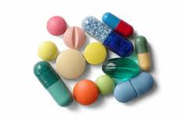
TABLETS
Dr. Arun Sharma
RAS SHASTRA & BHAISHAJYA KALPANA

Slide 2
Introduction
Tablet is defined as a compressed solid dosage form containing medicaments .
It is the most popular dosage form and 70% of the total medicines are dispensed in the form of tablet.

Slide 3
Contd.
According to Indian Pharmacopoeia Pharmaceutical tablets are solid, flat or biconvex dishes, unit dosage form, prepared by compressing a drugs or a mixture of drugs, with or without diluents.
They vary in shape and differ greatly in size and weight, depending on amount of medicinal substances and the intended mode of administration.

Slide 4
General Properties of Tablets
A tablet should have elegant product identity.
It should be free of defects like chips, cracks, discoloration and contamination.
It should have sufficient strength to withstand mechanical shock during its production, shipping and dispensing.
The tablet must be able to release the medicinal agents in a predictable and reproducible manner.
It must have a chemical stability over time so as not to follow alteration of the medicinal agents.

Slide 5
The advantages of tablet dosage forms are
Tablets are unit dosage forms.
Tablets offer the greatest capabilities of all oral dosage form for the greatest dose precision & the least content variability.
Cost is lowest of all oral dosage form.
Lighter & compact.
Easiest & cheapest to package & strip.
Easy to swallowing with least tendency for hang up.

Slide 6
Contd.
Sustained release product is possible by enteric coating.
Objectionable odour & bitter taste can be masked by coating technique.
Suitable for large scale production.
Greatest chemical & microbial stability over all oral dosage form.

Slide 7
Disadvantages of tablet dosage form
Difficult to swallow in case of children & unconscious patients.
Some drugs resist compression into dense compacts, owing to amorphous nature, low density character.
Drugs with poor wetting, slow dissolution properties, optimum absorption high in GIT may be difficult to formulate or manufacture as a tablet.
Bitter testing drugs, drugs with an objectionable odor or drugs that are sensitive to oxygen may require encapsulation or coating.

Slide 8
Classification of tablets:
Depending upon route of administration or function tablets can be classified as following:-
(A.)Tablets ingested orally
Compressed tablet, e.g. Paracetamol tablet.
Multiple compressed tablet
Repeat action tablet
Delayed release tablet e.g. Enteric coated Bisacodyl tablet.
Sugar coated tablet, e.g. Multivitamin tablet
Film coated tablet, e.g. Metronidazole tablet
Chewable tablet, e.g. Antacid tablet

Slide 9
Contd.
(B.)Tablets used in oral cavity:
Buccal tablet, e.g. Vitamin-C tablet
Sublingual tablet, e.g. Vicks Menthol tablet
Troches or Lozenges
Dental cone

Slide 10
Contd.
(C.)Tablets administered by other route:
Implantation tablet
Vaginal tablet, e.g. Clotrimazole tablet
(D.)Tablets used to prepare solution:
Effervescent tablet, e.g. Disprin tablet (Aspirin)
Dispensing tablet, e.g. Enzyme tablet (Digiplex)
Hypodermic tablet
Tablet triturates e.g. Enzyme tablet (Digiplex)

Slide 11
Tablet Ingredients
In addition to active ingredients, tablet contains a number of inert materials known as additives or excipients. Different excipients are:-
Diluent
Binder & adhesive
Disintegrants
Lubricants & glidants
Colouring agents
Flavoring & sweetening agents

Slide 12
Excipients (functions)
Impart weight, accuracy& volume (it allow accuracy of dose)
Improve solubility
Increase stability
Enhance bioavailability
Modifying drug release
Assist product identification
Increase patient acceptability
Facilitate dosage form design

Slide 13
Diluent
Diluents are fillers used to make required bulk of the tablet when the drug dosage itself is inadequate to produce the bulk. Secondary reason is to provide better tablet properties such as improve cohesion, to permit use of direct compression manufacturing or to promote flow.

Slide 14
Diluent :
A diluent should have following properties:
They must be nontoxic.
They must be commercially available in acceptable grade.
There cost must be low.
They must be physically & chemically stable by themselves & in combination with the drugs.
They must be free from all microbial contamination.
They do not alter the bioavailability of drug.
They must be compatible.

Slide 15
Commonly used tablet diluents:
Lactose-anhydrous & spray dried lactose
Directly compressed starch –Sta Rx 1500
Hydrolyzed starch-Emdex & celutab
Microcrystalline cellulose–Avicel(PH 101 & PH 102)
Dibasic calcium phosphate dehydrate
Calcium sulphate dihydrate
Mannitol
Sorbitol
Sucrose- Sugartab, DiPac, Nutab
Dextrose

Slide 16
Binders & adhesive
These materials are added either dry or in wet- form to form granules or to form cohesive compacts for directly compressed tablet.

Slide 17
Example of binders & adhesives:
Acacia, tragacanth- Solution for 10-25%
Cellulose derivatives:- Methyl cellulose, Hydroxy propyl methyl cellulose, Hydroxy propyl cellulose 1-3%
Gelatin:-10-20% solution
Glucose:-50% solution
Poly vinyl pyrrolidone (PVP)-2% conc.
Starch paste- 5-25% solution
Sodium alginate 1-3%

Slide 18
Disintegrants
Added to a tablet formulation to facilitate its breaking or disintegration when it contact in water in the GIT.

Slide 19
Disintegrants
Starch:-2-10% of tablet weight
Starch pregelatinized:- 5-10%
Magnesium aluminium silicate:-2-10%
Cellulose, microcrystalline :-upto 10%
Carboxy methyl cellulose:-1-5%
Alginic acid 2-10%
Gums (guar gum, karaya gum):-5-20%

Slide 20
Superdisintegrants
Swells up to ten fold within 30 seconds when contact with water.
Example:
Crosscarmellose- cross-linked cellulose. Crosspovidone- cross-linked povidone (polymer). Sodium starch glycolate- cross-linked starch.
These cross-linked products swells with in 30 seconds when in contact with water.

Slide 21
Lubricants
Lubricants are intended to prevent adhesion of the tablet materials to the surface of dies and punches, reduce inter particle friction and may improve the rate of flow of the tablet granulation.

Slide 22
Example of lubricants
Stearic acid:-1-3%
Magnesium stearate:-0.25-5%
Talc 1-10%
PEG (Polyethylene glycols):-2-5%
Sodium lauryl sulphate:-1-2%

Slide 23
Glidants
Glidants are intended to promote flow of granules or powder material by reducing the friction between the particles.

Slide 24
Example of glidants
Calcium silicate:-0.5-2% conc.
Talc-1-10% conc.
Silica derivative - Colloidal silicas such as Cab-O-Sil, Aerosil in 0.25-3% conc.
Starch:-2-10%

Slide 25
Coloring agents
The use of colors and dyes in a tablet has three purposes:
(1) Masking of off-color drugs
(2) Product Identification
(3) Production of more elegant product
All coloring agents must be approved and certified by FDA. Two forms of colors are used in tablet preparation – FD &C and D & C dyes. These dyes are applied as solution in the granulating agent or Lake form of these dyes. Lakes are dyes absorbed on hydrous oxide and employed as dry powder coloring.

Slide 26
Example of coloring agents
FD & C yellow 6-sunset yellow
FD & C yellow 5-Tartrazine
FD & C green 3- Fast green
FD & C blue 1-Brilliant blue
FD & C blue 2-Indigo carmine
D & C red 3- Erythrosine
D & C red 22- Eosin Y

Slide 27
Sweetening agents
Primarily used in chewable tablets
Sucrose
Mannitol (72% sweeter than sucrose)
Saccharine (artificial) 500 x Disadvantages:- sweeter than sucrose Bitter after taste &
carcinogenic
Aspartame Disadvantages:-
(new artificial sweetener) Lack of stability in
presence of moisture

Slide 28
Tableting procedure
The manufacture of granulations for tablet compression may follow one or a combination of three established methods:-
Direct compression
Dry compression or compression granulation
Wet granulation

Slide 29
Direct compression
Processing steps
Raw material
Weighing
Screening
Mixing
Compression

Slide 30
Contd.
Direct compression consists of compressing tablets directly from powdered materials without modifying physical nature of materials. This method is applicable for crystalline chemicals having good compressible characteristics and flow properties such as : Potassium salt (chlorate, chloride, bromide), Sodium chloride, Ammonium chloride, Methanamine etc.

Slide 31
Advantages of Direct compression
Low labour input
A dry process
Fewest processing steps.
Disadvantages of Direct compression
Stratification may occur due to differences in particle size & bulk density which results poor content uniformity.

Slide 32
Disadvantages of direct compression
A large dose drug may cause problem in direct compression . It requires diluents. The tablet become large in size which is difficult to swallow and also costly.
During handling of dry materials static charge may form which may prevent uniform distribution of drugs.
Direct compression diluent may interact with the drug . For e.g. amine drug with lactose produce yellow discoloration of tablet.

Slide 33
Dry granulation
Raw material
Weighing
Screen
Mixing
Slugging
Milling
Screening
Mixing Compression

Slide 34
Contd.
When tablet ingredient are sensitive to moisture or unable to withstand elevated temperature during drying & when the tablet ingredient have insufficient cohesive properties, slugging may be used to form granules.
This method is referred to as dry granulation.
This technique is used in preparation of aspirin, aspirin combination, acetophenetidin, thiamine hydrochloride, ascorbic acid, magnesium hydroxide.

Slide 35
Contd.
Compression granulation involves the compaction of the component of a tablet formulation by means of flat punch. These compact masses are called slug & the process is called slugging.
Slugs are then milled & screened to produce a granular form.
On large scale operation compression granulation can be performed on specially designed machine called Roller compactor or Chilsonator Roller compactor.

Slide 36
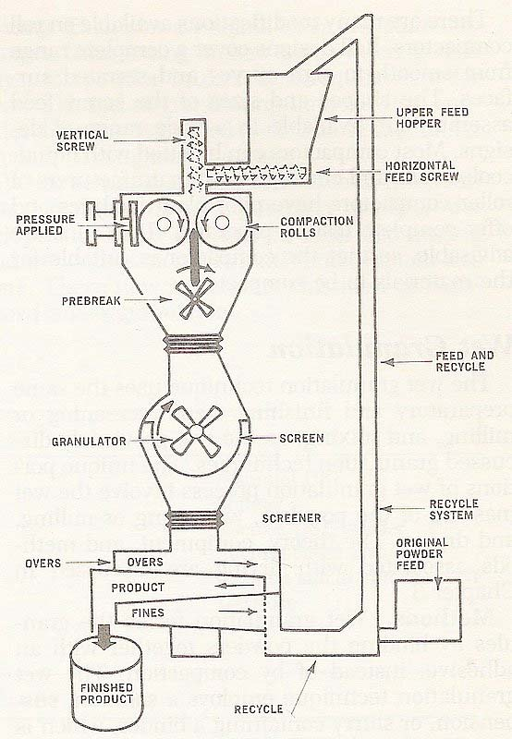
Chilsonator Roller compactor

Slide 37
Limitations of dry granulation
Dry granulation often produces a higher percentage of fine or non compacted products, which could compromise the quality or create yield problems for the tablet.
It requires drugs or excipients with cohesive properties.

Slide 38
Wet granulation
Raw material
Weighing
Screening
Wet massing
Sieving/Milling
Drying
Screening
Mixing Compression

Slide 39
Wet granulation
The most popular method (over70%) Granulation is done
To prevent segregation of the constituents of the powder blend.
To improve fluidity of the powder mixture.
To improve the compaction characteristics of the powder mixture due to better distribution of the binder within the granules.
To improve homogenecity and thus ensure content uniformity

Slide 40
Contd.
Wet granulation is a process of using a solution binder to the powder mixture. The amount of liquid can be properly managed; overwetting = the granules to be too hard, underwetting =too soft and friable.
Aqueous solutions are safer than other solvents.

Slide 41
Procedure of wet granulation
Step 1: Weighing and Blending
Step 2:Wet granulate prepared by adding the
binder solution.
Step 3: Screening the damp mass into pellets or
granules (6-8 mesh)
Step 4: Drying the granulation in
thermostatistically controlled ovens.
Step 5: Dry screening:

Slide 42
Contd.
Step 6:Mixing with other ingredients: A dry lubricant, antiadherent and glidant is added to the granules either by dusting over the spread-out granules or by blending with the granules. Dry binder, colorant or disintegrant may be also added in this step.
Step 7: Tableting: Last step in which the tablet is fed into the die cavity and then compressed.

Slide 43
Limitations of wet granulation
1- Multiple separate steps are involved.
2- Not suitable for heat and moisture sensitive drugs.
Equipments
Traditionally dry mixing in wet granulation process has been carried out using:-
Sigma blade mixer
Heavy duty planetary mixer.

Slide 44
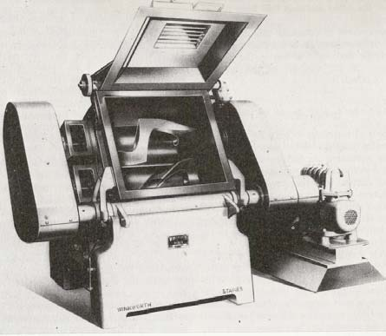
Sigma Z blade mixer

Slide 45
Processing problems
Capping is the partial or complete separation of the top or bottom crowns of a tablet from the main body of the tablet.
Lamination is separation of a tablet into two or more distinct layers. Both of these problems usually result from air entrapment during processing.
Picking is removal of a tablet’s surface material by a punch.

Slide 46
Contd.
Sticking is adhesion of tablet material to a die wall. These two problems (picking & sticking) result from excessive moisture or substances with low melting temperatures in the formulation
Mottling is an unequal color distribution on a tablet, with light or dark areas standing on otherwise uniform surface. This results from use of a drug with a color different from that of the tablet excipients or from a drug with colored degradation products.

Slide 47
Evaluation of tablets
Following tests should be done to evaluate the tablets:-
Weight variation & content uniformity
Hardness test
Friability test
Disintegration time
Tablet dissolution

Slide 48
Weight variation test
Take 20 tablets selected at random & weighed individually. Calculate average tablet weight & compare the individual tablet weight to the average. The tablet pass the U.S.P. if not more than two tablets are outside the percentage limit and if no tablet differ by more than two times the percentage limit.

Slide 49
Content uniformity
Randomly select 30 tablets. 10 of these assayed individually. The tablet pass the test if 9 of the 10 tablets must contain not less than 85% & not more than 115% of the labelled drug content & the 10th tablet may not contain less than 75% & more than 125% of the labelled content. If these conditions are not met, remaining 20 tablet assayed individually & none may fall outside of the 85 to 115% range.

Slide 50
Hardness test
Tablet requires a certain amount of strength or hardness & resistance to friability to withstand mechanical shocks of hand manufacture, packaging & shipping.
Tablet hardness can be defined as the force required breaking a tablet in a diametric compression. In this test the tablet is placed between two anvils, force is applied to the anvils, & the crushing strength that just causes the tablet to break is recorded.

Slide 51
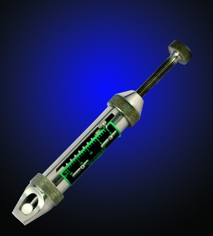
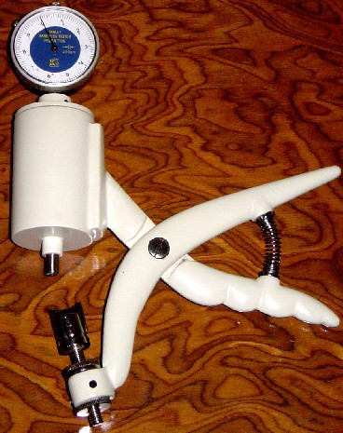
Hardness testers
Monsato tester
Pfizer tester

Slide 52
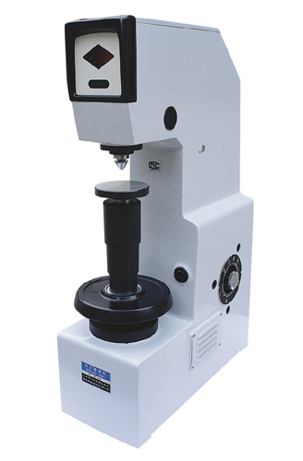
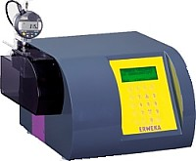
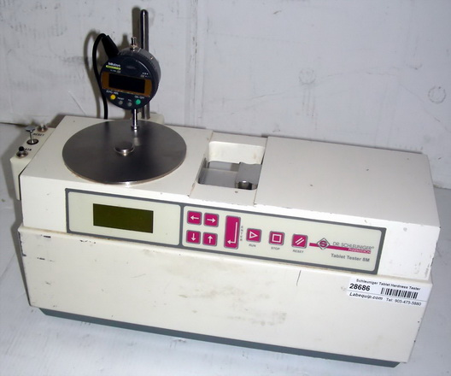
Hardness testers
Erweka Strong
Tester cobb
Schleuniger
Tester

Slide 53
Importance of hardness testing
To determine the need for pressure adjustments on the tableting machine.
Hardness can affect the disintegration.
If the tablet is too hard, it may not disintegrate in the required period of time. And if the tablet is too soft, it will not withstand during subsequent processing such as coating or packaging.

Slide 54
Factors affecting the hardness
Compression of the tablet & compressive force.
Amount of binder
Method of granulation in preparing tablet.
Limits:- 5 kg minimum & 8 kg maximum
Make hardness test & then take the average hardness.

Slide 55
Friability test
Friability of a tablet can determine in laboratory by Roche friabilator. This consist of a plastic chamber that revolves at 25 rpm, dropping the tablets through a distance of 6 inches in the friabilator, which is then operate for 100 revolutions. The tablets are reweighed. Compress tablet that lose less than 0.5 to 1.0% of the tablet weigh are consider acceptable.

Slide 56
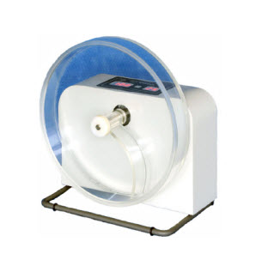
Roche friability test apparatus

Slide 57
Disintegration test
It is the time required for the tablet to break into particles. The device to test disintegration uses 6 glass tubes that are 3” long; open at the top & 10 mesh screen at the bottom end. To test for disintegation time, one tablet is placed in each tube & the basket rack is positioned in a 1-L beaker of water, simulated gastric fluid or simulated intestinal fluid at 37±2°C such that the tablet remain 2.5 cm below the surface of liquid on their upward movement & not closer than 2.5 cm from the bottom of the beaker in their downward movement .

Slide 58
Contd.
Move the basket containing the tablets up & down through a distance of 5-6 cm at a frequency of 28-32 cycles per minute. Floating of the tablets can be prevented by placing perforated plastic discs on each tablet.
According to test, the tablet must disintegrate and all particles must pass through the 10 mesh screen in the time specified. If any residue remains, it must have a soft mass.

Slide 59
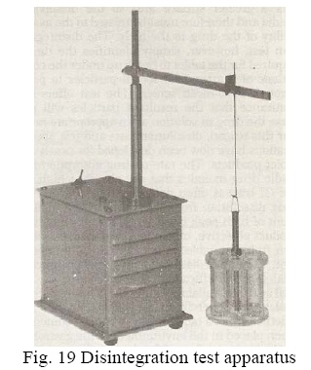
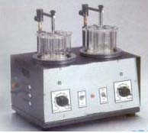
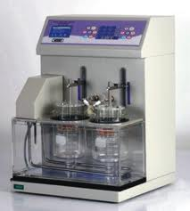
Disintegration test apparatus

Slide 60
Dissolution test
Dissolution is performed to test the percentage release from the dosage form i.e. tablets.
Tablet breaks down into small particles which offers a greater surface area to the dissolving media.
Disintegration test does not give assurance that particles will release drug in solution at an appropriate rate, that’s why dissolution test & it’s specifications developed for all tablet product.

Slide 61
Dissolution test apparatus 1
(Basket method)
A single tablet is placed in a small wire mesh basket attached to the bottom of the shaft connected to a variable speed motor. The basket is immersed in a dissolution medium (as specified in monograph) contained in a 100 ml flask. The flask is cylindrical with a hemispherical bottom. The flask is maintained at 37±0.5°C by a constant temperature bath. The motor is adjusted to turn at the specified speed and sample of the fluid are withdrawn at intervals to determine the amount of drug in solutions

Slide 62
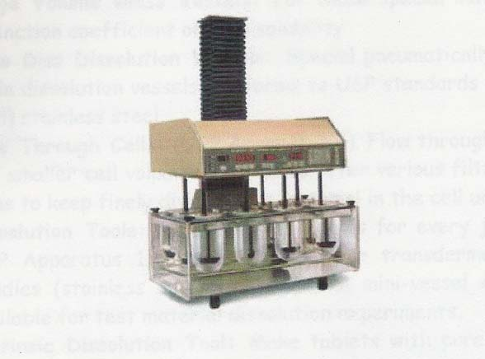
Dissolution test apparatus 1

Slide 63
Dissolution test apparatus 2 (paddle method)
It is same as apparatus-1, except the basket is replaced by a paddle. The dosage form is allowed to sink to the bottom of the flask before stirring. For dissolution test U.S.P. specifies dissolution test medium & volume, type of apparatus to be used, rpm of the shaft, time limit of the test & assay procedure. The test tolerance is expressed as a % of the labelled amount of drug dissolved in the time limit.

Slide 64
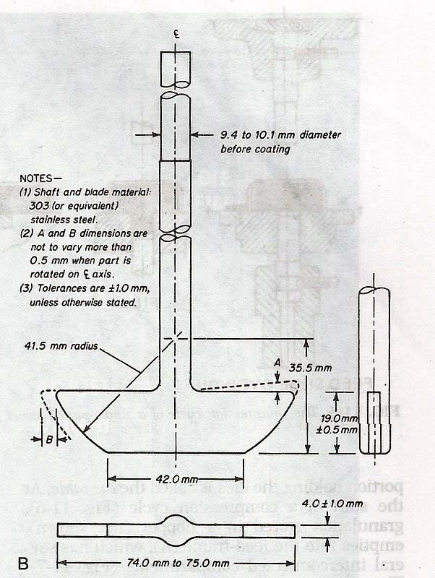
Dissolution test apparatus 2

Slide 65
Interpretation of dissolution test
Interpretation of dissolution testing can be done in three stages:-
Stage1:- 6 tablets are tested & are acceptable if all the tablets are not less than the monograph tolerance limit (Q) + 5% .
Stage2:- If tablets fail in stage1, another 6 tablets are tested individually. The tablets are acceptable if the average of 12 tablets is ≥ Q & no unit is less than Q -15%.

Slide 66
Contd.
Stage3:- If the tablets still fail, an additional 12 tablets are tested. The tablets are acceptable if the average of all 24 tablets is ≥ Q & if not more than 2 tablets are less than Q-15.

Slide 67
Protocols for testing
Description
Colour
Odour
Weight variation
Disintegration time- not more than 15 mins
not more than 60 mins for guggulu tablets.
Identification TLC/HPTLC/GLC
Assay

Slide 68
Contd.
Test for heavy/ toxic metals
Lead
Cadmium
Mercury
Arsenic
Microbial contamination
Total bacterial count
Total fungal count

Slide 69
Contd.
Test for specific pathogen
E. coli
Salmonella spp.
S.aureus
Pseudomonas aeruginosa
Pesticide residue
Organochlorine pesticides
Organophosphorus pesticides
Pyrethroids
Test for Aflatoxins (B1, B2, G1, G2)

Slide 70


THANK YOU
YouHere

