Slide 1
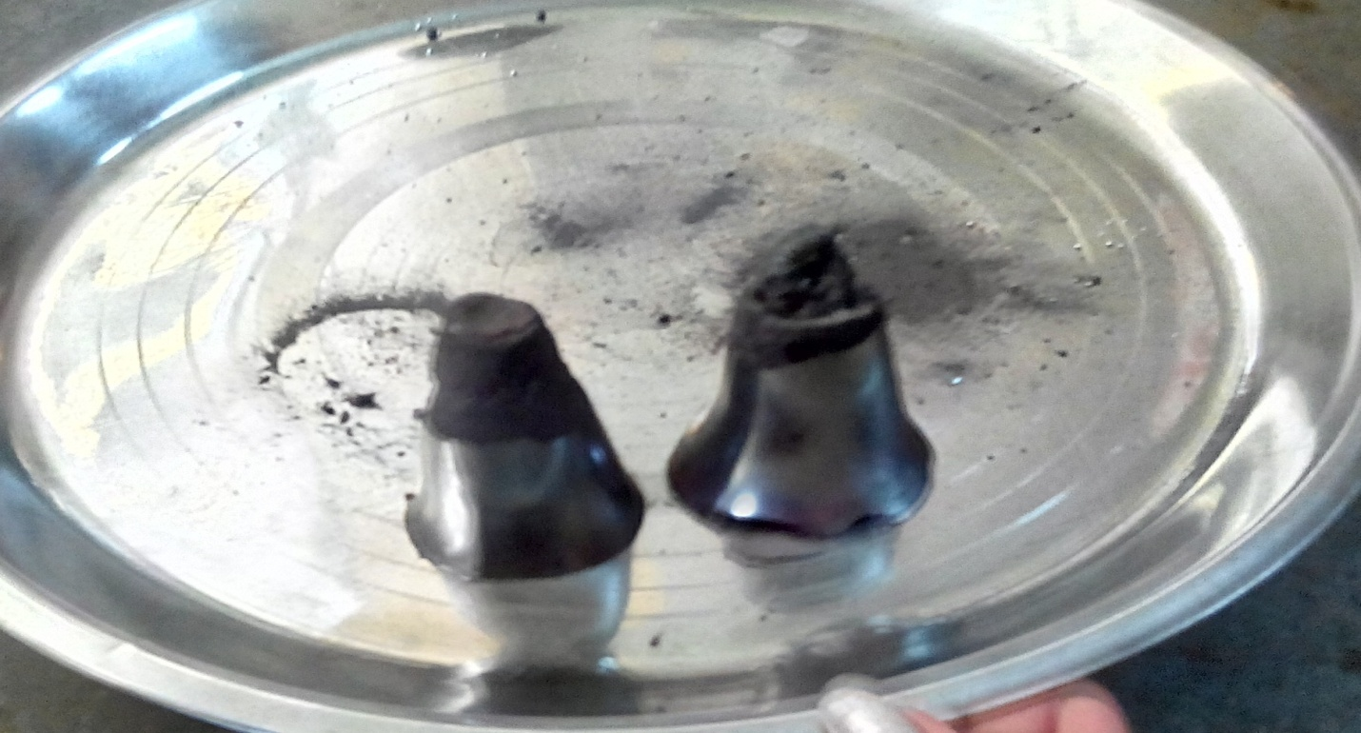
KUPIPAKWA RASAYANA
Dr. Arun Sharma
Assistant Professor
RASA-SHASTRA AND BHAISHAJYA KALPANA

Slide 2
NIRUKTI
कुपी इति काच कुपी पक्वम् इति अग्निना पक्वम् रसस्य पारदस्य अयनम् ।
अर्थात् कुप्याम् अग्निना पक्वम् यत् रसायनम् तत् कुपीपक्व रसायनम्॥
The mercurial formulation which is prepared in specific type of glass bottle by specific type of heat treatment is known as Kupipakwa Rasayana.
Kupipakwa Rasayana is Saagni Murcchana of Parada.

Slide 3
MURCCHANA
अथाव्यभिचरितव्याधिघातकत्वॱमूर्च्छना।
(आ०प्र०१।१३७)
The process by which Parada definitely acquires
disease curing capacity and converts into
therapeutically effective compound form is known as Parada Murcchana.

Slide 4
CHRONOLOGICAL GLIMPSES
Gandhaka Jarana is first of all seen in RasahridayaTantra of 10th cent. A.D.
Later on this process is blossomed completely as ‘Kupipakwa Rasa Vidhi’ in further
treaties.
Rasa Prakasha Sudhakar (13th cent.) is the first text to describe about the Kupipakwa Rasayana in the context of Rasa Bhasma.
Udayabhaskar Rasa is advised to be prepared through Siktayantra (Valuka Yantra) in this text.

Slide 5
Shri Anantdev Suri ( 15th cent. A.D.) has described ‘Rasaparthiva Rasa’ for the same preparation in his book ‘ Rasa Chintamani’.
Rasakaumudi, Rasakalpa Yoga (16th cent.) and Ayurveda Prakash (17th cent.) mention “Sinduranam Rasa” for Rasa Sindura.
Rasatarangini has many preparational variants of Rasa-Sindura, Rasapushpa, Rasakarpoora, Makardhwaja & Swarnavanga etc.

Slide 6
TYPES OF
KUPIPAKWA RASAYANA
Kupipakwa Rasayana is classified into three divisions :
1) According to ingredients
2) According to manufacturing method
3) According to place of finished product

Slide 7
ACCORDING TO INGREDIENTS
Sagandha Prepared with use of Gandhaka. | Nirgandha Prepared without use of Gandhaka

Slide 8
ACCORDING TO THE MANUFACTURING METHOD
ANTRADHUMA
The cork is applied in the beginning and the vapours are not allowed to escape.
BAHIRADHUMA
The cork is applied after burning of sulphur.

Slide 9
ACCORDING TO PLACE
OF FINISHED PRODUCT
Kanthastha The finished product is deposited at the neck. | Talastha The finished product is obtained from the bottom of the Kupi | Ubhayastha Finished product is obtained from both the sites

Slide 10
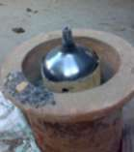
KANTHASTHA
RASA SINDURA

Slide 11
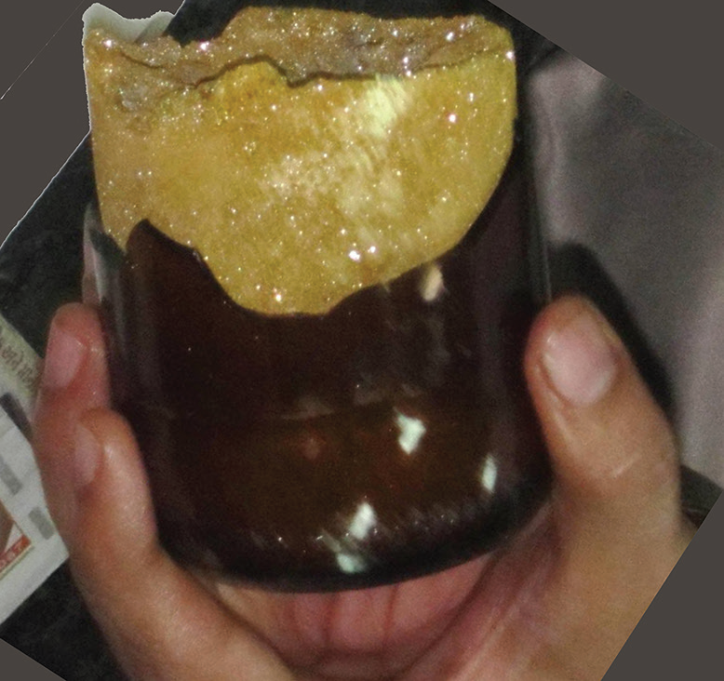
TALASTHA
SWARNA VANGA

Slide 12
PREPARATION
OF KUPIPAKWA RASAYANA
PURVA KARMA
PRADHANA KARMA
PASCHAHTA KARMA

Slide 13
PURVA KARMA
This section includes
Arrangement of equipments
Shodhana of raw material
Preparation of Kajjali
Bhavana
Kupi Bharana (Filling of Kajjali in the Kupi)

Slide 14
EQUIPMENTS
      Kupi
      Baluka Yantra
      Bhrastri ,Electric Muffle Furnace
      Fuel
      Shalaka .

Slide 15
KUPI
Synonyms of Kupi
Kupika, Rupika, Siddha, Golam, Chasakam ,Kothari, Khotika, Girindika.

Slide 16
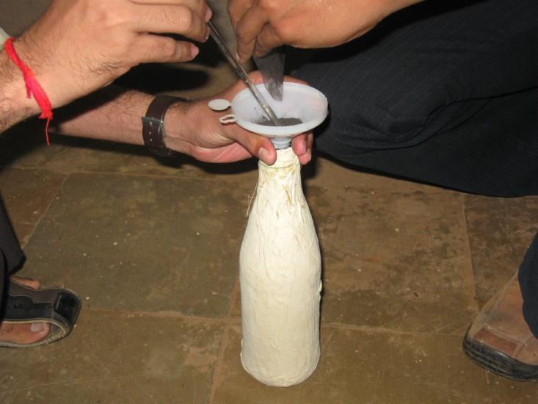
FILLING OF KUPI

Slide 17
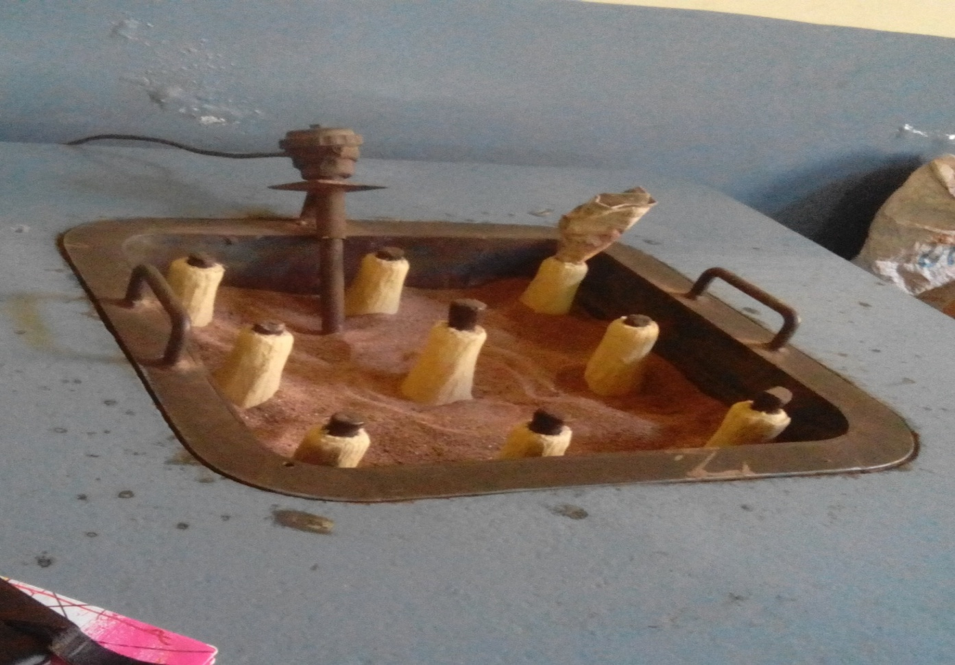
BALUKA YANTRA

Slide 18
Baluka Yantra is mentioned in Rasa Prakash Sudhakar by the name of Sikta Yantra in the preparation of Udayabhaskar Rasa.
According to Rasa Ratna Sammuchaya the vessel ( Naada) should hold the capacity of five Adhaka (aaprox.15kg) of sand.

Slide 19
CONTD..
Modified heating device i.e. Electric Muffle furnace is developed instead of traditional Baluka Yantra due to it easy to maintain heating pattern for specific period along with recording of the temperature pattern.
Bhrastri (Furnace):
Various furnaces viz; wooden furnace, coal furnace (movable / immovable), gas furnace, electric furnace etc. are used in the preparation of Kupipakwa Rasayana.

Slide 20
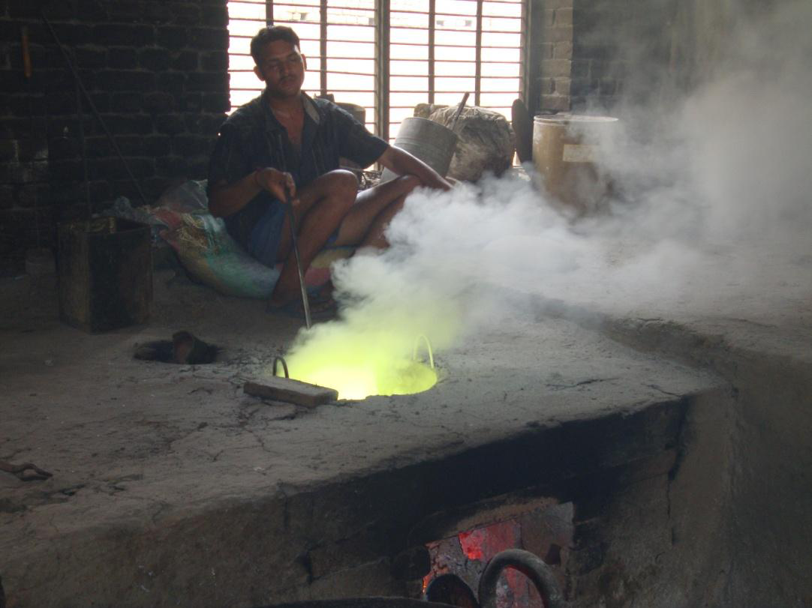
BHRASTRI

Slide 21
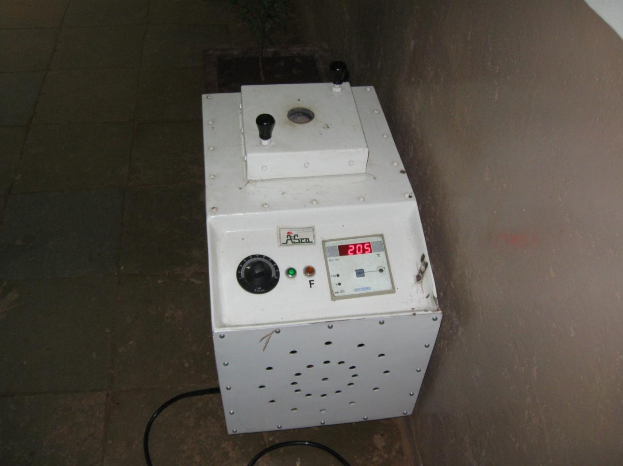
ELECTRIC MUFFLE FURNACE

Slide 22
SHALAKAS
Thin iron rod (0.5cm diameter) should be
used as Sheeta Shalaka to confirm time for
corking.
A thick iron or Stainless Steel rods of 1-1.5 cm diameter should be used for Tapta Shalaka to eradicate deposition of material inside head of neck during procedure and ultimately to prevent from self corking or eventually blasting of the bottle due to deposition.

Slide 23
PRADHANA KARMA
This process includes
Application of graded heat(Kramagini)
Temperature measurement
Shalaka Chalana (application of iron rods)
Observation of fumes and flames
Confirmative tests
Mukhamudrana (corking of Kupi)
Swanga Shitikarana (self cooling)

Slide 24
KRAMAGNI
In Rasendra Chintamani (16th century) there is a clear heating pattern named as Kramagni i.e. increasing manner of heat (Mrudu, Madhaya and Tivragni), with intermediate heating for a specific period has been mentioned.
Kramagni in terms of temperature can be defined as under:
Mrudu Agni upto 250 degree celsius.
Madhya Agni 250 to 450 degree celsius.
Tivra Agni 450 to 600 degree celsius.

Slide 25


Slide 26
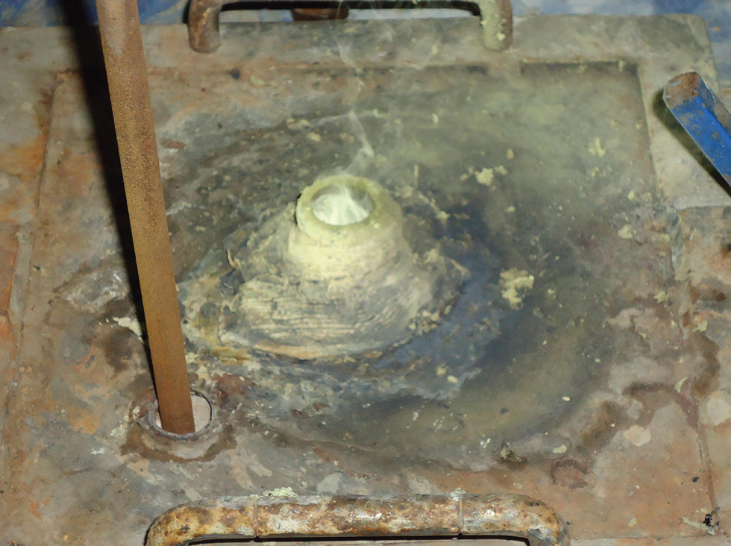
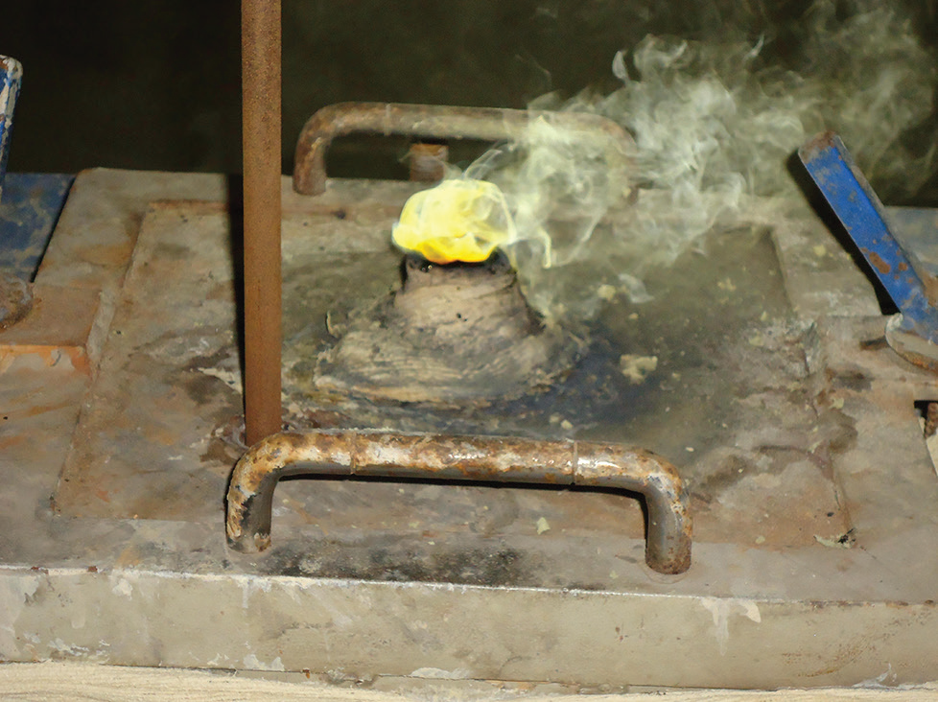
White fumes followed by yellow fumes during Swarna Vanga preparation

Slide 27
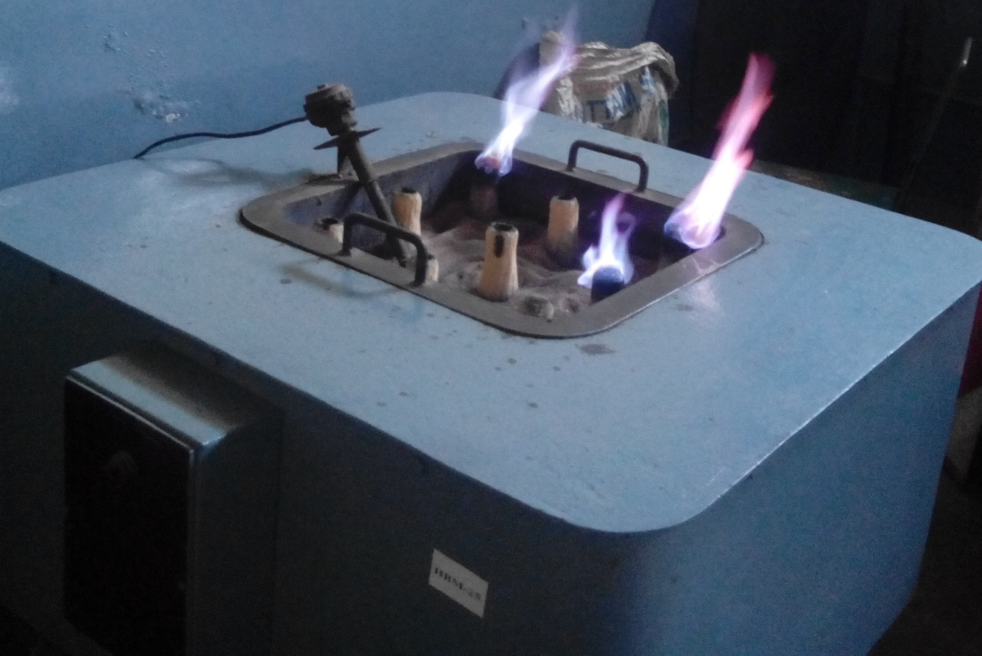

Slide 28
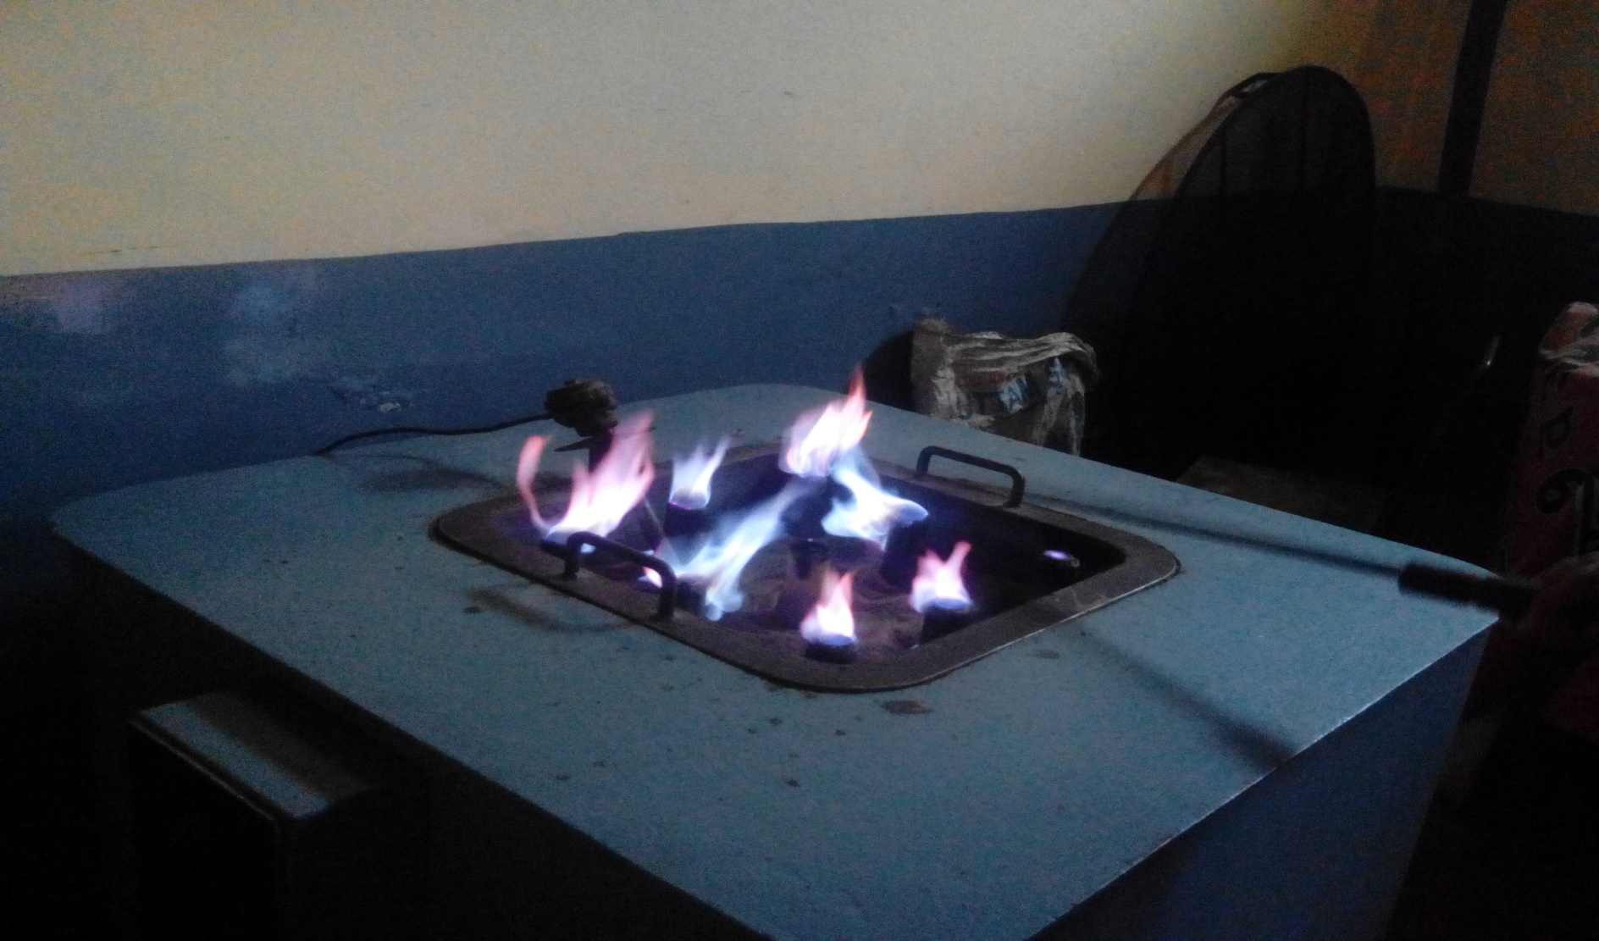

Slide 29
OBSERVATION OF FUMES
AND FLAMES
Fumes
color and odour differs according to ingredients.
Flames
time of appearance of flame, its color and duration is noted .

Slide 30
CONFIRMATIVE TEST
Before corking observe for-
Absence of fumes and flames
Copper coin test
Sheeta shalaka test
Appearance of redness at the bottom of kupi

Slide 31
PASCHATA KARMA
Removal of kupi from Baluka yantra
Breaking of kupi (kupibhagana)
Collection of product
Examination of product

Slide 32
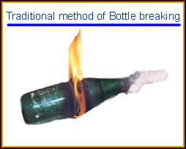

Slide 33
BREAKING OF KUPI
Traditional method :
Scrap and remove the layers of kupi .
A thread soaked in spirit should be tied around the middle of kupi then ignited and kept it horizontally
Rotate the kupi to burn thread and then wrap with wet cloth.

Slide 34
DOSE OF
KUPIPAKWA RASYANA
The general dose is 60- 480 mg (1/2- 4 gunja)
But the dose should be decided according to the particular drug and the patient.

Slide 35
SHELF LIFE OF
KUPIPAKWA RASAYANA
No expiry date
According to D & C Rules, 2009 Kupipakwa
Rasayana have very long shelf life and they became more efficacious with the passage of time.

Slide 36
IMPORTANCE OF
KUPIPAKWA RASAYANA
Potency of these drugs remains for longer period.
Easy for administration.
More potent as compared to other herbal preparations.
When mixed with other drugs, it reduces the dose of other drugs due to its augmenting effect.
Due to quicker action in minimal dose.

Slide 37
PRECAUTIONS
If Navasadara (Ammonium Chloride) or any Kshara is added, keep on cleansing the throat of the bottle with the start of smoke itself. Because the Kshara starts coming upside with smoke.
Inhalation of fumes during the process should also be avoided to restrict the harmful effect in the body.

Slide 38
CONTD..
If temperature is not provided in sufficient quantity, the medicine will remain at the bottom in Apakwa i.e. halfripen state.
Temperature of Baluka yantra should be increased gradually. Fluctuation of temperature in Baluka yantra should be avoided.

Slide 39
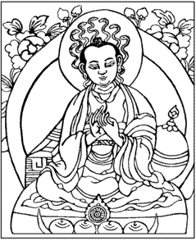
SIDDHE RASE KARISHYAMI NIRDARIDYAMAGADAYAM JAGAT
THANK YOU

