Slide 1
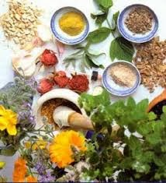
TRADITIONAL AND MODERN REVIEW OF CHURNA –KALPANA
PRESENTED BY - Dr. Arun Sharma
Assistant Professor
DEPARTMENT OF RASA – SHASTRA & BHAISHAJYA KALPANA

Slide 2
Iakpfo/k d’kk; dYiuk
“ iapfo/k d’kk; dYiua bfr- Lojl% dYd% J`r%
“khr %Qk.V% d’kk; bfr
rs’kka ;FkkiwoZ cykf/kD;a ......... “( polwo@4@6 &7)
“vFkkr% Lojl % dYd % DokFk”p fgeQk.VdkSA
Ks;k % d’kk;k% ipSrs y?ko% L;q;ZFkksRrrjre~”AA
(“kk 0e 01@1)

Slide 3
EVOLUTION OF CHURNA KALPANA
Probably one of the first instance of therapeutic use of kalka of herbal substances is mentioned for external use in some traumatic conditions. (Atharva 5/5/4)
There it is clearly mentioned about the method of preparation i.e. Triturating herbal drugs alongwith water to form a paste for external application in the name of karambha. (Atharva 4/7/2).

Slide 4
pjd lafgrk esa -
The description of churna Kalpana is available extensively in all samhitas.
Charak has described 32 sidhtama pradehas which has been taken for external application through churna Kalpana only.
“Ñrkfu pw.kkZU;srkfu n?kknopw.kZukFkZe~ “ AA
(p0lw0/ 3/11)

Slide 5
dYd dYiuk ds vUrxZr pw.kZ dYiuk
“”kq’dfi’V % lw{erkUroiVP;qPPkw.kZ % rL; leLrnzO; -
ifjR;kxknIyqrksi;ksxkPp dYdknHksn% “AA
( volo/do/8/10)
“dYd % fi’Vks nzokIyqr% pw.ksZk·Iyqr % ”AA
( v0g0@d0 @6@9 )

Slide 6
fu:fDr
“ pw.;Zrs fi’;rs ;r~ lEis’k.ksu tkrjt % “AA (“kCndYinzqe )”
The material obtained through the process of peshana (comminution)is known as “churna”.
”fPofr A pw.;Zrs A pw.kZ izs’k.ks ”A
(vejdks”k 2/ 6/ 133 )

Slide 7
ifjHkk’kk
“ vR;Ur”kq’da ;n~nzO;a lqfi’Va oL++=xkfyre~ A
rRL;kPpw.kaZ jt % {kksnLrUek=k d’kZlfEere~ ”
(“kk 0 e 0 6 @1)
Churna is that macerated without any liquid .
The term churna may be applied to the powder of a single drug or a mixture of two or more drugs which are powdered seprately prior to their being mixed to homogenicity .
Ik;kZ; - jt % {kksn
ek=k - 1 d’kZ

Slide 8
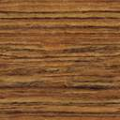
pw.kZ es iz{ksi nzO; -
“ pw.kZs xqM% leks ns;% “kdZjk fnwxq.kk Hkosr~ A
pw.kZs’kq HkftZra fgaxq ns;a uksRDysnd`nHkosr~ AA”
(“kk 0e 0 6@2)
PRAKSHEPA DRAVYA | QUANTITY
GUDA(JAGGERY) | SIMILAR TO CHURNA
SHARKARA(SUGAR) | DOUBLE TO CHURNA
HINGU(FERULA FOETIDA) | WHICH AMOUNT DOESN’T CAUSE UTKLEDA & IT MUST BE USED AFTER FRYING.

Slide 9

Pkw.kZkuqiku -
“fygsPpw.kZ nzOkS %loSZ?k`rk?kSfnxq.kkfsUerS % A
ficsPprqxqZ.kSjso pw.kZekyksfMar nzoS % ” AA
(“kk 0e 0 6@3)
Ghrita ,honey and oil – two times of churna
Any liquid material - four times of churna

Slide 10
pw.kZ es Hkkouk ifjek.k
“nzos.k ;kork lE;Dpw.kZ loZ Iyqra Hkosr AA
(“kk 0e 0 6@6)
pw.kkZfn dk vuqiku &
pw.kZZ ]voysg ] xqfVdk ,oe~ dYd dk vuqiku
okr jksx esaa &3 iy nzokuqiku
fiRrt jksx esa & 2iy nzokuqiku
dQt jksx esa &1iy nzokuqiku

Slide 11
चूर्ण की सवीर्यता अवधि
गुणहीनं भवेद्वर्षादूर्ध्व तद्रूपमौषधम्।
मासद्वयात्तथा चूर्णं हीनवीर्यत्वमाप्नुयात्।।
( “kk 0 iwoZ [k.M@1@51 &53 )
As per the Drug and Cosmetics (Sixth Amendment)Rules,2009 Ministry Of Health And Family Welfare( Department of AYUSH), the shelf life of churna and kwatha churna is 2years.

Slide 12
INTRODUCTION
POWDER-
A powder may be defined as a solid material in a finely divided state.
Any material ranging particle size from 0.1 to 10000 micron may be described as powders.
However , the powders used in pharmacy generally have a size between 0.1 to 10 micron.

Slide 13
TYPES OF POWDERS
FINE POWDERS &GRANULES- For internal administration.
DUSTING POWDERS-For application on the intact or broken skin.
INSUFFLATIONS- Micronised powders meant for being blown in the nasal tract , ears , tooth sockets , vagina etc.
DENTRIFRICES - Tooth powders.
PARENTERAL POWDERS-Powders for dissolution in vehicles before injection.

Slide 14
BLENDING OF POWDERS
SPATULATION-This method used in blending small amount of powders by movement of a spatula.
TRITURATION-It may be employed both to comminute and to mix powders.
SIFTING-Powders may also be mixed by passing them through sifters.
TUMBLING-Mixing the powders in a rotating
chamber.

Slide 15
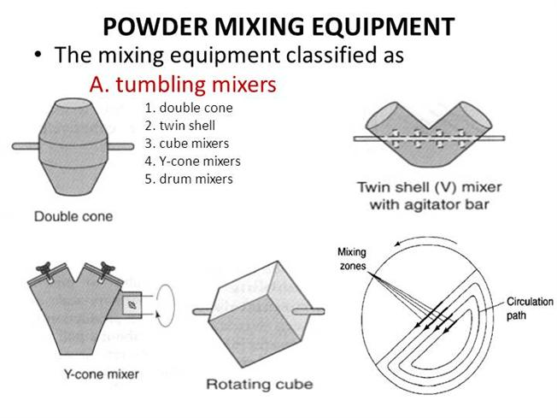
TUMBLING MIXERS

Slide 16
ANALYTICAL SPECIFICATIONS OF CHURNA
According to PLIM Ghaziabad, analytical testing for all types of churna are:
Description-
Macroscopic
Microscopic.
2 . Loss on drying at 105 degree celsius.
3 . Total-ash
4 . Acid-insoluble ash
5 . Water-soluble extractive
6 . Alcohol-soluble extractive

Slide 17
ANALYTICAL TESTS CONT.
7 . Particle size
(80-100 mesh for churna,40-60 mesh for kwatha churna and 125-150 mesh for avachurnam)
8 . Identification,TLC/HPTLC
9 . Test for metals
(only for avachurnam yoga- Mg,Si,Cl Al,Fe)
10 . Test for heavy metals
Lead,Cadmium ,Mercury and Arsenic.
11 . Microbial contamination-
Total bacterial count
Total fungal count.

Slide 18
ANALYTICAL TESTING CONT.
12- Test for specific pathogen-
E.coli, Salmonella spec.,S.aureus, Pseudomonas aeruginosa.
13- Pesticides residue-
Organochlorine, organophosphorus Pesticides,Pyrethroids
14- Test for Aflatoxins(B1,B2,G1,G2)

Slide 19
pkyuh
pkyuh &^^pkyuh f=fo/kk izksDrk --------------^^!!
¼j 0 pw 0 3/16-19)
os.kq fuÆer oa”kfuÆer dÆ.kdkj]”kkYeyh
vFkok ikfjtkr fuÆer

Slide 20
GRADES OF POWDERS AS PER BRITISH PHARMACOPOEIA
GRADE OF POWDER | SIEVE THROUGH WHICH ALL PARTICLES MUST PASS | SIEVE THROUGH WHICH NOT MORE THAN 40 % OF PARTICLES PASS
COARSE | 10 | 44
MODERATELY COARSE | 22 | 60
MODERATELY FINE | 44 | 85
FINE | 85 | NOT SPECIFIED
VERY FINE | 120 | NOT SPECIFIED

Slide 21
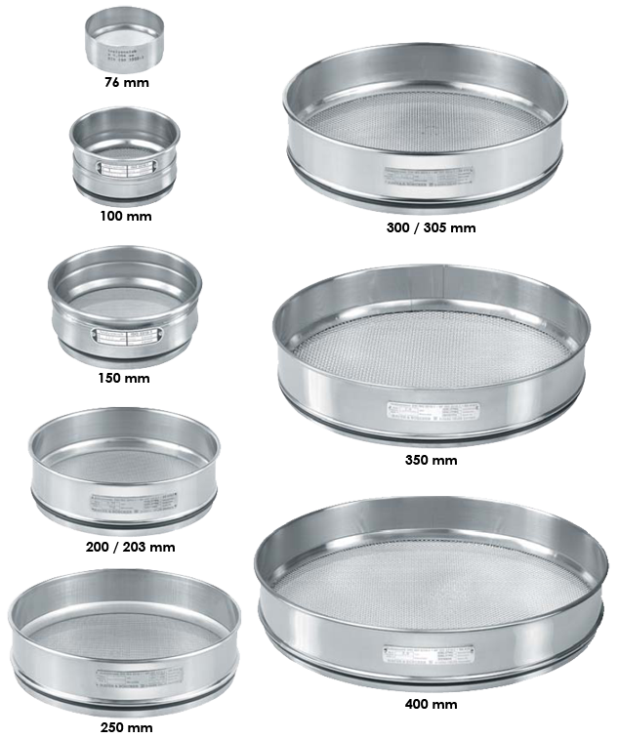
SIEVES

Slide 22
ADVANTAGES OF POWDERS
When any insoluble drug can’t be dispense as solution or suspension then it is better to dispense it as a powder.
When a bulky drug in large dose is to be administered ,a powder is a good way of administering it .
Powders dispense fast in the GIT and the drugs are absorbed quickly.
When the patients has to mix the ingredients before administration dispensing in separate divided powders is a convenient way.

Slide 23
DISADVANTAGES OF POWDERS
Preparing and packaging of powders is very time consuming.
They are bulky to carry.
Powder may spill when they are being opened.
When a medicament with an unpleasent taste has to be administered, it is difficult to administer in the form of powder.
Powders are not an ideal way of dispensing substances that are volatile , deliquescent & hygroscopic.

Slide 24
LACUNAE OF POWDER DOSAGE FORM
EUTECTIC MATERIALS -Sometimes when two substances having low melting point are brought in physical contact, they may form a liquid or a pasty mass e.g. Camphor , menthol , phenol , salicylic acid .
HYGROSCOPICITY AND DELIQUESCENCE -Transfer of atmospheric moisture to powdered material promoting chemical degradation and thus interfering with bio-availability .
EFFLORSCENCE - Substances like sodium borate, zinc sulphate containing water of crystallization tend to loose it wholly or partly depending upon the moisture content of the atmosphere

Slide 25
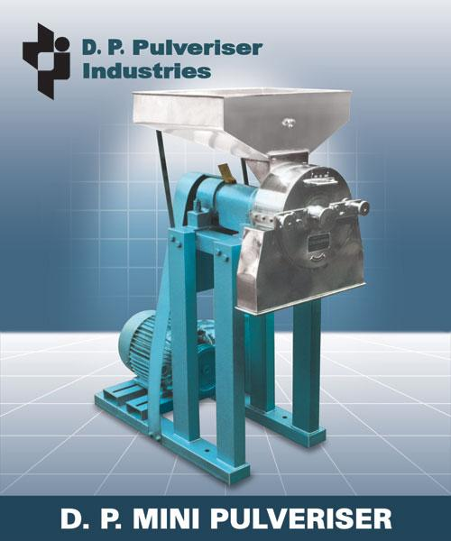
EQUIPMENTS USED FOR POWDER FORMATION

Slide 26
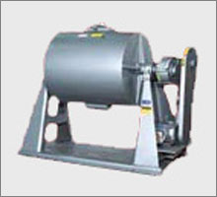
BALL MILL

Slide 27
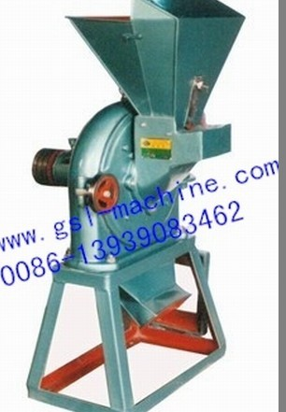
GRAIN MILL

Slide 28
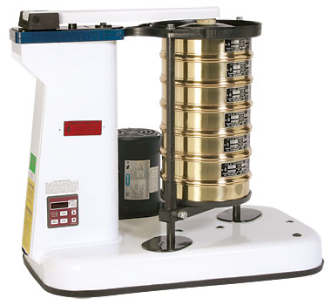
SIEVE SHAKER

Slide 29
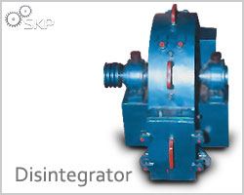
DISINTEGRATOR

Slide 30
THANK YOU

