Slide 1
Trachea

Slide 2
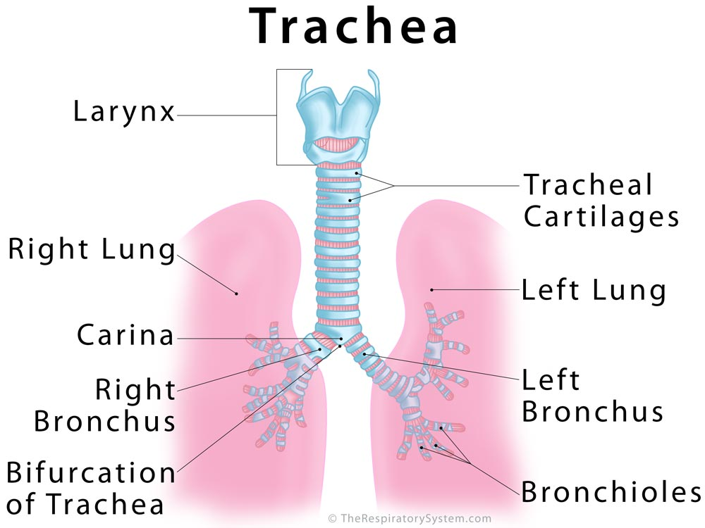

Slide 3
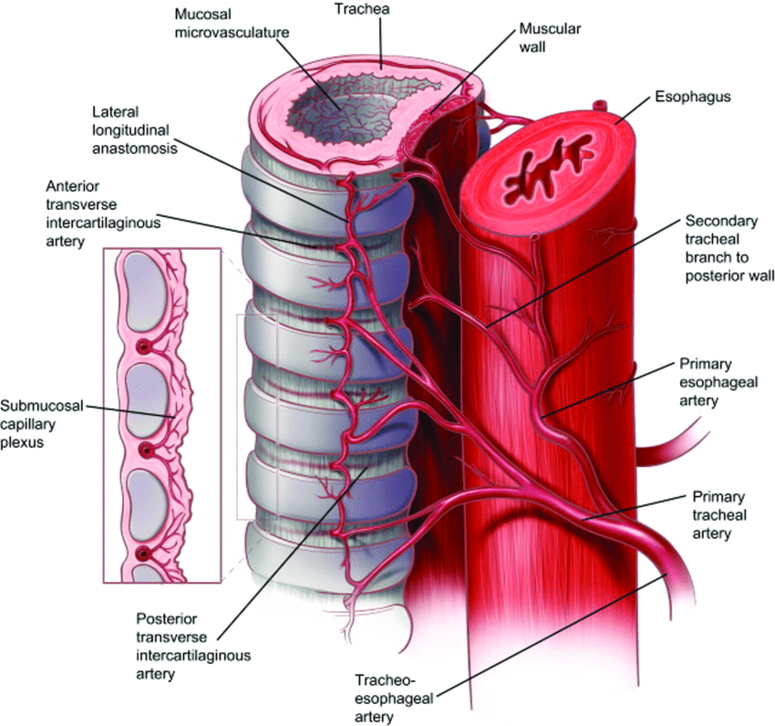
Trachea is a noncollapsible fibrocartilagenous tube
Kept patent because of the presence of C shaped cartilaginous ring in its wall
The soft posterior wall allows expansion of oesophagus during passage of food

Slide 4
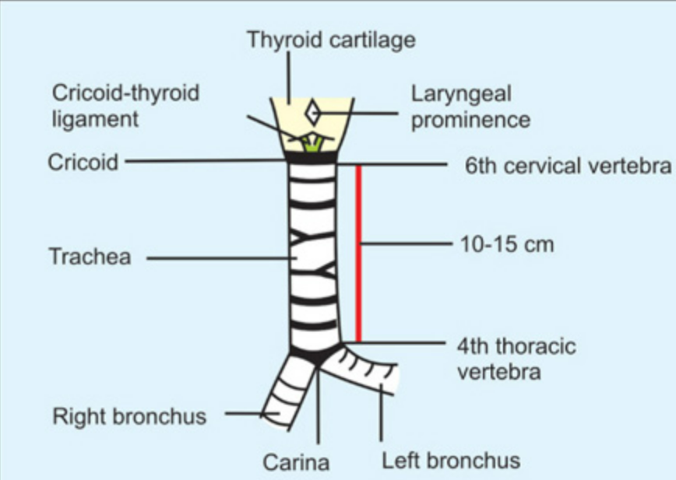
Location
Continuation of larynx
Extends from lower border of cricoid cartilage in neck to lower border of T4 vertebra in thorax.
Ends by dividing into right & left principal bronchus
Lies in median plane except at termination ,where it deviates to the right due to pressure of arch of aorta .
Upper part located in neck - Cervical part
Lower half in superior mediastinum – thoracic part

Slide 5
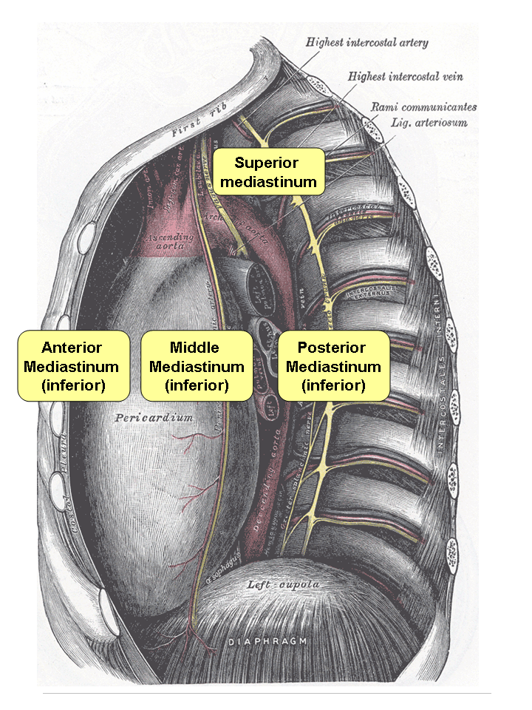
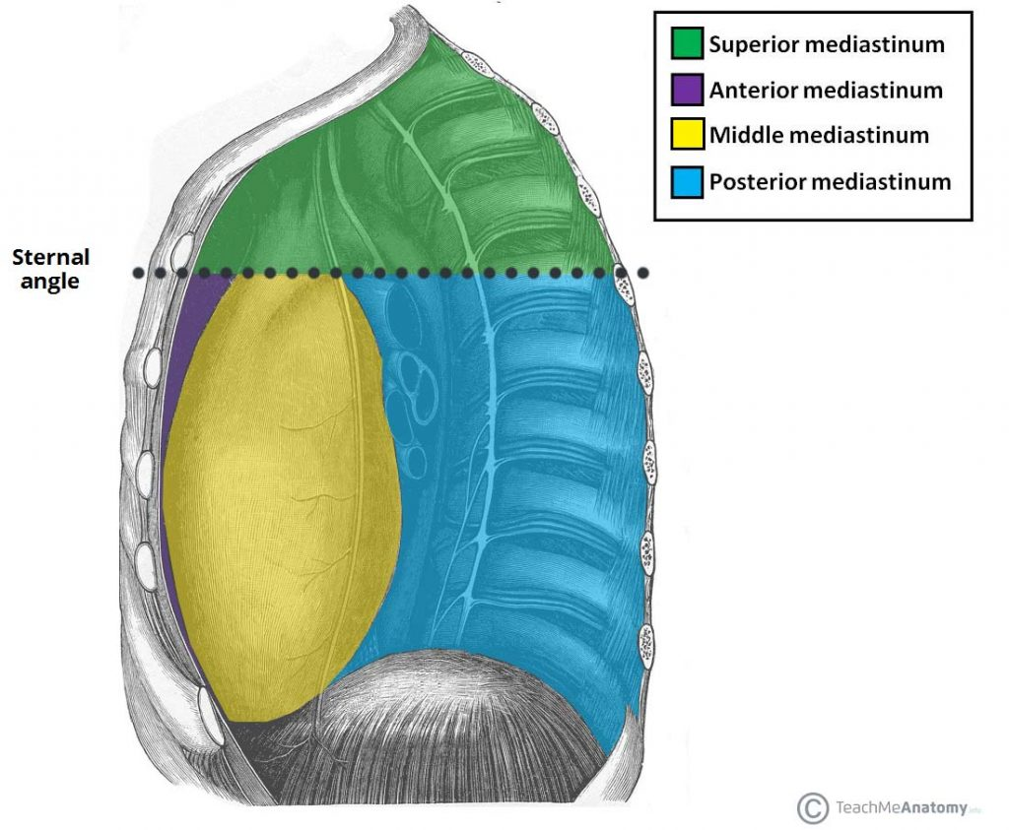
MEDIASTINUM

Slide 6
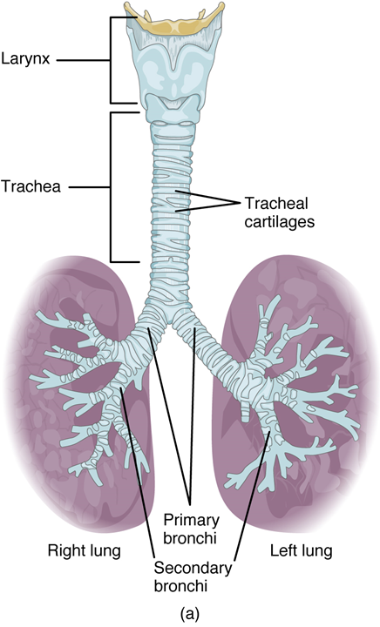
Dimensions
10 -12 cm long
External diameter – 2 cm in male ,1.5 cm in female
Internal - It is about 3 mm at 1 year of age(upto 3rd year ) ,and increases by 1mm each year upto 12th year -12 mm, after which it remains fairly constant

Slide 7
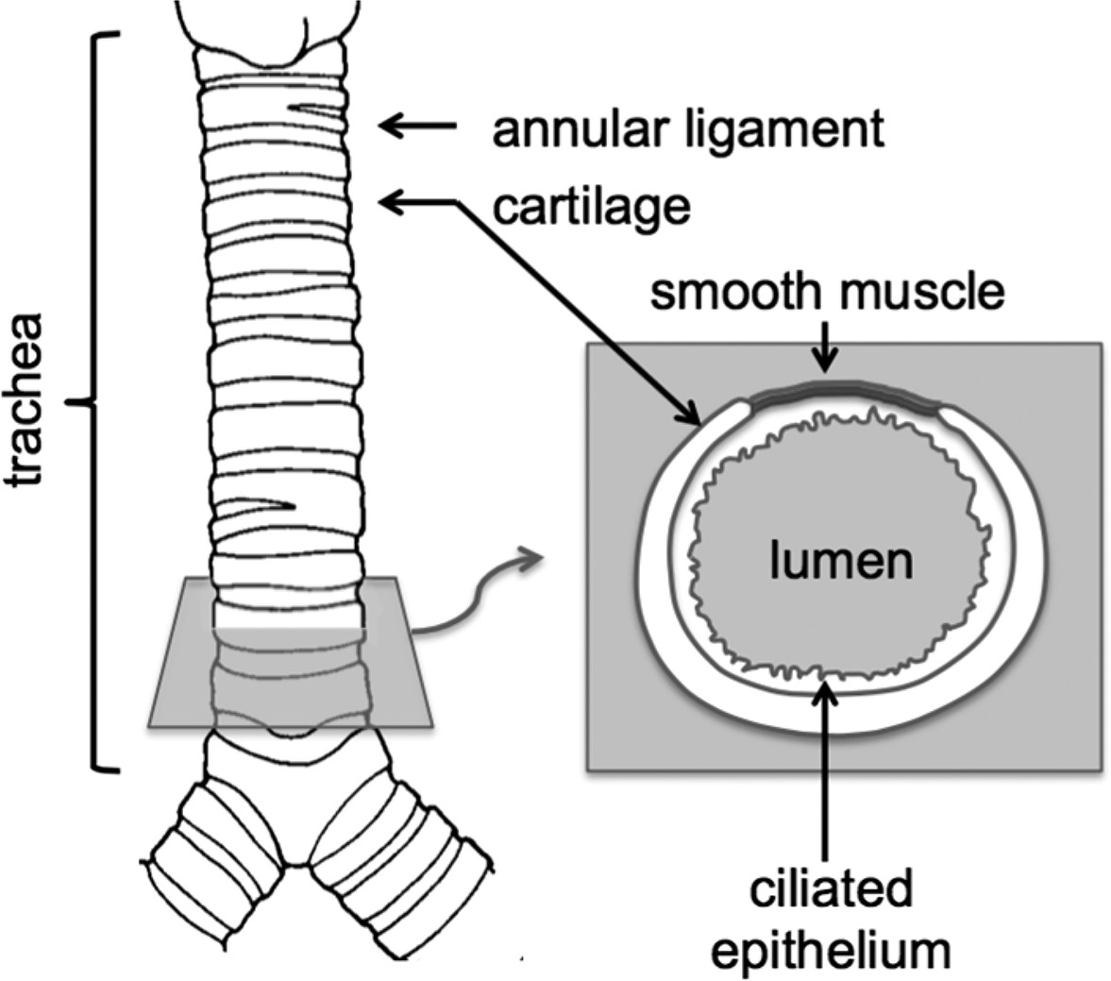
Parts of the trachea
Tracheal cartilages

Slide 8
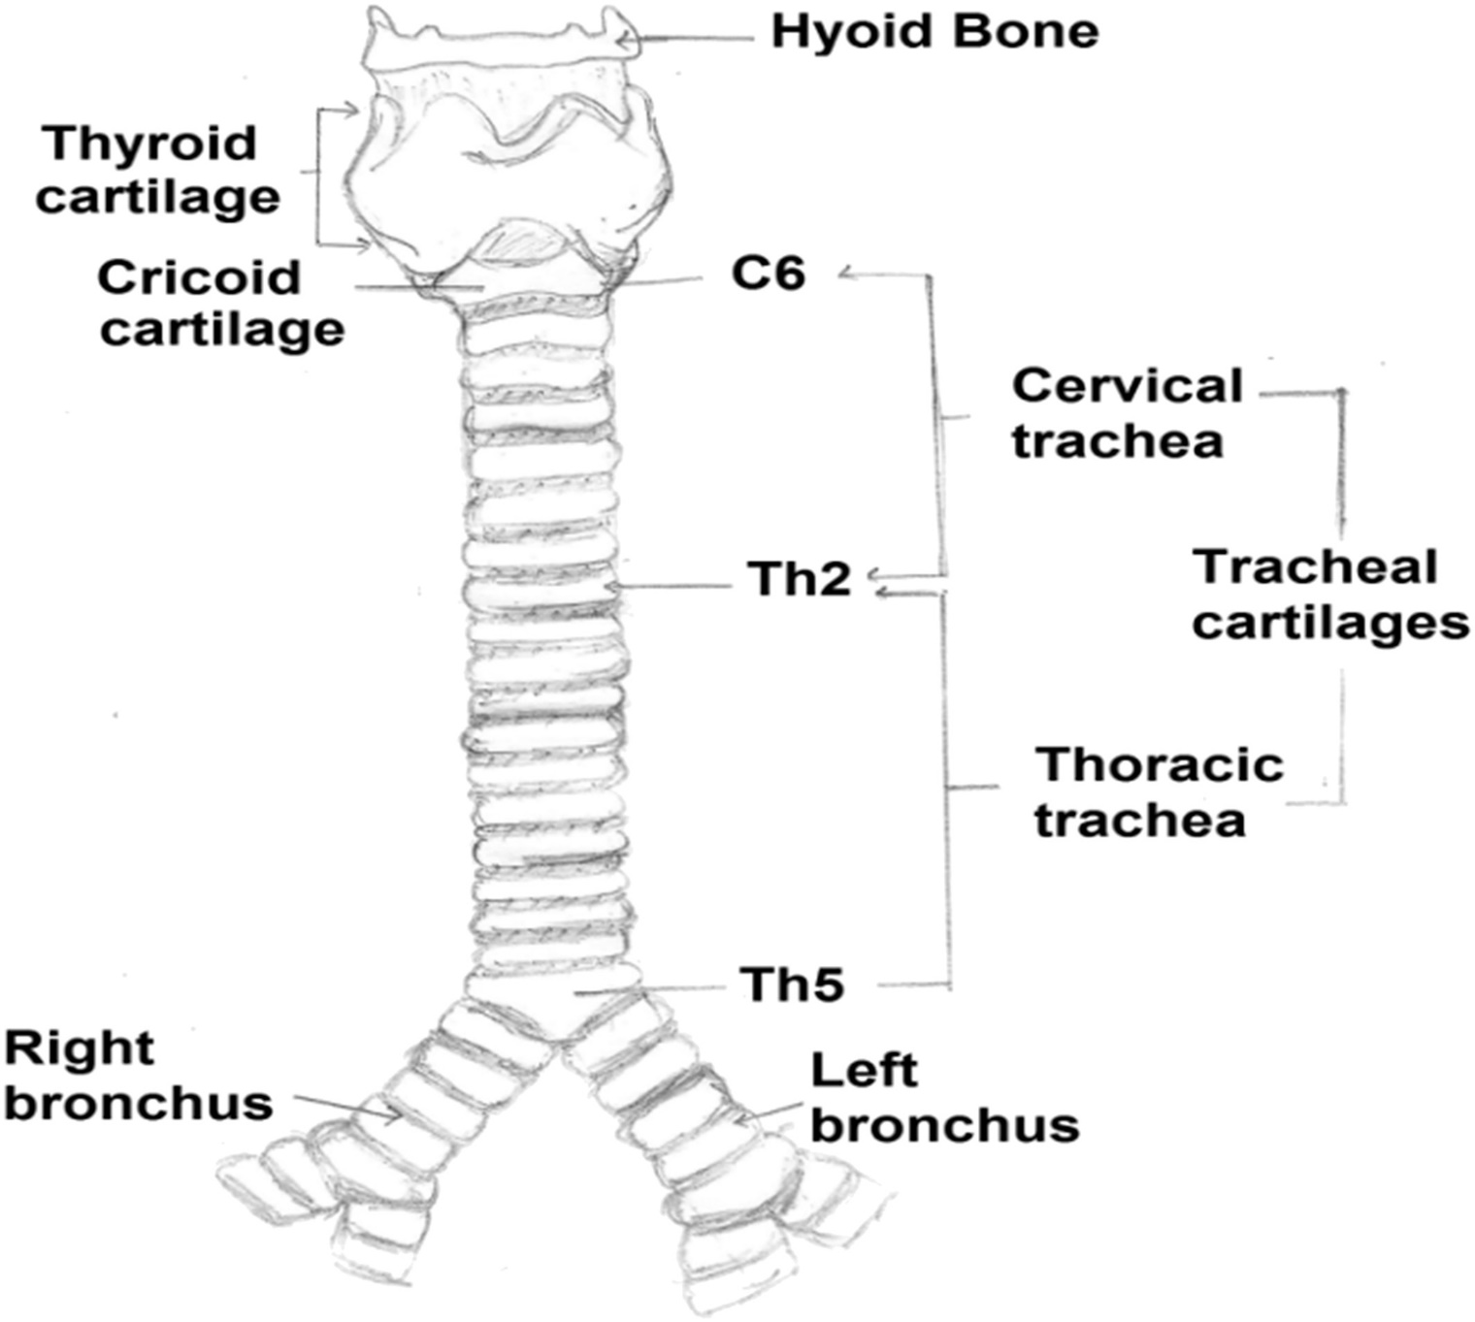
Cervical part of trachea
Begins at lower border of cricoid cartilage opposite lower border of C6 vertebra
Runs downwards and slightly backwards in front of oesophagus, follows the curvature of spine & enters the thorax

Slide 9
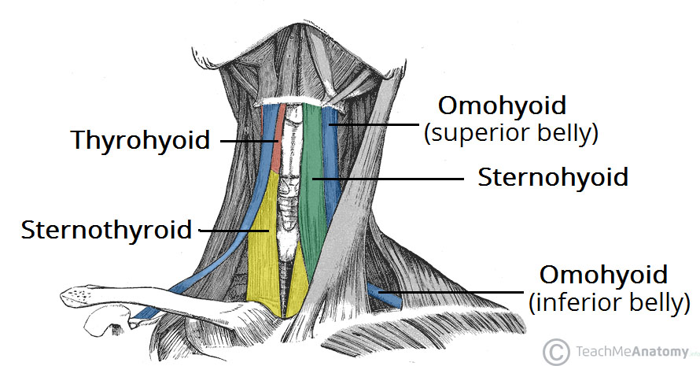
Relations
Anterior
Isthmus of thyroid covering 2nd & 3rd tracheal rings
Pretracheal fascia
Sternothyroid & sternohyoid muscles
Skin ,superfacial fascia,deep fascia

Slide 10
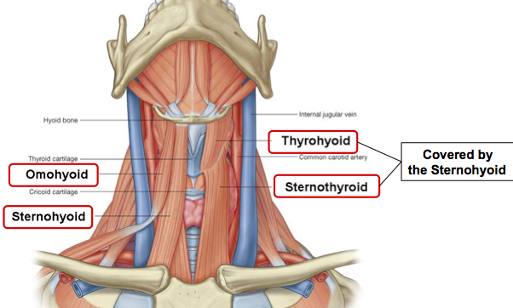
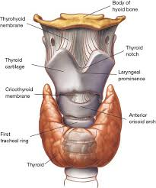

Slide 11
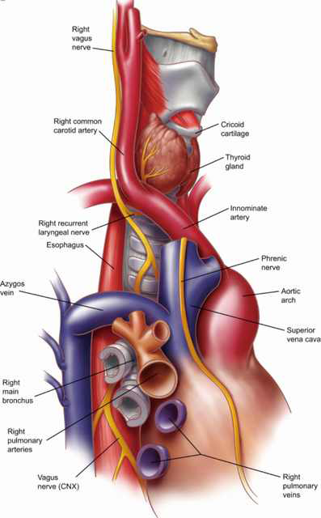
Posterior
Oesophagus
Longus colli
Recurrent laryngeal nerve

Slide 12
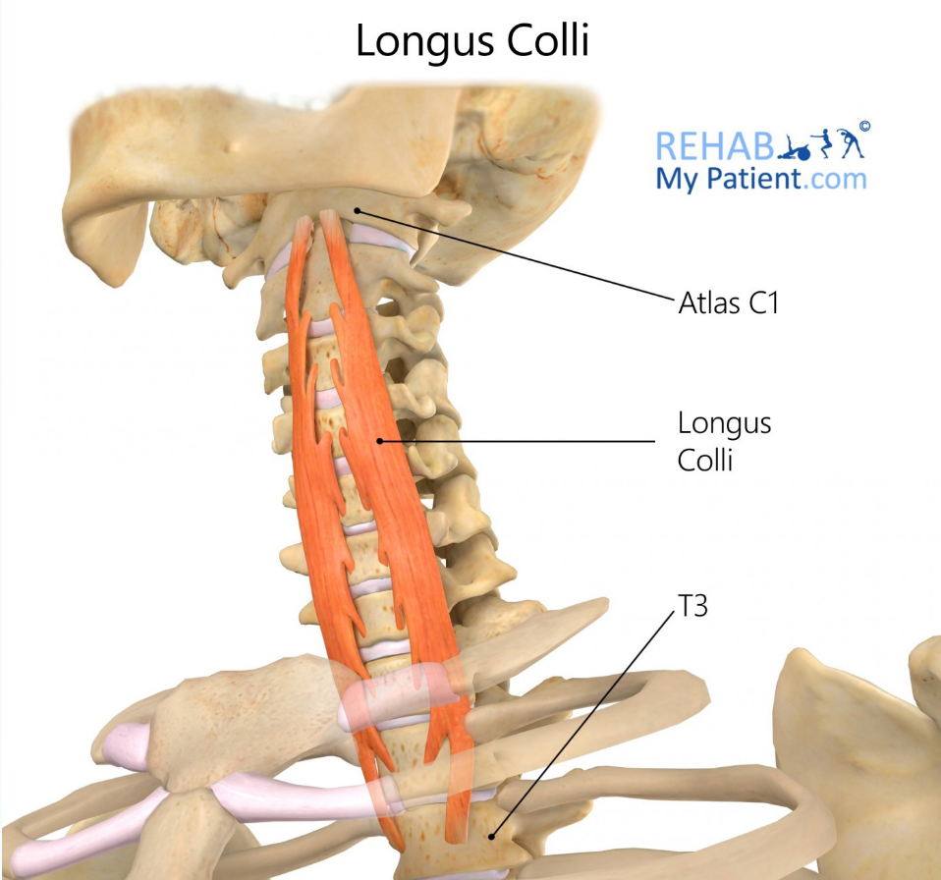
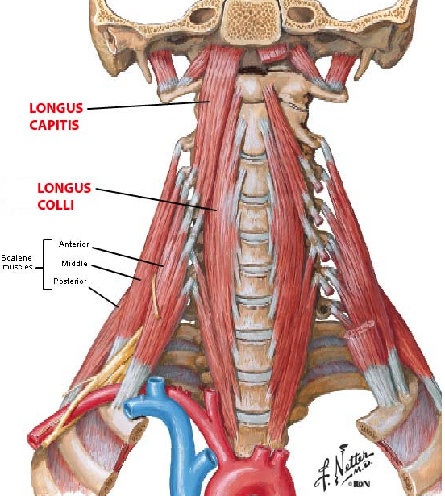

Slide 13
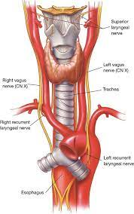
On each side
Corresponding lobe of thyroid
Common carotid artery with carotid sheath

Slide 14
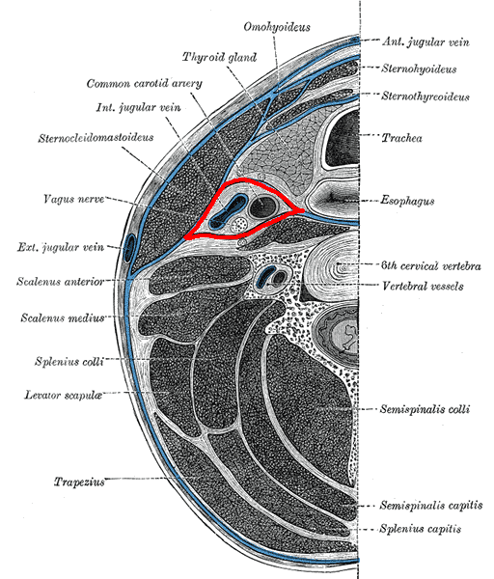

Slide 15
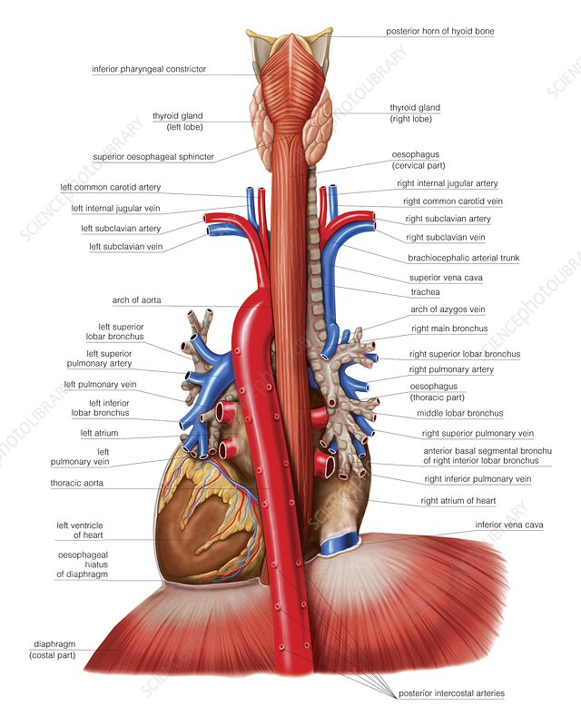

Slide 16
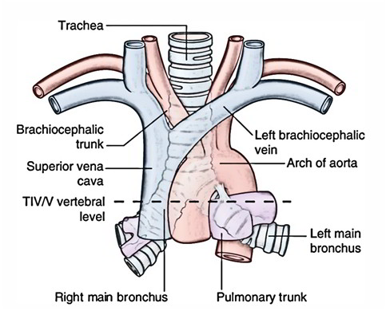
Thoracic part of trachea
Anterior
Manubrium sterni
Sternothyroid
Remains of thymus
Left brachiocephalic & inferior thyroid veins
Aortic arch ,brachiocephalic & left common carotid arteries
Deep cardiac plexus
Lymph nodes

Slide 17
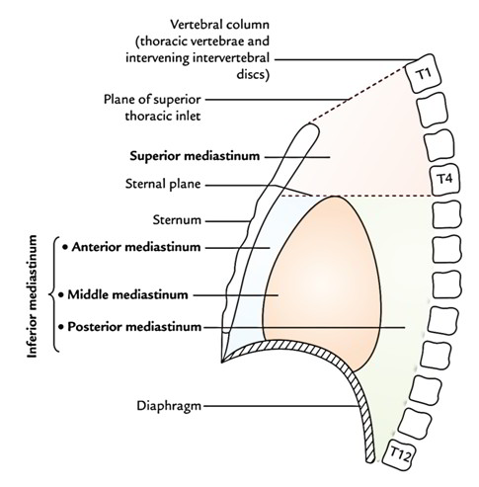
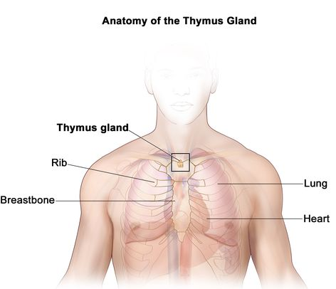

Slide 18
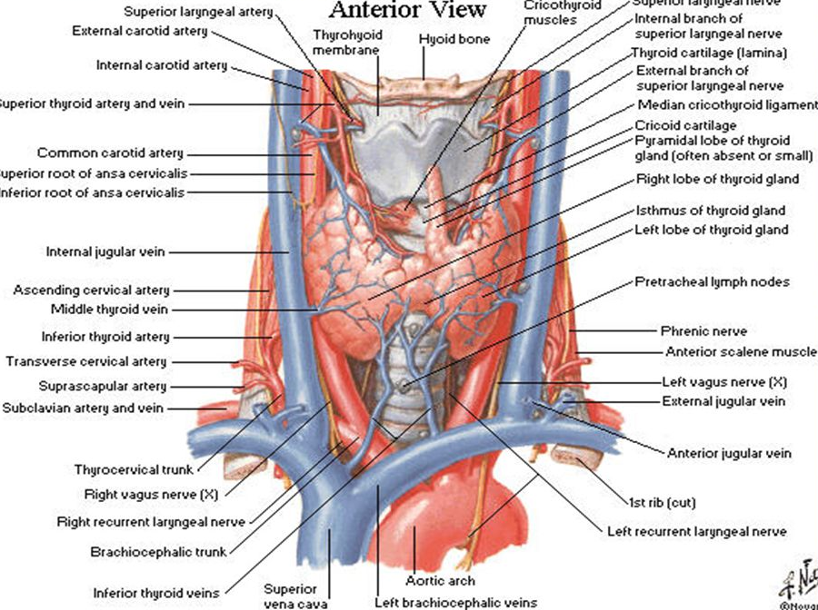
Inferior thyroid vein
Left brachiocephalic vein

Slide 19
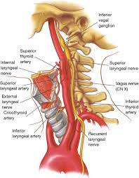

Slide 20
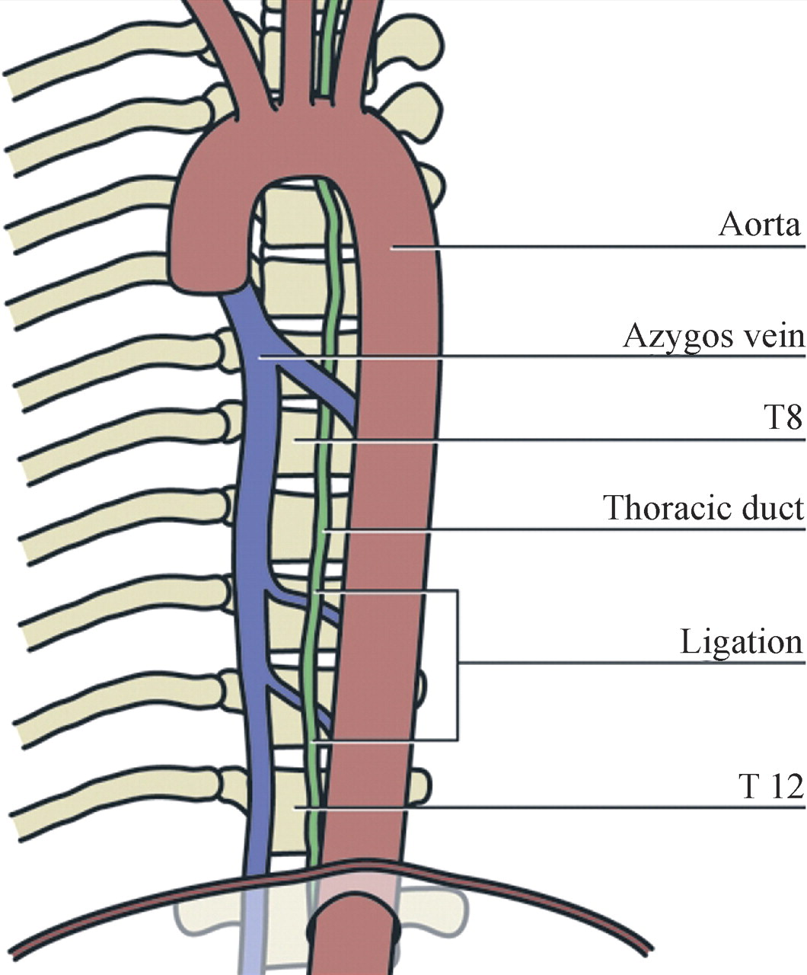
On right side
Right lung & pleura
Right vagus
Azygos vein

Slide 21
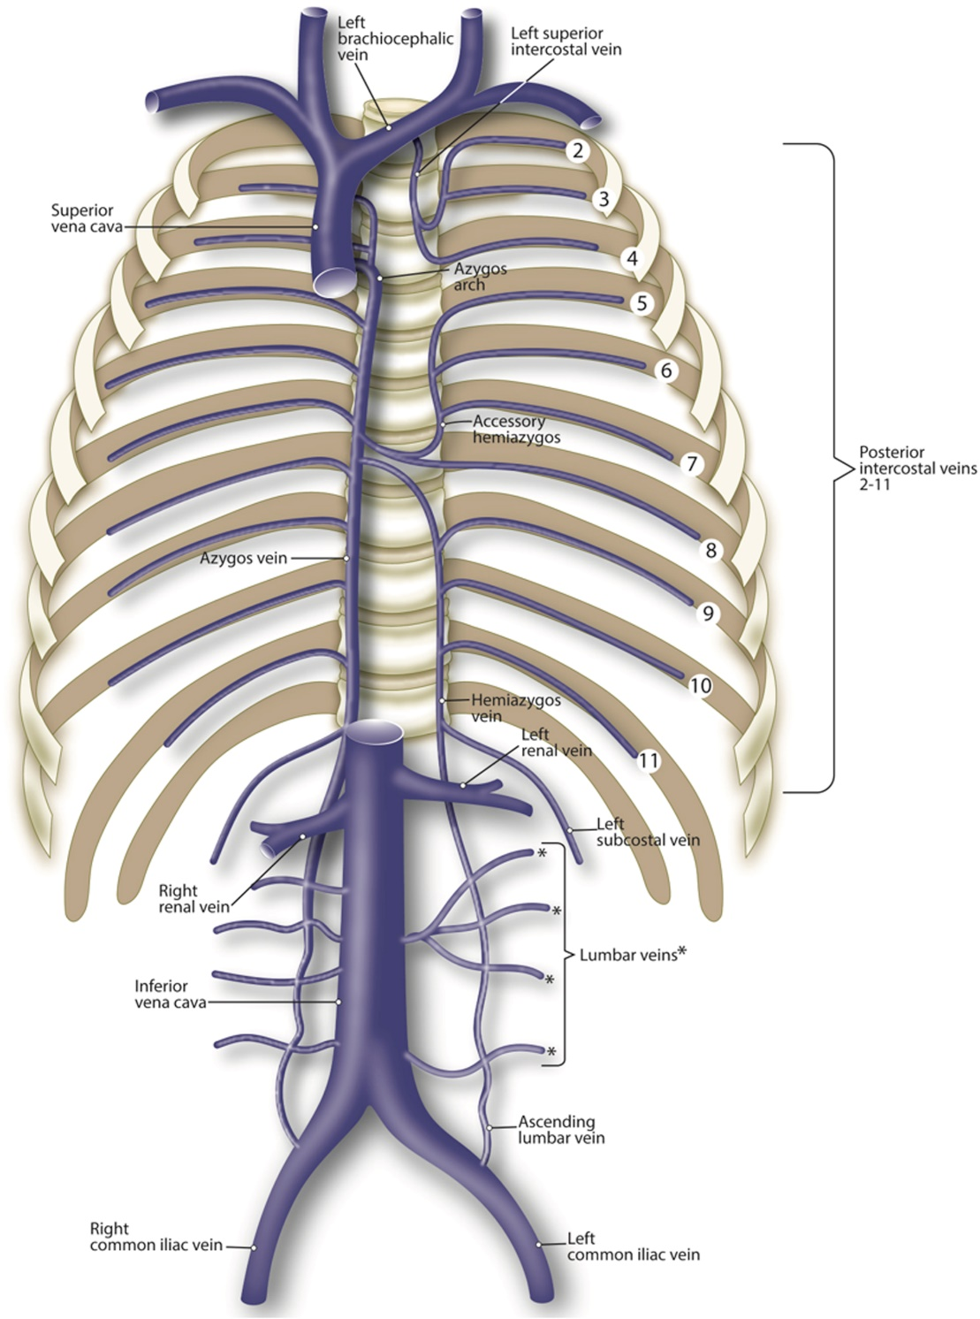

Slide 22
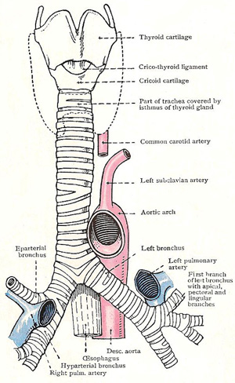
On left side
Arch of aorta ,left common carotid ,left subclavian
Left recurrent laryngeal nerve

Slide 23
Posterior
Oesophagus
Vertebral column

Slide 24
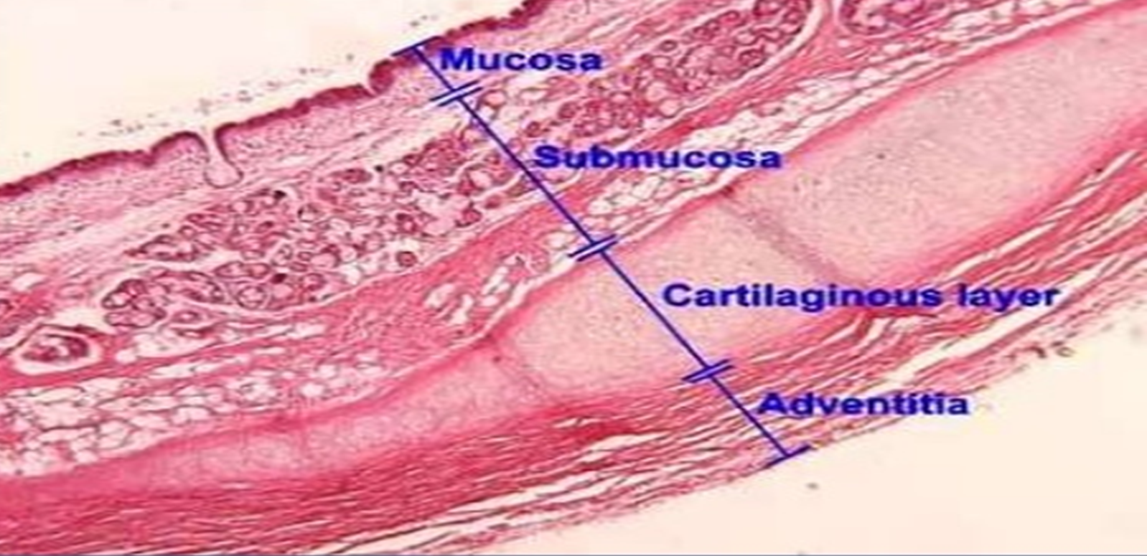
Microscopic structure
From within outwards
Mucosa
Submucosa
Cartilage & smooth muscle layer
(Perichondrium )
Fibrous membrane

Slide 25
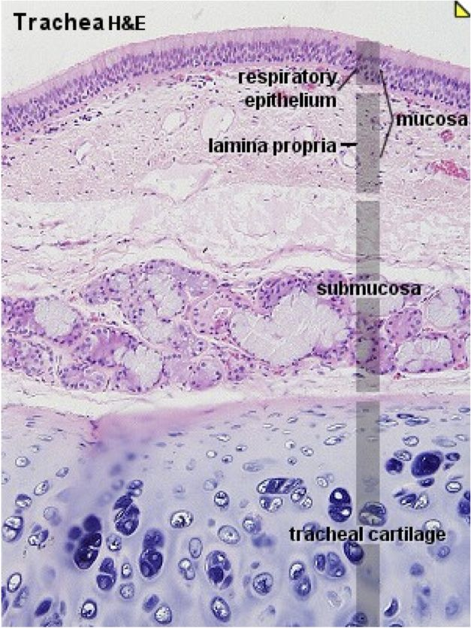
Mucosa - pseudostratified ciliated columnar epithelium with goblet cells
Submucosa - loose areolar tissue containing large number of serous & mucous glands
Cartilage & muscle layer – C shaped hyaline cartilage rings ,deficient posteriorly –gap filled by trachealis
(Perichondrium ) - encloses cartilage
Fibrous membrane – dense connective tissue

Slide 26
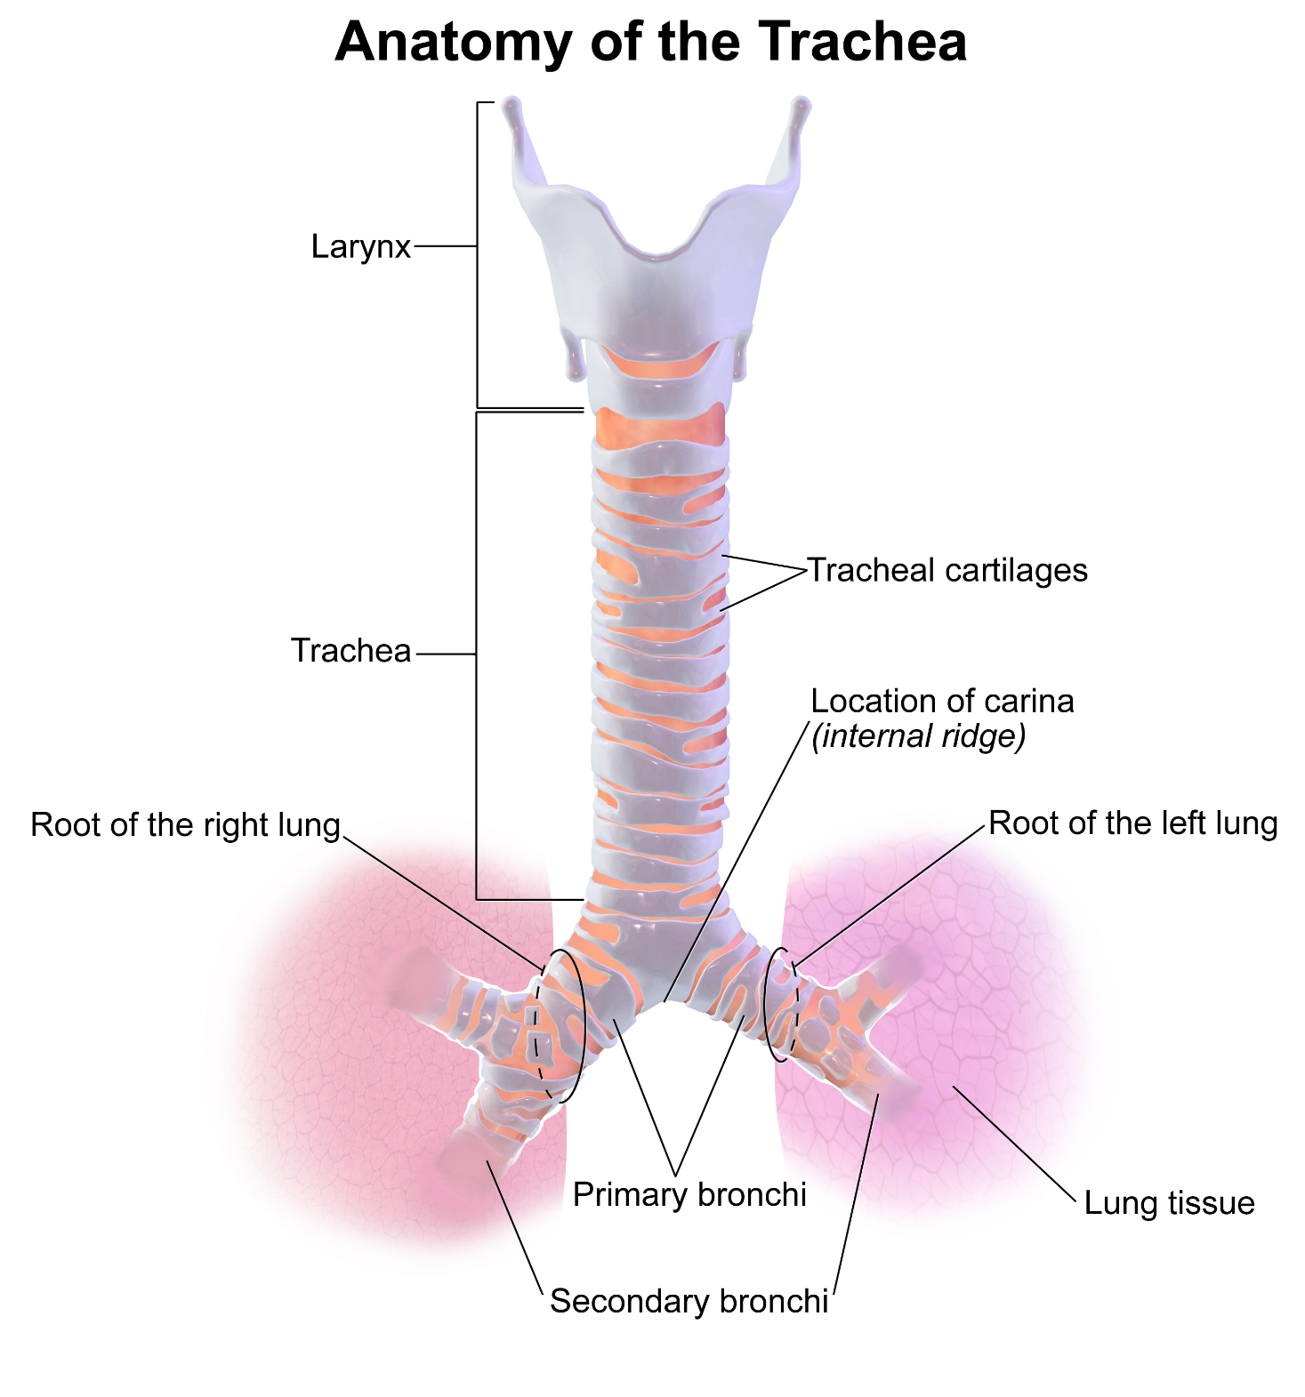
Cartilagenous rings
C shaped rings
16-20 in number
First one broadest
Last ring presents a triangular process known as Carina which hooks upwards from lower margin & surrounds the commencement of 2 bronchi
Carina presents a ridge in the interior of bifurcation and act as a guide for surgeons during bronchoscopic & other examinations

Slide 27
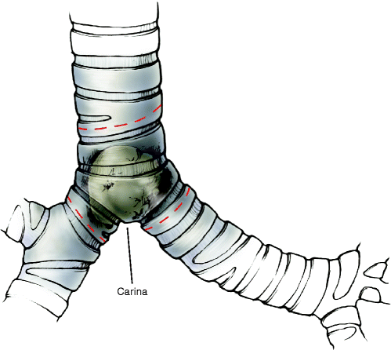
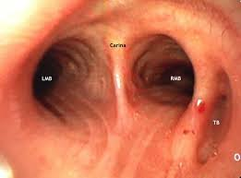

Slide 28
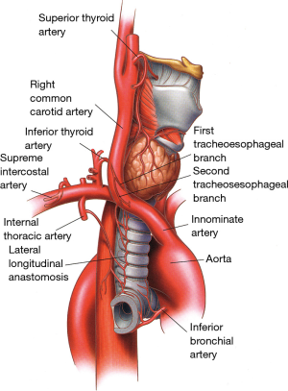
Blood supply
Inferior thyroid arteries (upper 2/3rd)
Bronchial arteries(lower 1/3rd)
VENOUS DRAINAGE
Inferior thyroid veins to Left brachiocephalic vein

Slide 29
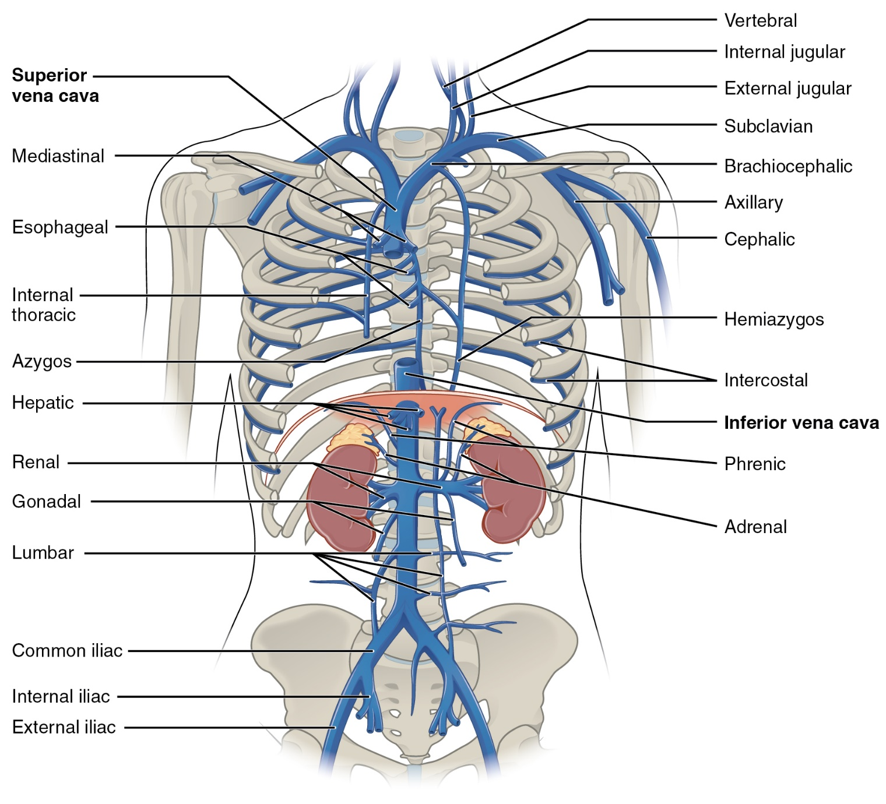
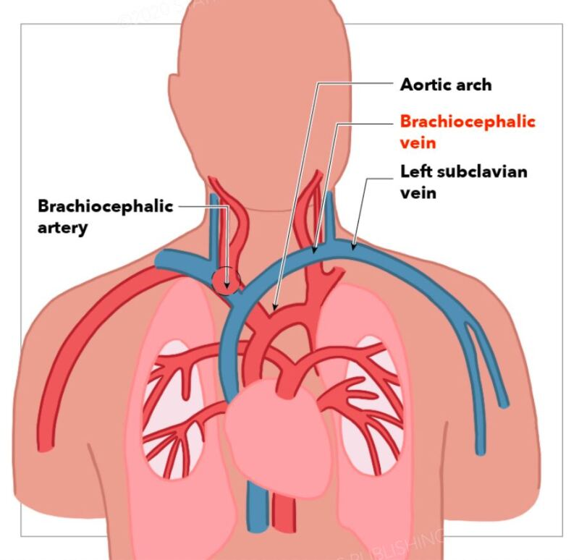

Slide 30
Lymphatic drainage
Pretracheal & paratracheal nodes

Slide 31
Nerve supply
Parasymphatetic – through vagus
Motor to trachealis
Sensory to mucous membrane
Sensory nerve supply is from vagus and recurrent laryngeal nerves
Symphathetic - fibres from middle cervical ganglion reach along inferior thyroid arteries and are vasomotor

Slide 32
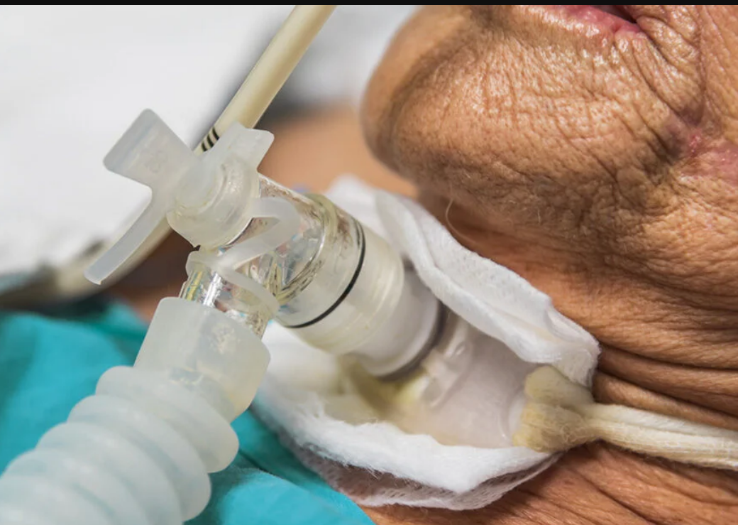
Applied aspects
Tracheostomy is a life saving emergency operation ,where an artificial opening is made in the trachea to relieve respiratory obstruction .(caused by foreign body ,diphtheria , carcinoma etc. )
High tracheostomy - interval between cricoid cartilage & isthmus of thyroid
Low tracheostomy – below isthmus of thyroid
(refer chapter 20 ,vol 1 of B D Chaurasia )

Slide 33
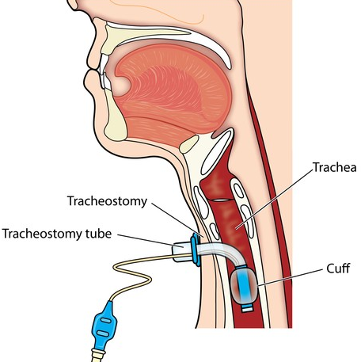

Slide 34
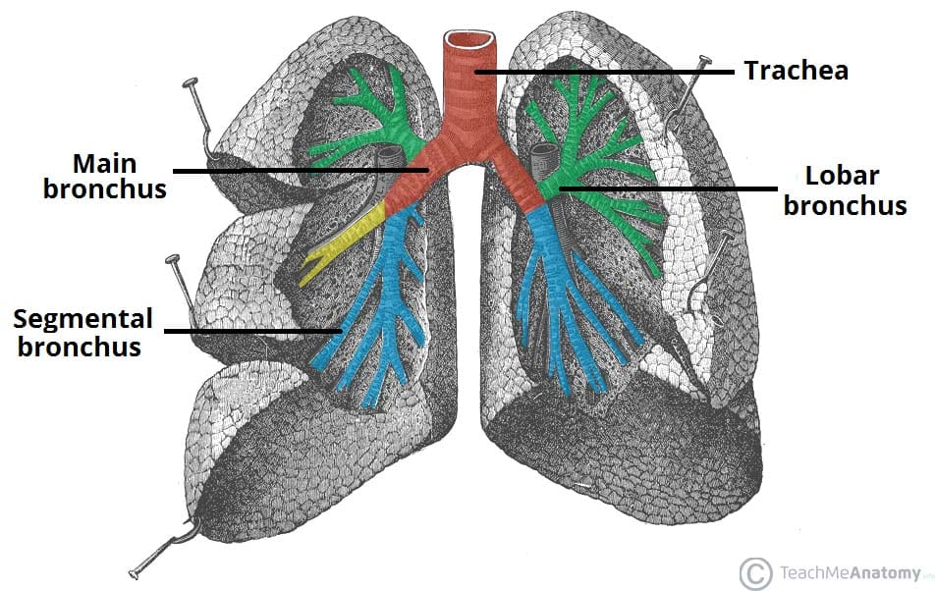
Bronchi
The trachea bifurcates into right & left bronchi and enters the hilum of corresponding lung
Each bronchus consists of extrapulmonary & intrapulmonary parts.

Slide 35
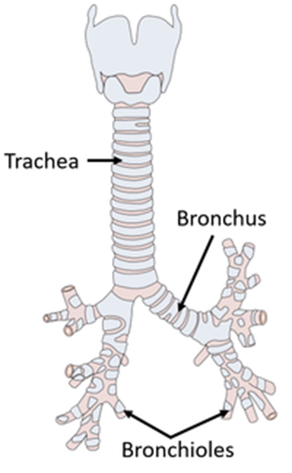
Right bronchus
Wider ,shorter and more vertical than left bronchus
Wider – supplies more voluminous right lung
Vertical – trachea at its bifurcation is deviated to right (foreign body usually aspirated to right lung )
Length - 2.5 cm

Slide 36
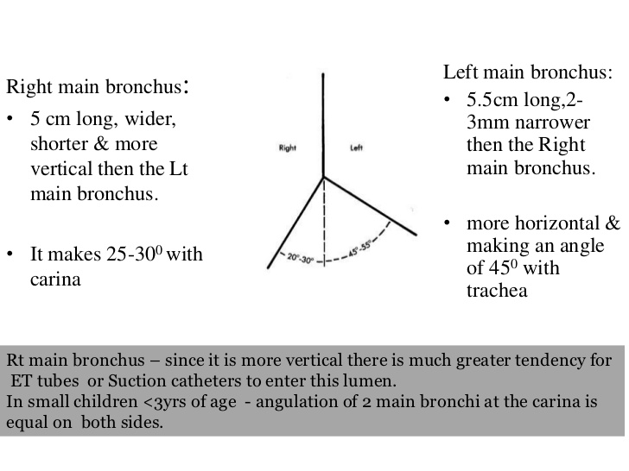

Slide 37
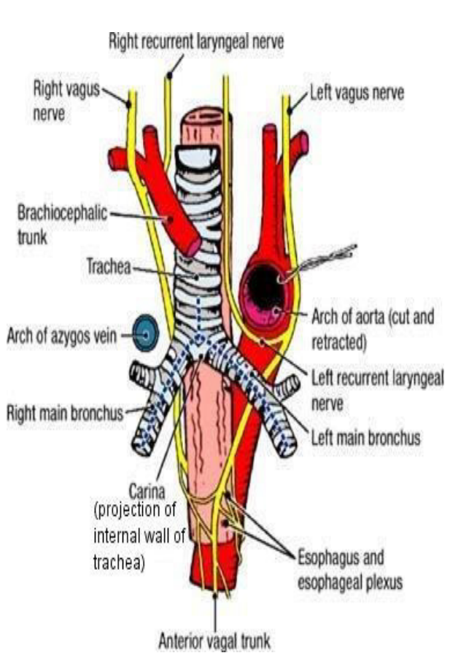
Right Extra pulmonary bronchus
Pass downwards & to right from bifurcation and makes an angle of 25 degree with median plane
It passes below the arch of azygos vein ,enters the root of right lung and reaches the hilum at the level of 5th thoracic vertebra
Within the lung root right bronchus is crossed in front by pulmonary artery
Bronchus gives off a lobar branch (eparterial )to upper lobe of right lung

Slide 38
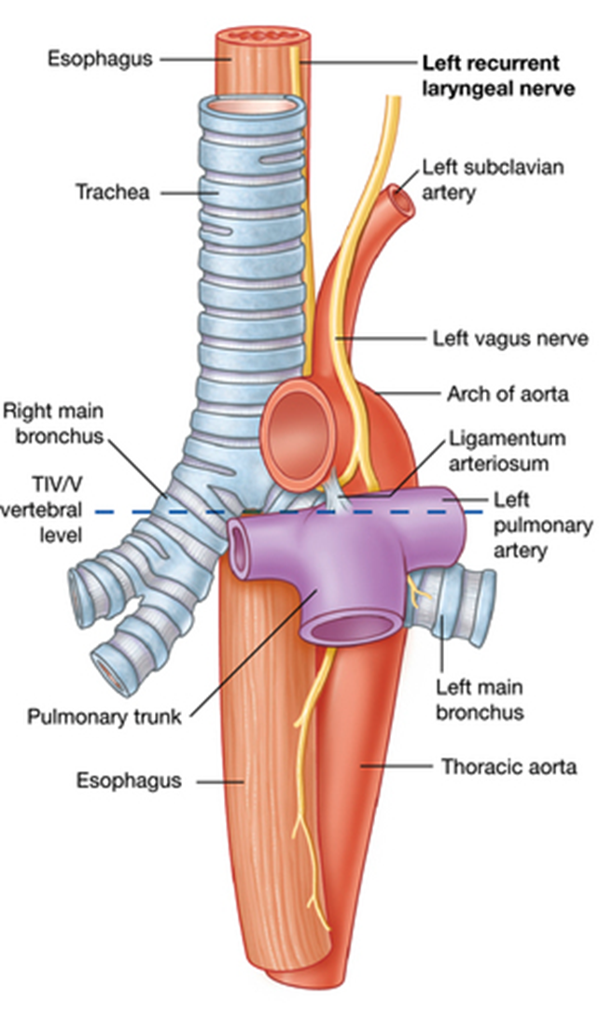
Left bronchus
Longer ,narrower, more oblique than right
Length – 5 cm
Makes an angle of 45 degree with median plane at tracheal bifurcation
Pass downwards below arch of aorta ,enters lung root and reach hilum at level of 6th thoracic vertebra

Slide 39
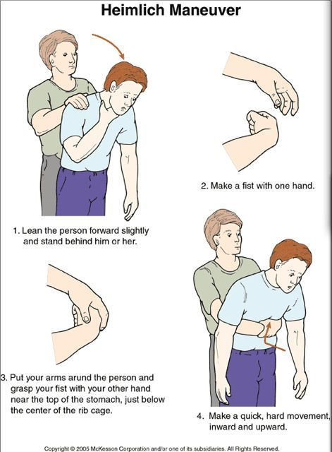
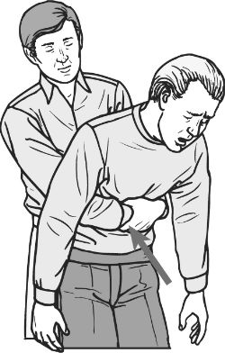
Heimlich maneuver

Slide 40
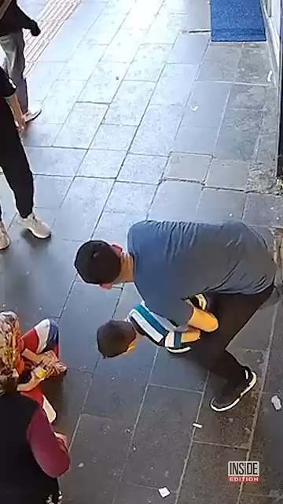

Slide 41
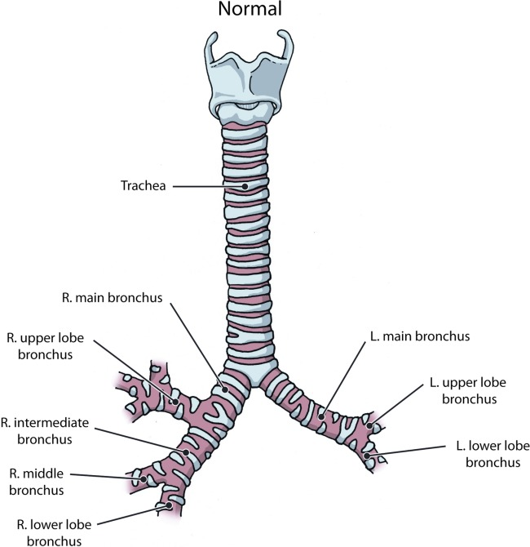

Slide 42
Lobar bronchus

Slide 43
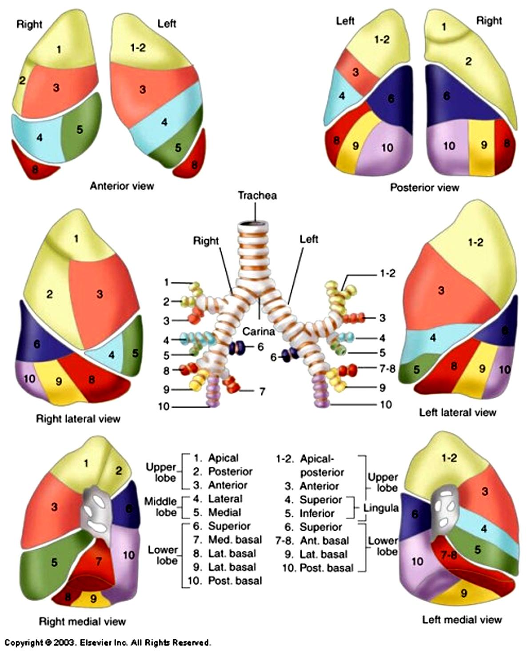
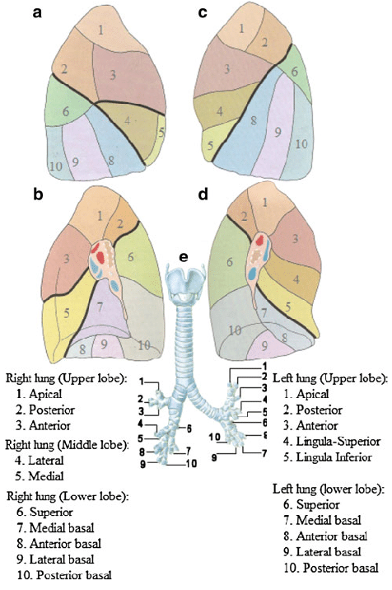
SEGMENTAL BRONCHI

Slide 44
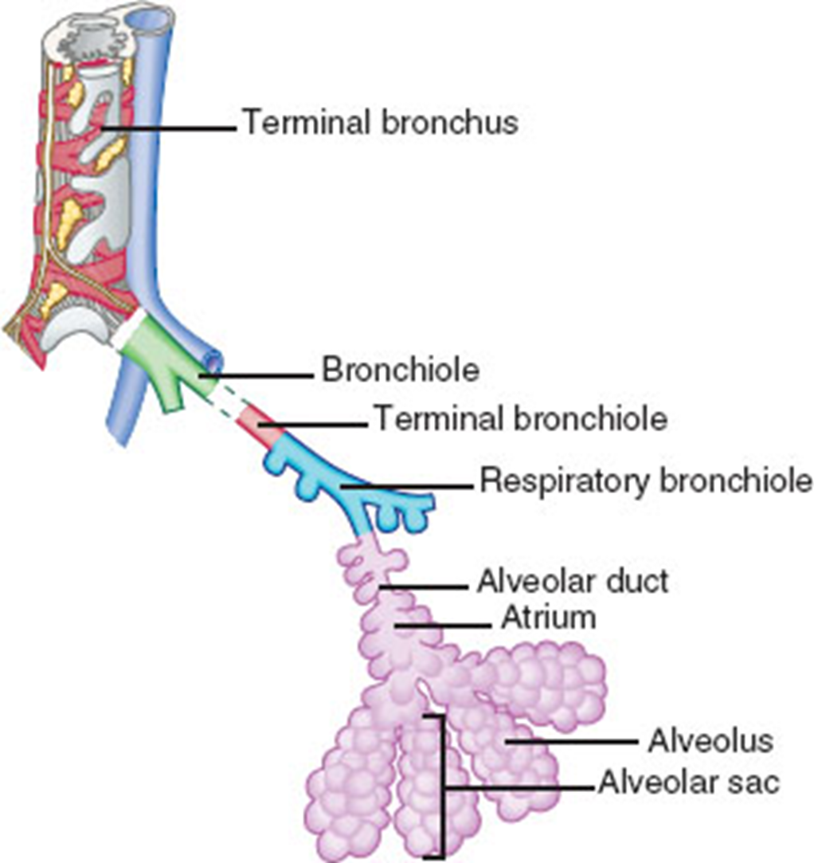


Slide 45
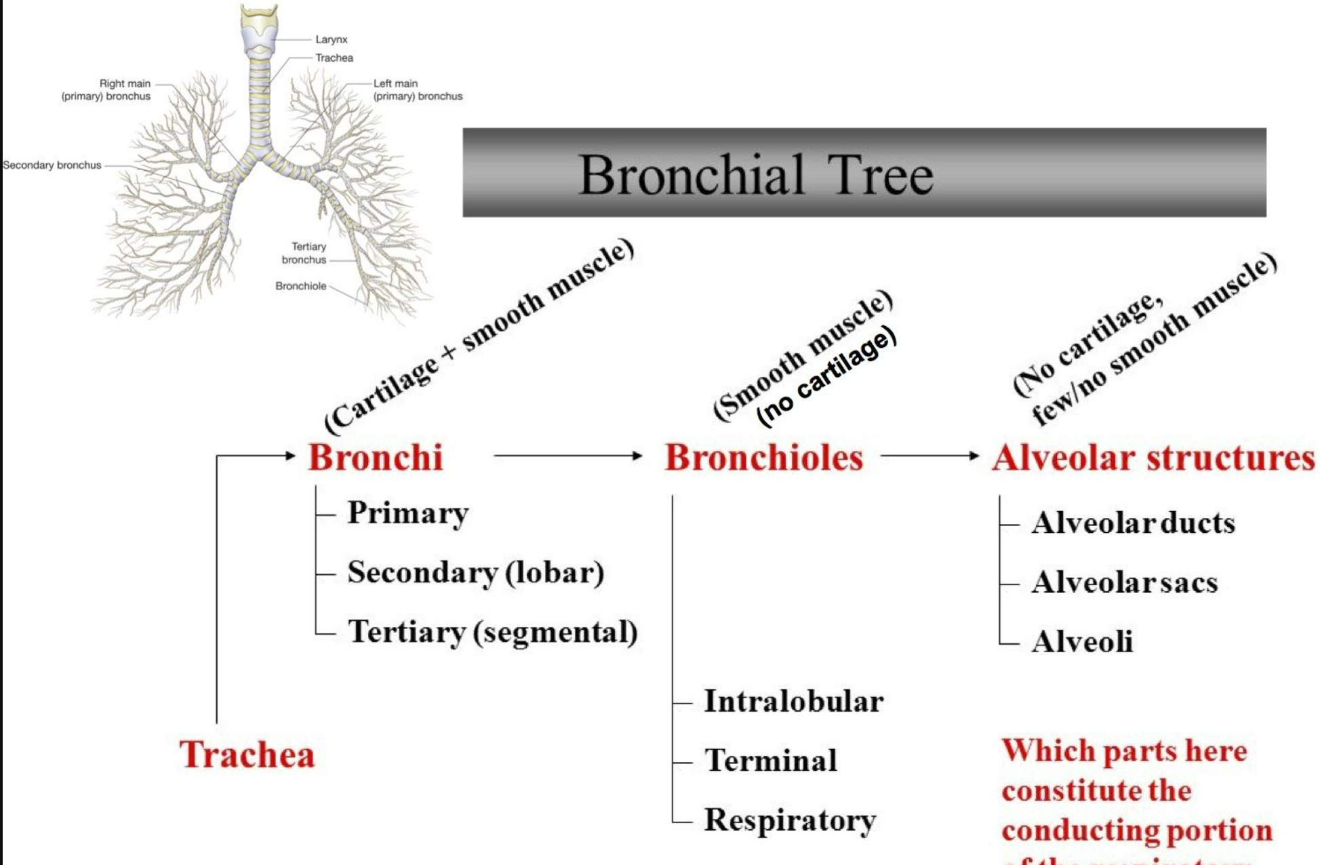




Slide 46
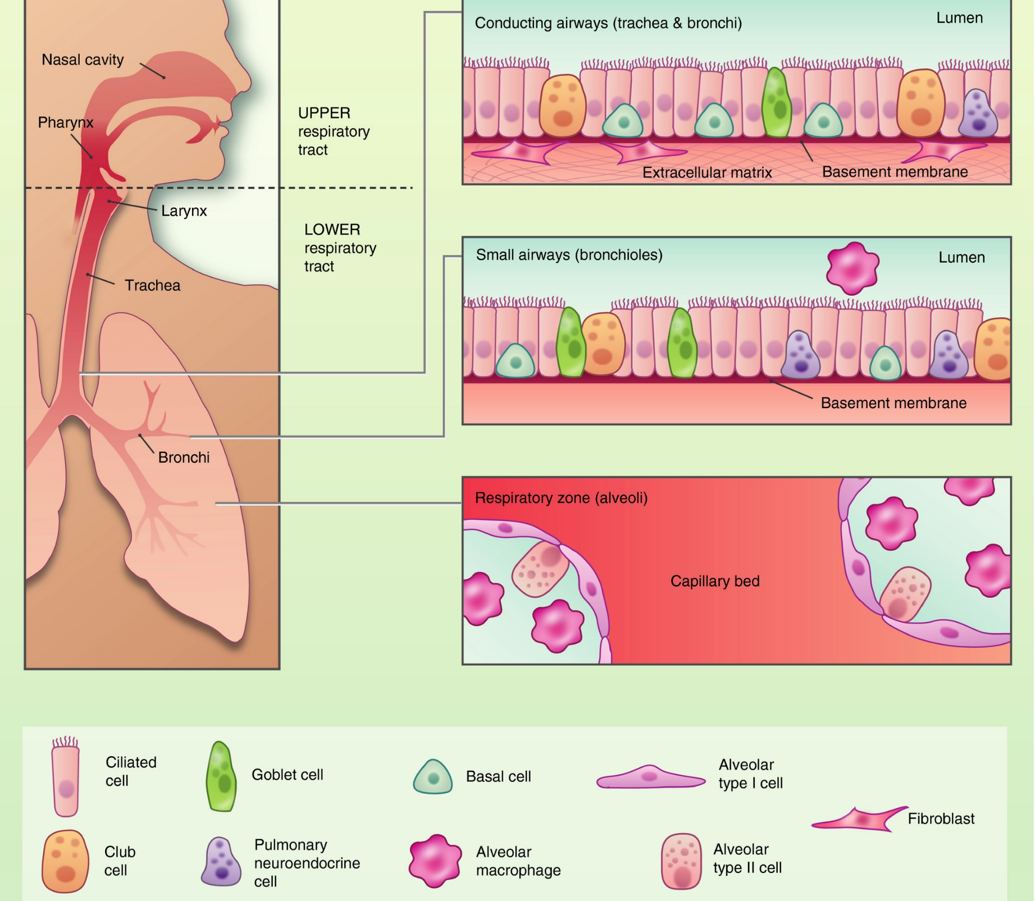

Slide 47
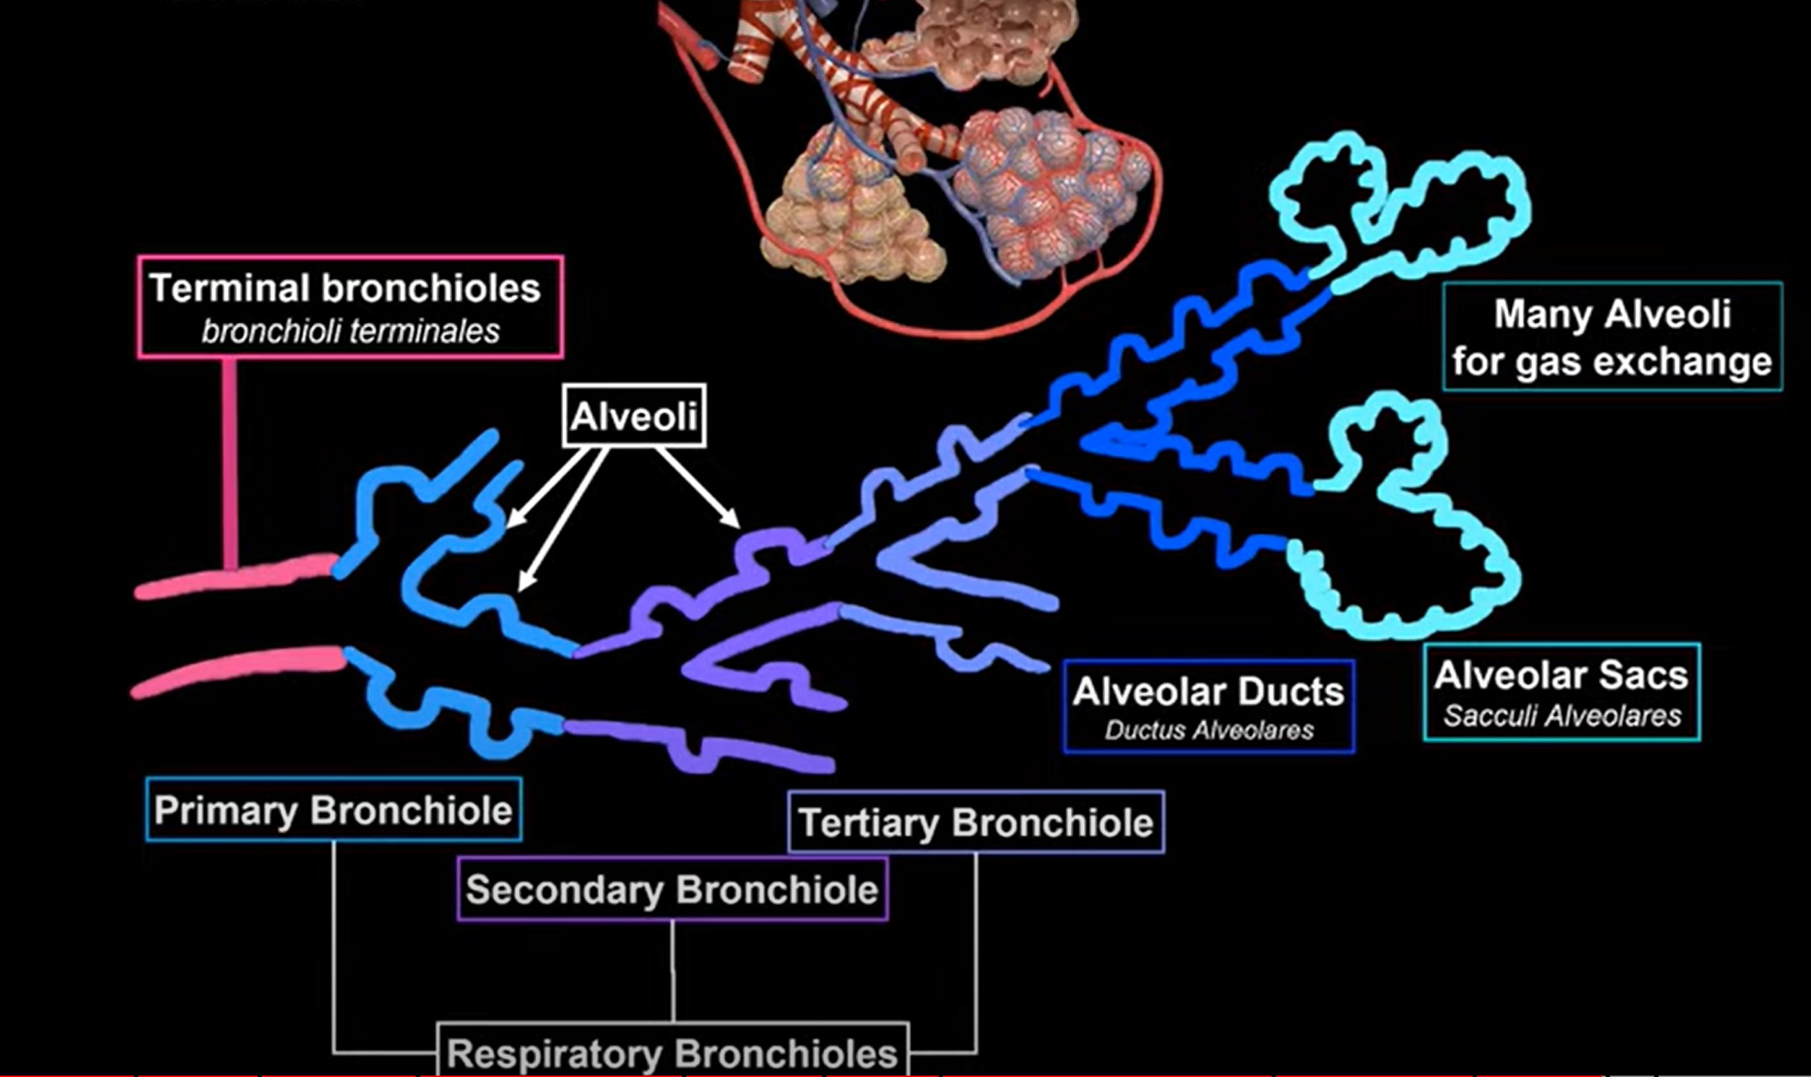


Slide 48


Slide 49
Thank you

Slide 50


