Slide 1
stomach

Slide 2
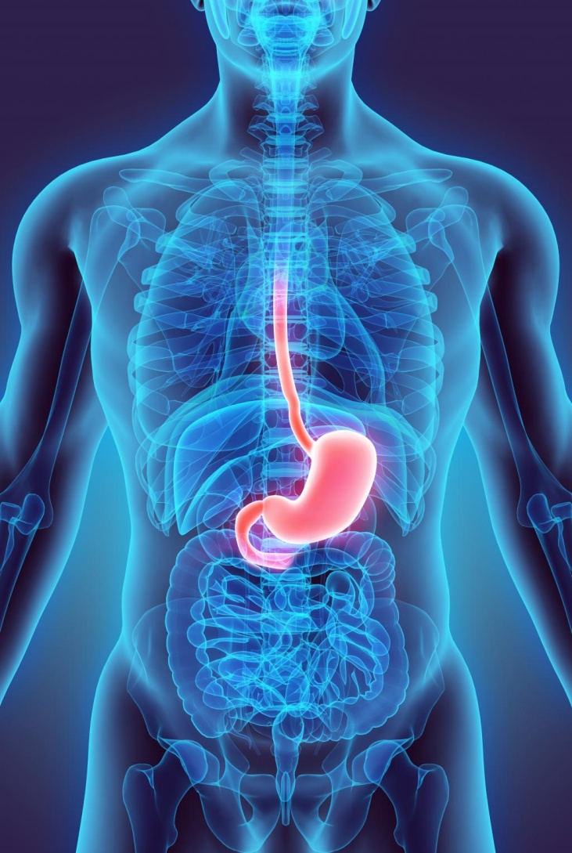
Introduction
Synonyms
gaster or venter
Definition
The stomach is a muscular bag forming the widest and most distensible part of the digestive tube. It is connected above to the lower end of the oesophagus, and below to the duodenum.

Slide 3
functions
It acts as a reservoir of food and helps in digestion of carbohydrates, proteins and fats.

Slide 4
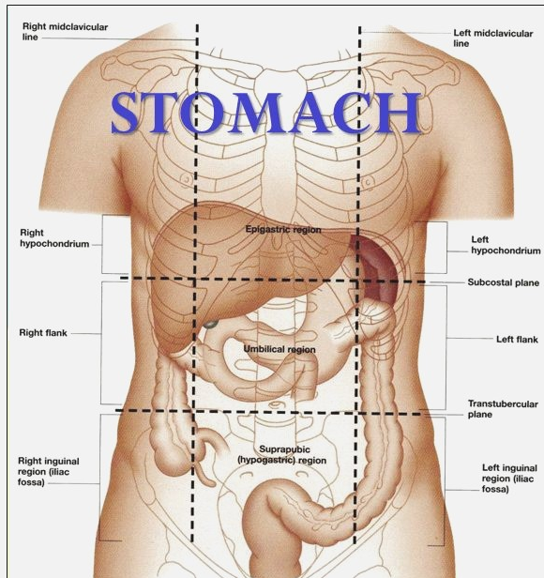
Location
The stomach lies obliquely in the upper and left part of the abdomen, occupying the epigastric, umbilical and left hypochondriac regions

Slide 5
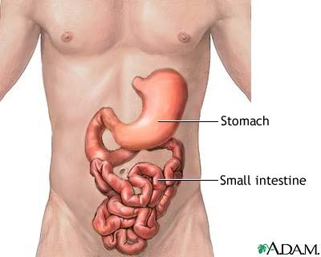
Shape and Position
The shape of the stomach depends upon the degree of I
When empty, the stomach is somewhat I J-shaped (vertical); when partially distended, it becomes pyriform in shape. In obese persons, it is more horizontal.

Slide 6
Size
The stomach is a very distensible organ.
It is about 25 cm. long, and the mean capacity is one ounce (30 ml) Iat birth,
one litre (1000 ml) at puberty, and
2 litres or more in adults

Slide 7
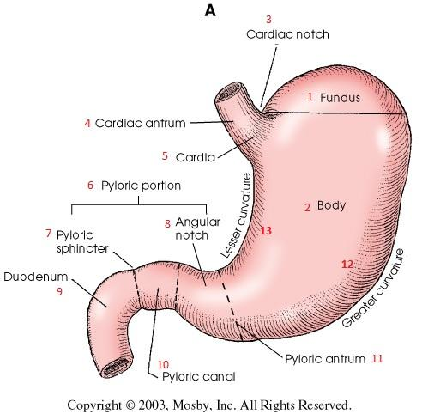
External Features
The stomach has two orifices or openings, two curvatures or borders, and two surfaces

Slide 8
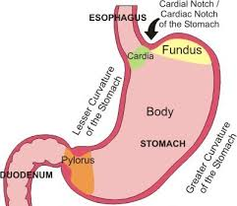
Cardiac orifice
The cardiac orifice is joined by the lower end of the oesophagus, at the level of vertebra T1
Behind the left 7th costal cartilage 2.5 cm from its junction with the sternum, There is physiological evidence of sphincteric action at this site,

Slide 9
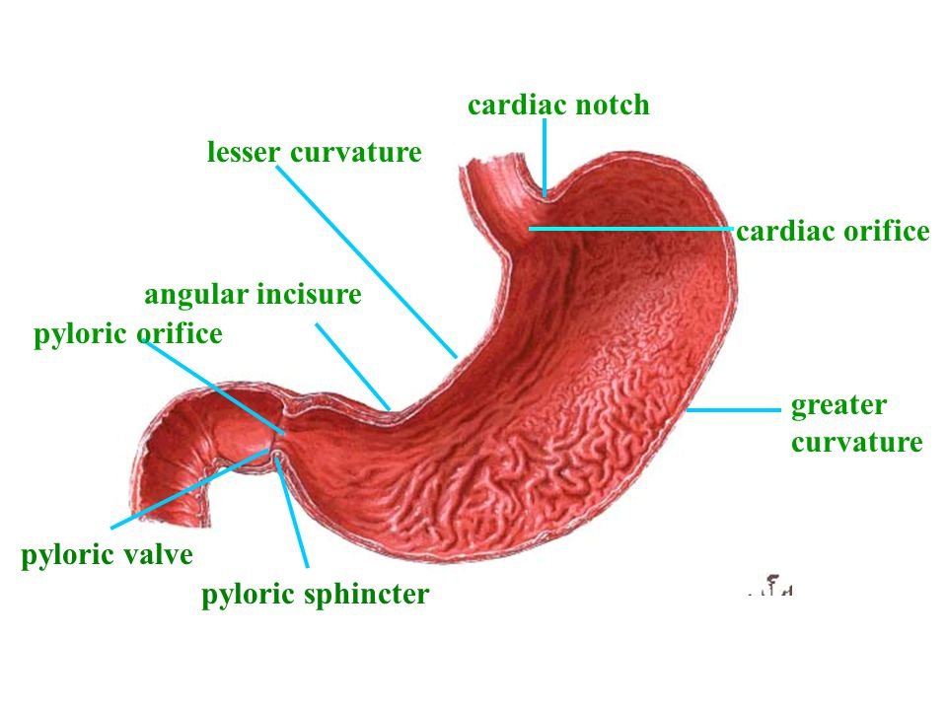
pyloric orifice
It opens into the duodenum. In an empty stomach and in the supine position, it lies 1.2 cm to the right of the median plane, at the level of the lower border of vertebra LI

Slide 10
Curavtures
lesser curvature is concave and forms the right border of the stomach. It provides attachment to the lesser omentum
The greater curvature is convex and forms the left border of the stomach. It provides attachment to the greater omentum, the gastrosplenic ligament and the gastrophrenic ligament.

Slide 11
Two Surfaces
The anterior or anterosuperior surface faces forwards and upwards.
The posterior or posteroinferior surface faces backwards and downwards.

Slide 12
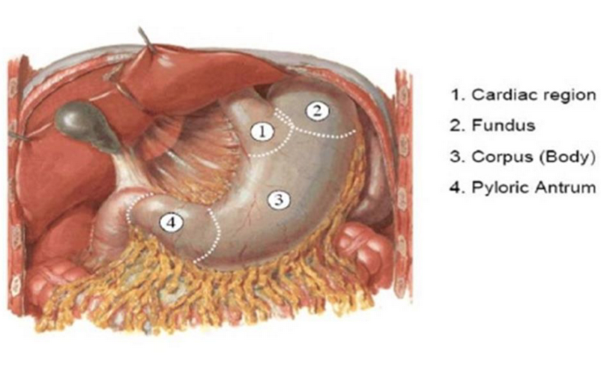
Parts of stomach
stomach is divided into two parts. 1. Cardiac and 2. pyloric by a line drawn downwards and to the left from the incisura angularis.

Slide 13
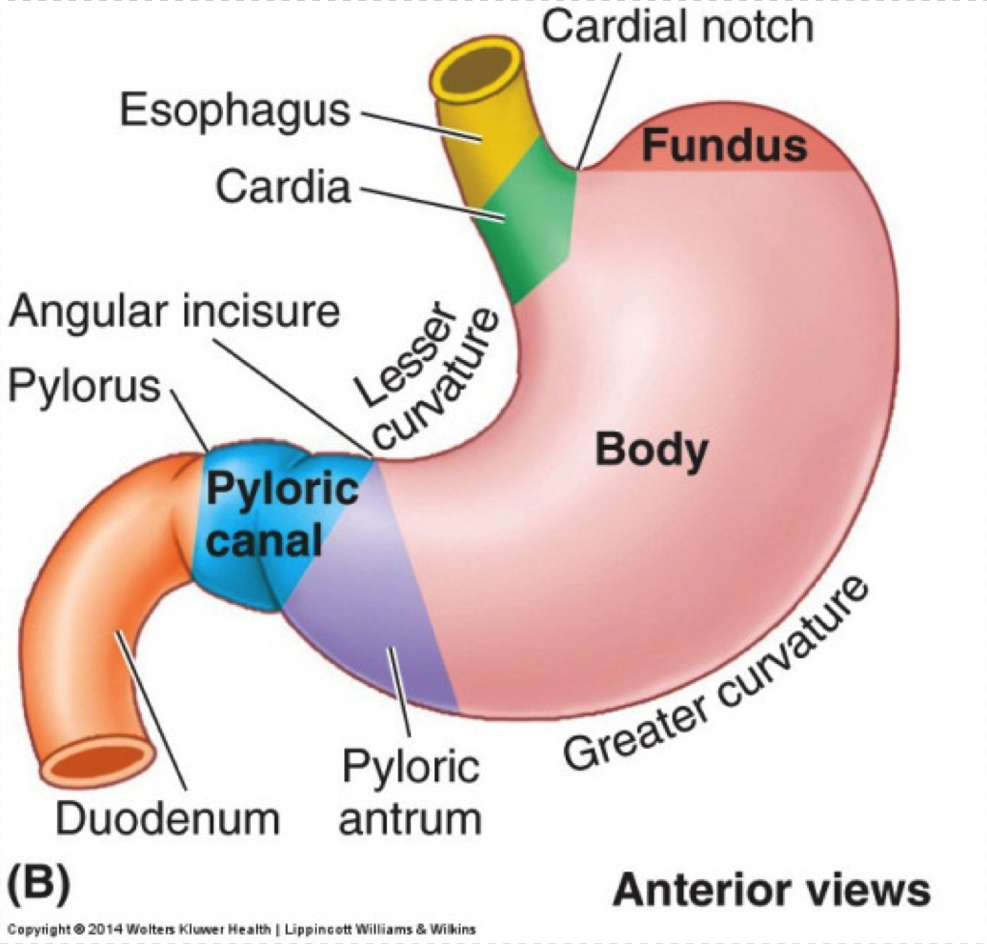
Subdivisions
Larger, cardiac part is further subdivided into the fundus and body, and the
Smaller, pyloric part is subdivided into the pyloric antrum and the pyloric canal

Slide 15
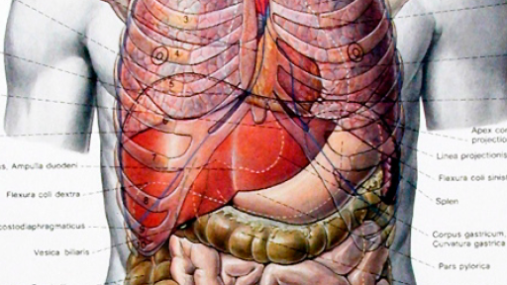
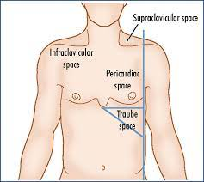
Fundus

Slide 16
Body or corpus of stomach

Slide 17
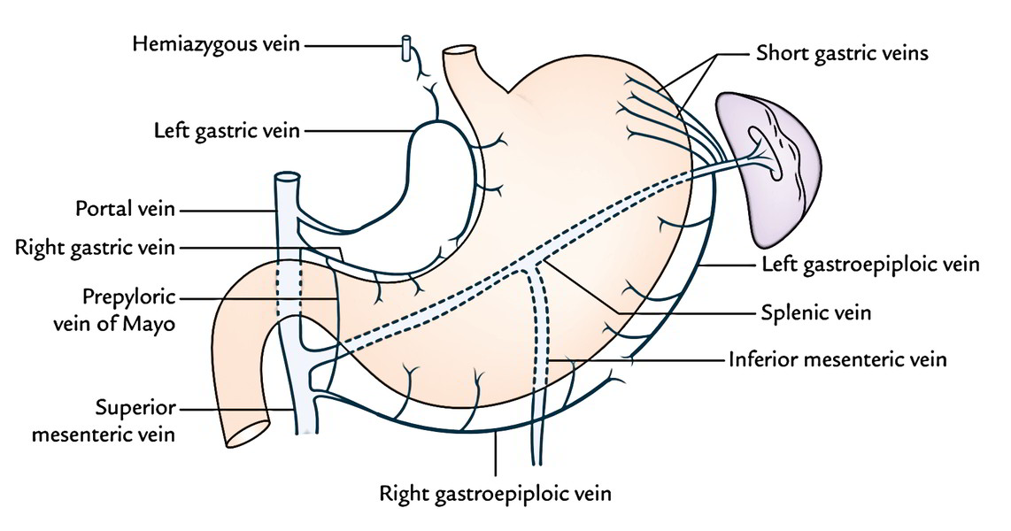
Pyloric part

Slide 18
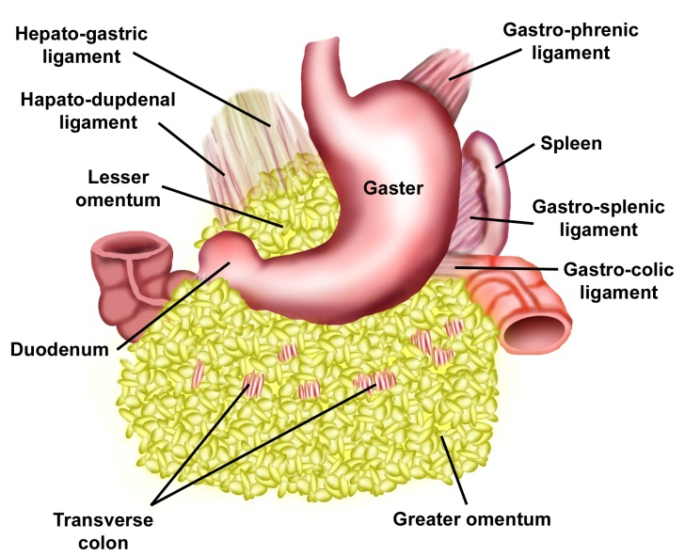
Relations of Stomach
Peritoneal Relations
  stomach is lined by peritoneum on both its surfaces. At the lesser curvature the layers of peritoneum lining the anterior and posterior surfaces meet and become continuous with the lesser omentum. Along the greater part of the greater curvature the two layers meet to form the greater omentum.

Slide 19
Near the fundus the two layers meet to form the gastrosplenic ligament. Near the cardiac end the peritoneum on the posterior surface is reflected on to the diaphragm as the gastrophrenic ligament.

Slide 20
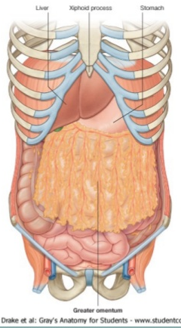
Visceral Relations
The anterior surface of the stomach is related to the liver, the diaphragm, and the anterior abdominal wall.

Slide 21
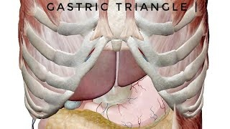
Gastric triangle

Slide 22
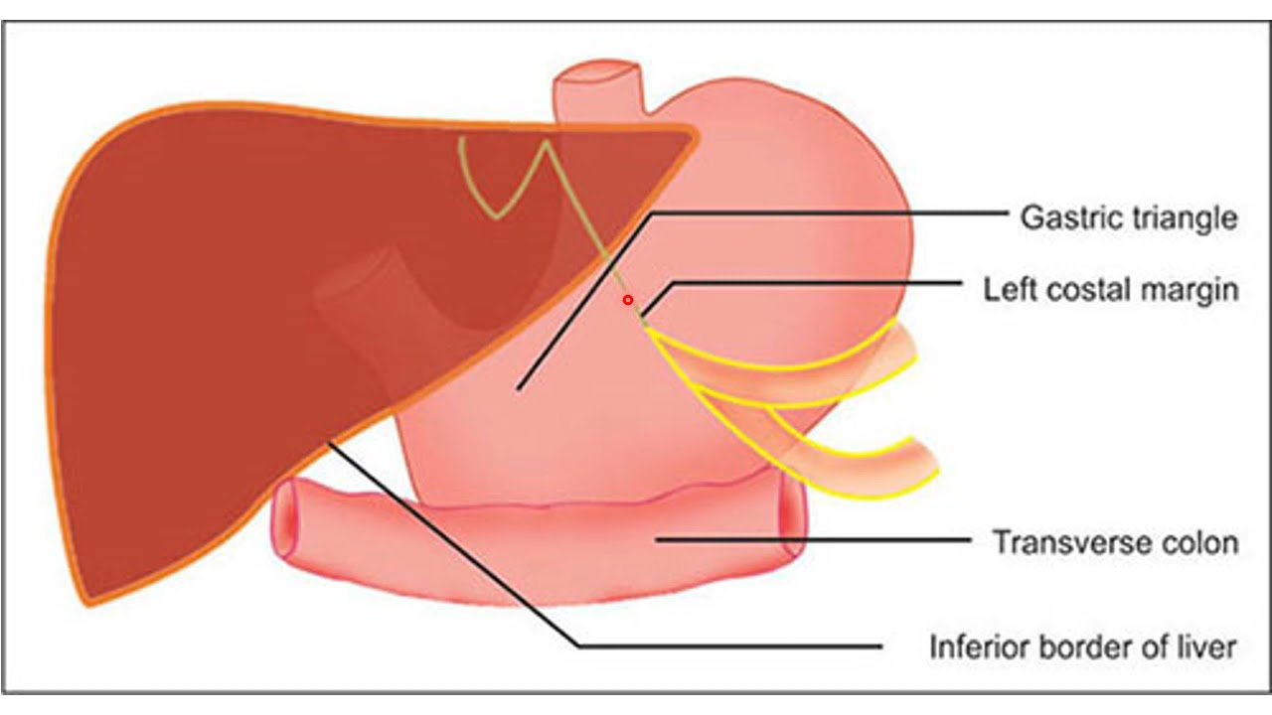

Slide 23
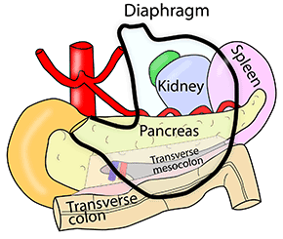
Stomach bed /posterior relations
(1) The diaphragm; (2) the left kidney; (3) the left suprarenal gland; (4) the pancreas; (5) the transverse mesocolon; (6) the splenic flexure of the colon; and (7) the splenic artery

Slide 24
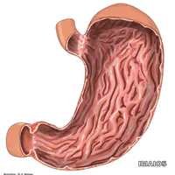
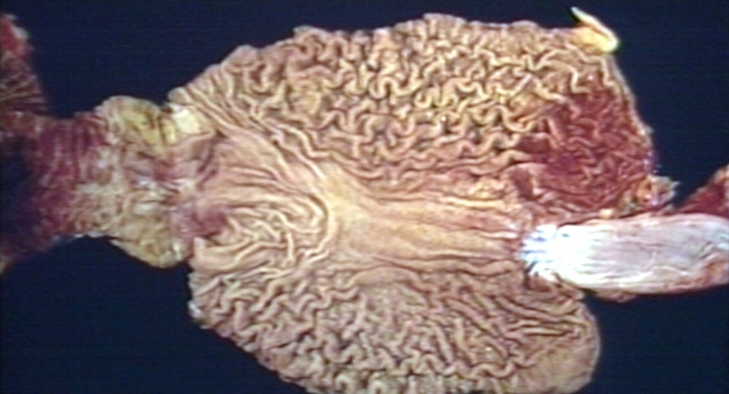
Interior of Stomach
1. The mucosa of an empty stomach is thrown into folds termed gastric rugae. The rugae are longitudinal along the lesser curvature

Slide 25
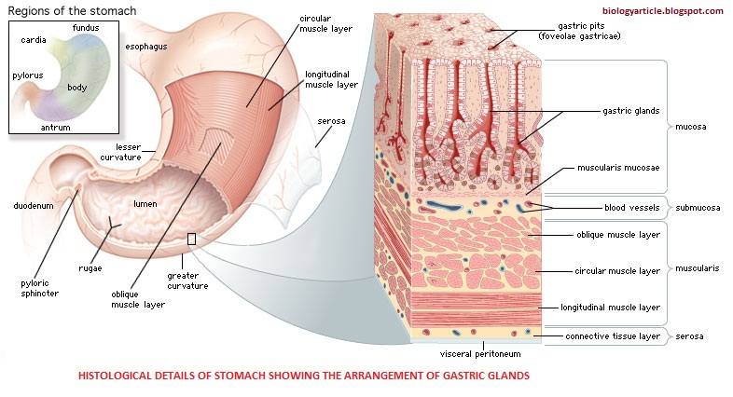
2. Submucous coat is made of connective tissue, arterioles and nerve plexus

Slide 26
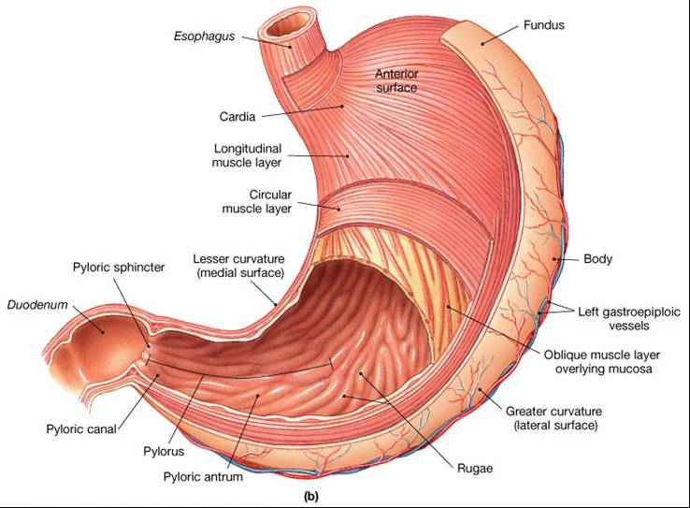
3. Muscle coat is arranged as under :
(i) Longitudinal fibres are most superficial mainly along the curvatures.
(ii) Inner circular fibres encircle the body and are thickened at pylorus to form pyloric sphincter.
(iii) The deepest layer consists of oblique fibres , spread in the fundus and body of stomach , on contraction form "gastric canal" for the passage of fluids.
4. Serous coat consists of the peritoneal covering

Slide 27
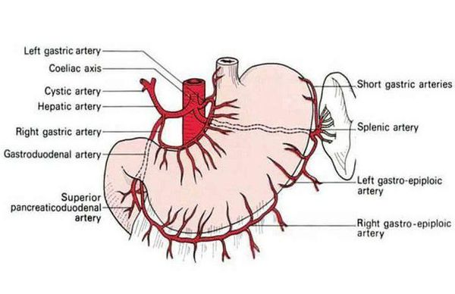
Blood Supply
The stomach is supplied by: (1) The left gastric artery, a branch of the coeliac trunk; (2) the right gastric artery, a branch of the common hepatic; (3) the right gastroepiploic artery, a branch of the gastroduodenal; (4) the left gastroepiploic artery, a branch of the splenic; and (5) 5 to 7 short gastric arteries, which are also branches of the splenic artery

Slide 28
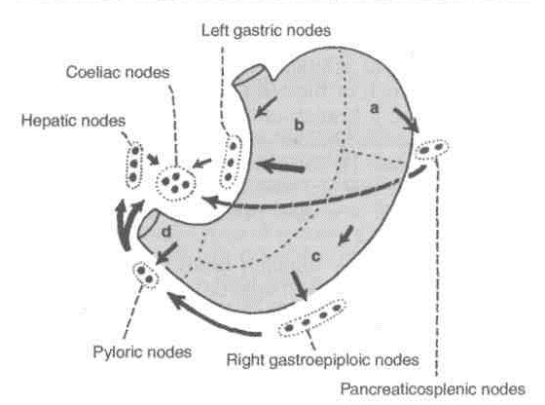
Lymphatic Drainage
The stomach can be divided into four lymphatic territories

Slide 30
Nerve Supply
The stomach is supplied by sympathetic and parasympathetic nerves. The sympathetic nerves are derived from thoracic six to ten segments of the spinal cord, These nerves are (a) vasomotor, (b) motor to the pyloric sphincter, but inhibitory to the rest of the gastric musculature; and (c) and are the chief pathway for pain sensations from the stomach
The parasympathetic nerves are derived from the vagi, through the oesophageal plexus and gastric nerves.

Slide 31
PARASYMPATHETIC SUPPLY

Slide 32
CLINICAL ANATOMY
1. Gastric pain is felt in the epigastrium because the stomach is supplied from segments T6 to T10 of the spinal cord, which also supply the upper part of the abdominal wall.

Slide 33
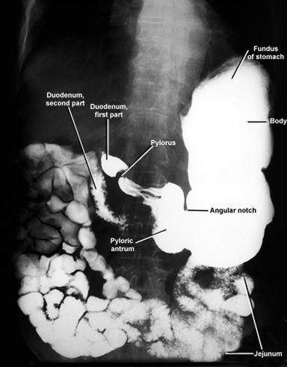
2. The interior of the stomach can be visualized by taking a X-ray after giving a barium meal .It can also be examined directly with the use of a gastroscope, which can be passed into the stomach through the mouth.

Slide 34
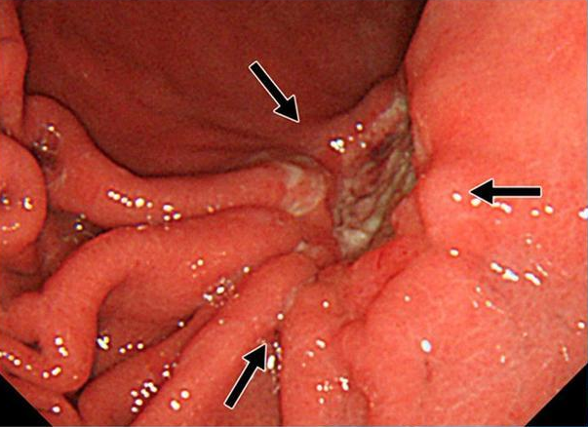
3. Peptic ulcer can occur in the sites of pepsin and hydrochloric acid, namely the stomach, first part of duodenum, lower end of oesophagus and Meckel's diverticulum
Gastric ulcer occurs typically along the lesser curvature.

Slide 35
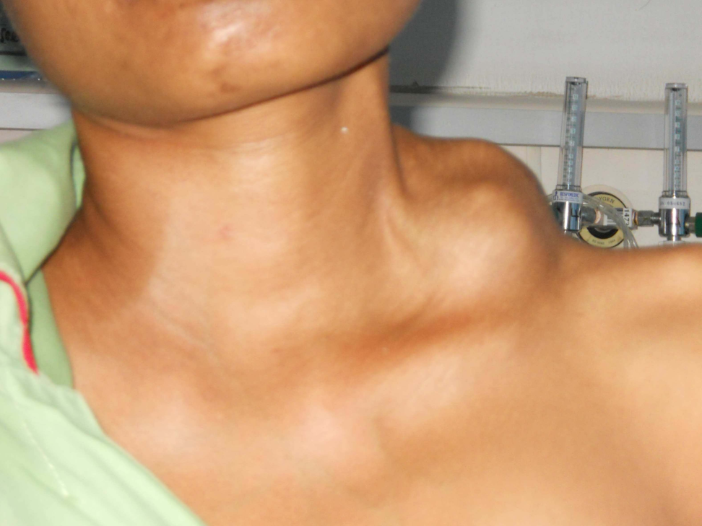
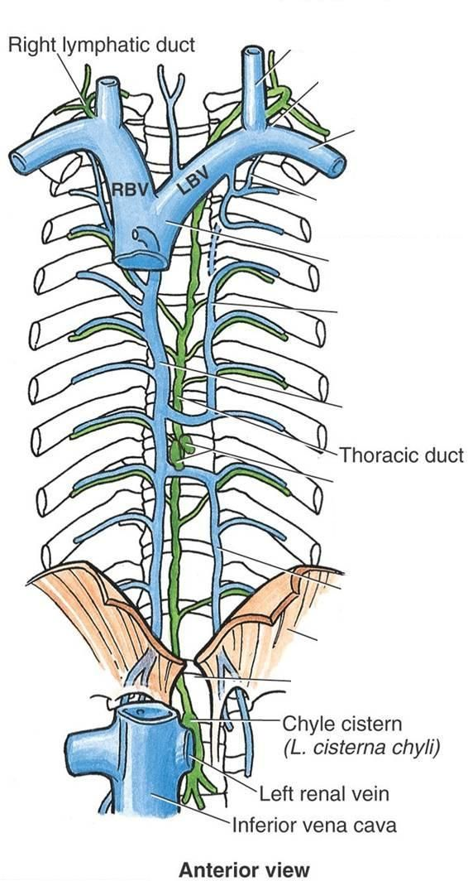
4. Gastric carcinoma is common and occurs along the greater curvature. On this account the lymphatic drainage of stomach assumes importance. Metastasis can occur through the thoracic duct to the left supraclavicular lymph node (Troisier's sign). These lymph nodes are called as "signal nodes".

Slide 36
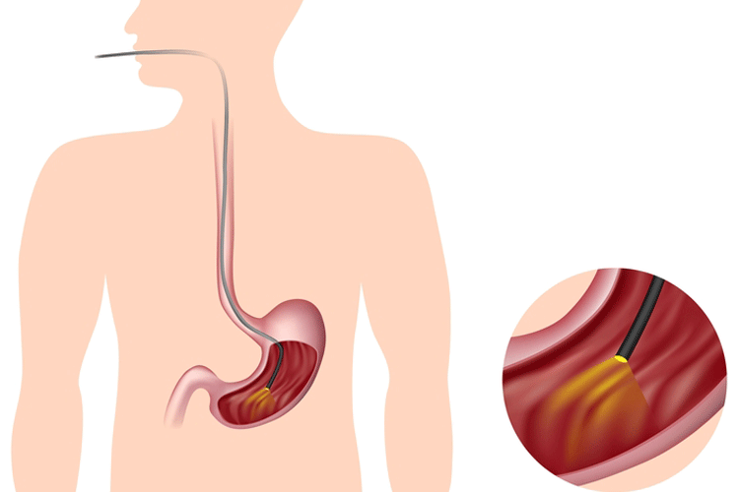
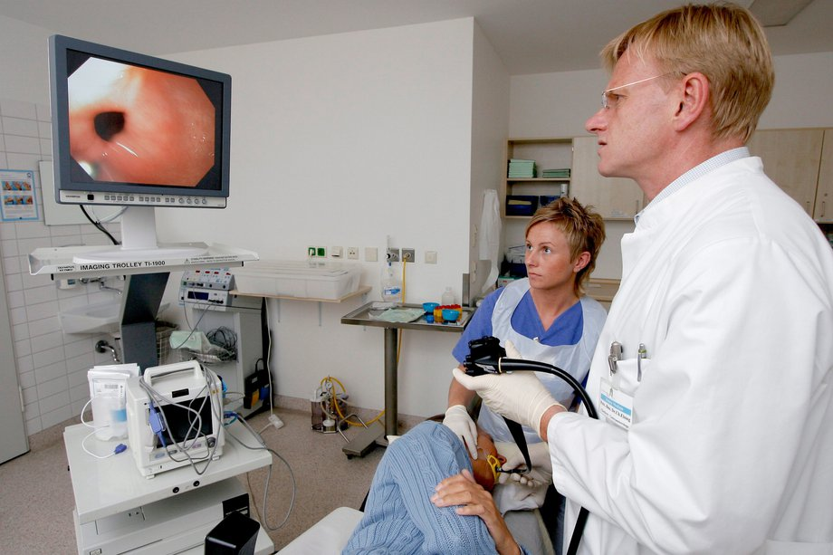
5. The common investigations of stomach axe:
(a) Chemical. Gastric analysis (fractional test meal) is done chiefly to estimate the gastric acidity.
(b) Radiological examination by the barium meal.
(c) Endoscopic: By gastroscopy the interior of stomach can be scanned under of direct vision.

Slide 37
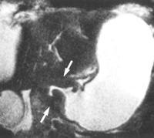
6. Pyloric obstruction can be congenital or acquired. It causes visible peristalsis in the epigastrium, and vomiting after meals

Slide 38
Vagotomy

