Slide 1
Spleen

Slide 2
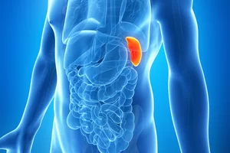
Introduction
Spleen is a lymphatic organ connected to the blood vascular system.
It acts as a filter for blood and plays an important role in the immune responses of the body

Slide 3
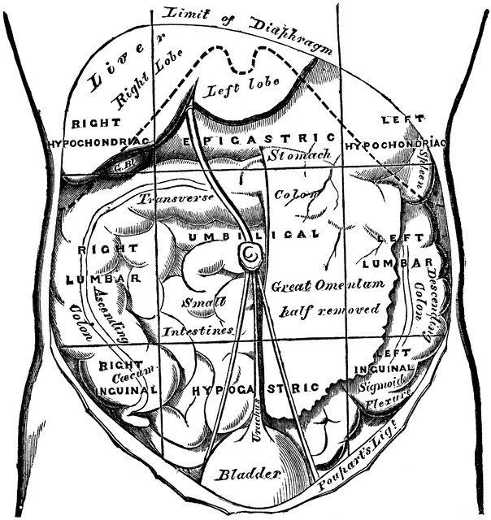
Shape and location
Spleen is a wedge-shaped organ
Located mainly in left hypochondrium, and partly in the epigastrium

Slide 4
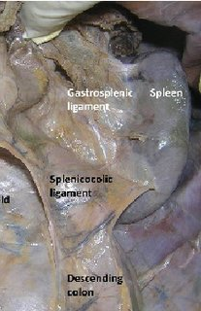
Texture and colour
spleen is soft, highly vascular and dark purple in colour.

Slide 5
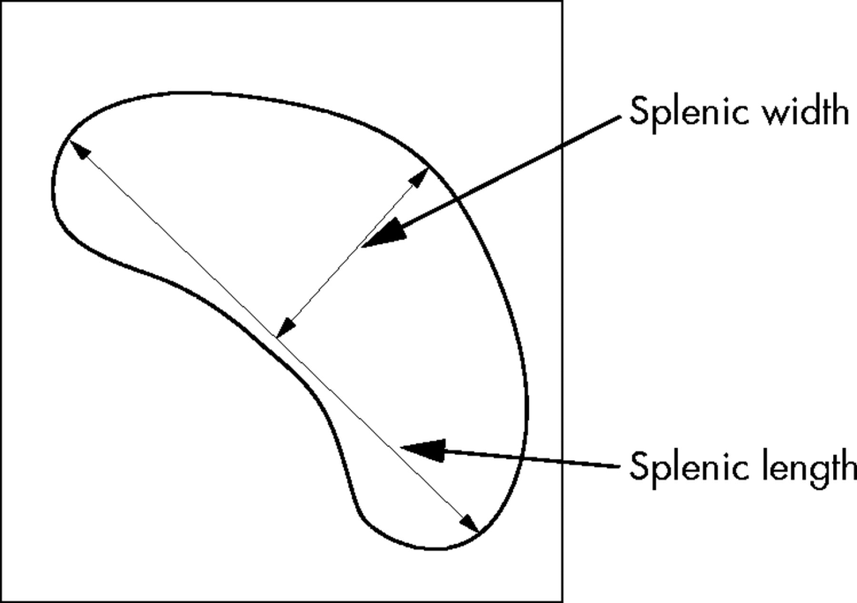
Dimensions
Size and weight of the spleen are markedly variable.
On an average the spleen is
1 inch or 2.5 cm thick,
3 inches or 7.5 cm broad,
5 inches or 12.5 cm long, 7 ounces in weight,
and is related to 9th to 11th ribs.
Normally, the spleen is not palpable

Slide 6
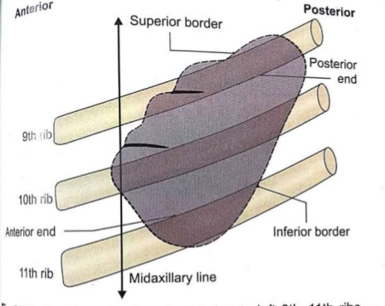
Position (Axis of Spleen)
The spleen lies obliquely along the long axis of the 10th rib.
Thus it is directed downwards, forwards and laterally,
making an angle of about 45 degrees with the horizontal plane

Slide 7
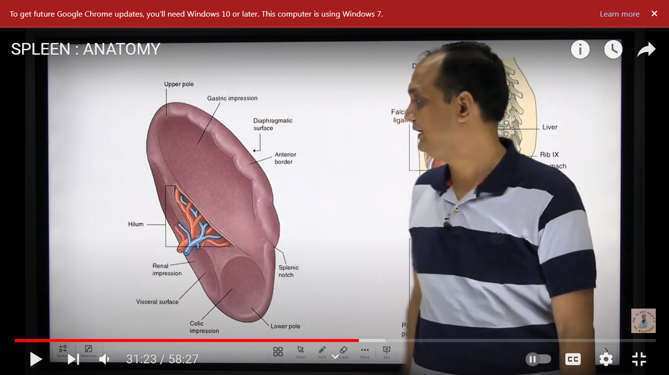
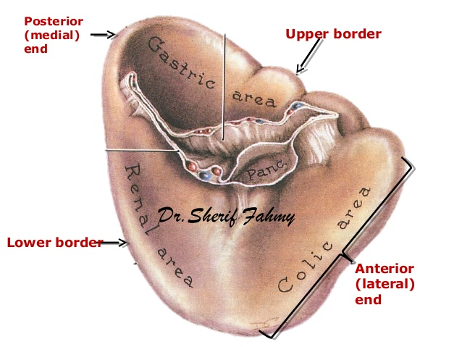
External Features
The spleen has two ends, three borders and two surfaces

Slide 8
Two Ends
The anterior end is expanded and is more like a border. It is directed downwards and forwards, and reaches the midaxillary line.
The posterior end is rounded. It is directed upwards, backwards and medially, and rests on the upper pole of the left kidney.

Slide 9
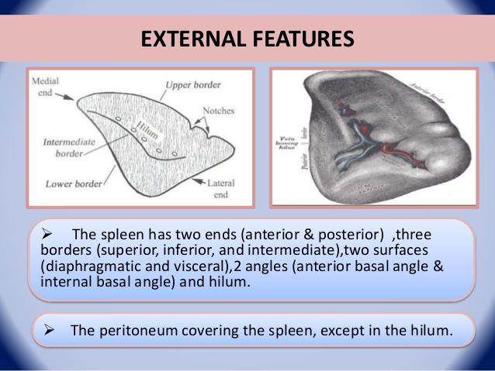
Borders
Superior border is characteristically notched near the anterior end.
Inferior border is rounded.
Intermediate border is also rounded and is directed to the right.

Slide 10
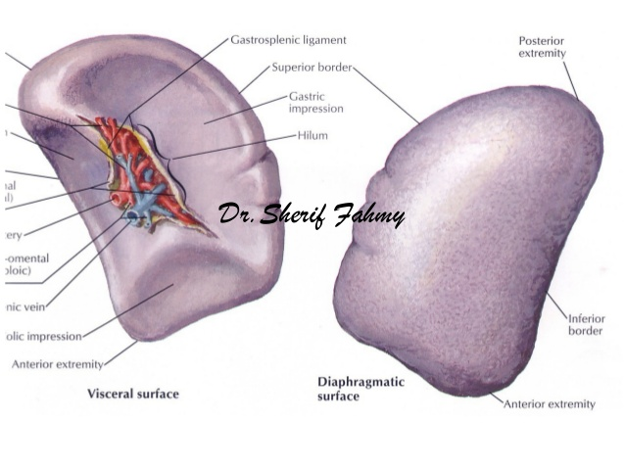
Surfaces
Diaphragmatic surface is convex and smooth
Visceral surface is concave and irregular.

Slide 11
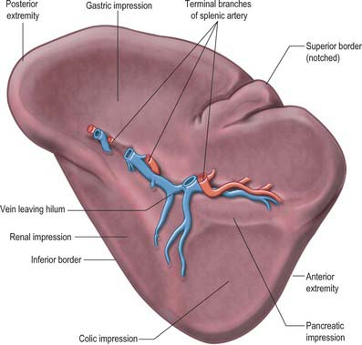
Visceral surface
It bears the following impressions.
Gastric impression, for the fundus of the stomach, lies between the superior and intermediate borders
Renal impression, for the left kidney, lies between the inferior and intermediate borders.
Colic impressions, for the splenic flexure of the colon, occupies a triangular area adjoining the anterior end of the spleen. Its lower part is related to the phrenicocolic ligament.
Pancreatic impression, for the tail of the pan-creas, lies between the hilum and the colic impression.

Slide 12
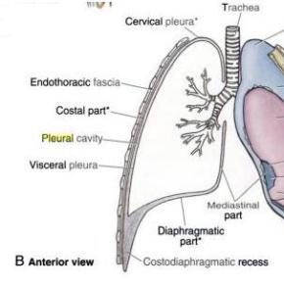
Diaphragmatic Surface
The diaphragmatic surface is related to the diaphragm which separates the spleen from the costo-diaphragmatic recess of pleura, lung and 9th, 10th and 11th ribs of the left side

Slide 13
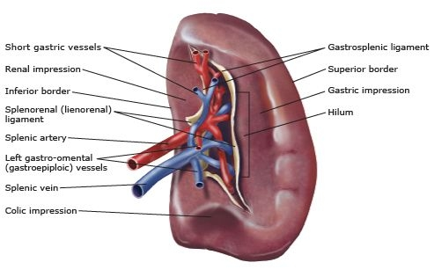
Hilum
Hilum lies on the inferomedial part of the gastric impression along the long axis of the spleen. It transmits the splenic vessels and nerves, and provides attachment to the gastrosplenic and lienorenal ligaments.

Slide 14
Relations
Spleen is surrounded by peritoneum, and is suspended by following ligaments
Gastrosplenic ligament extends from the hilum of the spleen to the greater curvature of the somach
Lienorenal ligament extends from the hilum of the spleen to the anterior surface of the left kidney. It contains the tail of the pancreas, the splenic vessels.
Phrenicocolic ligament is not attached to the spleen, but supports its anterior end.

Slide 15
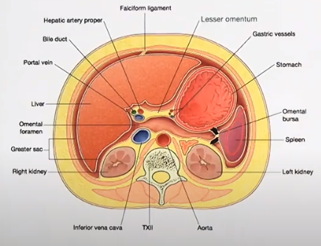

Slide 16
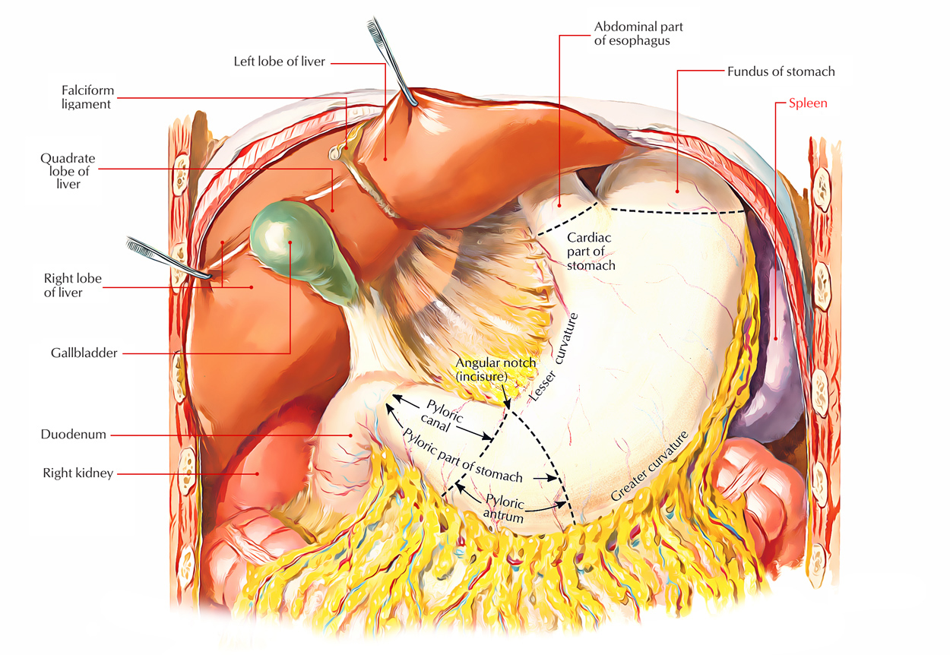

Slide 17
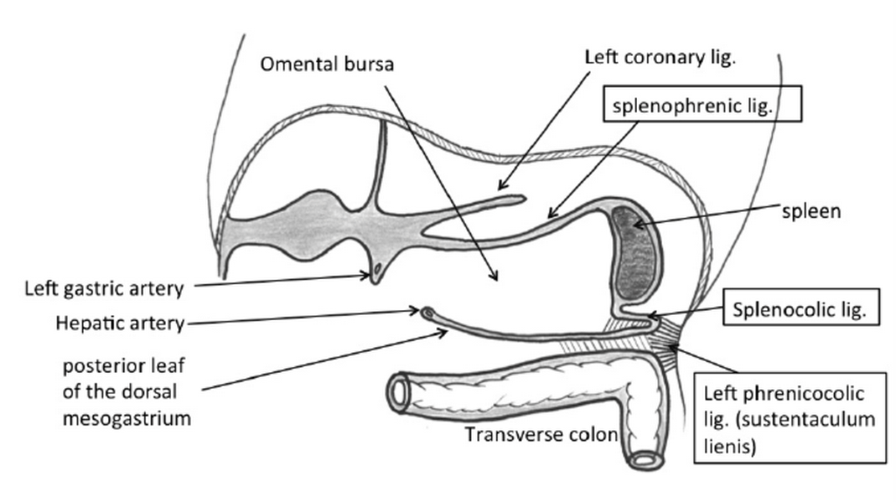

Slide 18
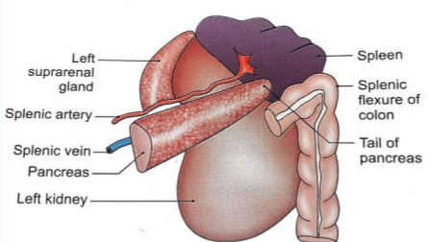
Visceral Relations
Visceral surface
It is related to the fundus of the stomach, the anterior surface of the left kidney, the splenic flexure of the colon and the tail of the pancreas.

Slide 19
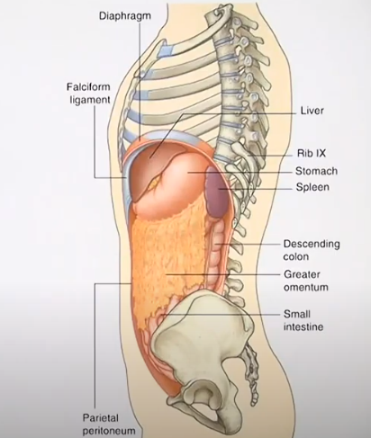

Slide 20
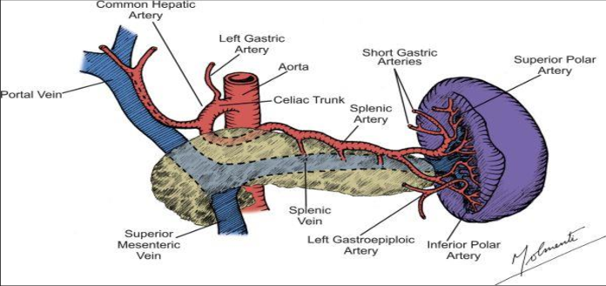
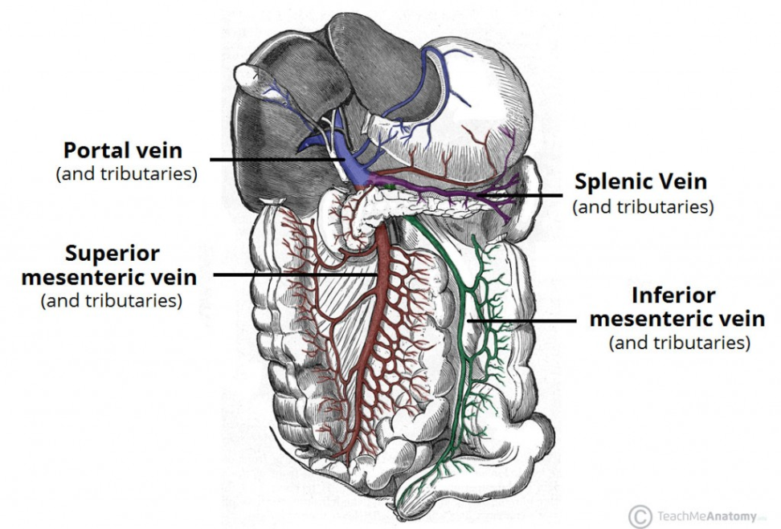
Blood supply
Spleen is supplied by the splenic artery which is the largest branch of the coeliac trunk. The artery is tortuous in its course to allow for movements of the spleen

Slide 21
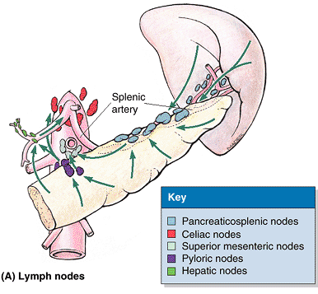
Lymphatic Drainage
Splenic tissue proper has no lymphatics. A few lymphatics arise from the connective tissue of the capsule and trabeculae and drain into the pan-creaticosplenic lymph nodes situated along the splenic artery.

Slide 22
Nerve Supply
Sympathetic fibres are derived from the coeliac plexus. They are vasomotor in nature.

Slide 23
Functions of the Spleen
1. Phagocytosis
2. Haemopoiesis
3. Immune responses:
Storage of RBCs

Slide 24
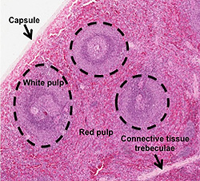
Histology

Slide 26
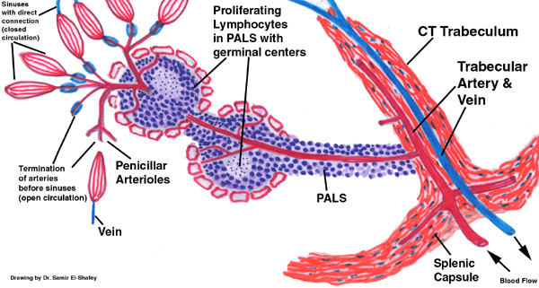

Slide 28
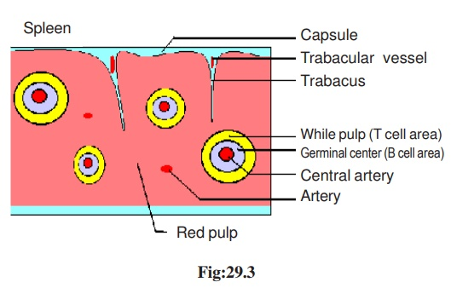

Slide 29
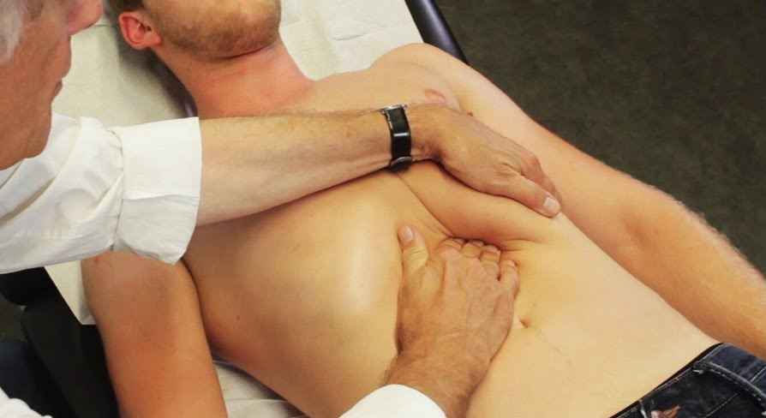
CLINICAL ANATOMY
1. Palpation of the spleen: A normal spleen is not palpable. An enlarged spleen can be felt under the left costal margin during inspiration.

Slide 30
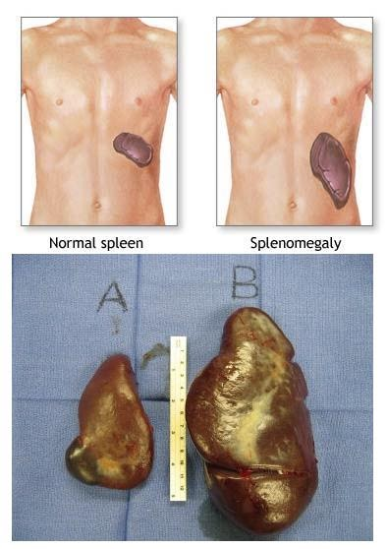
2. Splenomegaly: Enlargement of the spleen is called splenomegaly. It may occur in a number of diseases.
Parasitic infections, such as malaria. Cirrhosis and other diseases affecting the liver. Various types of hemolyticanemia — a condition characterized by early destruction of red blood cells. Blood cancers, such as leukemia

Slide 31
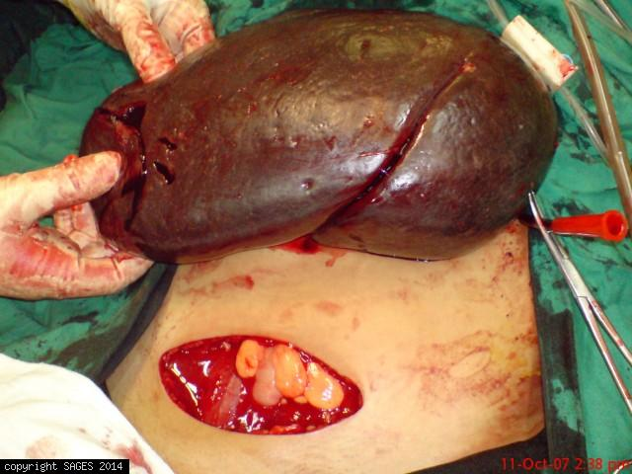
3. Splenectomy: Surgical removal of the spleen is called splenectomy. During this operation damage to the tail of the pancreas has to be carefully avoided, as the tail of pancreas is very rich in islets of Langerhans

Slide 32
4. Splenic puncture: Spleen can be punctured through the 8th or 9th intercostal space in the midaxillary line using a lumbar puncture needle. When enlarged, it can be punctured through the anterior abdominal wall.

Slide 33
5. Splenic infarction: The smaller branches of splenic artery are end arteries. Their obstruction (embolism) therefore results in splenic infarction which causes referred pain in the left shoulder (Kehr's sign).

Slide 34

KEHR’S SIGN

