Slide 1
Salivary glands

Slide 2
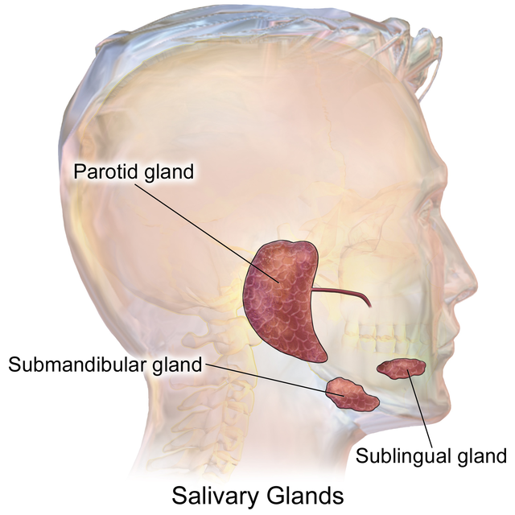
Saliva
Moistens and cleanses the mouth
Inhibit bacterial growth
Dissolves molecules
Helps in taste perception
Digest little starch and fat
Makes the food a small bolus
97-99.5% water
pH –6.8 -7

Slide 3
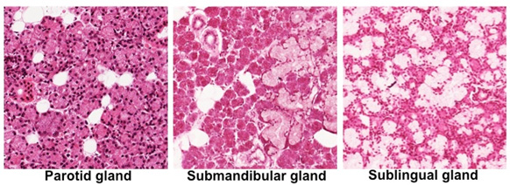

Slide 4
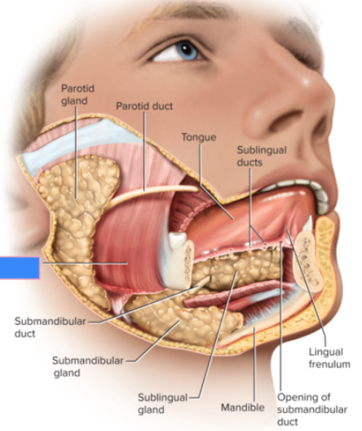
Salivary glands
Intrinsic & extrinsic
Intrinsic are indefinite number of glands dispersed amidst oral tissue –lingual glands, labial glands ,buccal glands ,palatal glands
Extrinsic are 3 pairs of discrete organs located outside oral mucosa . They are compound tubuloacinar glands

Slide 5
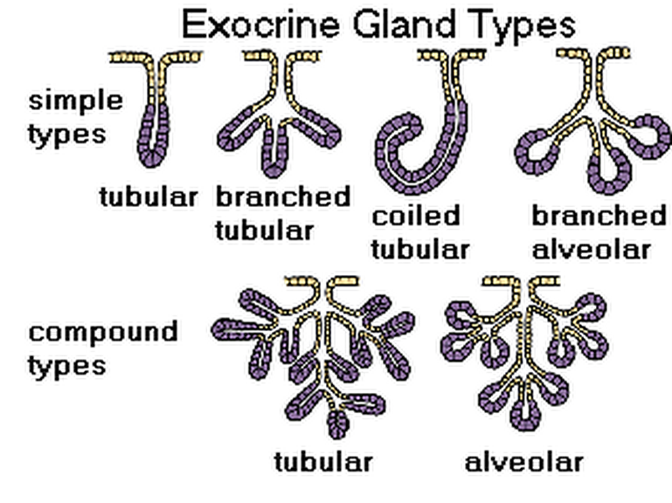

Slide 6
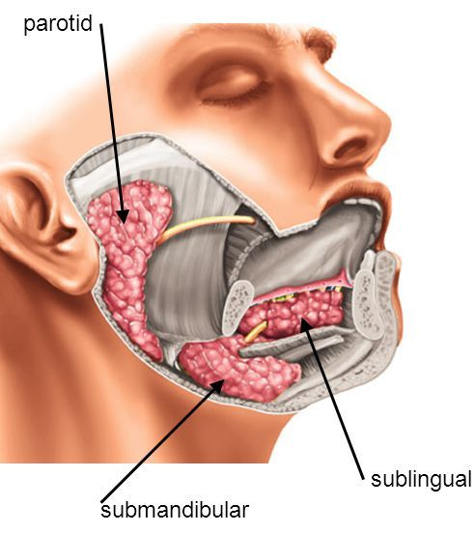
Three pairs of large, multicellular salivary glands:
  parotid glands
  submandibular glands
  sublingual glands

Slide 7
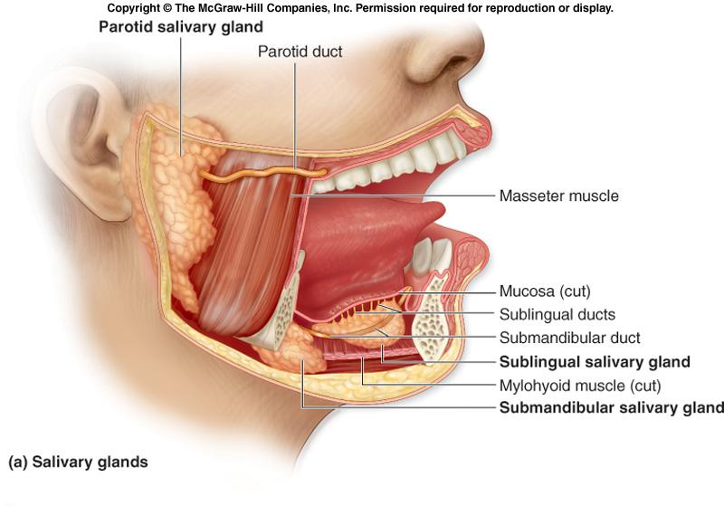

Slide 8
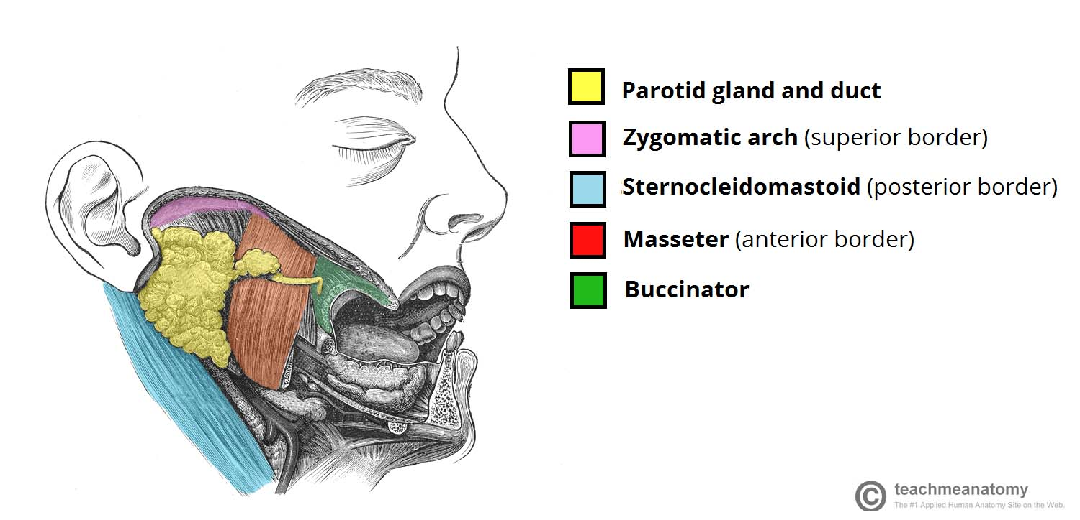
Parotid region
Posterolateral aspect of face
Boundaries
Anterior –posterior border of ramus of mandible
Posterior –external ear & sternocleidomastoid ,mastoid process
Superior –zygomatic arch ,external acoustic meatus
Inferior –posterior belly of digastric ,stylohyoid muscles
Medial –styloid process& muscles
Lateral –skin of face

Slide 9
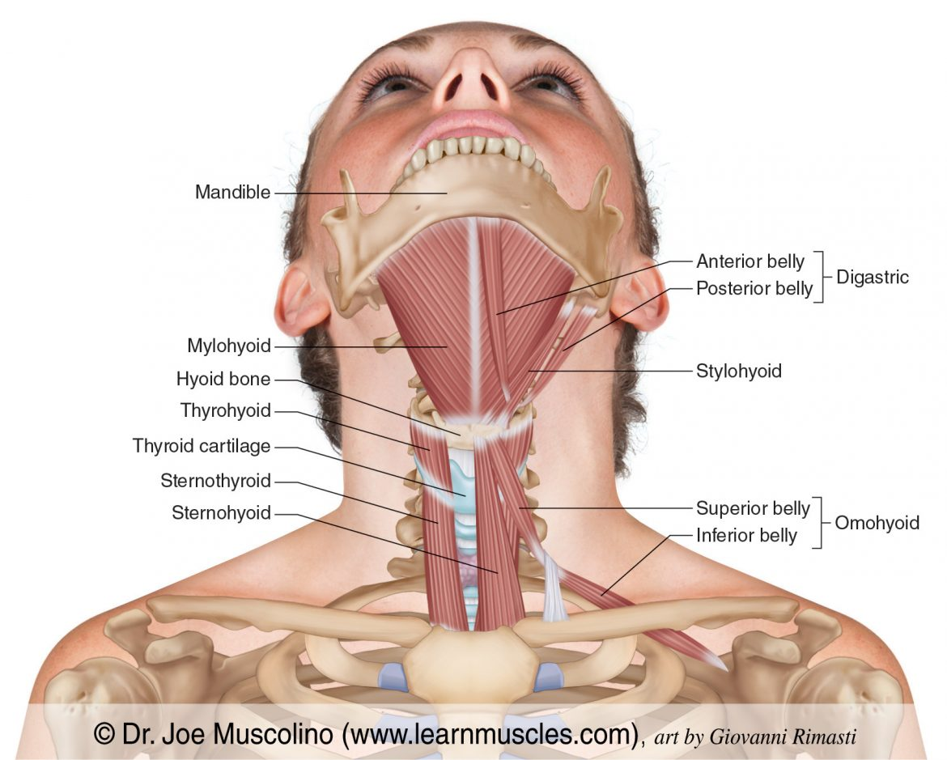

Slide 10
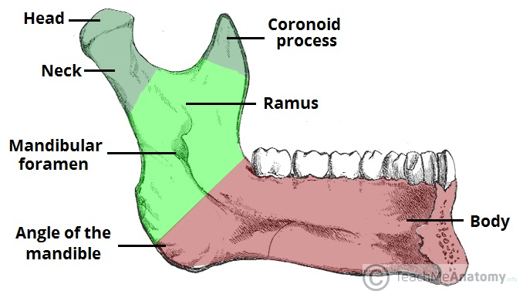

Slide 11
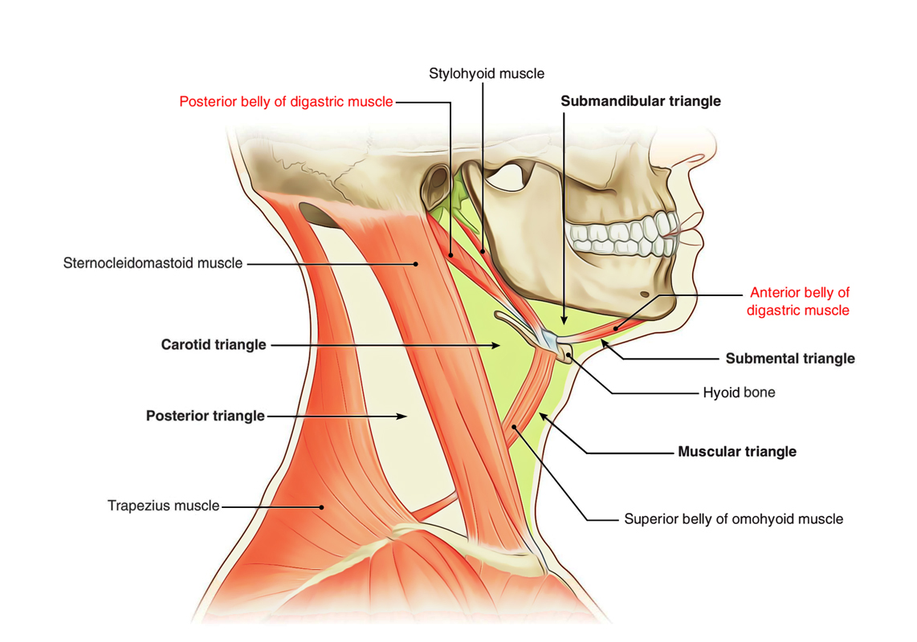

Slide 12
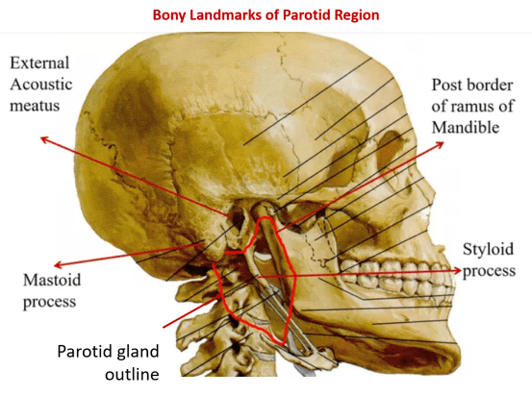

Slide 13
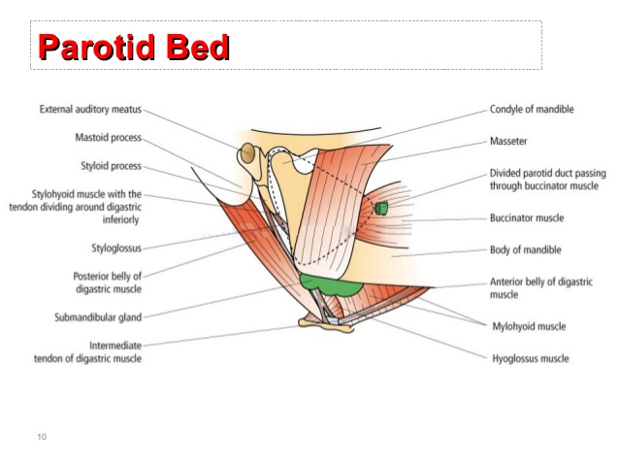

Slide 14
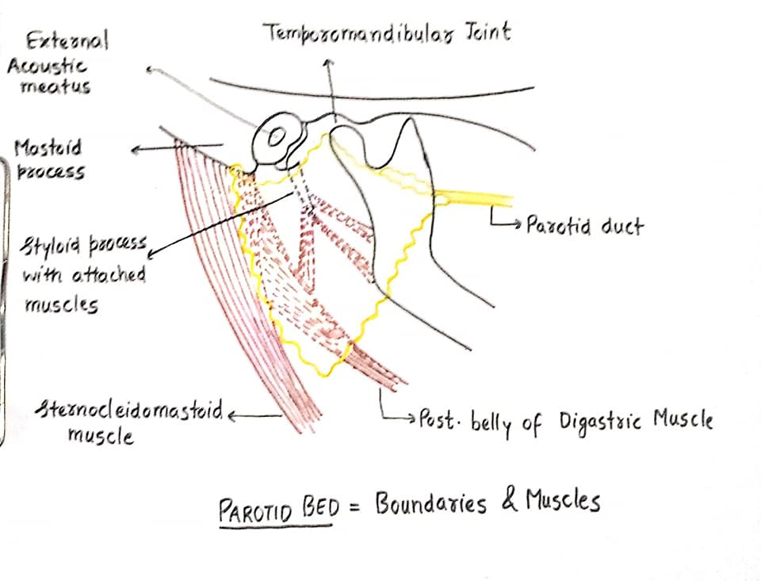

Slide 15
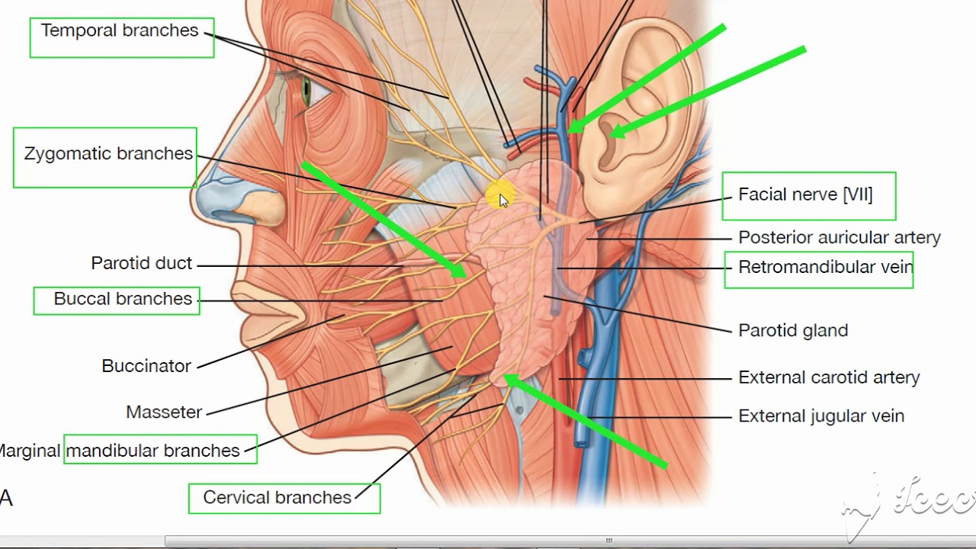

Slide 16
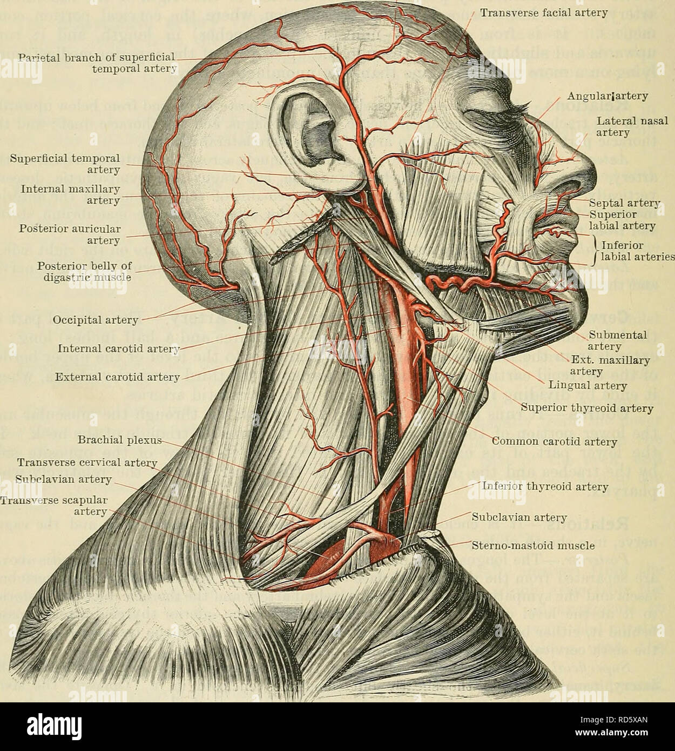

Slide 17
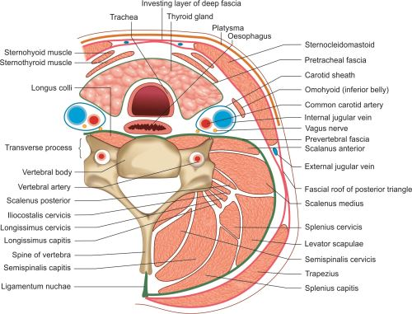

Slide 18
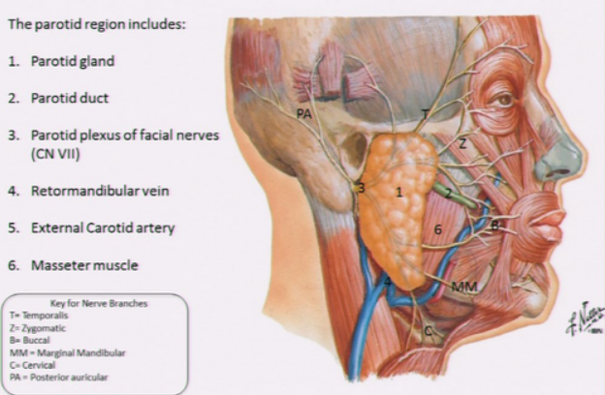
Contents of region
Parotid gland
Facial nerve –terminal branches –parotid plexus
Retromandibular vein
External carotid artery

Slide 19
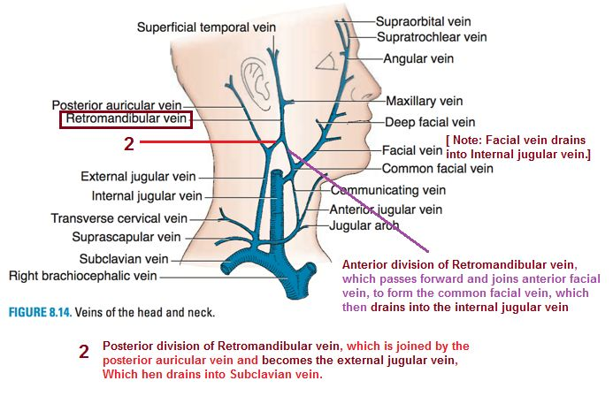

Slide 20
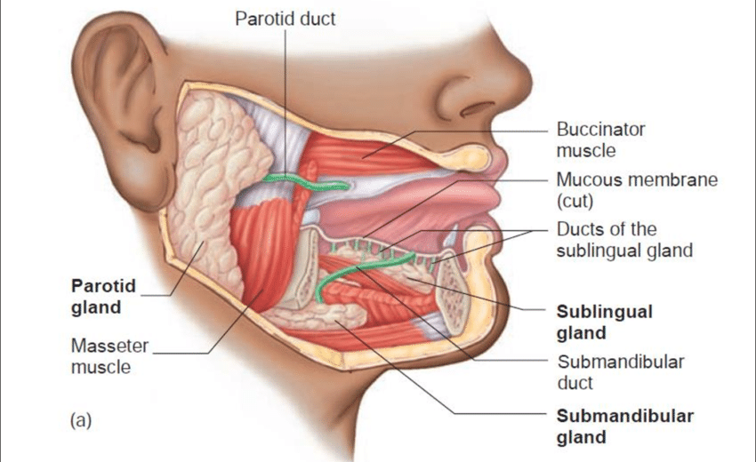
Parotid gland

Slide 21
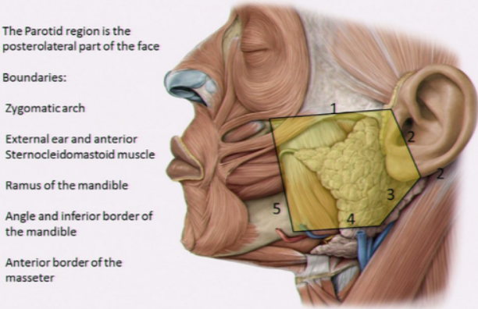
Parotid gland
Largest salivary gland
Located in parotid fossa –below external acoustic meatus ,behind mandible & in front of sternocleidomastoid
Shape –inverted pyramid
Weight - 15 - 25 gms
Anterior – ramus of mandible
Posterior – mastoid process /sternocleidomastoid
Above – zygomatic arch
Below ,medially – styloid process and 2cm below angle of mandible

Slide 22
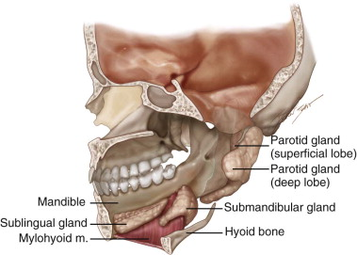

Slide 23
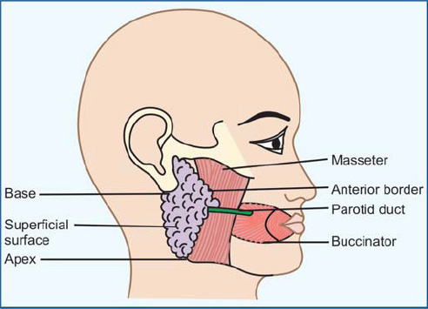
Presenting parts
Apex
Base
3 borders –anterior ,posterior ,medial
3 surfaces –superficial /lateral ;anteromedial ,posteromedial

Slide 24
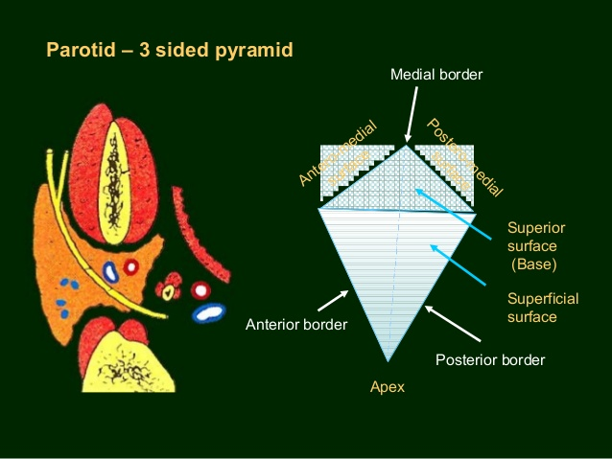

Slide 25
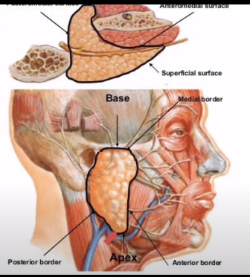
Apex
Narrow ,downwards
Between sternocleidomastoid and angle of mandible
Cervical branch of facial nerve emerges through apex
Two divisions of retromandibular vein

Slide 26
Base /superior
Broader ,concave
Related to EAM, & posterior surface of temporomandibular joint
Related to auriculotemporal nerve
Glenoid process –part extending
between TMJ &EAM

Slide 27
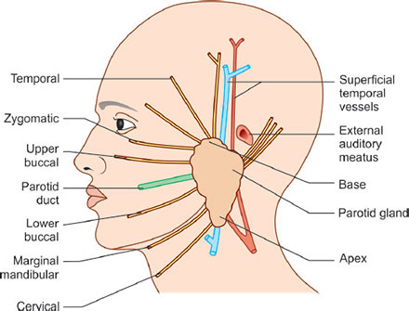
Structures passing through the base
Temporal branch of facial nerve
Superficial temporal vessels
And auriculo-temporal nerve

Slide 28
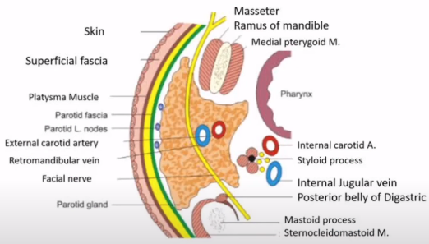
Lateral surface
Flat ,covered by skin & fascia
Anteriorly extends superficial to massater
Posteriorly overlaps sternocleidomastoid
In fascia –fibres of platysma ,lymph nodes of superficial parotid group

Slide 29
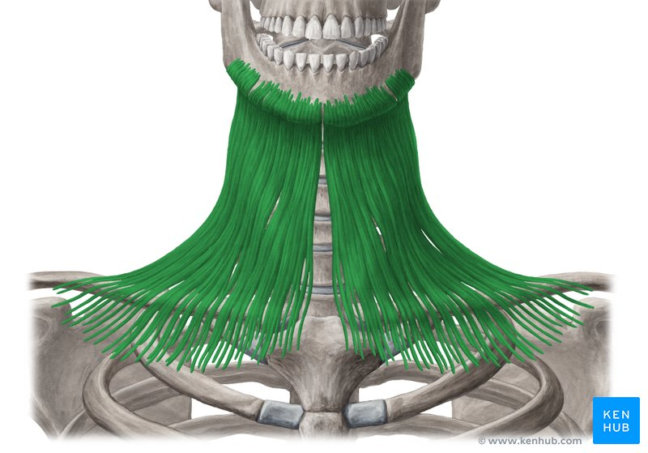

Slide 30
Anteromedial
Contact with 1 bone & 2 muscles
2 processes
Bone –ramus of mandible
Muscles –masseter ,medial pterygoid
Process –
Accessory /facial –part of gland over masseter
Pterygoid -part extending to pterygoid muscles
Maxillary artery leaves & maxillary vein enters through this surface

Slide 31
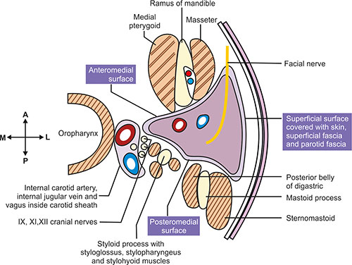
Posteromedial
Moulded to mastoid process
2 parts –upper & lower
Upper –facial nerve enters
Lower –external carotid artery enters
Related to styloid process & muscles which separate it from internal carotid artery & internal jugular vein
Carotid process –gland extending posterior to external carotid

Slide 32
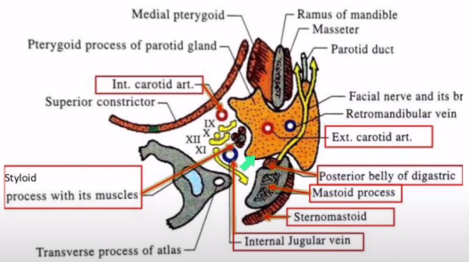

Slide 33
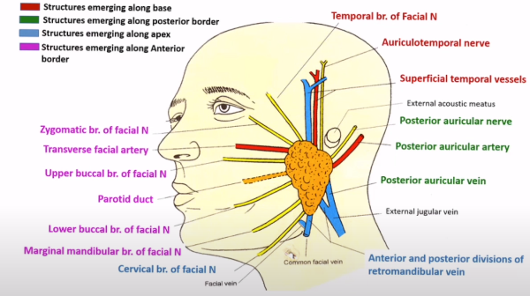
Borders
Anterior –separates lateral &anteromedial surfaces
branches of facial nerve emerge from this border
parotid duct
Transverse facial vessels

Slide 34
Structures emerging through the anterior border

Slide 35
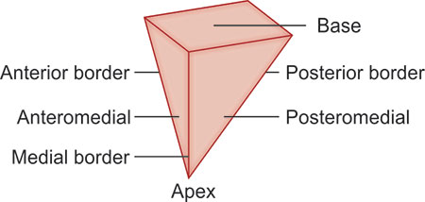
Posterior - separates lateral & posteromedial surfaces
Overlaps sternocleidomastoid
Medial /pharyngeal border – separates anteromedial & posteromedial surfaces
Related to lateral wall of pharynx

Slide 36
Structures emeging from the posterior border

Slide 37
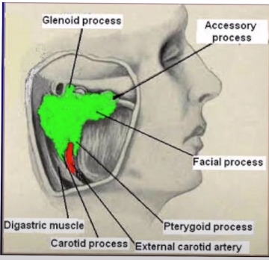

Slide 38
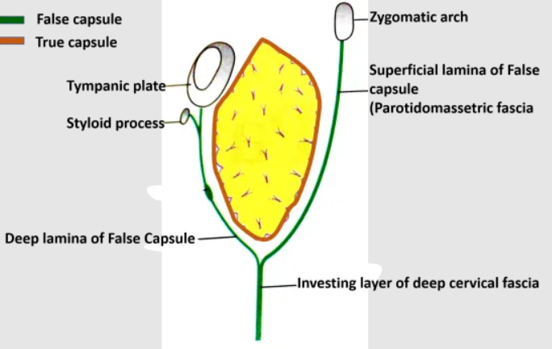
Parotid capsule
Tough fascial sheath –from investing layer of deep cervical fascia
At lower end ,the layer divides into two –superficial & deep
Superficial –attached to lower border of zygomatic arch ,thick and strong ,blends with fascia of massater to form parotidomasseteric fascia
Deep –ascends deep to gland ,thin,attached to styloid process , tympanic plate & mandible.
Thickened band from styloid to posterior margin of ramus of mandible –stylomandibular ligament
Separates parotid from submandibular

Slide 39
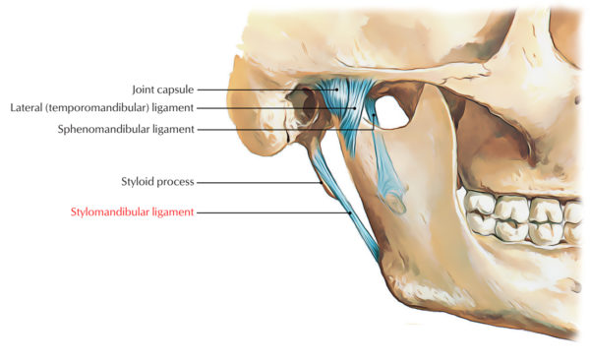

Slide 40
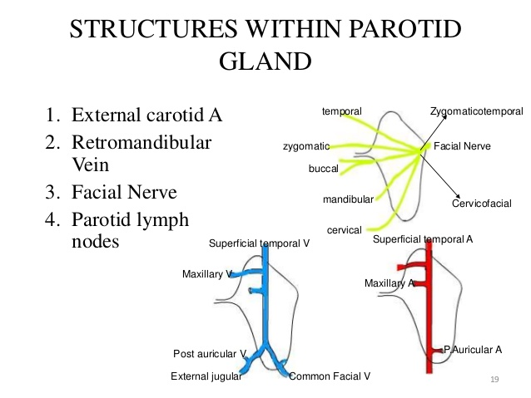

Slide 41
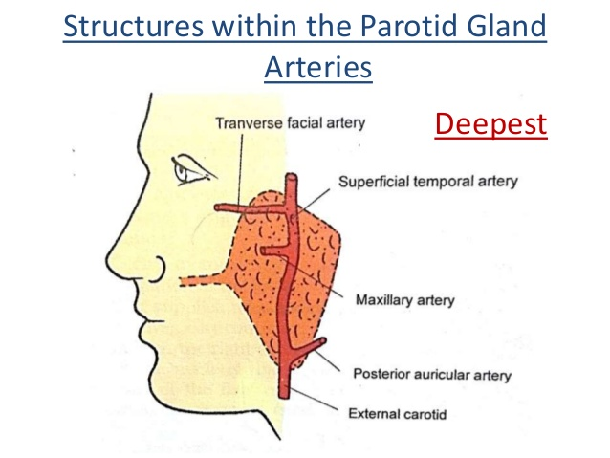

Slide 42
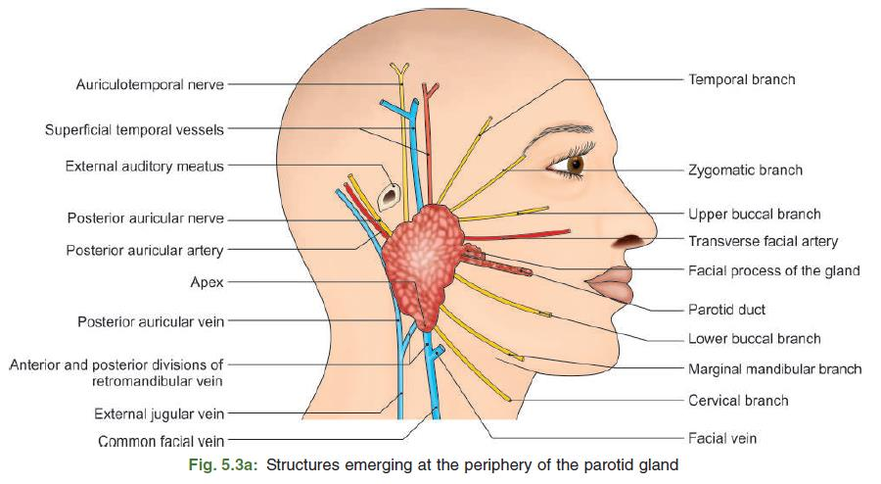
Structures in the gland
Facial nerve
Enters through upper part of posteromedial surface
Divides into temperofacial & cervicofacial trunks
Temporal –temporal & zygomatic
Cervical –buccal ,marginal mandibular, cervical
Terminal branches radiate like goose’s foot – pes anserinus
Trunks divide the gland into superficial & deep part with an isthmus in between

Slide 43
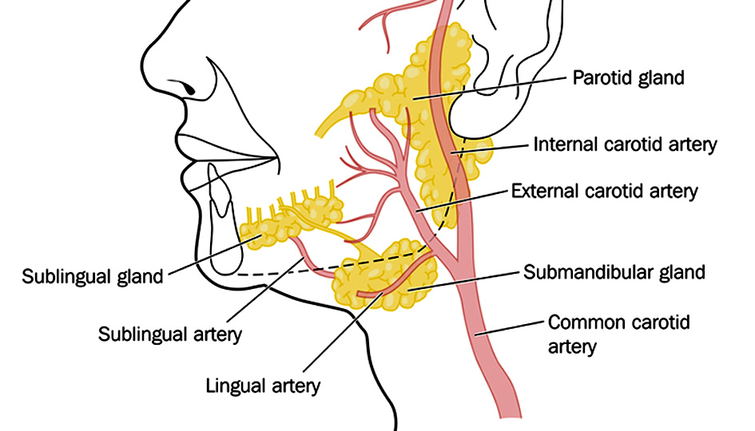
External carotid artery
Enters lower part of posteromedial surface
Ascends and divides into terminal branches –superficial temporal & maxillary
Emerge through anteromedial surface
Posterior auricular artery arises just before the vessel enters the gland

Slide 44
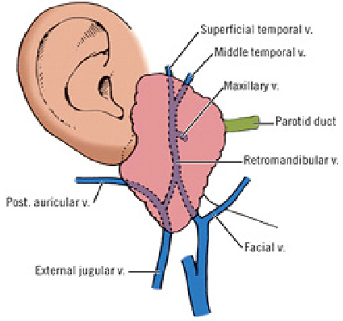
Retromandibular vein
Union of superficial temporal and maxillary veins
Divides into anterior and posterior divisions
Divisions emerge through the apex
Anterior branch + anterior branch of facial vein –common facial vein –internal jugular vein
Posterior branch + posterior auricular vein -external jugular vein

Slide 45
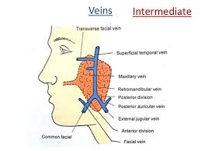

Slide 46
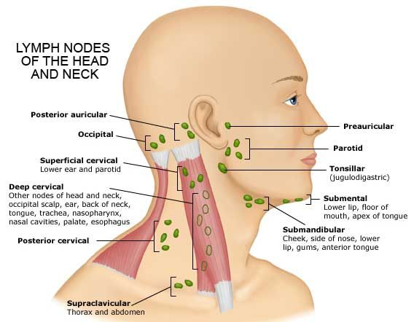
Parotid nodes
Superficial parotid nodes –on lateral surface
Deep -within the gland

Slide 47

Neurovascular plane of gland
Superficial -facial nerve
Intermediate –retromandibular vein
Deep - external carotid artery

Slide 49
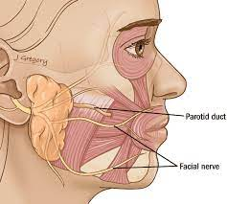
Parotid duct -Stenson’s duct
Formed by union of 2 ducts within the gland
Length -5 cm ,diameter -3 cm
Emerges from middle of anterior border of parotid gland
Runs forwards across masseter
At anterior border of masseter ,turns medially & pierces buccal pad of fat , buccopharyngeal fascia & buccinator.
Opens into vestibule of mouth opposite the crown of upper 2nd molar tooth

Slide 50


Slide 51
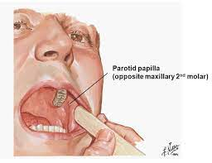

Slide 52
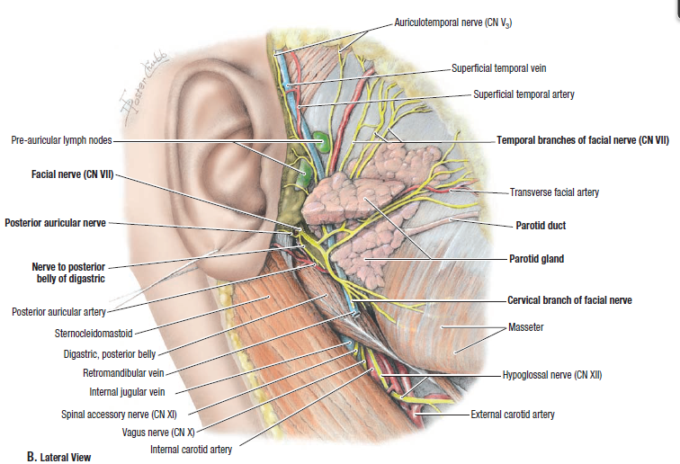
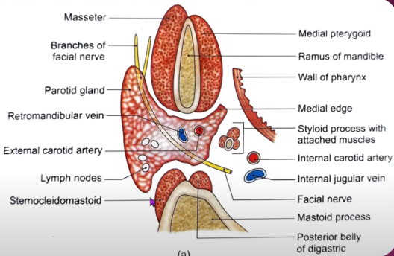

Slide 53
Blood supply
External carotid artery & divisions
Veins drain into internal jugular veins & external jugular veins

Slide 54
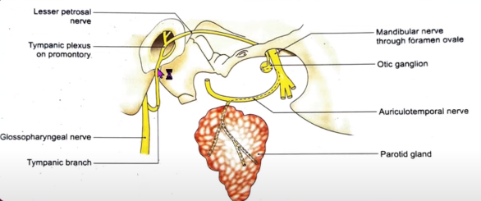
Nerve supply
Parasympathetic –
Inferior salivatory nucleus – glossopharyngeal nerve –tympanic plexus in tympanic cavity –lesser petrosal nerve –otic ganglion –auriculotemporal nerve –parotid gland .stimulation produces thin & watery saliva
Sympathetic – cervical ganglia – external carotid plexus –to gland .stimulation causes vasoconstriction result in reduced secretion
Sensory – great auricular & auriculotemporal nerve

Slide 55
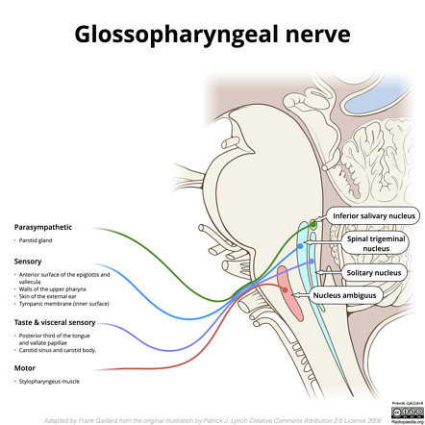

Slide 56
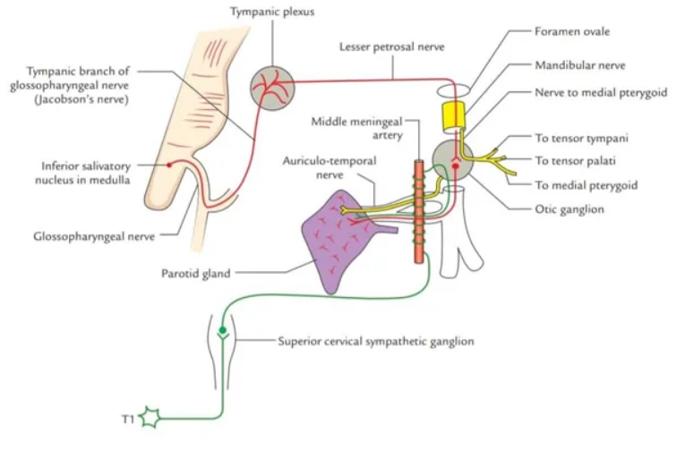

Slide 57
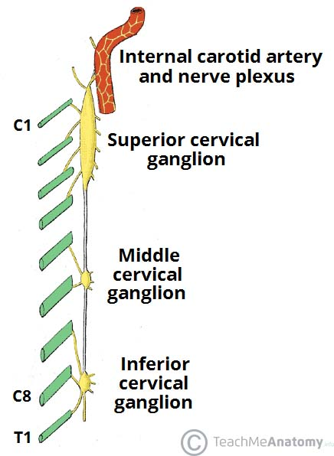

Slide 58
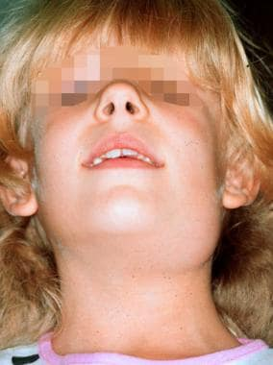
Applied anatomy
Parotitis refers to inflammation of the parotid gland, usually as a result of an infection. The parotid gland is enclosed in a tough fibrous capsule. This limits swelling of the gland, producing pain.
The pain produced can be referred to the external ear. This is because the auriculotemporal nerve provides sensory innervation to the parotid gland and the external ear.

Slide 59

Submandibular gland
Located in the submandibular region
Walnut in shape
10-20 gms
Partly below & partly deep to body of mandible
Has a large superficial & a small deep parts which are continuous around the posterior border of mylohyoid

Slide 60



Slide 61

Superficial part
Has 2 ends & 3 surfaces
2 ends –anterior & posterior
3 surfaces –inferior,medial,lateral

Slide 62

Anterior end –extend upto anterior belly of digastric
Posterior end - extend upto stylomandibular ligament ,presents a groove for lodgement of ascending part cervical loop of facial artery
Inferior surface –in digastric triangle ,facing laterally
covered by skin ,superficial fascia ,platysma ,deep cervical fascia, submandibular lymph nodes present

Slide 63

Lateral surface
Related with body of mandible
Relations –submandibular fossa of mandible
Posterior part separated from mandible by medial pterygoid
Related to cervical loop of facial artery

Slide 64


Slide 65


Slide 66

Medial surface
Anterior part –related to mylohyoid ,mylohyoid vessels & nerve
Intermediate – rest on hyoglossus ,lingual nerve ,submandibular ganglion ,hypoglossal nerve ,intermediate tendon of digastric
Posterior part – styloglossus ,stylopharyngeus ,glossopharyngeal nerve,posterior belly pf digastric ,middle constrictor of pharynx ,hypoglossal nerve ,1st part of lingual artery

Slide 67


Slide 68



Slide 69

Deep part
Extends in the interval between mylohyoid laterally and hyoglossus medially
Related to lingual nerve and submandibular ganglion superiorly and to hypoglossal nerve inferiorly
Extends upto posterior end of sublingual gland

Slide 70

Submandibular duct
5 cm long
Wharton’s duct
Begins from the deep surface of the superficial part behind posterior border of mylohyoid
Duct passes upwards & backwards and then forwards for 4-5 mm through deep part of gland between mylohyoid & hyoglossus
Then runs anteriorly between sublingual gland and genioglossus
Finally opens in oral cavity on sublingual papilla

Slide 71

Blood supply of the submandibular salivary gland

Slide 72

Sublingual gland
Smallest
Almond shape
3-4 gms
In the floor of anterior part of oral cavity deep to oral mucous membrane

Slide 73

Relations
Inferiorly – mylohyoid
Posteriorly –near the deeper part of submandibular gland
Laterally -in contact with sublingual fossa
Medially – rest on genioglossus
Secretions of gland –number of small ducts –duct of Rivinus
Small duct from anterior part join to form Bartholin duct which opens along with submandibular duct

Slide 74


Slide 75


Slide 76

Histology
Large serous gland –compound tubular acinar type
Stroma & parenchyma
Stroma - connective tissue capsule ,septa extending into gland dividing it into lobes & lobules .septa contains blood vessels , nerves & ducts of glands
Parenchyma – secretory parts and ducts

Slide 77


Slide 78


Slide 79


Slide 80


