Slide 1
Respiratory system

Slide 2
Contributes to homeostasis by providing for the exchange of gases –oxygen and carbon dioxide – between atmospheric air ,blood and tissue cells .

Slide 3
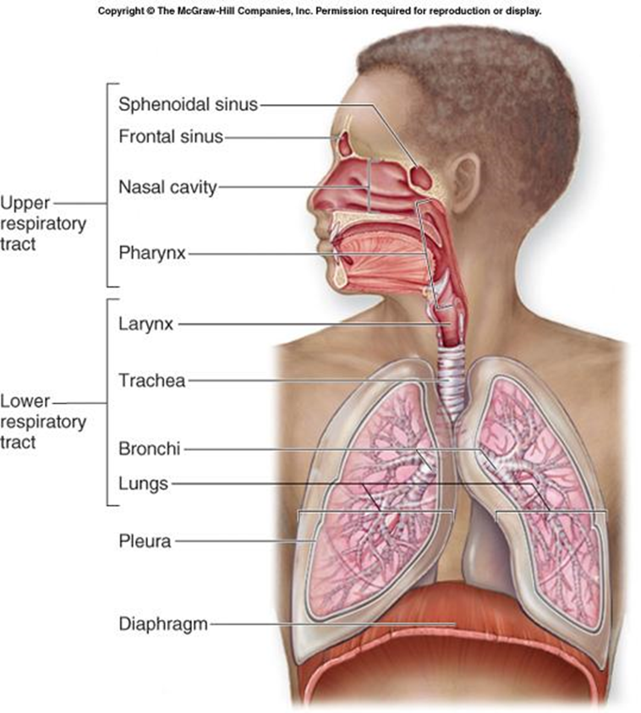
Structural classifications:
  upper respiratory tract
  lower respiratory tract.
functional classifications:
Conducting portion: transports air.
  Respiratory portion: carries out gas exchange.

Slide 4
Functional classifications: continued
  Conducting portion: transports air.
    Nose
    nasal cavity
    Pharynx
    Larynx
    Trachea
    progressively smaller airways, from the primary bronchi to the bronchioles
  Respiratory portion: carries out gas exchange.
    respiratory bronchioles
    alveolar ducts
    air sacs called alveoli
Upper respiratory tract is all conducting
Lower respiratory tract has both conducting and respiratory portions

Slide 5
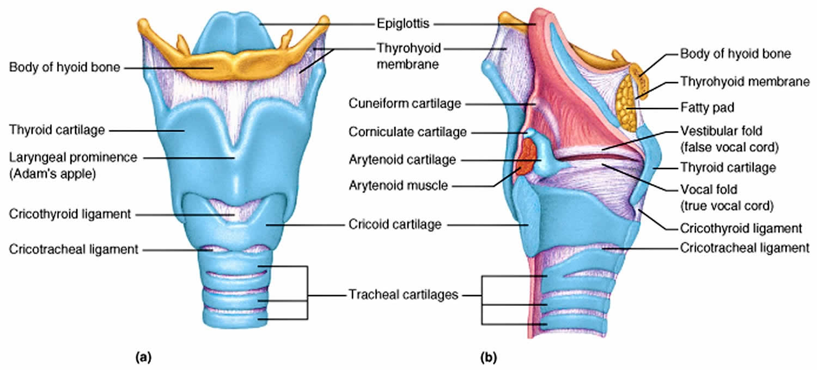

Slide 6
Composed of
  the nose
  the nasal cavity
  the paranasal sinuses
  the pharynx (throat)
  and associated structures.

Slide 7
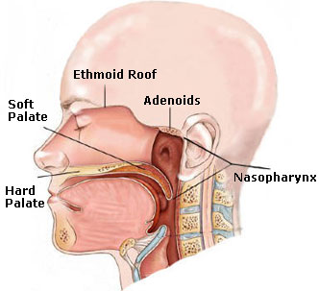
Nose
The nose is the part of the respiratory tract superior to the hard palate
• It contains organ for the sense organ of smell
The anatomy of nose can be discussed under two sections.
The external nose
The nasal cavity

Slide 8
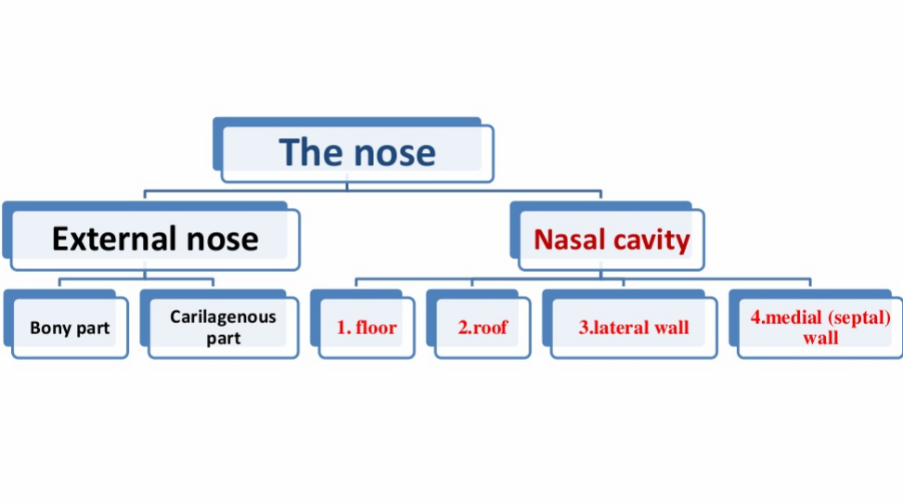

Slide 9
Functions:
Olfaction (smelling)
• Respiration (breathing)
• Filtration of dust
• Humidification of inspired air
• Reception and elimination of secretions from the paranasal sinuses and nasolacrimal ducts

Slide 10
External Nose
It is the visible portion that projects from the face
Its skeleton is mainly cartilaginous along with small bony parts
It has the following parts
Root
Dorsum/Bridge
Ala
Apex

Slide 11
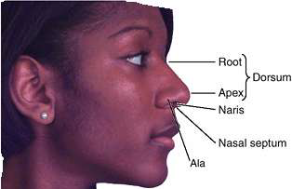

Slide 12
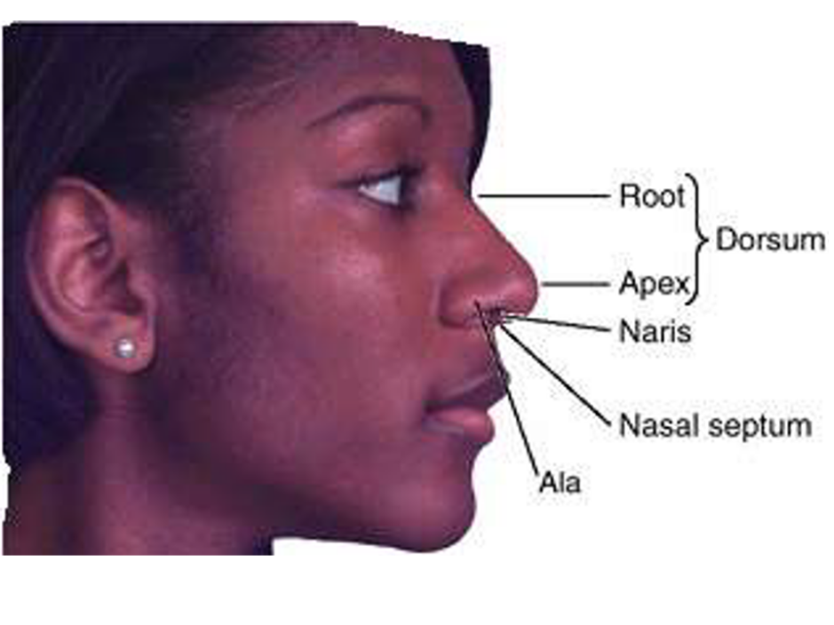
Nasal root is the part of the nose that connects with your forehead.
The part of the external nose that extends from the root of the nose to the apex (tip) of the nose is called the dorsum.
Inferior surface of the nose is pierced by two piriform openings called nares (nostrils, anterior nasal apertures)
The superior bony part of the nose, including its root, is covered by thin skin
• The skin over the cartilaginous part of the nose is covered with thicker skin, which contains many sebaceous glands

Slide 13
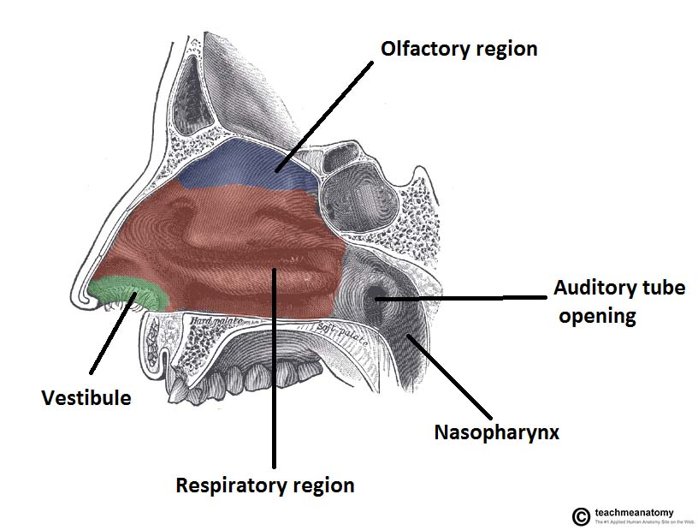
The skin extends into the anterior part of the nasal cavity called the vestibule of the nose
• The vestibule of the nose has a variable number of stiff hairs called vibrissae
• These hairs are usually moist and these help to filter dust particles from air entering the nasal cavity

Slide 14
Skeleton of the External Nose
composed of:
I. bones
II. cartilages

Slide 15
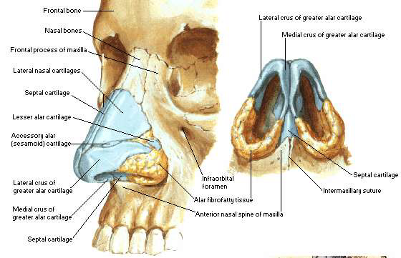
The bony part consists of the:
nasal bones
frontal processes of the maxillae
nasal spine
bony parts of the nasal septum

Slide 16
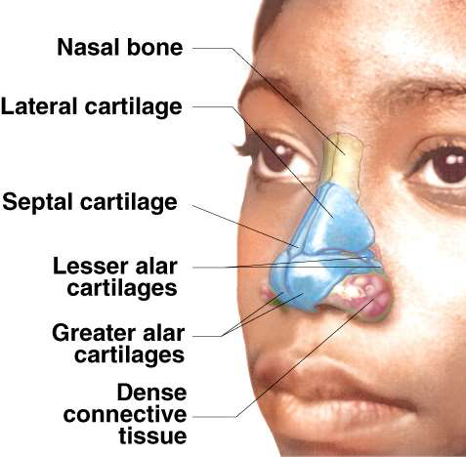
Cartilaginous part of the nose
The cartilaginous part of the nose consists of five main cartilages and
Two lateral cartilages,
Two alar cartilages,
One septal cartilage
3 or 4 minor alar cartilages
The U-shaped alar cartilages are free and movable; they dilate or constrict the nares when the muscles acting on the nose contract

Slide 17
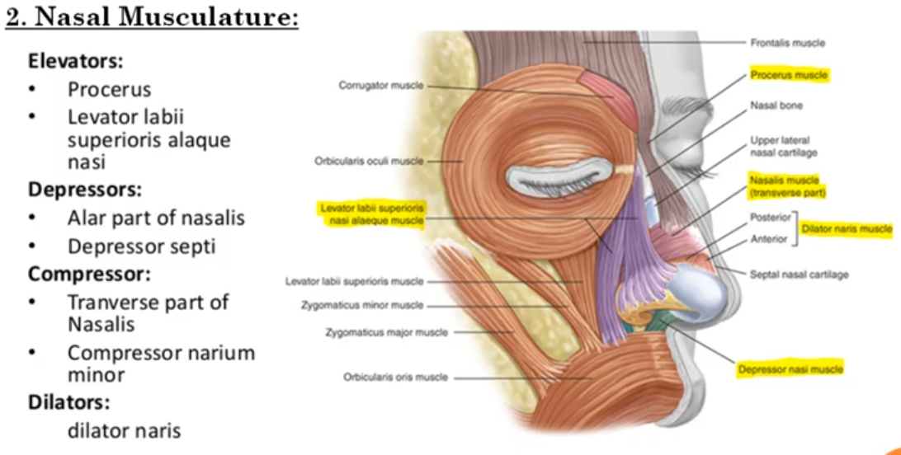

Slide 18
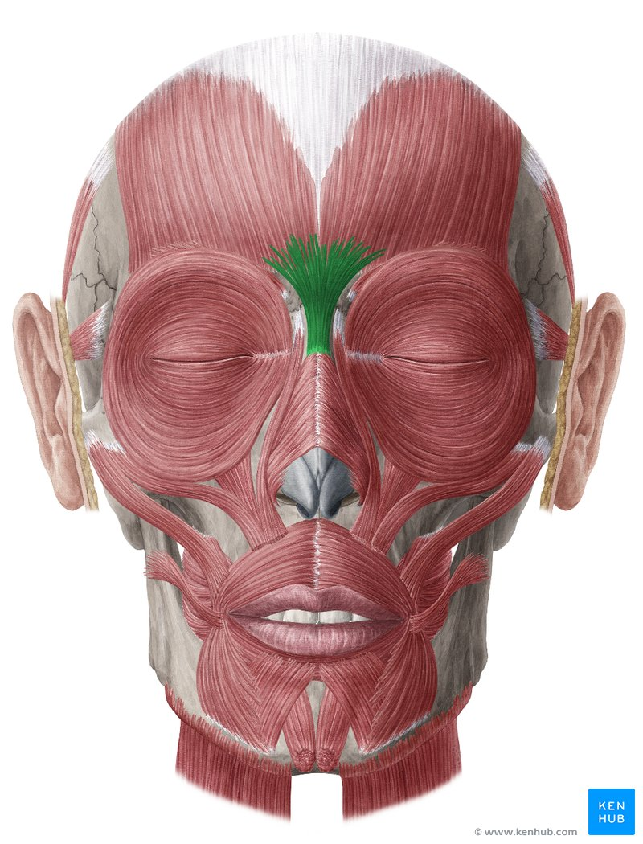
Procerus
Origin-Nasal bone, (superior part of) lateral nasal cartilage
Insertion----Skin of glabella, fibers of frontal belly of occipitofrontalis muscle
Action-Depresses medial end of eyebrow, wrinkles skin of glabella

Slide 19
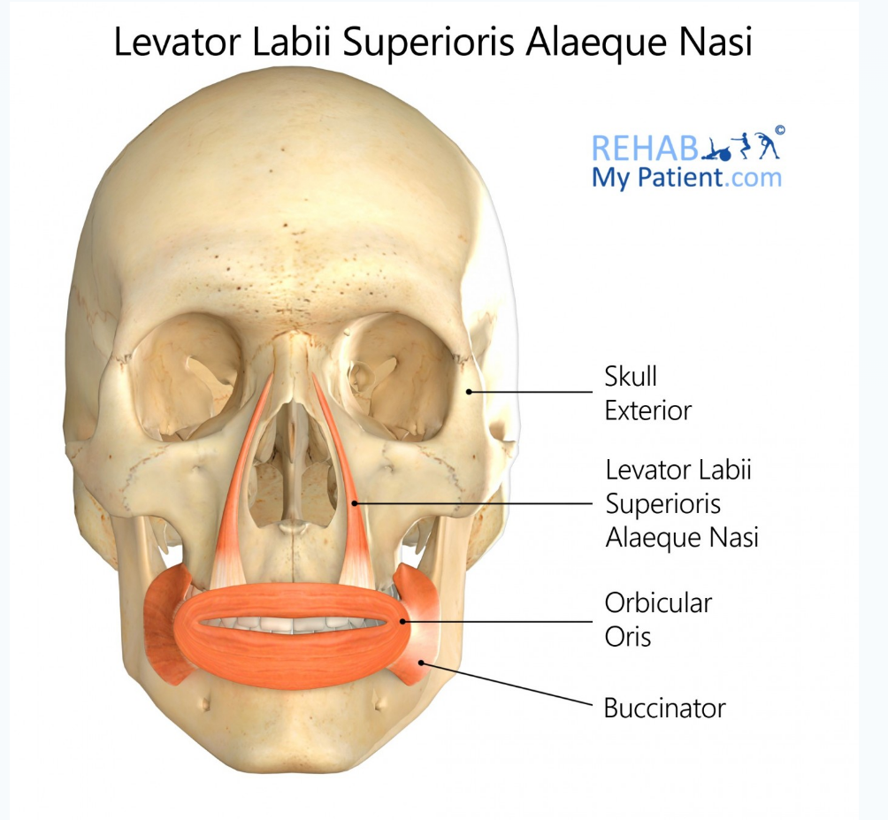
it originates from frontal process of maxilla
and it is inserted over the skin over the lateral aspect of the nostril and the upper part of the lips

Slide 20
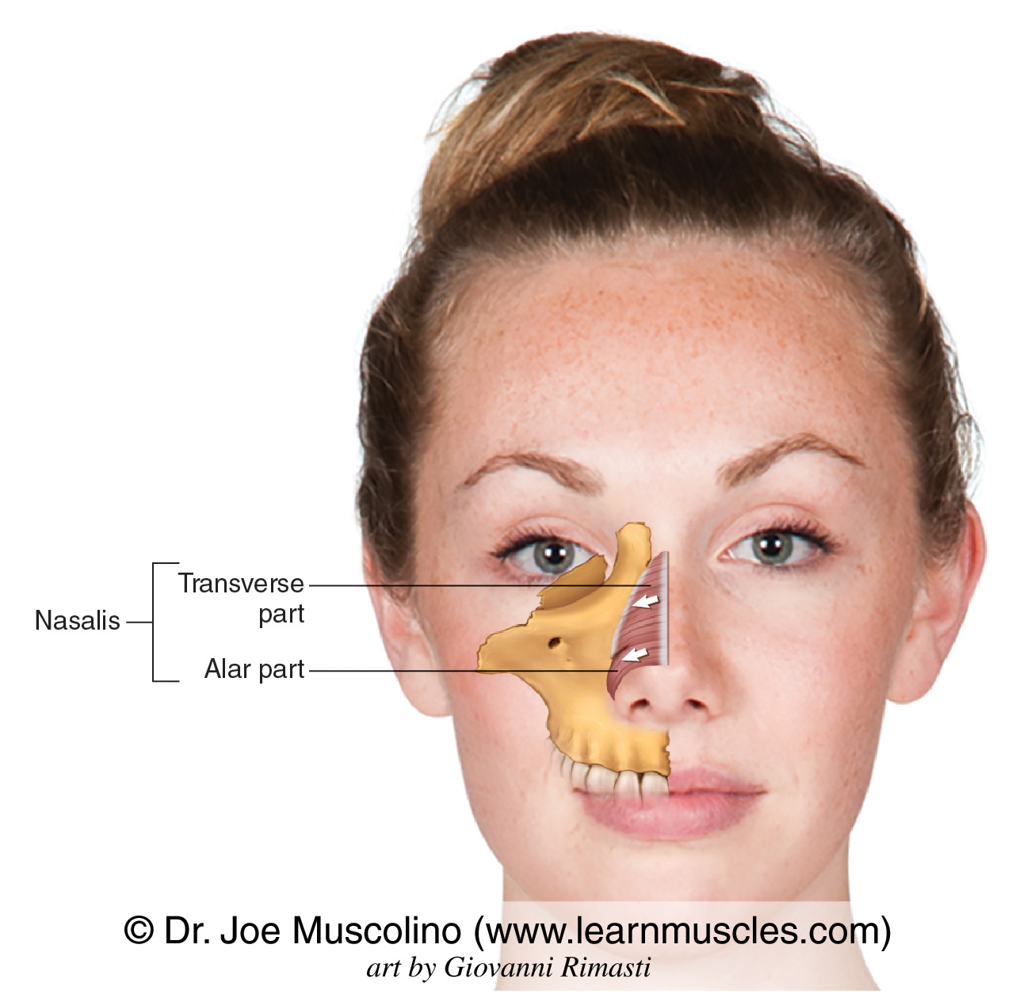

Slide 21
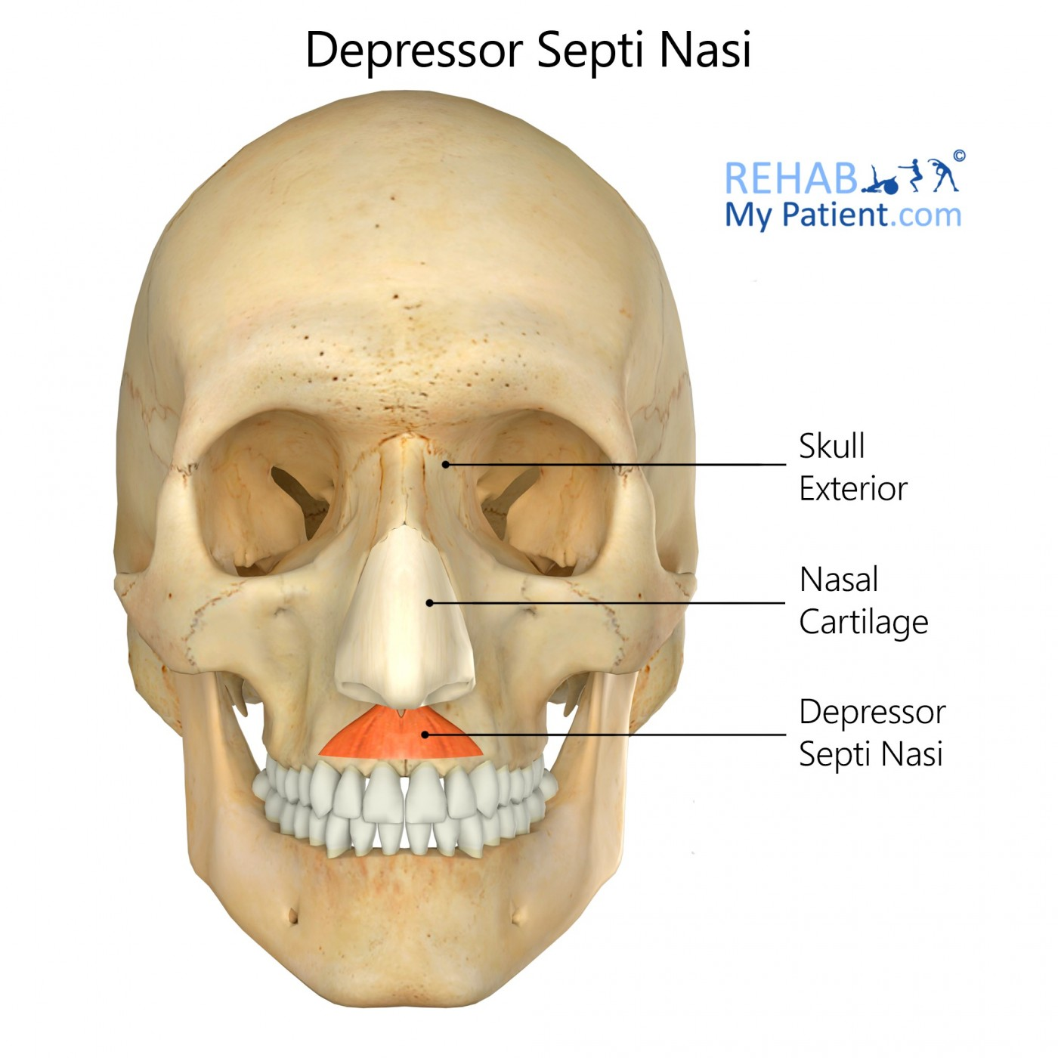

Slide 22
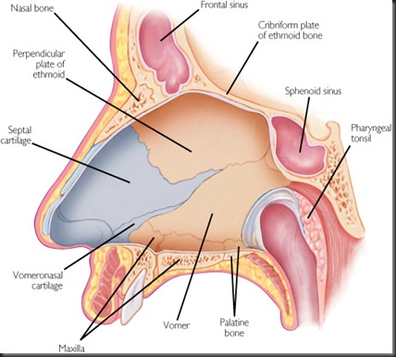
Nasal Septum
It divides the chamber of the nose into two nasal cavities
It has a:
bony part
a soft mobile cartilaginous part

Slide 23
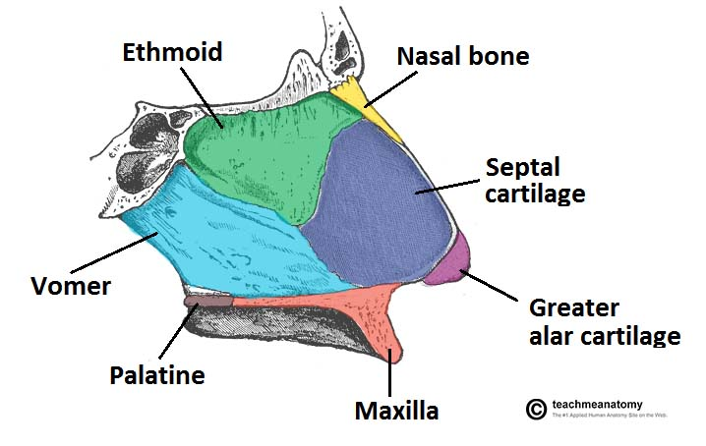
Parts of the nasal septum
The components of the nasal septum are
Perpendicular plate of the ethmoid bone
Vomer bone
septal cartilage
Nasal crest of the maxillary bone
Nasal crest of palatine bone
The perpendicular plate of ethmoid, vomer, nasal crests of maxillary and palatine bones form the bony part of nasal septum
While the septal cartilage forms the cartilagenous part

Slide 24
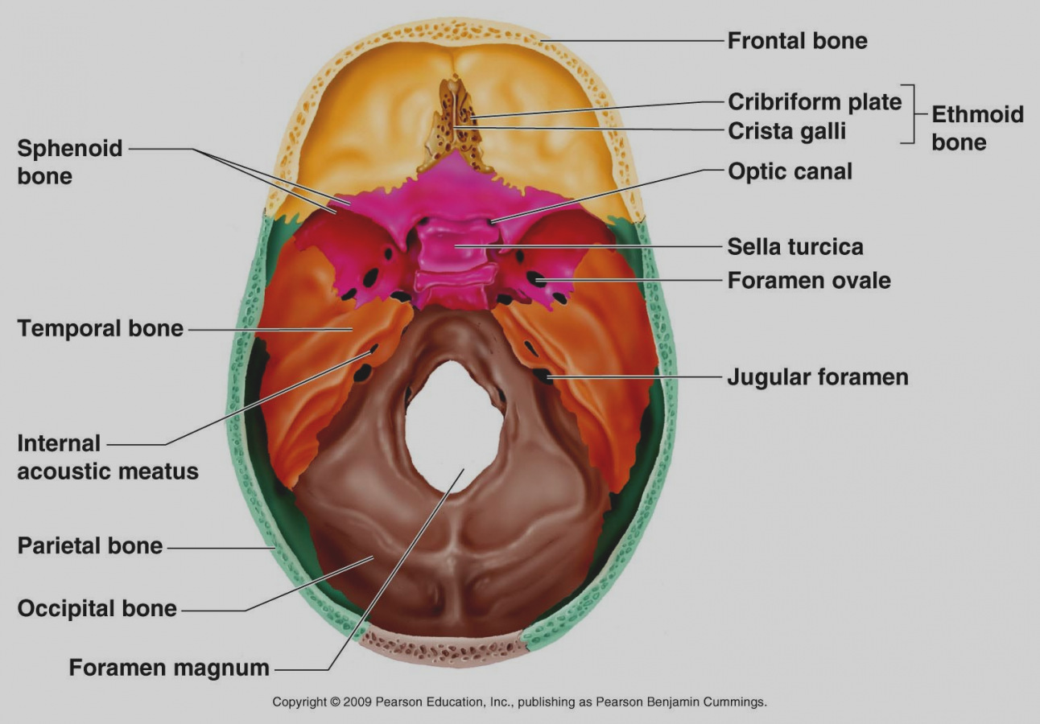
The thin perpendicular plate of the ethmoid bone: forming the superior part of the nasal septum descends from the cribriform plate and is continued superior to this plate as the crista galli

Slide 25
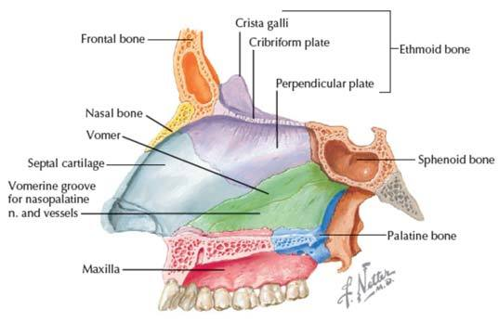
The vomer: a thin flat bone, forms the posteroinferior part of the nasal septum, with some contribution from the nasal crests of the maxillary and palatine bones

Slide 26
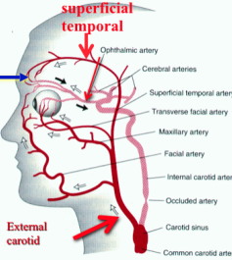
Blood Supply of the External Nose
Blood supply of the nose derived from branches of both the ECA & ICA
The skin of the external nose is supplied by branches of the ophthalmic and the maxillary arteries.
The skin of the ala and the lower part of the septum are supplied by branches from the facial artery.

Slide 27
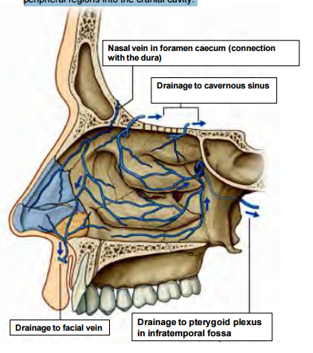
Venous drainage
Veins form a plexus which is more marked in the lower part of the septum.
The plexus drains anteriorly into the facial vein, posteriorly through the sphenopalatine vein to pterygoid venous plexus.

Slide 28
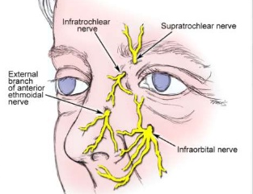
Nerve Supply of the External Nose
The infratrochlear and external nasal branches of the ophthalmic nerve and the infraorbital branch of the maxillary nerve.

Slide 29
CLINICAL ANATOMY
Nasal Fractures
Because of the prominence of the nose, fractures of the nasal bones are common facial fractures in automobile accidents and sports (unless face guards are worn)
Epistaxis (nosebleed) usually occurs
In severe fractures, disruption of the bones and cartilages results in displacement of the nose.
When the injury results from a direct blow, the cribriform plate of the ethmoid bone may also fracture

Slide 30
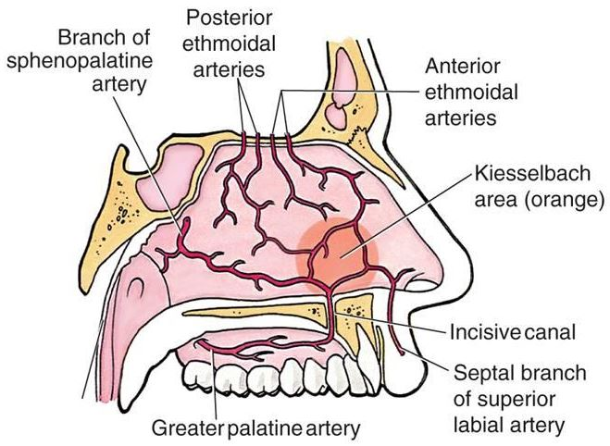
Kiesselbach's plexus, which lies in Kiesselbach's area, Kiesselbach's triangle, or Little's area, is a region in the anteroinferior part of the nasal septum where four arteries anastomose to form a vascular plexus. The arteries are:
Anterior ethmoidal artery (branch of the ophthalmic artery)
Sphenopalatine artery (terminal branch of the maxillary artery)
Greater palatine artery (from the maxillary artery)
Septal branch of the superior labial artery (from the facial artery)

Slide 31
Deviation of the Nasal Septum
• The nasal septum is usually deviated to one side or the other
• This could be the result of a birth injury, but more often the deviation results during adolescence and adulthood from trauma (e.g., during a fist fight)
• Sometimes the deviation is so severe that the nasal septum is in contact with the lateral wall of the nasal cavity and often obstructs breathing or exacerbates snoring
• The deviation can be corrected surgically

Slide 32
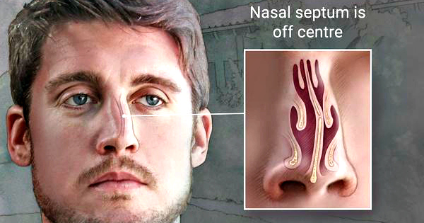

Slide 33
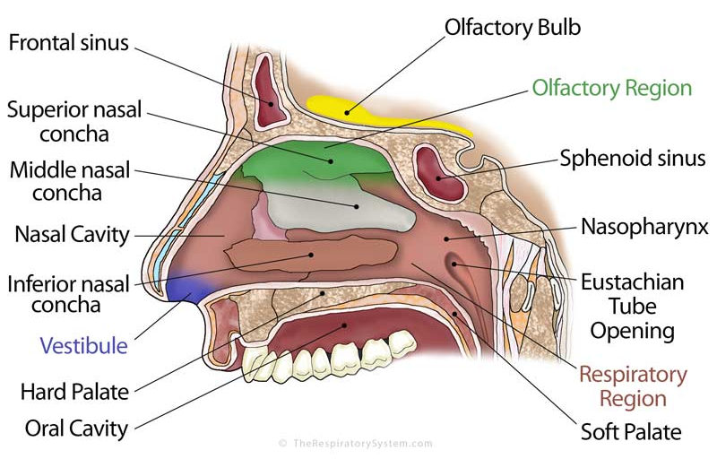
Nasal Cavity
Extent- from external nares to posterior nasal apertures
Divided into right and left halves by the nasal septum
Mucosa lines the nasal cavity, except for the nasal vestibule, which is lined with skin
The superior one third of the nasal mucosa forms the olfactory area
The inferior two thirds of the nasal mucosa forms the respiratory area
The olfactory area contains the peripheral organ of smell;

Slide 34
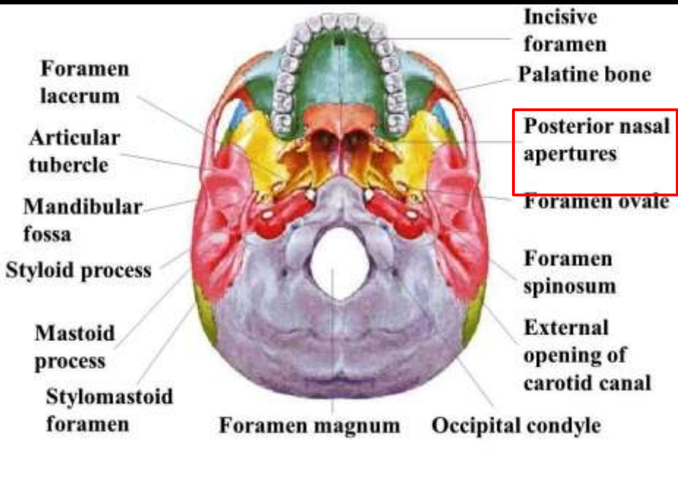
Poserior nasal apperture

Slide 35
Boundaries of the Nasal Cavity
The nasal cavity has a:
Roof
Floor
Medial wall
Lateral wall

Slide 36
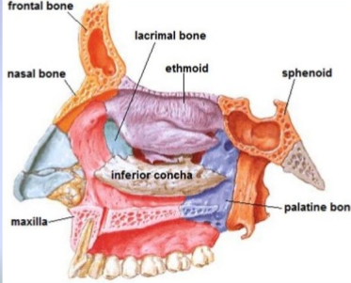
Roof
It is 7cm long and 2 mm wide
is curved and narrow, except at its posterior end
it is divided into 3 parts
frontonasal
ethmoidal
sphenoidal

Slide 37
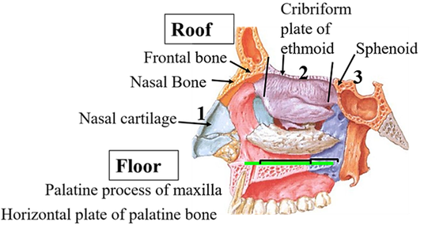
Floor
It is wider than the roof – 5cm long and 1.5cm wide
It is formed by the;
Palatine processes of the maxilla
Horizontal plates of the palatine bone

Slide 38
The medial wall :
formed by the nasal septum

Slide 39
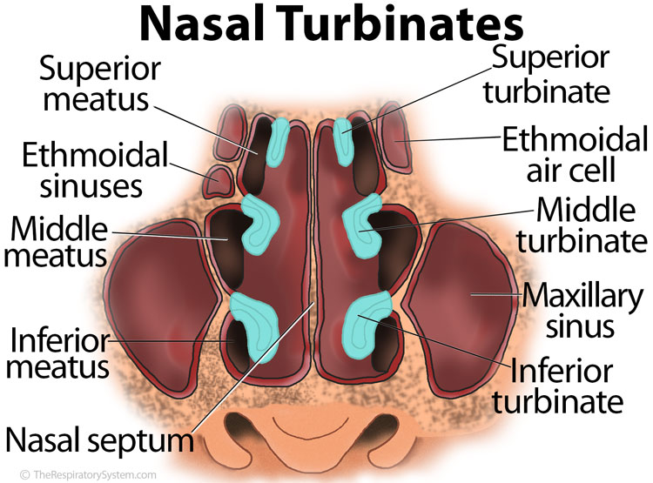
Lateral wall of the nose
They are irregular owing to three bony plates, the nasal conchae.
Increase the surface area of the nose for effective air-conditioning of the inspired air

Slide 40
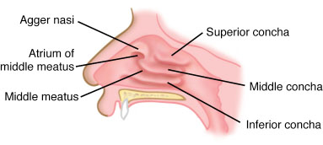
Parts of the lateral wall
The lateral wall can be subdivided into three parts.
(a)A small depressed area in the anterior part is called the vestibule. It is lined by modified skin containing short, stiff, curved hairs called vibrissae.
(b)The middle part is known as the atrium of the middle meatus.
(c) The posterior part contains the conchae. Spaces separating the conchae are called meatuses

Slide 41
skeleton of the lateral wall
Partly bony, partly cartilaginous, and partly made up only of soft tissues

Slide 42
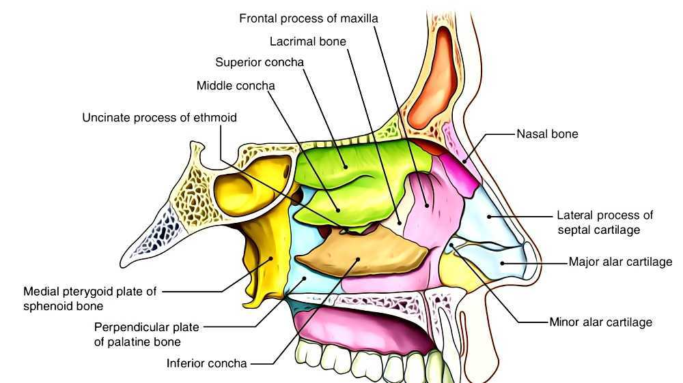
Bones of the lateral wall
(1) Nasal
(2) frontal process of maxilla;
(3) lacrimal
(4) labyrinth of ethmoid with superior and middle conchae;
(5) inferior nasal concha
(6) perpendicular plate of the palatine bone
(7) medial pterygoid plate

Slide 43
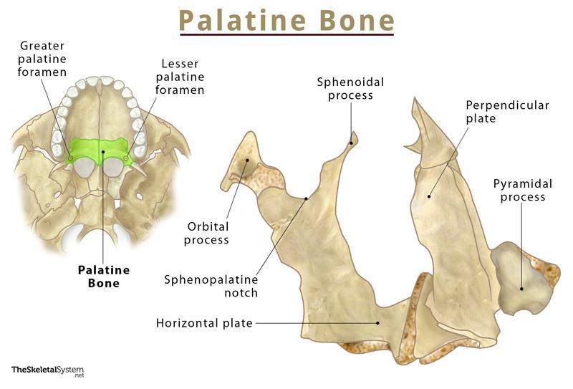

Slide 44
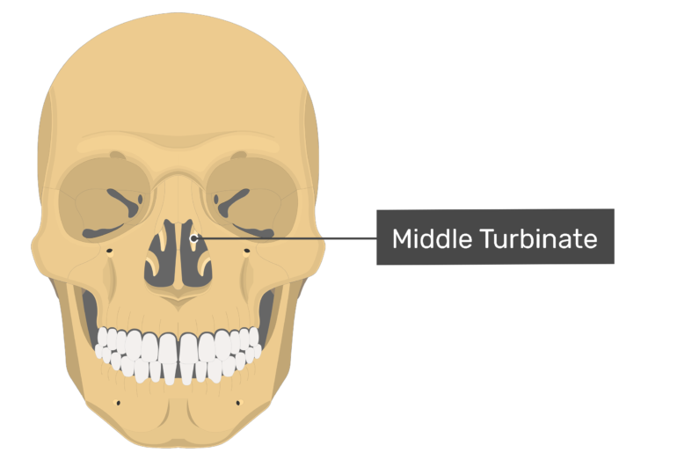

Slide 45
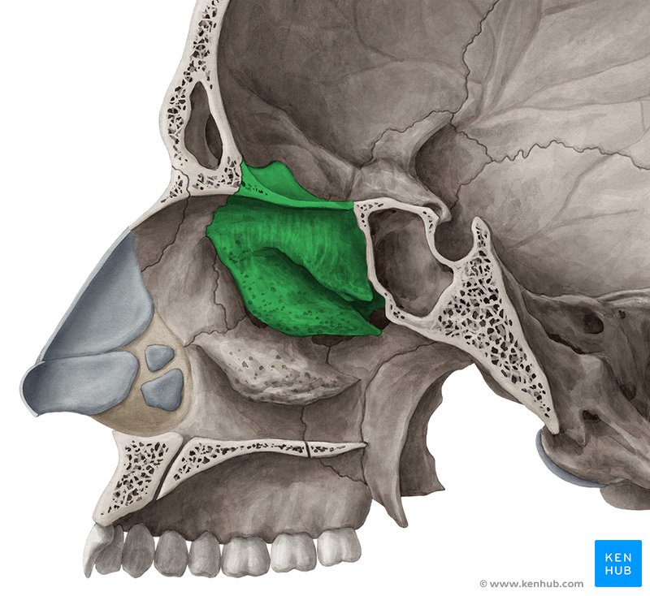

Slide 46
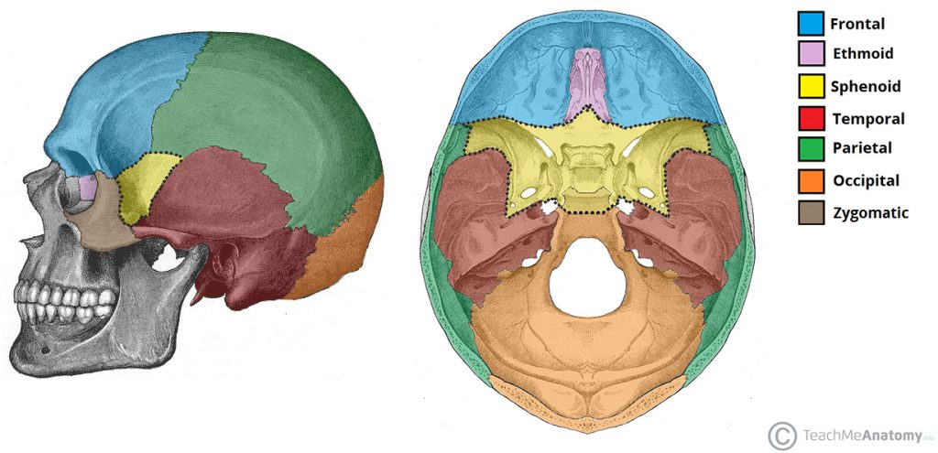

Slide 47
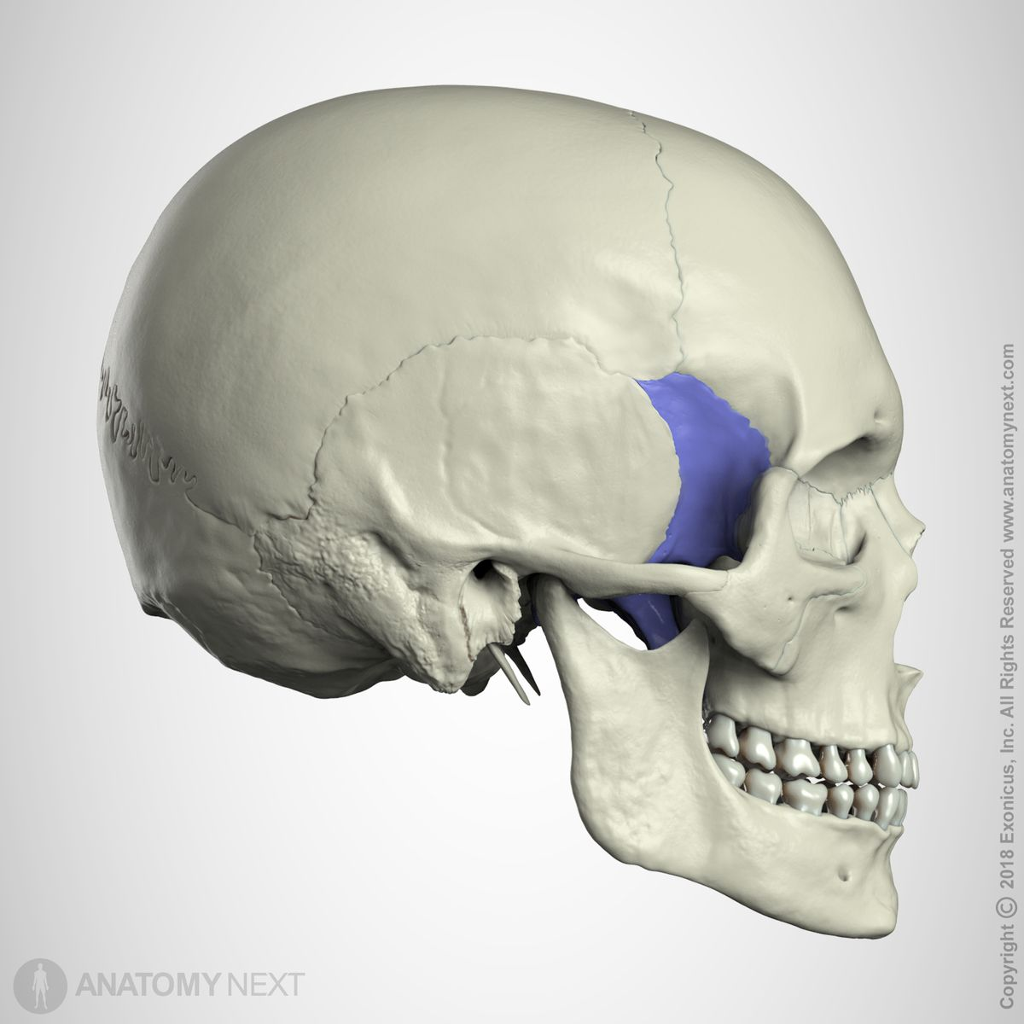

Slide 48
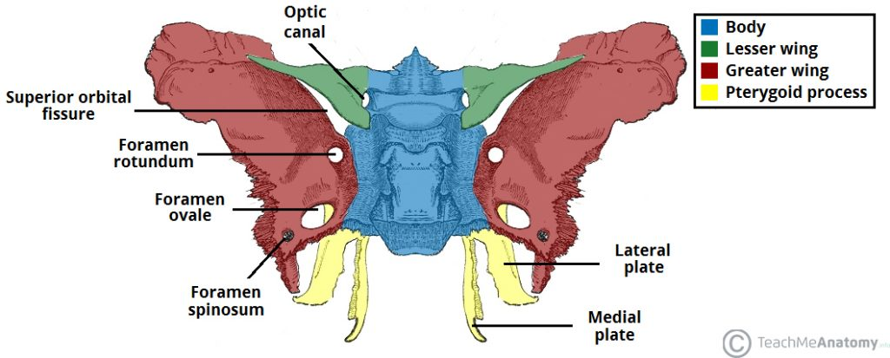

Slide 49
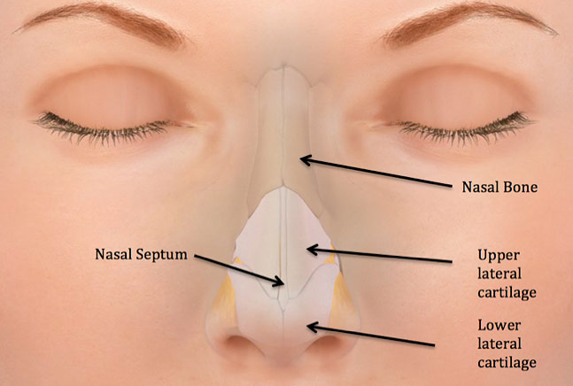
Cartilaginous part
Cartilaginous part is formed by:
The superior nasal cartilage;
the inferior nasalcartilage
(c) 3 or 4 small cartilages of the ala.
The cuticular lower part is formed by fibrofatty tissue covered with skin.

Slide 50
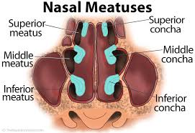
Chonchae and Meatuses
The nasal conchae are curved bony projections directed downwards and medially.
The following three conchae are usually found:
1.The inferior concha is an independent bone.
2.The middle concha is a projection from themedial surface of the ethmoidal labyrinth .
3.The superior concha is also a projection from the medial surface of the ethmoidal labyrinth

Slide 51
Meatus
The meatuses of the nose are passages beneath the overhanging conchae.
The inferior meatus lies underneath the inferior concha
2. The middle meatus lies underneath the middle concha.
3. The superior meatus lies below the superior concha.

Slide 52
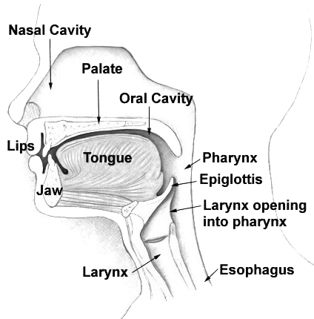
Posteriorly
We have the posterior wall of pharynx
And the part of the pharynx which is behind the nasal cavity is known as nasopharynx

Slide 53
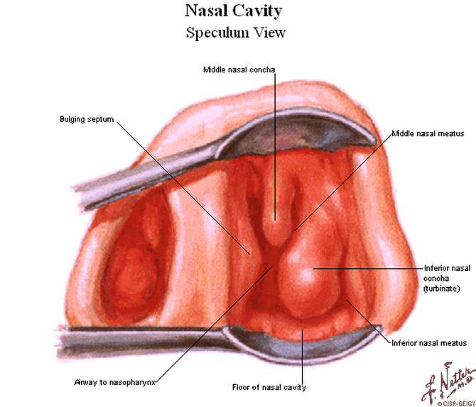

Slide 54
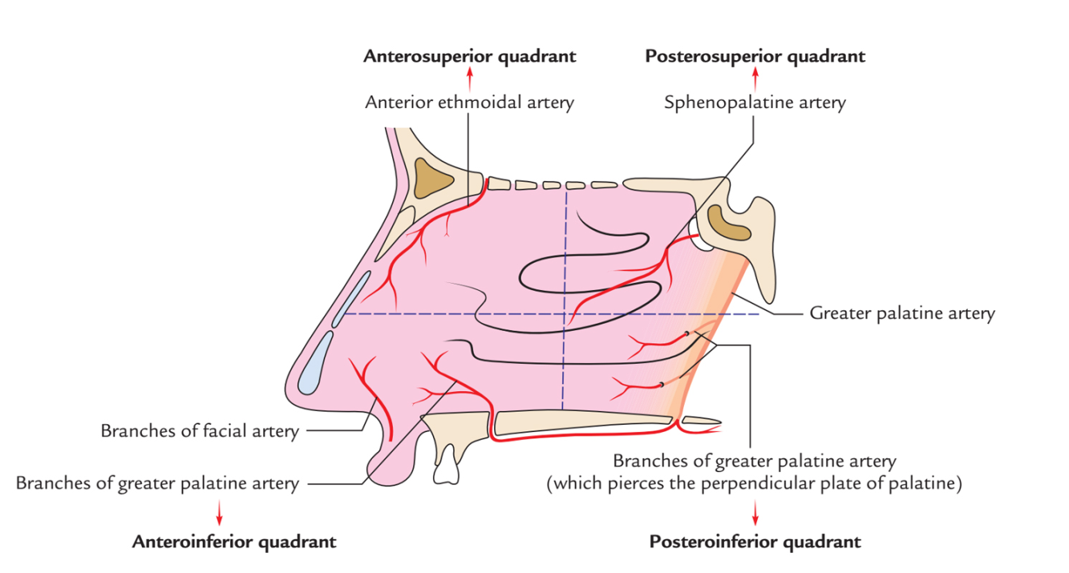
Arterial Supply of Lateral Wall
1.The anterosuperior quadrantis supplied by the anterior ethmoidal artery assisted by the posterior ethmoidal and facial arteries.
2.The anteroinferior quadrant, is supplied by branches from the facial and greater palatine arteries
3.The posterosuperior quadrant, is supplied by the sphenopalatine artery.
4.The posteroinferior quadrant is supplied by branches from the greater palatine artery which pierce the perpendicular plate of the palatine bone.

Slide 55
Venous Drainage
The veins form a plexus which drains anteriorly into the facial vein; Posteriorly, into the pharyngeal plexus of veins; and from the middle part, to the pterygoid plexus of veins.

Slide 56
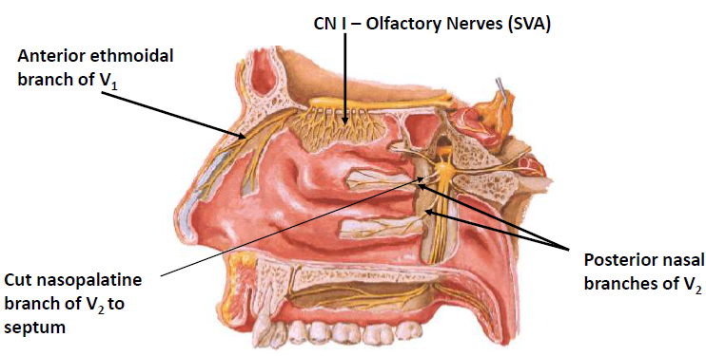
Nerve Supply of the Nasal Cavity
The olfactory nerves from the olfactory mucous membrane ascend through the cribriform plate of the ethmoid bone to the olfactory bulbs .
The nerves of ordinary sensation are branches of the ophthalmic division (V1) and the maxillary division (V2) of the trigeminal nerve

Slide 57
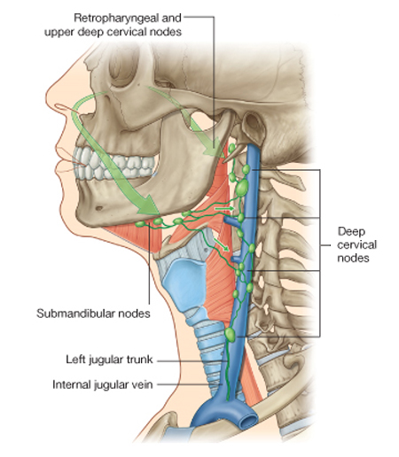
Lymph Drainage of the Nasal Cavity
The lymph vessels draining the vestibule end in the submandibular nodes.
The remainder of the nasal cavity is drained by vessels that pass to the upper deep cervical nodes.

Slide 58
CLINICAL ANATOMY
1.Common cold or rhinitis is the commonest infection of the nose.

Slide 59
The relations of the nose to the anterior cranial fossa through the cribriform plate, and to the lacrimal apparatus through the nasolacrimal duct are important in the spread of infection.

Slide 60
Hypertrophy of the mucosa over the inferior nasal concha is a common feature of allergic rhinitis, which is characterized by sneezing, nasal blockage and excessive watery discharge from the nose.

Slide 61
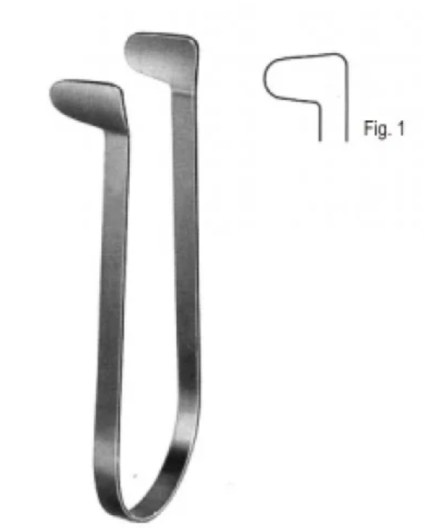
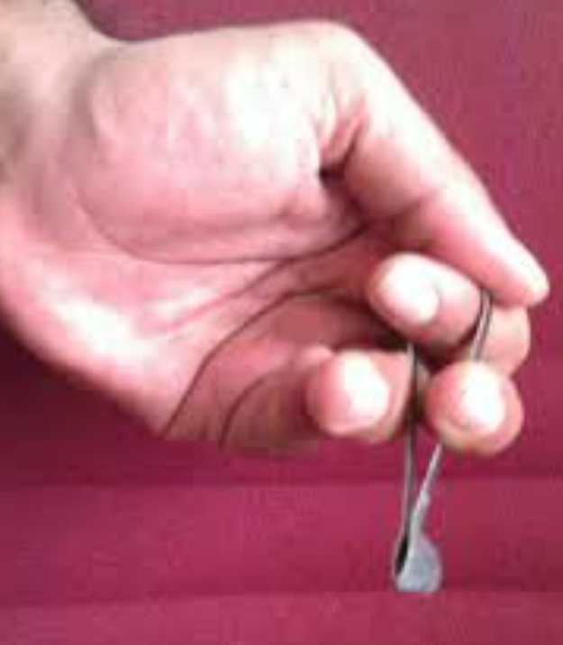
Thudichum Nasal Speculum

