Slide 1
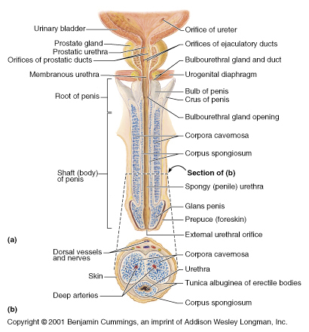
Bulbo urethral glands
They are a pair of small gland situated on both sides of the membraneous urethra
Their ducts open into intra bulbar fossa of the spongy urethra
Their secretion form a part of semen

Slide 2
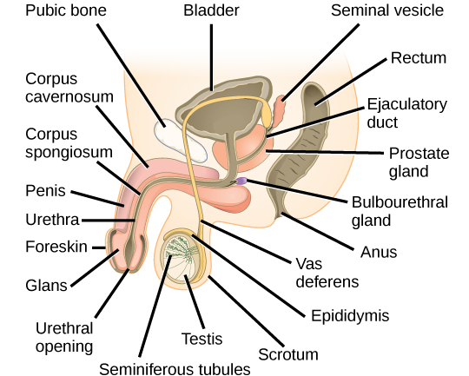

Slide 3
Spermatic cord
It is a tubular sheath containing vas deferns nerves and vessels of epididymis and testis
It is about 7.5 cm long
Anatomical course of the spermatic cord is relatively short, beginning in the inferior abdomen and ending in the scrotum.
The spermatic cord is formed at the opening of the inguinal canal (see slide no 5), known as the deep inguinal ring.
The cord passes through the inguinal canal, entering the scrotum via the superficial inguinal ring. It continues into the scrotum, ending at the posterior border of the testes. Here, its contents disperse to supply the various structures of the testes and scrotum.

Slide 4
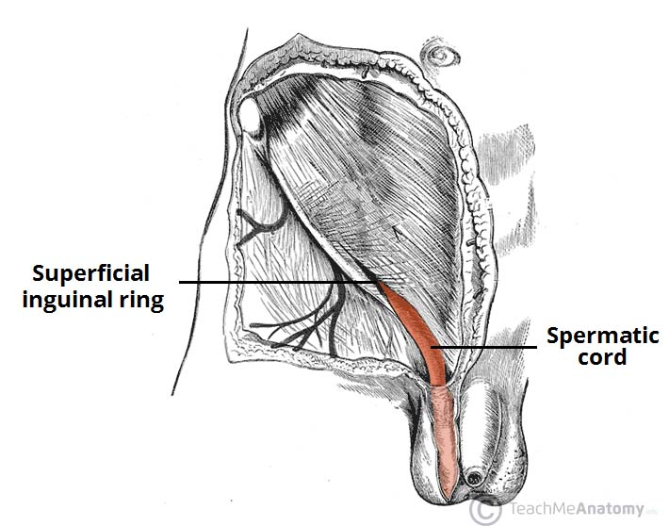

Slide 5
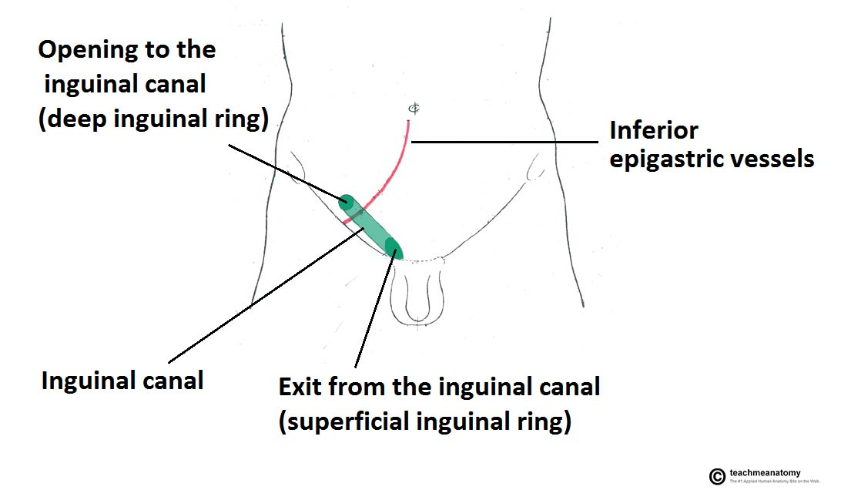
The superficial (external) ring marks the end of the inguinal canal, and lies just superior to the pubic tubercle. It is a triangle shaped opening

Slide 6
Contents of the spermatic cord
Vas deferens lies along the posterior part of the cored
Pampiniform plexus(The pampiniform plexus is a loose network of small veins found within the male spermatic cord. The plexus begins in the scrotum with veins arising from the mediastinum testis,)
Arteries- testicular artery, artery to vas deferens , and cremastric artery
Lymphatics of testis and epididymis
Nerves – genital branch of genitofemoral nerve, testicular plexus of sympathetic nerves and illioinguinal nerve
Loose connective tissue
Processus vaginalis – projection of peritoneum that forms the pathway of descent for the testes during embryonic development. In the adult, it is fused shut.

Slide 7
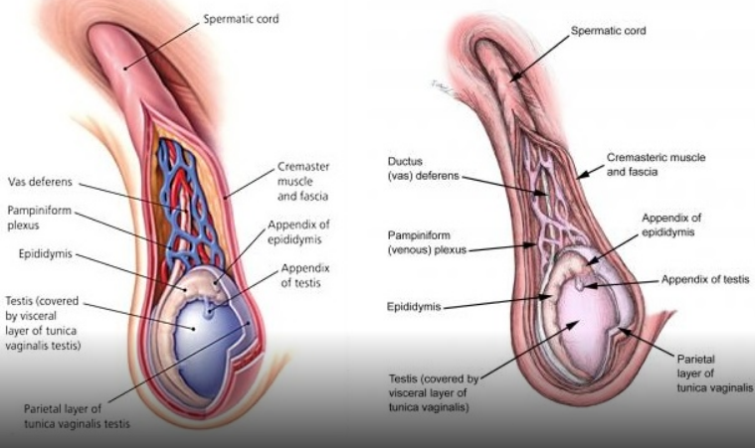
Ts at this level

Slide 8
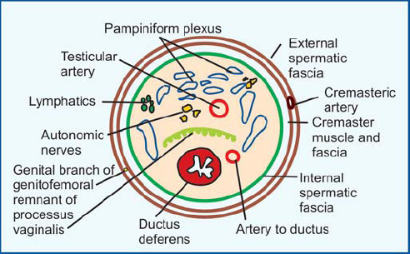
Transverse section of the cord showing its contents

Slide 9
Scrotum
It is a cutaneous pouch of the lower part of the anterior abdominal wall containing the right and left testis.
It houses and protects the testis and also maintains a lower temperature than that of the abdomen
The scotum is divided into right and left parts parts by a ridge which is known as the median raphae which continues on to the underside of the penis
Left half of the scrotum hangs a bit lower than the right because of the greater length of the the left spermatic cord

Slide 10
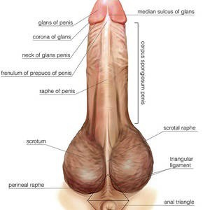

Slide 11
Layers of scrotum external to internal
Skin
Dartos muscle
External spermatic fascia
Cremastric muscle fascia
Internal spermatic fascia
Parietal layer of tunica vaginalis

Slide 12
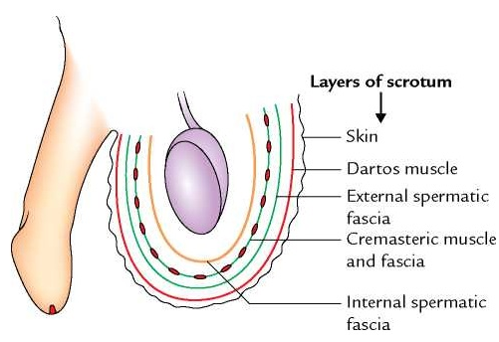

Slide 13
Layers of scrotum external to internal
Skin is thin elastic and pigmented and corrugated due to its adhesion with dartos muscle inside . And is abundant in the number of sebeceous and sweat glands
Dartos muscle – it is a subcutaneous involuntary muscle which sents a septum at the median raphae
This septum divides the scotum into 2 compartments

Slide 14
Layers of scrotum external to internal
External spermatic fascia is derived from the aponeurosis of the external oblique muscle at the margin of superficial inguinal ring
Cremastric muscle and fascia (SEE SLIDE NO 15)- it is a detached part of the internal oblique muscle
It spreads in the scrotum as a series of Ushaped loops which are held togeather by and areolar fascia
It is an involuntary muscle
Internal spermatic fascia is derived from the tranversalis fascia at the margin of deep inguinal ring

Slide 15
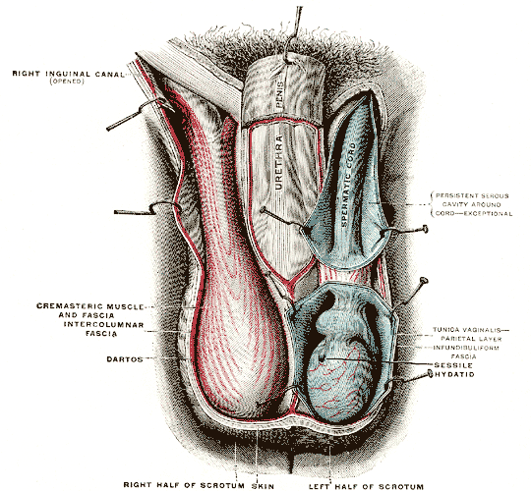

Slide 16
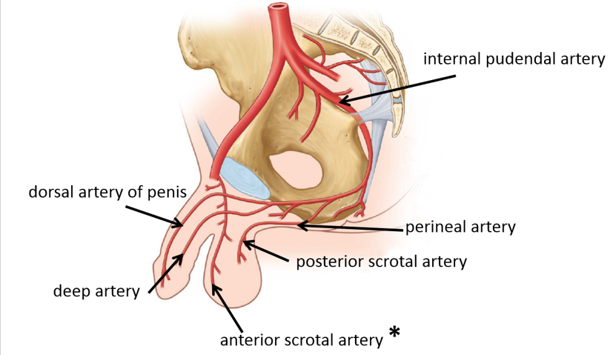
Arterial supply of scrotum
It is supplies by superficial and deep external pudental branches of femoral artery
And by the posterior scrotal branches of internal pudental artery

Slide 17
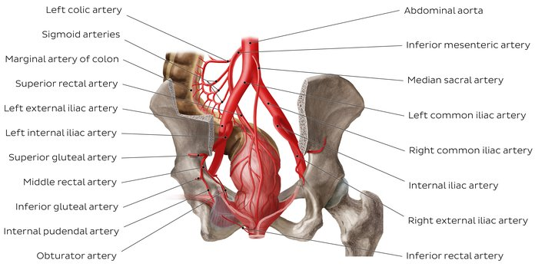

Slide 18
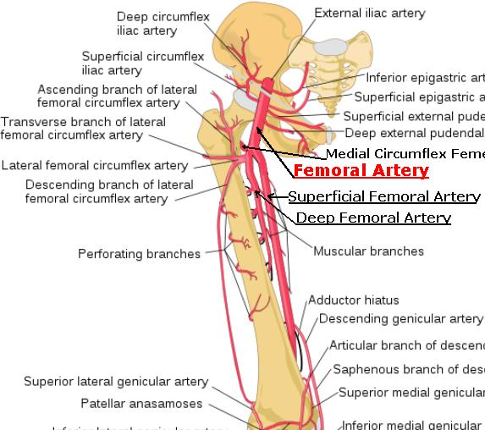

Slide 19
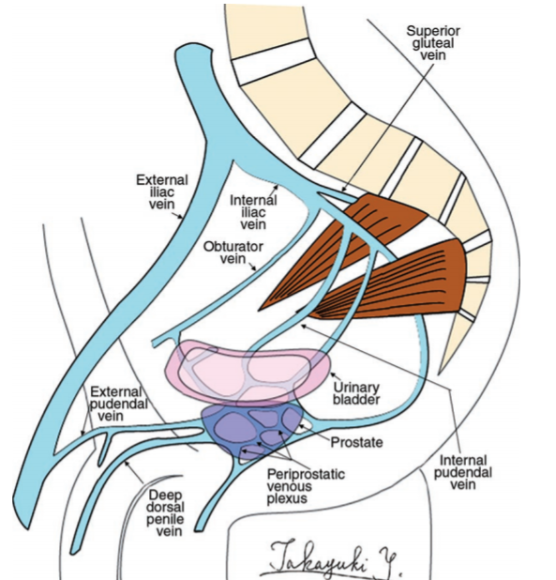
Venous drainage of scrotum
Veins drain into great sepahenous vein partly in the internal illiac vein

Slide 20
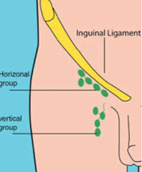
Lymphatics of scrotum
They drain into horizontal set of superficial inguinal lymph nodes

Slide 21
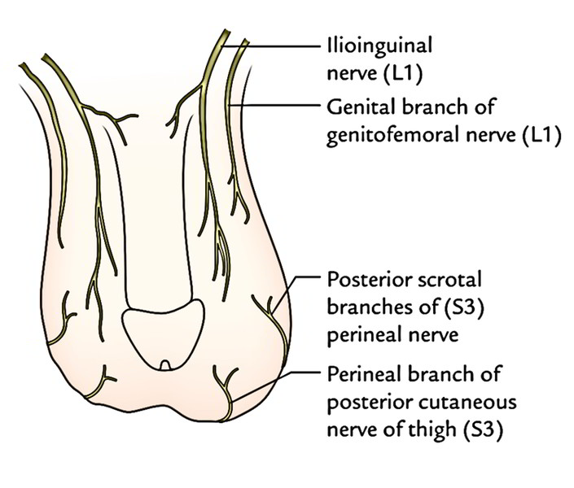
Nerve supply of scrotum
Anterrior 1/3rd of scrotum is supplied by illio-inguinal and genitofemoral nerves conveying fibers from the L1 segment
Posterior 2/3rd supplied by the posterior scrotal branches of the pudental nerve and perineal branch of posterior femoral cutaneous nerve derived from S3 and S4 segments

Slide 22
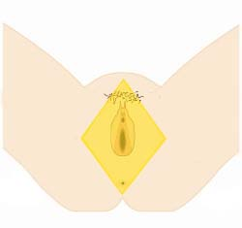
perineum is an anatomical region in the pelvis. It is located between the thighs, and represents the most inferior part of the pelvic outlet.
perineum” is frequently used to describe the area between the external genitalia and the anus. However, in anatomical terms, the perineum is a diamond-shaped structure.

Slide 23
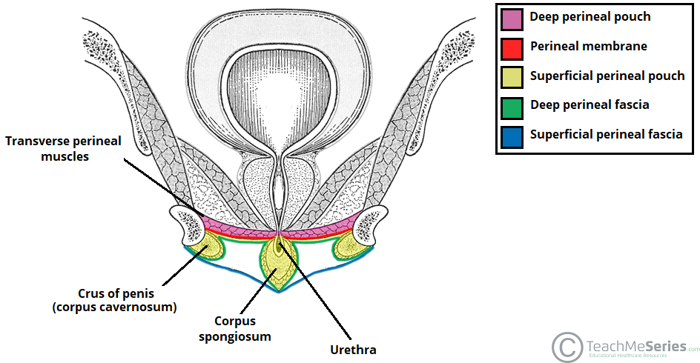
Superficial perineal pouch – a potential space between the perineal membrane (superiorly) and the superficial perineal fascia (inferiorly). It contains the erectile tissues that form the penis

Slide 24
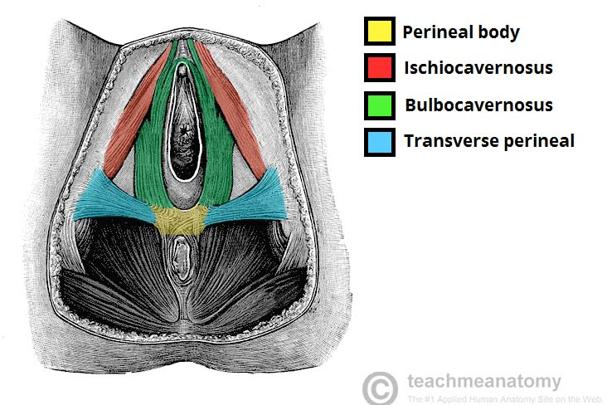
The perineal body (or central tendon of perineum) is a pyramidal fibromuscular mass in the middle line of the perineum at the junction between the urogenital triangle and the anal triangle.(see slide no 25)It is found in both males and females.

Slide 25
