Slide 1
Reproductive system

Slide 2
Introduction
Reproductive system is a collection of internal and external sex organs which work together for the purpose of sexual reproduction.

Slide 3
Essential features of human Reproduction
Release of ovum
Fertilization of the ovum by the spermatozoa
Transport of fertilized ovum into the uterus
Implantation
Formation and maintenance of the foetus during the entire period of gestation
Birth of child and expulsion of foetus
Lactation and care of the child

Slide 4
Reproductive system
Male
Female

Slide 5
Male reproductive system

Slide 6
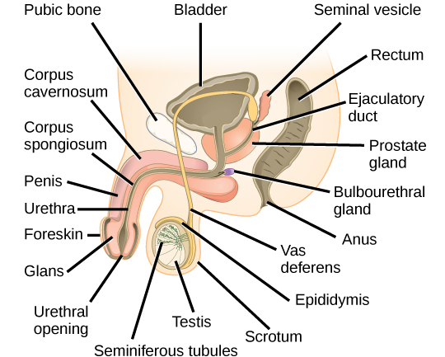
FUNCTION OF MALE REPRODUCTIVE SYSTEM
Production, nourishment maturation and storage of male gamets.
Delivery of spermatozoa in semen into the female reproductive tract
Hormone production
Which develops the secondary sexual characters

Slide 7
Male genital system
EXTERNAL GENITAL ORGANS
INTERNAL GENITAL ORGANS
Penis
Scrotum
Testis
Epididymes
Spermatic cord
  Part of vasdeferns
  Seminal vesicles
  Ejaculatory duct

Slide 8
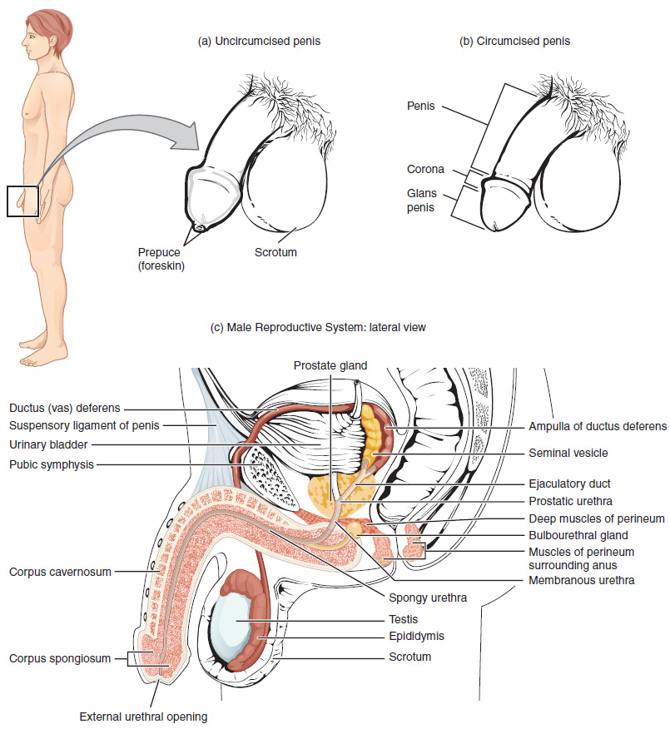

Slide 9
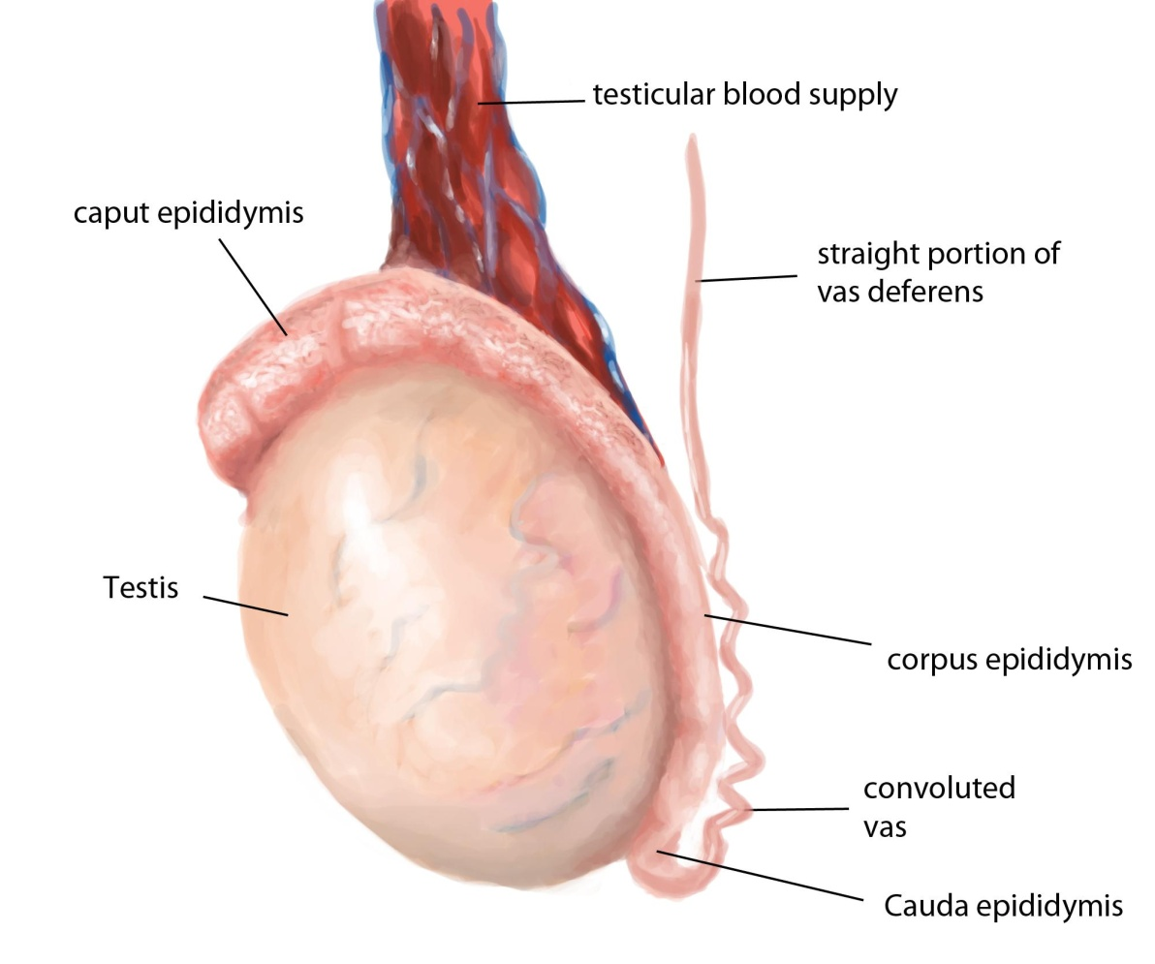
Testes
introduction
They are a pair of male reproductive glands homologous with ovary in female
They are ovoid/ellipsoid, reproductive and endocrine organs responsible for sperm production and testosterone production.
Location – Suspended into the scrotum by the corresponding spermatic cords

Slide 10
Measurements of testis
Average testicular dimensions are
Length- 4–5 cm,
Breadth- 2.5 cm
Anteroposterior diameter -3 cm
weight varies from 10.5–14 g

Slide 11
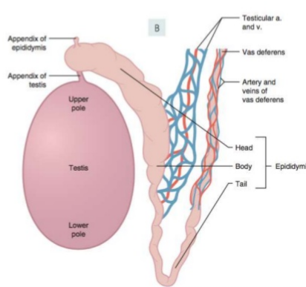
Parts of the testis
It has
2 ends – upper end and lower end
2 borders – anterior and posterior
2 surfaces – medial and lateral

Slide 12
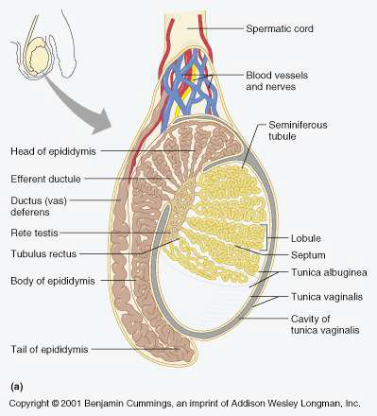
Coverings of testis
Each testis presents 3 intrinsic coverings or capsules
From outside to inward
Tunica vaginalis
Tunica albuginea
Tunica vasculosa

Slide 13
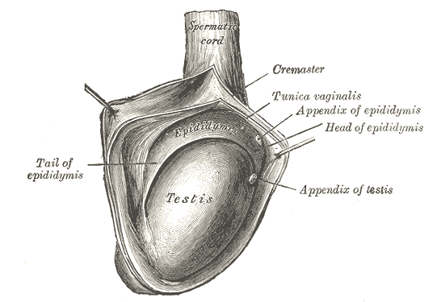
Tunica vaginalis

Slide 14
Tunica vaginalis
Tunica vaginalis is the lower end of the peritoneal processus vaginalis, whose formation precedes the descent of the fetal testis from the abdomen to the scrotum
The tunica is reflected from the testis onto the internal surface of the scrotum, so forming the visceral and parietal layers of the tunica.
The visceral layer covers all aspects of the testis except most of the posterior aspect. Posteromedially it is reflected forwards to the parietal layer
There is always a very fine film of fluid between the two layers of the tunica vaginalis. This fluid layer can increase in inflammatory and neoplastic conditions of the testis, leading to a hydrocele

Slide 15
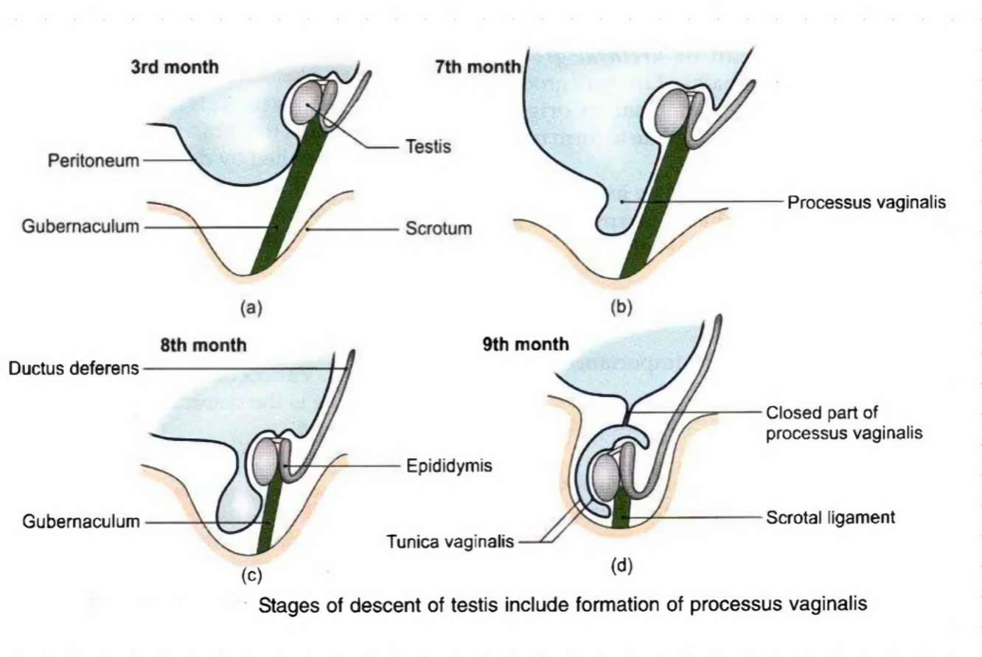

Slide 16
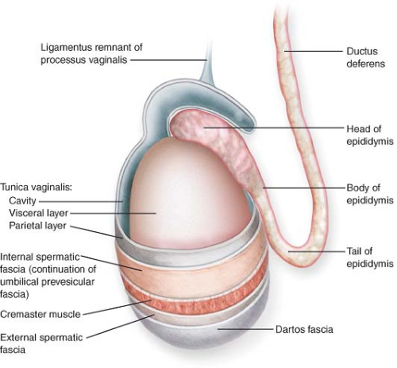

Slide 17
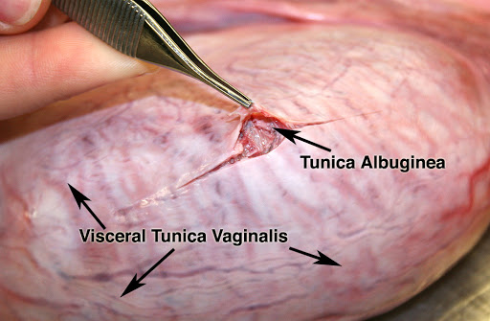
tunica albuginea
Tunica albuginea is a dense, bluish-white covering for the testis,
Composed mainly of interlacing bundles of collagen fibres
It is covered externally by the visceral layer of the tunica vaginalis, except at the epididymal head and tail and the posterior aspect of the testis, where vessels and nerves enter

Slide 18
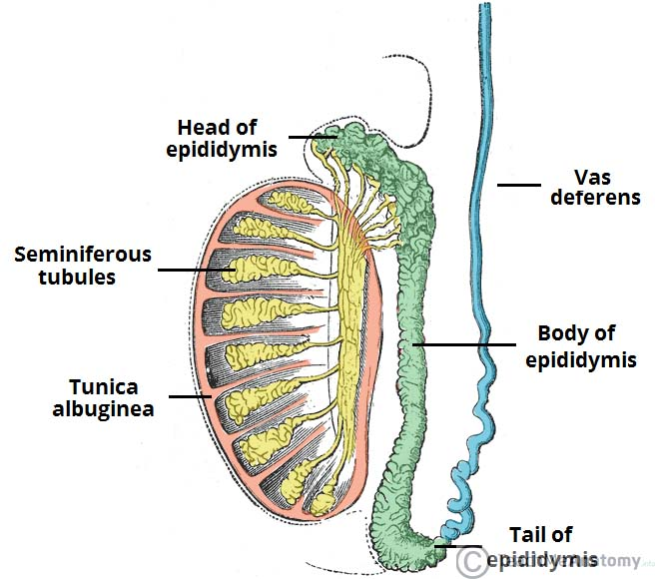

Slide 19
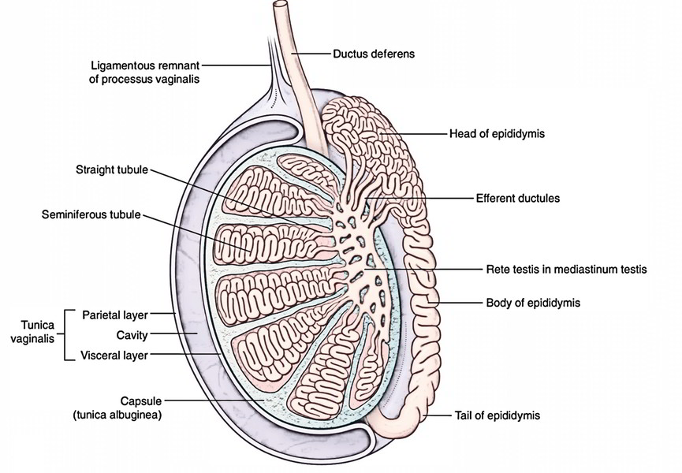
tunica albuginea
Posterior border of TA is thickened and projects into the testicular interior as a thick, incomplete fibrous septum, the mediastinum testis,
From this mediastinum, testis numerous septas divide the testis into 200 to 300 lobules

Slide 20
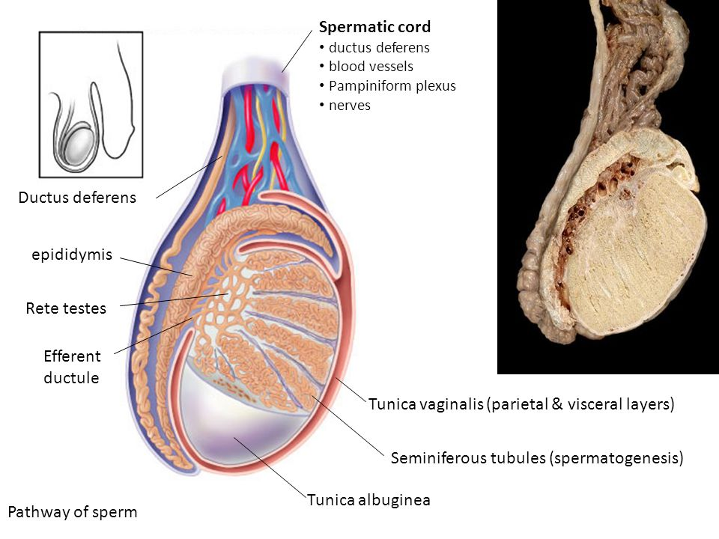
Tunica vasculosa
Tunica vasculosa contains a plexus of blood vessels and delicate loose connective tissue
Extends over the internal aspect of the tunica albuginea, covering the septa and therefore all the testicular lobules.

Slide 21
Structure of testis
Macroscopic structure
Glandular part of testis consists of 200 to 300 lobules
Each lobule contains 1-3 seminiferous tubules and cells of leydig

Slide 22
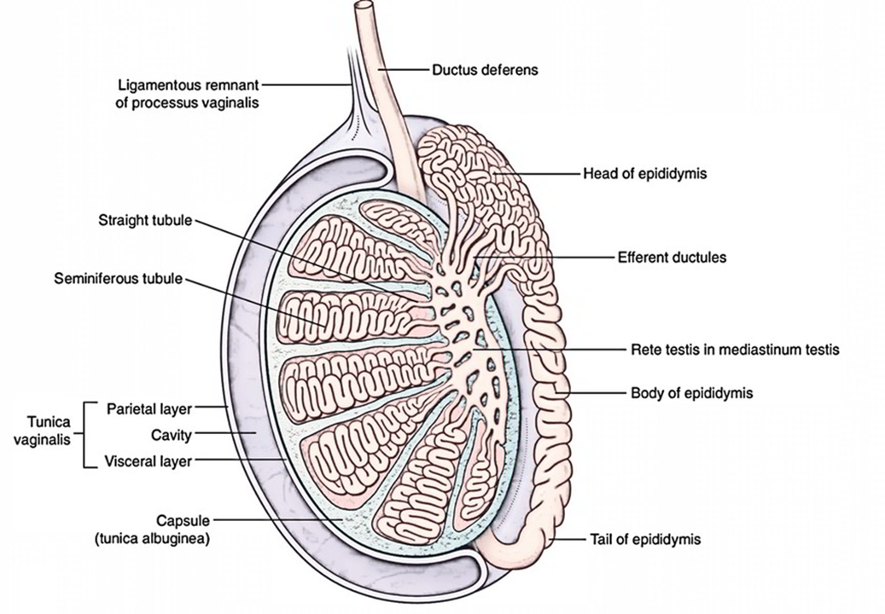

Slide 23
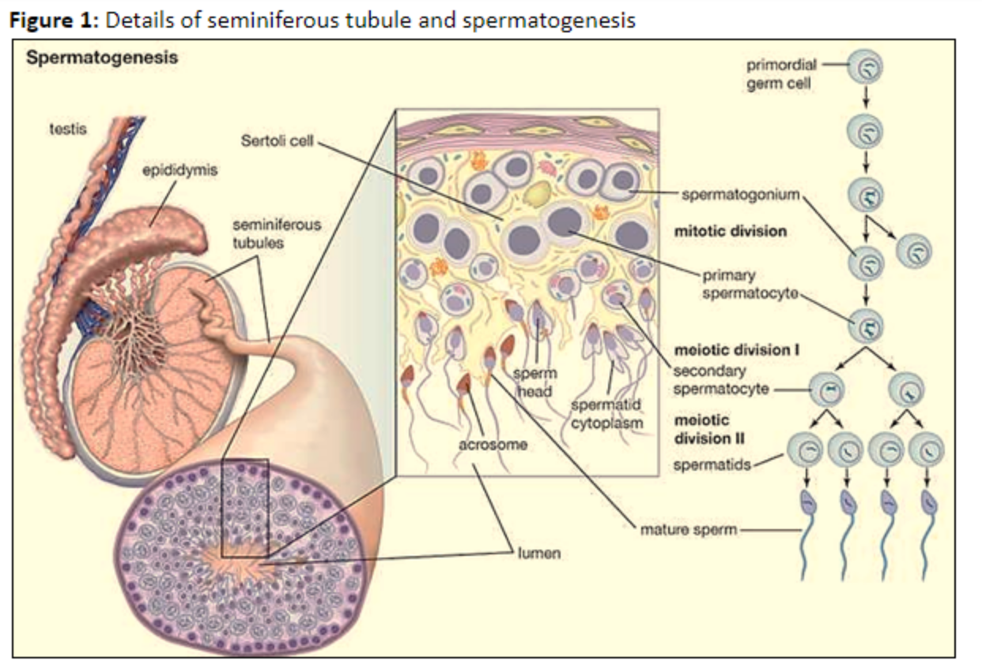

Slide 24
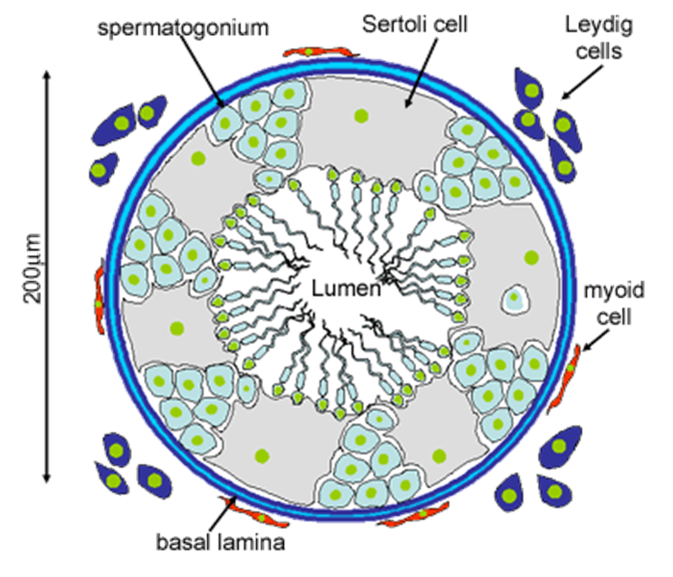

Slide 25
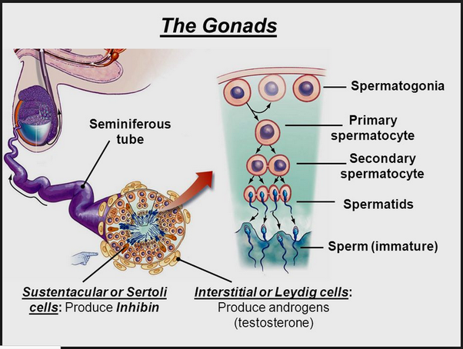

Slide 26
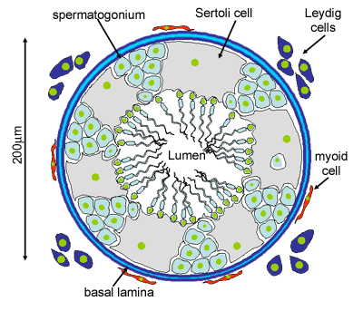
Microscopic structure of seminiferous tubules
Each seminiferous tubules is covered by
Basement membrane
Basement membrane supports 2 types of cells
Spermatogenic cells
Supporting cells of sertoli /sustentacular cells

Slide 27
During sexual maturity the spermatogenic cells proliferate cyclically untill mature spermatozoa are set free in the lumen of seminiferous tubules
The cells will be arranged into 3 well defined zones
Outer zone – consists of cells which are direct desendants of primitive male sex cells or gonocytes
Intermediate zone- consist of outer layer of primary spermatocytes and an inner layer of secondary spermatocytes
Primary spermatocytes are the daughter cells of typeb spermatogonia secondary cells are daughters of primary spematogonia
Inner zone consists of two or more layers of spermatids and residual bodies

Slide 28
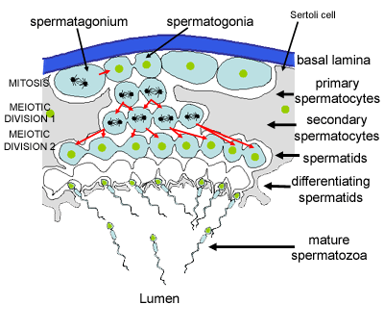

Slide 29
Sertoli cells
They are elongated polyhyderal cells which extent from basement membrane to the lumen of seminiferous tubules
Functions-
Physical support to spermatogenic cells
Spermatogenic cells depend on sertoli cells for nutrients
Phagocytosis of residual bodies

Slide 30
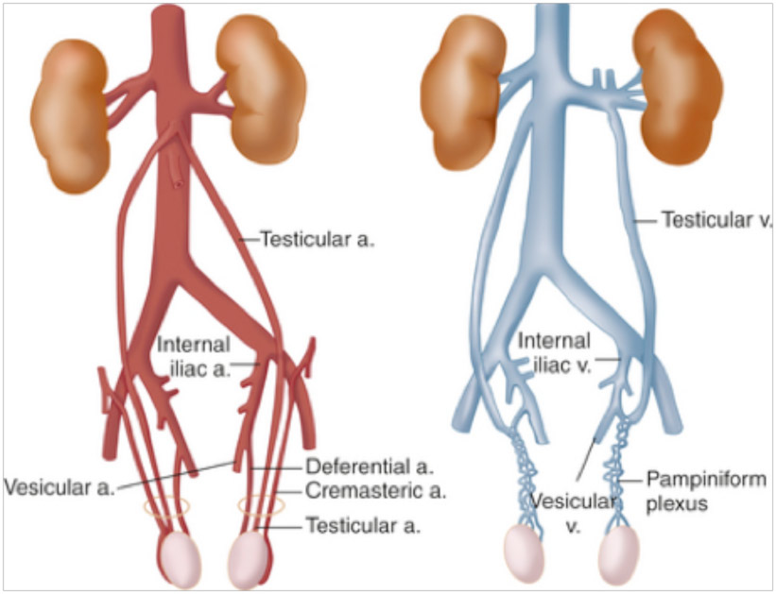
Arterial supply of testis
It is mostly supplied by testicular artery which is a branch of abdominal aorta
Testis is also partly supplied by artery to vas deferens which is a branch of superior or inferior vesicular artery

Slide 31
Venous drainage of testis
About 15 to 20 veins appear from the posterior border of testis and epididymes and unite to form pampiniform plexus
At the superficial inguinal ring the plexus unite to form 4veins
At the deep ring they ubite to form 2 veins
Finally these 2 join to form a single vein ie. Right and left testicular artery which drains to inferior vena cava

Slide 32
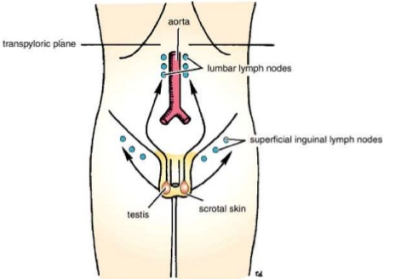
Lymphatic drainage of testis
Lymphatics drain into pre-aortic and para-aortic lymph nodes following the course of testicular blood vessels

Slide 33
Nerve supply of testis
It is supplied by sympathetic nerves arising from T10 segment of the spinal cord

Slide 34
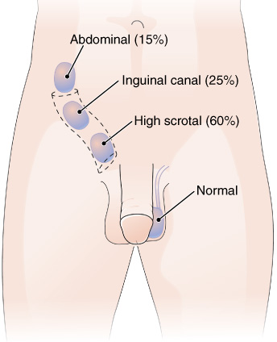
Anomalies of testis
Anorchism or crytorchism - where both testis are retained in the abdomen may undergo malignant changes
Monorchism –one testis decents
Ectopic testis – may occupy an abnormal position

Slide 35
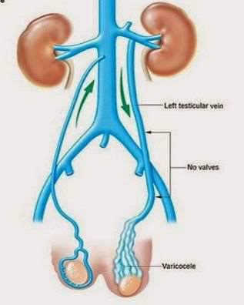
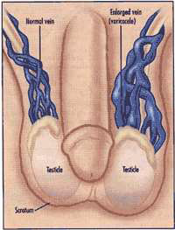
Varicocele
It is caused due to the dialation of pampiniform plexus
Usually on the left side due longer testicular vein

Slide 36
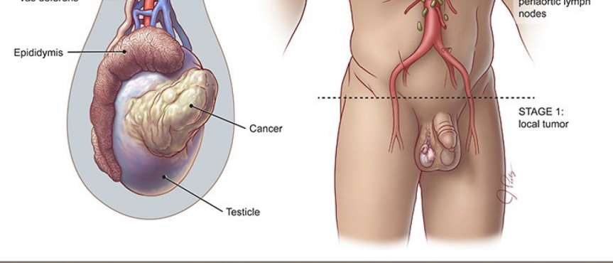
Testicular Ca
Testis can be a site for tumours

Slide 37
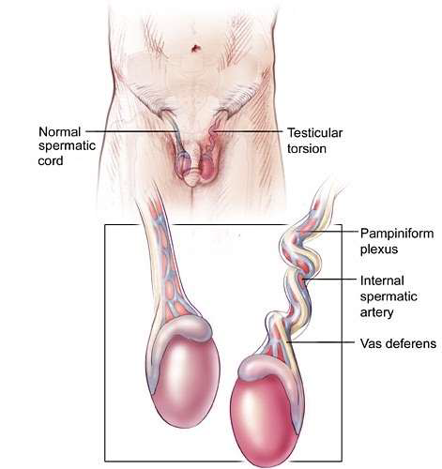
Torsion of testis
Testicular torsion occurs when a testicle rotates, twisting the spermatic cord that brings blood to the scrotum. The reduced blood flow causes sudden and often severe pain and swelling.
Testicular torsion is most common between ages 12 and 18, but it can occur at any age, even before birth.

