Slide 1
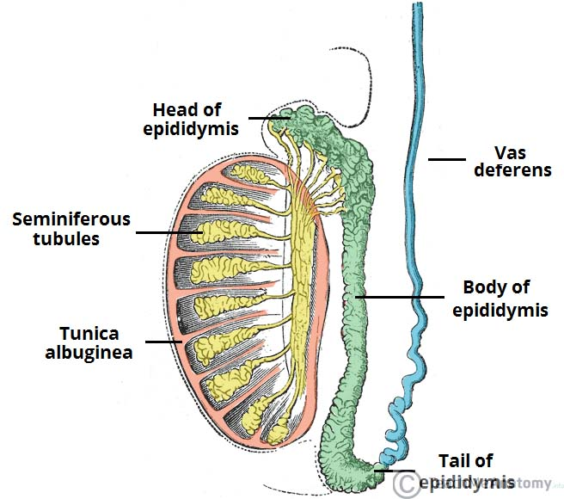
Epididymes
Epididymis lies posteriorly and slightly lateral to the testis, and the vas deferens lies along its medial side.
Parts-
It has an expanded
head or globus major superiorly,
a body (corpus) and a
tail (cauda or globus minor).

Slide 2
Vas deferns /ductuctus deferens
It is a thick cord like tubular sturture about 45 cms in length

Slide 3
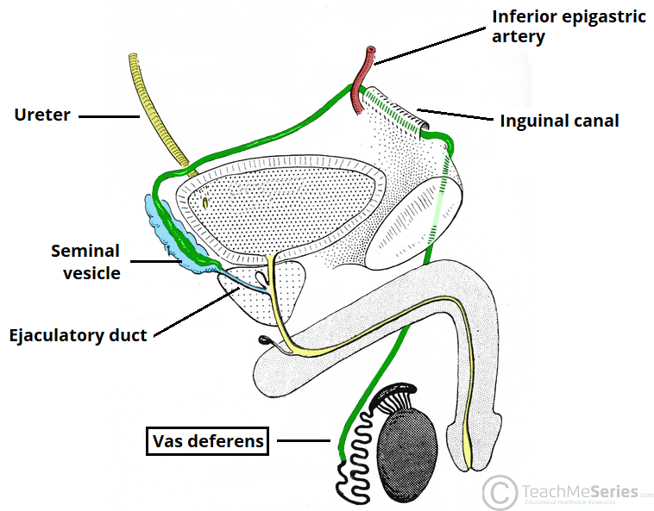
Course of vas deferns
Vas begins from the tail of epididymis
Passes tortuously upwards behind the testis and medial the epididymis
Enters the spermatic cordas an important content and lies posteriorly
It travels upwards to the superficial inguinal ring and then the inguinal canal

Slide 4
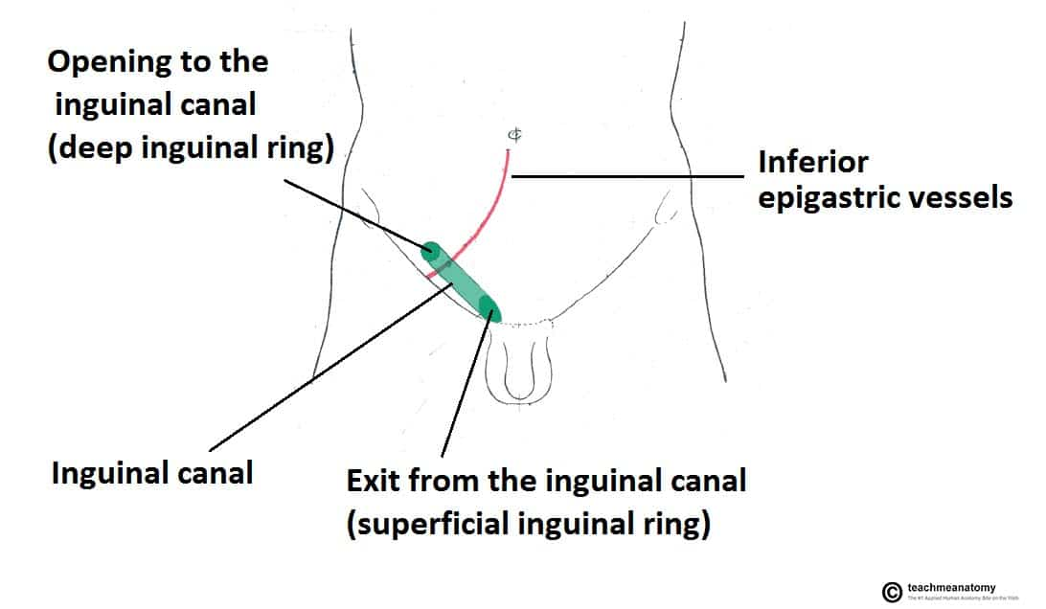

Slide 5
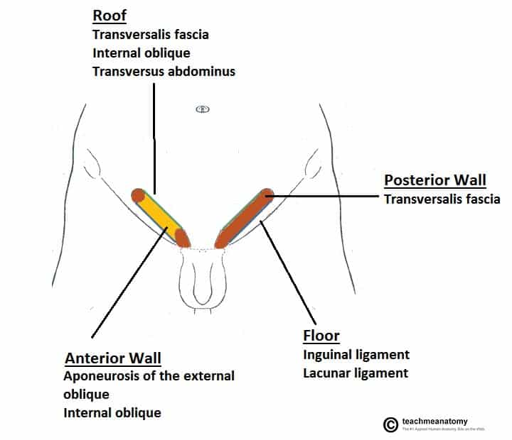

Slide 6
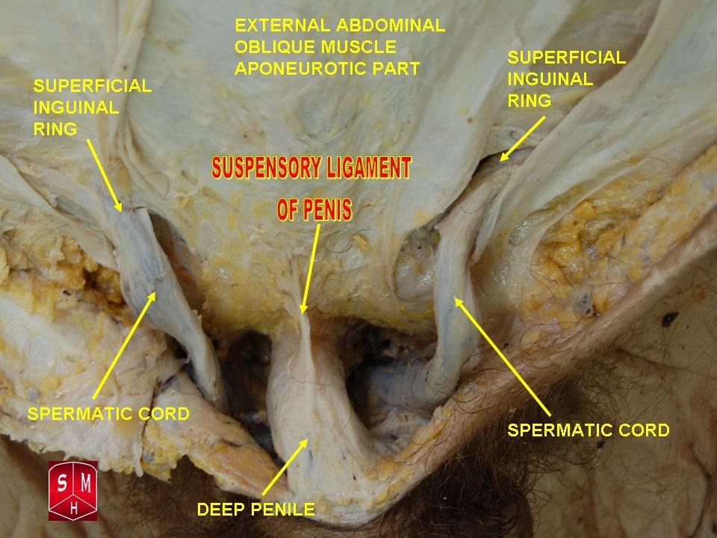

Slide 7
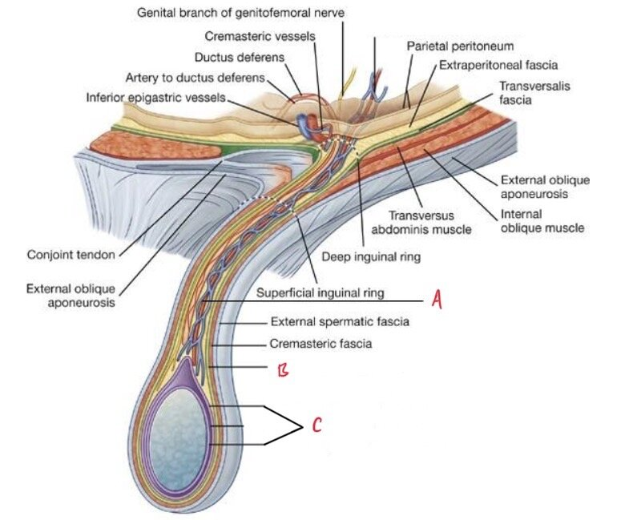
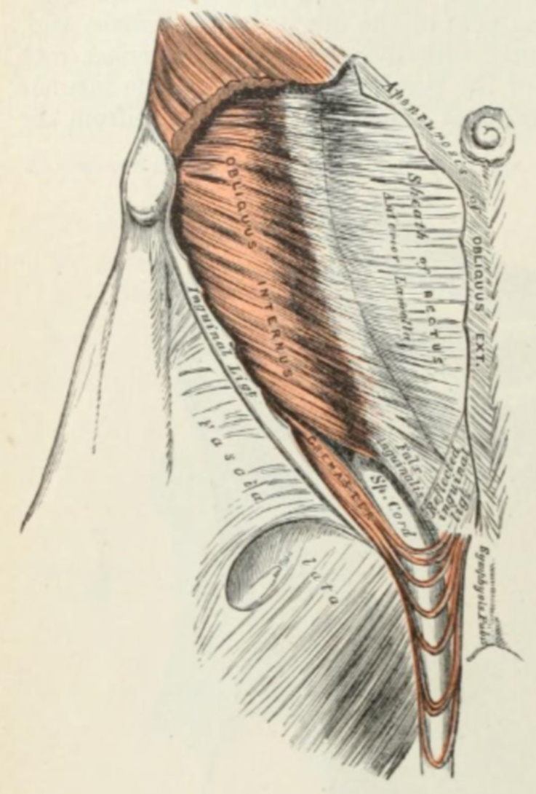

Slide 8
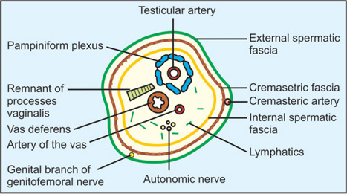
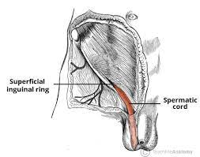
Spermatic cord contains the draining spermatic veins, the testicular artery, the vas deferens, and the draining lymphatics and nerves.

Slide 9
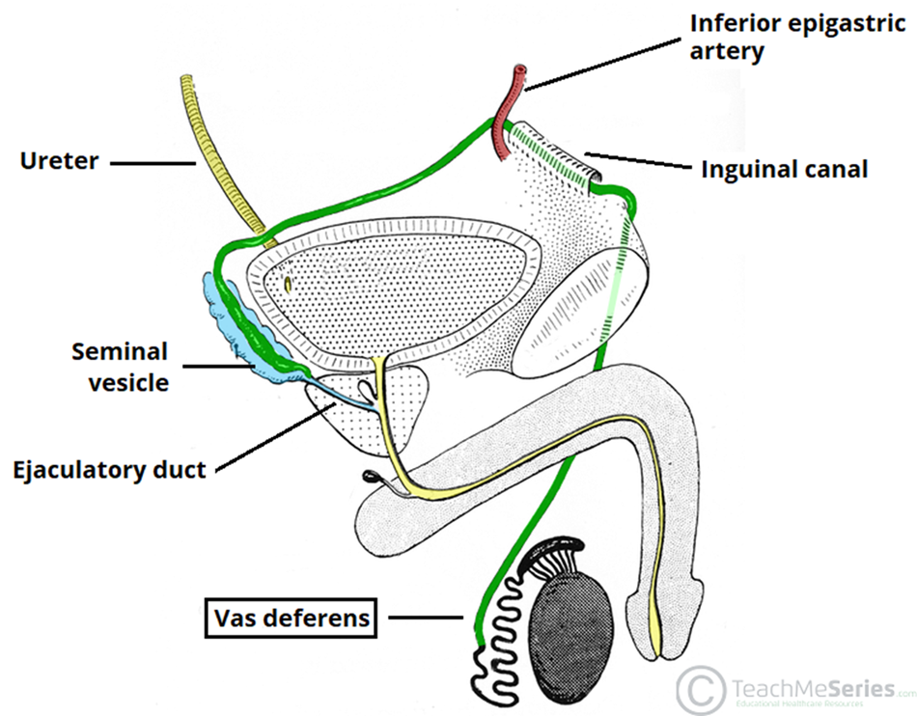
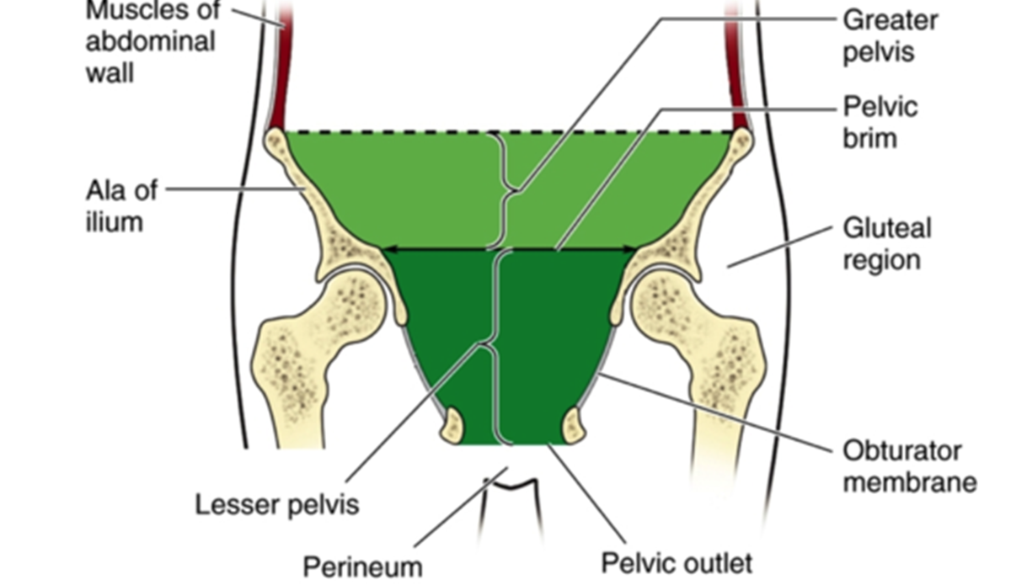
Course of vas deferns
In the greater pelvis, it leaves the other contents of the spermatic cord and winds round the lateral side of inferior epigastric artery
And then it passes backwards and medially across the external illiac vessels and enters the lesser pelvis

Slide 10
Course of vas deferns
In the lesser pelvis vas deferns runs downwards and backwards on the lateral pelvic wall (refer the image given in the next slide)
Reaching the base of the urinary bladder and vas runs forwards downwards and medially to the seminal vesicle
The part of the vas deferns lying posterior to the base of the bladder is known as ampulla
At the base of the prostate it is joined by the duct of seminal vesicle to form the ejaculatory duct

Slide 11
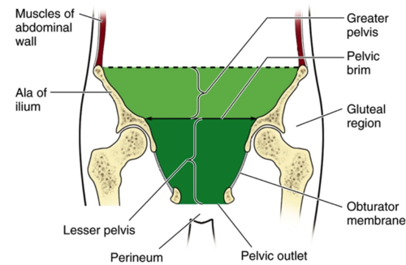

Slide 12


Slide 14
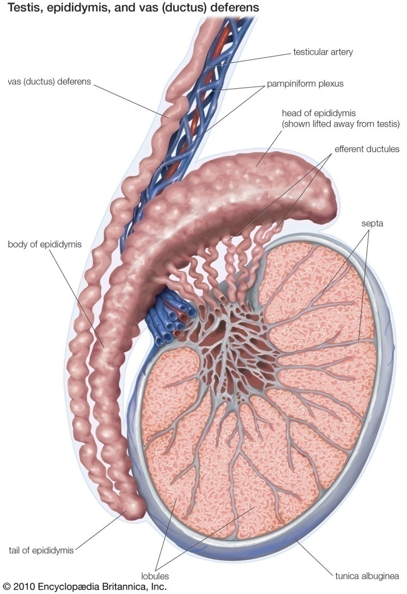
Blood supply and venous drainage of vas deferns
It is supplied by artery to vas deferens which is a branch of vesical artery

Slide 15
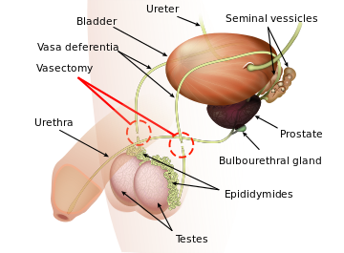
Applied anatomy of vas deferens
Bilateral ligation of vas deferens – vasectomy is applied as one of the methods of family planning

Slide 16
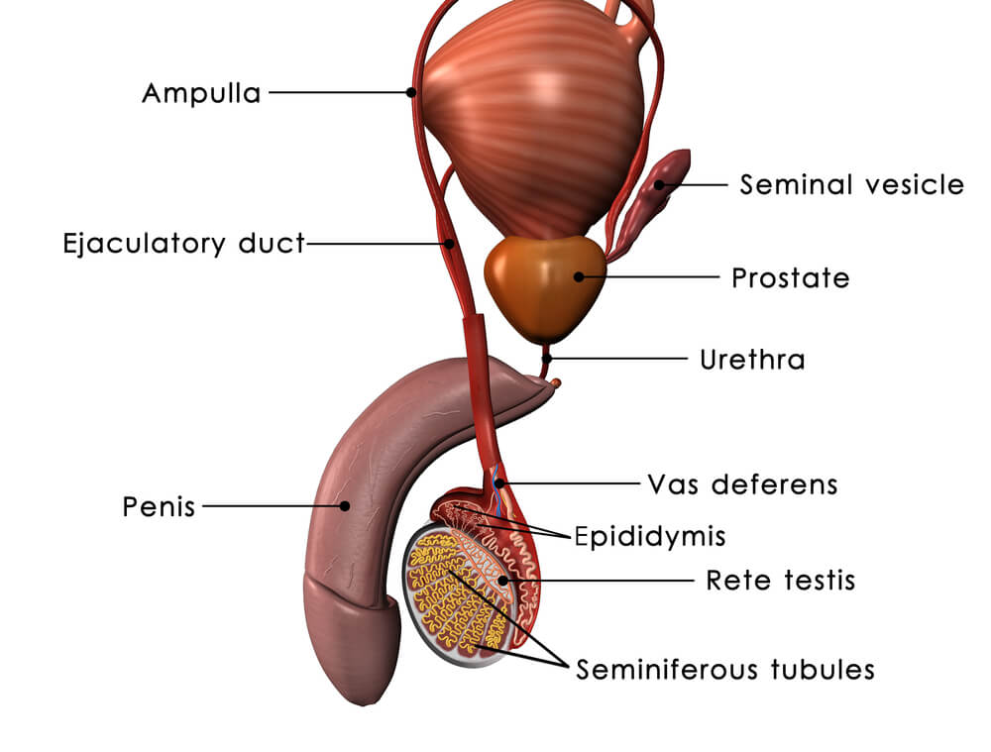
Seminal vessicles
Shape & location- They are pair of compressed pyramidal organs situated between ampula of rectum and base of the bladder.
Base of each vessicle is directed lateraly and upwards
It comes in contact with the terminal part of ureter
Apex of the vesicle converges at the base of the prostate & joins the vas deferens to form the ejaculatory duct

Slide 17
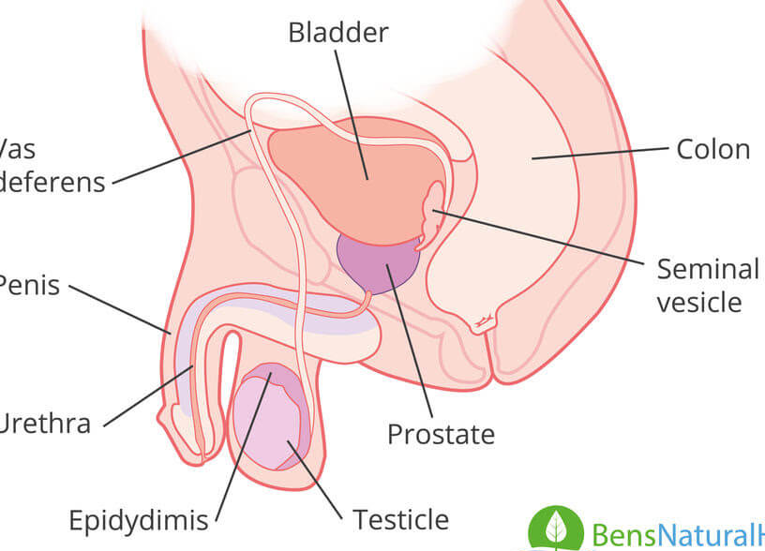
Relation of seminal vesicles
In front: base of bladdr
Posteriorly: ampulla of rectum
Medially : Ampula of vas deferens
Laterally: posterior true ligament of bladder containg vesical plexus of veins

Slide 18
Secretion of the vesicle is viscid yellowish white and alkaline
Forms the bulk of seminal fluid
It is rich in fructose prostragladin and a coagulating enzyme known as vesiculase

Slide 19
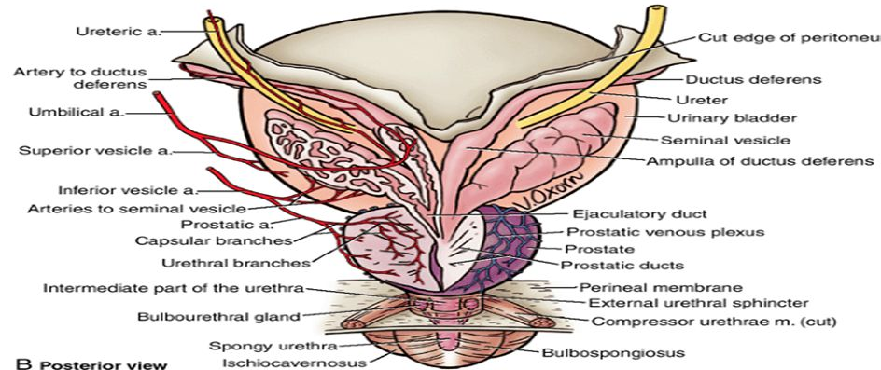
Blood supply of seminal vesicle
Supplied by inferior vesical and middle rectal arteries

Slide 20
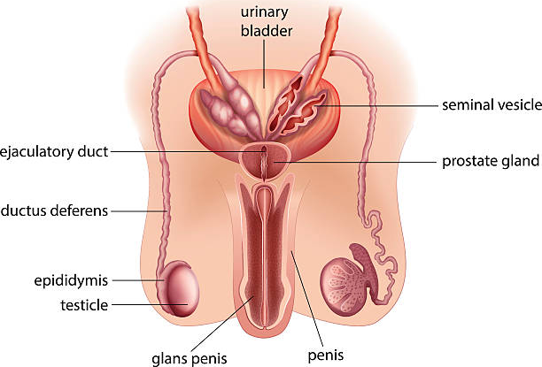
Ejaculatory ducts
It is 2 cm long
Formed by the union of vas deferens & seminal vesicle
It passes downwards & medially posterolaterally to the median lobe of prostate and opens into colliculus seminalis

Slide 21
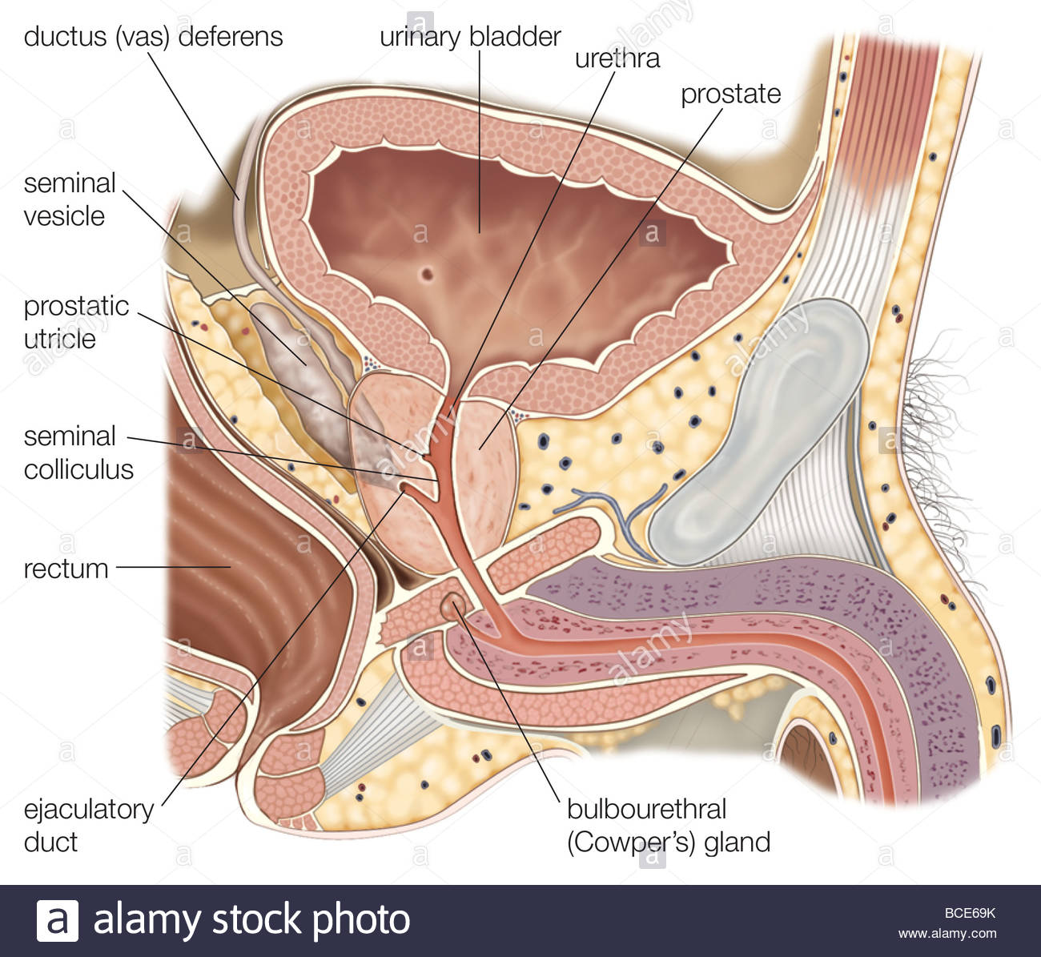

Slide 22
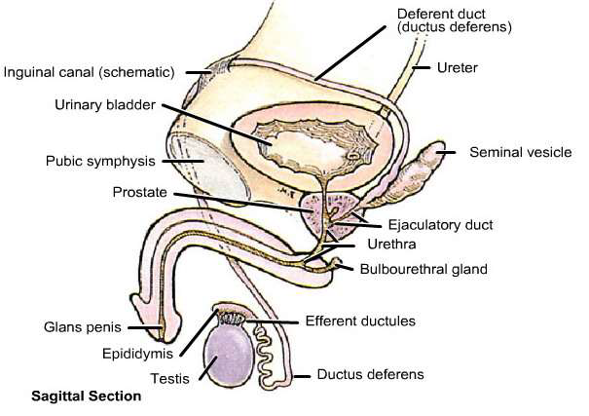
Prostate
it is a conical fibromusculo glandular organ situated around the proximal part of male urethra

Slide 23
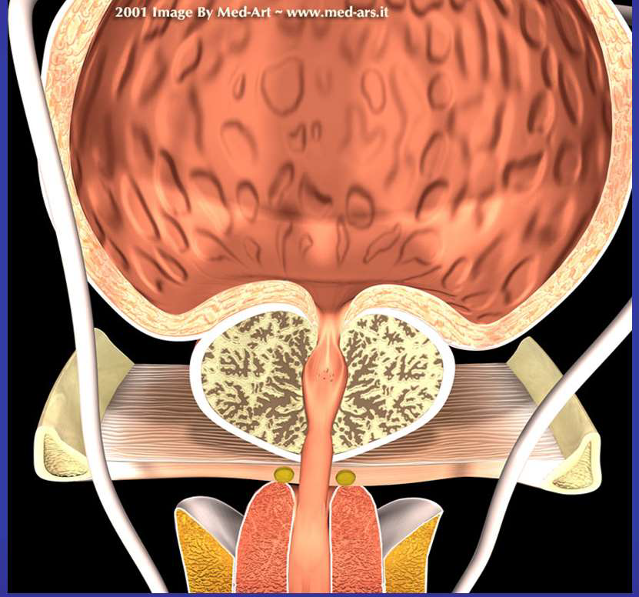
Importance of prostate
It secreation is slightly acidic and contains acid phophatase , fibrinolysin, prostragalndin and large amounts of zinc
The presence of prostraglandin and large amounts of zinc provides protection to spermatozoa against spermiophagic cells of the female genital tract

Slide 24
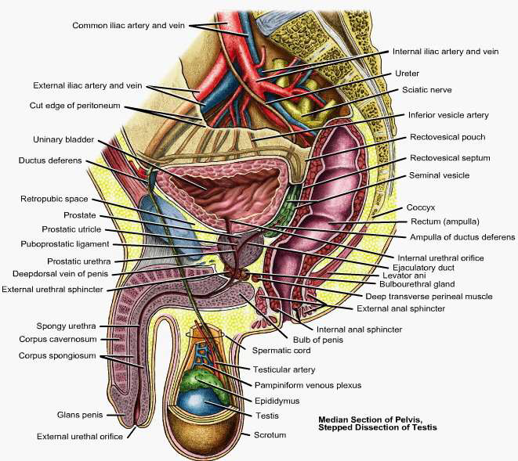
location
Loacted in the lesser pelvis
Below the neck of urinary bladder
Above the urogenital diaphagm
Behind the lower aspect of pubic symphysis
In front of the ampulla of rectum

Slide 26
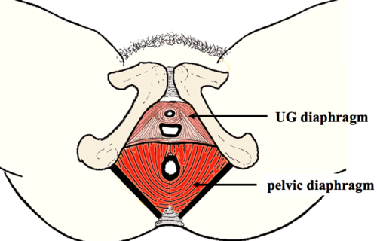
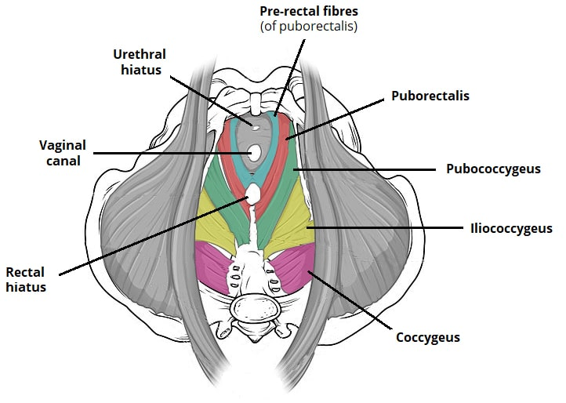

Slide 27
Measurements of prostate
Transversely at the base : 4cm
Verticaly – 3 cm
Anterio posteriorly -2cm
Wieght -8gm

Slide 28
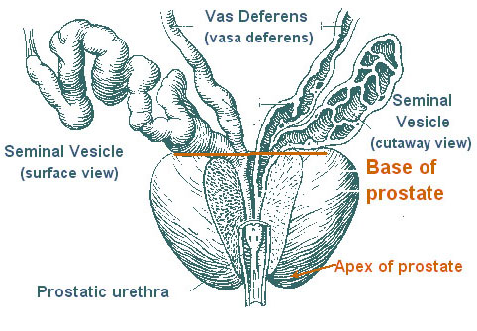
External features of prostate
prostate presents
Apex
Base
4 surfaces-
Anterior
Posterior
2inferolateral surfaces

Slide 29
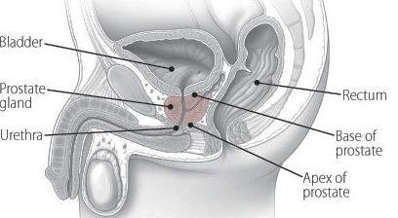
Apex of prostate
It is directed downwards surrounds the junction of prostratic and membraneous part of urethra

Slide 30
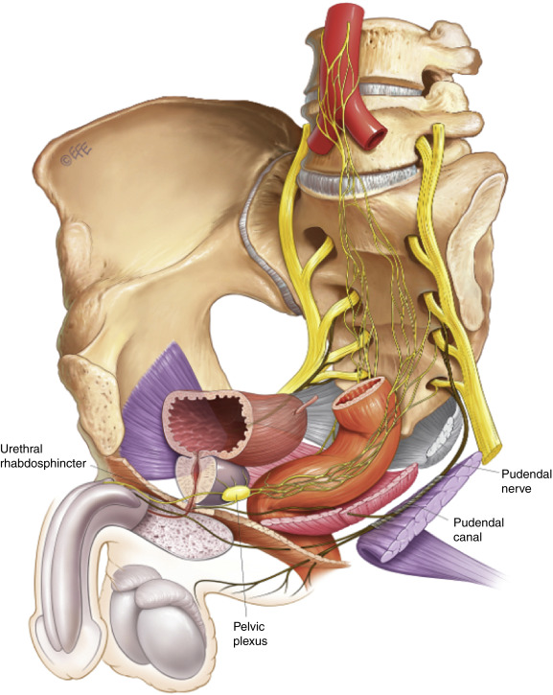
Base of prostate – superior surface
Is directed above and surrounds the neck of the bladder .
It is pierced by urethra in the median plane at the junction of anterior 1/3rd and posterior 2/3rd of the gland

Slide 31
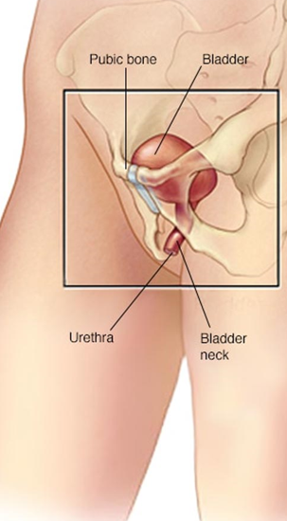
Anterior surface
It is narrow & convex and situated 2cm behind the lower part of symphysis pubis
It is seperated from the symphysis by retro pubic fat prostratic venous plexus

Slide 32
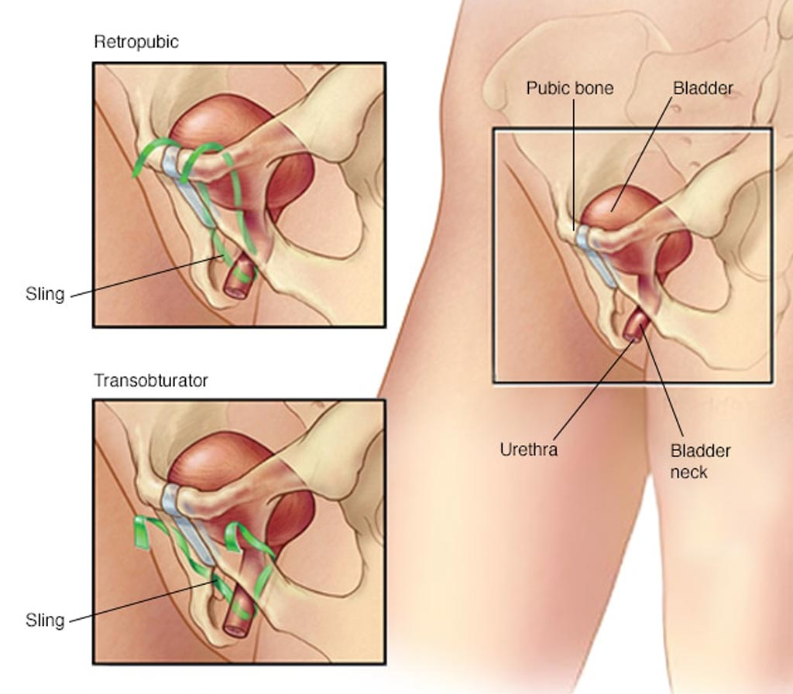

Slide 33
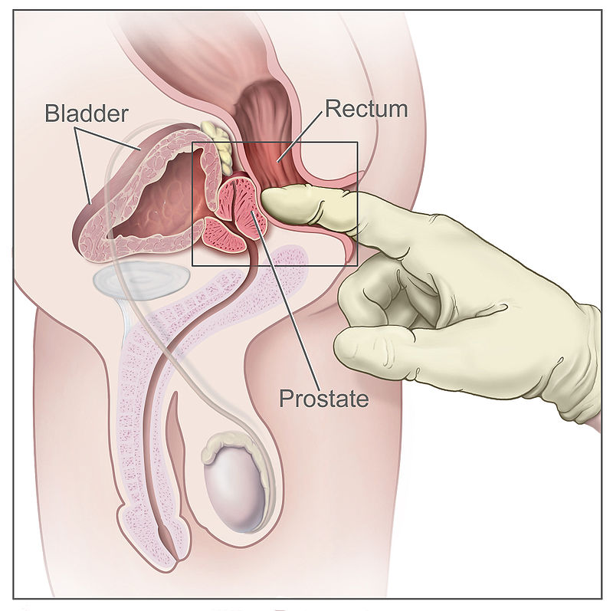
Posterior surface
It is flat and is related to the ampulla of rectum.
This surface is palpable by rectal examination 4cm above the anus
The posterior surface is divided by a transverse groove into upper smaller and lower larger area
The tranverse groove is pierced on each side by the ejaculatory duct

Slide 34
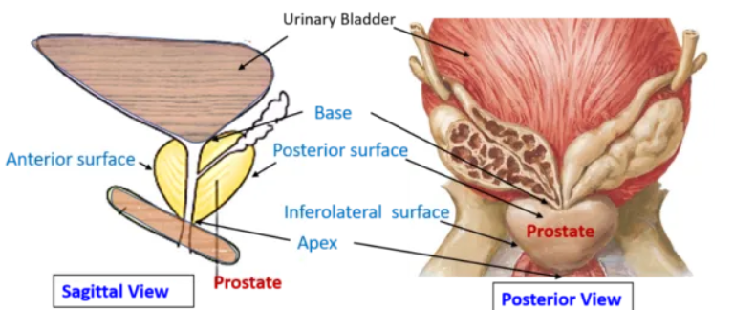
Posterior surface
Upper area of the posterior surface forms the median lobe
Lower area is subdivided into 2 lateral lobes

Slide 35
Inferolateral surface
It is related to the lateral walls of pelvis

Slide 36
Lobes of prostate
Anatomically it is divided into 3 lobes
Medial
Right and left lateral
Surgically it is divided into 5 lobes
Anterior
Posterior
Median
Two lateral

Slide 37
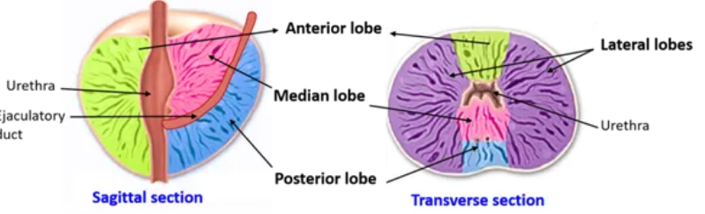
Lobes of prostate
Median lobe – it is wedge shaped and has its apex directed below. Medial lobe is bounded anteriorly by urethra and posteriorly by the ejaculatory duct
Two lateral lobe- they are seperated from each other by a posterior median sulcus

Slide 38
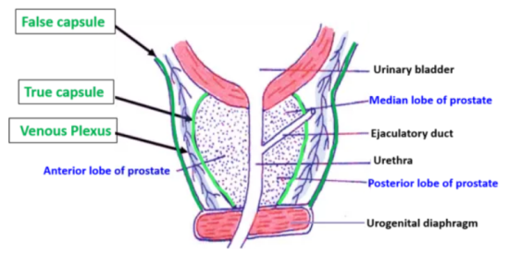
Coverings of prostate

Slide 39
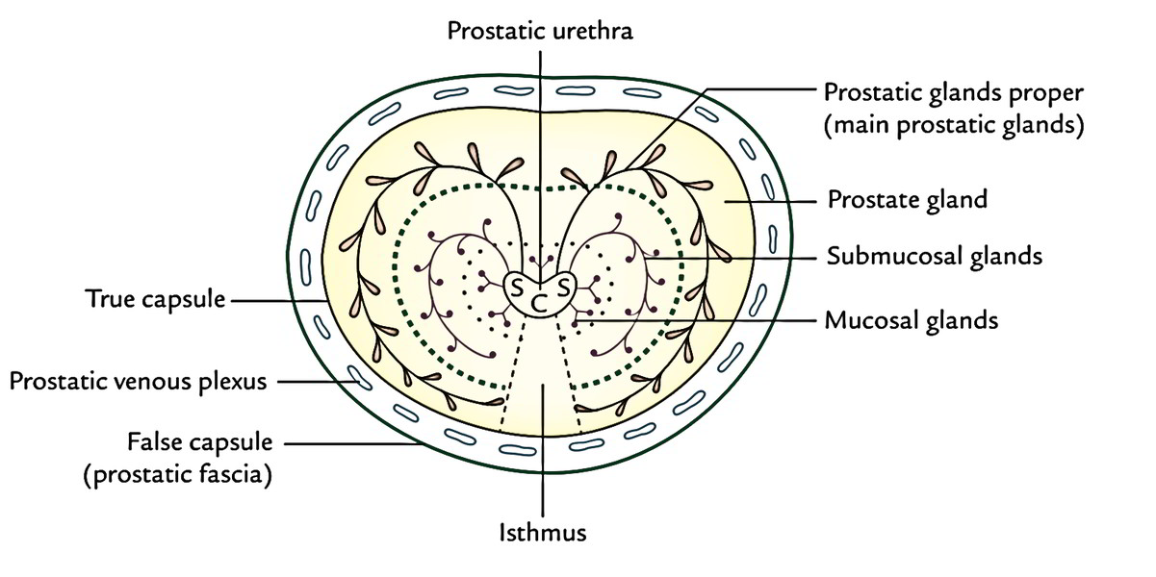
Coverings of prostate
Prostate has an inner true capsule & and an outer false capsule
True capsule – intimately covers the whole organ and is formed by the condensation of fibrous stroma of the gland

Slide 40
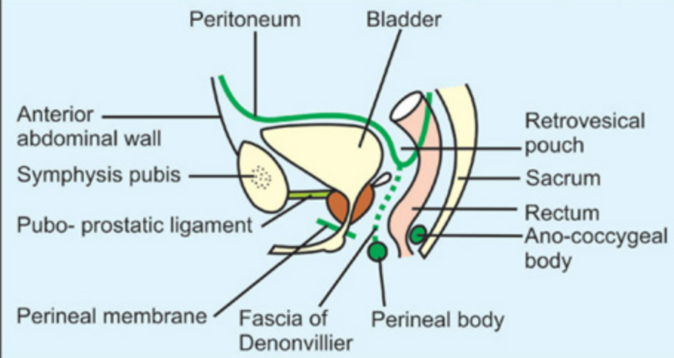
False capsule
Lies outside the true capsule
-it is also known as prostatic sheath .
Derived from visceral layer of pelvic fascia.
Anteriorly false capsule is continous with the puboprostatic ligaments
Posteriorly –it is formed by the recto-vesical fascia of denoviller
medial and lateral puboprostatic ligaments connect false capsule to pubic bone and act as a support to the gland

Slide 41
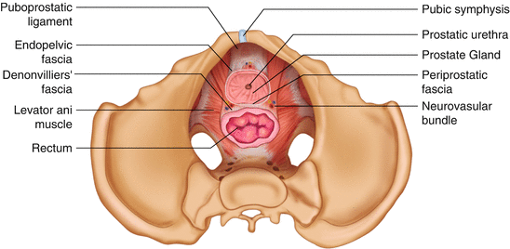

Slide 42
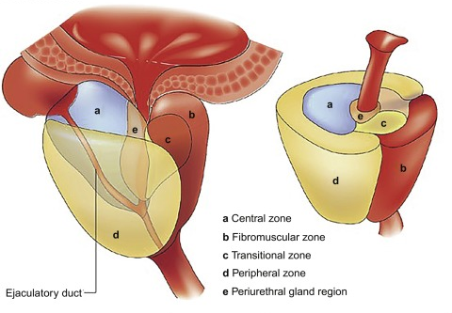
Zonal anatomy of Prostate
The glandular part of prostate is divided into 3 distinct zones
Peripheral zone:70%
Central zone:25%
Transitional zone: 5%

Slide 43
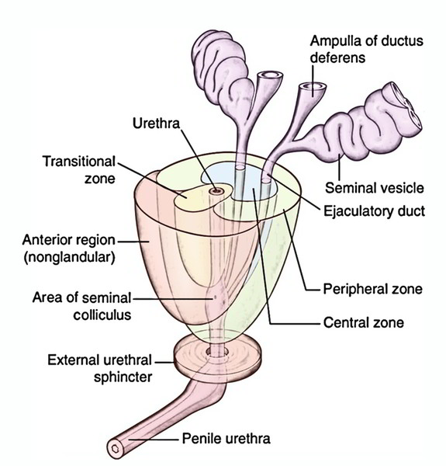
Zonal anatomy of Prostate
Central zone: it is conical in shape surrounds the ejaculatory ducts
Situated behind the urethra with its apexat the collicullus seminalis
Transitional zone: found around the distal part of preprostatic urethra .benign prostatic hyperplasia aries from this area
Peripheral zone: is cup shaped and encloses the central transitional zone &preprostatic urethra
Area is vulnerable for cancer

Slide 44
Structures within the prostate
Prostatic urethra
Ejaculatory duct
Prostatic utricle
Urethra runs vertically downwards at the junction of anterior1/3rd and posterior 2/3rd
Prostatic utricle is a blind sac directed upwards and downwards
Ejaculatory duct passes posterolaterally to median lobe and opens into the colliculus on each side of the prostaic utricle

Slide 45
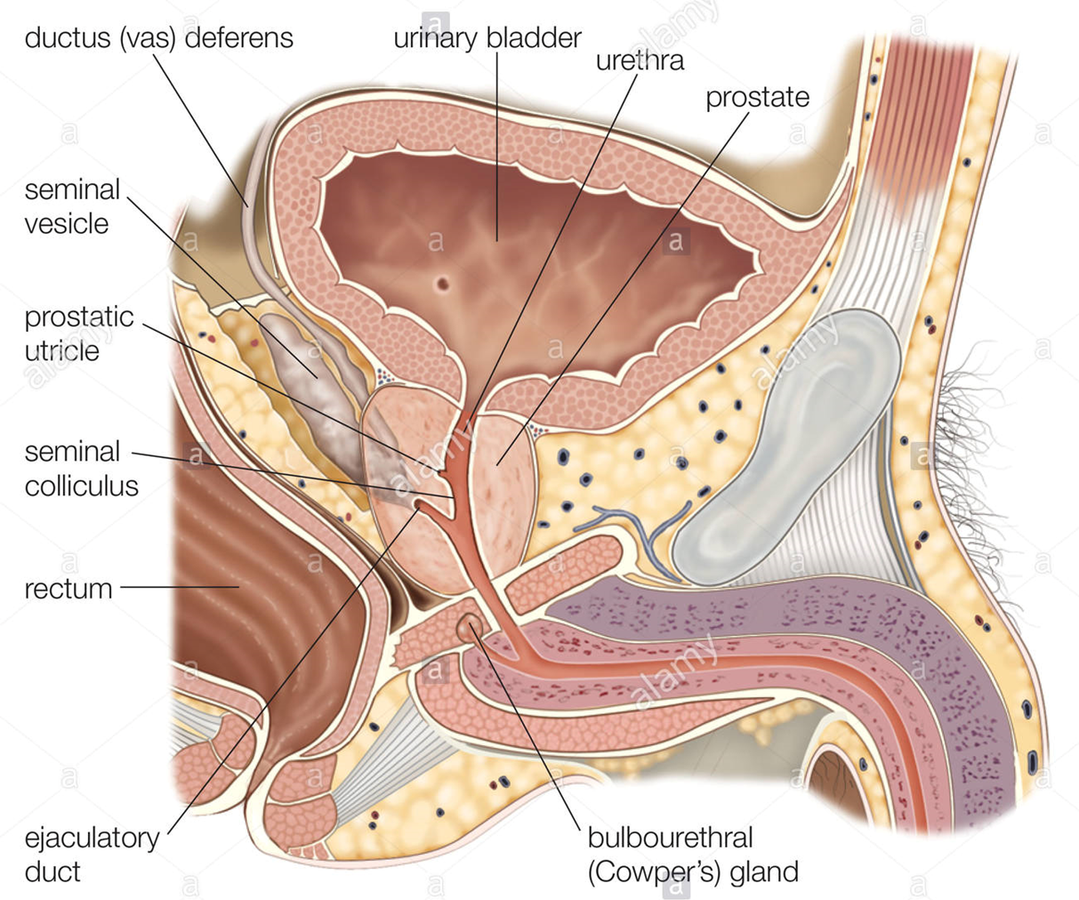

Slide 46
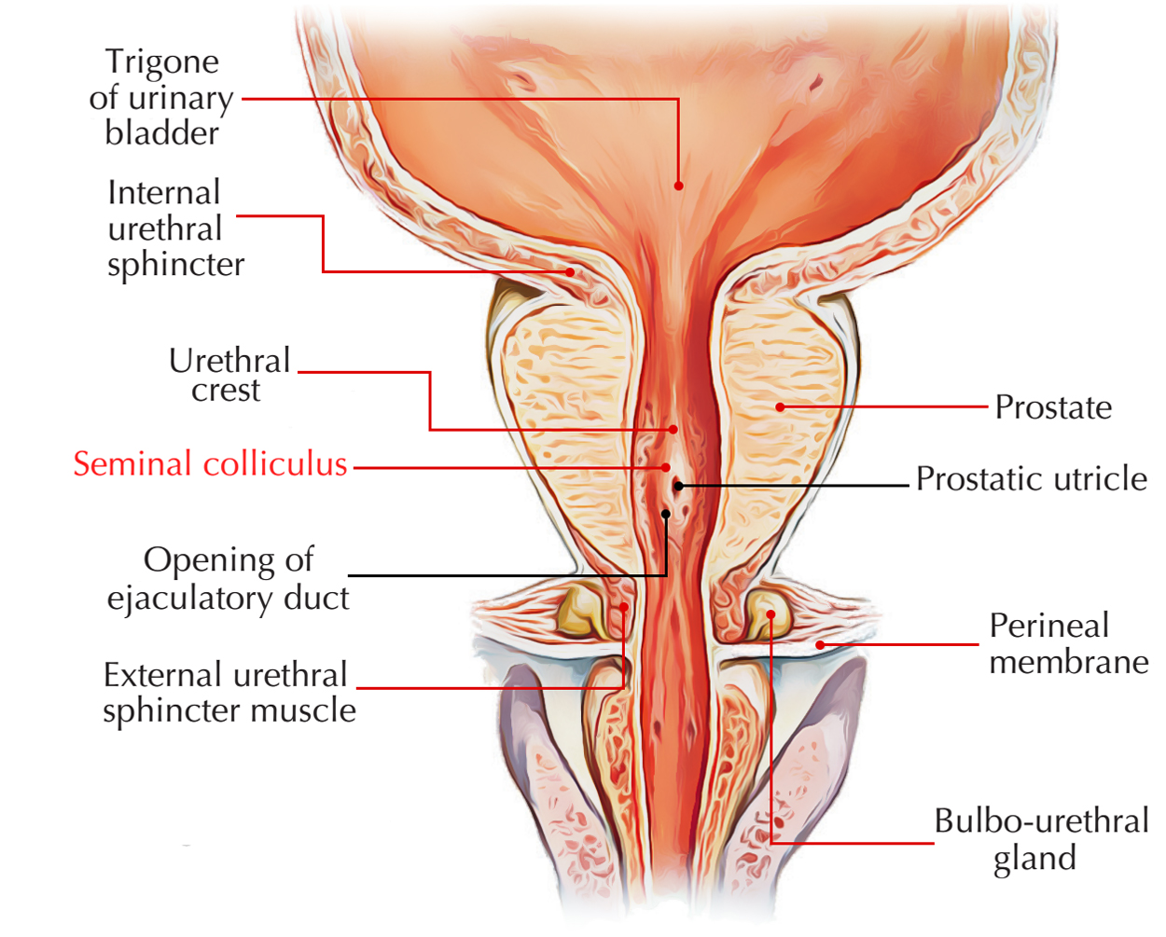

Slide 47
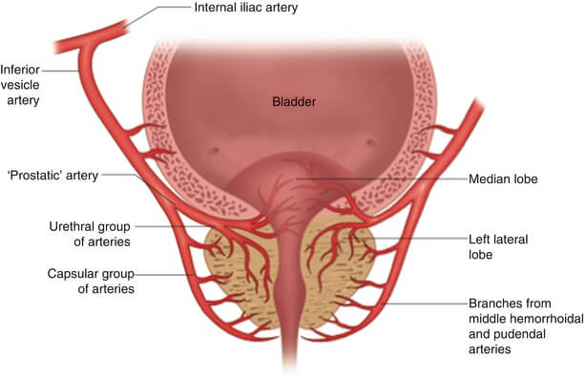
Arterial supply of prostate
It is supplied by the
inferior vesical
Middle rectal
And internal pudental arteries

Slide 48
Venous drainage of prostate
Veins forms a prostatic plexus in the space between true & false capsules around the sides and base of the gland
This plexus communicates with the vesical plexus and drains into vesical and internal iliac veins
Some veins are connected to the vertebral veins
Damage to plexus during surgery lead to severe haemorrhage

Slide 49
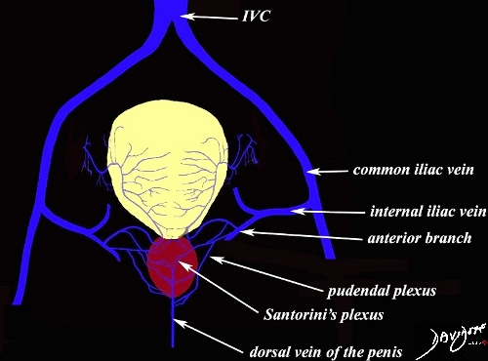

Slide 50
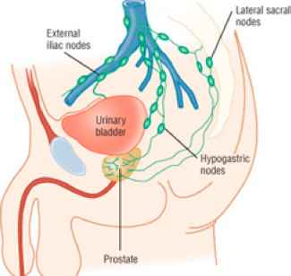
Lymphatic drainage
Lymphatics drain into
internal illiac
External illiac
Sacral groups of lymph nodes

Slide 51
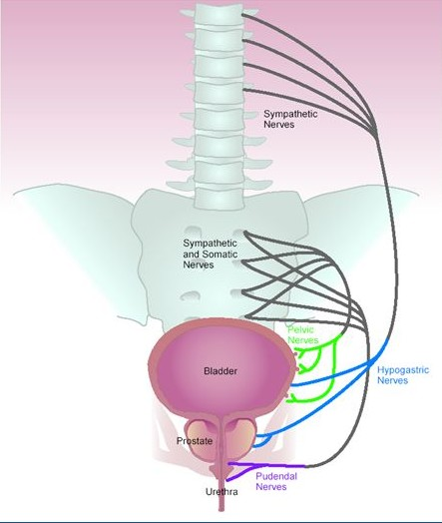
Nerve supply of prostate
Sympathetic fibers are derived from the superior hypogastric plexus
Parasympathetic fibers are derived from S2,S3, and S4

Slide 52
Changes In prostrate with age
In new born it is more like a duct system in a fibro muscular stroma
At puberty it exibits a sudden growth and become double the size of a neonatal stage
In old age it may undergo atrophy or progressive increase in size

