Slide 1
Rectum

Slide 2
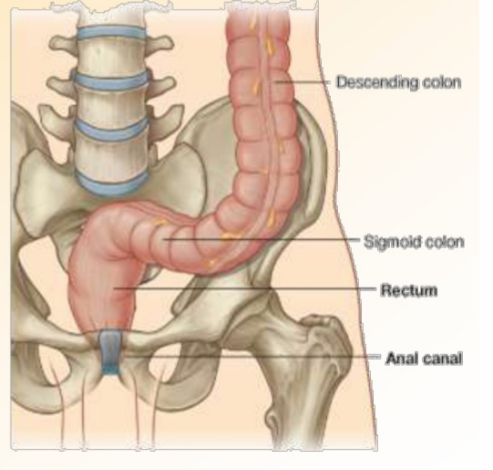
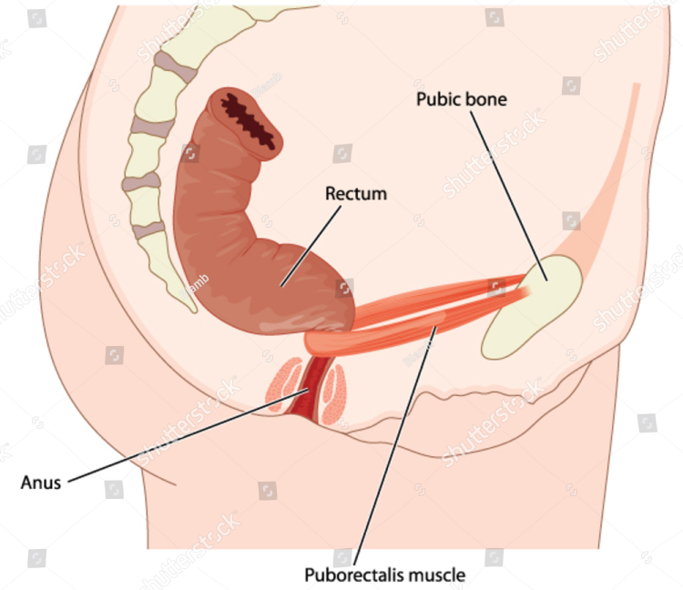
Introduction
Lowest part of the gastrointestinal tract is formed by the rectum and anal canal.
Useful components of the food are absorbed and waste material is stored in this part of the gut to be expelled from the anus

Slide 3
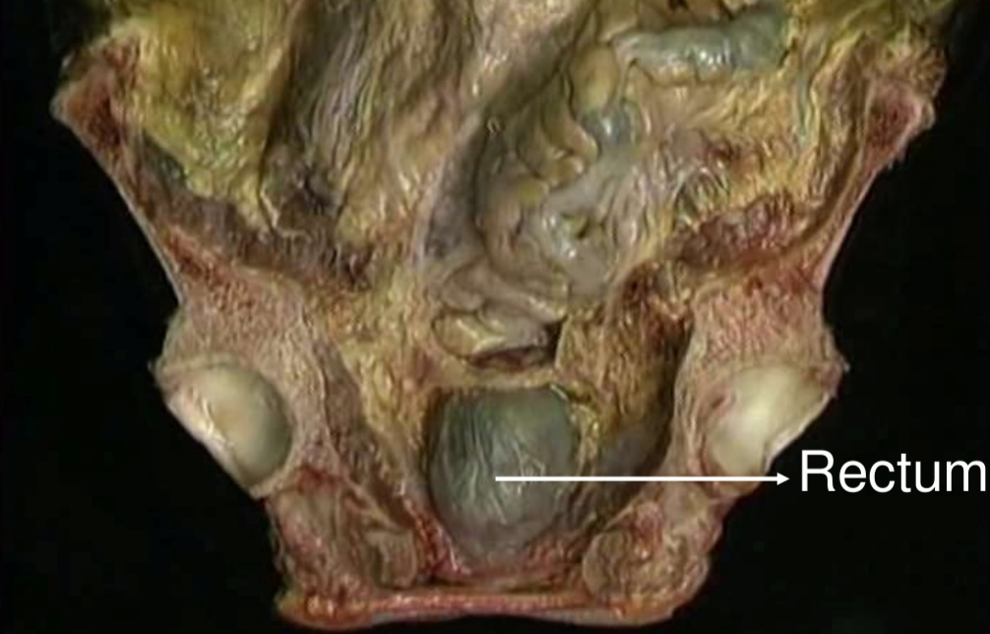
RECTUM
Rectum is the distal part of the large gut.
It is placed between the sigmoid colon above and the anal canal below.
Distension of the rectum causes the desire to defaecate.

Slide 4
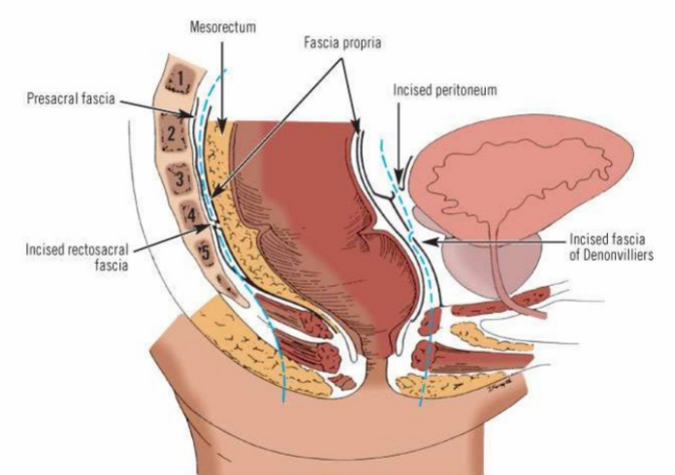
Location
Rectum is situated in the posterior part of the lesser pelvis, in front of the lower three pieces of the sacrum and the coccyx.

Slide 5
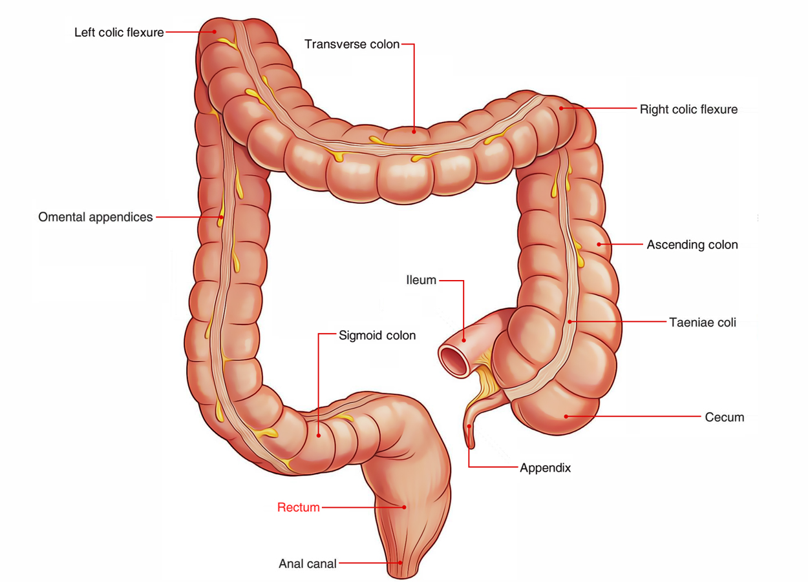
Extent
Rectum begins as a continuation of the sigmoid colon at the level of third sacral vertebra.
Rectum ends by becoming continuous with the anal canal at the anorectal junction.
Junction lies 2 to 3 cm in front of and a little below the tip of the coccyx.

Slide 6
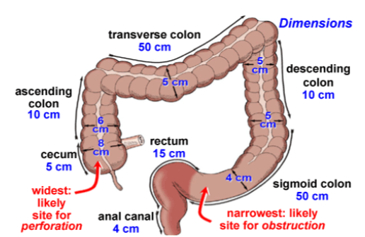
Dimensions
The rectum is 12 cm long.
In the upper part it has the same diameter of 4 cm as that of the sigmoid colon, but in the lower part it is dilated to form the rectal ampulla.

Slide 7
Course and Direction
Rectum runs first downwards and backwards, then continues downwards, and finally downwards and forwards.

Slide 8
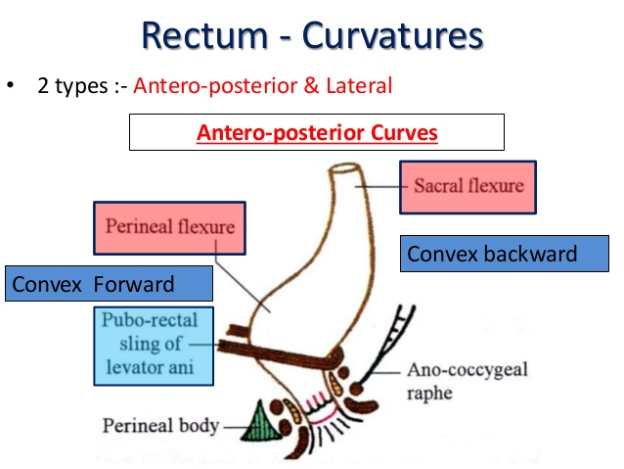
Rectum is not straight.
it is curved in an anteroposterior direction and also from side to side.

Slide 10
Curvatures of rectum
Beginning and the end of the rectum lie in the median plane, but it shows two types of curvatures in its course.

Slide 11
Two anteroposterior curves : (I) The sacral flexure of the rectum follows the concavity of the sacrum and coccyx; (2) Perineal flexure of the rectum is the backward bend at the anorectal junction

Slide 12
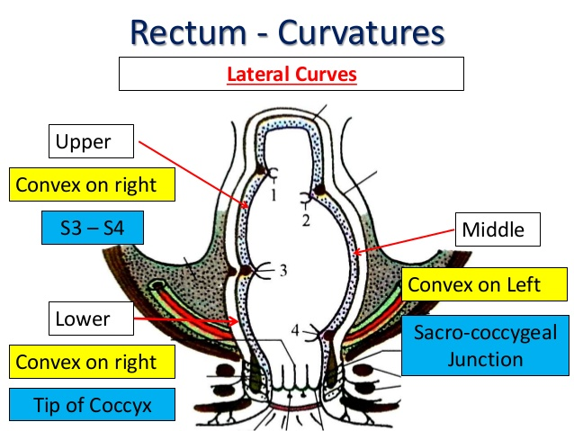
Three lateral curves
: (1) Upper lateral curve of rectum is convex to the right;
(2) Middle lateral curve is convex to the left and is most prominent; and
(3) Lower lateral curve is convex to the right.

Slide 13
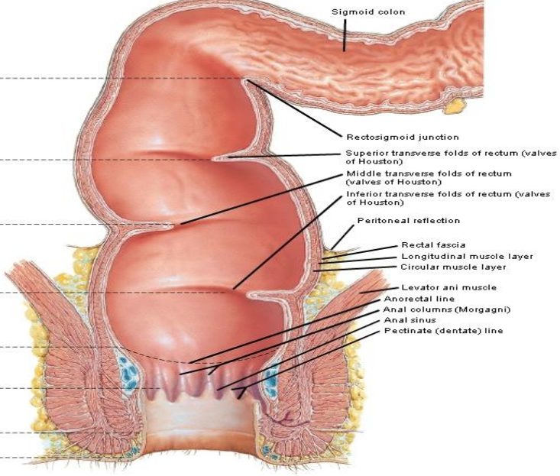
Interior of Rectum
Mucous membrane of rectum shows2 types of mucous folds – temporary & permanent
Temporary folds –longitudinal in direction -disappear on distention
permanent folds - transverse folds -3 /4 folds or valve of Houston
Permanent – along the concavities of lateral curvature of rectum semilunar, 4 in number (1,3 –constant ,2,4 –inconstant )

Slide 14
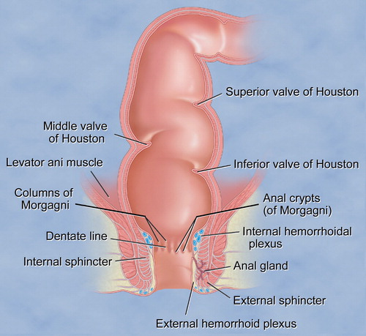
Permanent folds
1st valve –rectosigmoidal junction ,from right or left side, 12-14 cm above anus
2nd valve – 2.5 cm above third valve , from left wall
3rd valve - most important & constant , at S5 level, from anterior & right wall , lies 5 cm above anus
4th valve – 2.5 cm below third , from left wall of rectum

Slide 15
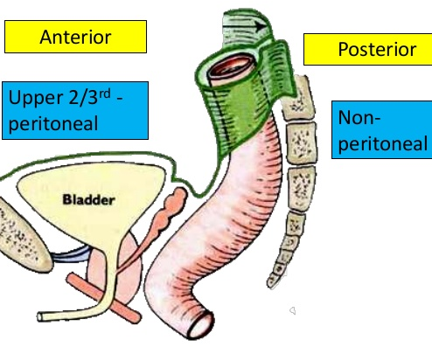
Relations
Peritoneal Relations
(1) The upper one-third of the rectum is covered with peritoneum in front and on the sides;
(2) the middle one-third is covered only in front; and
(3) the lower one-third, which is dilated to form the ampulla, is devoid of peritoneum,

Slide 16
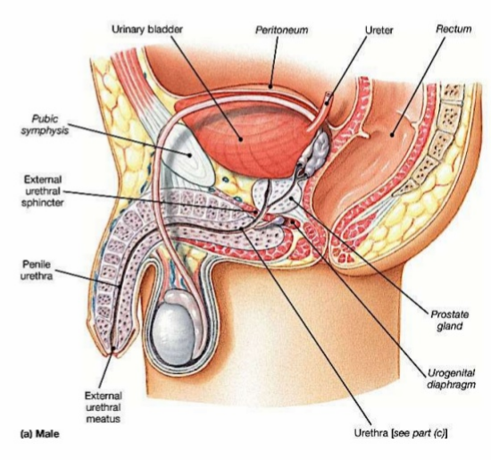
Anterior Visceral Relations
(a) Anteriorly in males : (1) The upper two-thirds of the rectum are related to the rectovesical pouch with coils of intestine and sigmoid colon;
(2) the lower one-third of the rectum is related to the base of the urinary bladder, the terminal parts of the ureters, the seminal vesicles, the deferent ducts and the prostate

Slide 17
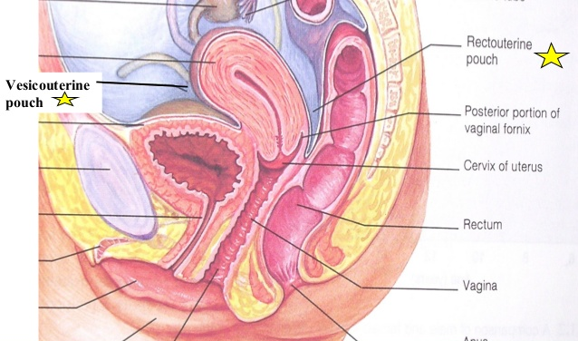
Anterior Visceral Relations
Anteriorly in females :
(1) Upper two-thirds of the rectum are related to the rectouterine pouch with coils of intestine and sigmoid colon
(2) Lower one-third of the rectum is related to the lower part of the vagina

Slide 18
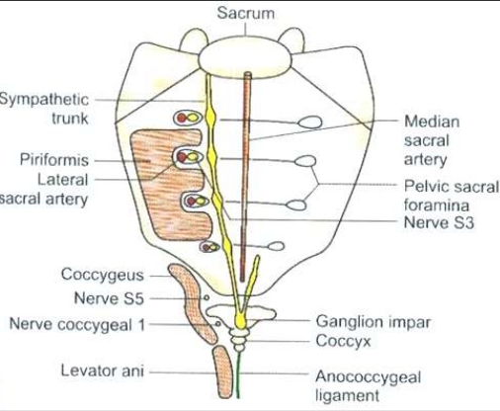
Posterior visceral relations
(b) Posteriorly the relations are the same in the male and female. They are as follows :
(1) Lower three pieces of the sacrum, the coccyx and the anococcygeal ligament
2) Piriformis, the coccygeus and the levator ani;
(3) Median sacral, the superior rectal and the lower lateral sacral vessels.
(4) Sympathetic chain with the ganglion impar; the anterior primary rami of S3, S4, S5, Co1 and the pelvic splanchnic nerves; lymph nodes, lymphatics and fat

Slide 19
Mucosal Folds
The mucous membrane of an empty rectum shows two types of folds, longitudinal and transverse.
The longitudinal folds are transitory. They are present in the lower part of an empty rectum, and are obliterated by distension.

Slide 20
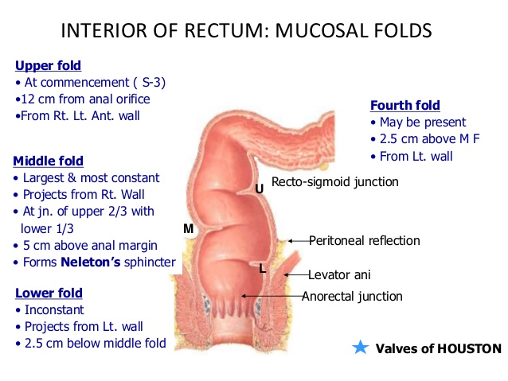
The transverse or horizontal folds or Houston's valves or plicae transversales are permanent and most marked when the rectum is distended.
(1) Upper fold lies near the upper end of the rectum, and projects from the right or the left wall. Sometimes it may encircle and partially constrict the lumen.
(2) Middle fold, the largest and most constant, lies at the upper end of the rectal ampulla, and projects from the anterior and right walls.
(3) Lowest fold which is inconstant lies 2.5 cm below the middle fold, and projects from the left wall

Slide 21
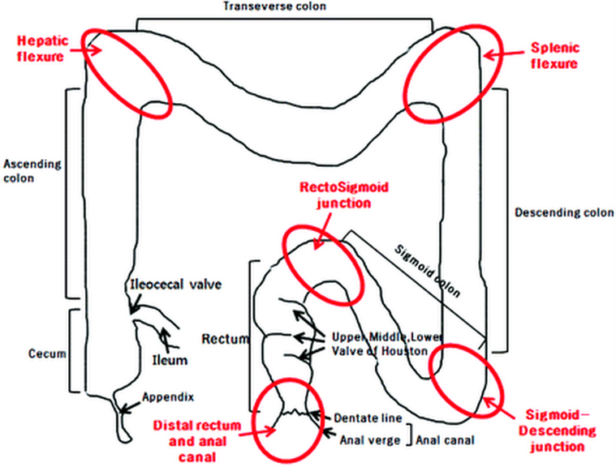
Recto-sigmoid junction

Slide 22
Functional Parts of Rectum
Upper part related to the peritoneum acts as a faecal reservoir which can freely distend anteriorly.
The lower part devoid of peritoneum is empty in normal individuals, but may contain faeces in cases of chronic constipation, or after death. Being sensitive, its distension causes the desire to defaecate.

Slide 23
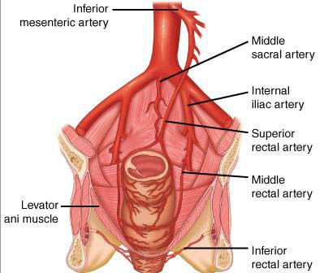
Arterial Supply
1. Superior rectal artery
2. Middle rectal arteries
3. Median sacral artery

Slide 24
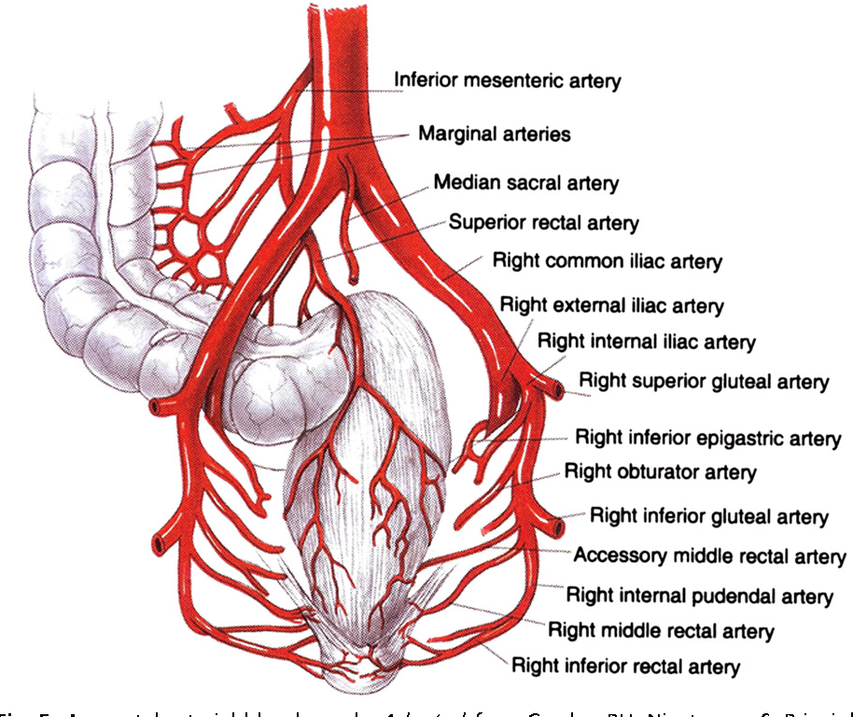

Slide 25
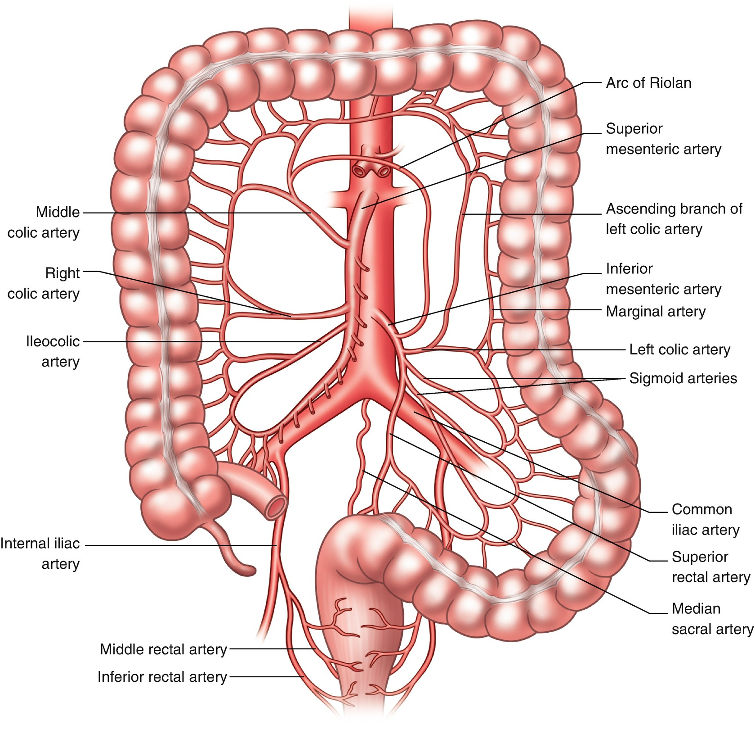

Slide 26
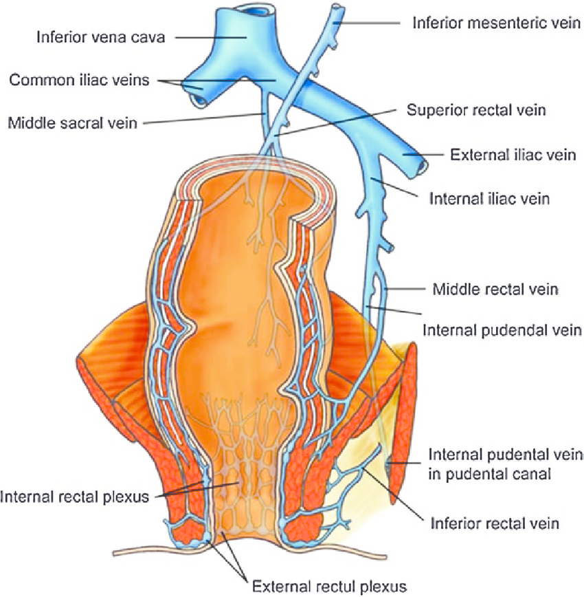
Venous Drainage
1. Superior rectal vein
2. Middle rectal vein

Slide 27
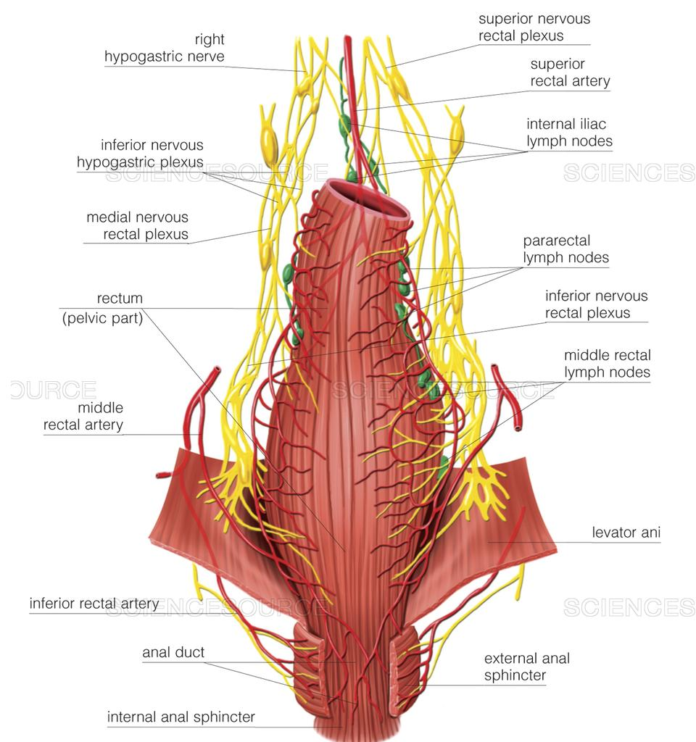
Lymphatic Drainage
1. Lymphatics from more than the upper half of the rectum pass along the superior rectal vessels to the inferior mesenteric nodes after passing through the pararectal and sigmoid nodes.
2. Lymphatics from the lower half of the rectum pass along the middle rectal vessels to the internal iliac nodes

Slide 28
Nerve Supply
The rectum is supplied by both sympathetic (LI, L2) and
Parasympathetic (S2, S3, S4) nerves through the superior rectal or inferior mesenteric and inferior hypogastric plexuse

Slide 29
Supports of Rectum
1. Pelvic floor formed by levator ani muscles.
2. Fascia of Waldeyer
3. Lateral ligaments of the rectum:
4. Rectovesical fascia of Denonvilliers :
5. Perineal body with its muscles.

Slide 30
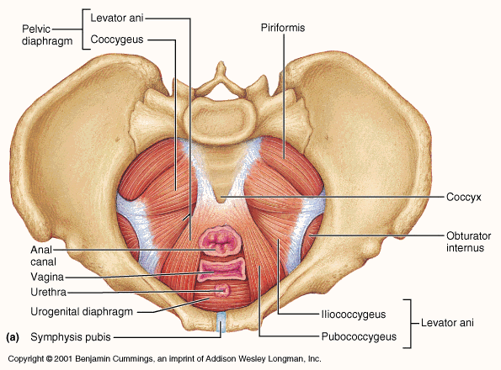
1. Pelvic floor formed by levator ani muscles

Slide 31
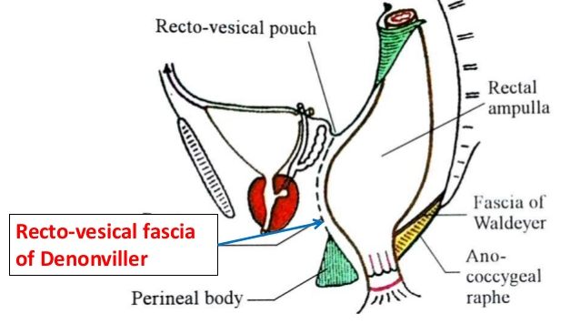
2. Fascia of Waldeyer: It attaches the lower part of the rectal ampulla to the sacrum. It is formed by condensation of the pelvic fascia behind the rectum. It encloses the superior rectal vessels and lymphatics.

Slide 32
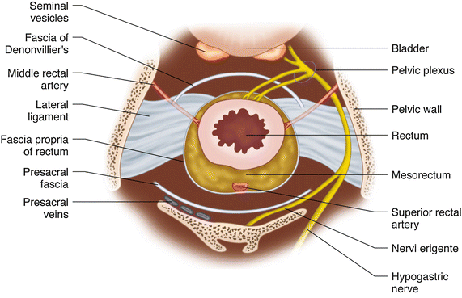
3. Lateral ligaments of the rectum: They are formed by condensation of the pelvic fascia on each side of the rectum.
They attach the rectum to the posterolateral walls of the lesser pelvis

Slide 33
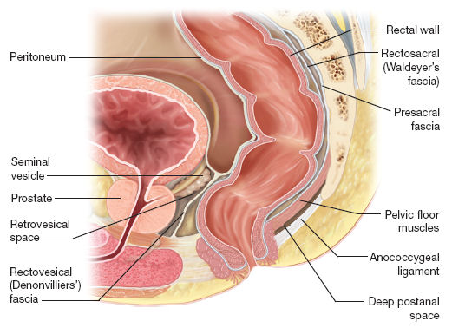
4. Rectovesical fascia of Denonvilliers : It extends from the rectum behind to the seminal vesicles and prostate in front

Slide 34
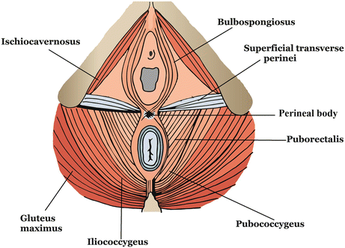
6. Perineal body with its muscles.

Slide 35
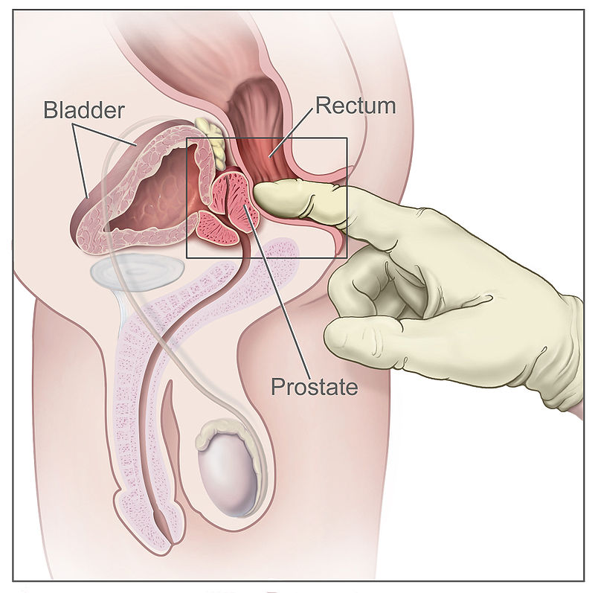
CLINICAL ANATOMY
Digital Per Rectum (PR) Examination

Slide 36
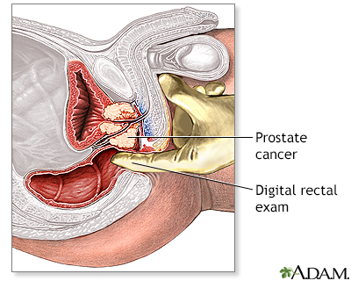

Slide 37
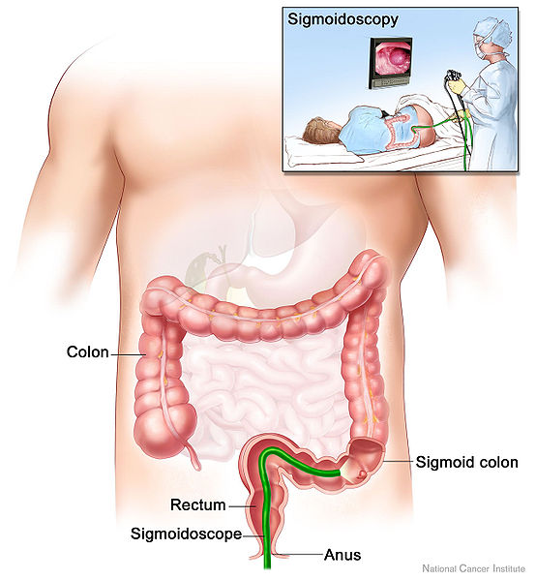
Proctoscopy Sigmoidoscopy

Slide 38
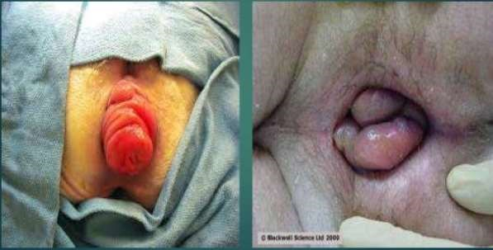
Prolapse of Rectum

Slide 39
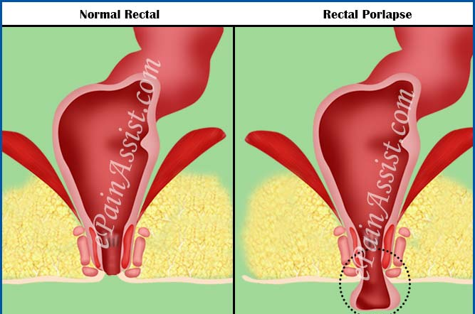

Slide 40
Neurological Disturbances of the Rectum

Slide 41
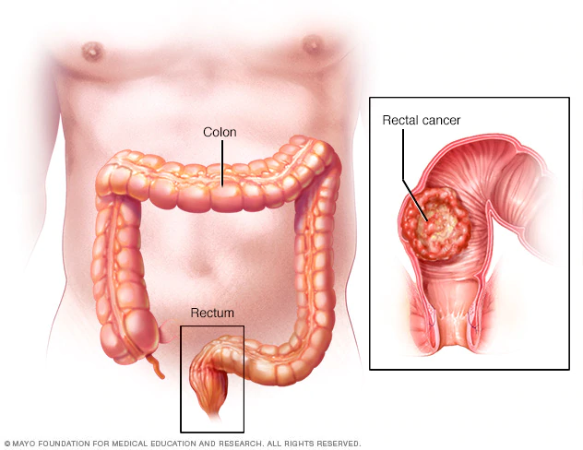
Carcinoma of Rectum

