Slide 1
Pleura

Slide 2
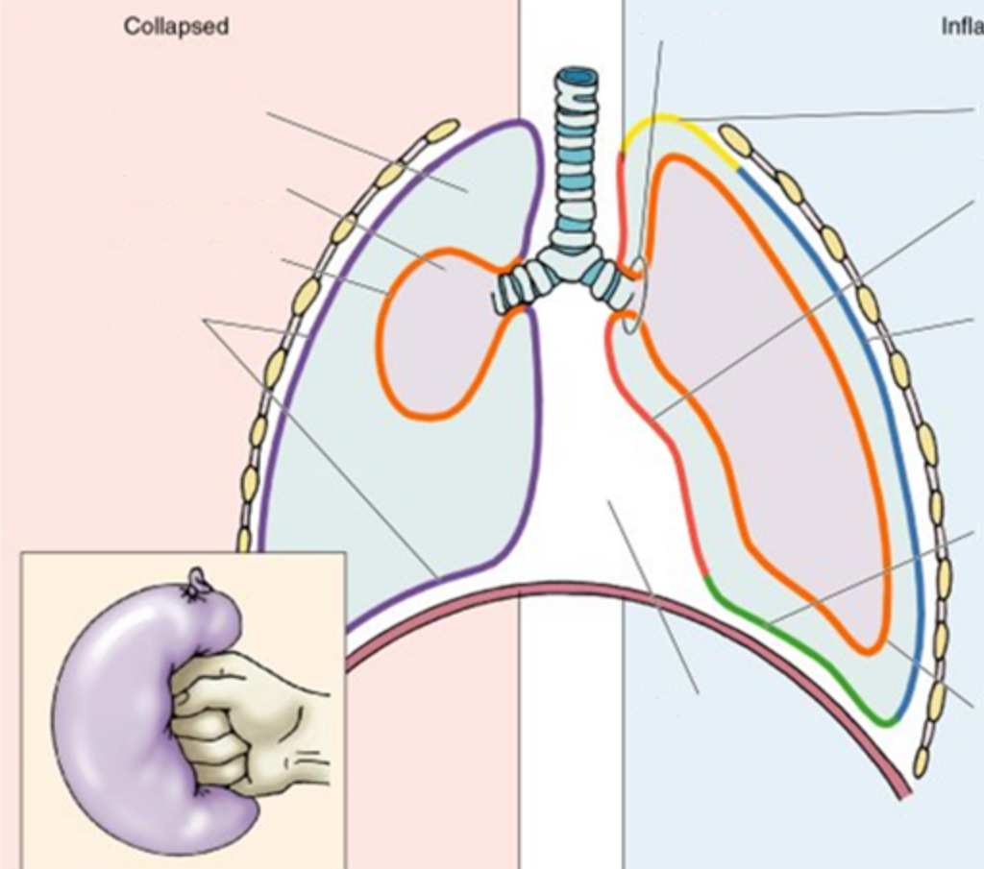
Introduction
The serous membrane covering the right & left lung is known as pleura
Each sac is invaginated by lungs from medial side
So Two layers – parietal layer and visceral layer
The two layers are continuous at the root of the lungs.
The slit like potential space between the layers is known as pleural cavity.

Slide 3
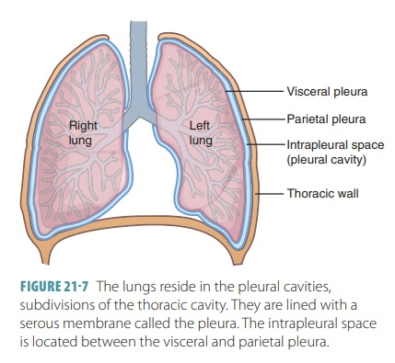
The pleural cavity is filled with a thin film of tissue fluid which lubricates the adjoining surfaces of pleura and allow them to move on each other without friction .

Slide 4
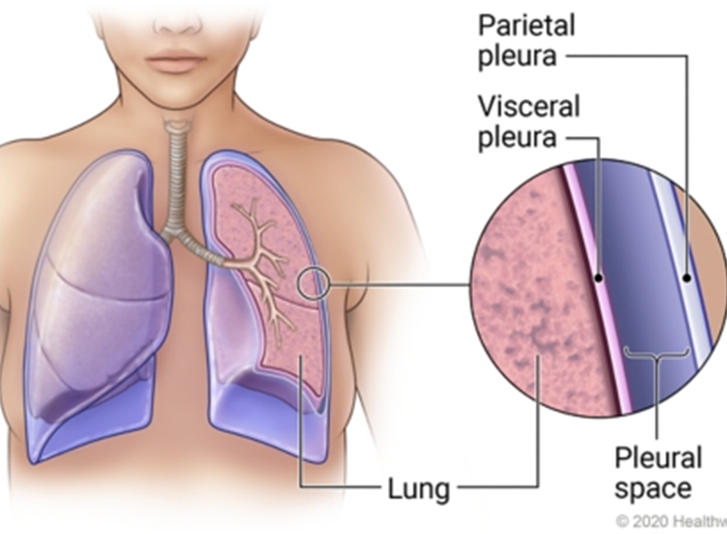
Pleural layers
Outer parietal layer
inner visceral layer
Visceral layer – pulmonary pleura –it completely covers the surface of lung except at the hilum & along the attachment of pulmonary ligament .
It also extends into the depths of fissures of lungs .It is firmly adherent to lung surface & cannot be separated from it .

Slide 5
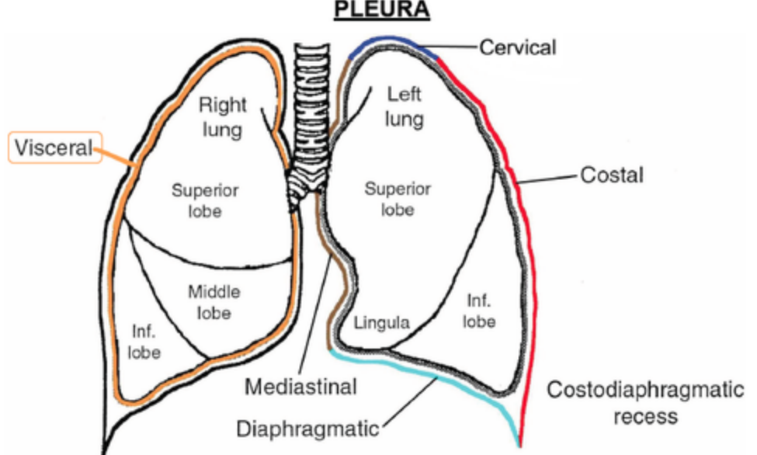
Parietal pleura
It is thicker than visceral & lines the thoracic cavity . It is like a half cone
It is divided into 4 parts ( corresponding to the region which it lines )
Costal pleura
Diaphragmatic pleura
Mediastinal pleura
Cervical pleura

Slide 6
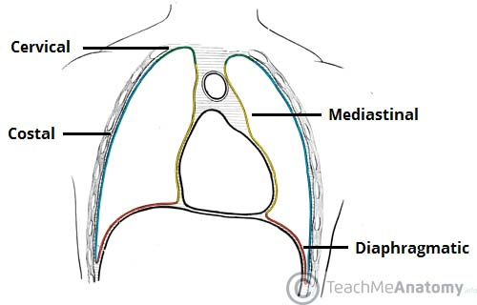
Costal pleura - Lines the inner surface of thoracic wall (ribs, costal cartilage , intercostal spaces )to which it is loosely attached by a thin layer of loose areolar tissue called endothoracic fascia .
Diaphragmatic pleura –covers superior surface of diaphragm .
Mediastinal pleura - lines the corresponding surface of mediastinum & forms its lateral boundary .It is reflected as a cuff over the root of lung & becomes continuous with visceral pleura

Slide 7
Cervical pleura – it is the dome of parietal pleura ,which extends into the root of neck about 1 in (2.5 cm )above the medial end of clavicle and 2 in ( 5 cm ) above the 1st costal cartilage .
It is called cupola and covers the apex of lung
It is covered by the suprapleural membrane .( it is a dome shaped musculofascial expansion which protects the apex of lung & cervical pleura from structures of neck .muscular part is derived from scalenus minimus muscle & fascial part from endothoracic fascia

Slide 8
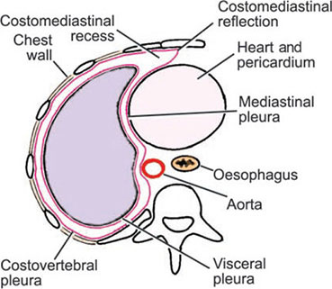
At back of sternum costal pleura becomes continuous with the mediastinal pleura along costomediastinal line of reflection.inferiorly it becomes continuous with diaphragmatic pleura at costo diaphragmatic line .above continues as cervical pleura along the inner border of 1st rib .

Slide 9
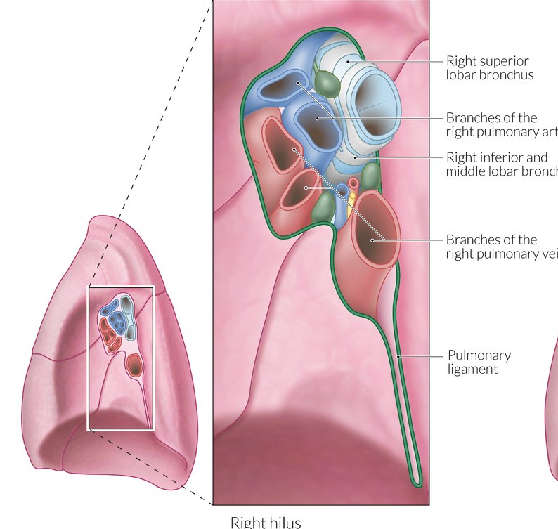
Pulmonary ligament
The pleura surrounds the root of lung similar to cuff ( sleeve ) of the jacket around the wrist .It extends down as a fold called pulmonary ligament .It extends from root of lung as far down as diaphragm between lung & mediastinum .This fold is filled with loose areolar tissue and contains few lymphatics
It provides a dead space into which the pulmonary vessels can expand during increased venous return as in exercise

Slide 10
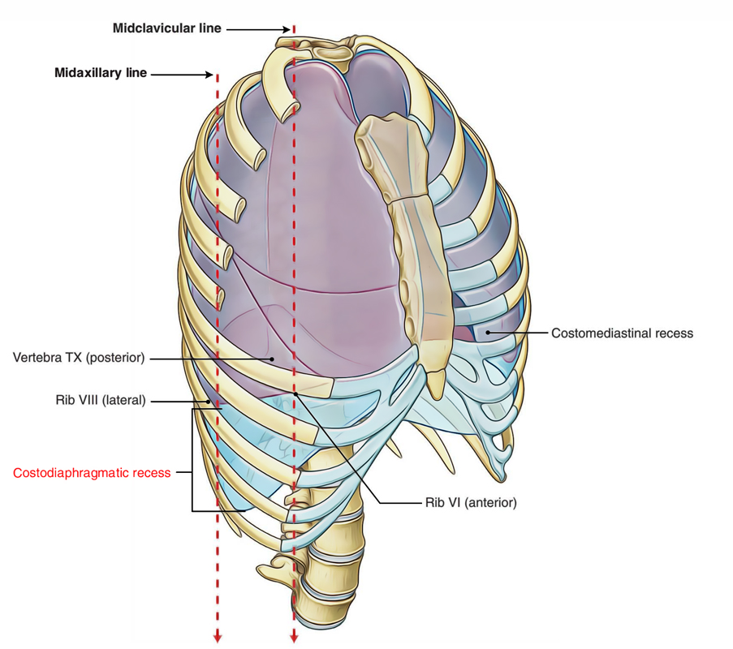
Recesses of pleura
2 recesses of parietal pleura
Act as reserve spaces for lung to expand during deep inspiration
Costodiaphragmatic recess
Costomediastinal recess

Slide 11
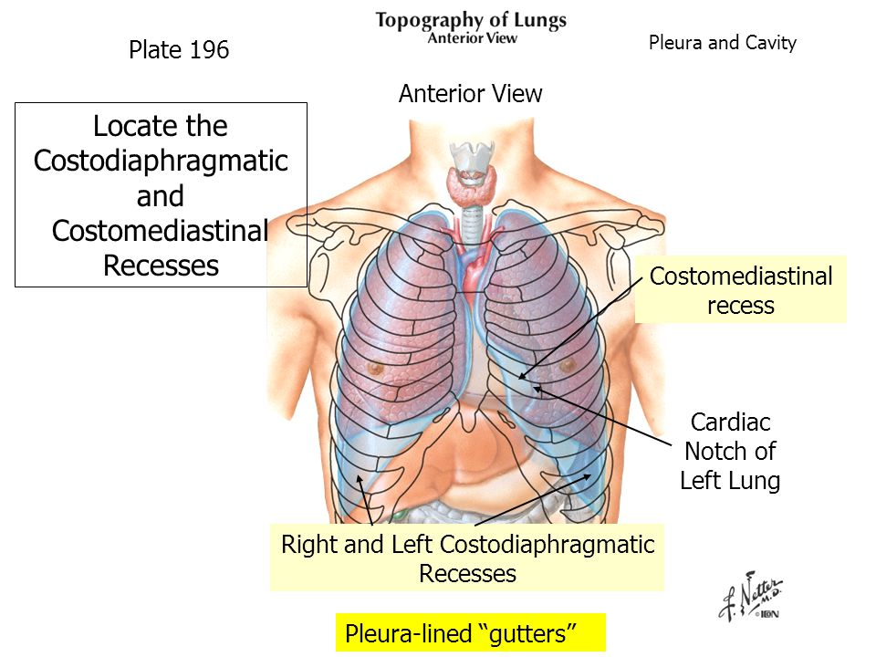

Slide 12

Costodiaphragmatic recess
Cleft like potential space between the lower limit of pleural sac & lower border of corresponding lungs
It makes a provision to allow expansion of lung in full inspiration
It is the most dependent part of pleural sac .if fluid appears in the pleural sax ,it collects first in costo diaphragmatic recess

Slide 13
Costomediastinal recess
Lies anteriorly behind sternum & costal cartilages between costal & mediastinal pleura
This recess is filled by anterior margin of lungs during quiet breathing
So only obvious in the region of cardiac notch

Slide 14
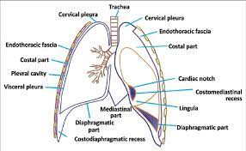

Slide 15
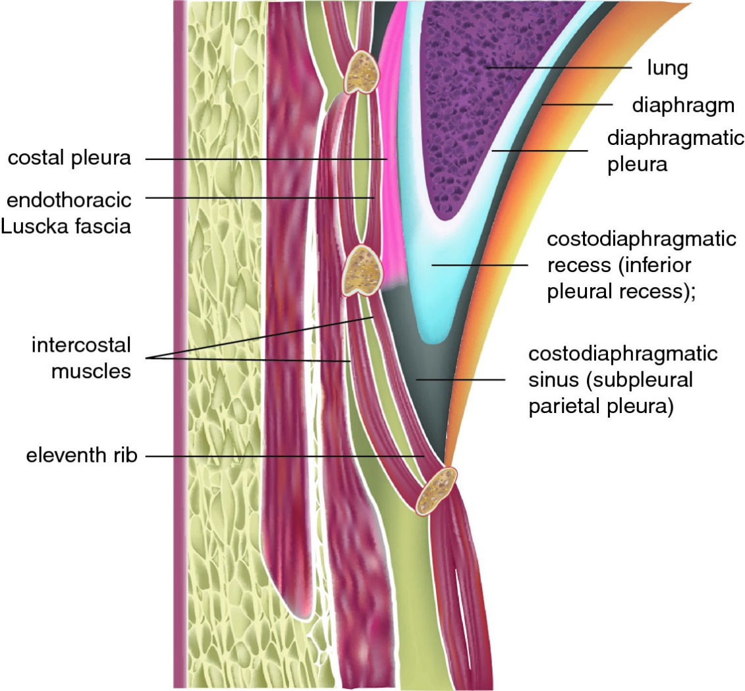

Slide 16
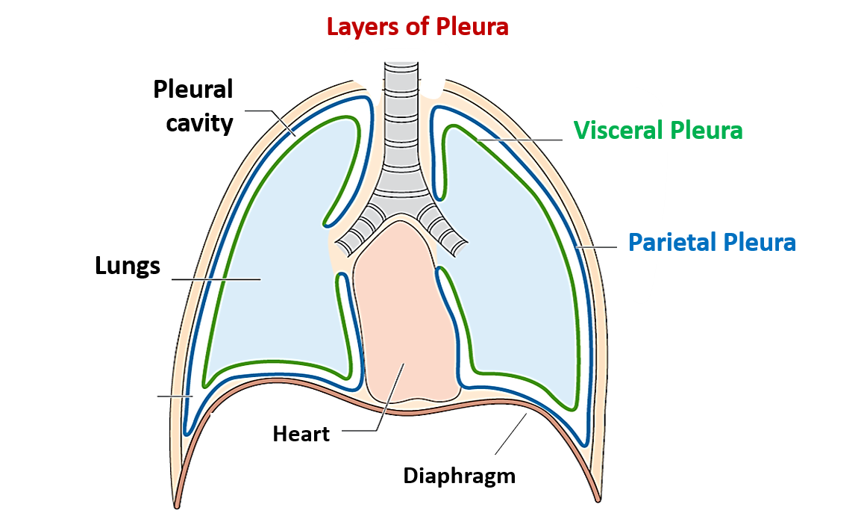

Slide 17
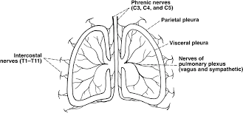
Nerve supply
Parietal pleura – from somatopleuric layer of lateral plate mesoderm
So supplied by somatic nerves
Intercostal & phrenic nerves
Sensitive to pain
Pulmonary pleura – from splanchnopleuric layer
Autonomic nerves
Sympathetic – T2nd to T5th sympathetic ganglia
Parasympathetic - vagus
Insensitive to pain

Slide 18
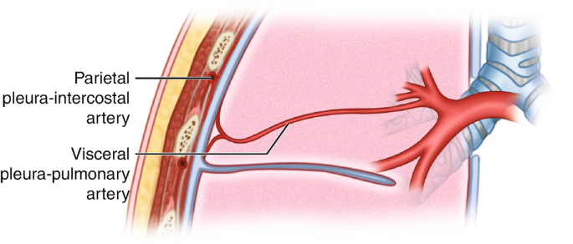
Blood supply & lymphatics
Pareital pleura
arteries –intercostal ,internal thoracic & musculophrenic
Veins – azygos & internal thoracic veins
Lymphatics – intercostal nodes ,posterior mediastinal ,diaphragmatic nodes
Pulmonary pleura
Arteries – bronchial arteries
Veins –bronchial veins
Lymphatics – bronchopulmonary nodes

Slide 19
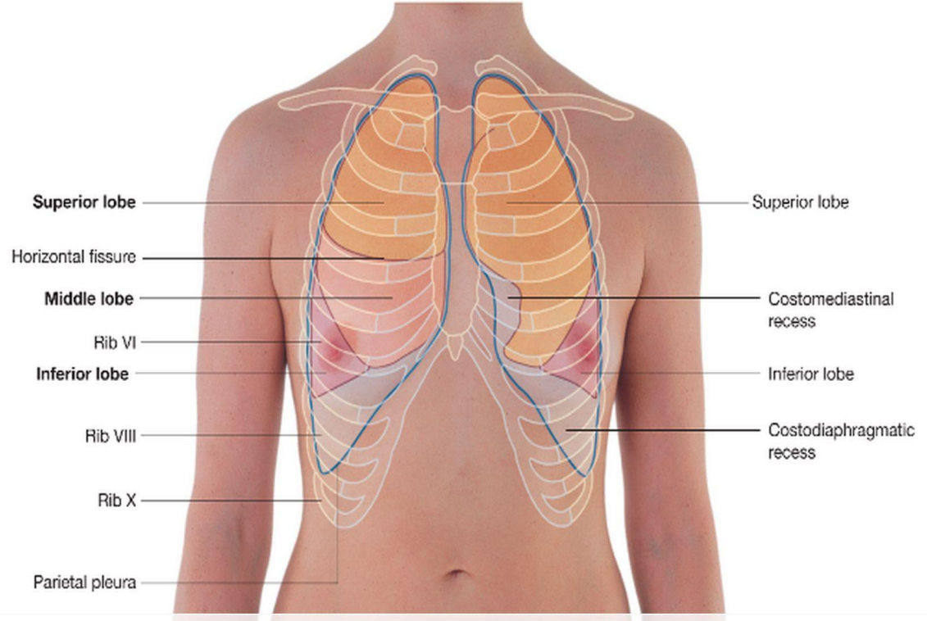
surface marking of pleura
Apex – is represented by a line convex upwards with a point rising 2.5 cm above the medial 1/3rd of clavicle .
Anterior border
Right pleura – corresponds to anterior margin of costomediastinal line of pleura and is obtained by joining 3 points
Point at sternoclavicular joint
A point in the median plane at sternal angle
A point in the median plane just above the xiphisternal joint

Slide 20
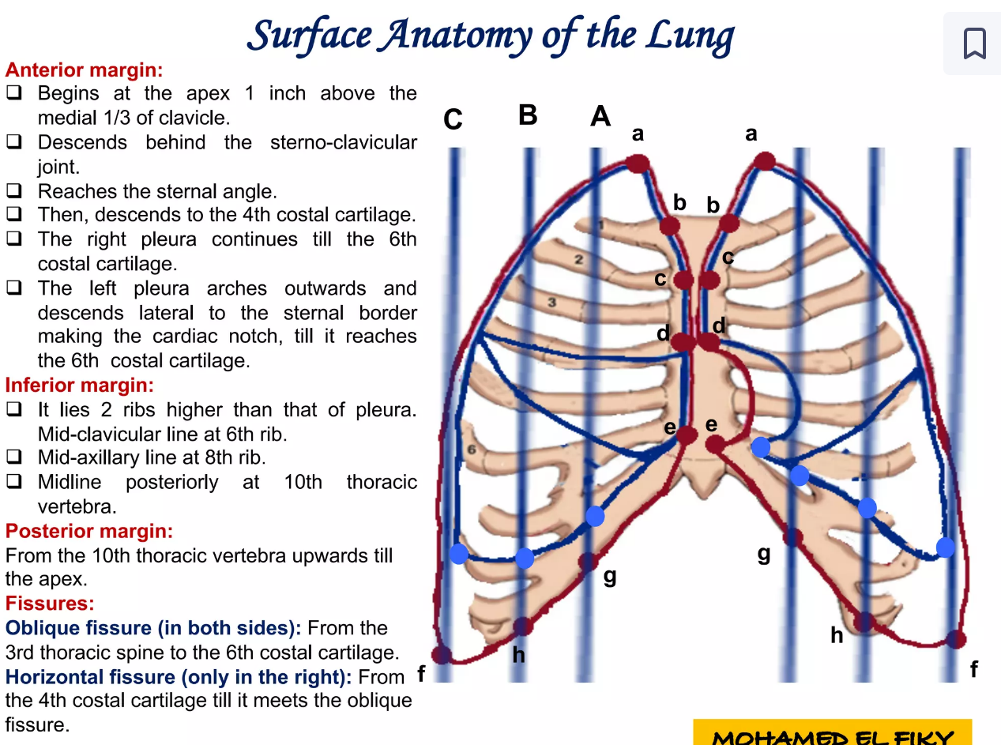

Slide 21
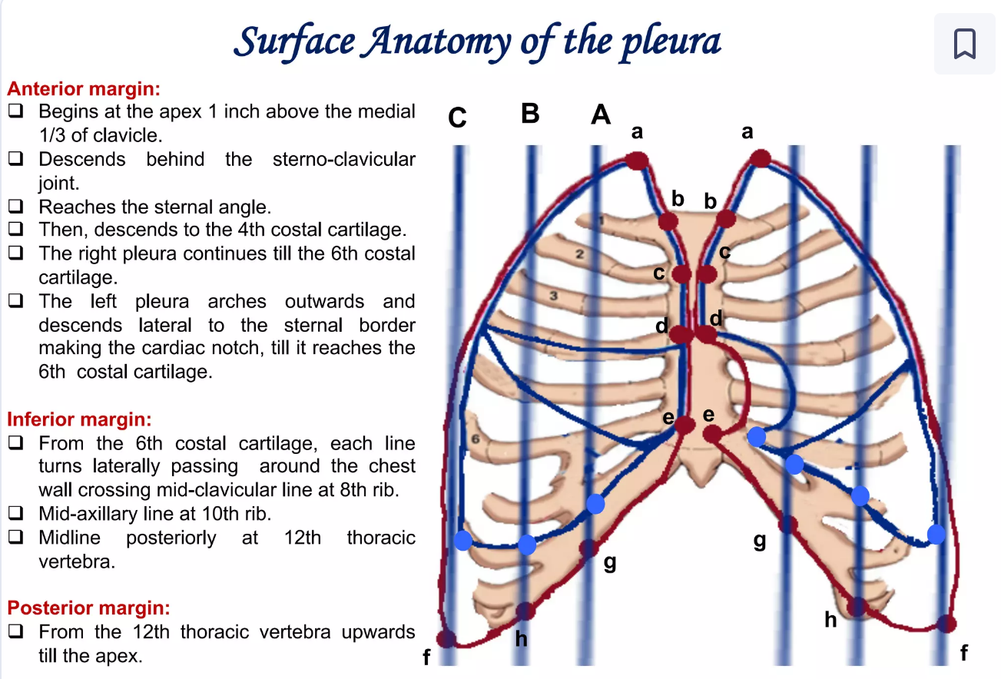

Slide 22
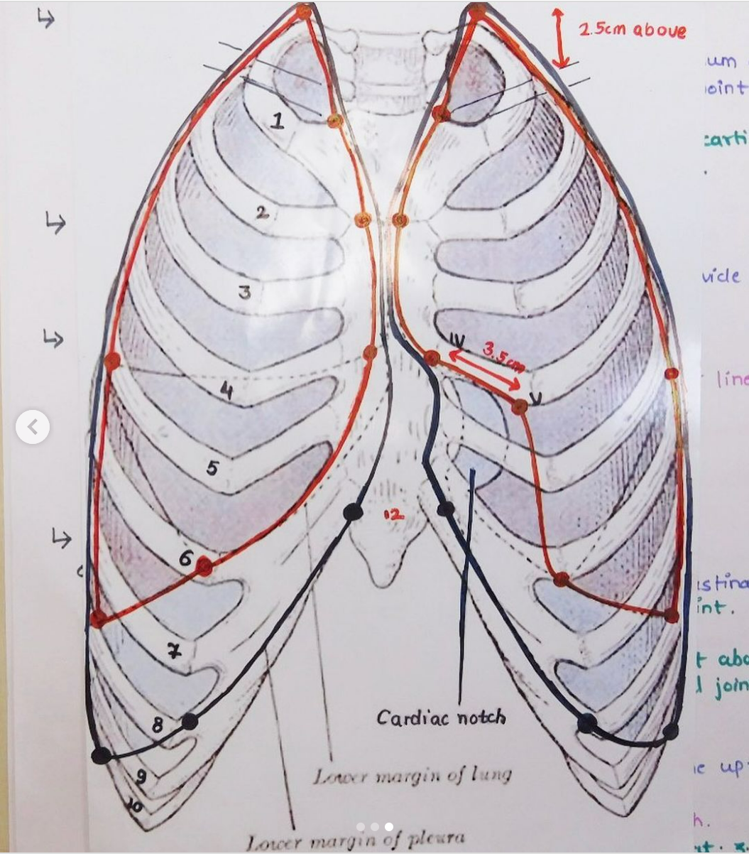

Slide 24
Left side – anterior margin same upto the level of 4th costal cartilage . It then arches outwards & descends along the sternal margin upto 6th costal cartilage .
Lower border – from anterior margin it passes laterally & crosses 8th rib in midclavicular line ,10th rib in midaxillary line & 12th rib at lateral border of erector spinae .Then passes horizontally towards the lower border of 12th thoracic vertebrae ,2cm lateral to upper border of 12th thoracic spine

Slide 25
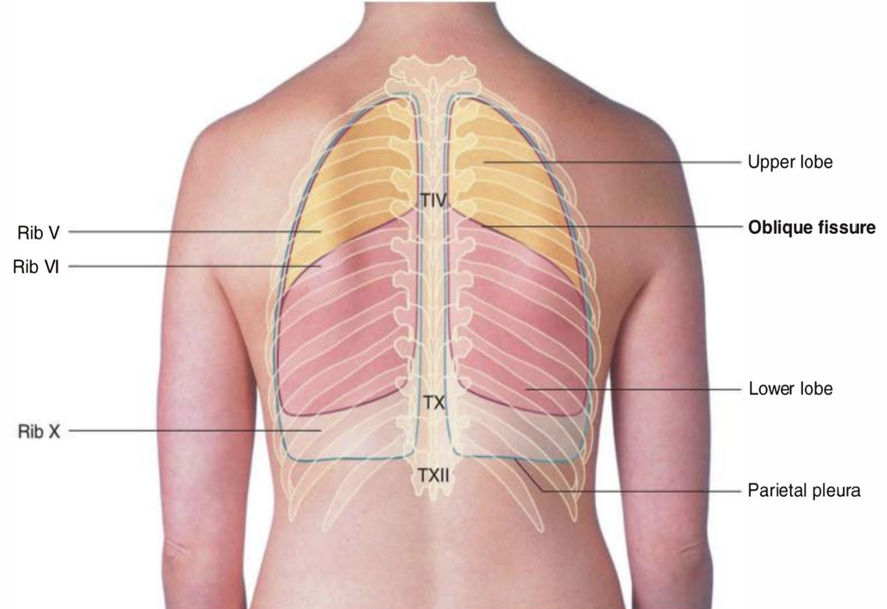
Posterior margin - pass from a point 2 cm lateral 12th thoracic spine to a point 2 cm lateral to 7th cervical spine
Lung & visceral pleura –
anterior border
From 4th costal cartilage it passes laterally for 3.5 cm from the sternal margin and then curves downwards & medially to reach the 6th costal cartilage 4 cm from the median plane

Slide 26
Lower border
Lies 2 ribs higher than the parietal pleural reflection
It crosses 6th rib in the midclavicular line ,8th rib in the mid axillary line & 10th rib at the lateral border of erector spinae & ends 2 cm lateral to 10t thoracic spine

Slide 27
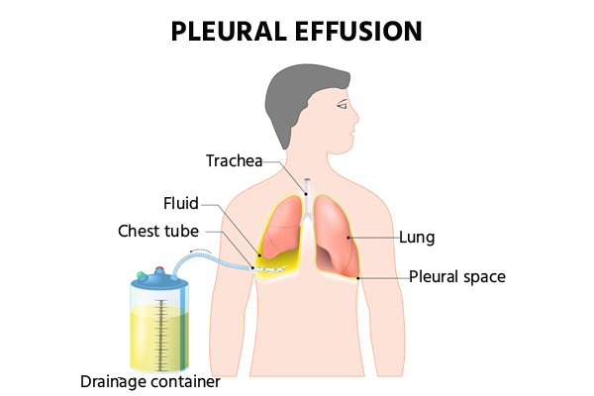
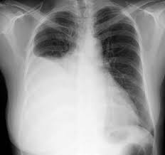
Pleural effusion

Slide 28
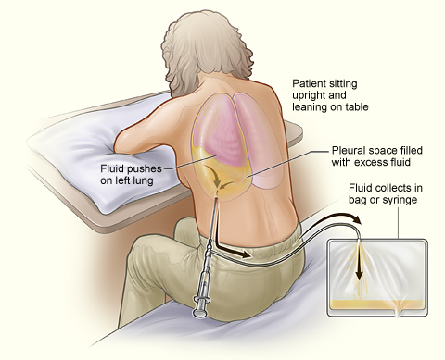
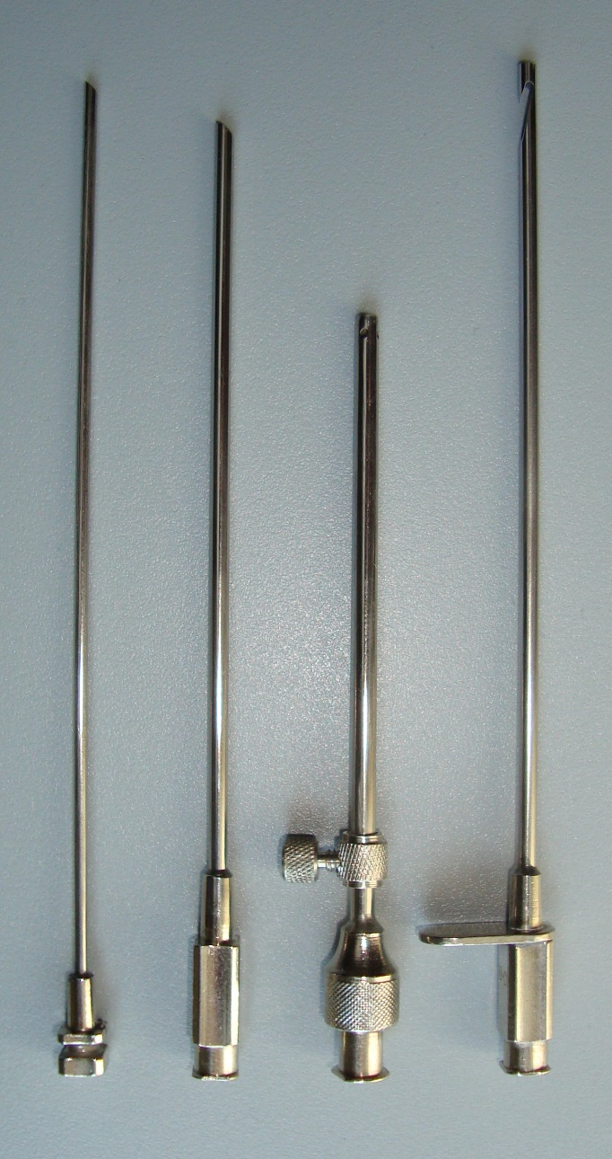

Slide 29
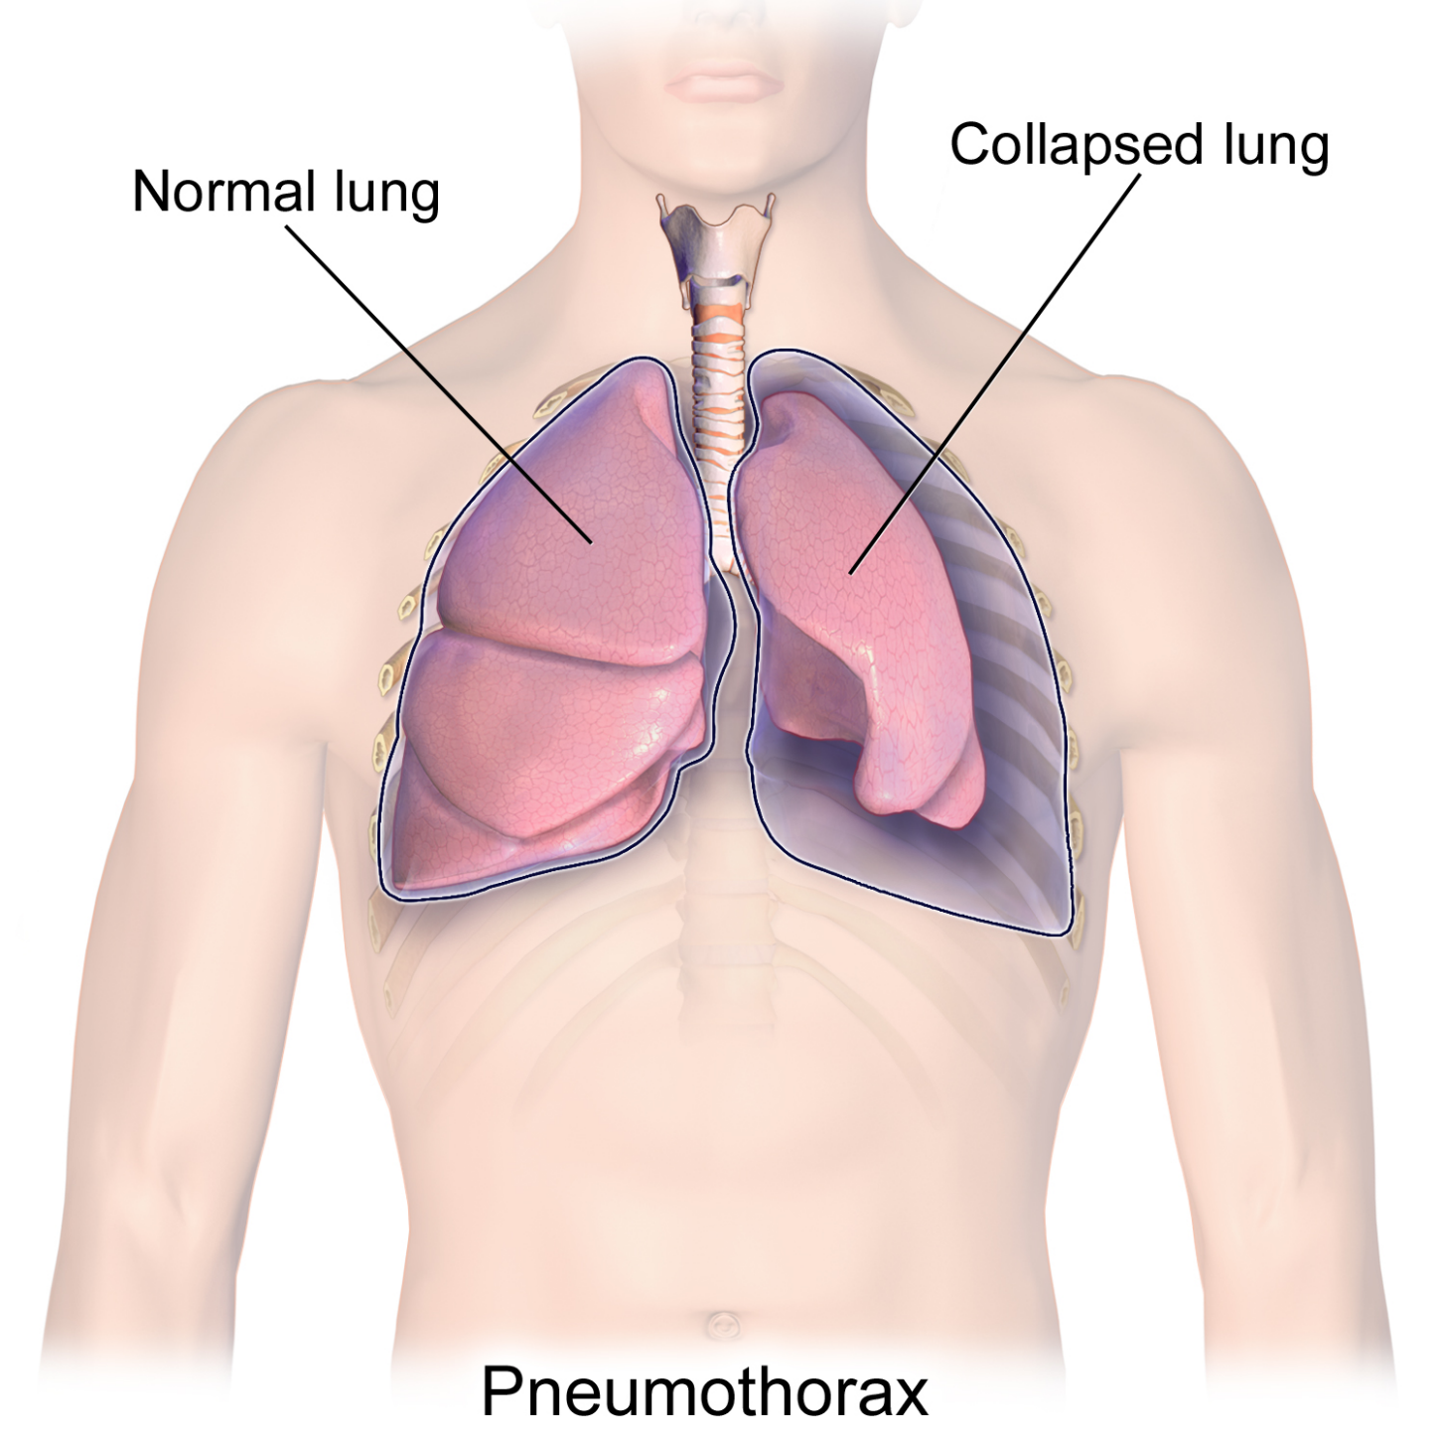
pneumothorax

