Slide 1
Pharynx

Slide 2
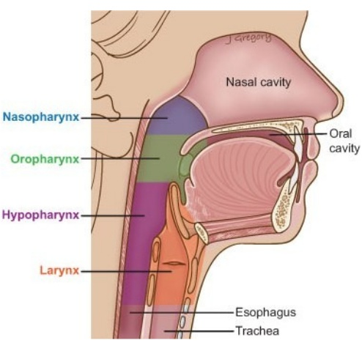
introduction
It is a common passage for respiratory and digestive system
It is a wide muscular tube situated behind the nose, mouth, and larynx
The upper part transmits only air
The middle part is a common passage for food and air but only one at a time

Slide 3
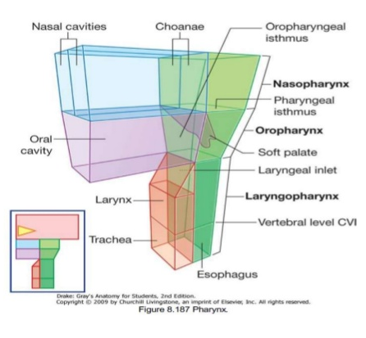
dimension
Length – 12cm
Width –
Upper part -3.5cm (widest)
Middle and lower part 3cm
Lower end is the narrowest part of the alimentary canal

Slide 4
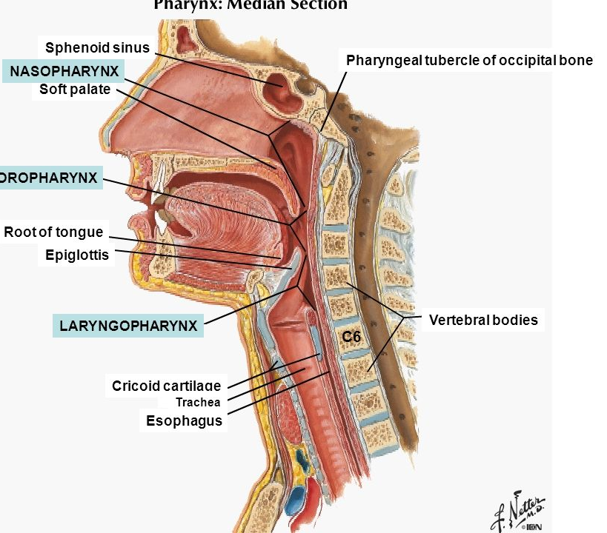
Extend
It begins at the base of the skull,
and ends at the inferior border of the cricoid cartilage(C6).

Slide 5
Boundaries
Superiorly – base of the skull made up of sphenoid and occipital bones
Inferiorly- continous with the oesophagus at the level of C6 vertebrae
Posteriorly – pre vertebral fascia which separates it from the vertebrae
Anteriorly – communicates with nose mouth, larynx hence anterior wall is incomplete

Slide 6
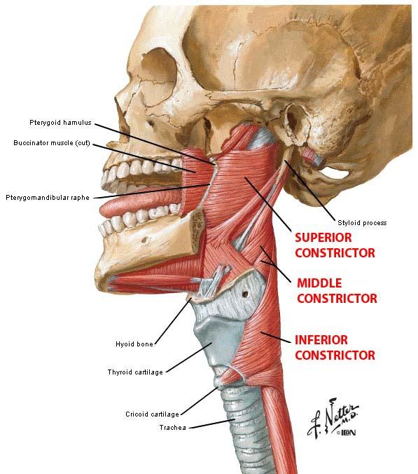
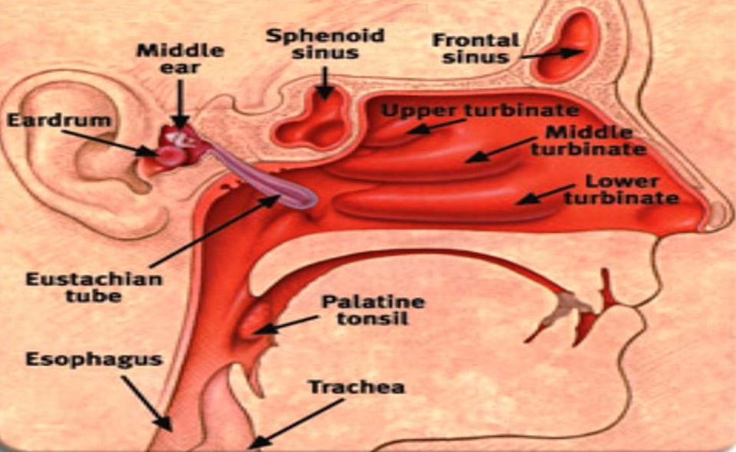
Boundaries
On each side
Pterygo mandibular raphe
Mandible
Tongue
Hyoid bone
Thyroid and cricoid cartilages
It communicates with the middle ear cavity through eaustachian tube

Slide 7
Parts of the pharynx
The pharynx is comprised of three parts (superior to inferior)
Nasal part or nasopharynx
Oral part/ oropharynx
Laryngeal part / laryngopharynx

Slide 8
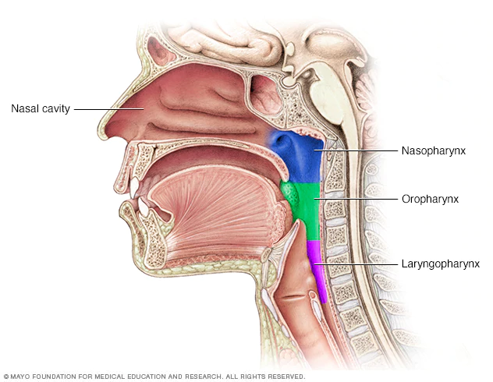
Nasopharynx
This is the upper part of the pharynx situated behind the nose and lower border of the soft palate
It resembles the nose structurally and functionally and its respiratory in function.
Anteriorly the nasopharynx communicates with nasal cavity through the posterior nasal appertures but below its continuous with the oropharynx

Slide 9

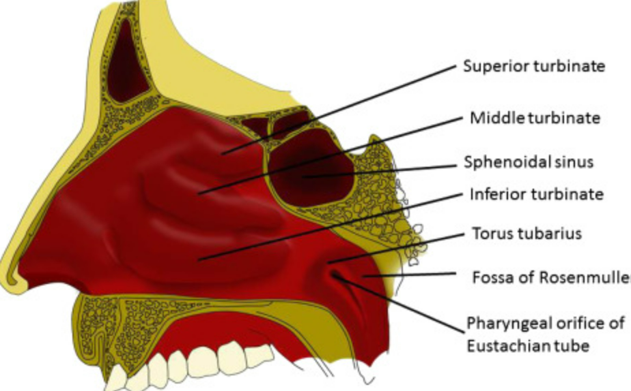
Relations of the nasopharynx

Slide 10
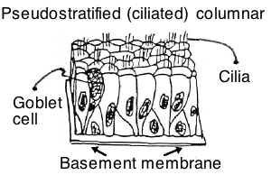
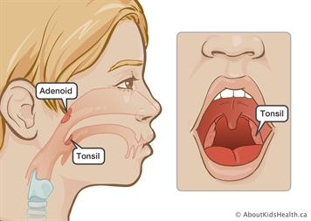
Nasopharynx
This part of the pharynx is lined with respiratory epithelium; ciliated pseudostratified columnar epithelium with goblet cells.
The posterosuperior nasopharynx contains the adenoid tonsils, which enlarge between 3-8 years of age and then regress.

Slide 11
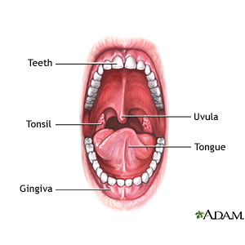
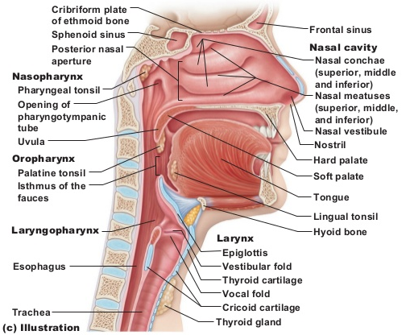
Oral part or oropharynx
This is the middle part of the pharynx.
It communicates with the oral cavity in front through the fauces
Extent- located between the soft palate and the superior border of the epiglottis.
Between the softpalate and the posterior wall is the isthmus through which the oropharynx and the nasopharynx communicate
It takes part in digestion as well as in respiration

Slide 12
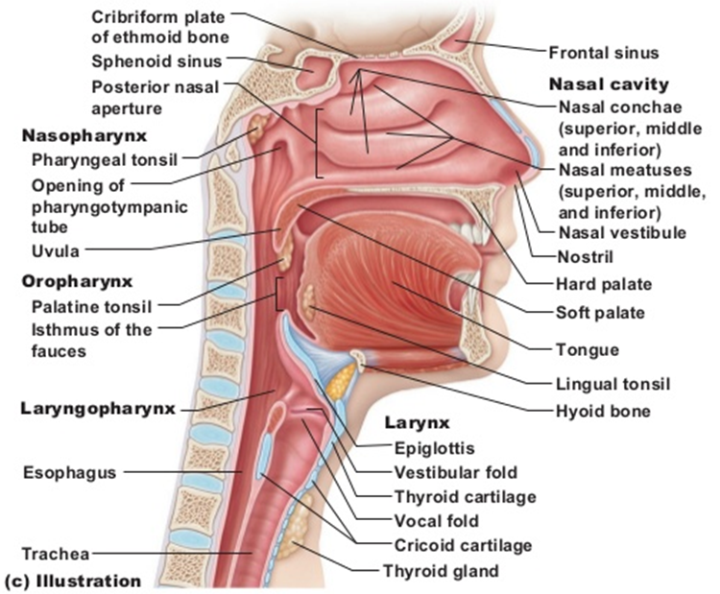
Relations of the oropharynx

Slide 13
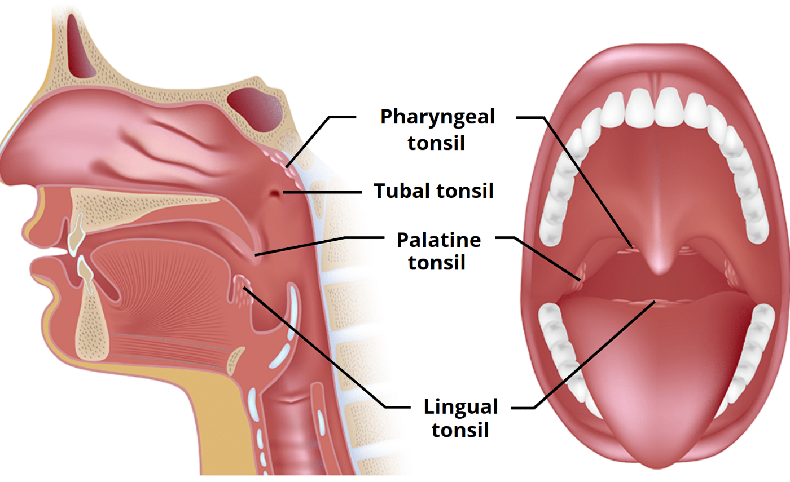
Oropharynx is lined by stratified squamous non keratinised epithelium and it acts as a passage for air as well as food

Slide 14
Structures present In oropharynx
Posterior 1/3 of the tongue.
Lingual tonsils – lymphoid tissue at the base of the tongue.
Palatine tonsils – lymphoid tissue located in the tonsillar fossa (between the palatoglossal and palatopharyngeal arches of the oral cavity).
Superior constrictor muscle

Slide 15
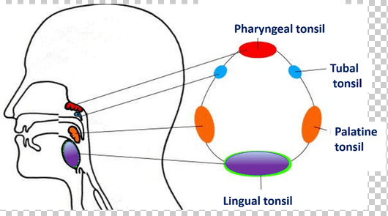
Waldeyer’s ring
Waldeyer’s ring is the ring of lymphoid tissue in the naso- and oropharynx formed by the paired palatine tonsils, the adenoid tonsils and lingual tonsil.

Slide 16
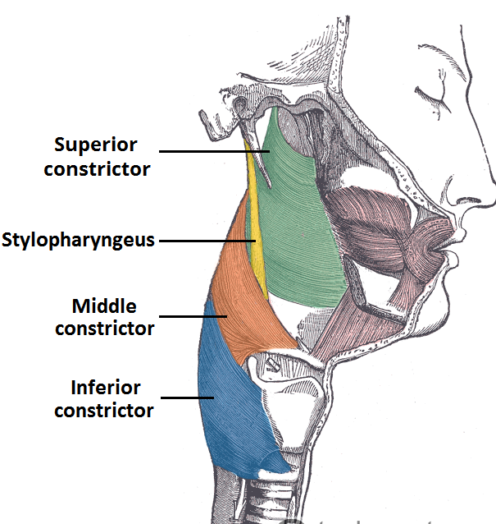
Laryngeal part
Most distal part of the pharynx
Begins behind the trachea and extends from the opening of larynx to the opening of oesophagus.
Extent- Located between the superior border of the epiglottis and inferior border of the cricoid cartilage (C6)
in a state of rest when there is no swallowing the anterior and posterior walls of this part remains in contact and separate only when the food passes through it
Anteriorly it is bound by epiglotis
The laryngopharynx contains the middle and inferior pharyngeal constrictors.

Slide 17
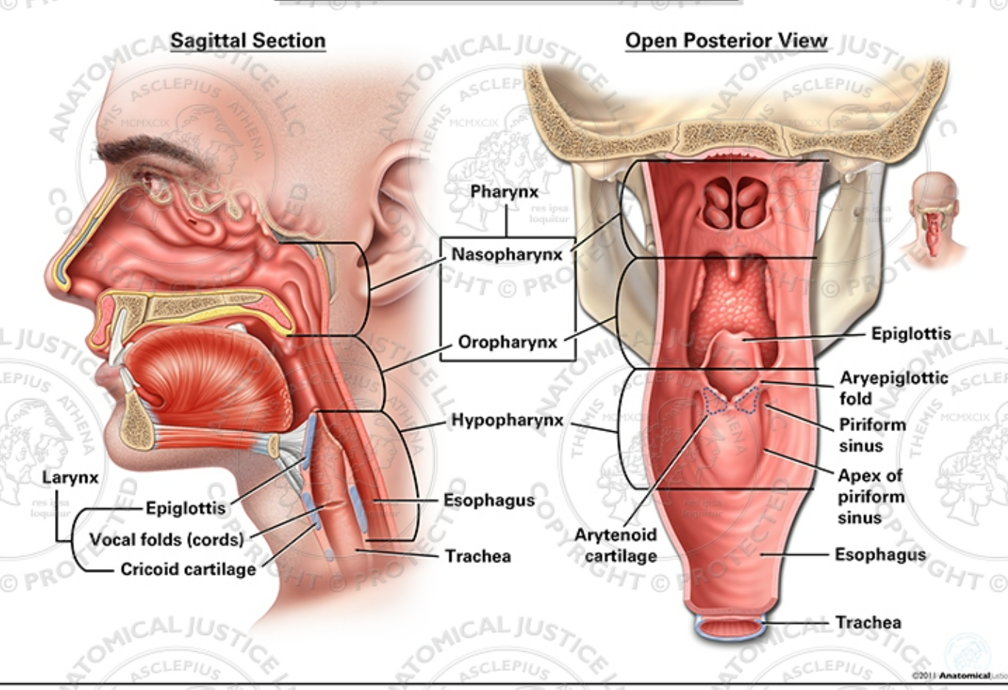
Relations of laryngopharynx

Slide 18
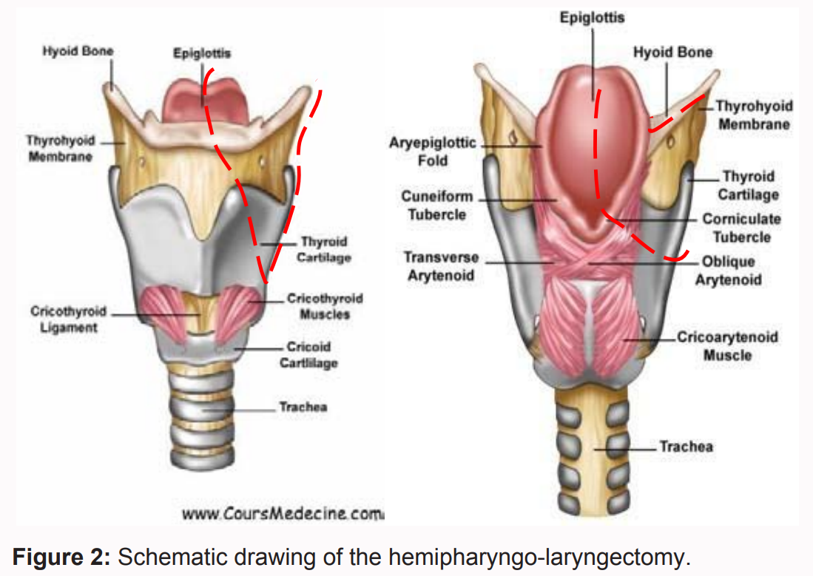

Slide 19
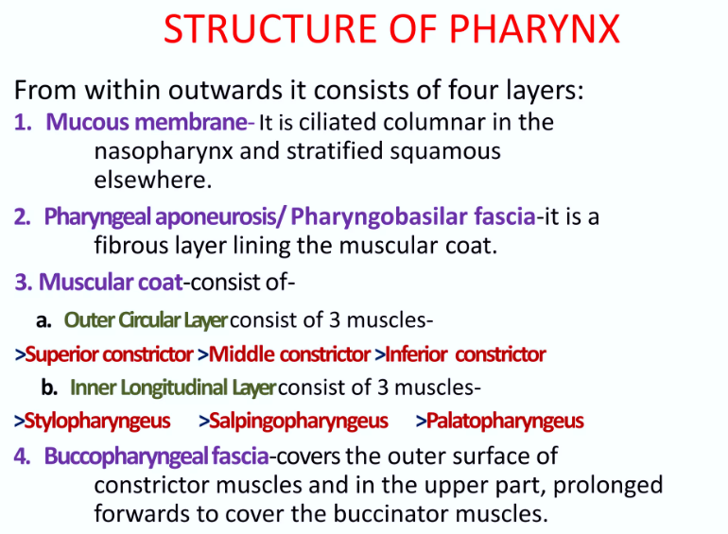
Layers of pharynx

Slide 20
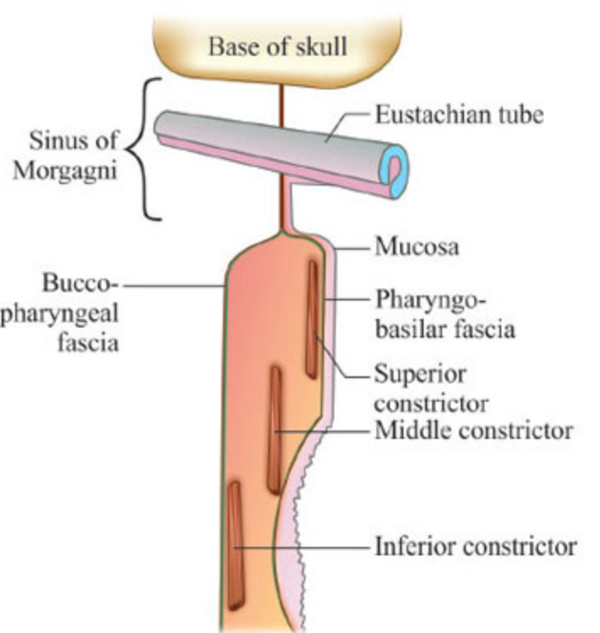
Layers of pharynx

Slide 21
Muscles of pharynx
There are two main groups of pharyngeal muscles;
Longitudinal
Circular
The muscles of the pharynx are mostly innervated by the vagus nerve

Slide 22
Circular muscles
There are three circular pharyngeal constrictor muscles;
Superior pharyngeal constrictor,
Middle pharyngeal constrictor
Inferior pharyngeal constrictors.
They are stacked like glasses, which form an incomplete muscular circle as they attach anteriorly to the neck.
The circular muscles contract sequentially from superior to inferior to constrict the lumen and propel the bolus of food inferiorly into the oesophagus.

Slide 23
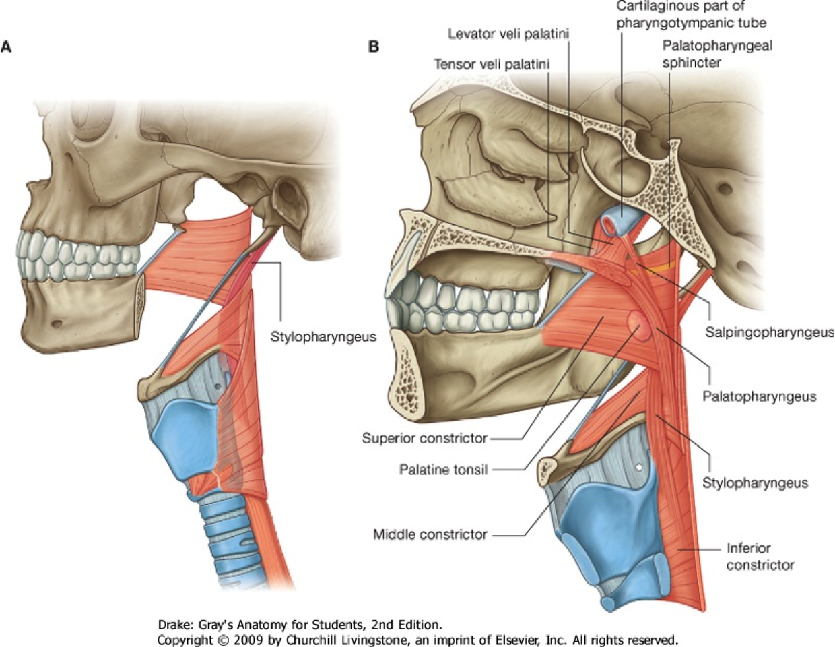
Longitudinal muscles
The longitudinal muscles are the
Stylopharyngeus,
Palatopharyngeus
Salpingopharyngeus.
They act to shorten and widen the pharynx, and elevate the larynx during swallowing.

Slide 24
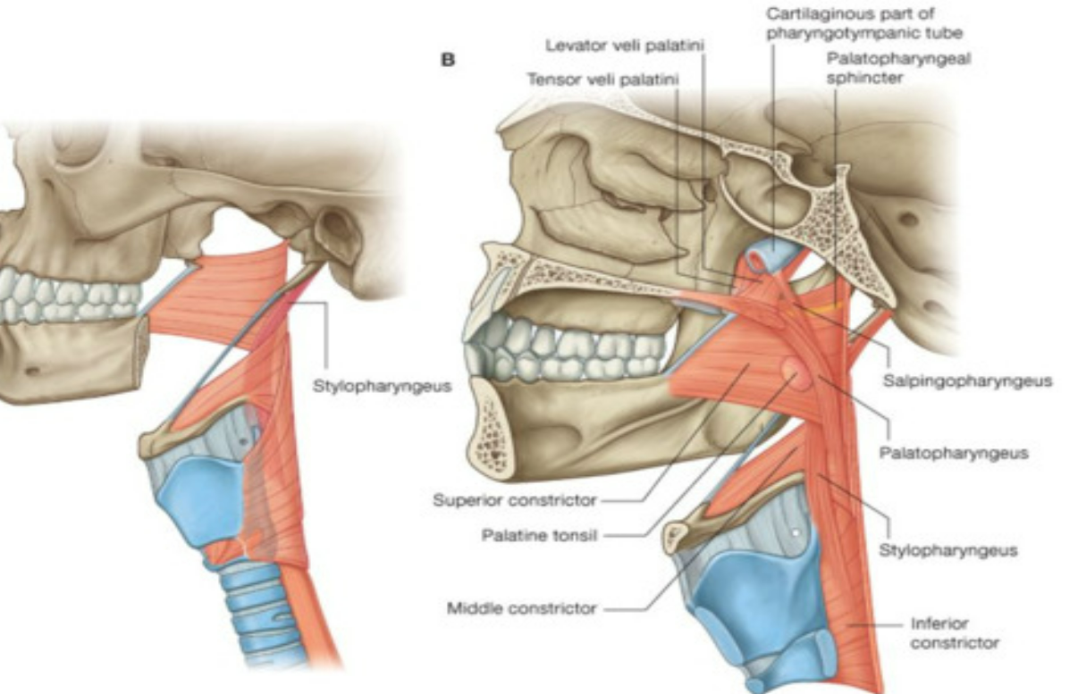
Stylopharyngeus
Origin Medial base of styloid process of temporal bone
Insertion Blends with pharyngeal constrictors, lateral glossoepiglottic fold, posterior border of thyroid cartilage
Actions Elevates pharynx and larynx
Innervation Glossopharyngeal nerve (CN IX)

Slide 25
Palatopharyngeus
Origin Posterior border of hard palate, palatine aponeurosis
Insertion Posterior border of thyroid cartilage, blends with contralateral palatopharyngeus muscle
Action Elevates pharynx superiorly, anteriorly and medially (shortening it to swallow)
Innervation Branches of pharyngeal plexus (CN X)

Slide 26
Salpingopharyngeus
Origin Inferior/cartilaginous part of auditory (Eustachian) tube
Insertion Blends with palatopharyngeus muscle
Action Elevates pharynx, opens auditory tube during swallowing
Innervation Branches of pharyngeal plexus (CN X)

Slide 27
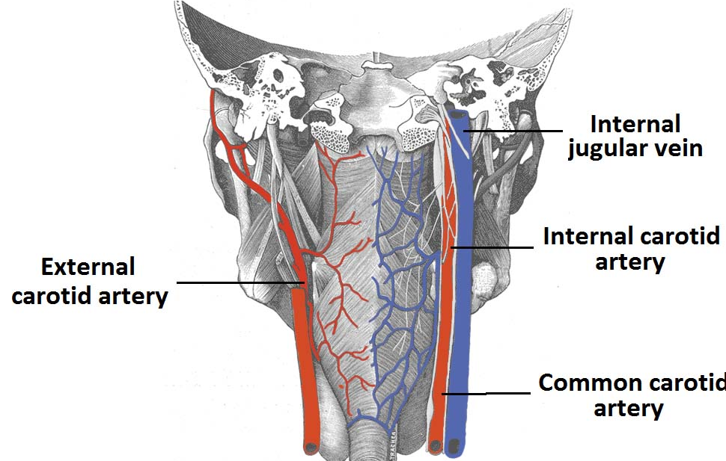
Blood supply
Arterial supply to the pharynx is via branches of the external carotid artery:
Ascending pharyngeal artery
Branches of the facial artery
Branches of the lingual and maxillary arteries

Slide 28
Venous drainage
Venous drainage is achieved by the pharyngeal venous plexus, which drains into the internal jugular vein.

Slide 29
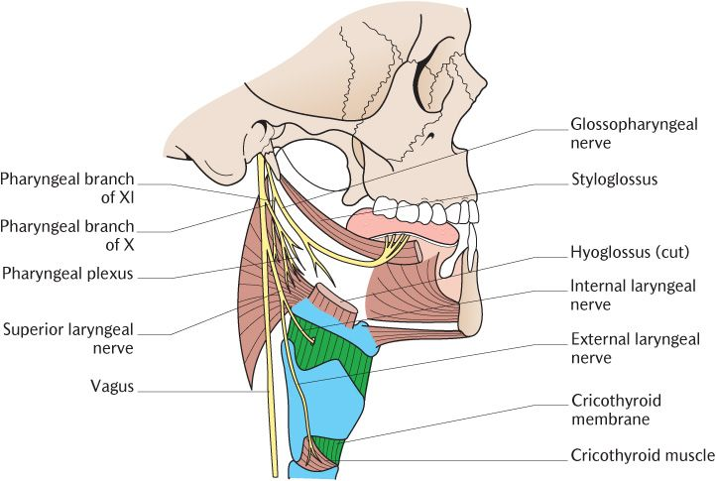
Nerve supply
Motor and sensory innervation of the majority of the pharynx (except nasopharynx) is achieved by the pharyngeal plexus.
The pharyngeal plexus, which mainly overlies the middle pharyngeal constrictor, is formed by:
Pharyngeal branches from the glossopharyngeal nerve (CN IX).
Pharyngeal branch of the vagus nerve (CN X).
Branches from the external laryngeal nerve.
Sympathetic fibres from the superior cervical ganglion.

Slide 30
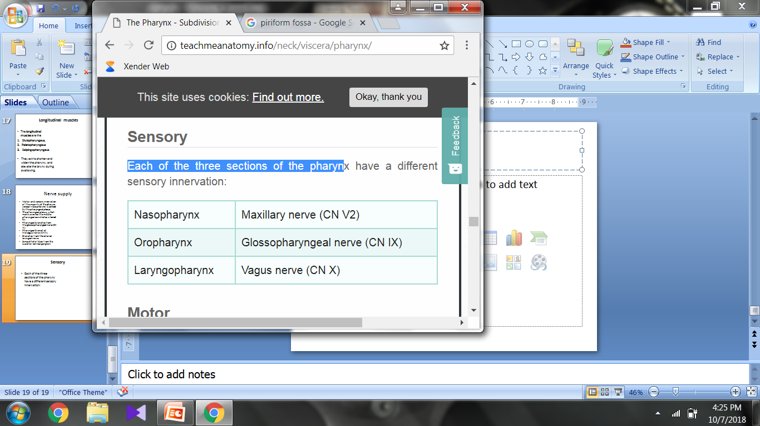
Sensory
Each of the three sections of the pharynx have a different sensory innervation:
Motor
All the muscles of the pharynx are innervated by the vagus nerve (CN X), except for the stylopharyngeus, which is innervated by the glossopharyngeal nerve (CN IX).

Slide 31
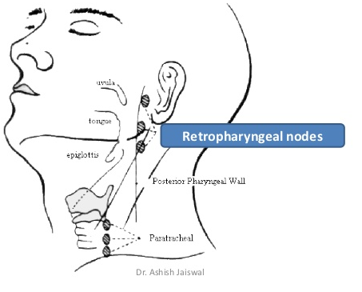
Lymphatic drainage
Lymph drains into retropharyngeal and deep cervical lymph nodes

Slide 32
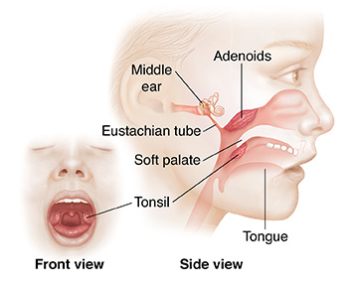
Applied anatomy
Adenoid tonsils can become pathologically enlarged due to viral infections of the upper respiratory tract.
In the case of recurrent infections, they can become chronically enlarged. When enlarged, the adenoids can obstruct the opening of the Eustachian tube

Slide 33
Infections may pass from the throat to the middle ear through the auditory tube.
This is more common in children because the tube is shorter

Slide 34
2.Inflammation of the auditory tube (Eustachian catarrh) is often secondary to an attack of common cold, or of sore throat. This causes pain into the ear

