Slide 1
Pancreas

Slide 2
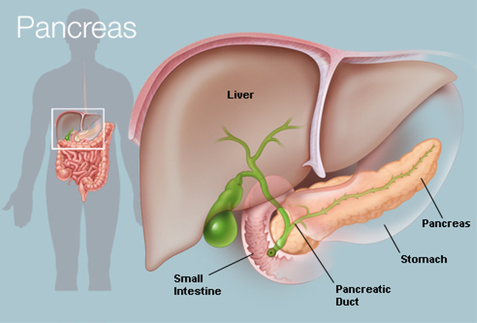
Introduction
It is soft, lobulated and elongated organ.
Pancreas is a gland that is partly exocrine and partly endocrine
. The exocrine part secretes the digestive pancreatic juice; and the endocrine part secretes hormones, e.g., insulin

Slide 3
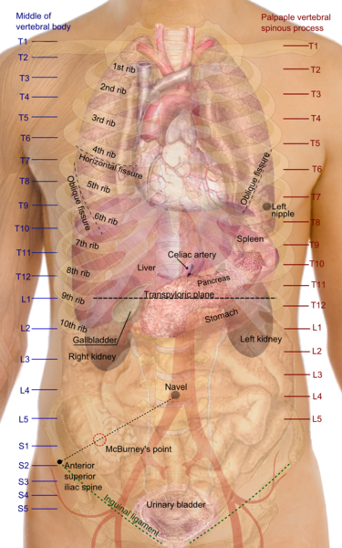
Location
Pancreas lies more or less transversely across the posterior abdominal wall, at the level of first and second lumbar vertebrae.

Slide 4
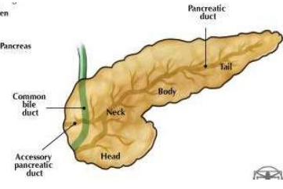
Size and Shape
It is J-shaped or retort-shaped, set obliquely.
Bowl of the retort represents its head,
Stem of the retort, its neck, body and tail
It is about 15-20 cm long, 2.5-3.8 cm broad and 1.2-1.8 cm thick and weighs about 90 g.

Slide 5
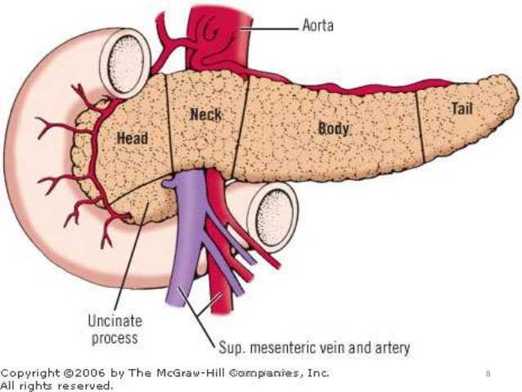
Parts of pancreas
Pancreas is divided (from right to left) into the head, the neck, the body and the tail.
The head is enlarged and lies within the concavity of the duodenum.
The tail reaches the hilum of the spleen

Slide 6
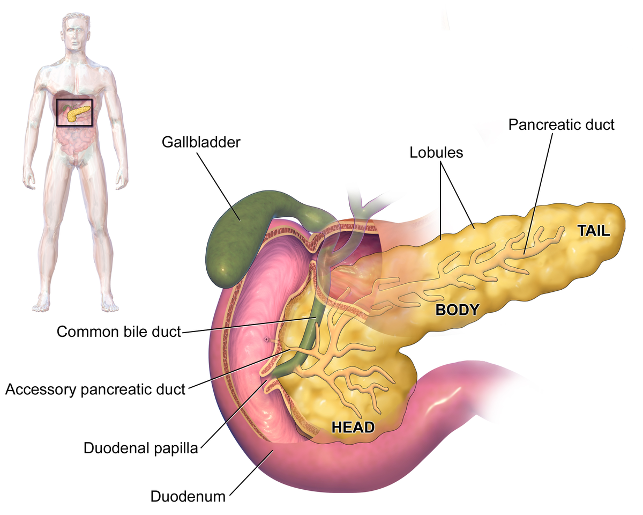
Head of the Pancreas
Head is the enlarged flattened right end of the pancreas, situated within the curve of the duodenum

Slide 7
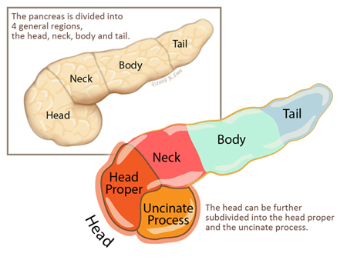
Head - External Features
Head has three borders,
superior,
inferior
right lateral;
Two surfaces,
Anterior
Posterior;
One process, called the uncinate process

Slide 8
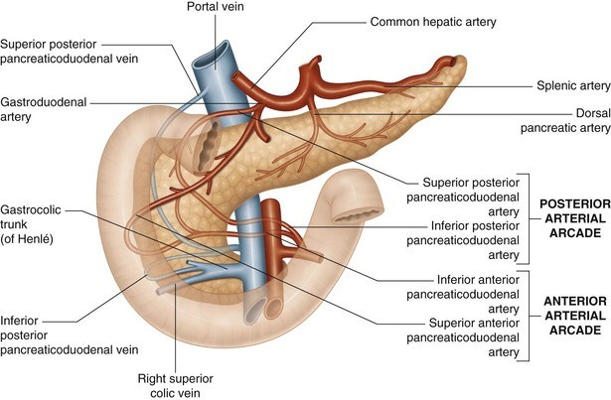
Borders of head relations
The superior border is overlapped by the first part Of pancreaticoduodenal artery.
The inferior border is related to the third part of the duodenum and to the inferior pancreaticoduodenal artery.
The right lateral border is related to the second part of duodenum, the terminal part of the bile duct and anastomosis between the two pancreaticoduodernal arteries

Slide 9
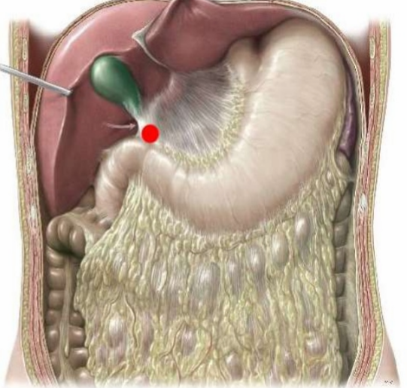
Surface relations of head
The anterior surface is related, from above downwards to :
(1) Gastroduodenal artery;
(2) Transverse colon
(3) Jejunum which is separated from it by peritoneum

Slide 10
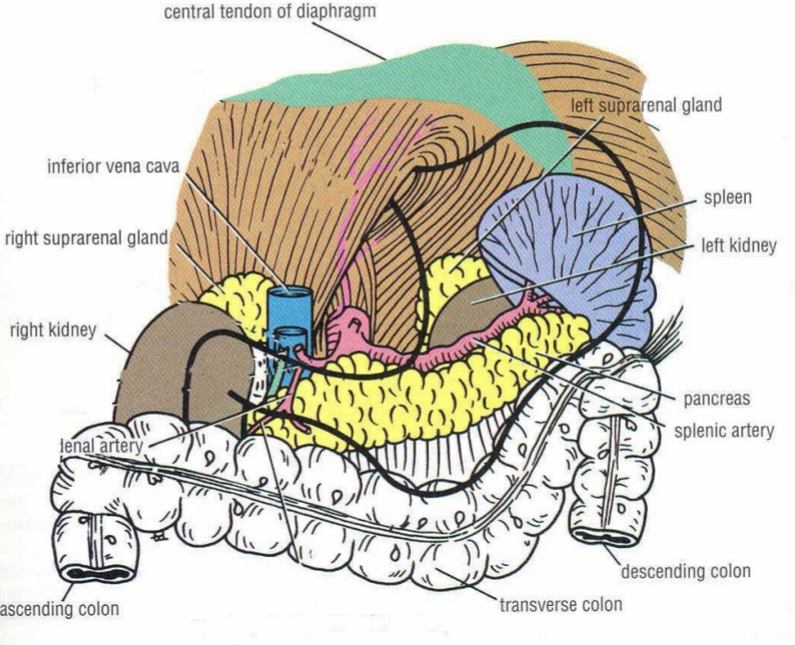
Head posterior surface relations
The posterior surface is related to :
(1)Inferior vena cava,
(2)Terminal parts of the renal veins,
(3)Right crus of the diaphragm, and (4)Bile duct which runs downwards and to the right and is often embedded in the substance of pancreas

Slide 11
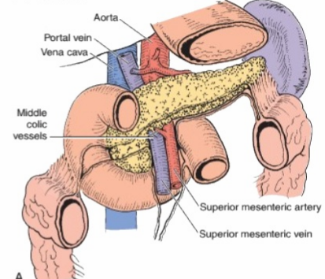
Uncinate Process
It is related anteriorly to the superior mesenteric vessels, and posteriorly to the aorta.

Slide 12
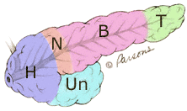
■Neck of the Pancreas
This is the slightly constricted part of the pancreas between its head and body. It is directed forwards, upwards and to the left. It has two surfaces, anterior and posterior

Slide 13
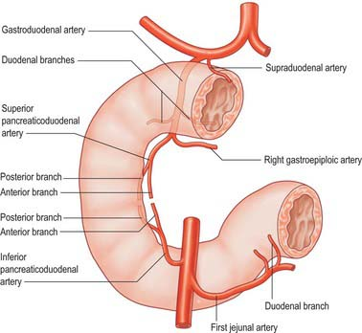
Relations -neck
The anterior surface is related to: (1) The peritoneum covering the posterior wall of the lesser sac, and (2) the pylorus
The posterior surface is related to the termination of the superior mesenteric vein and the beginning of the portal vein

Slide 14
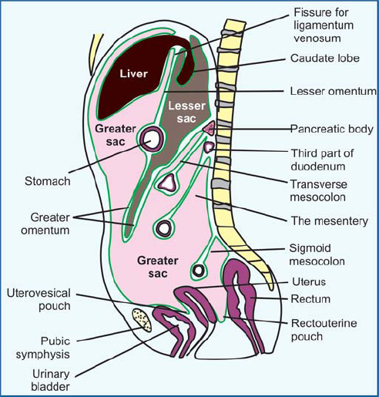

Slide 15
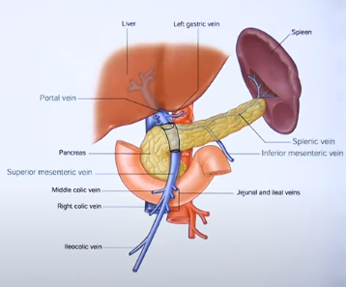

Slide 16
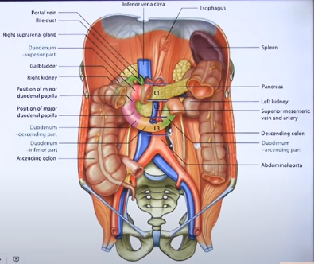

Slide 17
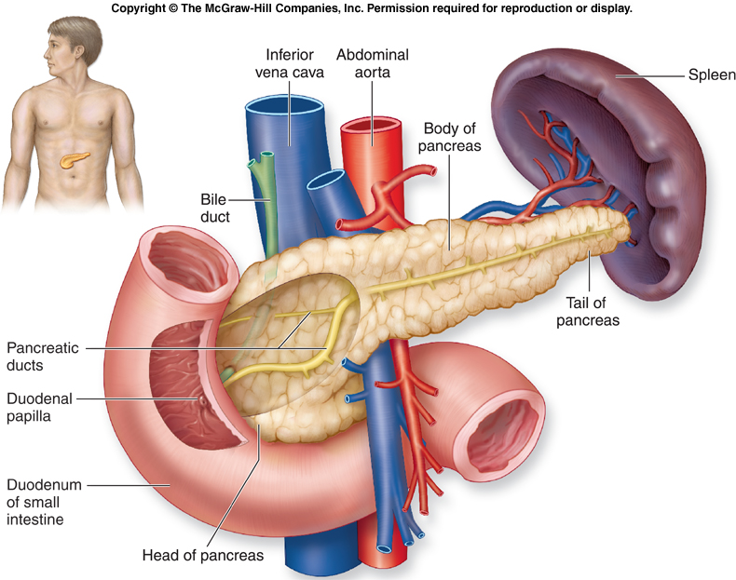
Body of the Pancreas
The body of the pancreas is elongated. It extends from its neck to the tail. It passes towards the left with a slight upward and backward inclination.

Slide 18
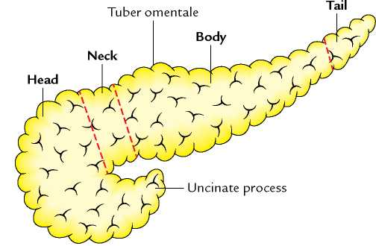
External features of body
It is triangular on cross-section, and has three borders (anterior, superior and inferior).
A part of the body projects upwards beyond the rest of the superior border, a little to the left of the neck. This projection is known as the tuber omentale

Slide 19
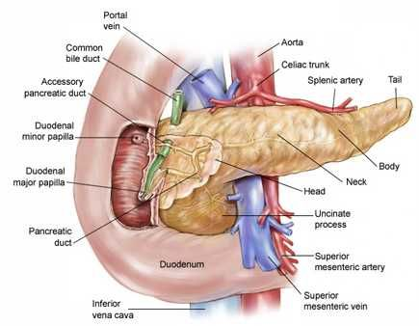
Relations
Anterior border -provides attachment to the root of the transverse mesocolon.
The superior border is related to coeliac trunk over the tuber omentale, the hepatic artery to the right, and the splenic artery to the left.
The inferior border is related to the superior mesenteric vessels at its right end

Slide 20
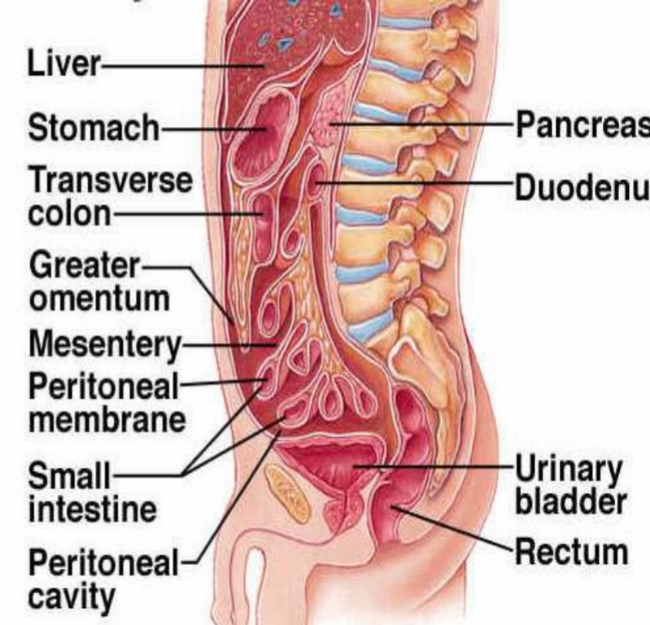

Slide 21
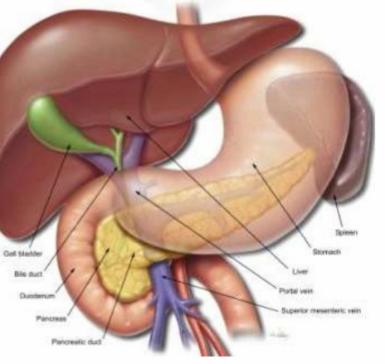
Three Surfaces
The anterior surface is concave and is directed forwards and upwards. It is covered by peritoneum, and is related to the lesser sac and to the stomach.

Slide 22
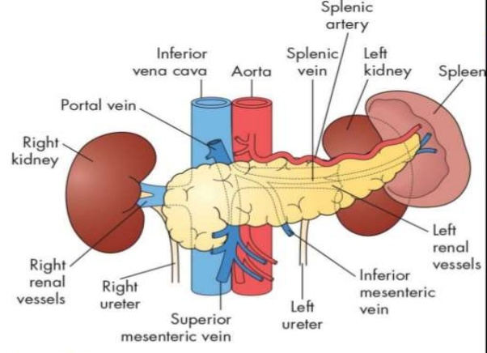
Posterior surface
It is devoid of peritoneum, and is related to
Aorta with the origin of the superior mesenteric artery,
(2) Left crus of the diaphragm,
(3) Left suprarenal gland,
(4) Left kidney
(5) Left renal vessels, and
(6) Splenic vein

Slide 23
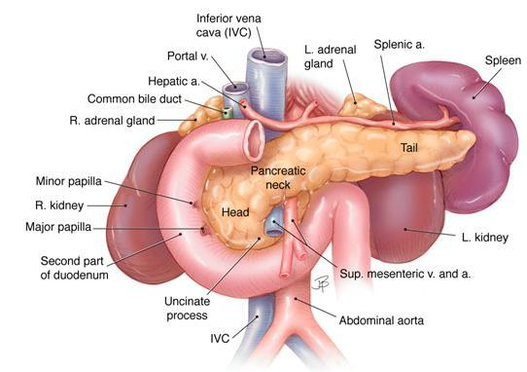
The inferior surface is covered by peritoneum, and is related to the duodenojejunal flexure, coils of jejunum and the left colic flexure

Slide 24
Tail of the Pancreas
This is the narrow left end of the pancreas.
It lies in the lienorenal ligament together with the splenic vessels.
It comes into contact with the lower part of the gastric surface of the spleen

Slide 25
Ducts of the Pancreas
Exocrine pancreas is drained by two ducts, main and accessory

Slide 26
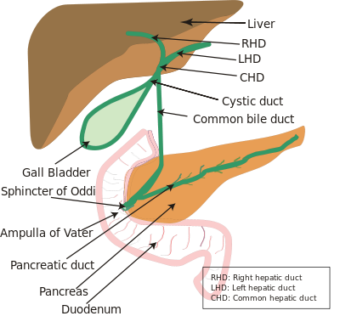
Duct of Wirsung
1. The main pancreatic duct of Wirsung lies near the posterior surface of the pancreas and is recognised easily by its white colour.
It begins at the tail; runs towards the right through the body; and bends at the neck to run downwards, backwards and to the right in the head.

Slide 27
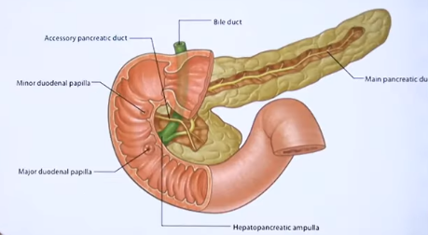

Slide 28
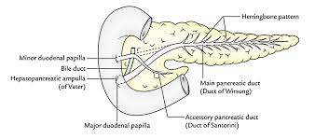
Features of Duct of Wirsung
Lumen is about 3 mm in diameter
It receives numerous small tributaries which join it at right angles to its long axis forming what has been described as a 'herring bone pattern'.

Slide 29
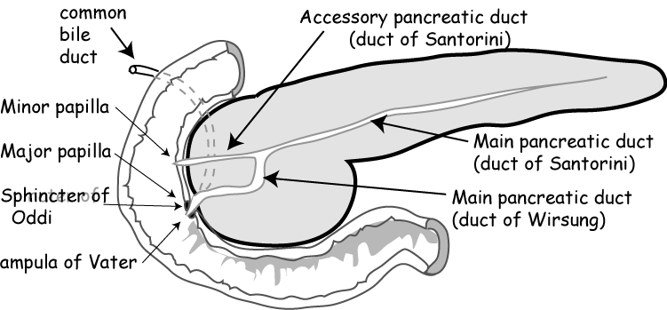
Accessory pancreatic duct of "Santorinzbegii
It isin the lower part of the head, crosses the front of the main duct with which it communicates and open into the duodenum at the minor duodenal papilli

Slide 30
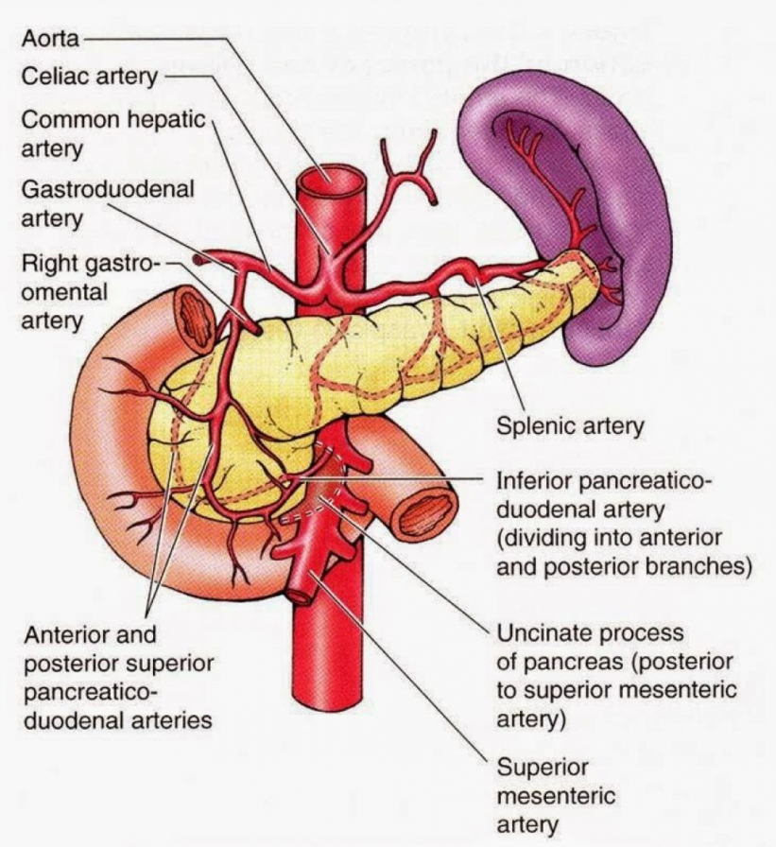
Arterial Supply-
(1)Pancreatic branches of the splenic artery,
(2)Superior pancreaticoduodenal artery,
(3) Inferior pancreaticoduodenal artery

Slide 31
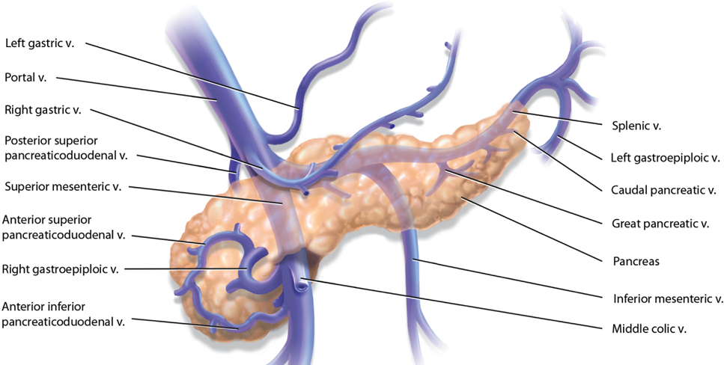
Venous Drainage
Veins drain into splenic, superior mesenteric and portal veins

Slide 32
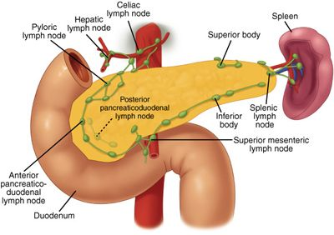
Lymphatic Drainage
Lymphatics follow the arteries and drain into the pancreaticosplenic, coeliac and superior mesenteric groups of lymph nodes

Slide 33
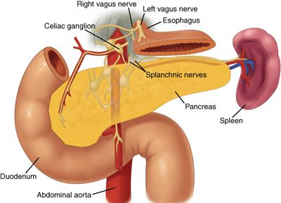
Nerve Supply
Vagus or parasympathetic and splanchnic or sympathetic nerves supply the pancreas through the plexuses around its arteries.
Sympathetic nerves are vasomotor. Parasympathetic nerves control pancreatic secretion.

Slide 34
Functions
1. Digestive: Pancreatic juice contains many digestive enzymes of which the important ones are as follows. Trypsin breaks down proteins to lower peptides. Amylase hydrolyses starch and glycogen to disaccharides. Lipase breaks down fat into fatty acids and glycerol.
2. Endocrine:Insulin helps in utilizations of sugar in the cells. Deficiency of insulin results in hyperglycaemia. The disease is called diabetes
Pancreatic juice: It provides appropriate alkaline medium (pH 8) for the activity of the pancreatic enzymes.

Slide 35
CLINICAL ANATOMY
1. Deficiency of insulin causes the disease diabetes mellitus.
2. Deficiency of pancreatic enzymes causes digestive disturbances.
3. Carcinoma is common in the head of the pancreas.

Slide 36
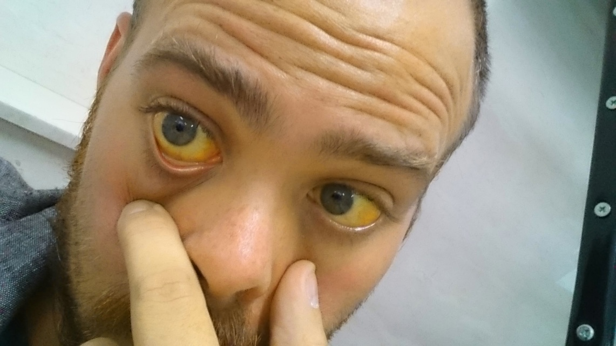
Pressure over the bile duct leads to persistent obstructive jaundice
Acute pancreatitis may be due to mumps infection

Slide 37
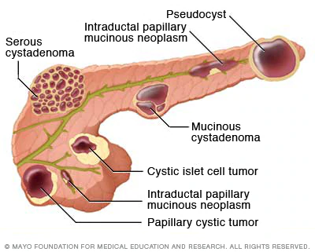
Pancreatic cyst presents as a large fixed tumour in the upper part of abdomen along the median plane. They are often symptomless.

