Slide 1
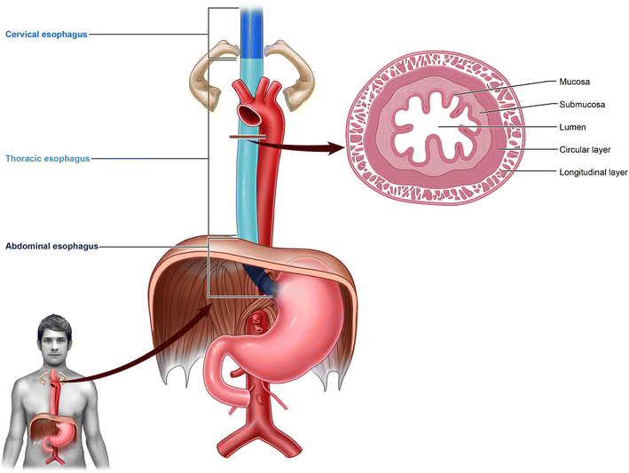
Oesophagus

Slide 2
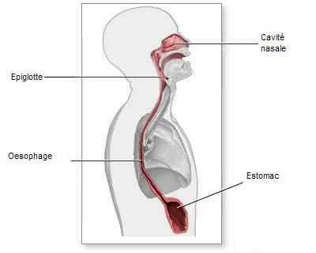
Introduction
Muscular tube for the passage of food from pharynx to stomach
Extends from 6th cervical to 11th thoracic vertebrae
Starts in the neck at lower end of laryngopharynx
Ends at cardiac orifice of stomach at the level of T 11

Slide 3
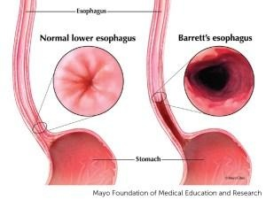
Dimensions
25 cm in length
2.5 cm in diameter
Lumen – flattened anteroposteriorly .Normally it is kept closed &opens only during passage of food

Slide 4
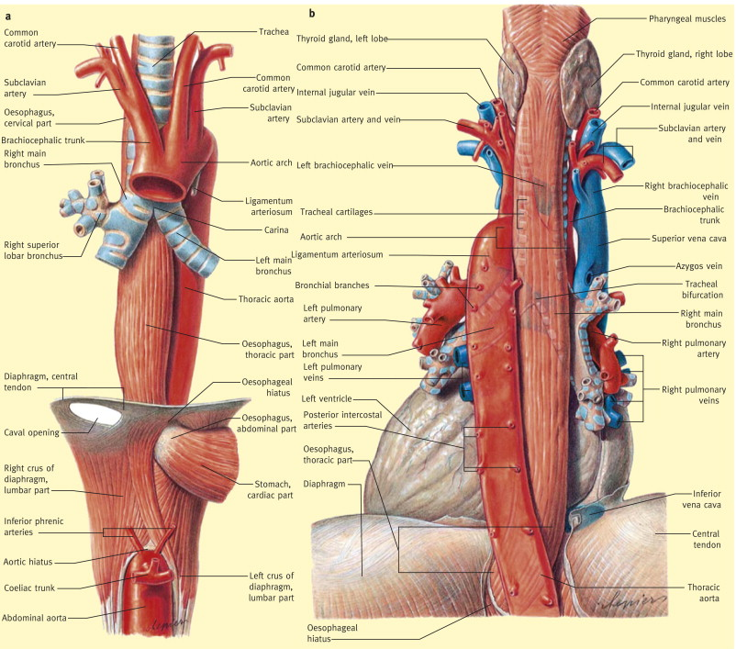

Slide 5
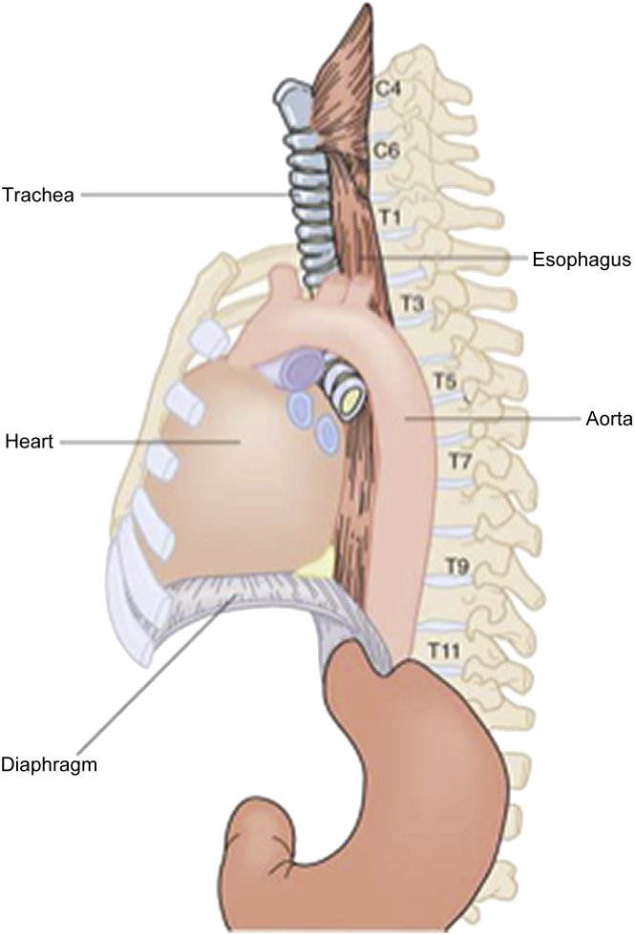
Course
Cervical –in neck . enters thorax at thoracic inlet at T1,4 cm ,C6-T1
Thoracic – pass through superior mediastinum and posterior mediastinum ,20 cm, T1- T10
leaves the thorax by passing through an aperture in diaphragm –at 10th thoracic vertebrae ,2-3 cm to left of midline & enters abdomen
Abdominal – at the level of 11th ,it joins stomach ,1.25 cm ,T10-T11

Slide 6
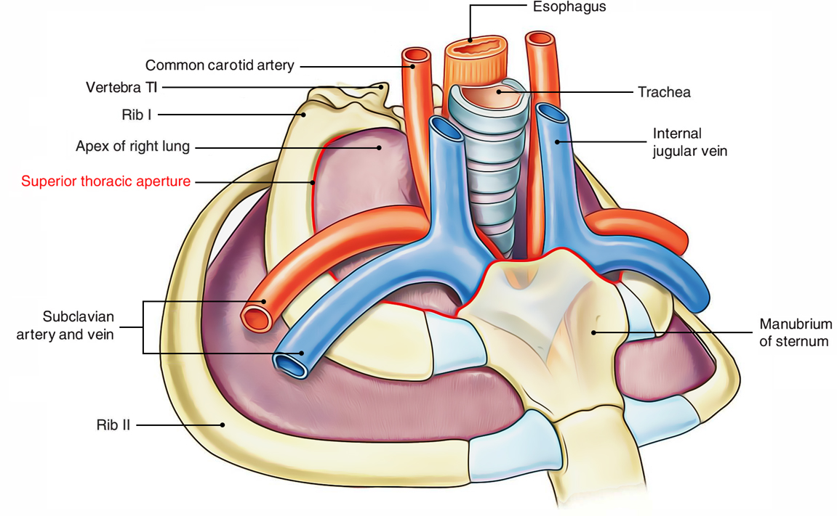

Slide 7
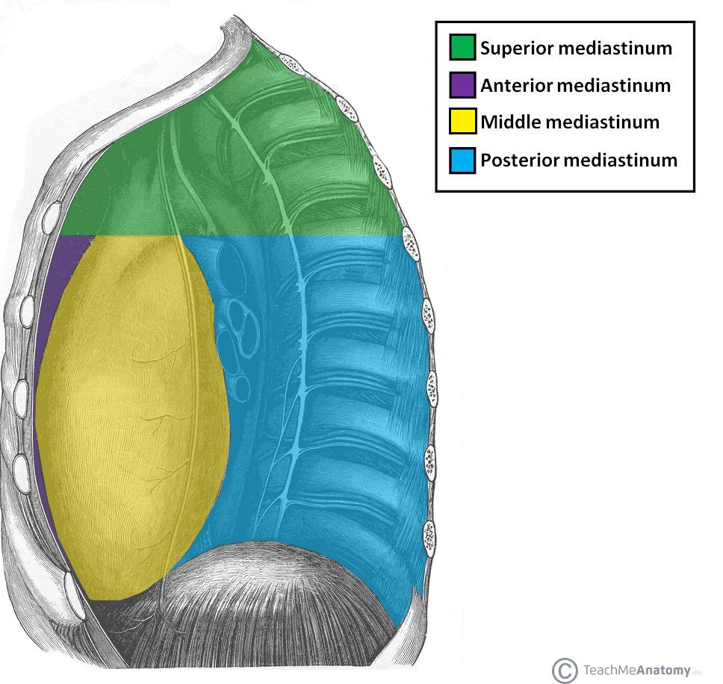

Slide 8
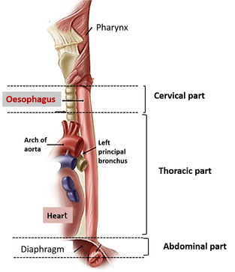
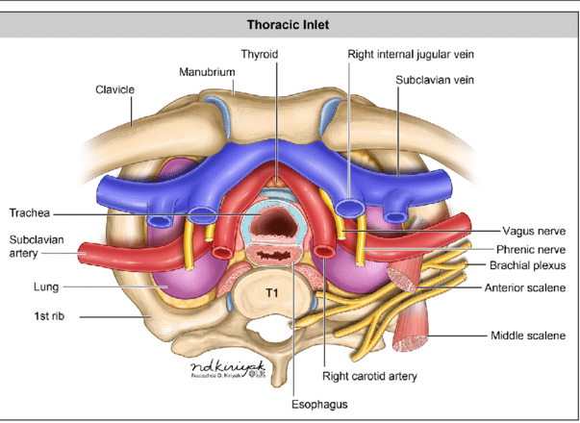

Slide 9
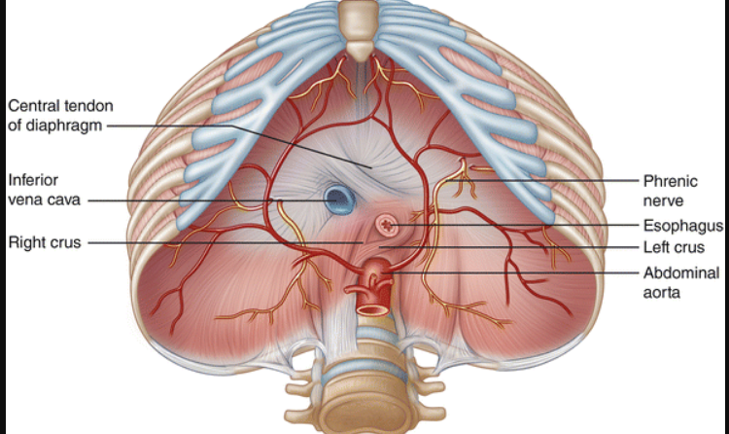

Slide 10
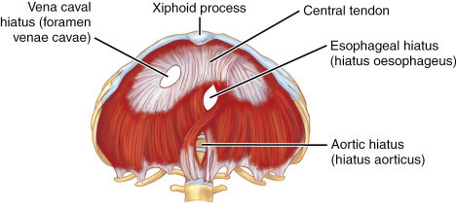

Slide 11
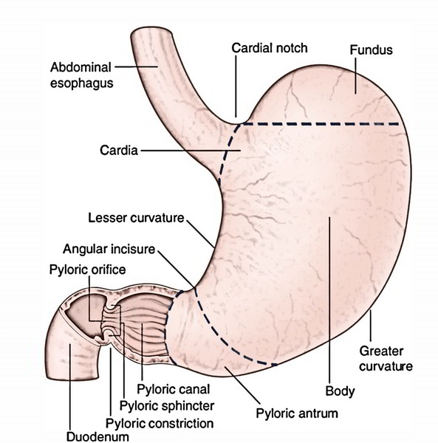

Slide 12
Curvatures
2 lateral
2 anteroposterior

Slide 13
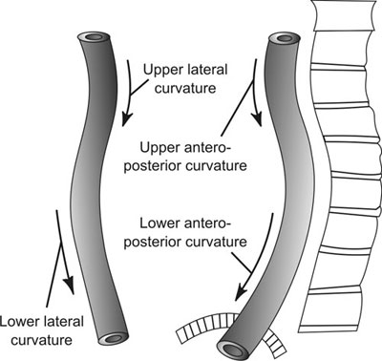
Anteroposterior
Cervical –anterior convexity
Thoracic –posterior convexity
Lateral – to left
At root of neck –before entering thoracic inlet(then returns to midline at T5 )
At T 7 – passing in front of thoracic aorta

Slide 14
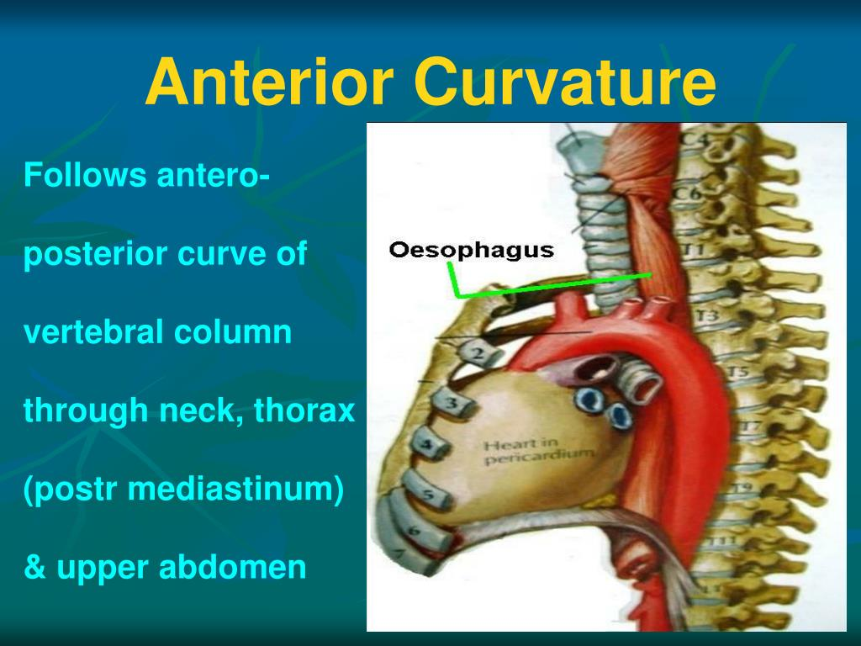

Slide 15
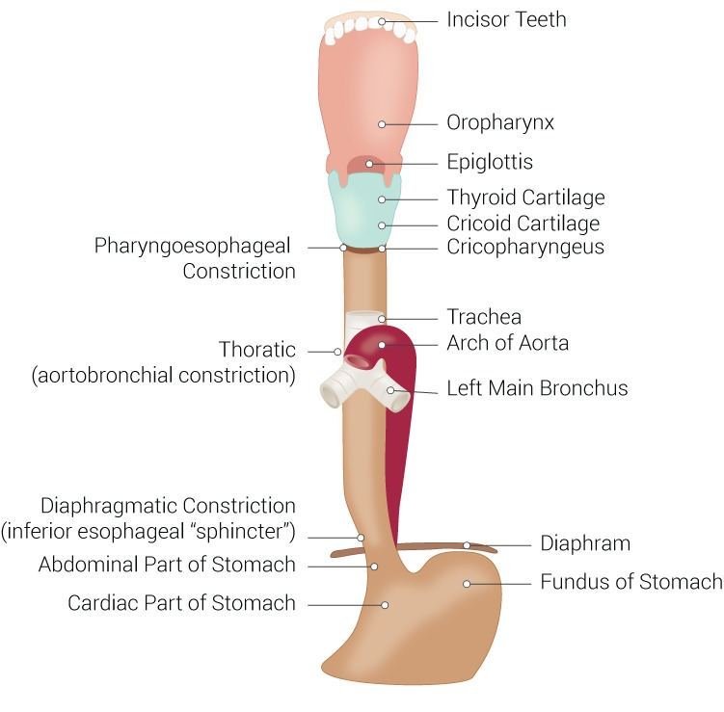
Constrictions
Constrictions –areas of narrowing ,4 places
C6 Level - 15 cm from incisor
T4 level - 22.5 cm “ -crossing of arch of aorta
T6 - 27.5 cm “” - crossing of left bronchus
T10 -40 cm “ -pierces diaphragm

Slide 16
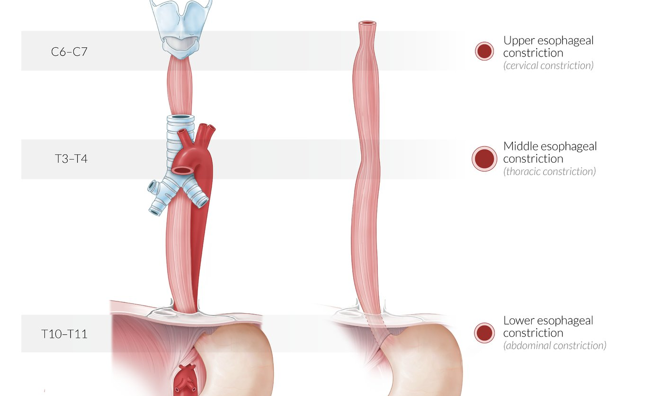
Constrictions –areas of narrowing ,4 places
C6 Level - 15 cm from incisor
T4 level - 22.5 cm “ -crossing of arch of aorta
T6 - 27.5 cm “” - crossing of left bronchus
T10 -40 cm “ -pierces diaphragm

Slide 17
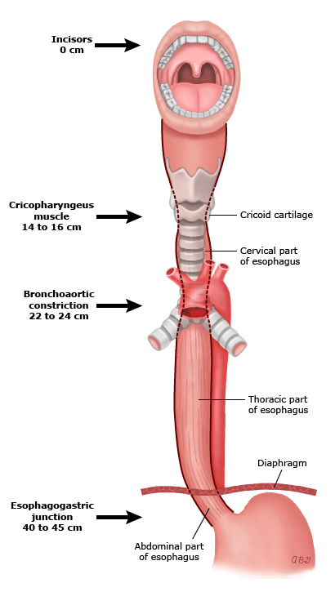
Constrictions –areas of narrowing ,4 places
C6 Level - 15 cm from incisor
T4 level - 22.5 cm “ -crossing of arch of aorta
T6 - 27.5 cm “” - crossing of left bronchus
T10 -40 cm “ -pierces diaphragm

Slide 18
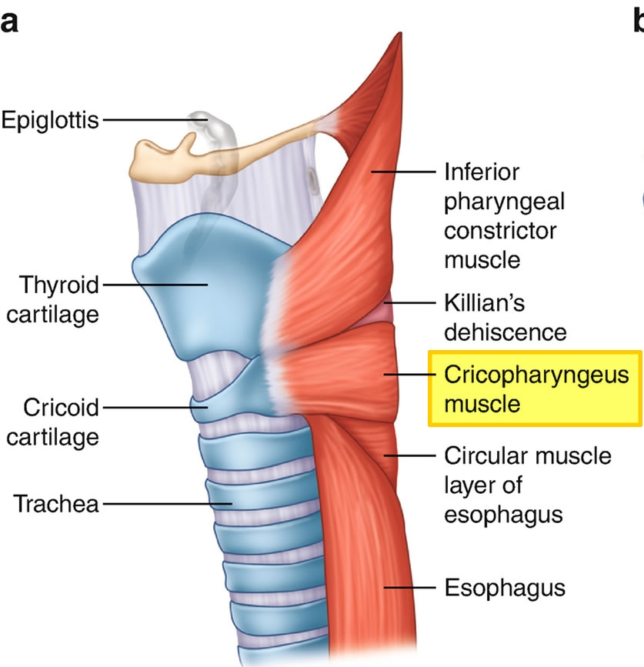
`Physiological constrictors
Two sphincters present in the oesophagus
Known as the upper and lower oesophageal sphincters.
They act to prevent the entry of air and the reflux of gastric contents respectively.

Slide 19
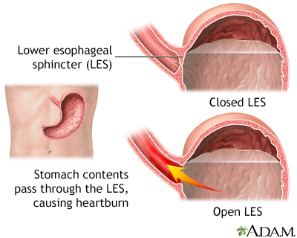

Slide 20
Clinical significance of constrictions
These are sites where swallowed foreign bodies are most likely to be lodged in oesophagus
These are the sites where strictures develop after ingestion of corrosive substances
These sites have predilection for carcinoma of oesophagus
These are sites through which it may be difficult to pass oesophagoscope /gastric tube .

Slide 21
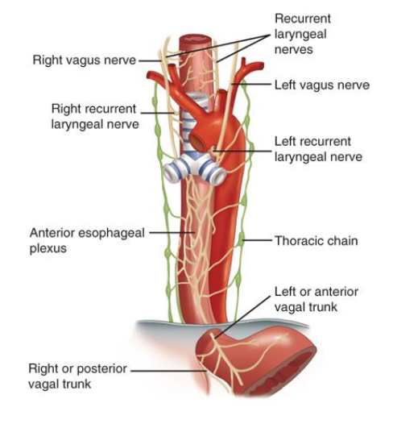
Cervical part
Anterior
Trachea
Recurrent laryngeal nerve
Lateral
Common carotid artery
Lateral lobe of thyroid
Thoracic duct

Slide 22
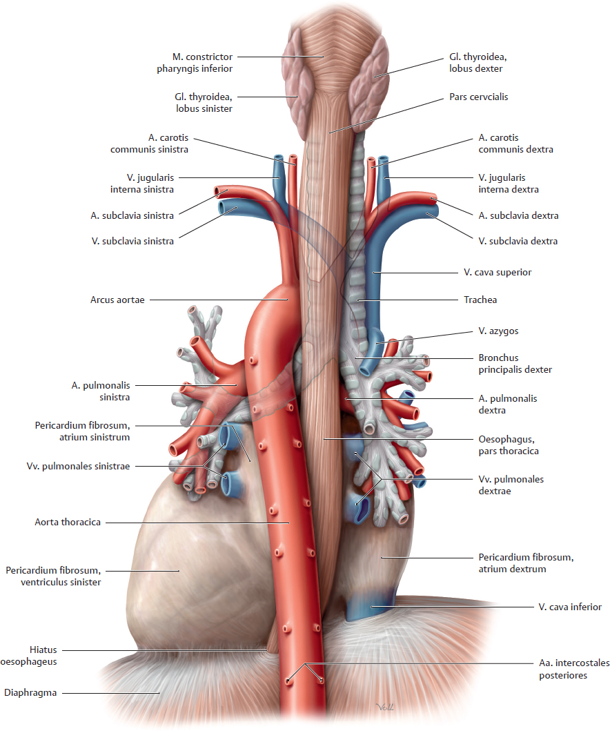

Slide 23
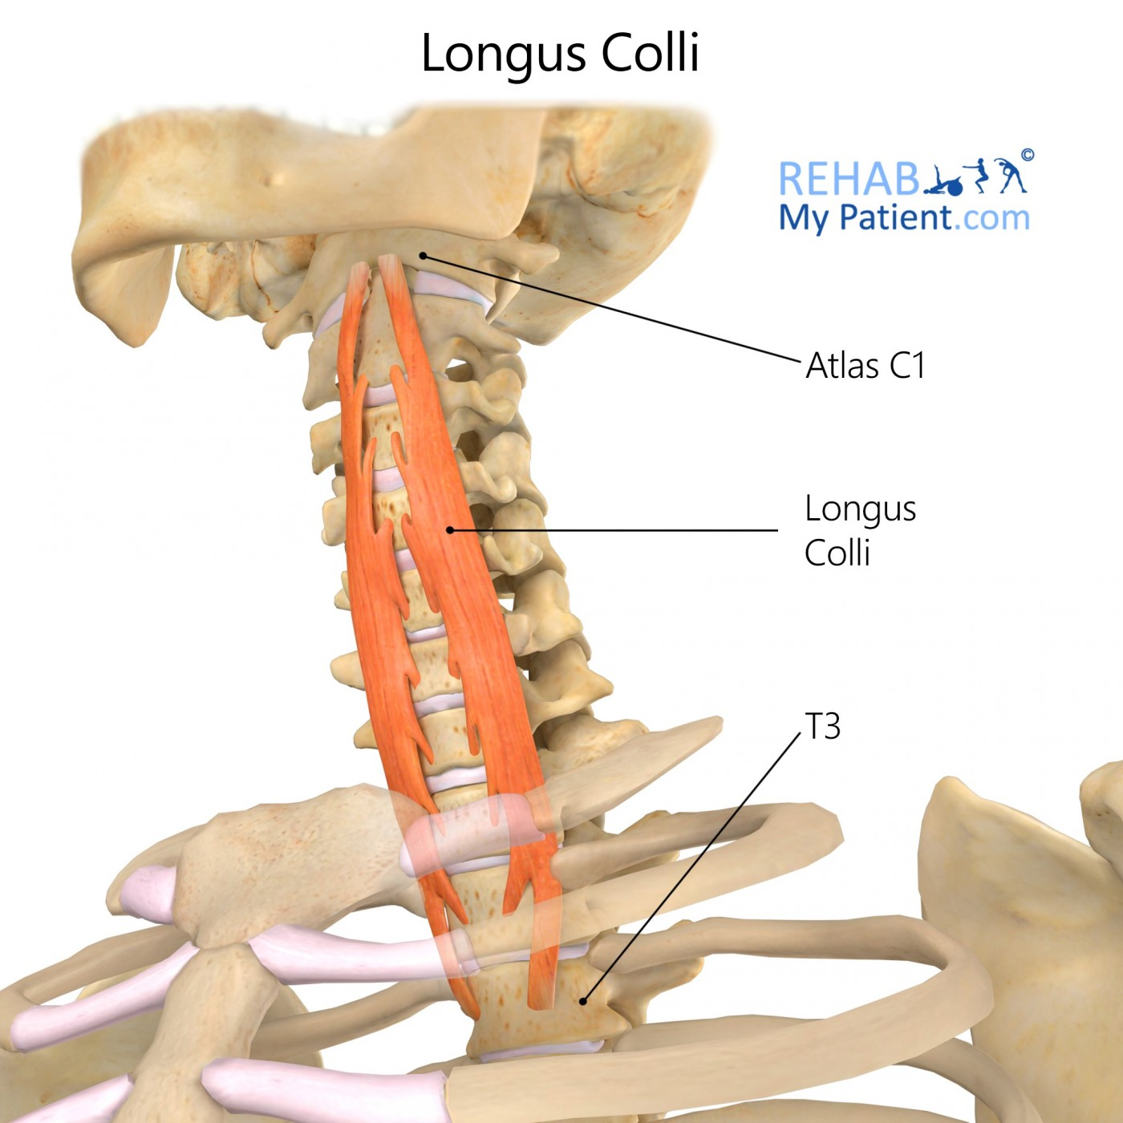
Posterior
Cervical vertebra
Prevertebral fascia
Longus colli

Slide 24
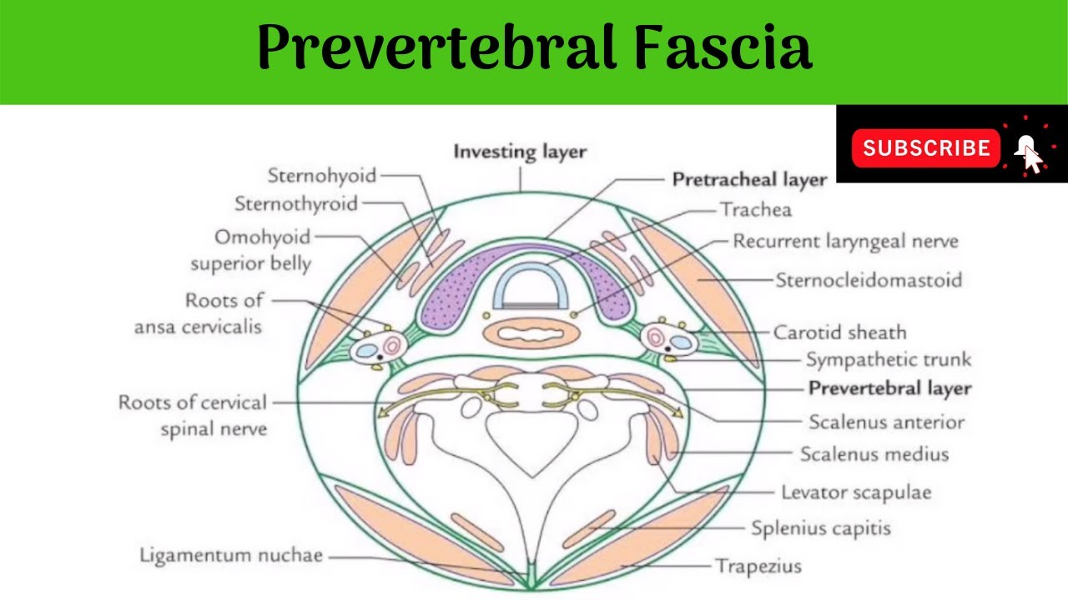

Slide 25
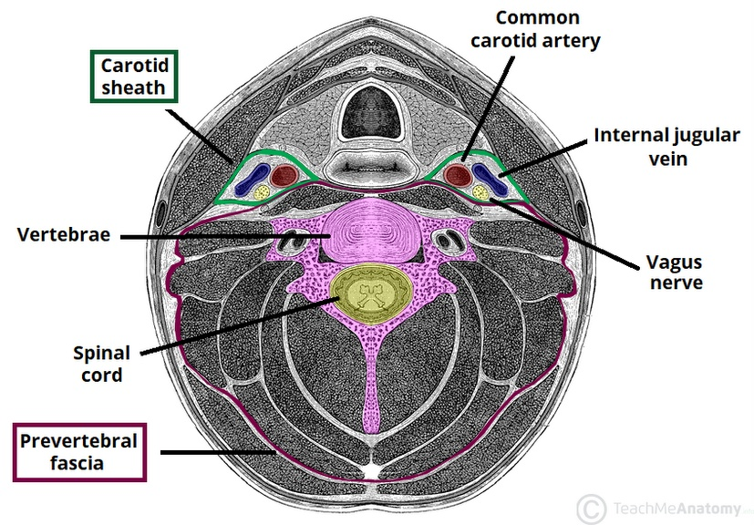

Slide 26
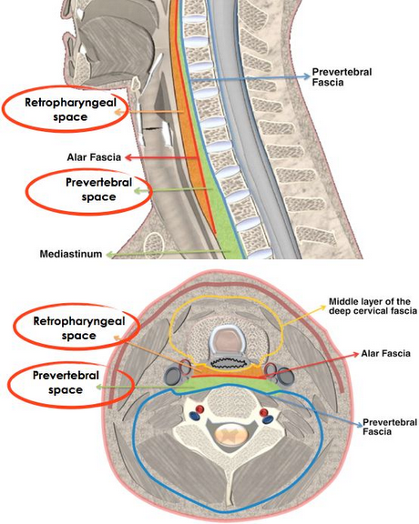

Slide 27
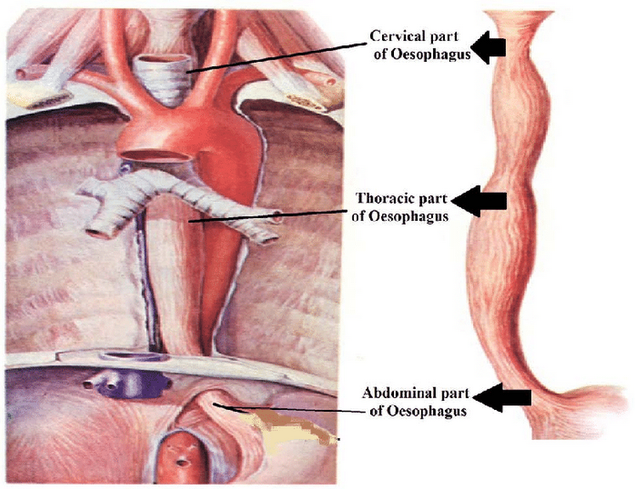
Thoracic
Enters through thoracic inlet at T1
Pass through superior & posterior mediastinum ,lies to left
At T4 ,moves to right behind root of lung & in midline at T5
Descend in midline up to T7 & then again to left

Slide 28
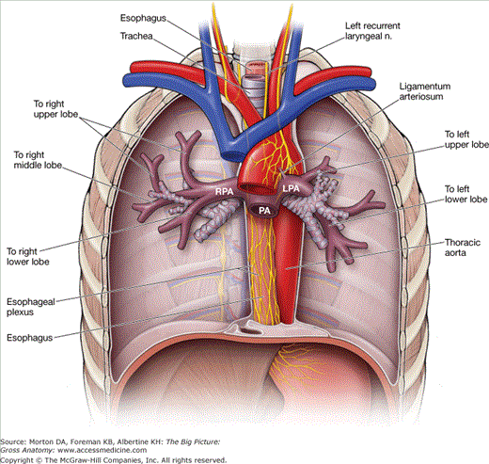
Relations of thoracic part
Anteriorly
Trachea
Right pulmonary artery
Left bronchus
Pericardium with left atrium
Diaphragm

Slide 29
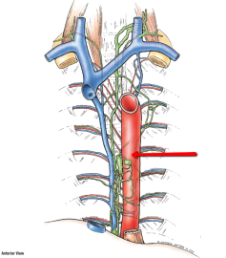
Posteriorly
Vertebral column
Right posterior intercostal arteries
Thoracic duct
Azygos vein
Thoracic aorta
Diaphragm

Slide 30
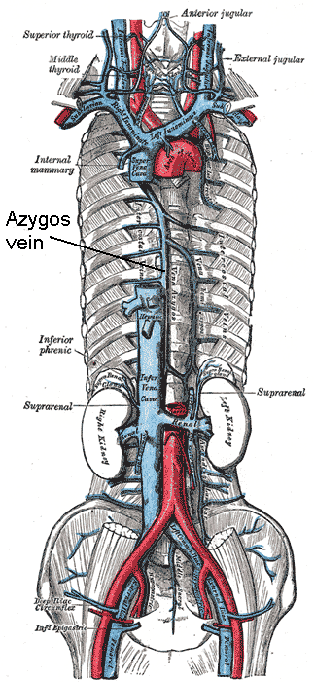

Slide 31
Right
Right lung & pleura
Azygos vein
Right vagus
Left
Aortic arch
Left subclavian artery
Thoracic duct
Left lung & pleura

Slide 32
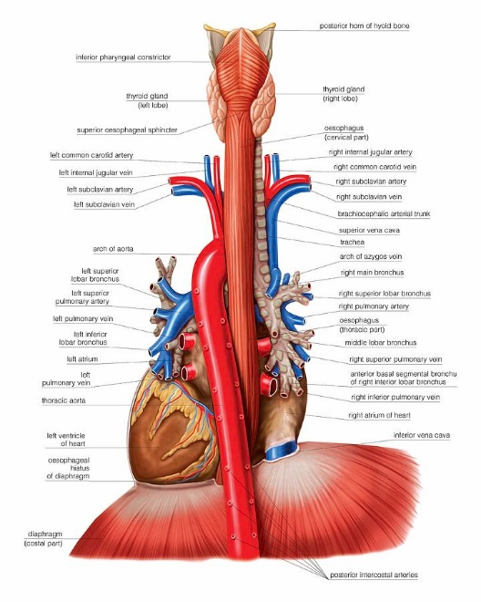
In posterior mediastinum
Descending thoracic aorta
Left lung & mediastinal pleura

Slide 33
Abdominal part
1.25 cm in length
At T10 ,oesophageal orifice of diaphragm ,slightly to left of median plane
Runs downwards in front of left crus of diaphragm & inferior surface of left lobe of liver
At T11 opens into cardiac end of stomach ,about 2.5 cm to left of median plane
Opening also transmits anterior & posterior gastric nerves & oesophageal branches of left gastric arteries

Slide 34
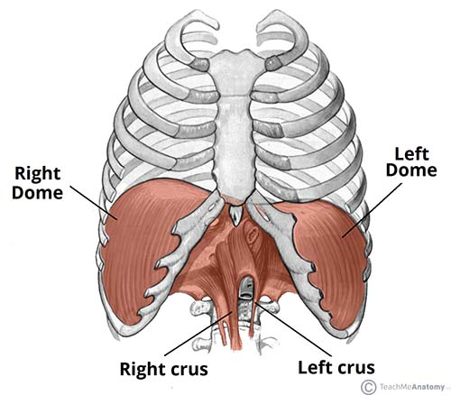

Slide 35
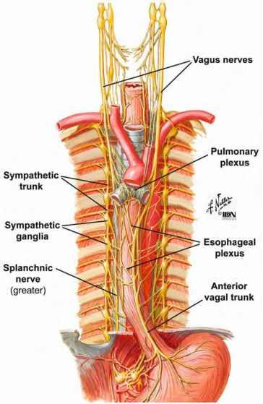
Relations
Anterior - oesophageal groove of left lobe of liver ,anterior vagal trunk
Posterior – left crus of diaphragm ,posterior vagal trunk ,left inferior phrenic vessels

Slide 36
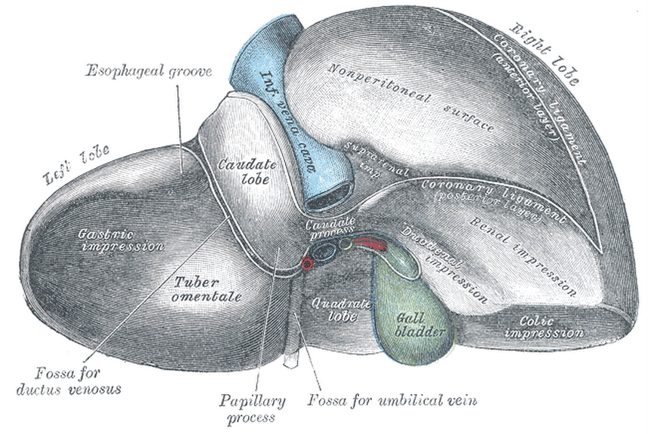

Slide 37
Histology
Mucosa –epithelium ,lamina propria ,muscularis mucosa
Submucosa
Muscularis externa
Adventitia

Slide 38
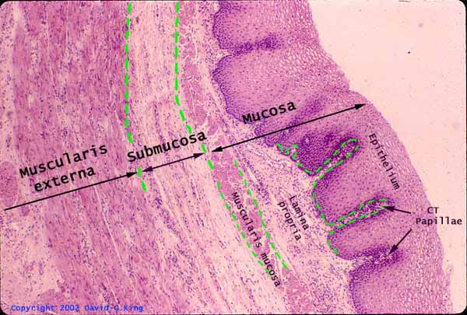
Mucous membrane – stratified squamous nonkeratinised .lamina propria consists of loose connective tissue with scattered lymphatic follicles .Muscularis mucosa –distinct in lower part –by longitudinal muscle fibres
Submucosa –loose areolar tissue & mucous secreting oesophageal glands

Slide 39
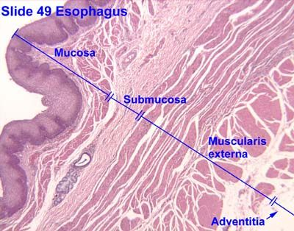
Muscularis externa –striated muscle in upper third ,mixed type in middle third,smooth muscles in lower third.
outer layer longitudinal & inner layer circular
At upper portion –circular fibres continuous with inferior constrictors
Longitudinal fibres form a V shaped gap in initial 4 cm on dorsal aspect .two limbs of V diverge and get attached to the ridge on back of lamina of cricoid .Triangular area in between is weak –for herniation –oesophageal diverticulum
Adventitia – connective tissue with capillaries & nerves

Slide 40
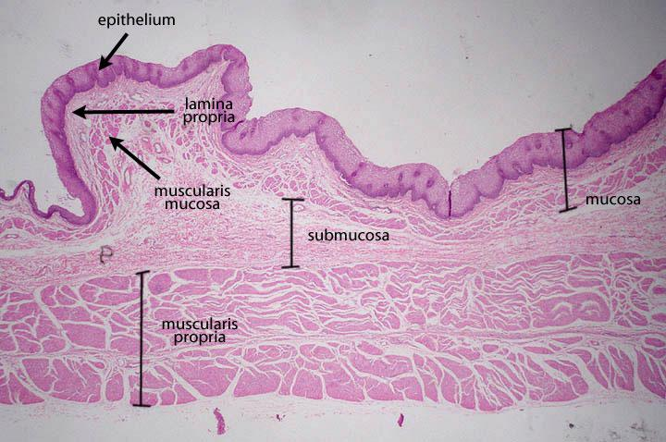

Slide 41
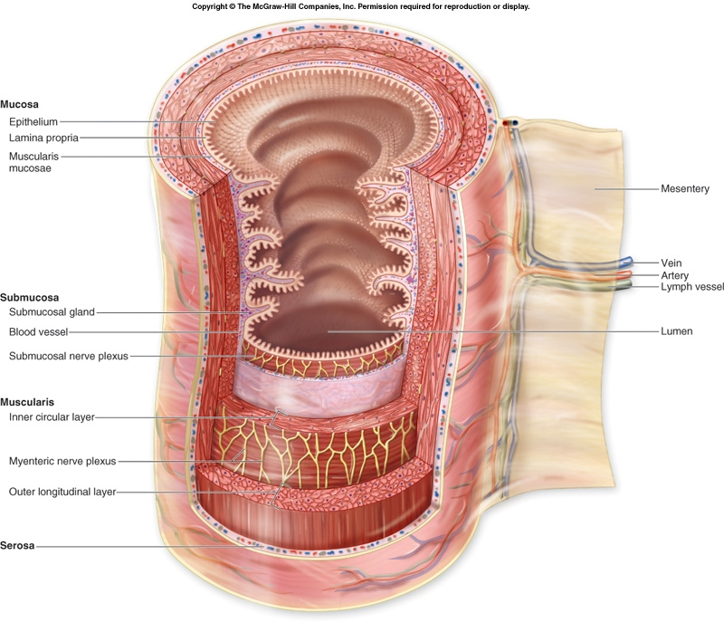

Slide 42
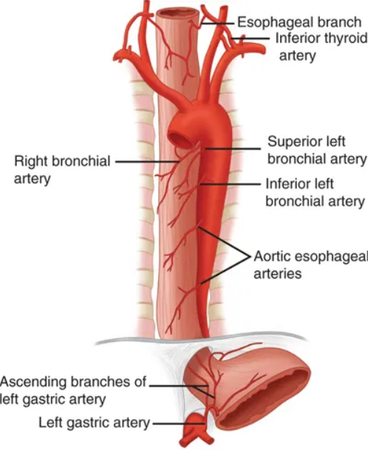
Blood supply
Arterial
Cervical - inferior thyroid artery ,ascending pharyngeal artery
Thoracic -descending thoracic aorta, left bronchial artery
Abdominal –left gastric ,inferior phrenic artery

Slide 43
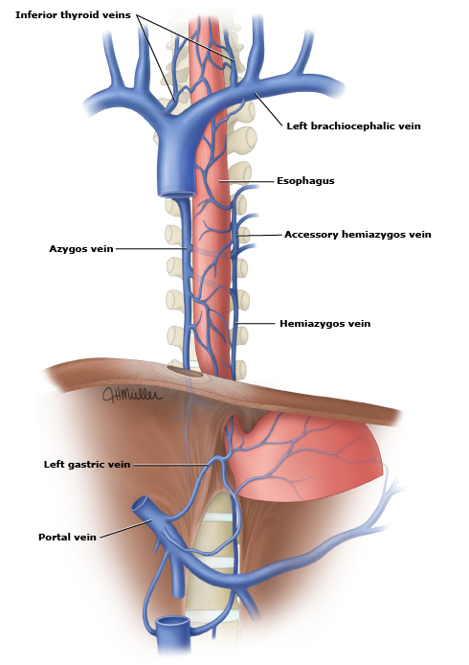
Venous
Cervical –inferior thyroid vein -brachiocephalic vein
Thoracic –azygos vein ,hemiazygos ,left gastric
Abdominal -to Portal system –left gastric & inferior phrenic
to systemic - inferior hemiazygos

Slide 44
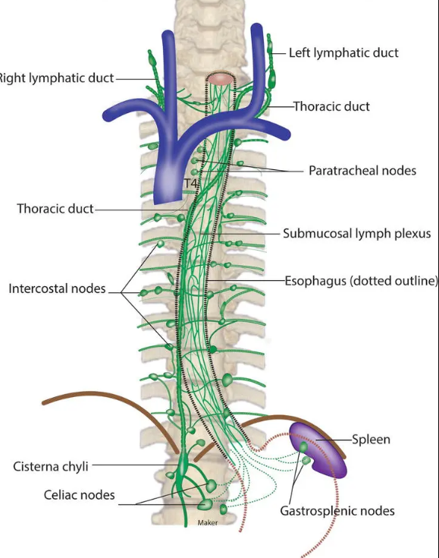
Lymphatic drainage
Cervical –jugulo-omohyoid
Thoracic – para-tracheal ,tracheobronchial ,posterior mediastinal
Abdominal –celiac group

Slide 45
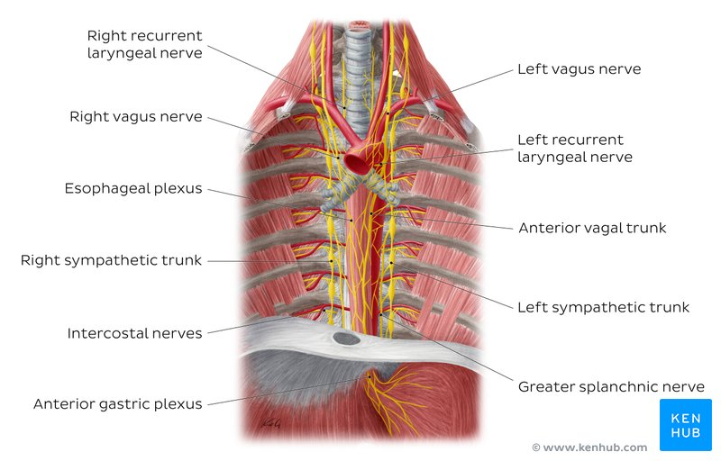
Nerve supply
Cervical – recurrent laryngeal nerve ,branches from middle & inferior cervical ganglion
Thoracic - oesophageal plexus ,thoracic splanchnic ,sympathetic plexus around left gastric artery ,anterior & posterior gastric nerves
Abdominal - thoracic splanchnic ,sympathetic plexus around left gastric artery ,anterior & posterior gastric nerves

Slide 46
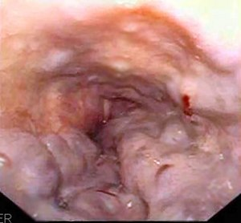
Applied anatomy
Oesophageal varices
Lower end of oesophagus is one of important sites of portocaval anastomosis.
In portal hypertension ,due to cirrhosis of liver there is back pressure in portal circulation .As a result ,collateral channels of portocaval anastomosis not only open up but become dilated & tortuous to form oesophageal varices .The ruptured varices cause hematemesis.

Slide 47
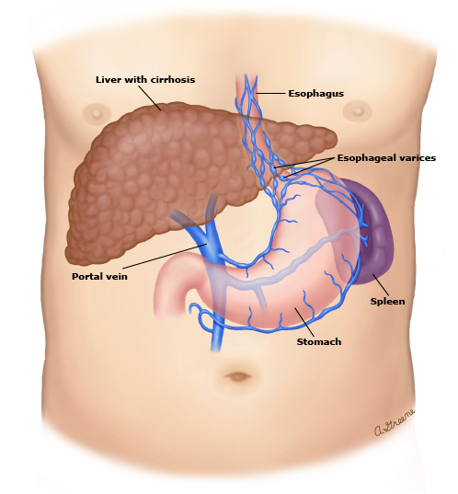

Slide 48
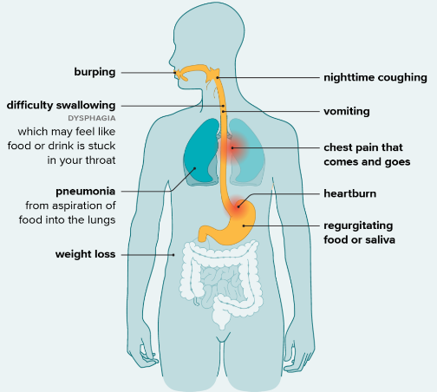
Referred pain of oesophagus
Oesophageal pain is referred to lower thoracic region & epigastric region of abdomen .(through T 4 & T5 spinal segments )
Achalasia cardia
It is a clinical condition in which the sphincter at the lower end of oesophagus fails to relax when food is swallowed . As a result, food accumulates in oesophagus & its regurgitation occurs. This condition occurs probably due to congenital absence of ganglion cells in myenteric plexus of nerves in oesophageal wall.

