Slide 1
Nasal cavity contd…

Slide 2
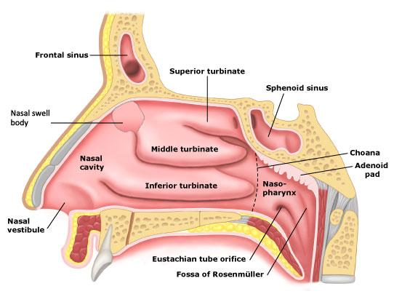
Lateral wall contd….features
Divided into 3 areas
Anterior -vestibule
Middle - atrium
Posterior - conchae or turbinates

Slide 3
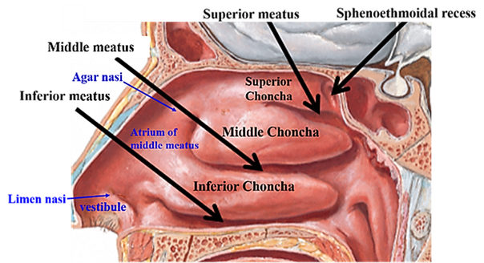

Slide 4
Conchae or turbinates
They are curved bony projections directed downwards and medially
Below and lateral to each conchae is the corresponding meatus
From above downwards -3 concha –superior,middle,inferior
3 meatus – superior ,middle and inferior meatuses

Slide 5
Superior and middle conchae are projections from medial side of ethmoidal labyrinth
Inferior concha is an independent bone
Superior concha is smallest and inferior is the largest .

Slide 6
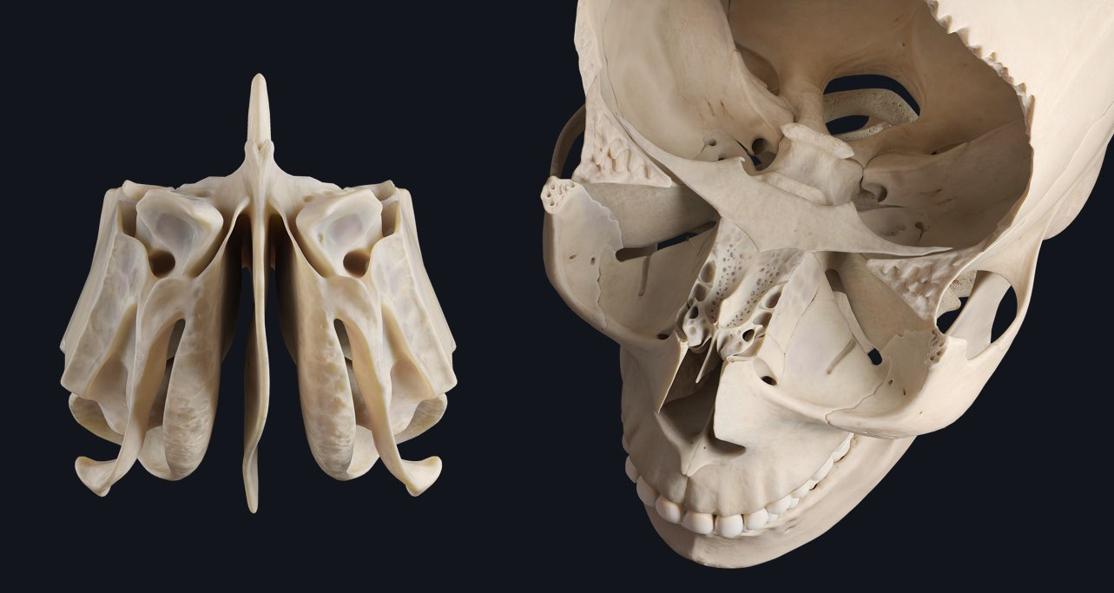

Slide 7
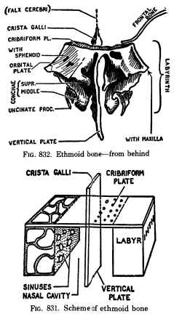

Slide 8
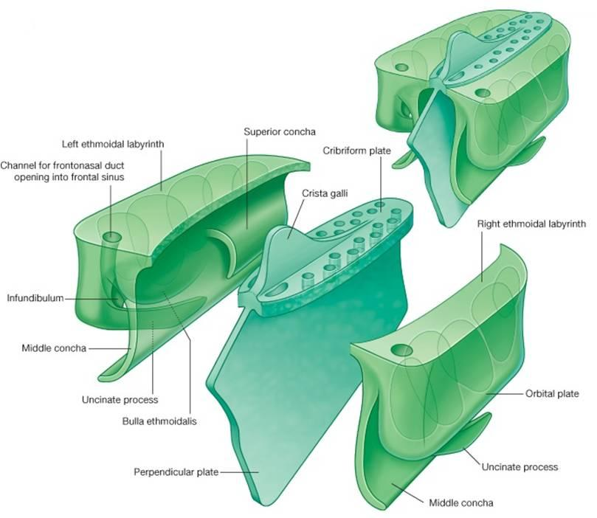

Slide 9
Meatuses
They are passages (recesses ) beneath the overhanging conchae .(they can be seen once the conchae are removed )
Inferior meatus is the largest beneath the inferior concha.
Superior meatus is the smallest and lies below superior concha .
A triangular depression above and behind the superior concha is known as sphenoethmoidal recess

Slide 10
Middle meatus lies below middle concha .presents following features
Ethmoidal bullae –round elevation produced by underlying middle ethmoidal sinus
Hiatus semilunaris – deep semicircular sulcus below ethmoidal bullae
Infundibulum – a short passage at the anterior end of middle meatus

Slide 11
Openings in lateral wall
Sites | Openings
Sphenoethmoidal recess | Sphenoidal sinus
Superior meatus | Posterior ethmoidal rcess
Middle meatus On bulla In hiatus semilunaris Anterior part Middle part Posterior part | Middle ethmoidal sinus Frontal sinus Anterior ethmoidal sinus Maxillary sinus
Inferior meatus | Nasolacrimal duct

Slide 12
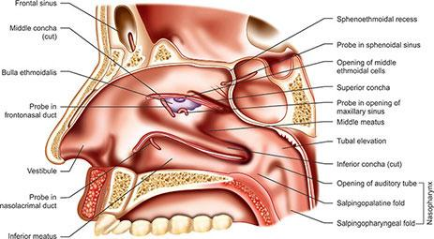

Slide 13
Arterial supply of nasal septum
Septal branches
  of anterior ethmoidal (branch of ophthalmic ),
  posterior ethmoidal , ( ‘’ ‘” )
  Sphenopalatine ( maxillary,)
  greater palatine , (maxillary )
  superior labial (facial artery )

Slide 14
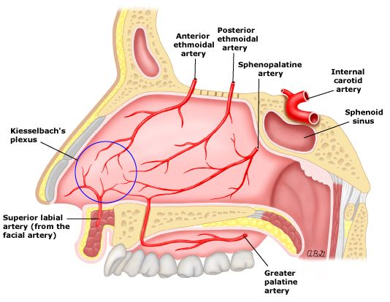

Slide 15
Arterial supply of lateral wall
From branches of ophthalmic,maxillary and facial
Arranged in 4 quadrants
Anterosuperior -anterior ethmoidal
Anteroinferior -facial and greater palatine
Posterosuperior - sphenopalatine
Posteroinferior - greater palatine

Slide 16
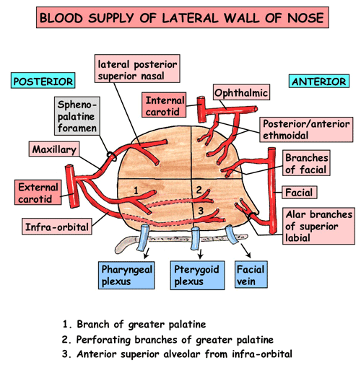

Slide 17
Venous drainage of nasal cavity
Veins form plexus beneath the mucosa and in general accompany the arteries . They drain into facial ,pterygoid venous plexus ,and pharyngeal venous plexus .

Slide 18
Lymphatics of nasal cavity
From anterior half of nasal cavity to submandibular lymph nodes
From posterior half to retropharyngeal lymph nodes

Slide 19
Nerve supply of nasal cavity
Olfactory nerve - carry the sense of smell from olfactory region of nasal cavity
Nerves of general sensation – from trigeminal through maxillary and ophthalmic
Autonomic nerves – secretomotor –from pterygopalatine ganglion
(for nasal glands )
Vasomotor – upper 3 or 4 thoracic segments ( cause vasoconstriction )

Slide 20
Clinical aspects
Nasal fractures
As nose is the most projecting part of face ,the fractures of nasal bones are the common facial fracture .
DNS –Deviated nasal septum – it is an important cause of nasal obstruction .males are affected than females. If DNS is severe causing difficulty in breathing ,sinusitis ,headache ,excessive snoring etc. it is corrected by submucous resection or septoplasty

Slide 21
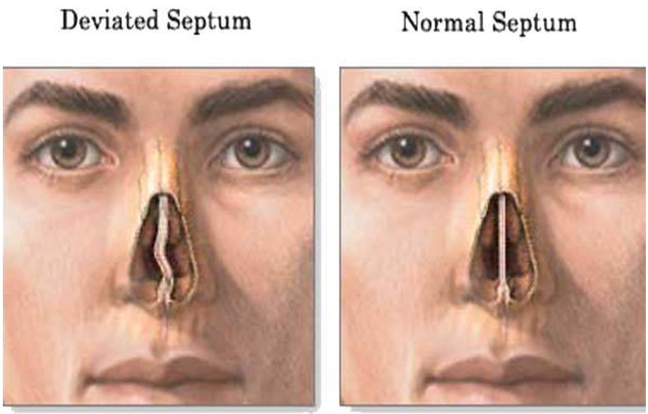
DNS

Slide 22
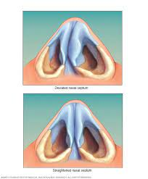
Deviated septum

Slide 23
Little’s area – it is an area in the anteroinferior part of nasal septum just above the vestibule .It is highly vascular .Here the septal branches of anterior ethmoidal ,sphenopalatine ,greater palatine and superior labial arteries anastamose to form a vascular plexus called Kiesselbach’s plexus .This area of nasal septum is the commonest site of epistaxis (nasal bleeding )

Slide 24
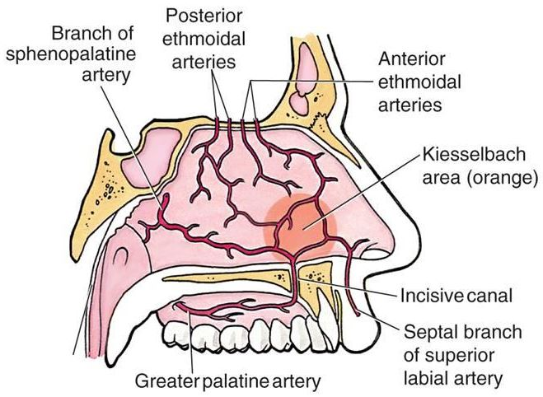

Slide 25
Fracture of cribriform plate of ethmoid can cause damage to olfactory rootlets .If meningeal tear is present ,CSF may drip from nasal cavity .
Common cold or rhinitis is the commonest infection of nose

Slide 26
Epithelial lining of nasal cavity
3 areas
Vestibule
Respiratory area
Olfactory area
Vestibule
Lined by skin ,coarse hairs ,sebaceous and sweat glands .Filter the foreign particles

Slide 27
Respiratory
Lined by ciliated pseudostratified columnar epithelium
Provided by goblet cells & mucous and serous glands
Secretions make the surface sticky and entraps injurious inhaled particles and microorganisms .
The entrapped materials are swayed back by cilia and are ejected by sneezing and coughing
The lamina propia contains vascular spaces which communicate with arterioles and venules .Normally the spaces remain collapsed. But in allergy the spaces get distended with blood due to vasodilation and produces running nose .

Slide 28
Olfactory
Occupies the roof and adjoining septal and lateral walls of nasal cavity above superior conchae .The mucous membrane is lined by bipolar olfactory cells ,tall columnar supporting cells ,and basal cells.
The peripheral process of bipolar cells act as dendrites and respond to the odorous stimuli .Central processes form axons of olfactory nerves.

Slide 29
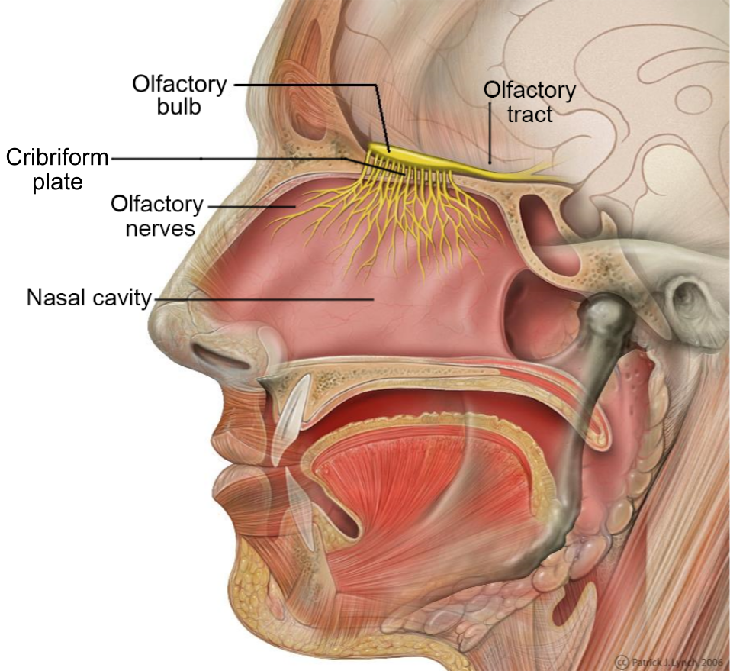

Slide 30
