Slide 1
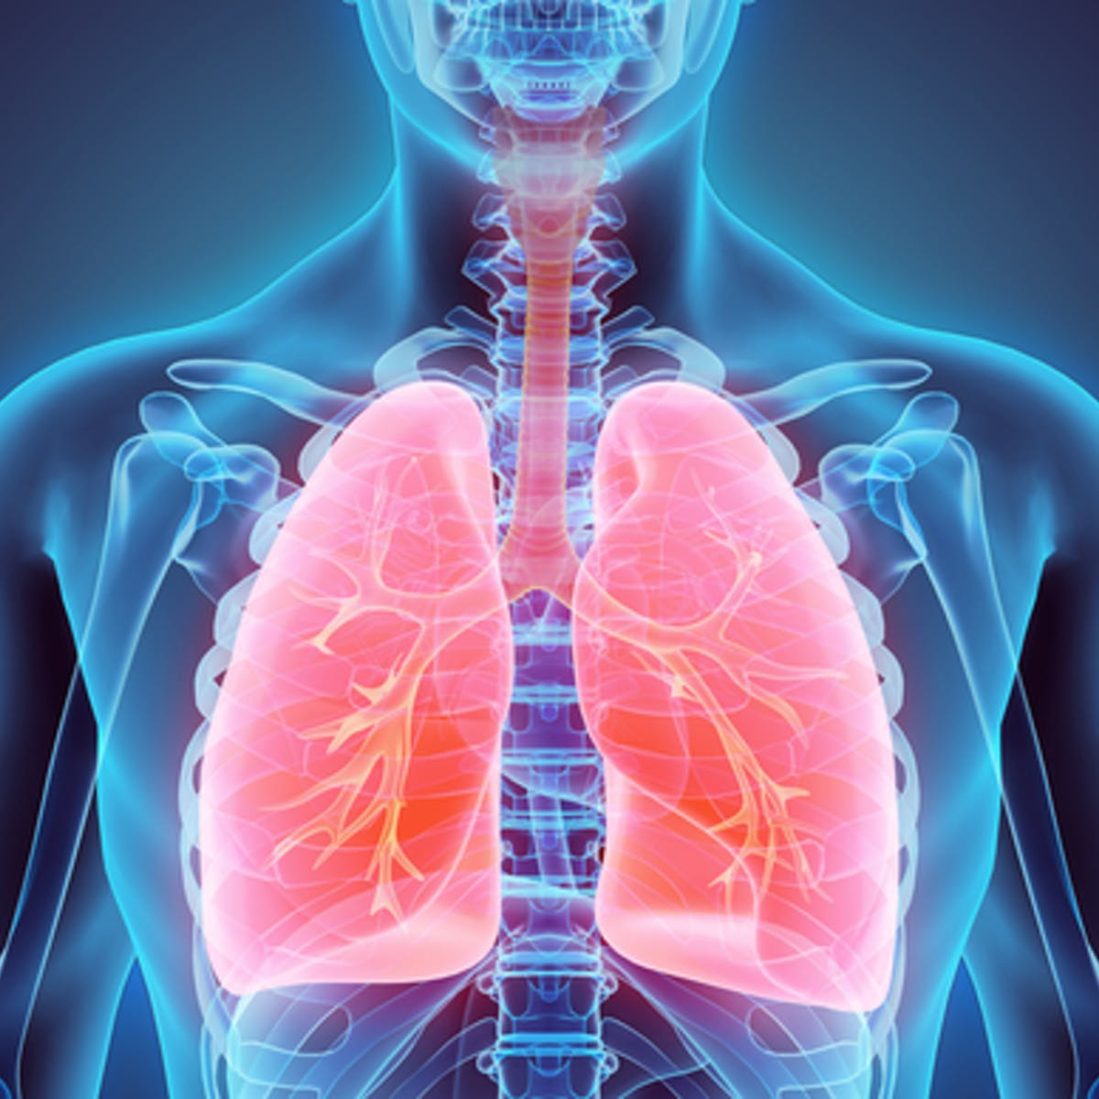
Lungs

Slide 2
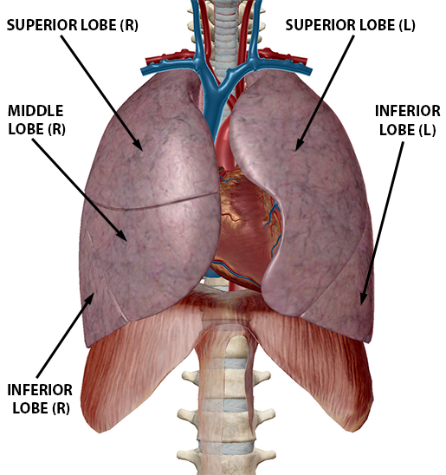
INTRODUCTION
Lungs are the principal organs of respiration situated in the thoracic cavity .
It occupies major portion of thoracic cavity leaving a little space for heart
The two lungs holds the heart tight between them providing protection
The right & left lungs are located on either side of mediastinum enclosed in pleural sac.

Slide 3
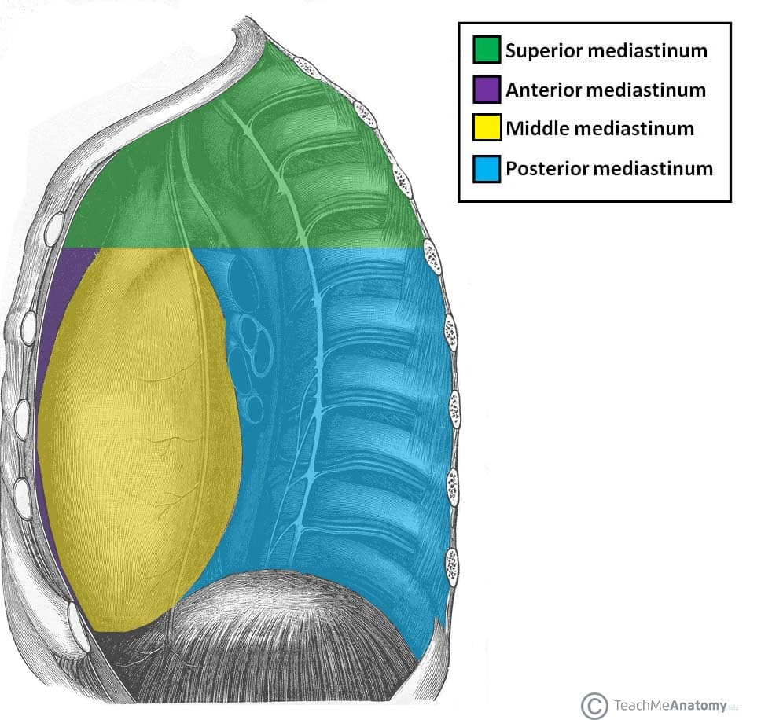
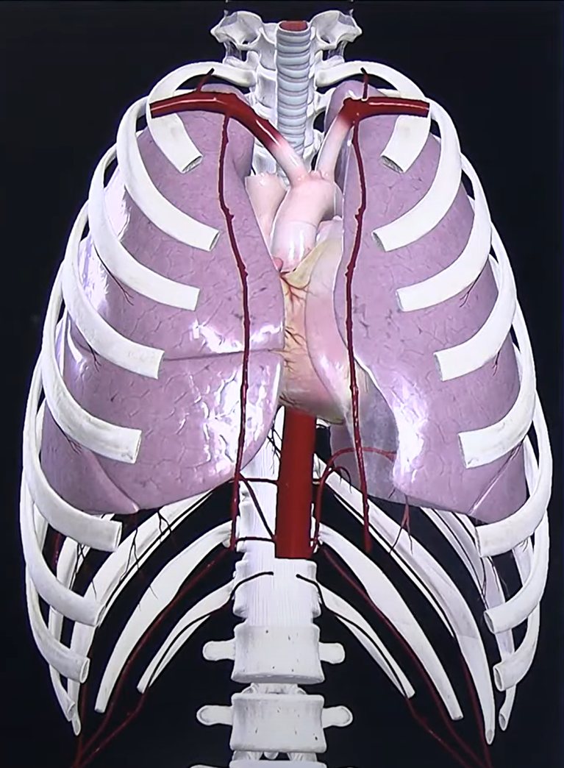

Slide 4
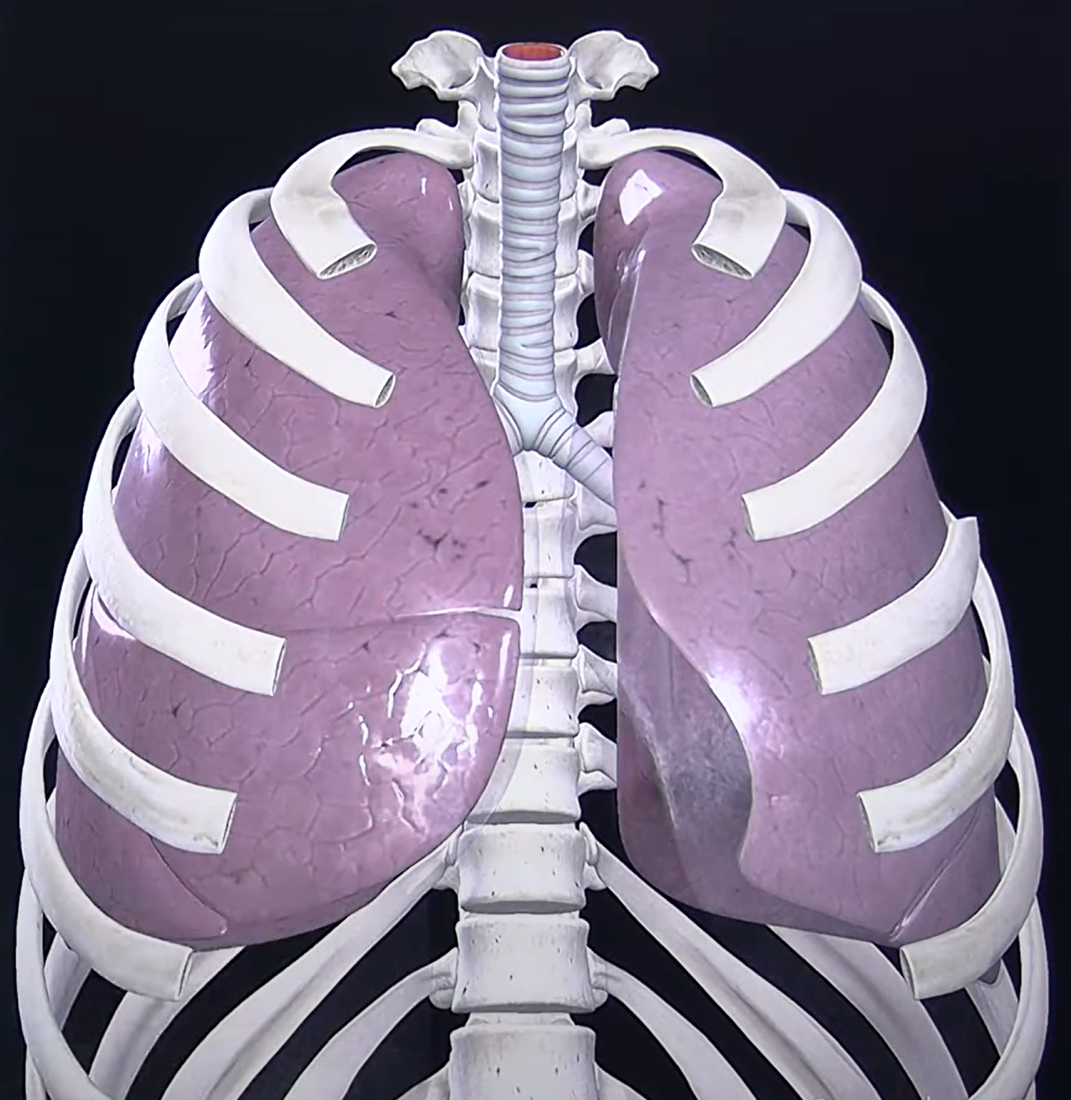
TEXTURE AND WEIGHT
Spongy in texture
In newborns ,rosy pink in colour
In young , brown or grey in colour
Gradually becomes mottled black because of deposition of inhaled carbon particles
Right lung – 700 gm
Left lung - 600-650 gm

Slide 5
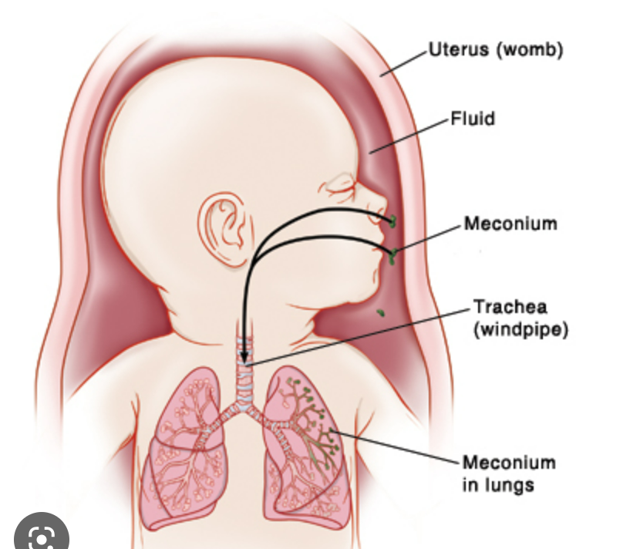

Slide 6
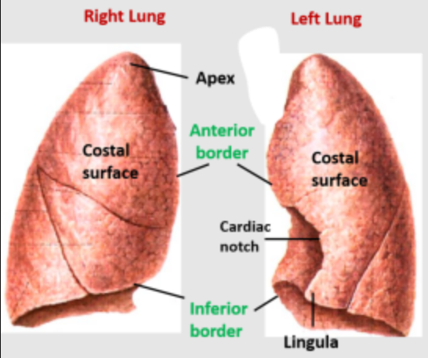
External Features of lungs
Conical in shape
Apex
Base
3 borders -anterior ,posterior ,inferior
2 surfaces - costal , medial

Slide 7
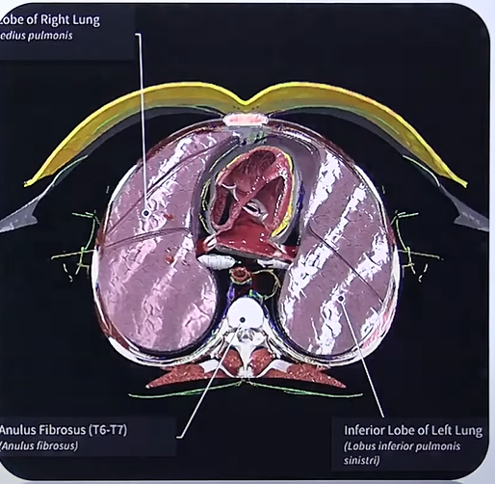

Slide 8
Side determination
The conical end or apex is directed upwards.
The broader base is directed downwards.
The convex surface or costal surface is outwards and comes in contact with ribcage.
The medial surface presenting hilum is directed inwards.
Its thin margin is the anterior border so it should face forwards.
Cardiac notch present on left side.
The posterior border is rounded and should face backwards.
The right lung has three lobes and the left lung has two lobes.

Slide 9
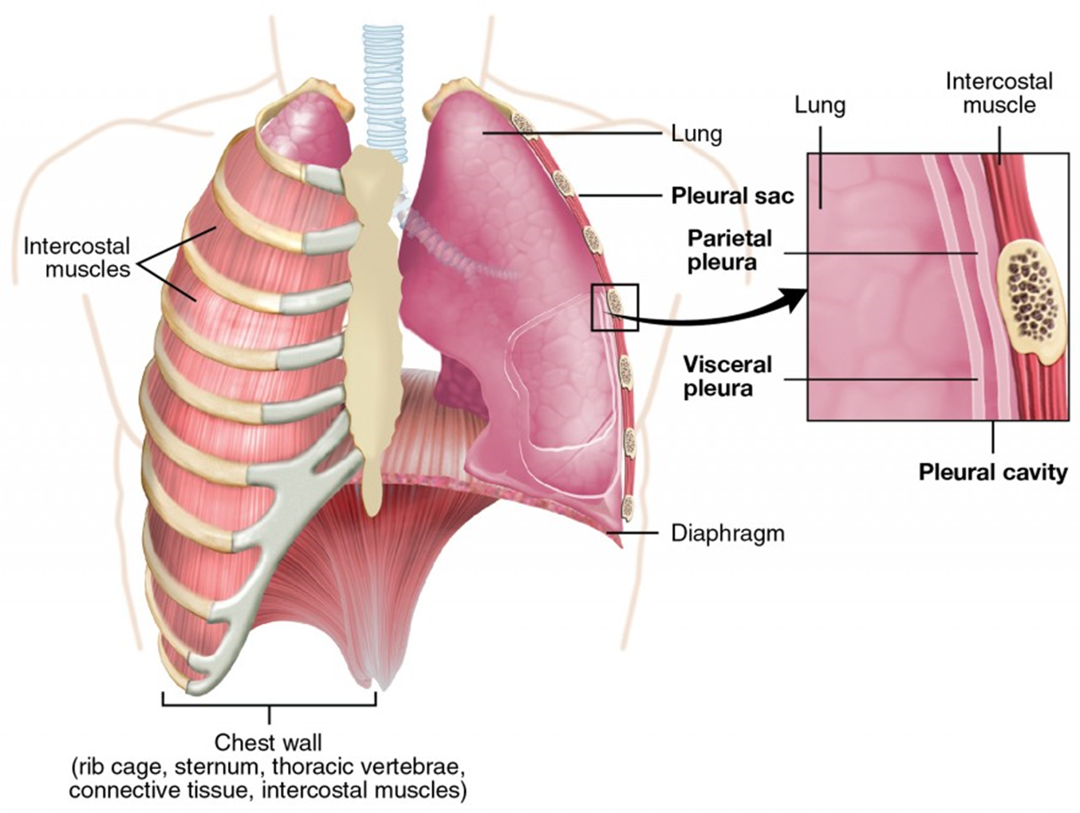
Apex
Rounded /Blunt superior end
Extends to root of neck
Lies above the level of anterior end of 1st rib
Reaches nearly 2.5 cm above the medial 1/3rd of clavicle
Covered with cervical pleura & suprapleural membrane
Apex is grooved by subclavian artery on medial side & in front
Posteriorly related to neck of 1st rib

Slide 10
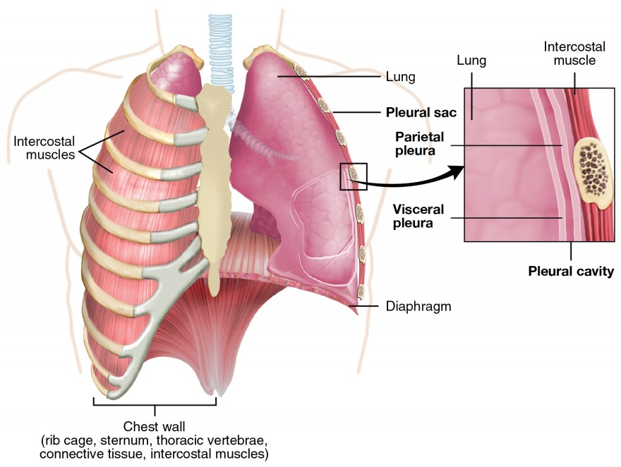
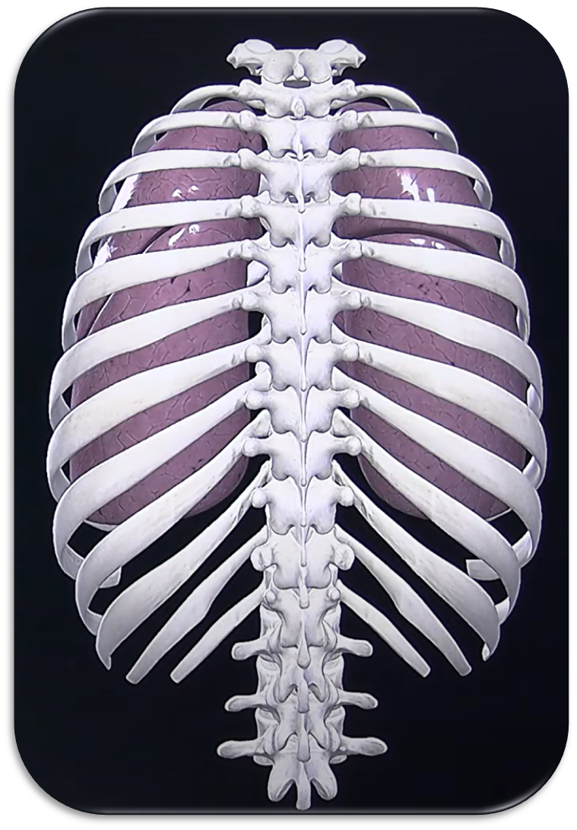
APEX

Slide 11
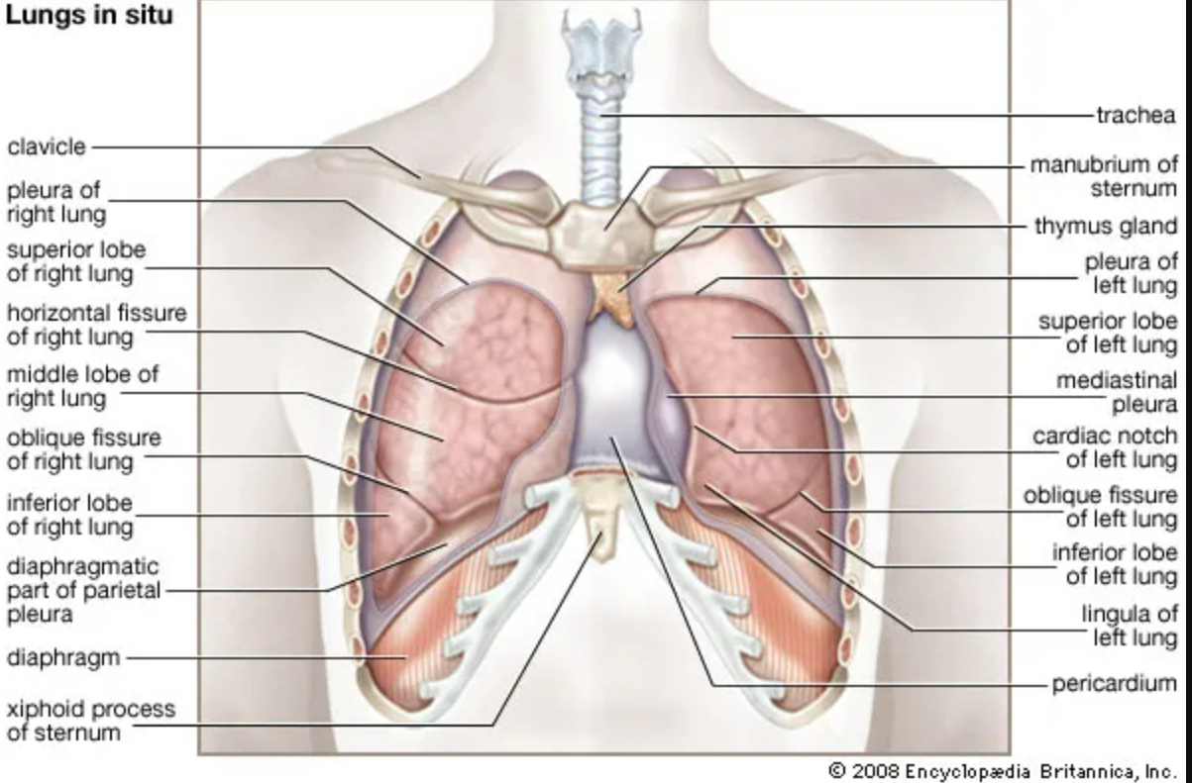

Slide 12
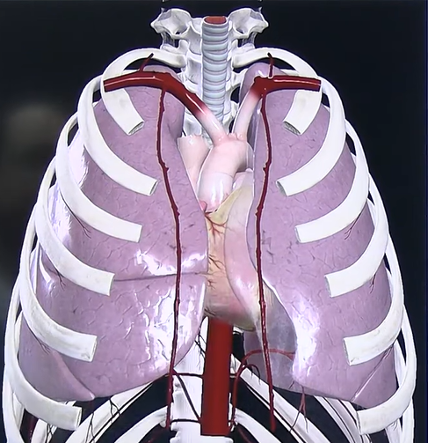
RELATIONS OF THE APEX
Anterior relations of the apex
Subclavian artery
Origin of internal thoracic artery ( starts from the subclavian artery )
Insertion of scalenus anterior

Slide 13
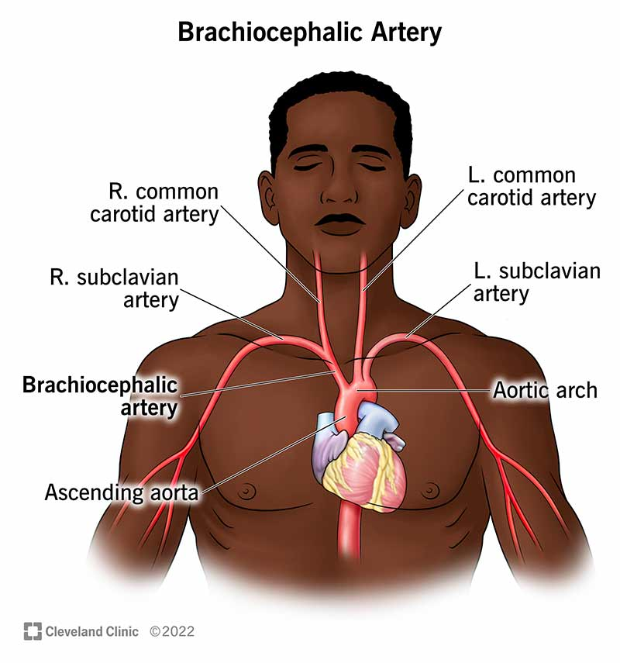

Slide 14
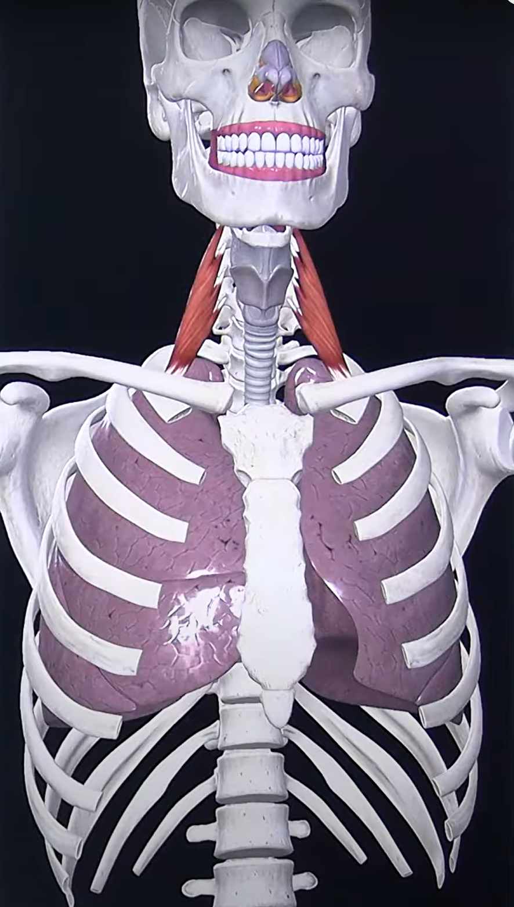

Slide 15
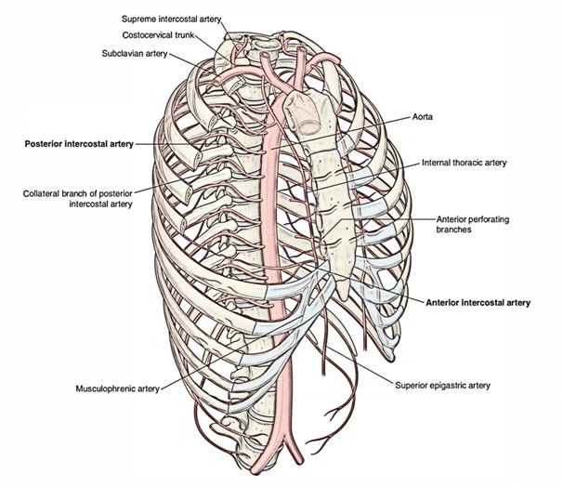
POSTERIOR RELATION OF THE APEX
Apex is in contact with neck of 1st rib and structures in front of it (medial to lateral) are
1. Sympathetic chain
2. First posterior intercostal vein
3. Superior intercostal artery
4. Ventral ramus of first thoracic nerve.

Slide 16
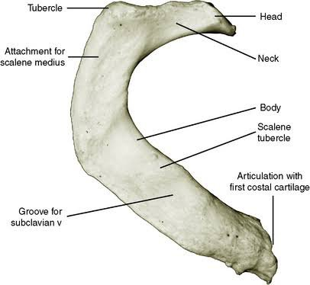

Slide 17
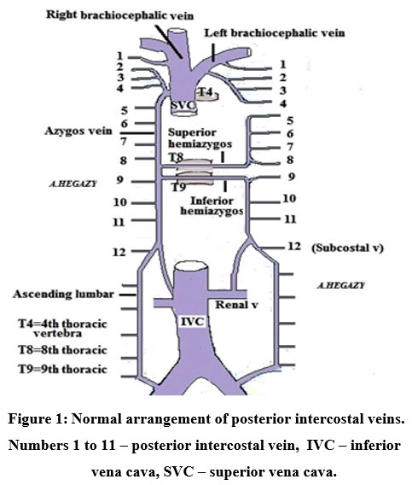
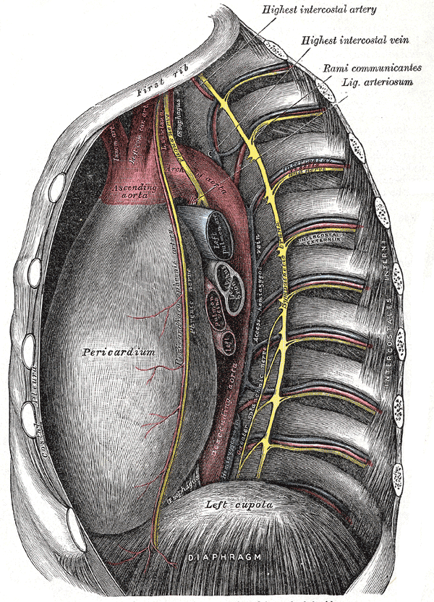
Posterior intercostal vein and arteries

Slide 18
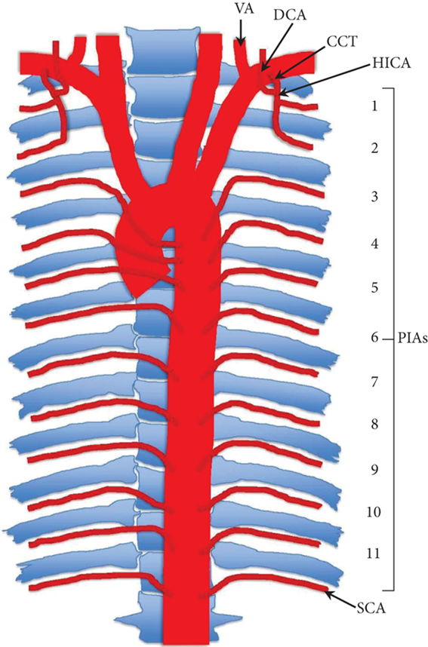

Slide 19
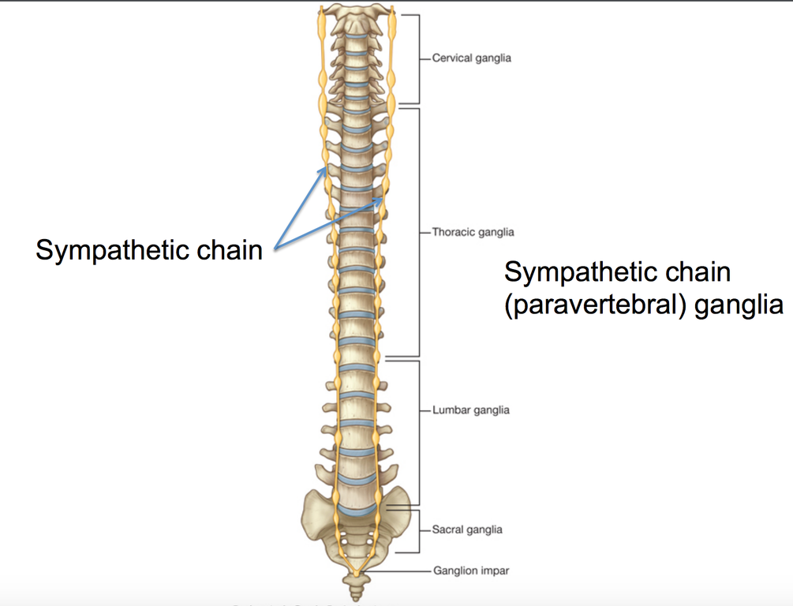
Sympathetic trunk

Slide 20
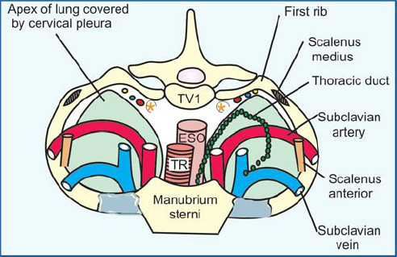
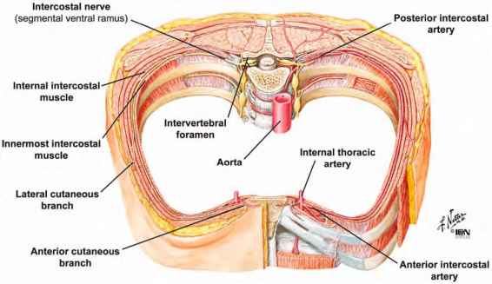
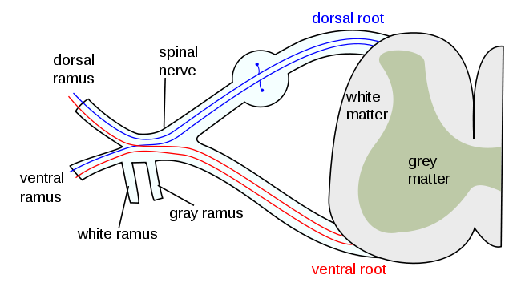

Slide 21
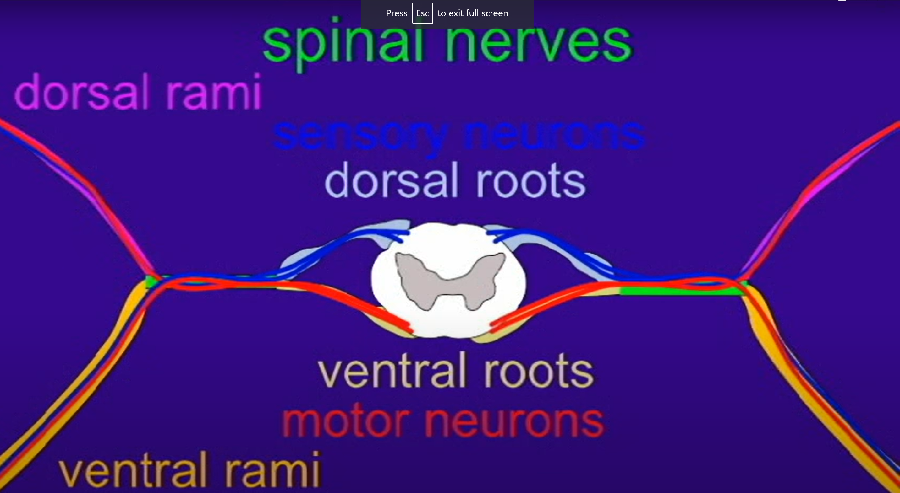

Slide 22
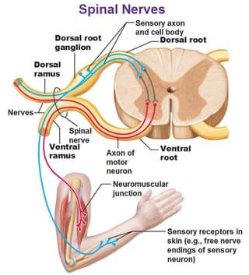
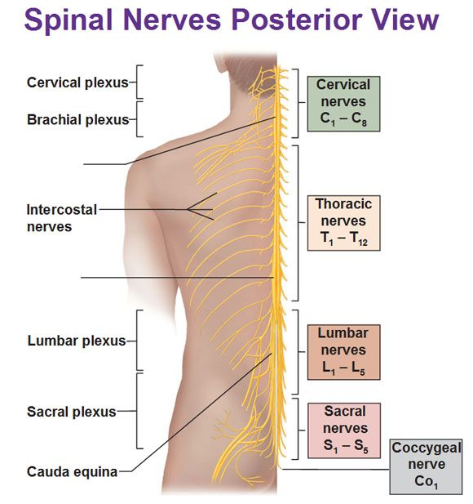

Slide 23
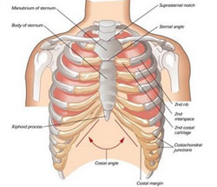
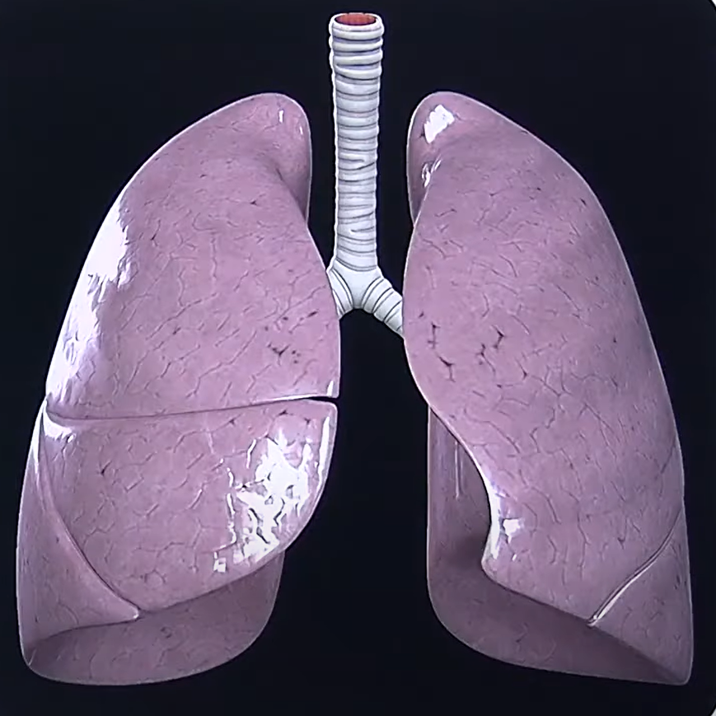
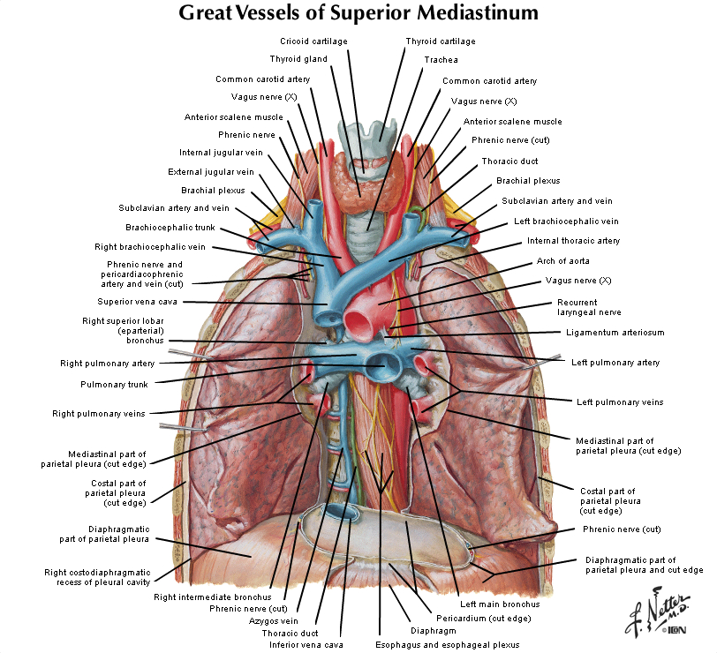

Slide 24

Medial relations of the apex
Right lung:
Right brachio-cephalic vein
Brachio-cephalic trunk
3. Right Pericardio-phrenic vessels
4. Right phrenic nerve
5. Trachea.

Slide 25
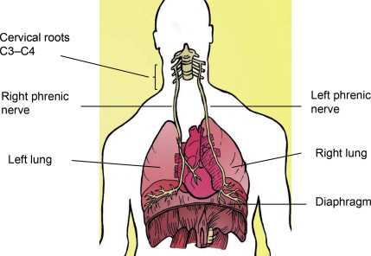

Slide 26
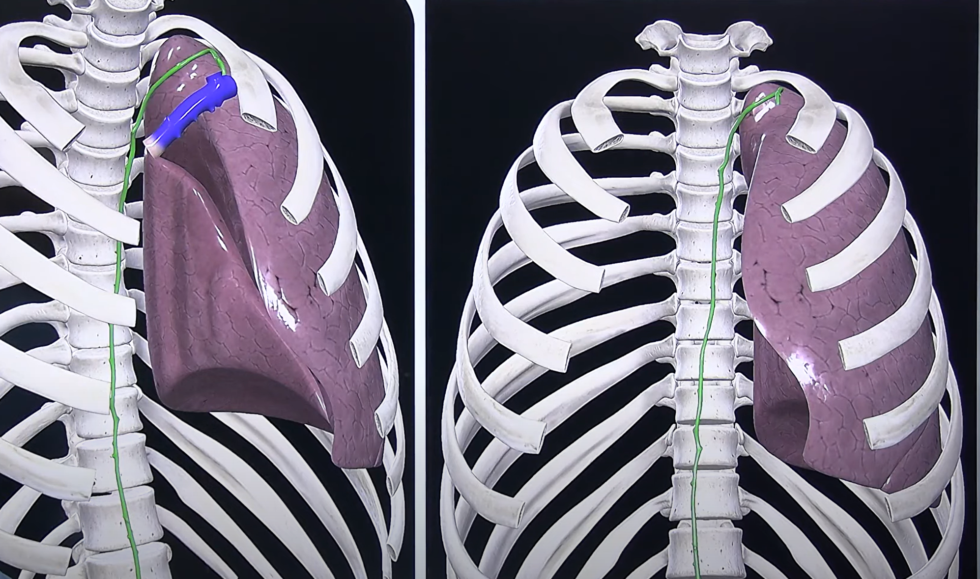
Medial relations of the apex
Left lung:
Left brachio-cephalic vein
Left subclavian artery
Left edge of esophagus
4. Thoracic duct

Slide 27
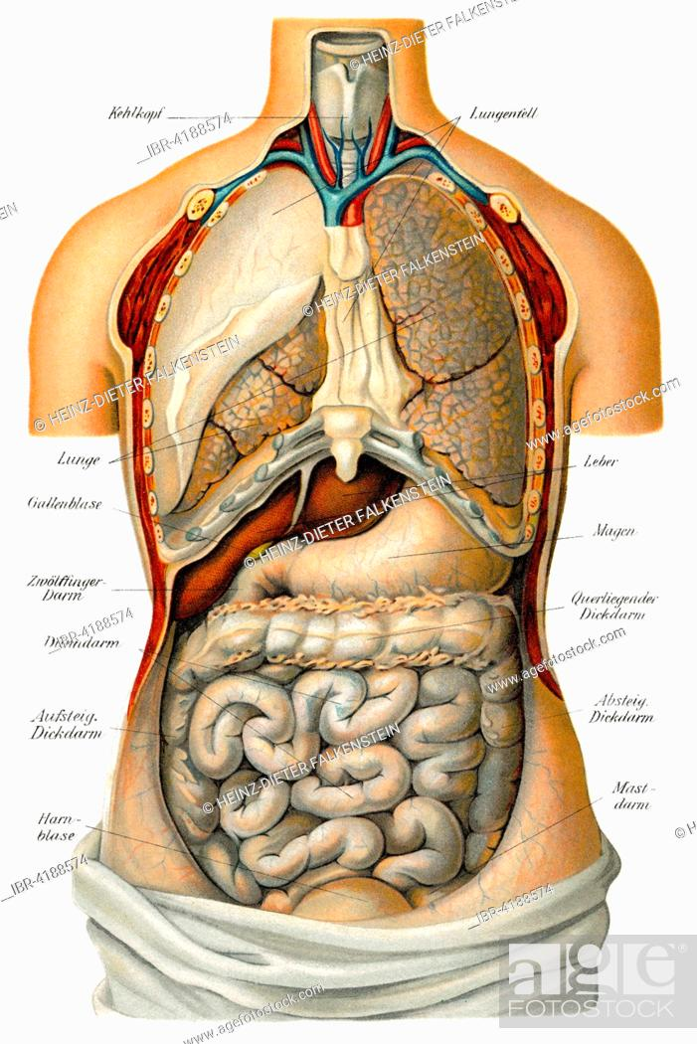
Base
Lower semilunar concave surface that rest on dome of diaphragm
Also known as diaphragmatic surface
Relations
Right side -lung separated from liver by diaphragm
Left side - lung separated from spleen & fundus of stomach

Slide 28
Base

Slide 29
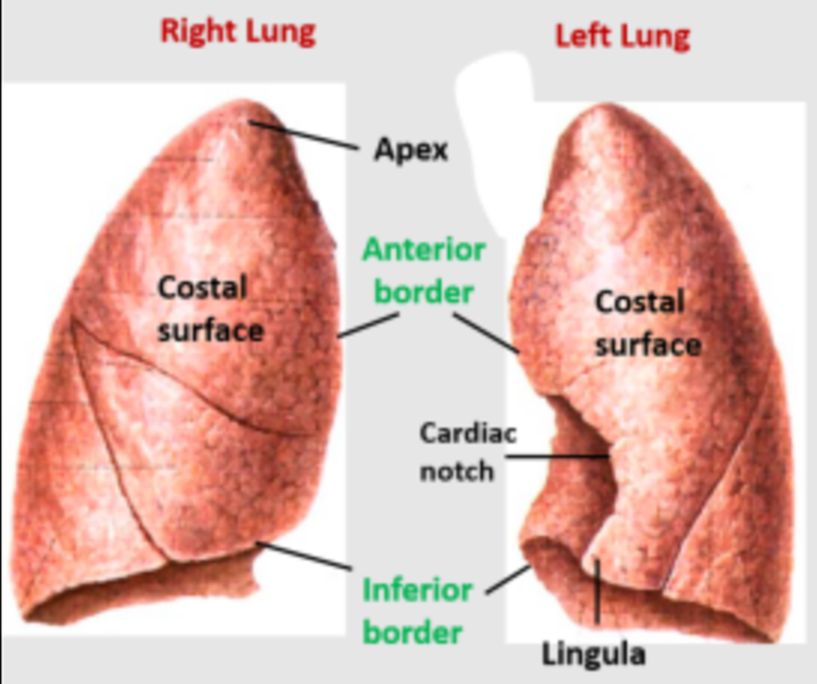
Borders
Anterior -thin & shorter than posterior border
In right lung – anterior border is vertical
In left – anterior border presents a wide cardiac notch ,occupied by heart & pericardium
Below the notch ,it presents a tongue shaped projection called lingula

Slide 30

Anterior border of the left lung
The anterior border of left lung presents a wide cardiac notch below the level of 4th costal cartilage, which is occupied by the heart and pericardium.
In this region, the heart and pericardium are not covered by the lung
Hence this region is responsible for an area of superficial cardiac dullness.
Below the cardiac notch, it presents a tongue-shaped projection called lingula.

Slide 31
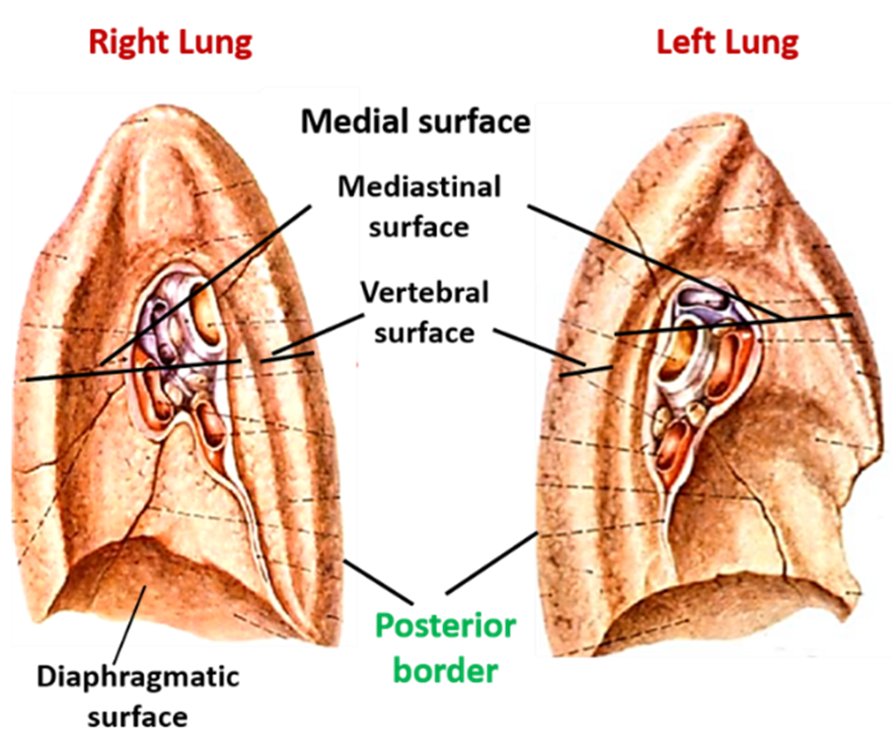
Posterior –thick & rounded ,extends from spine of C7 vertebra to spine of T10 vertebra
Inferior – it is semilunar in shape & separates the base from costal & medial surface

Slide 32
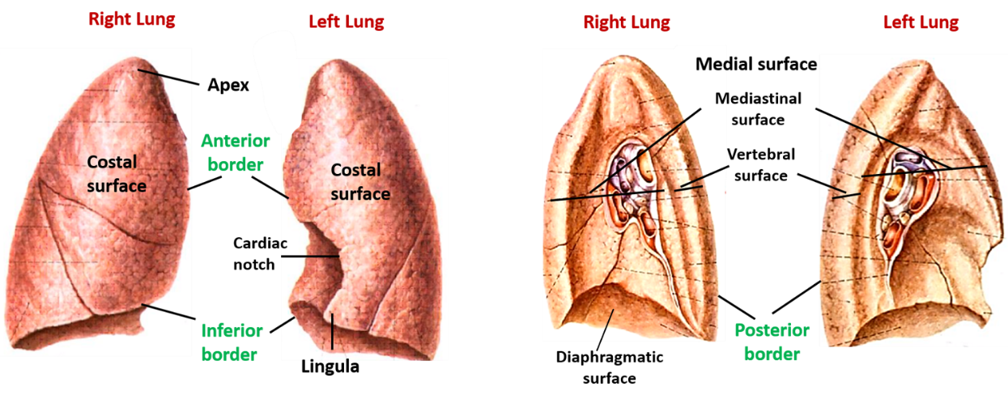
Borders & surfaces

Slide 33
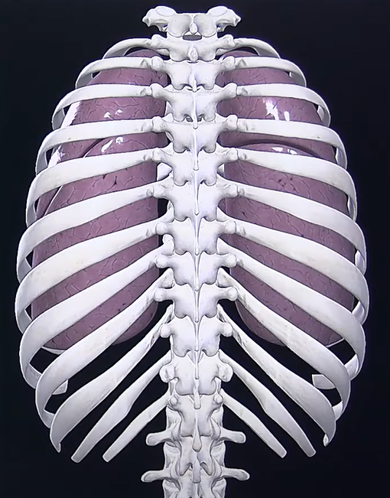
Costal surface
–Large ,smooth & convex ,covered by costal pleura & endothoracic fascia
RELATIONS• It is related to the lateral thoracic wall. (In embalmed lung impressions of the ribs are present.)
• The number of ribs related to this surface is as follows:
Upper 6 ribs in midclavicular line
Upper 8 ribs in midaxillary line.
Upper 10 ribs in scapular line:

Slide 34
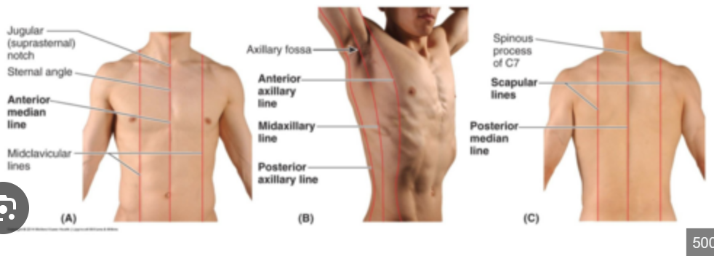
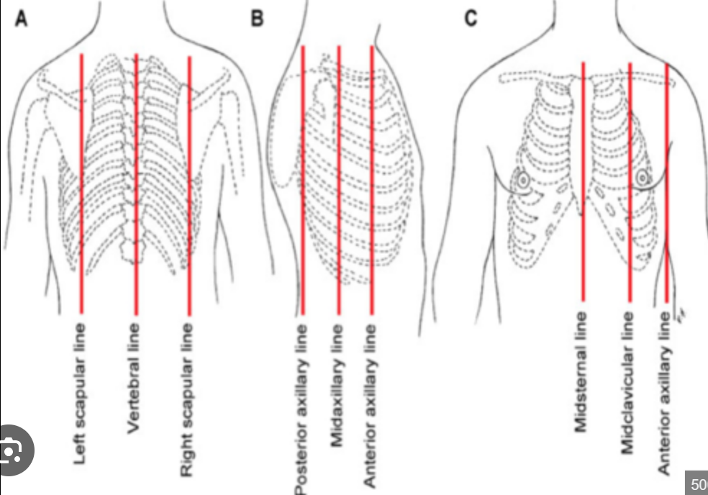

Slide 35
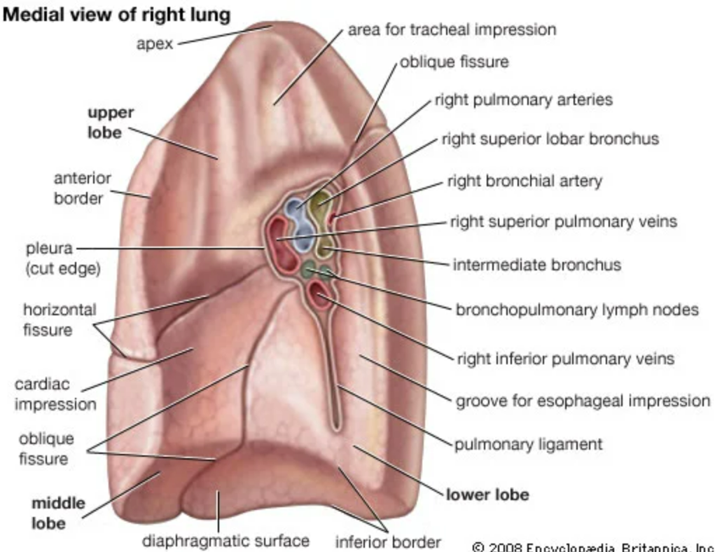
Medial surface
– divided into 2 –
small posterior part –vertebral part
large anterior part - mediastinal part

Slide 36
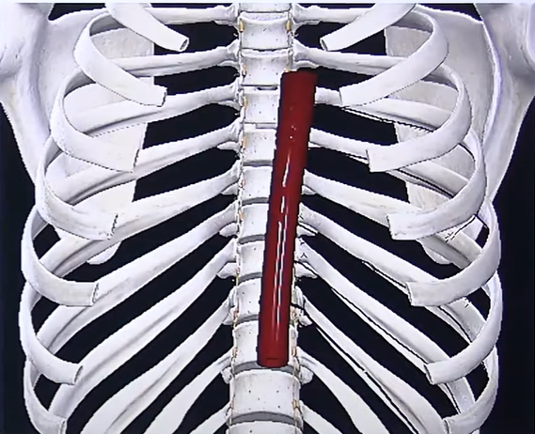
Relations of the medial aspect
Relations:
The vertebral part is flat and related to:
The upper 10 thorac's vertebral bodies,
Posterior intercostal vessels,
and
3. Greater and lesser splanchnic nerves.

Slide 37
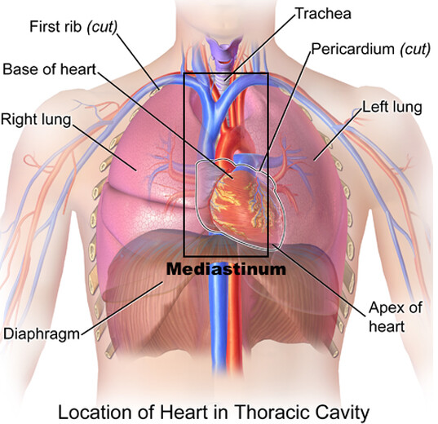
Mediastinal part
Mediastinal part presents hilum ,related to mediastinal structures –heart ,great vessels & nerves

Slide 38
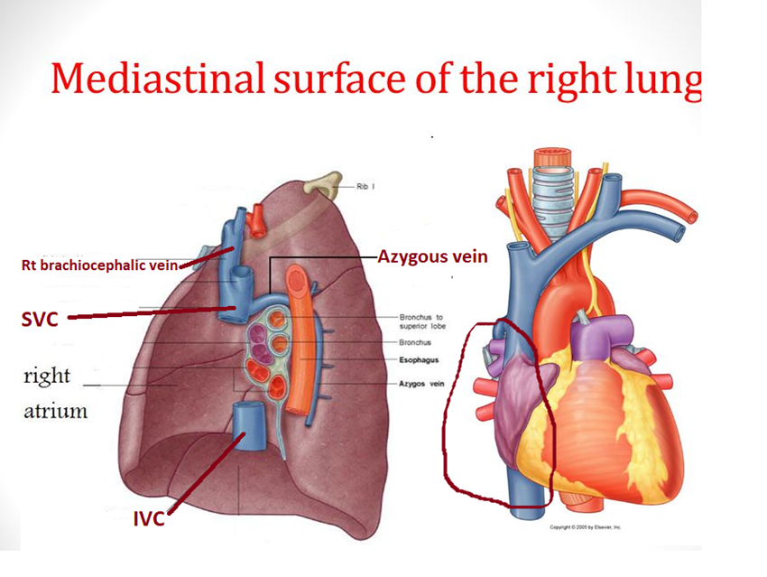
Mediastinal surface of right lung
Right atrium
Superior & inferior venacava
Azygous vein
Right brachiocephalic vein
Oesophagus & trachea
Right phrenic,vagus & symphathetic chain

Slide 39
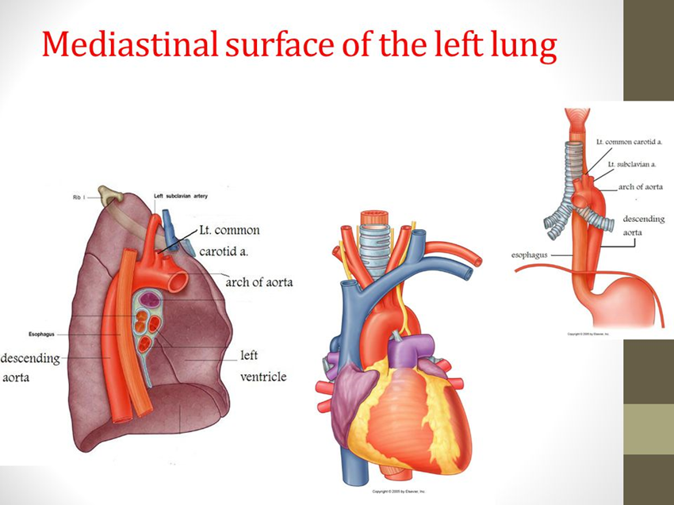
Mediastinal surface of left lung
Left ventricle
Ascending aorta
Arch & descending aorta
Left common carotid & left subclavian artery
Oesophagus
Thoracic duct
Left phrenic,vagus,recurrent laryngeal , sympathetic chain

Slide 40
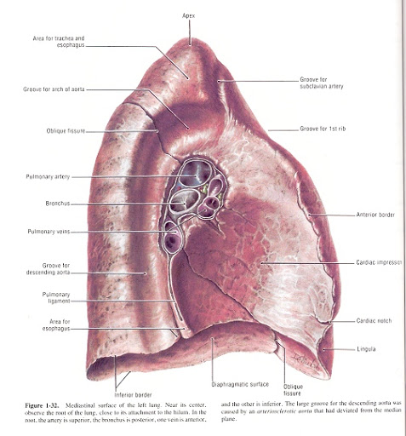

Slide 41
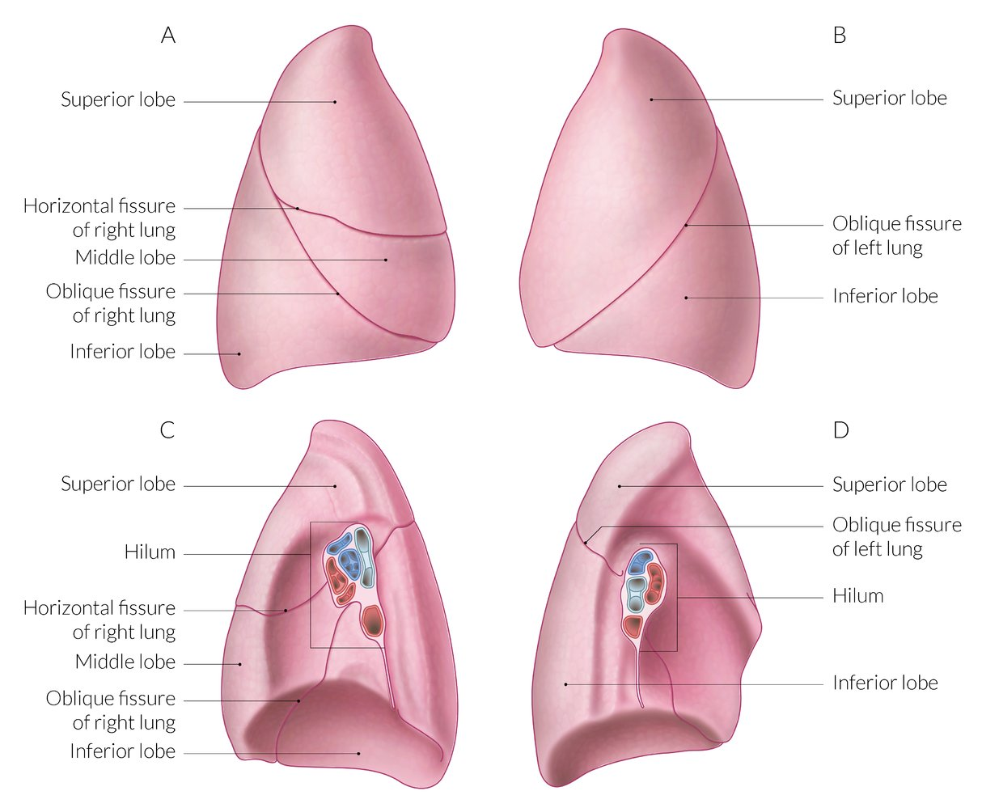
Lobes
Right lung is divided into three lobes by 2 fissures
Lobes - superior ,middle & inferior lobes
Fissures – oblique & horizontal
Left lung is divided into two lobes by 1 fissure
Lobes - superior & inferior
Fissure - oblique

Slide 42
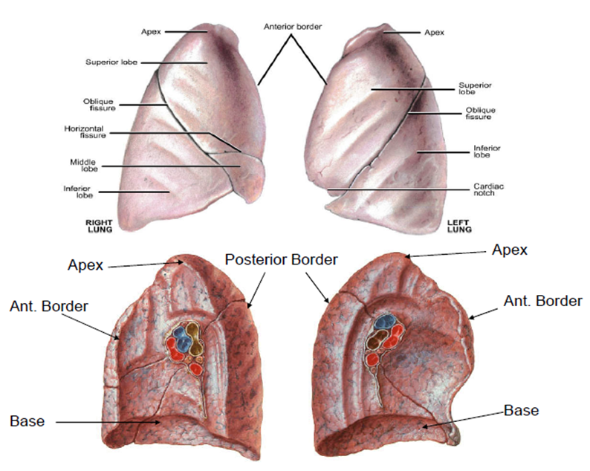

Slide 43
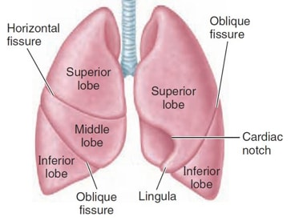
Fissures & lobes
Oblique fissure - Runs downwards & forwards crossing posterior border about 6 cm from apex and inferior border about 7.5 cm from midline .Due to the obliquity ,the lower lobe is more posterior & upper and middle lobes are anterior
Horizontal fissure – only in right lung .starts from oblique fissure at midaxillary line & runs horizontally forwards to anterior border of lung at the level of 4th costal cartilage .It separates superior & middle lobes

Slide 44
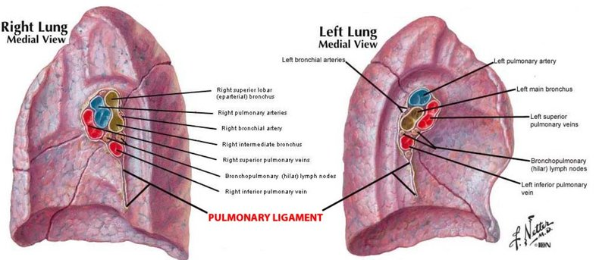
Hilum of lungs
Hilum is the area on mediastinal surface of lung through which structures enter or leave the lung

Slide 45
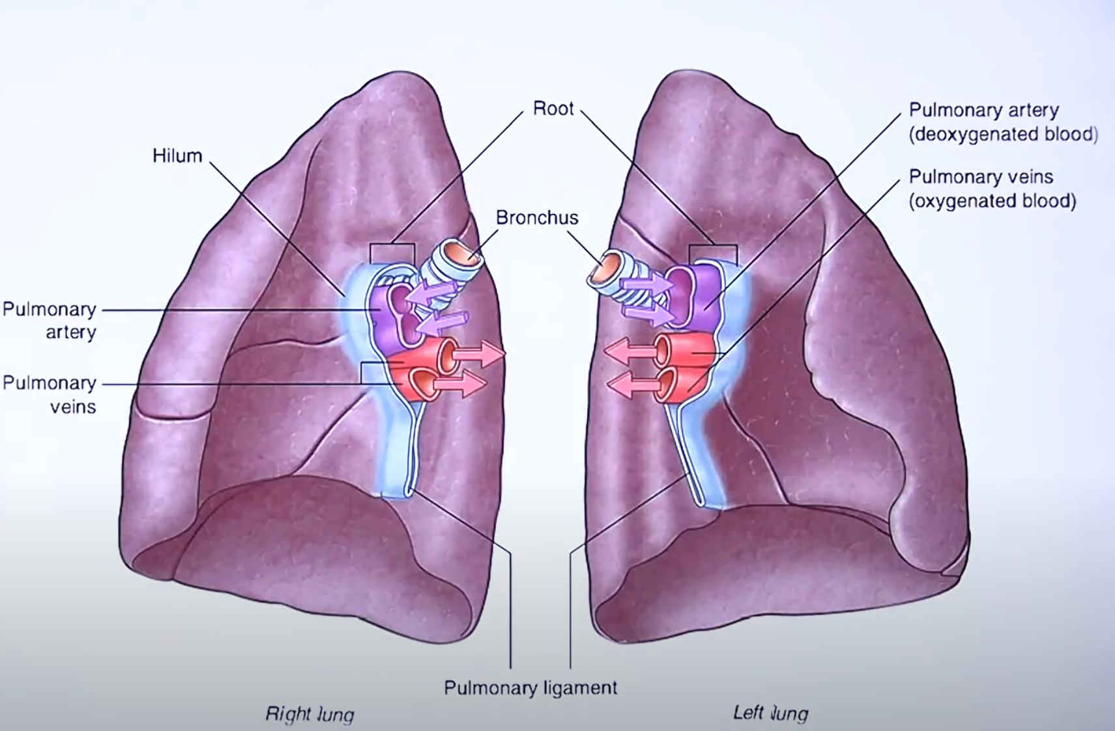
Root
The root is a short broad pedicle connecting the medial surface of the lung with mediastinum
.It consists of structures entering & leaving the lung at the hilum .Lies opposite the bodies of 5th ,6th & 7th thoracic vertebra
Root of lung is surrounded by a tubular sheath derived from mediastinal pleura

Slide 46
Components of root
Principal bronchus in left lung ,eparterial and hyparterial in right lung
Pulmonary artery
Pulmonary veins (2 in number )
Bronchial artery ( 1 in right side, 2 on left )
Bronchial veins
Lymphatics
Anterior & posterior pulmonary plexus of nerves

Slide 47


Slide 48


Slide 49

Arrangement of structures in root
From before backwards (VAB )
Pulmonary vein ( superior )
Pulmonary artery
Bronchus

Slide 50
From above downwards
Right – eparterial bronchus
Pulmonary artery
Hyparterial bronchus
Inferior pulmonary vein
Left – pulmonary artery
Bronchus
Inferior pulmonary vein

Slide 51

RELATIONS OF THE ROOT OF THE LUNG
Anterior:
Phrenic nerve
Anterior pulmonary plexus.
Superior vena cava (on right side only).
Posterior:
Vagus nerve
• Posterior pulmonary plexus
Descending thoracic aorta (on left side only).
Superior:
• Arch of azygos vein (on right side only
• Arch of aorta (on left side only).
Inferior
Pulmonary ligament

Slide 52



Slide 53



Slide 54

Internal structure
Made up of intrapulmonary bronchial tree which is concerned with the conduction of air to & fro from the lung and pulmonary units which are concerned with the gaseous exchange within the lungs .

Slide 55

Principal bronchi
Trachea at the level of T4 divides into 2 principal bronchi –right and left
Right – shorter ,wider and vertical ,2.5 cm long ,25 degree with trachea
Left – narrower ,longer ,more horizontal ,5 cm long ,45 degree with trachea
Left bronchus passes to left below arch of aorta in front of oesophagus
Right passes below arch of azygos vein

Slide 56

Lobar bronchi
Right principal bronchus divides into 3 lobar bronchi ,one for each lobes
Left divides into two lobar bronchi ,one for each lobe of left lung

Slide 57
Segmental bronchi (tertiary )
Lobar divides into segmental for each bronchopulmonary segments (10 on both sides )
Segmental terminal bronchiole respiratory bronchiole
                pulmonary unit

Slide 58

Bronchial tree
Principal bronchus
Secondary Lobar bronchi
Tertiary Segmental bronchi
Terminal bronchioles
Respiratory bronchioles
Pulmonary units- alveolar duct atria
air saccule alveoli

Slide 59


Slide 60


Slide 61

Bronchopulmonary segments
Well defined anatomic ,functional and surgical sectors of lung
Wedge shaped sectors aerated by tertiary bronchi
Subdivision of lobe of lung
Surrounded by connective tissue
Pyramidal with apex directed towards hilum and base towards surface of lung
Each segment has its own artery ,lymphatics ,nerve supply
Drained by intersegmental veins
Surgically resectable

Slide 62
Bronchopulmonary segments
Well defined anatomic ,functional and surgical sectors of lung
Wedge shaped sectors aerated by tertiary bronchi
Subdivision of lobe of lung
Surrounded by connective tissue
Pyramidal with apex directed towards hilum and base towards surface of lung
Each segment has its own artery ,lymphatics ,nerve supply
Drained by intersegmental veins
Surgically resectable

Slide 63


Slide 64



Slide 65
Right
Left
Upper lobe – apical ,anterior , posterior
Middle – lateral ,medial
Lower -superior , medial basal, lateral basal, anteriorbasal,posterior basal
Upper - apical , anterior, posterior, superior lingular, inferior lingular
Lower – superior , medial basal, lateral basal, anteriorbasal,posterior basal

Slide 66


Slide 67


Slide 68


Slide 69


Slide 70



Slide 71

Applied anatomy

Slide 72



Slide 73


