Slide 1
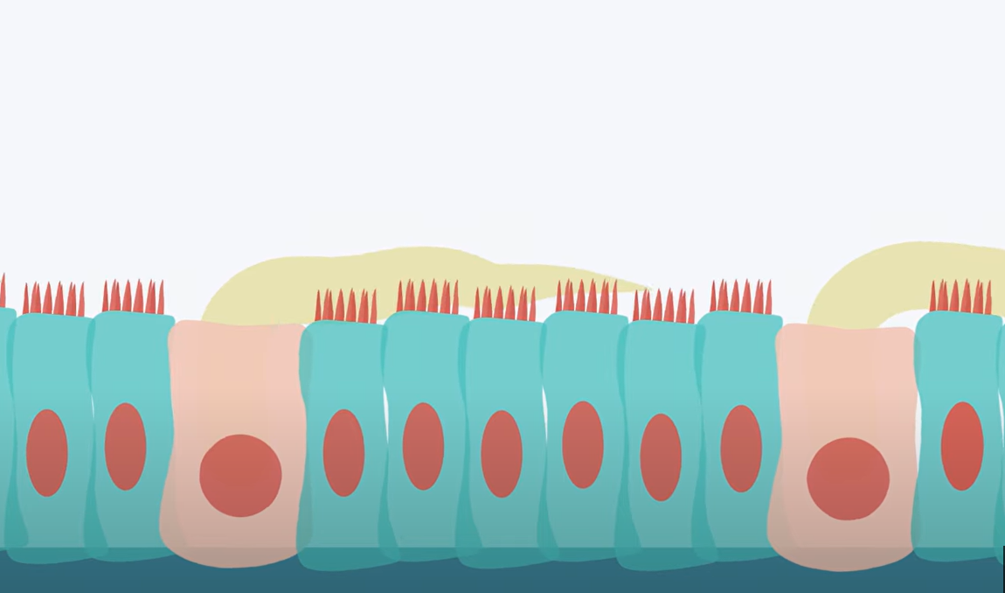
Lungs
Microscopic structure,
Blood supply ,lymphatics innervation

Slide 2
Lung is composed from outside inwards –of
Serous coat
Subserous areolar tissue
Pulmonary substance

Slide 3
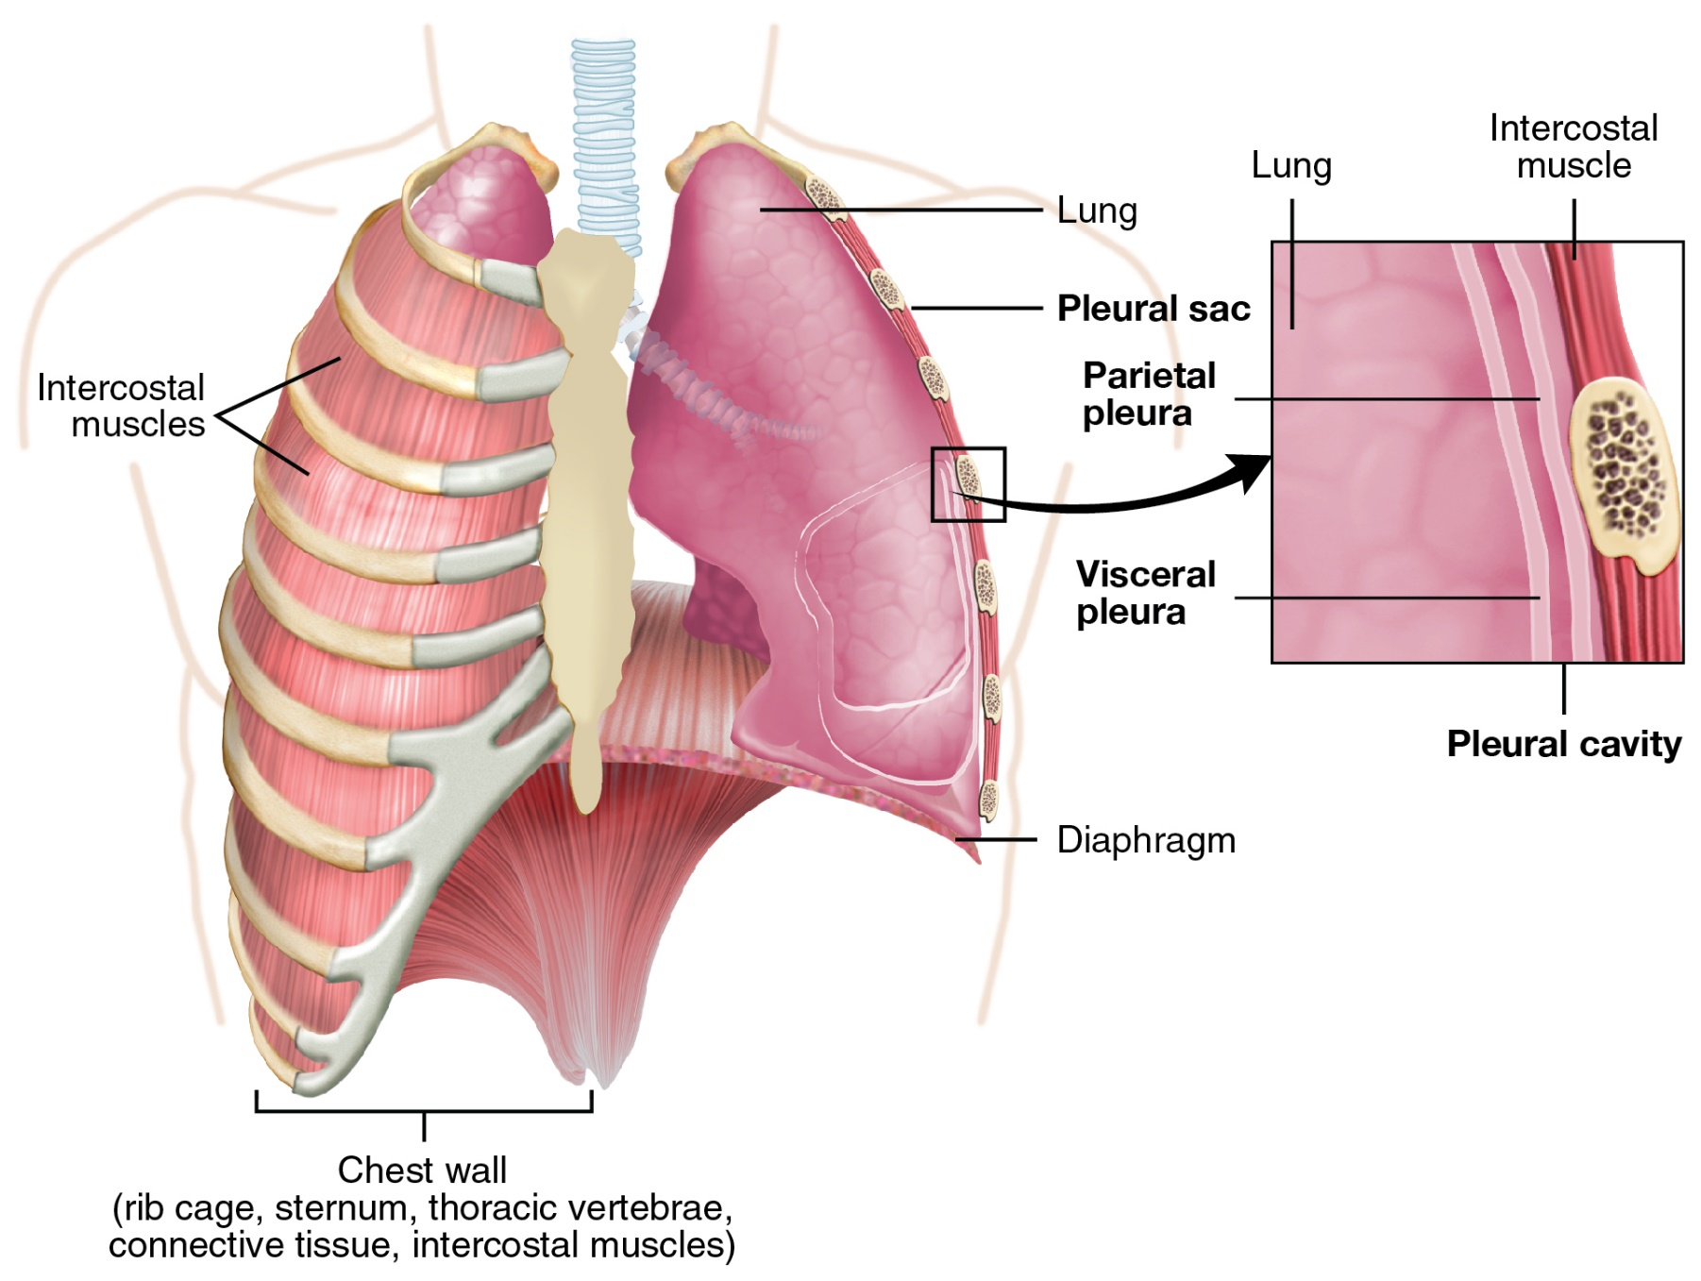
Serous coat
Derived from pulmonary pleura which intimately invests the entire lung except the hilum & pulmonary ligament

Slide 4
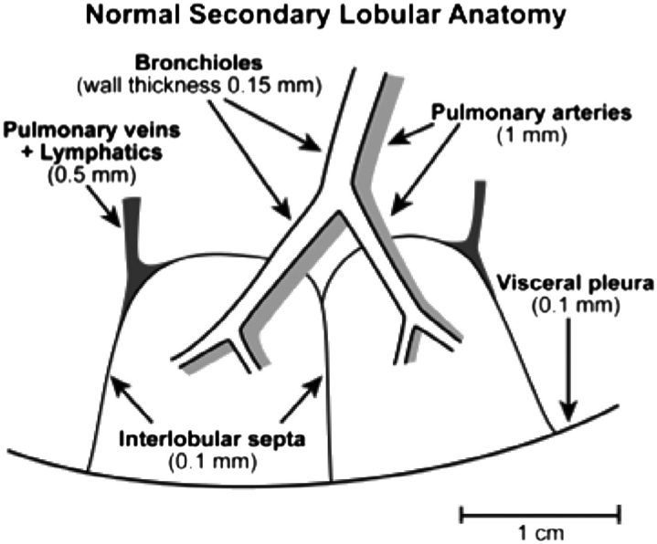
Subserous coat
Consists of elastic fibroareolar tissue which invests the lung & projects into its interior from hilum as numerous fibro-elastic septa .
The space between these septa are known as lung lobules
Each of the lobule receives a preterminal bronchiole
All divisions of the intrapulmonary bronchi run in interlobular septum accompanied by corresponding pulmonary & bronchial vessels

Slide 5
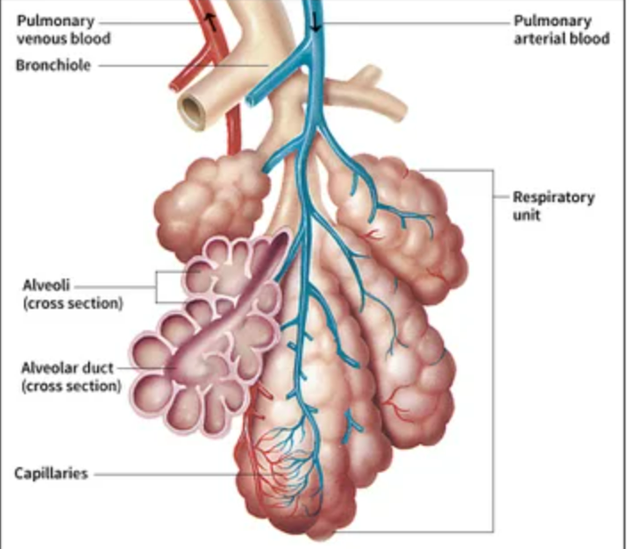
Pulmonary substance
Includes all structures within the lung lobule
Each lobule is provided with one preterminal bronchiole ,terminal bronchiole, respiratory bronchiole ,alveolar duct, atria, alveoli
The area supplied by a terminal respiratory bronchiole is known as lung unit or pulmonary unit
23 orders of division are encountered from principal bronchus to the alveoli

Slide 6
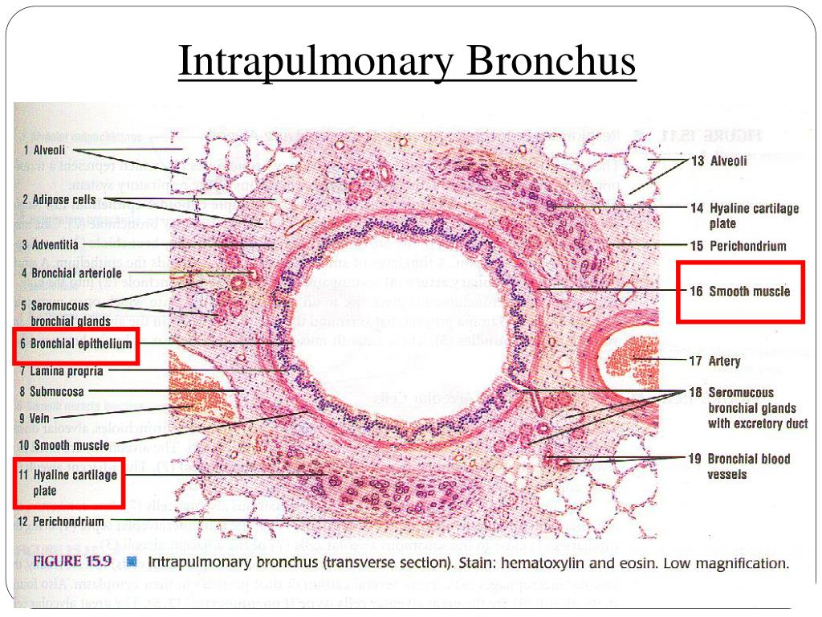
Structure of bronchus
From outside inwards –
Fibroelastic coat
Irregular plates of hyaline cartilage
Submucous coat (mucous & serous glands
Involuntary bronchial muscles
Mucous membrane & lamina propria

Slide 7
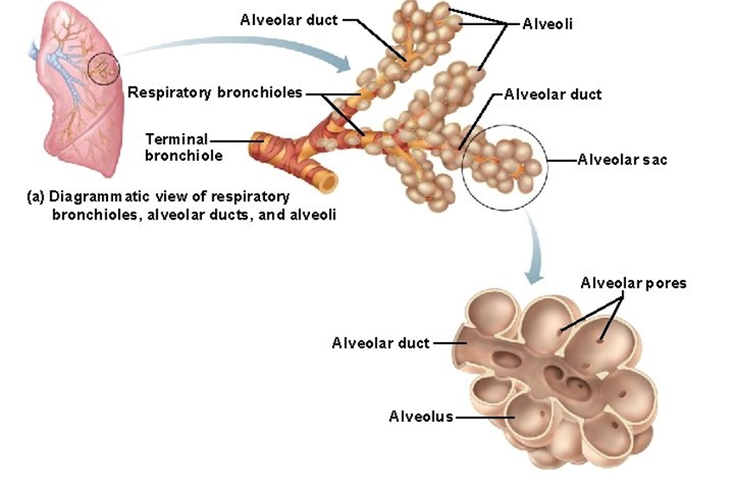
Terminal bronchiole is less than 1 mm in diameter .lined by columnar epithelium .Cartilage and glands are absent .lamina propria contains elastic & smooth muscles
Respiratory bronchiole is lined by cuboidal epithelium .The wall contains connective tissue with elastic & smooth muscle fibres .
Alveoli are thin walled polyhedral sacs, lined by squamous epithelium . The main support is by elastic fibres .
2 types of cells – type I pneumocytes & type II Pneumocytes (secrete surfactant wich lowers surface tension & prevents alveoli from collapsing )

Slide 8
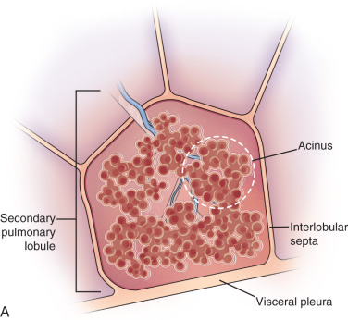


Slide 9
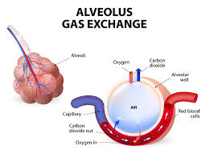
The alveoli within the lung units are lined by simple squamous epithelium resting on basement membrane & surrounded externally by intense pulmonary capillary plexus .
Exchange of gases takes place through the lung units
All lung units make up the respiratory part of lung whereas intrapulmonary bronchial tree upto beginning of respiratory bronchioles are known as conducting part

Slide 10
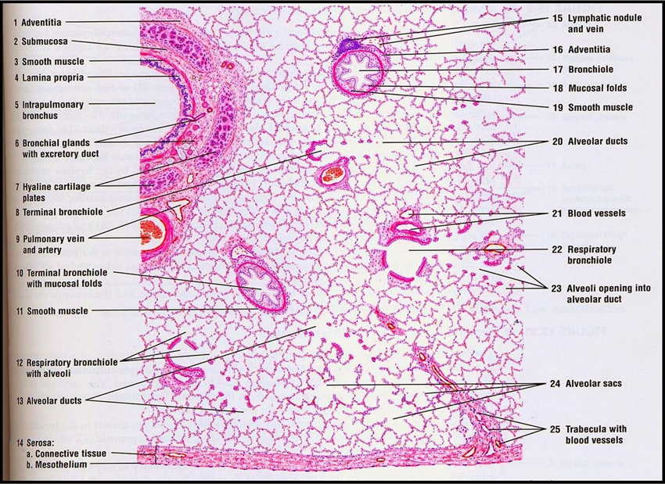
Air – blood barrier
Flattened epithelium of alveoli
Basement membrane upon which epithelium rests
Basement membrane for capillary endothelium
Flattened endothelium of capillaries

Slide 11
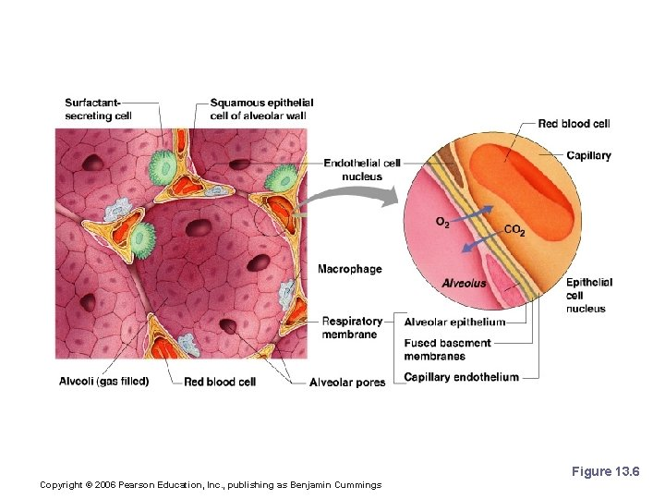
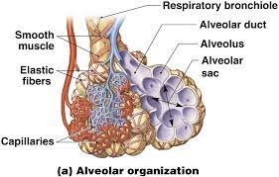

Slide 12
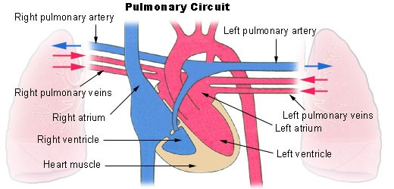
Pulmonary vessels
Pulmonary arteries
Each lung provided with 1 pulmonary artery
Within the lungs the branches of pulmonary artery follow the division of bronchial tree & supply the corresponding bronchopulmonary segments

Slide 13
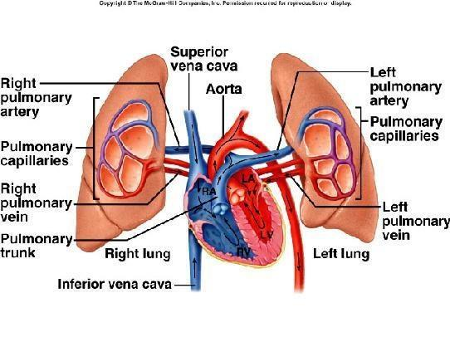
Pulmonary veins
Each lung presents two pulmonary veins ,upper & lower
Upper vein on right –drains upper & middle lobes
Left lung – only upper
Lower vein – lower lobes
Pulmonary veins begin from pulmonary capillary plexus & terminate directly into left atrium

Slide 14
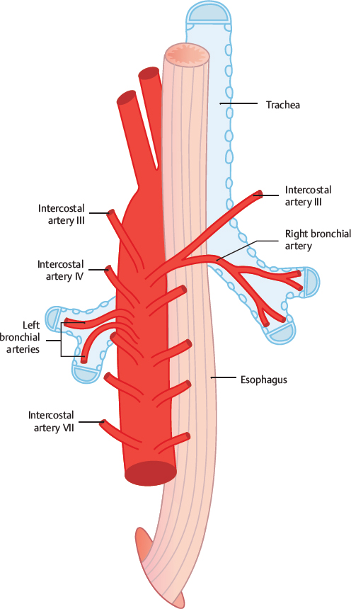
Nutrition of lungs
From two sources –bronchial arteries ,pulmonary arteries
Bronchial arteries - upto the beginning of respiratory bronchioles
Pulmonary arteries – respiratory part
Bronchial arteries – on right side -1 bronchial artery
on left side – 2 bronchial arteries

Slide 15
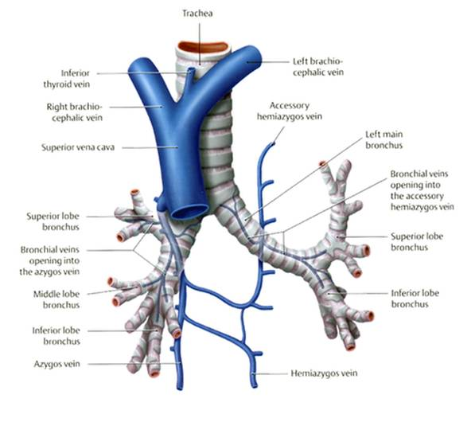
Bronchial & pulmonary veins
2 systems – superficial & deep
Superficial veins – from pulmonary pleura ,extrapulmonary& lobar bronchus
- Drained by bronchial veins (2 bronchial veins )
On right side drains into azygos ,on left into left superior intercostal vein or superior hemiazygos
Deep veins – from intrapulmonary bronchus & bronchioles ,terminate into pulmonary veins or directly into left atrium

Slide 16
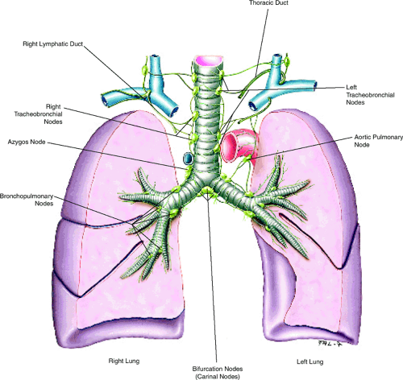
Lymphatics
2 sets of lymphatics – drains to bronchopulmonary nodes
Superficial vessels- drain the peripheral lung tissue
Deep vessels - drain bronchial tree ,pulmonary vessels,& connective tissue septa -drains to bronchopulmonary nodes

Slide 17
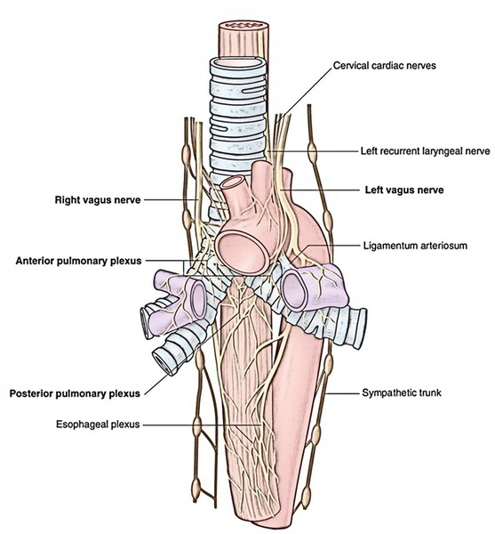
Nerve supply
Parasympathetic nerves – vagus
( motor to bronchial muscles ,secretomotor to mucous glands , cough & stretch reflex pass through sensory fibres )
Sympathetic nerves - from 2nd to 5th sympathetic ganglion
Both sympathetic & parasympathetic nerves form anterior & posterior pulmonary plexus ,in front & behind the lung roots. From the plexus the nerves are distributed to the lungs

Slide 18
Thank you

