Slide 1
liver

Slide 2
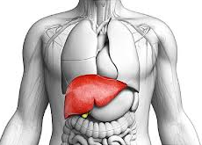
Introduction
Liver is a large, solid, gland situated in the right upper quadrant of the abdominal cavity.
Liver is the largest gland in the body. It secretes bile and performs various other metabolic functions.
Liver is also called the 'hepar' from which we have the adjective 'hepatic' applied to many structures connected with the organ

Slide 3
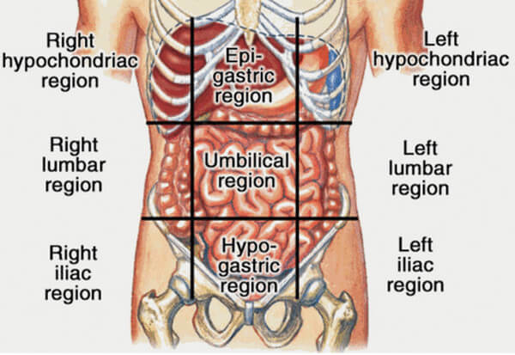
Location
Liver occupies the whole of the right hypo-chondrium, the greater part of the epigastrium, and extends into the left hypochondrium reaching up to the left lateral line.

Slide 4
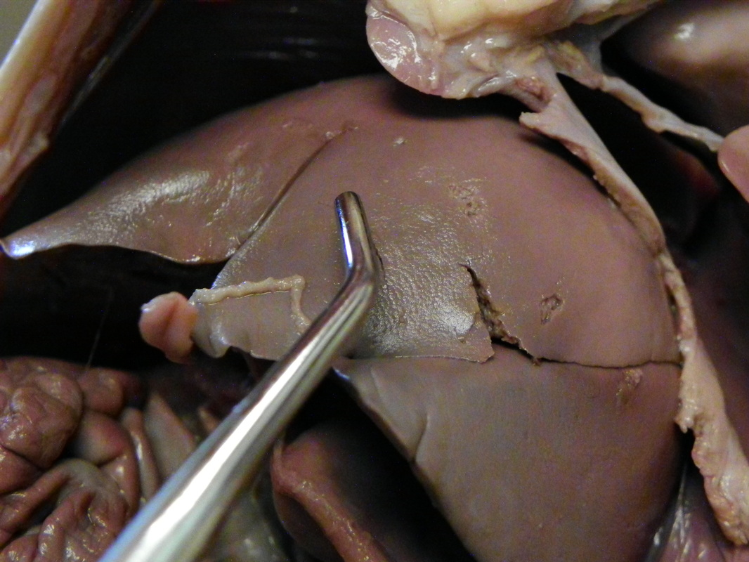
Texture and colour
. In the living subject, the liver is reddish brown in colour, soft in consistency, and very friable.
It weights about 1600 g in males and about 1300 g in females

Slide 5
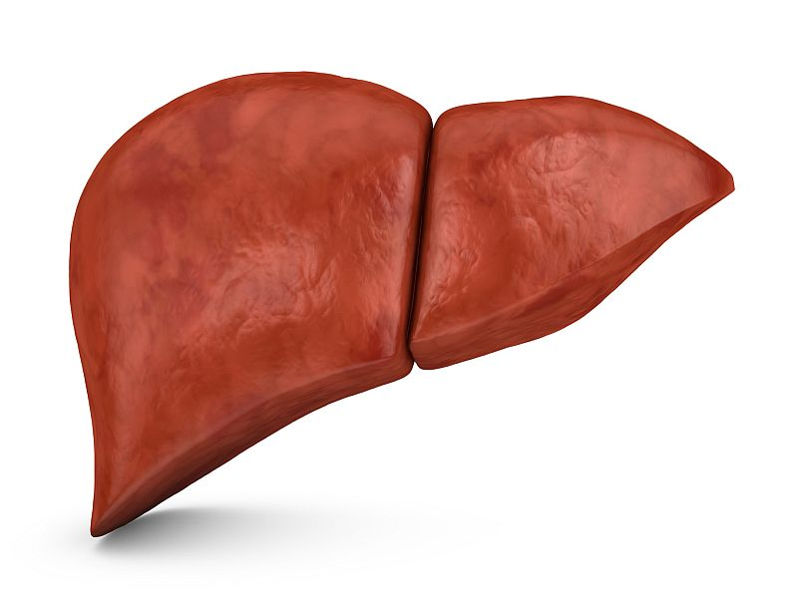
EXTERNAL FEATURES
The liver is wedge-shaped. It resembles a four-sided pyramid laid on one side
It has five surfaces. These are :
(1) Anterior,
(2) Posterior,
(3) Superior,
(4) Inferior,
(5) Right

Slide 6
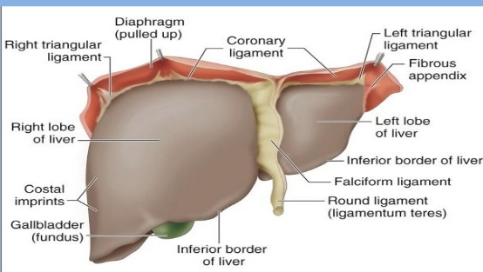
One Prominent Border
The inferior border is sharp anteriorly where it separates the anterior surface from the inferior surface.
Sharp anterior part is marked by (a) an interlobar notch or the notch for the ligamentum teres, and (b) a cystic notch for the fundus of the gall bladder

Slide 7
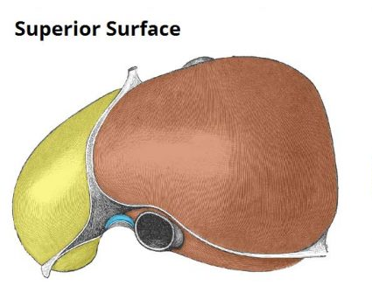
Lobes
Liver is divided into right and left lobes by the attachment of the falciform ligament anteriorly and superiorly;
By the fissure for the ligamentum teres I inferiorly ; and
By the fissure for the ligamentum venosum posteriorly.

Slide 8
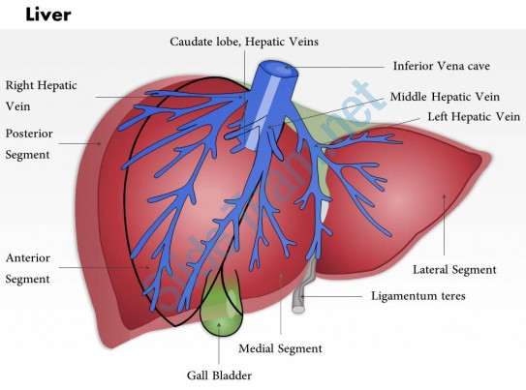
Right lobe
The right lobe is much larger than the left lobe, and forms five sixth of the liver. It contributes to all the I five surfaces of the liver, and presents the caudate and quadrate lobes.

Slide 9
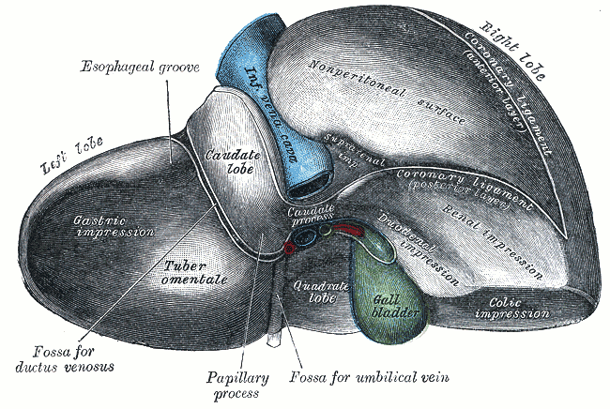
Caudate lobe
The caudate lobe is situated on the posterior surface.
It is bounded on the right by the groove for the inferior vena cava, on the left by the fissure for the ligamentum venosum,
Inferiorly by the porta hepatis.
Above it is continuous with the superior rface.

Slide 10
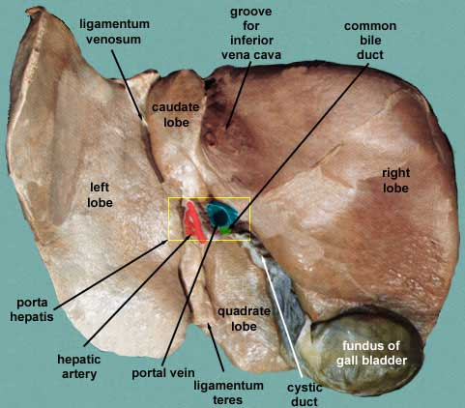
Porta hepatis
Porta hepatis is a deep, transverse fissure about 5 cm long, situated on the inferior surface of the right lobe of the liver.
It lies between the caudate lobe above and the quadrate lobe below and in front.
The portal vein, the hepatic artery and the hepatic plexus of nerves enter the liver through the porta hepatls, while the right and left hepatic ducts and a few lymphatics leave it.

Slide 11
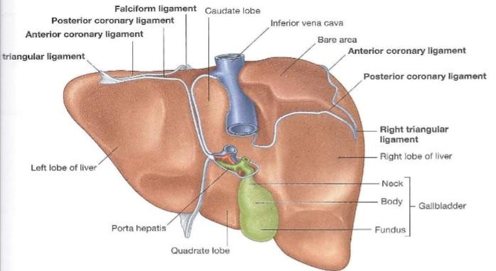
RELATIONS
Peritoneal Relations
Most of the liver is covered by peritoneum. The areas not covered by peritoneum are as follows : (a) triangular 'bare area', on the posterior surface of the right lobe, limited by the upper and lower layers of the coronary ligament and by the right triangular ligament;
(b) Groove for the inferior vena cava,
(c) Fossa for the gall bladder which lies on the inferior surface (d) the coronary ligament having superior and inferior layers, which enclose the bare area of the liver;
(e) Lesser omentum

Slide 12
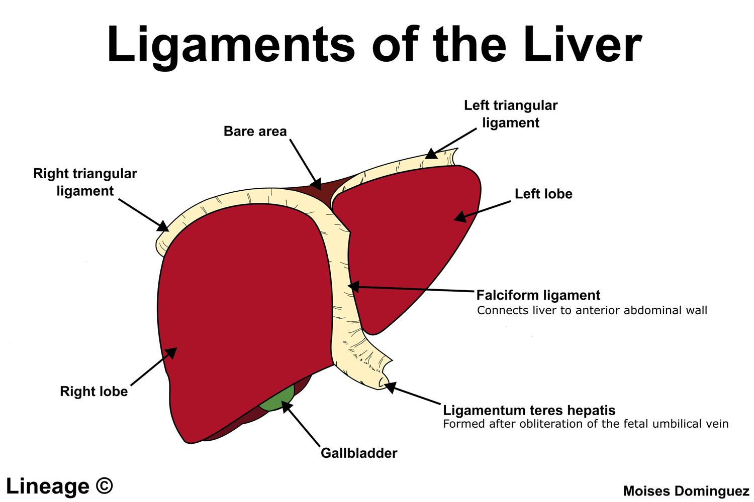
Peritonial ligaments

Slide 13
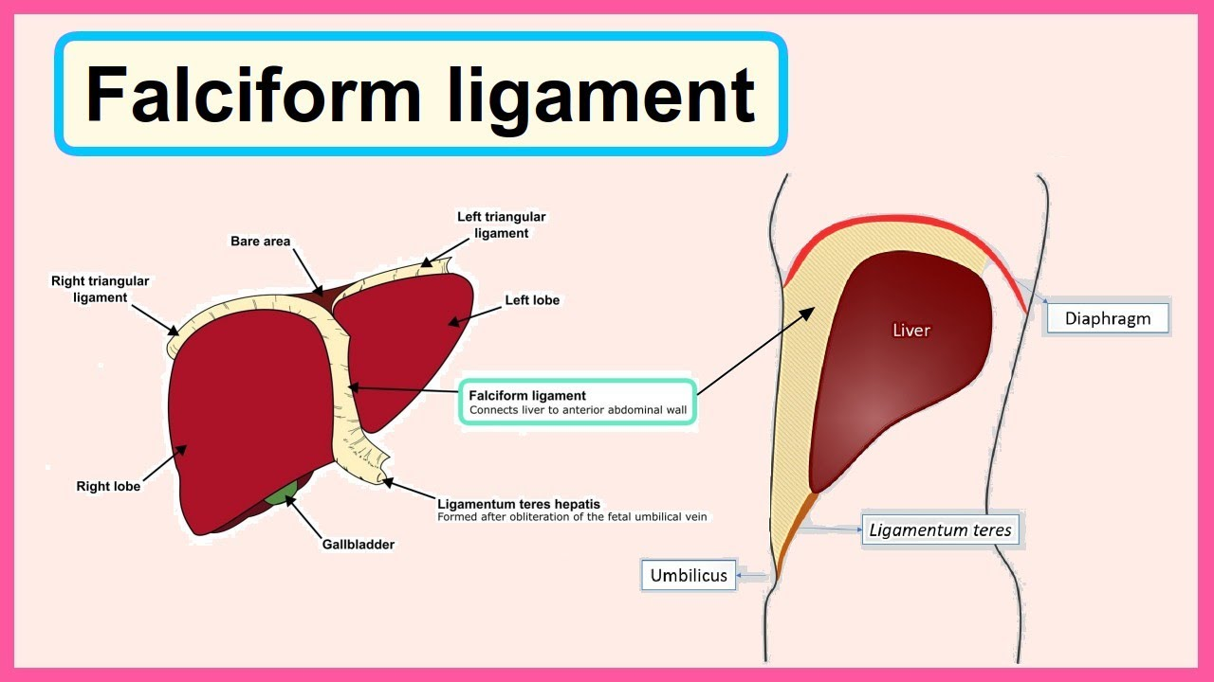
Falciform ligament

Slide 14
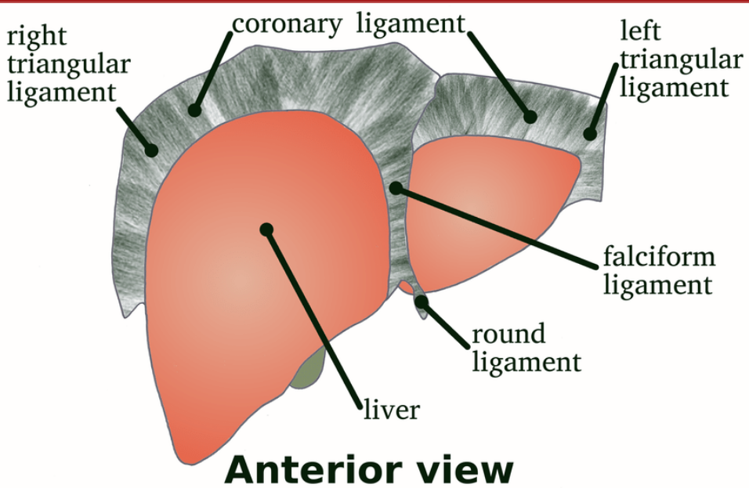
Coronary ligament

Slide 15
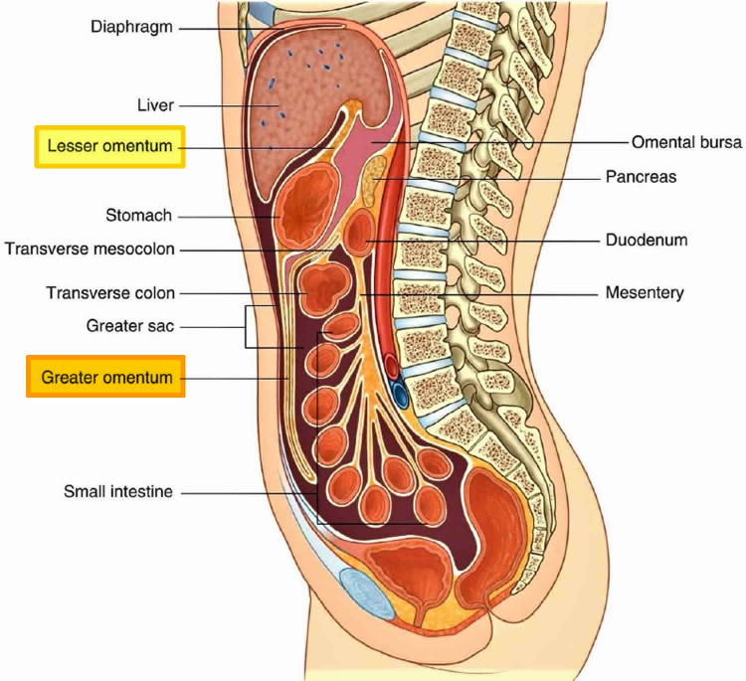
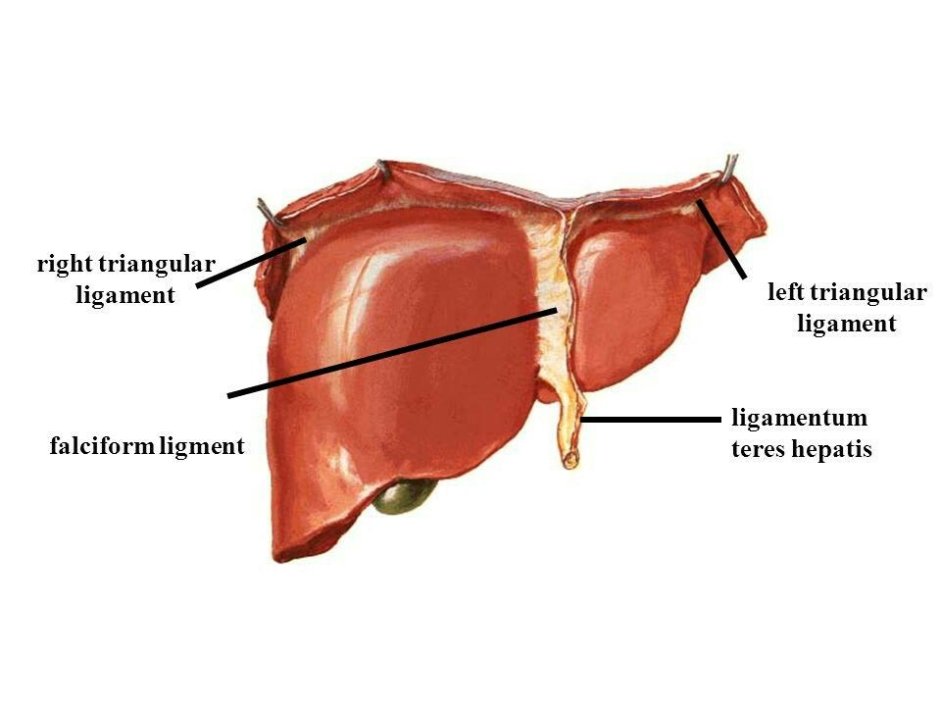
Lesser omentum ligamentum teres

Slide 16
Bare area of liver
1. A triangular area
2. Groove for IVC
3. Fossa for gall bladder
4. Line of attachment of lesseromentum around porta hepati
5. Fissure for ligamentum venosum

Slide 17
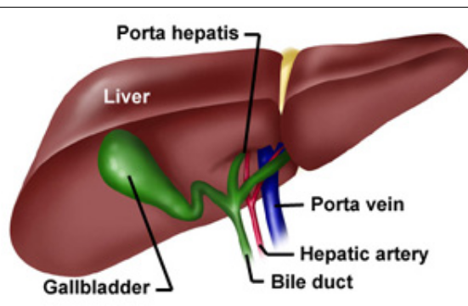
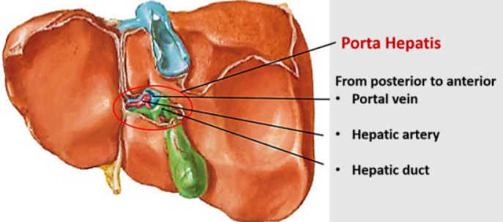
Porta Hepatis

Slide 18
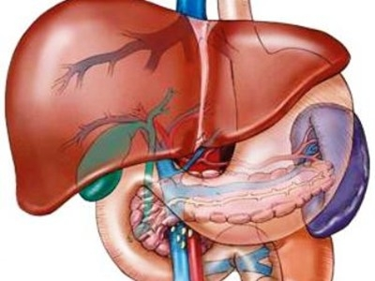
Visceral Relations
Anterior Surface
The anterior surface is triangular and slightly convex.
It is related to the xiphoid process and to the anterior abdominal wall in the median plane; and to diaphragm on each side.
The falciform ligament is attached to this surface a little to the right of the median plane.

Slide 19
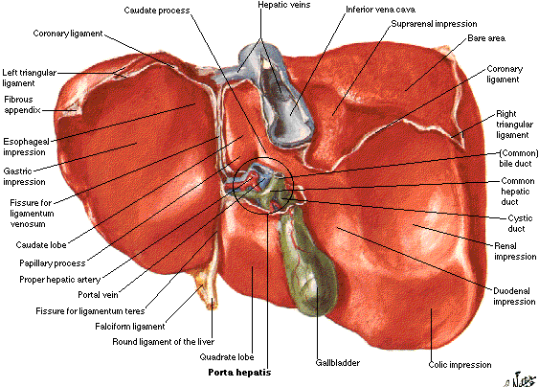
Posterior Surface
Its middle part shows a deep concavity for the vertebral column
The bare area is related to the diaphragm; and to the right suprarenal gland near the lower end of the groove for the inferior vena cava.
The groove for the inferior vena cava lodges the upper part of the vessel, and its floor is pierced by the hepatic veins.

Slide 20
The caudate lobe lies in the superior recess of the lesser sac. It is related to the crura of the diaphragm above the aortic opening, to the right inferior phrenic artery, and to the coeliac trunk.

Slide 21
The ligamentum venosum is a remnant of the ductus venosus of foetal life; it is connected below to the left branch of the portal vein, and above to the left hepatic vein near its entry into the inferior vena
5. The posterior surface of the left lobe is marked by the oesophageal impression.

Slide 22
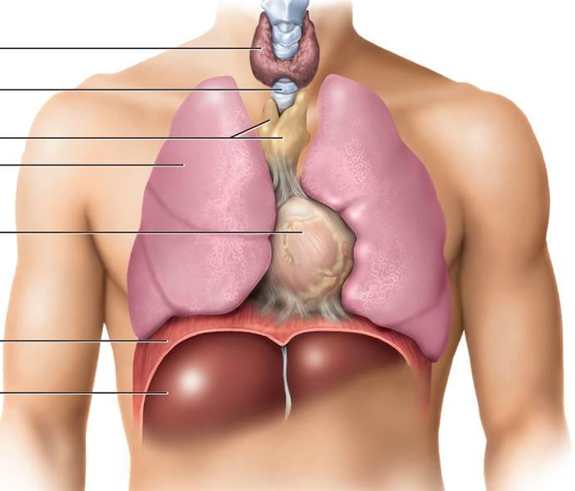
Superior Surface
The superior surface is quadrilateral and shows a concavity in the middle. This is the cardiac impression.
On each side of the impression the surface is convex to fit the dome of the diaphragm.
The diaphragm separates this surface from the pericardium and the heart in the middle; and from pleura and lung on each side.

Slide 23
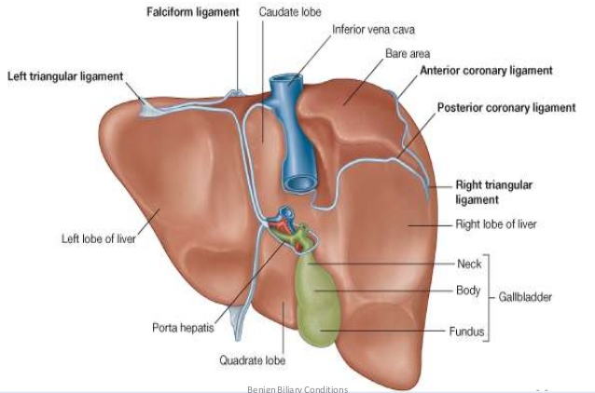
Inferior Surface
The inferior surface is quadrilateral and is directed downwards, backwards and to the left. It is marked by impressions for neighbouring viscera as follows

Slide 24
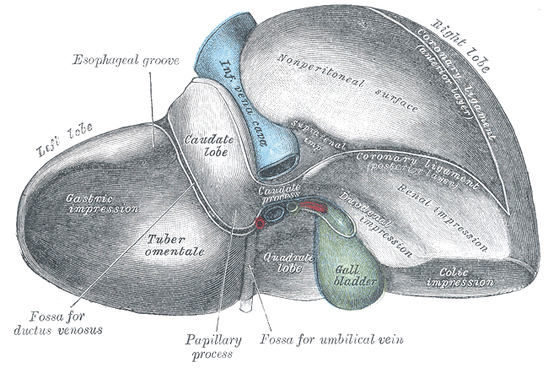
Inferior surface relations
1. On the inferior surface of the left lobe there is a large concave gastric impression
2. The fissure for the ligamentum teres passes from the inferior border to the left end of the porta hepatis. The ligamentum teres represents the obliterated left umbilical vein

Slide 25
3. The quadrate lobe is related to the lesser omentum, the pylorus, and the first part of the duodenum.
4. The fossa for the gall bladder lies to the right of the quadrate lobe
5. To the right of this fossa the inferior surface of the right lobe bears the colic impression for the hepatic flexure of the colon, the renal impression for the right kidney, and the duodenal impression for the second part of the duodenum.

Slide 26
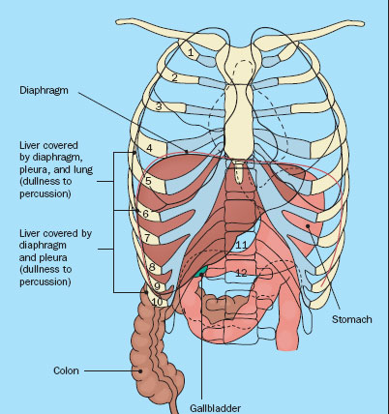
Right Surface
The right surface is quadrilateral and convex.
It is related to the diaphragm opposite the 7th to 11th ribs in the midaxillary line.

Slide 27
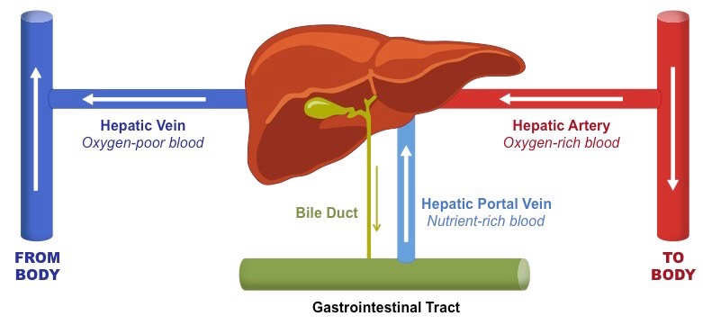
Blood Supply
Liver receives 20% of its blood supply through the hepatic artery, and 80% through the portal vein.

Slide 28
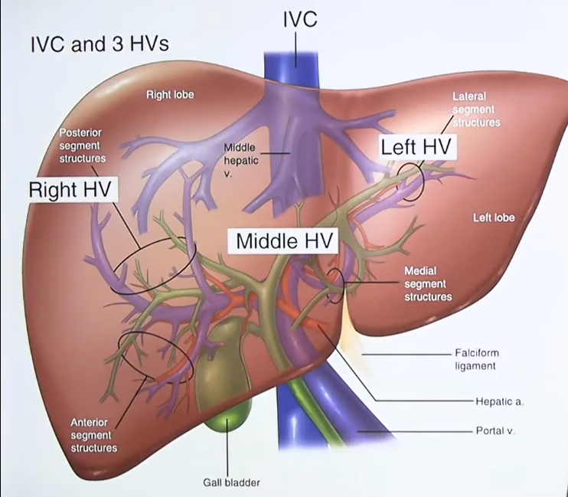
Venous Drainage
Hepatic sinusoids drain into interlobular veins, which joins to form sublobular veins. These in turn unite to form the hepatic veins which drain directly into the inferior vena cava.

Slide 29
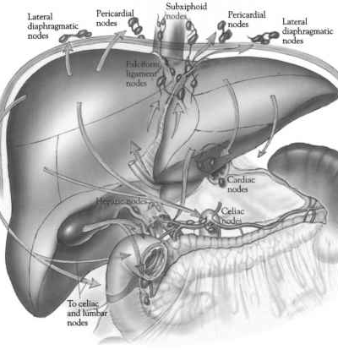
Lymphatic Drainage
Superficial lymphatics of the liver run on the surface of the organ beneath the peritoneum, and terminate in caval, hepatic, paracardial and coeliac lymph nodes. Some vessels from the coronary ligament may directly join the thoracic duct.
Deep lymphatics end partly in the nodes around the end of the inferior vena cava, and partly in the hepatic nodes.

Slide 30
Nerve Supply
The liver receives its nerve supply from the hepatic plexus which contains both sympathetic and parasympathetic or vagal fibres. Nerves also reach the liver through its various peritoneal ligaments.

Slide 31
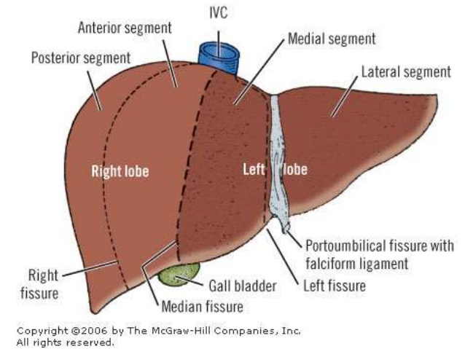
Hepatic Segments
On the basis of the intrahepatic distribution of the hepatic artery, the portal vein and the biliary ducts, the liver can be divided into the right and left functional lobes.

Slide 32
The right lobe is subdivided into anterior and posterior segments, and the left lobe into medial and lateral segments. Thus there are four segments In the liver: (1) Right anterior, (2) right posterior, (3) left lateral, and (4) left medial,

Slide 33
Functions
(1) Metabolism of carbohy-drates, fats and proteins;
(2) Synthesis of bile and prothrombin;
(3) Excretion of drugs, toxins, poisons, cholesterol, bile pigments and heavy metals;
(4) Protective by conjugation, destruction, phagocytosis, antibody formation and excretion; and
(5) Storage of glycogen, iron, fat, vitamin A and D.

Slide 34
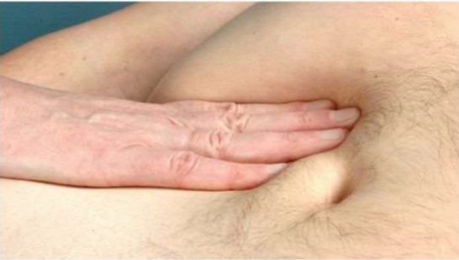
CLINICAL ANATOMY
1. In the infrasternal angle, the liver is readily accessible to examination on percussion, though it is normally not palpable due to the normal tone of the recti muscles and the softness of the liver

Slide 35
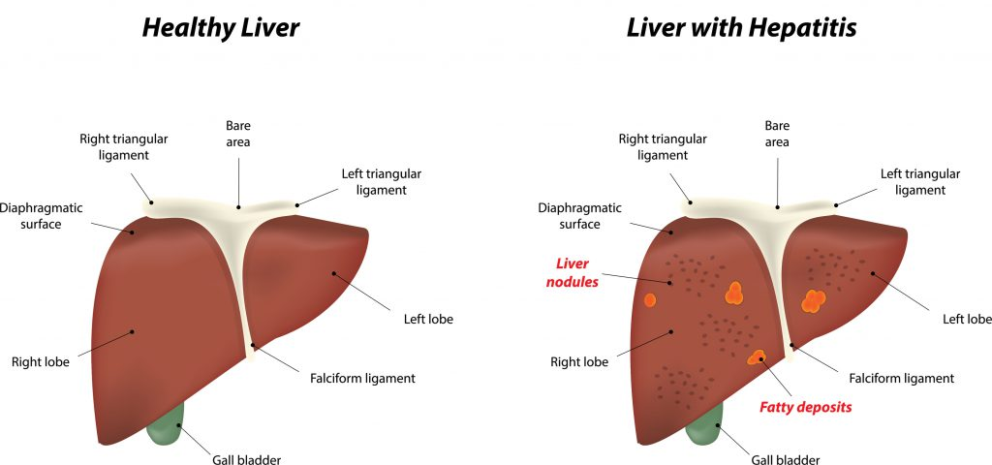
2. Inflammation of the liver is referred to as hepatitis. It may be infective hepatitis or amoebic hepatitis.

Slide 36
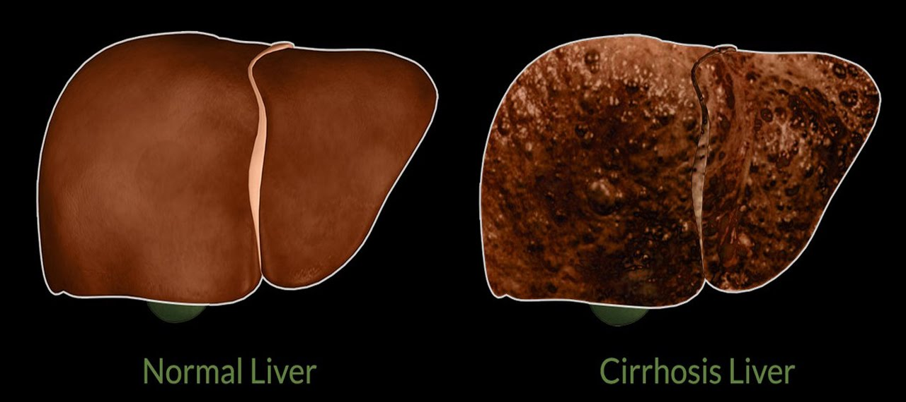
3. Under certain conditions liver tissue undergoes fibrosis and shrinks. This is called cirrhosis of the liver

Slide 37
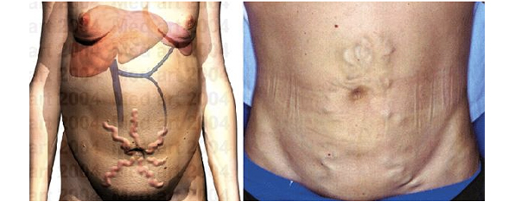
Caput medusae
Caput medusae, also known as palm tree sign, is the appearance of distended and engorged superficial epigastric veins, which are seen radiating from the umbilicus across the abdomen

Slide 38
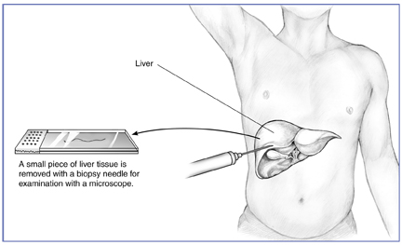
4. Liver biopsy needs to be done in certain clinical conditions. Liver biopsy needle is passed through right 8th intercostal space. It traverses both the pleural and peritoneal cavities

Slide 39
Liver transplantation

