Slide 1
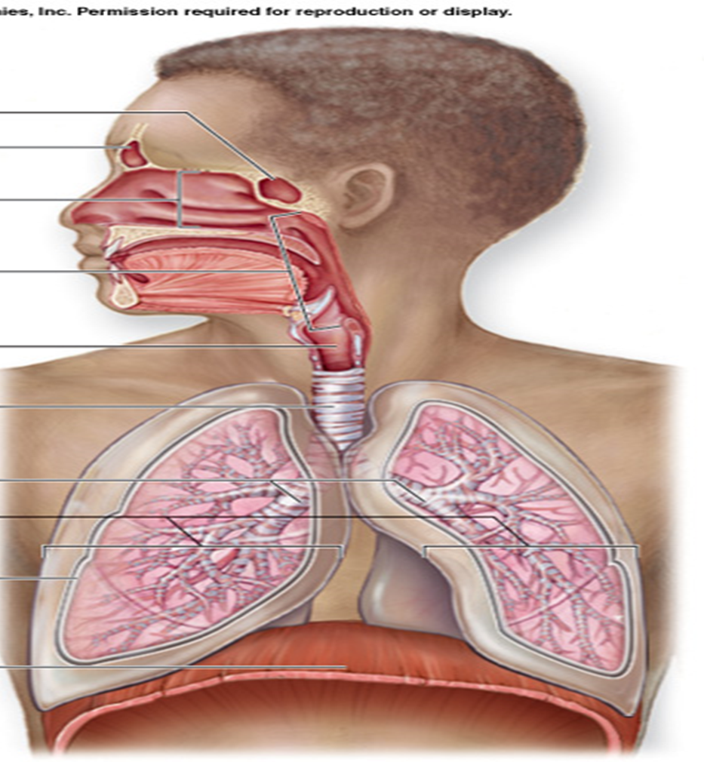
Larynx

Slide 2
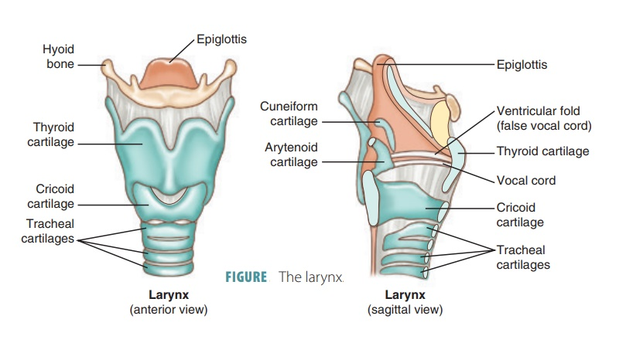
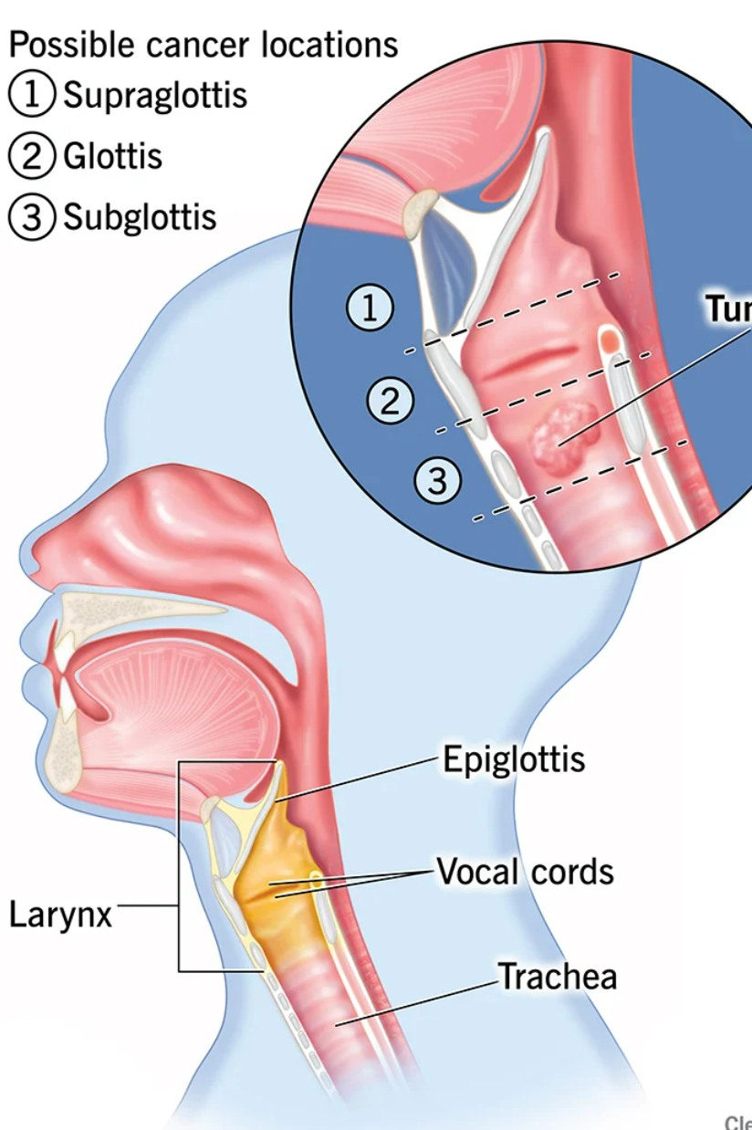

Slide 3
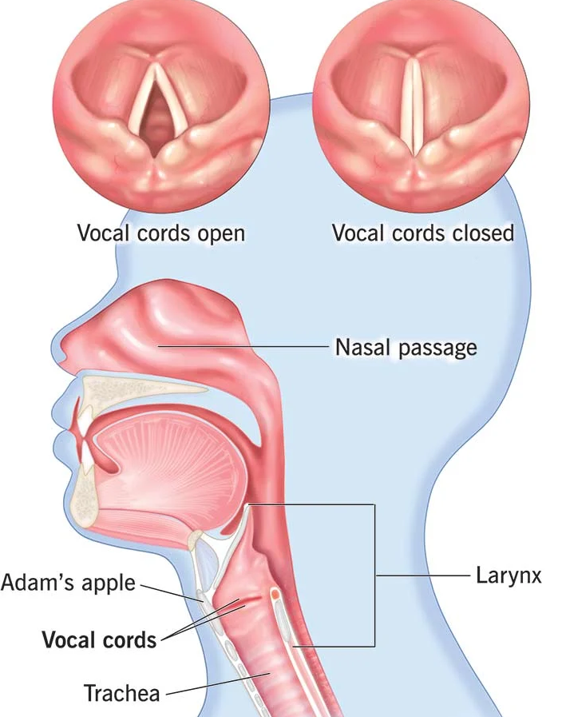
LARYNX -VOICE BOX
In greek – larynges –
upper wind pipe
Organ of production of voice (phonation )
Air passage
Act as a sphincter at the inlet of lower respiratory passage
Deglutition

Slide 4
Location & dimension
In the anterior midline of upper part of neck
From root of tongue to trachea
In males – C3 –C6
In females and children – at a little higher level – C1 –C4
 | vertical | Transverse | Anteroposterior
Male | 44mm | 43 mm | 36 mm
Female | 36 mm | 41mm | 26 mm

Slide 5
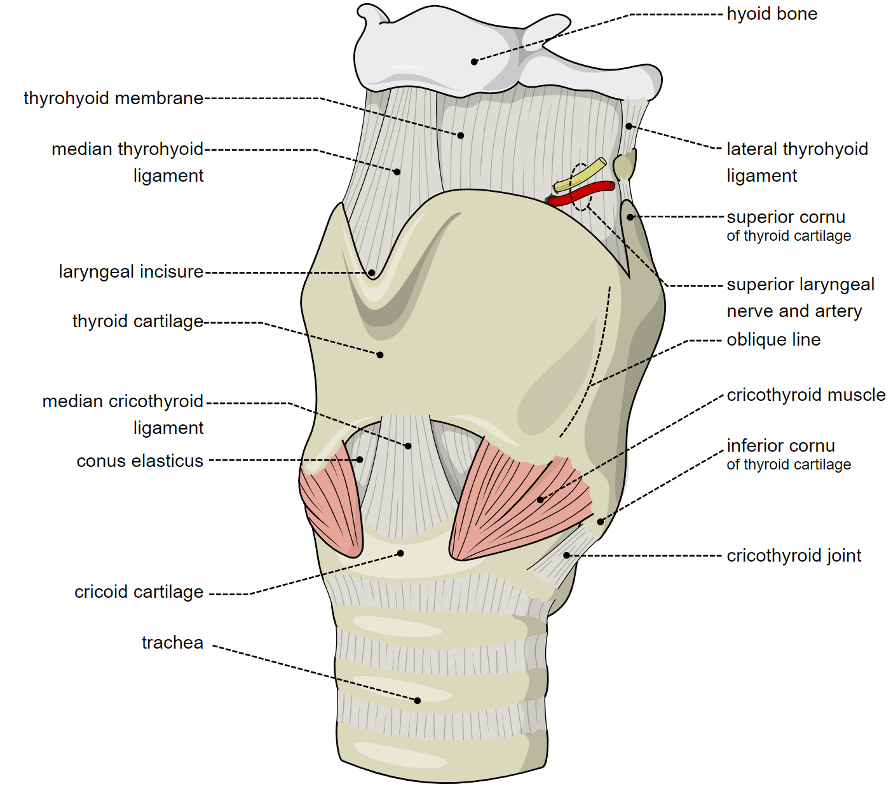
CONSTITUTION OF LARYNX
Made of skeletal framework of cartilages which are connected by joints, ligaments , & membranes
The movements are done by muscles attached to cartilages
cavity is lined by mucous membrane

Slide 6
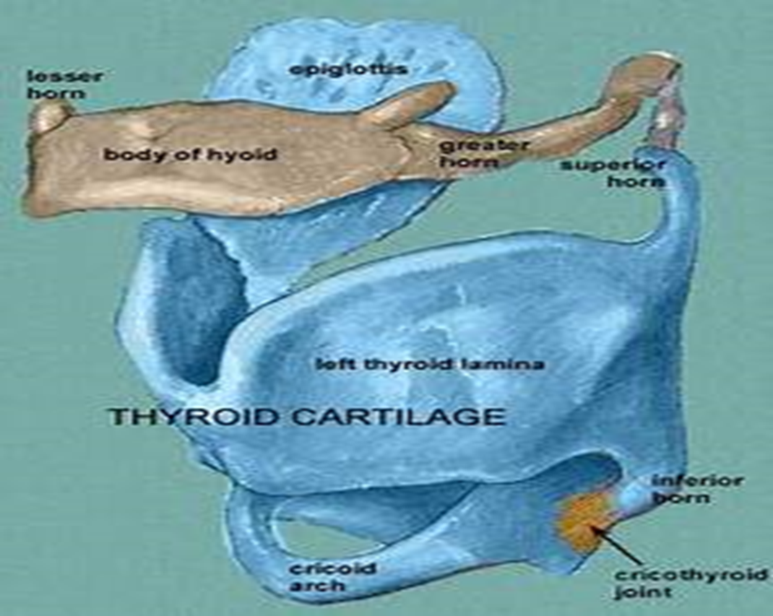
Cartilages (SKELETON OF THE LARYNX)
Total 9 cartilages
3 paired
3 unpaired
Unpaired
Thyroid
Cricoid
Epiglottis
Paired
Arytenoid
Corniculate
Cuneiform

Slide 7
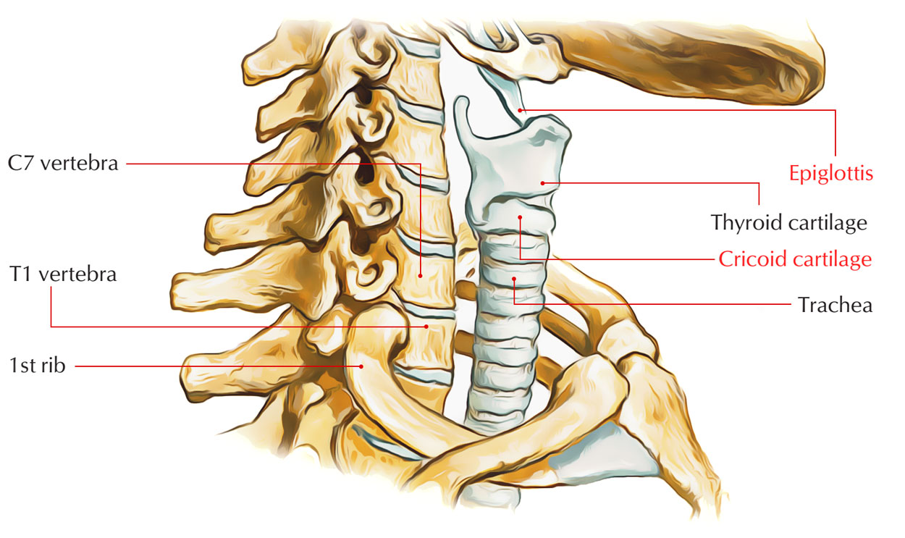

Slide 8
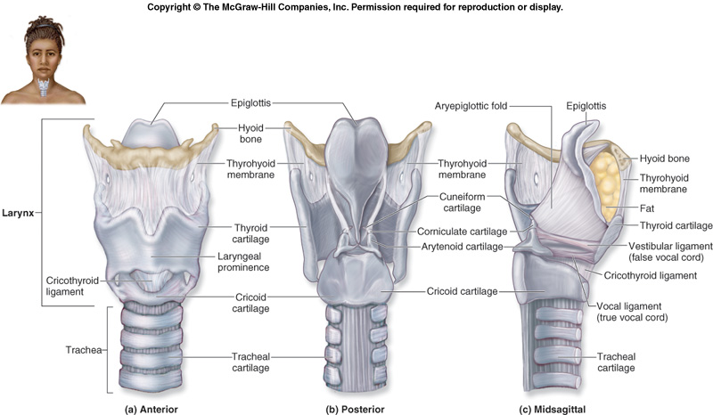

Slide 9
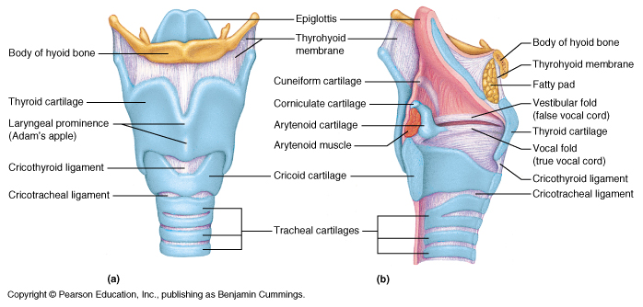

Slide 10
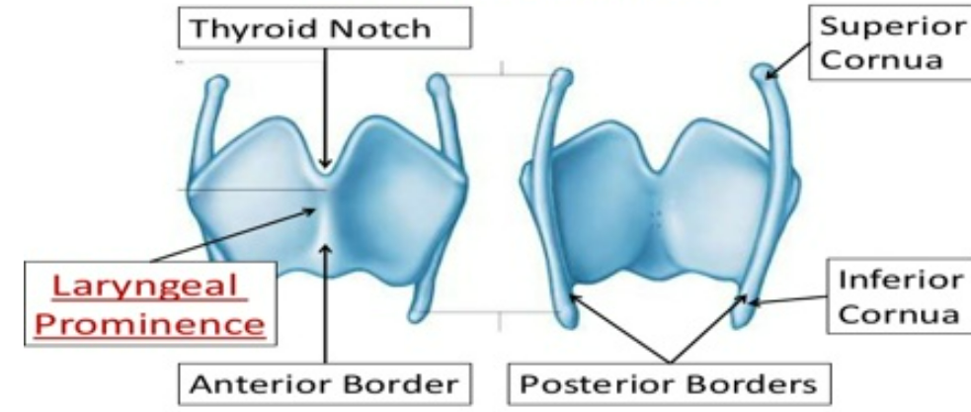
Thyroid cartilage
Greek – shield like
V shaped in cross section
Consists of quadrilateral right & left laminae
Laminae placed slightly oblique to midline
Anterior borders approach each other at an angle –about 90degree in male & about 120 degree in females
Lies opposite the C4 & C5

Slide 11
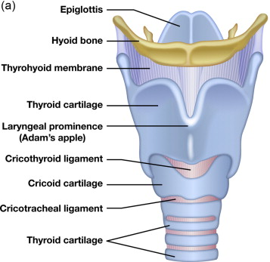
Thyroid cartilage
Lower parts of anterior borders fuse to form a median projection called laryngeal prominence .
Upper borders do not meet ,separated by thyroid notch
Posterior borders are free ,prolonged upwards & downwards as superior & inferior cornua or horns .
Inferior border almost straight in front & concave behind
Outer surface of each lamina has an oblique line which extends from superior thyroid tubercle to inferior thyroid tubercle .

Slide 12
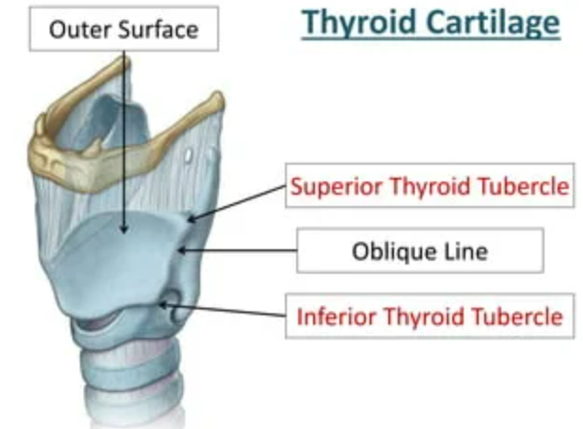

Slide 13
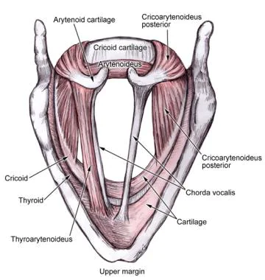

Slide 14
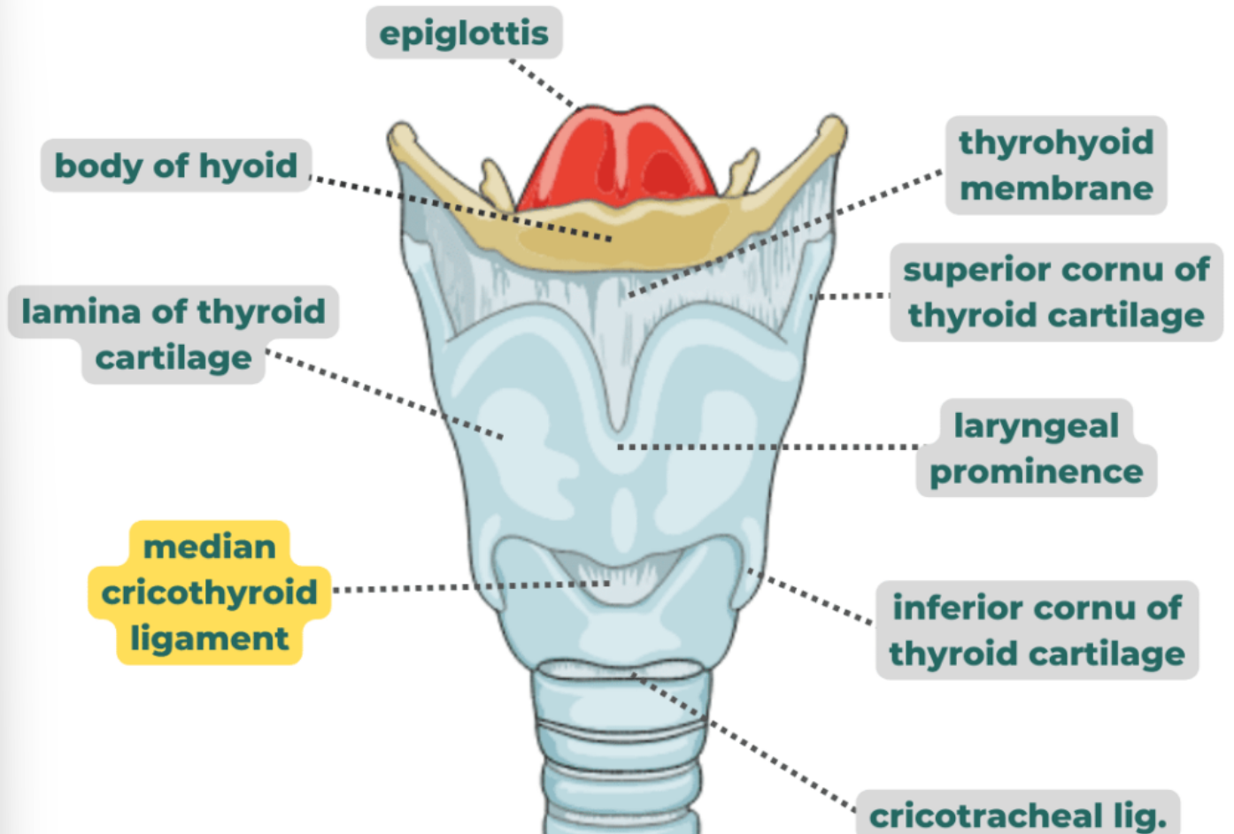
PARTS OF THE THYROID LAMINA
Each lamina is quadrilateral and consists of 4 borders
1. Upper
2. Lower
3. Anterior
4. Posterior

Slide 15
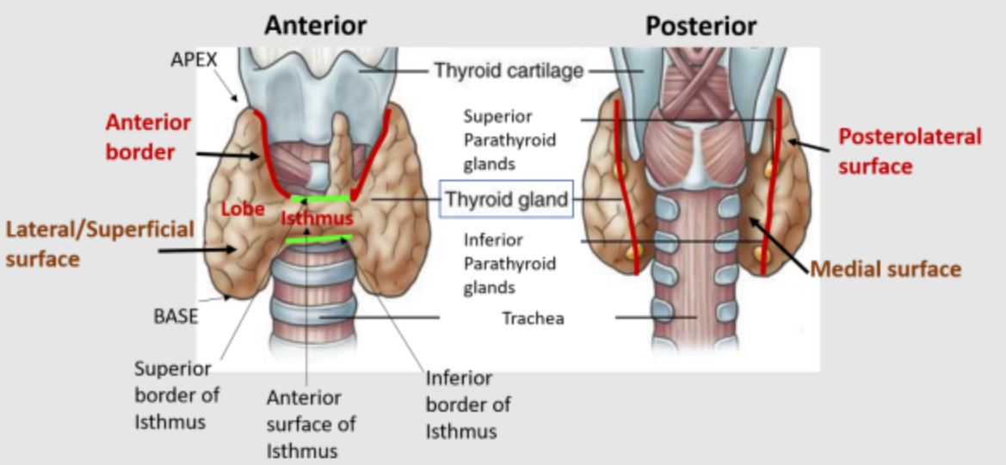

Slide 16
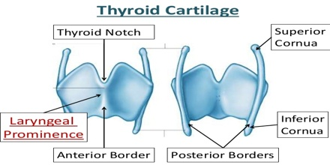

Slide 17
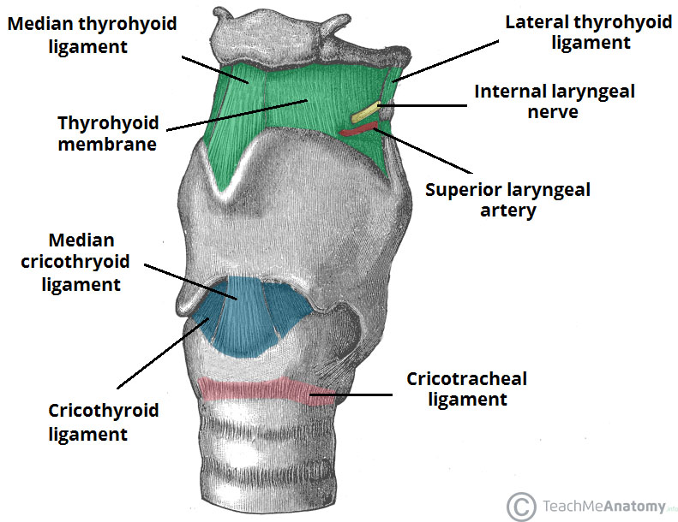
Attachments of thyroid cartilage
Superior cornua – with greater cornua of hyoid by lateral thyrohyoid ligament
Inferior cornua articulate with cricoid to form cricothyroid joint
Inferior border is connected to cricoid cartilage by conus elasticus, cricothyroid muscle
Superior border – thyrohyoid membrane

Slide 18
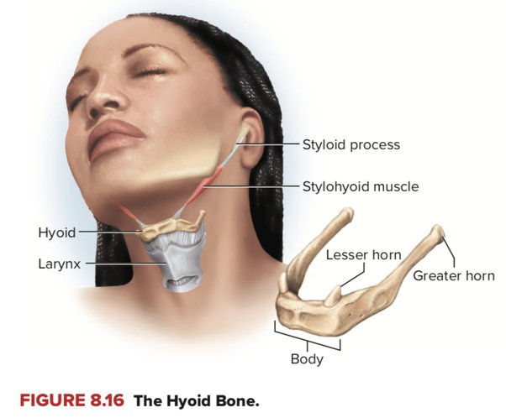

Slide 19
Attachments of thyroid cartilage
ANTERIOR BORDER:
The anterior borders meet at the thyroid angle.
Just superior to the laryngeal prominence, the superior thyroid notch separates the two laminae.
• There is a less distinct inferior thyroid notch present near the base.

Slide 20
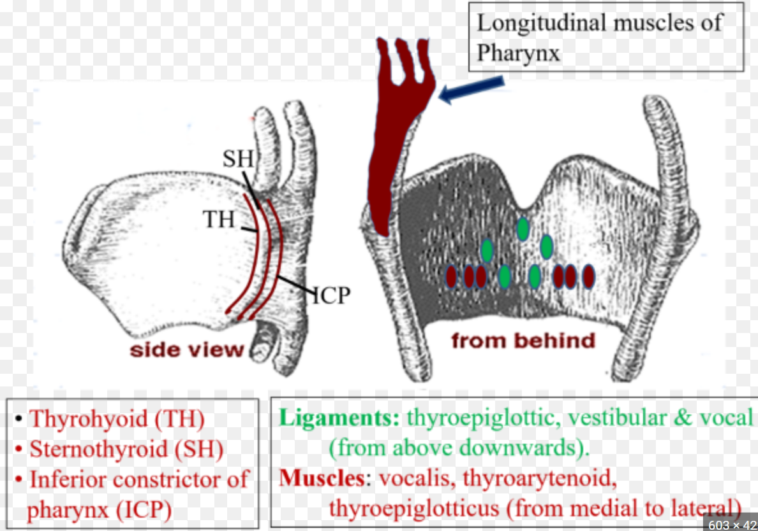
Muscles
Thyrohyoid ,sternothyroid , thyropharyngeus to oblique line
Palatopharyngeus,
salpingopharyngeus , stylopharyngeus –posterior border towards line

Slide 21
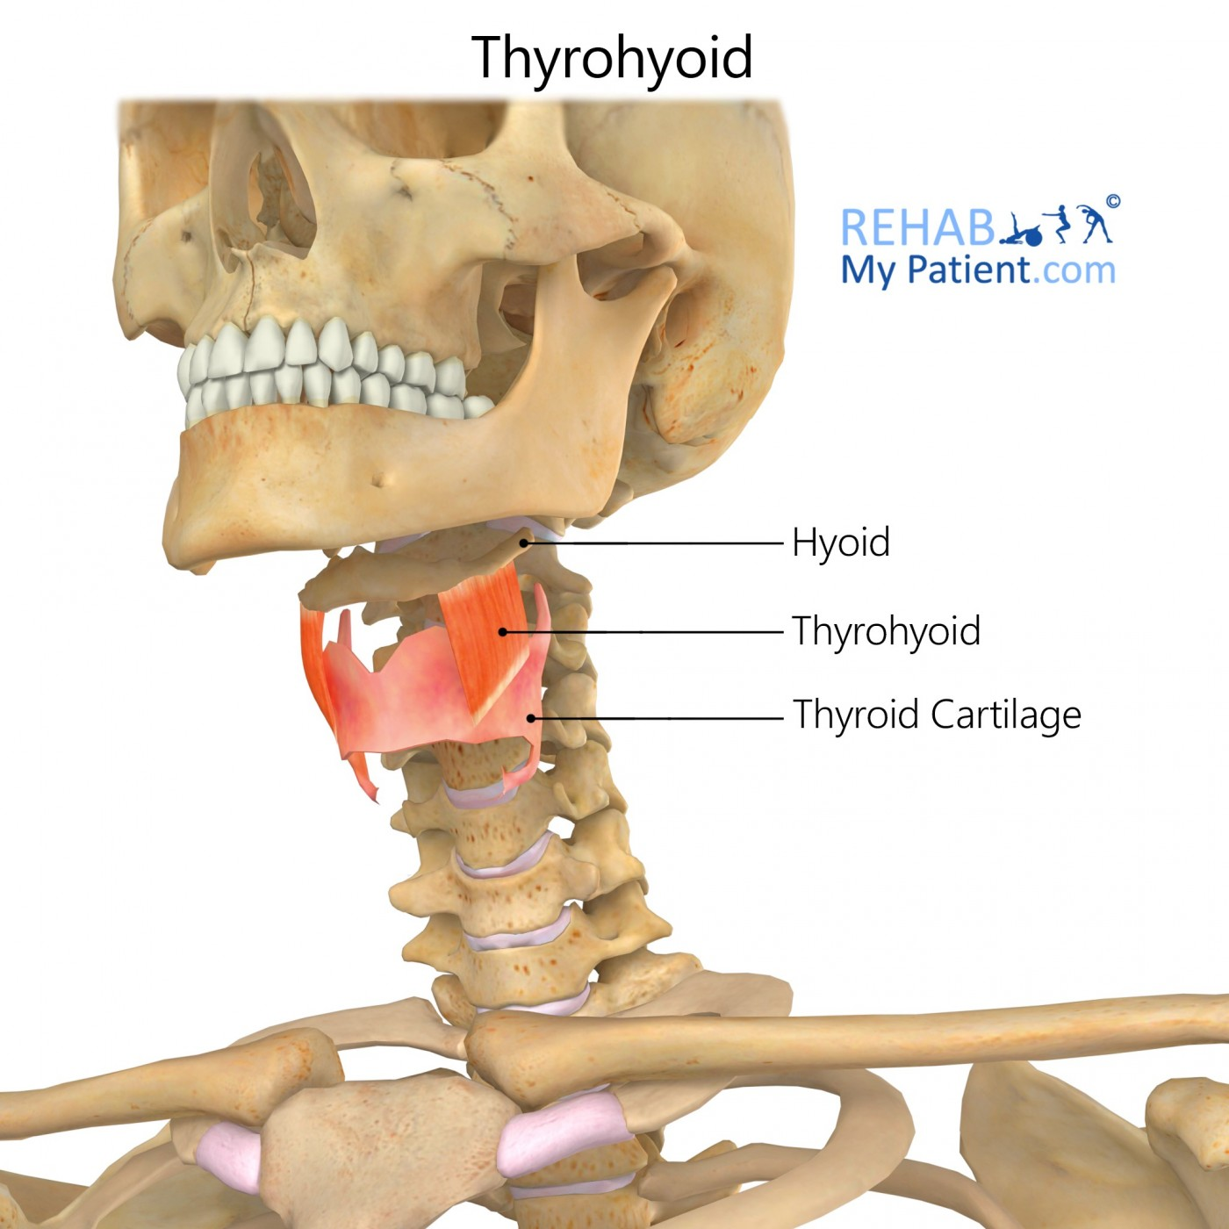
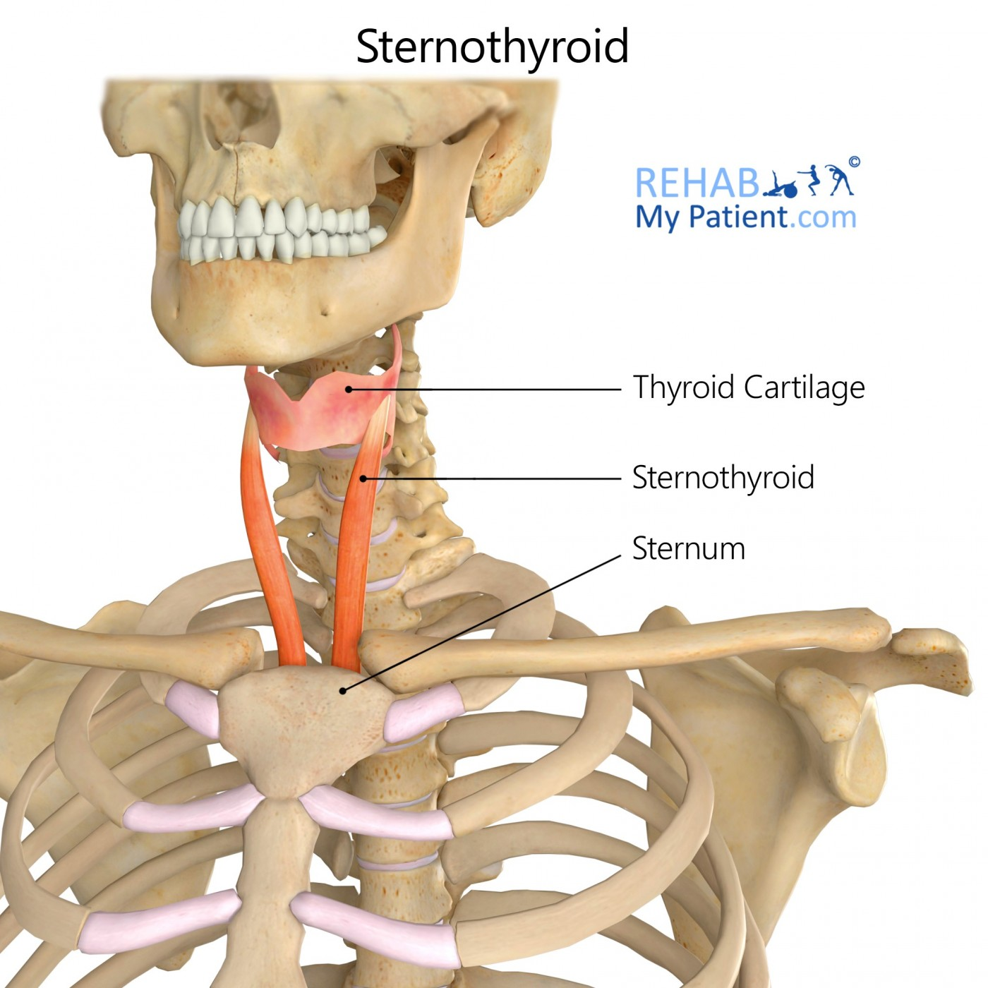

Slide 22
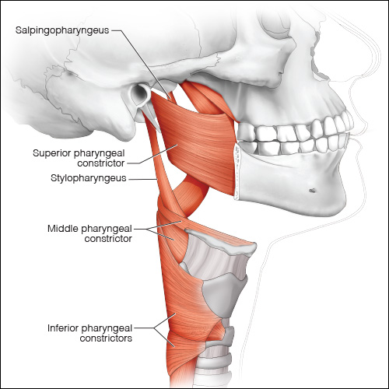
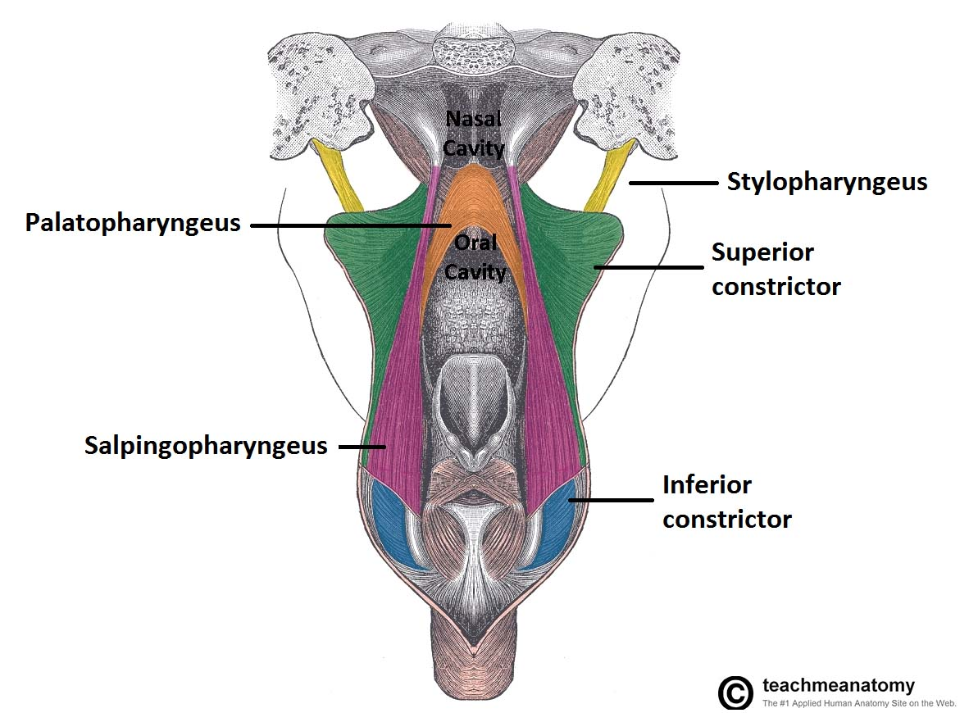

Slide 23
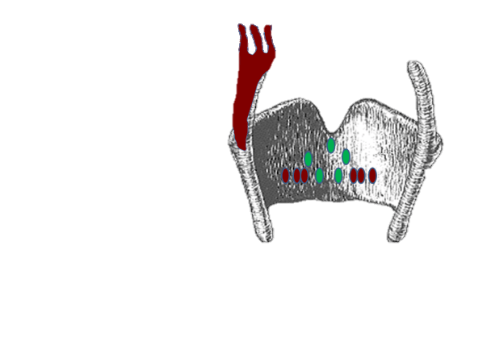
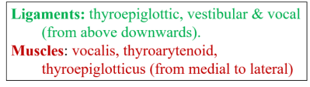
Structures attached to the inner surface of the thyroid
Internal surface of thyroid
Median thyroepiglottic ligament
Vestibular folds
Vocal folds
Vocalis muscle
Thyroarytenoid
Thyroepiglottic muscle

Slide 24
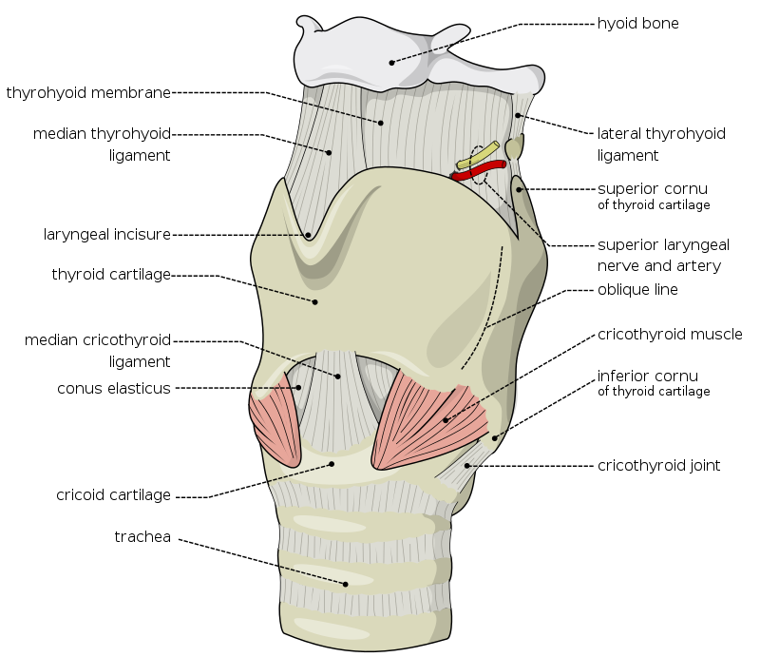
POSTERIOR BORDER OF THYROID CARTILAGE
The posterior margin of each lamina of the thyroid cartilage is free.
It elongated to form a superior hornand an inferior horn.
The medial surface of the inferior horn has a facet for articulation with the cricoid cartilage to form the crico- thyroid joint.
superior horn is connected by a lateral thyro-hyoid ligament to the posterior end of the greater horn o the hyoid bone.

Slide 25
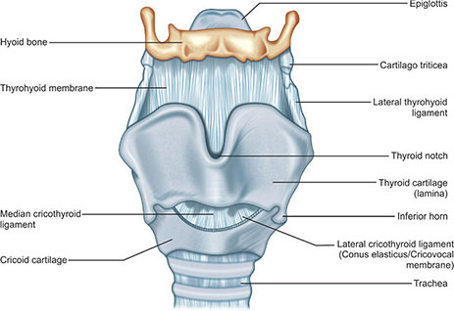

Slide 26
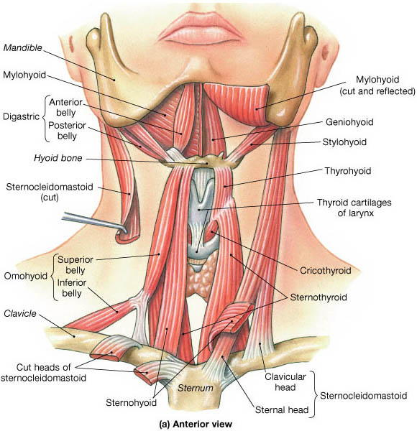
LATERAL SURFACE OF THYROID CARTILAGE
The lateral surface of each thyroid lamina is marked by a ridge (the oblique line).
This line curves anteriorly from the base of the superior horn to the inferior margin of the lamina.
The ends of the oblique line are expanded to form superior and inferior thyroid tubercles.
The oblique line is a site of attachment for the extrinsic muscles of the larynx (sternothyroid, thyrohyoid, and inferior .constrictor).

Slide 27
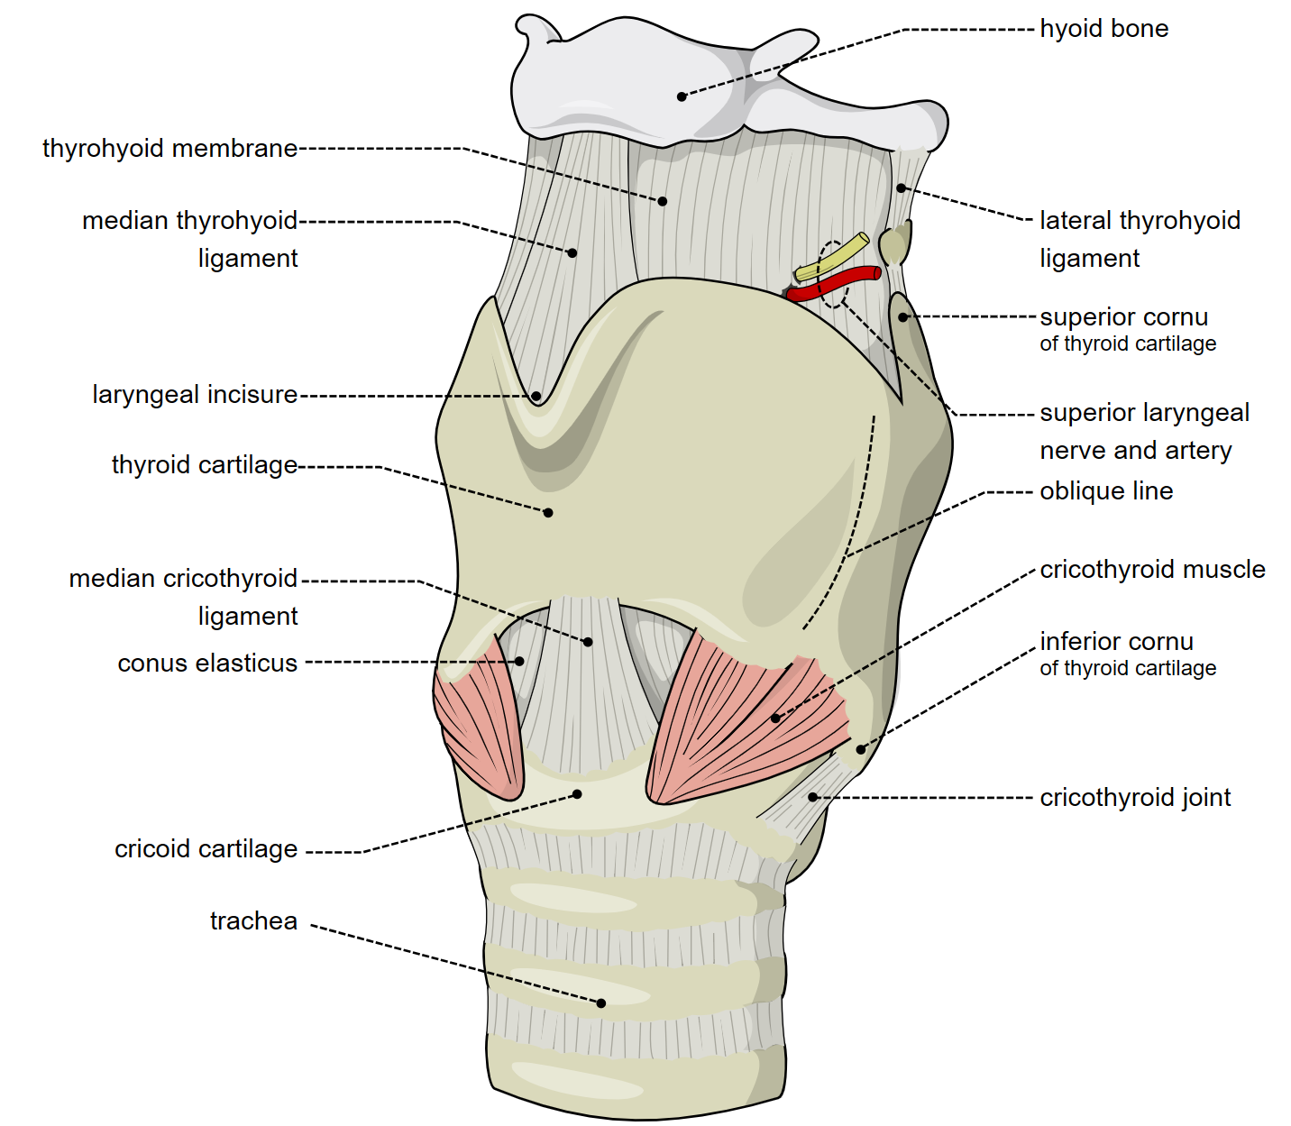

Slide 28
Cricoid cartilage
Shaped like a ring
Below thyroid cartilage ,foundation of larynx
Thicker & stronger than thyroid
Has a narrow anterior part called arch & broad posterior part called lamina
Lamina projects upwards behind the thyroid & gives attachment to arytenoid cartilage
Inferior cornua of thyroid articulate with side of cricoid at junction of arch & lamina

Slide 29
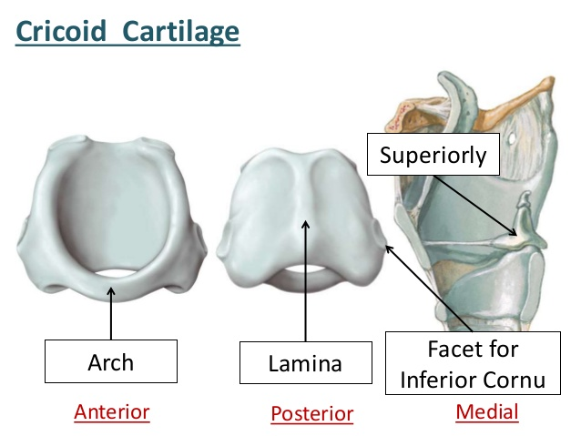

Slide 30
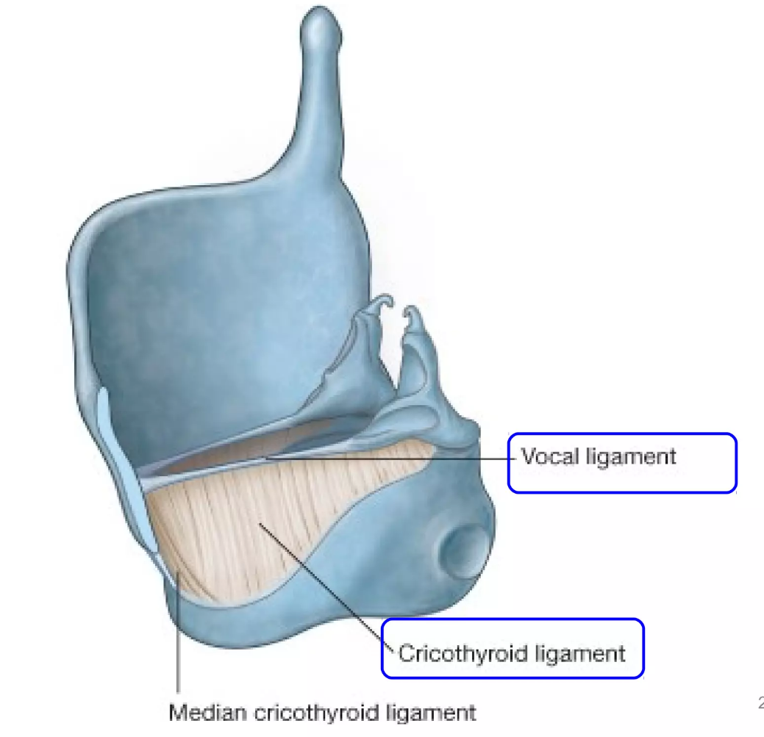
Arch has upper & lower borders and outer & inner surfaces
Upper border – fibroelastic cricovocal membrane(cricothyroid ligament) ,pass beneath thyroid lamina ,forms a thickened upper margin –vocal ligament
Ligament extends from inner surface of thyroid to vocal process of arytenoid .It is covered with mucous membrane and forms vocal folds .
Lower border – to trachea -by cricotracheal ligament

Slide 31

CRICOID ARCH SUPERIOR BORDER
The superior border gives attachment to the following structures:
1. Thick median cricothyroid ligament,
2. laterally to the conus elasticus
3. Lateral cricoarytenoid muscle.
The arch is separated from thyroid cartilage by a depression containing the conus elasticus.
The cricotracheal ligament that attaches the cricoid cartilage to the first tracheal cartilage inferiorly.

Slide 32
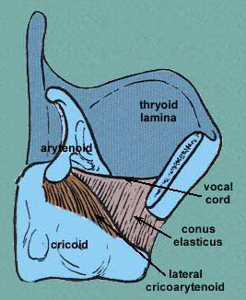
LATERAL CRICOARYTENOID MUSCLE

Slide 33
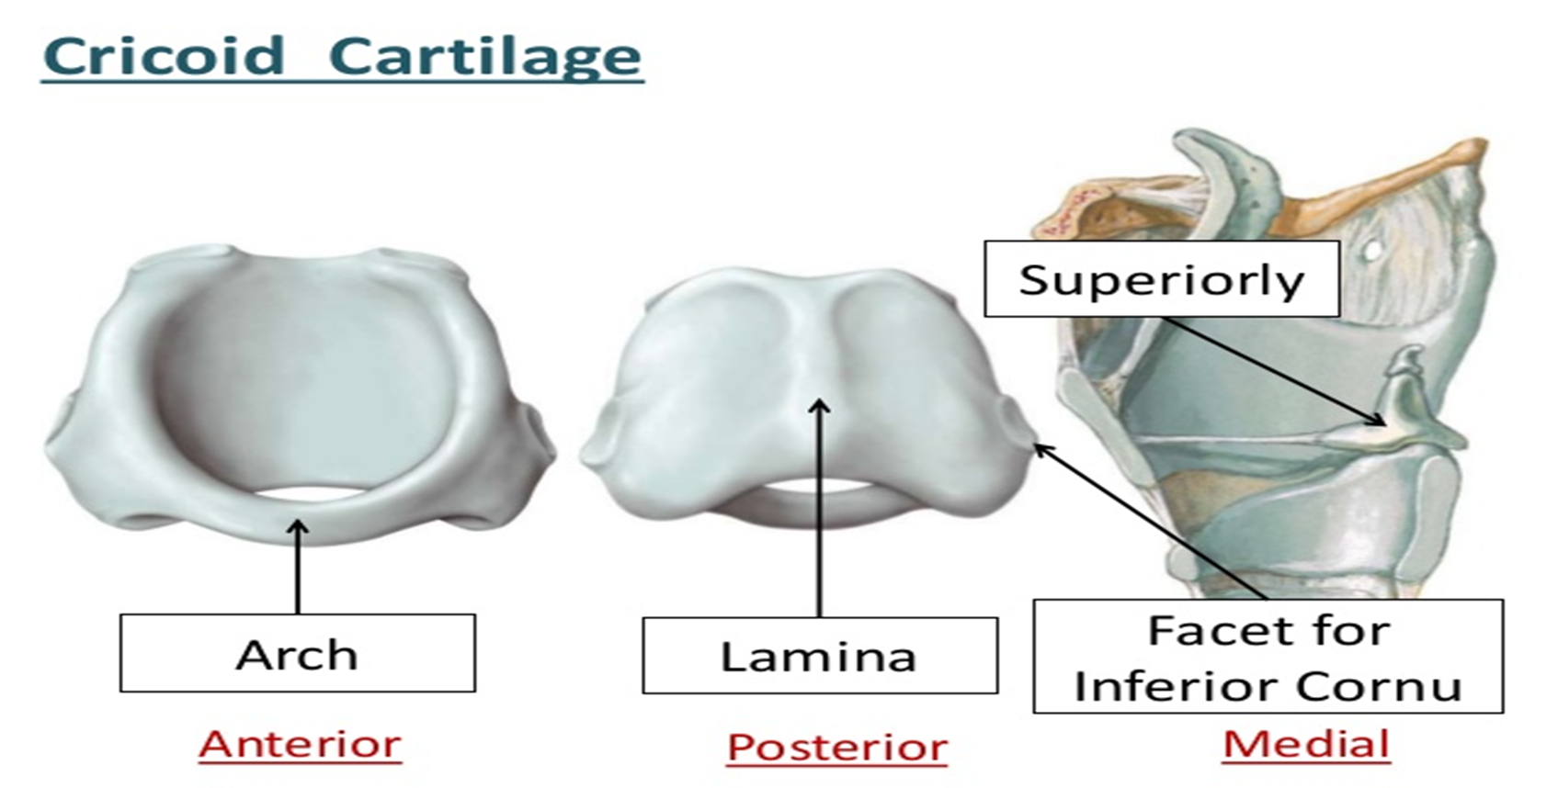
CRICOID LAMINA
The cricoid lamina is approximately quadrilateral in outline.
It bears a posterior median vertical ridge that creates posteriorconcavities on either side.
• The ridge gives attachment to longitudinal muscle fibres of the oesophagus.
• The depressions are for attachment of the posterior cricoarytenoid muscles.

Slide 34
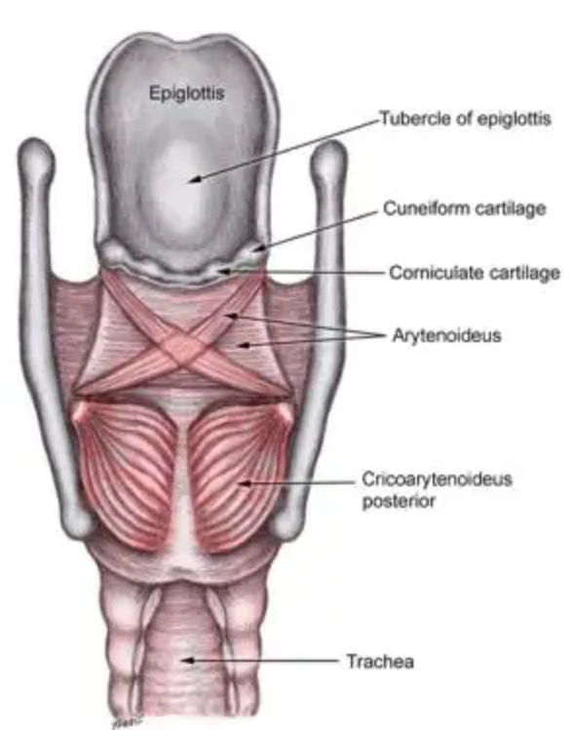
POSTERIOR CRICOARYTENOID
MUSCLE

Slide 35
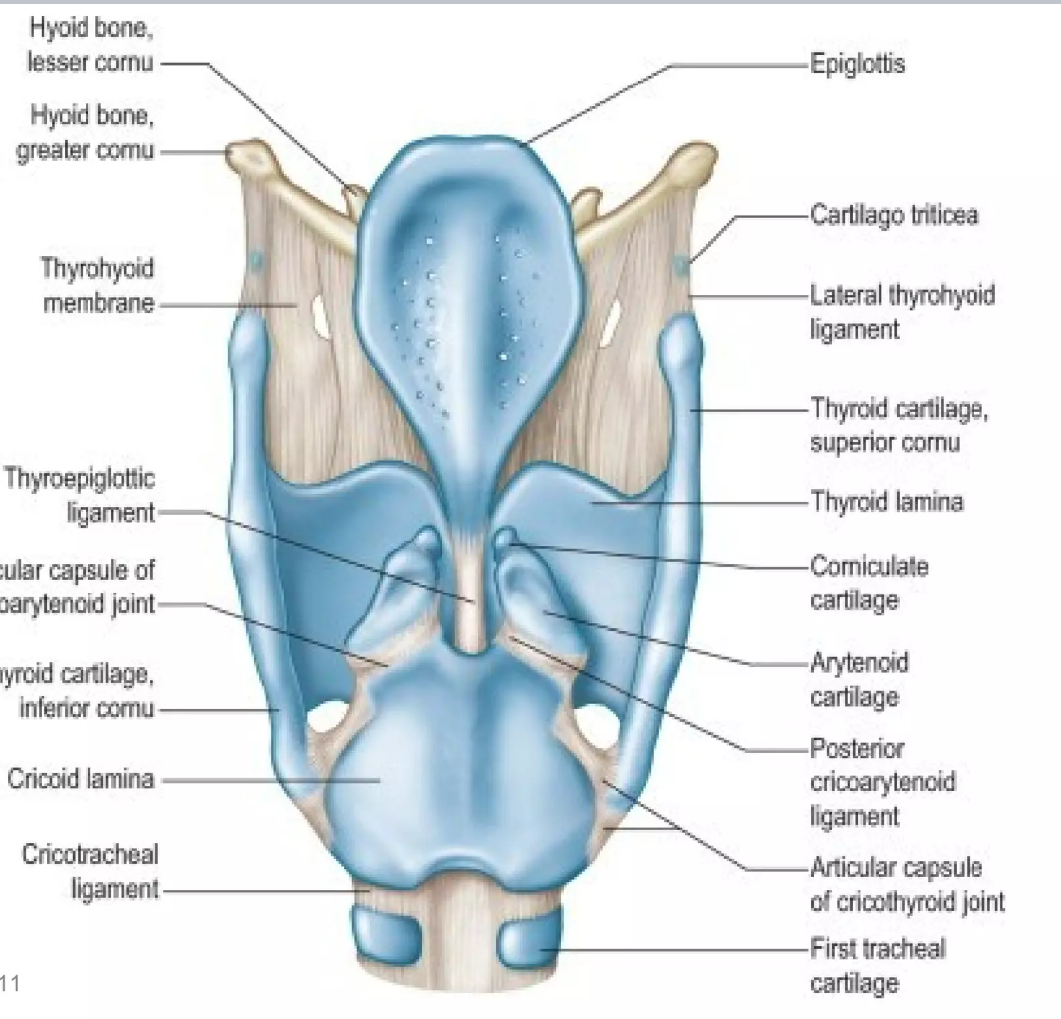
CRICOID LAMINA facets
The cricoid cartilage has two articular facets on each side for articulation with other laryngeal cartilages:-
A. One facet is on the upper part of the lamina has sloping shoulders. It articulates with the base of an arytenoid cartilage.
B. The other facet is on the lateral surface of the lamina near its base. It is the junction of the arch and lamina. It articulate with the medial surface of the inferior horn of the thyroid cartilage.

Slide 36
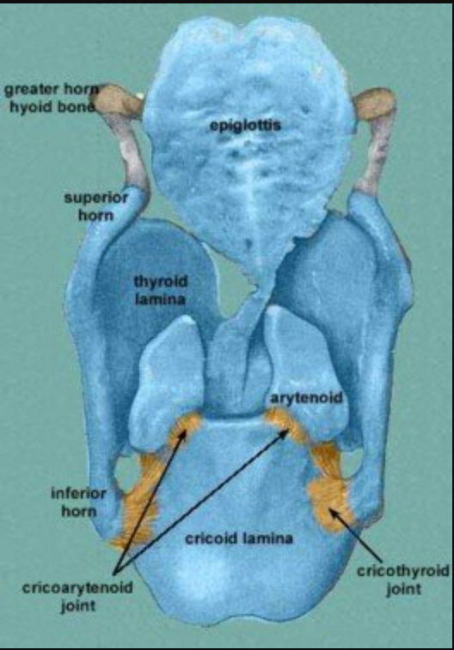
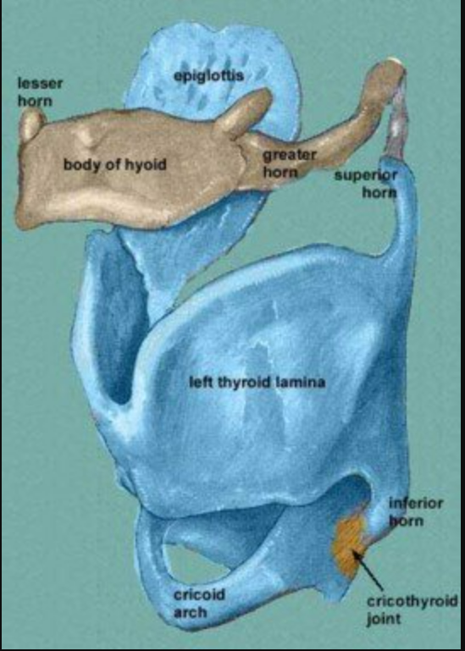

Slide 37
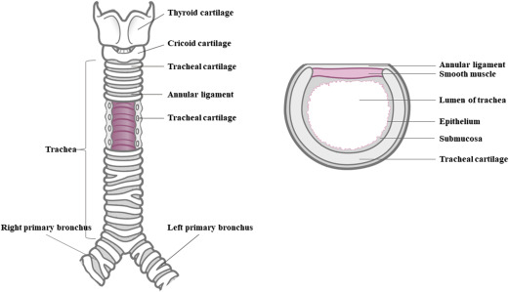
Posterior lamina - broad and quadrilateral
Upper & lower borders and anterior & posterior surfaces
Upper border -articulation to arytenoid cartilage –cricoarytenoid joint
Lower border – trachealis muscle
Posterior surface –median ridge – attachment to tendon of oesophagus
Lateral side of ridge – posterior cricoarytenoid

Slide 38


Attachments
Cricothyroid muscle -outer surface (arch )
Lateral cricoarytenoid - outer lip
Posterior cricoarytenoid –posterior surface of lamina
Cricothyrid membrane (conus elasticus )

Slide 39
Epiglottis
Leaf shaped cartilage
Placed at anterior wall of upper part of larynx
Upper end broad and free ,projects beyond hyoid bone & tongue
Lower end pointed ,attached to upper part of angle of thyroid between 2 lamina –by thyroepiglottic ligament
Anterior surface –connected to tongue by median & pair of lateral glossoepiglottic folds with a depression –vallecula

Slide 40
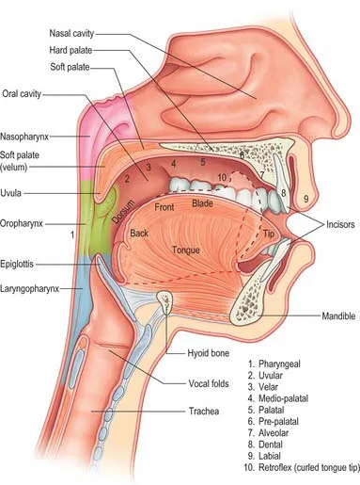
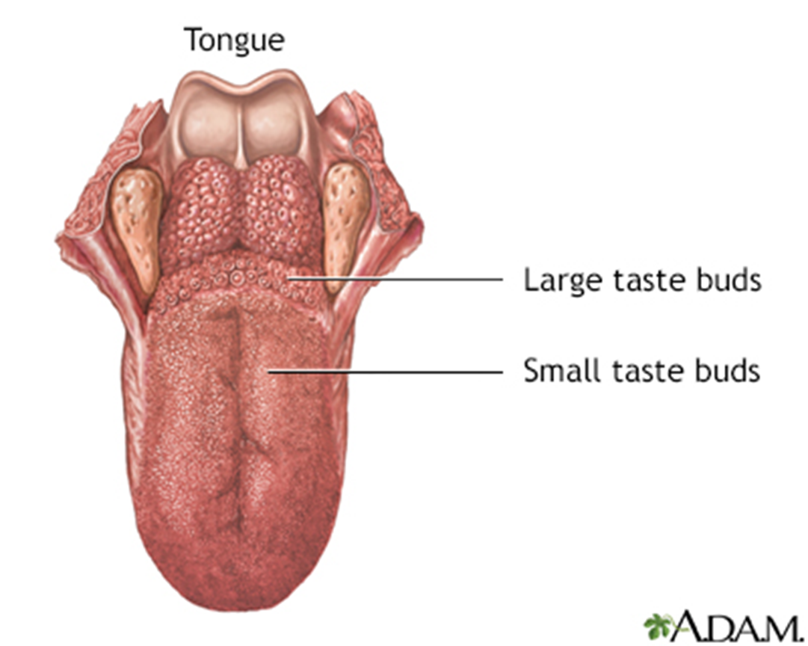

Slide 41
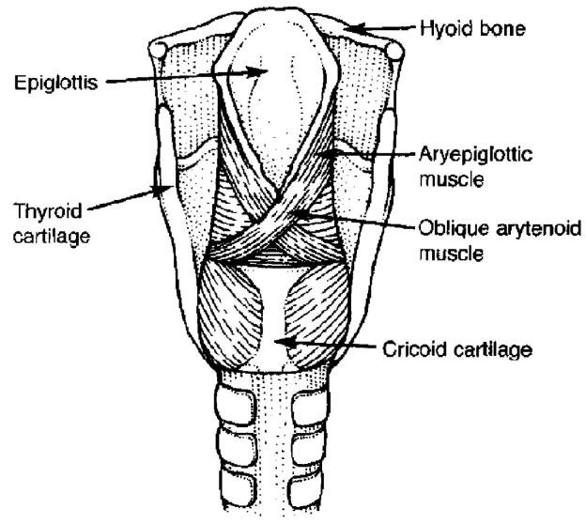
Lower end of epiglottis
Right & left margins – aryepiglottic folds
Posterior surface – covered by mucous membrane ,has a tubercle in lower part
Thyroepiglottic muscle
Aryepiglottic muscle

Slide 42
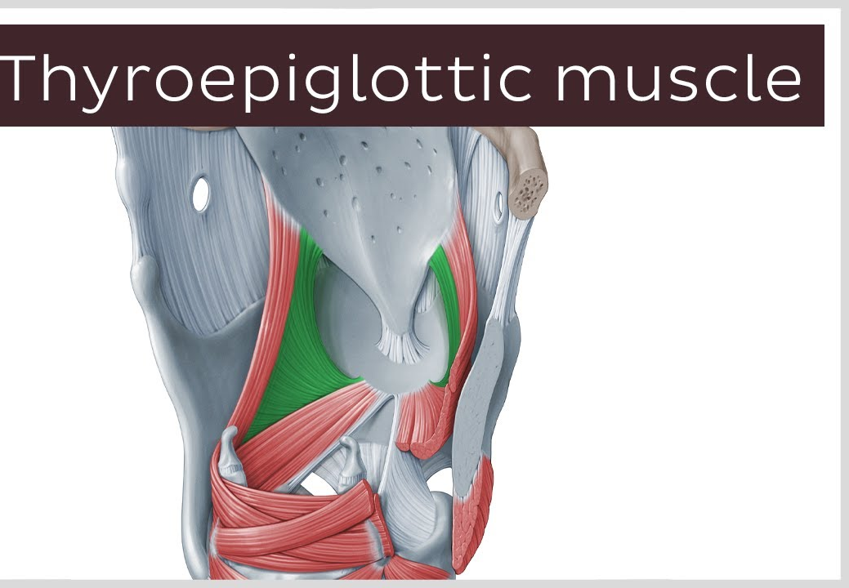

Slide 43
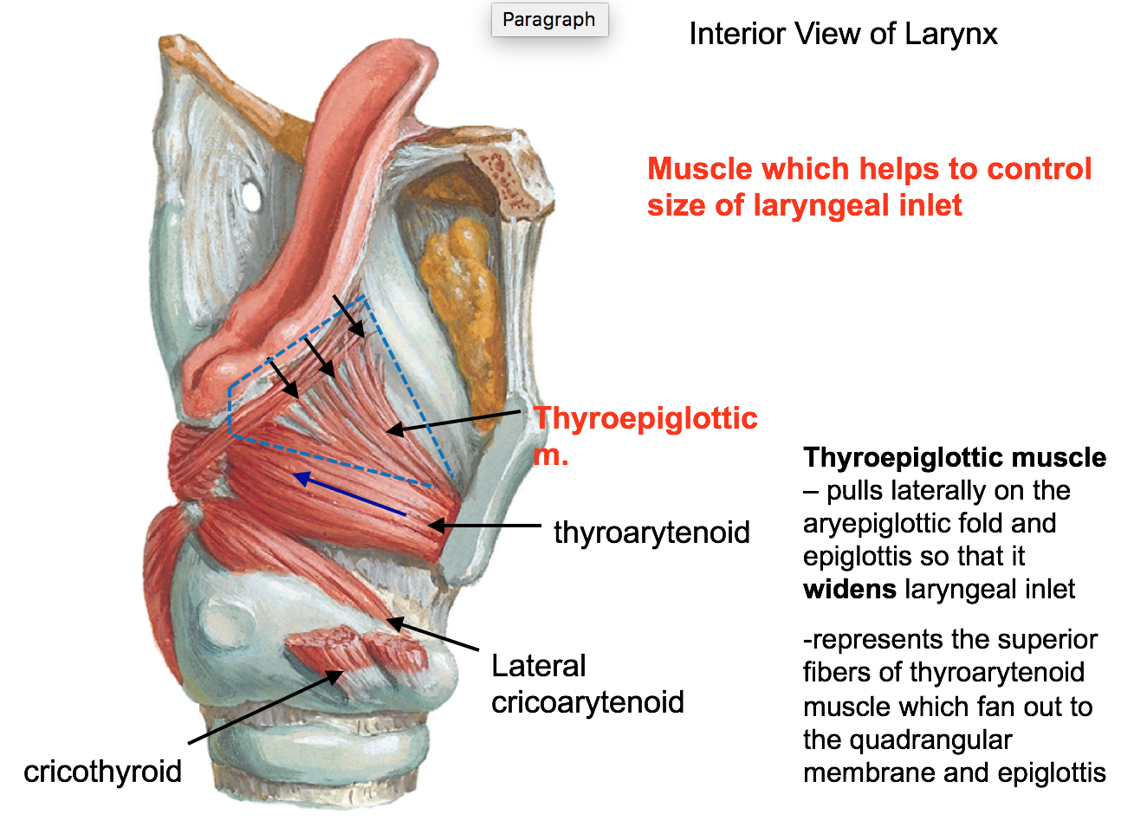

Slide 44
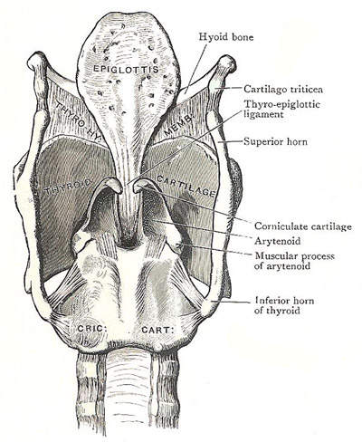
POSTERIOR SURFACE
OF EPIGLOTTIS
The posterior surface form the anterior wall of the upper part of laryngeal cavity.
The inferior half of the posterior surface of the epiglottis is raised slightly to form an epiglottic tubercle.
The posterior surface below the apex is pitted by mucous glands.

Slide 45
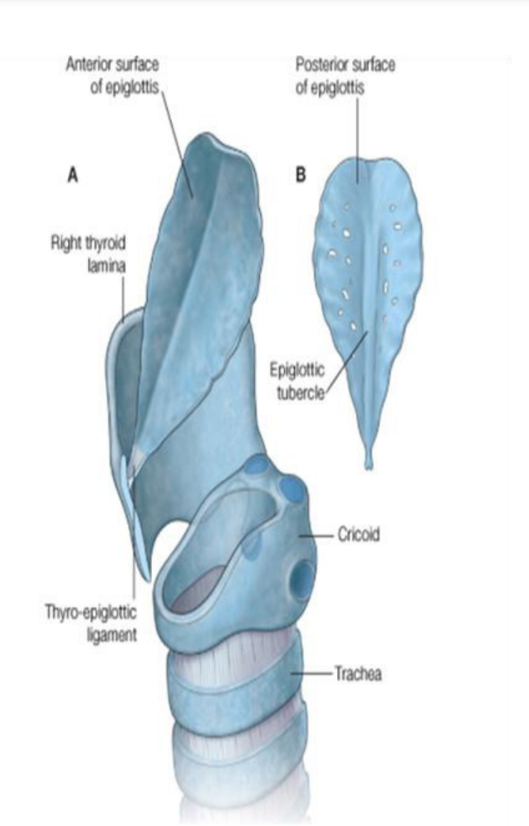
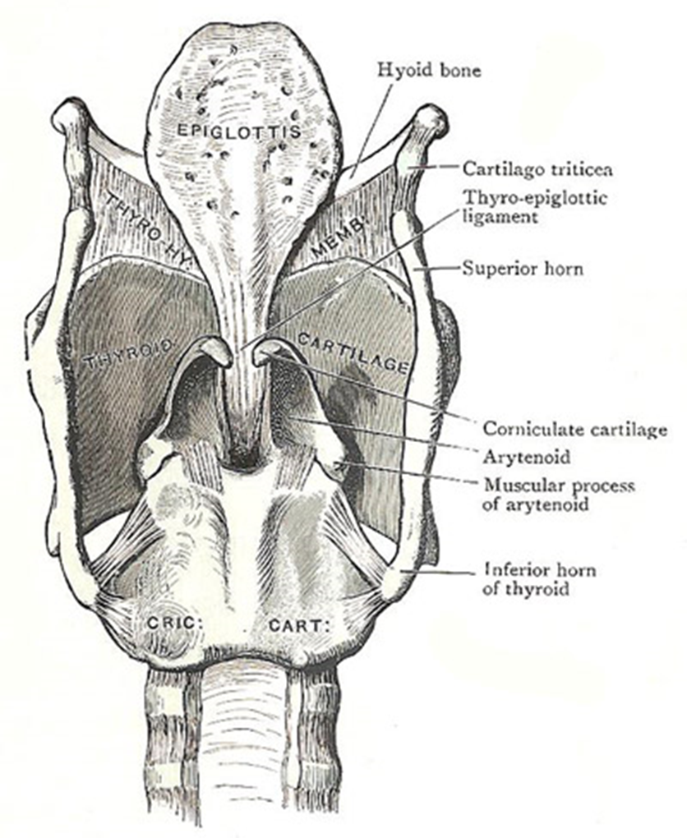
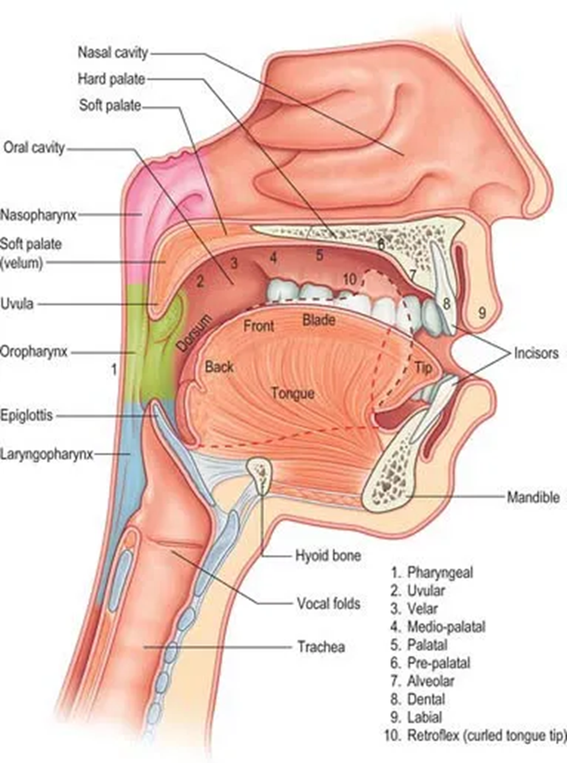

Slide 46

Anterior surface of epiglottis
Anterior surface(upper part):-Upper part of epiglottis attaches to the base of the tongue in the midline and laterally by the median and lateral glossoepiglottic folds that bound the valleculae.

Slide 47
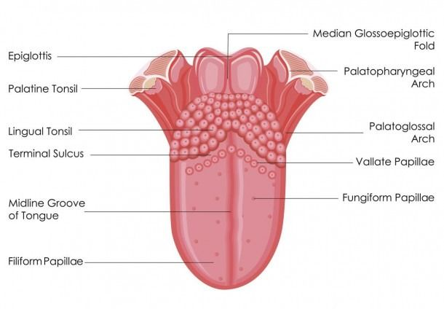

Slide 48
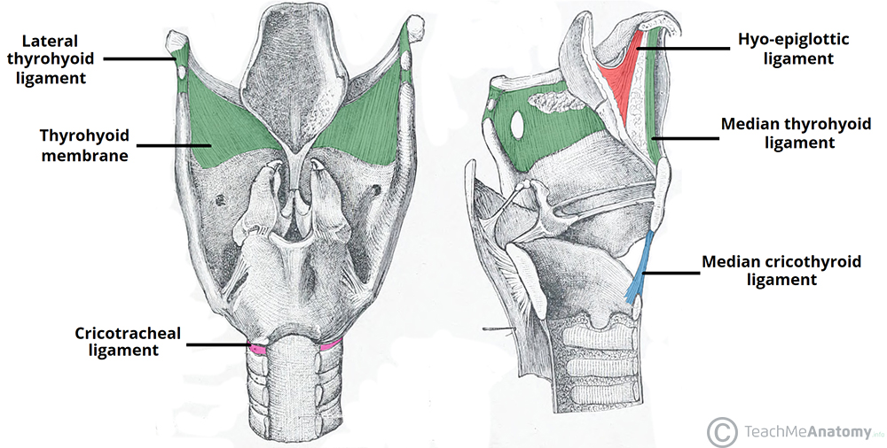
Lower part of the anterior surface of epiglottis
Lower part of the anterior surface is connected to the hyoid bone by hyo-epiglottic ligament

Slide 49
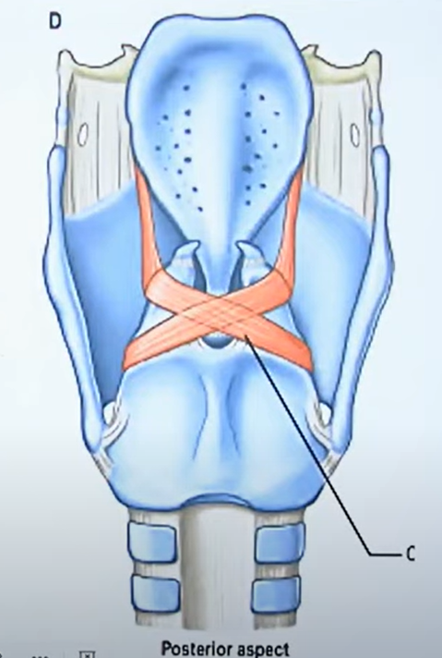
Lateral borders of epiglottis (aryepiglottic folds )
Provides attachment to thearyepiglottic folds.
These fold attached inferiorly to thearytenoid cartilages.
The aryepiglottic folds intervenes between laryngeal inlet medially and piriform fossa laterally.
The aryepiglottic folds contain the aryepiglottis muscles that contract during swallowing and reduce the opening into the larynx.

Slide 50



Slide 51

Arytenoid cartilage
2 small pyramidal shaped cartilages lying on upper border of lamina of cricoid cartilage
Apex – curved posteromedillay ,articulates with corniculate cartilage
Base is concave ,articulate with upper border of cricoid lamina
Base prolonged anteriorly to form vocal process & laterally to form muscular process
Surfaces are medial ,anterolateral ,& posterior

Slide 52

BASE OF ARYTENOID
The base is concave and articulates with the sloping articular facet on the superolateral surface of the lamina of cricoid cartilage.
The base is having two processes:
1. Muscular process
2. Vocal process

Slide 53

Muscular process of arytenoid cartilage
The lateral angle of triangular base of the arytenoid cartilage is elongated into a muscular process.
It is for attachment of two muscles:posterior and lateral crico-arytenoid muscles.

Slide 54

Attachments
Vocal process – vocal folds & vocalis muscle
Above vocal process – vestibular folds
Muscular process – posterior aspect gives insertion to posterior cricoarytenoid muscle
Anterior aspect – insertion to lateral cricoarytenoid muscle
Posterior surface – transverse arytenoid
Between base & apex – oblique arytenoid

Slide 55

Antrolateral aspect of the arytenoid cartilage
The anterolateral surface has two depressions, separated by a ridge.
These are for vocalis muscle and vestibular ligament attachment.

Slide 56

CORNICULATE
CARTILAGE
Horn shaped
2 small conical nodules which articulate with apex of arytenoid cartilages
Directed posteromedially
Lies in posterior part of
aryepiglottic folds

Slide 57


Slide 58

Cuneiform cartilages
Wedge shaped
2 small rod shaped cartilages placed in aryepiglottic folds just ventral to corniculate cartilages

Slide 59
Histology of laryngeal cartilages
Thyroid ,cricoid & basal part of arytenoid – are hyaline cartilage(ossify after 25 years )
Epiglottis , corniculate , cuneiform & processes of arytenoid – elastic cartilages (do not ossify )

Slide 60
Joints
2 synovial joints
Cricothyroid – between inferior cornua of thyroid & side of cricoid . permits rotatory movements around transverse axis –permits tension & relaxation of vocal cords
Cricoarytenoid – between base of arytenoid & upper border of lamina of cricoid cartilage
Permits rotatory movements around vertical axis – permits adduction & abduction

Slide 61


Slide 62


Slide 63
Thank you

