Slide 1
Larynx contd….
Ligaments,membranes ,muscles, cavity of larynx

Slide 2
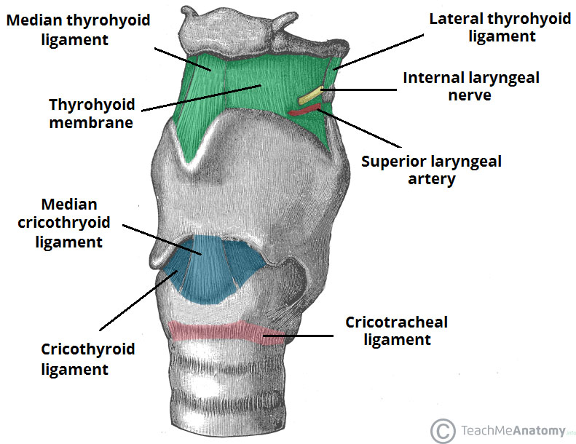
Ligaments and membranes
Thyrohyoid membrane –connects thyroid to hyoid
Median & lateral parts are thickened to form median &lateral thyrohyoid ligaments
Pierced by internal laryngeal nerve & superior laryngeal vessels
Hyoepiglottic ligament –connects upper end of epiglottic cartilage to hyoid bone
Cricotracheal ligament -connects cricoid cartilage to upper end of trachea

Slide 3
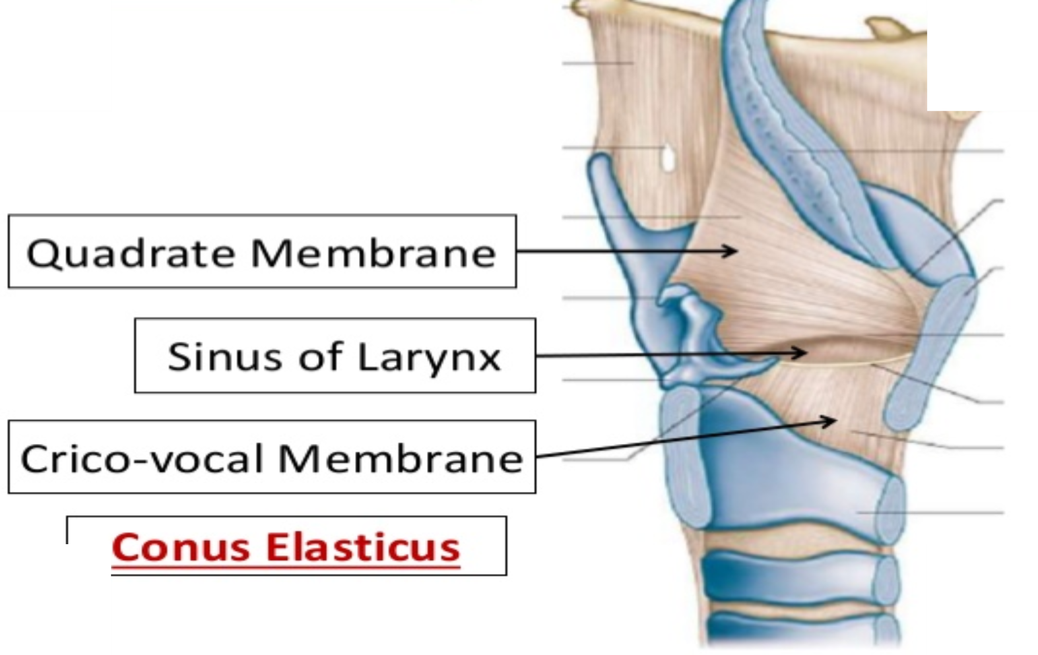

Slide 4
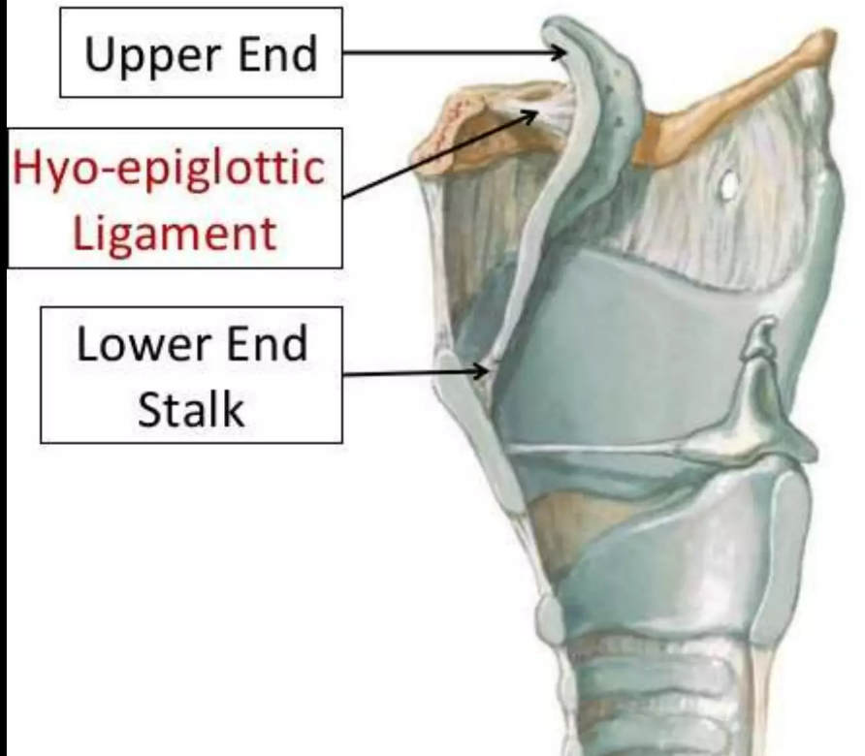
Thyrohyoid membrane
It is an extrinsic membrane that anchors the skeleton of the larynx to the hyoid bone.
The thyrohyoid membrane connects the whole length of the upper border of the laminae and the superior horns of thyroid cartilage to the body and greater horns of the hyoid bone.

Slide 5
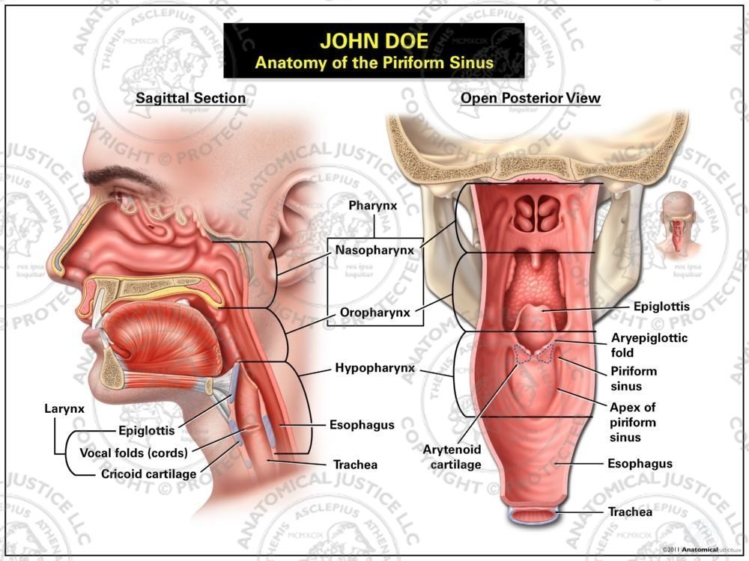

Slide 6
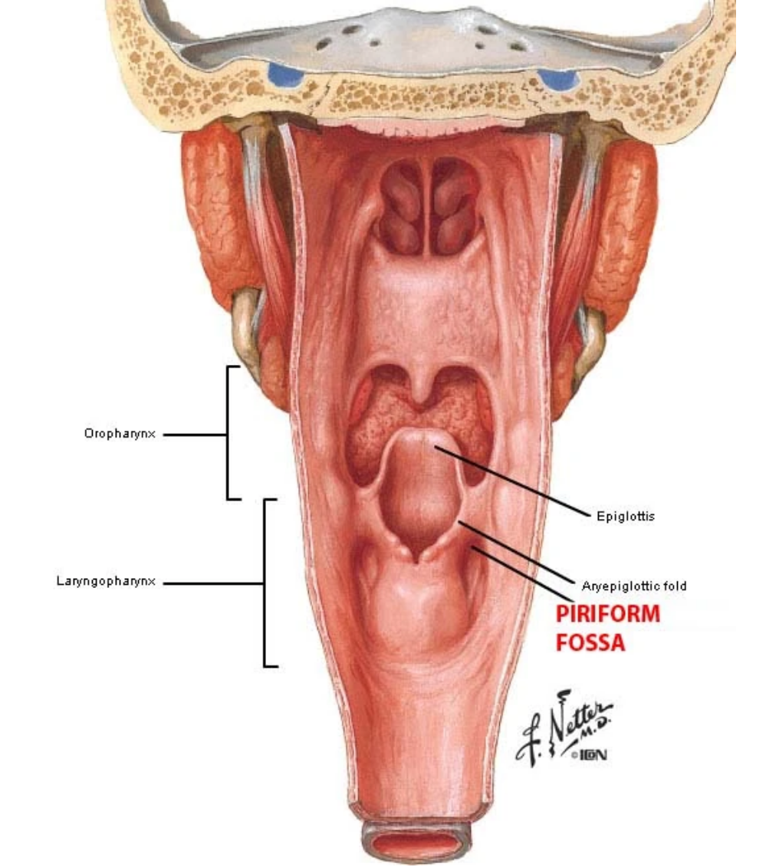

Slide 7
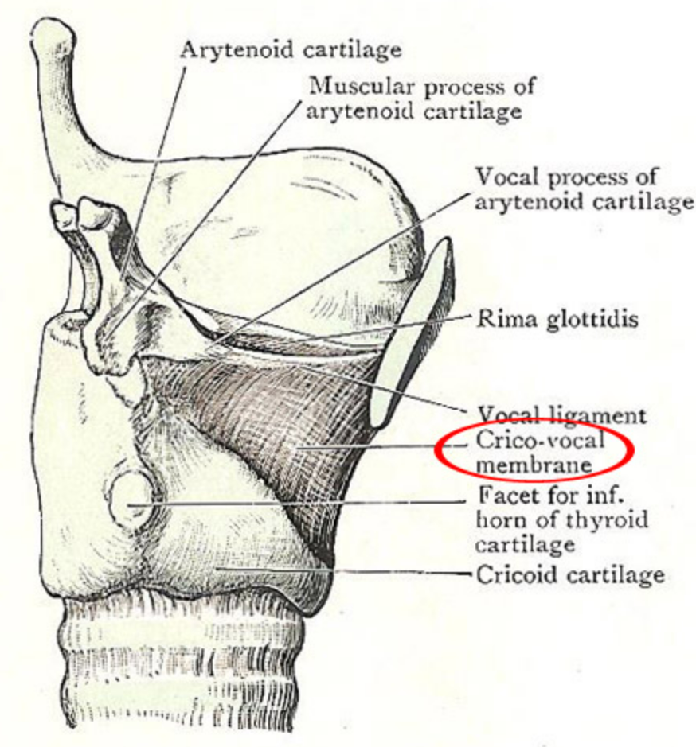
Intrinsic
The fibroelastic membrane of the larynx lies within the cartilaginous skeleton ofthe larynx.
These membranes lies beneath the laryngeal mucosa.
Membrane forms a discontinuous sheet, separated on both sides of the larynx by a horizontal cleft
Cleft lies between the vestibular andvocal ligaments..

Slide 8
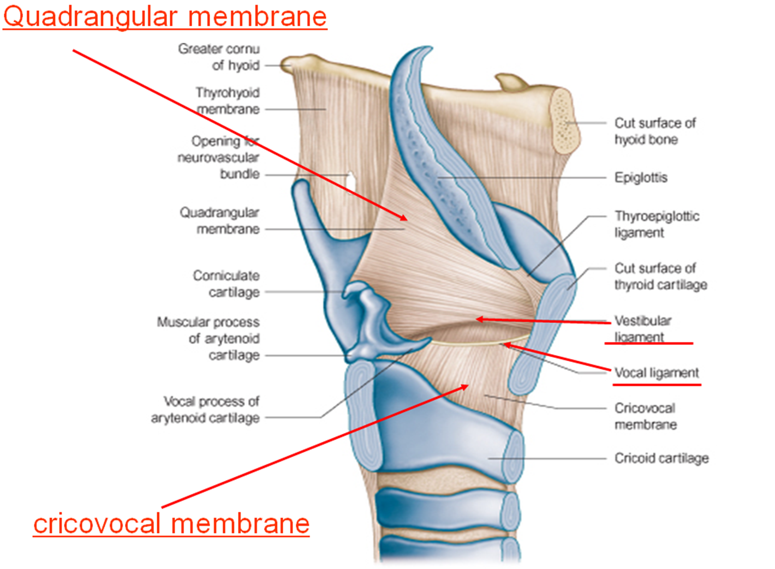
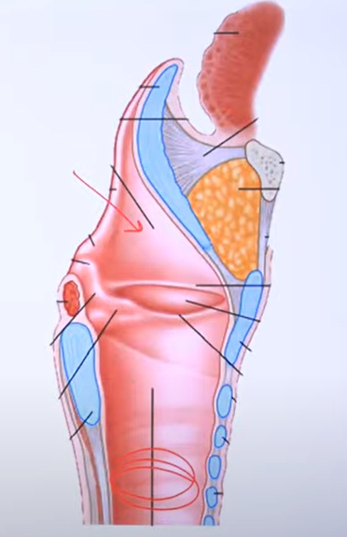

Slide 9
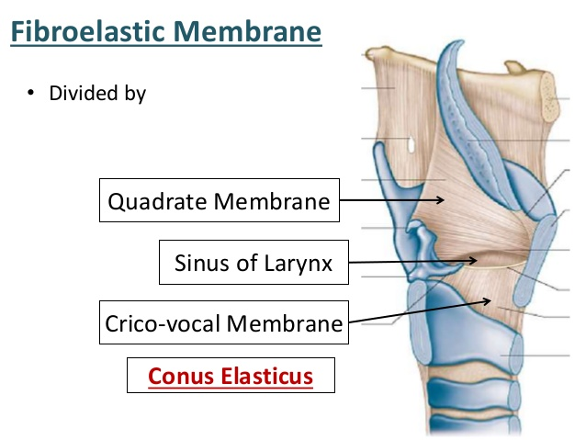

Slide 10


Slide 11
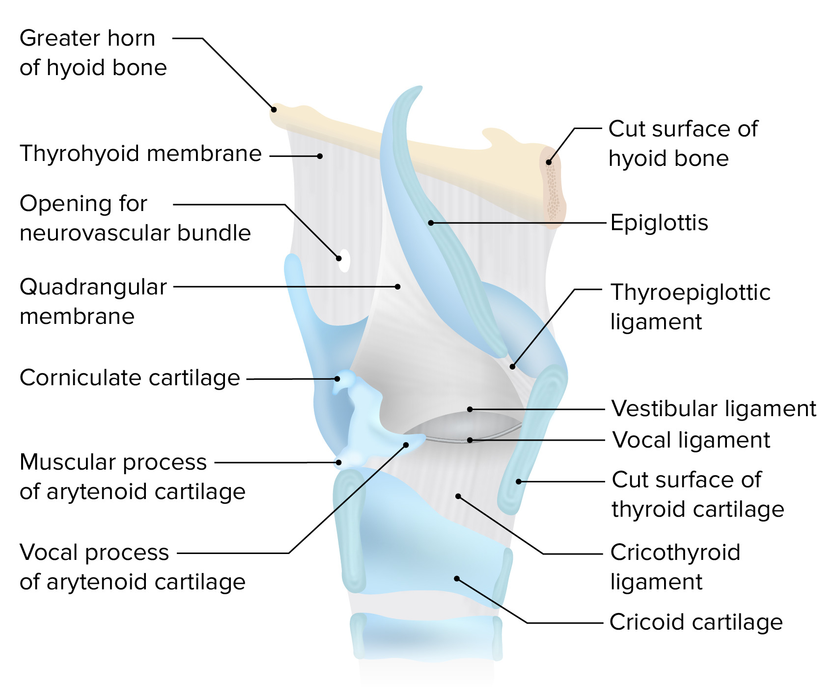
Quadrangular membrane – extends from sides of epiglottis to arytenoids. Its lower edge is free & attached anteriorly to posterior surface of thyroid cartillage & posteriorly to lateral surface of arytenoid cartilage (in front of muscular process).The lower edge is thickened to form vestibular ligament

Slide 12
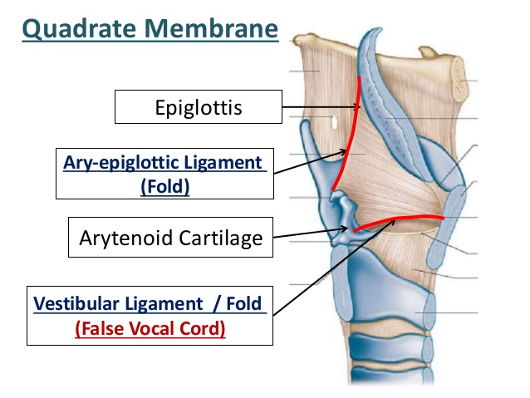

Slide 13
Conus elasticus
The conus elasticus is that part of the fibroelastic membrane found in the lower part of the cavity of the larynx.
• There are two synonyms for theconus elasticus:
CHICOVOCAL MEMBRANE
CRICOTHYROID MEMBRANE.

Slide 14
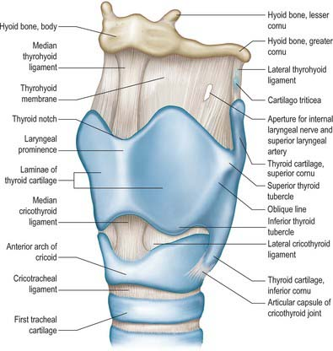
PARTS OF CONUS ELASTICUS
The conus elasticus or cricothyroid membrane consists of three distinct parts
Right and left lateral parts and thickened median portion.
The term conus elasticus is frequently applied to the lateral parts.
The lateral parts are thinner than themedian cricothyroid ligament.
• The median part is often called the median or the anterior cricothyroid ligament.

Slide 15


Slide 16
Muscles
Extrinsic
Palatopharyngeus
Salpingopharyngeus
Stylopharyngeus
Thyrohyoid
Sternothyroid
Intrinsic
Cricothyroid
Oblique arytenoid
Transverse arytenoid
Aryepiglotticus
Lateral cricoarytenoid
Posterior cricoarytenoid
Thyroarytenoid
Thyroepiglotticus

Slide 17
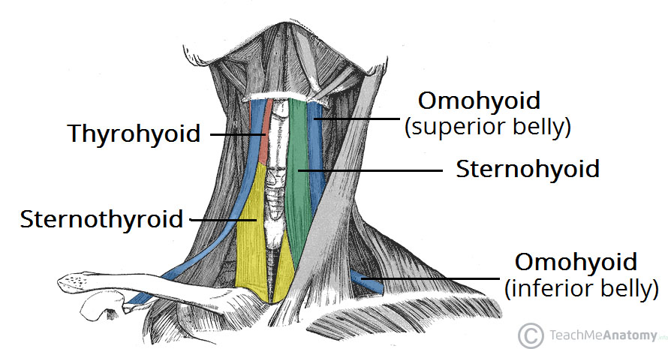
EXTRINSIC MUSCLES
The extrinsic muscles connect the larynx to neighbouring structures.
They include:
Infrahyoid strap muscles like thyrohyoid, sternothyroid and sternohyoid.
Inferior constrictor muscle of the pharynx.
Longitudinal muscles of the pharynx salpingopharyngeus, stylopharyngeus and palatopharyngeus, are connected to the posterior aspect of thyroid cartilage laminae and cornua.

Slide 18
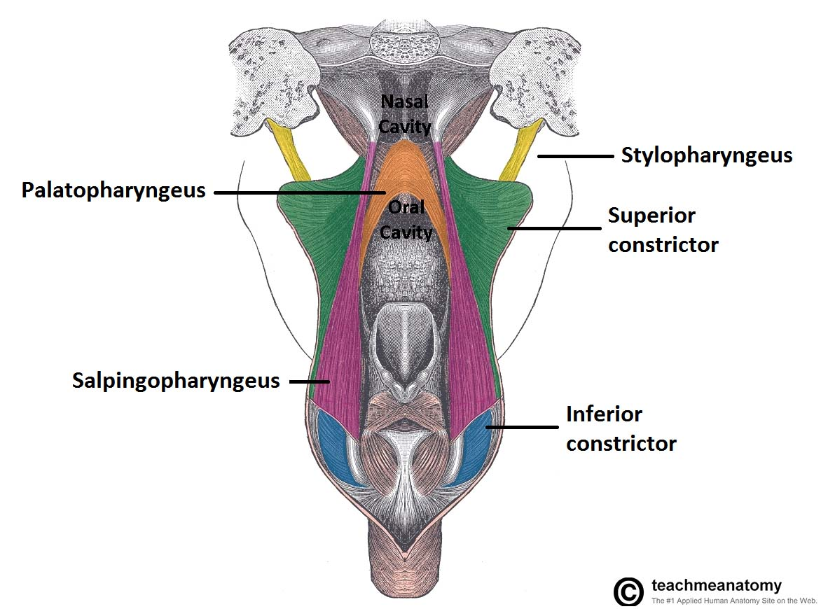
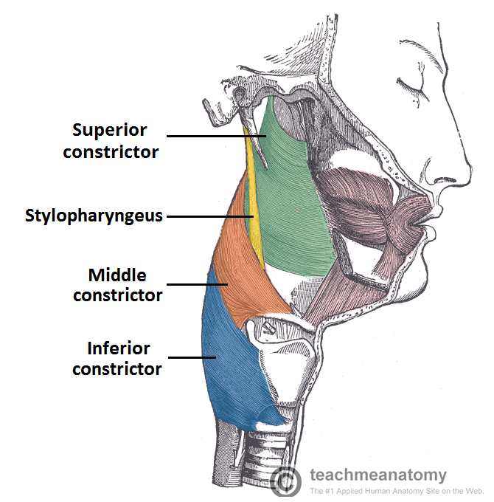
Extrinsic muscles…..

Slide 19
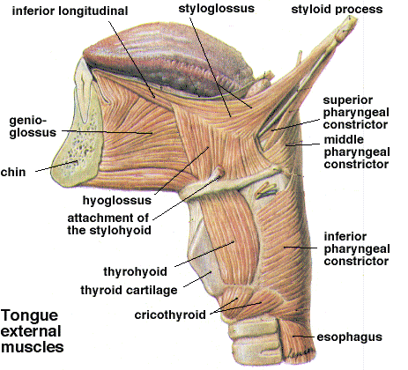
Function of the extrinsic muscles
These are responsible for moving larynx vertically up and down.
• This movements of larynx affect the pitch and the quality of the voice.
Stylopharyngeus and palatopharyngeus causes elevation of the larynx.
The elevation of larynx causes increase in pitch.

Slide 20
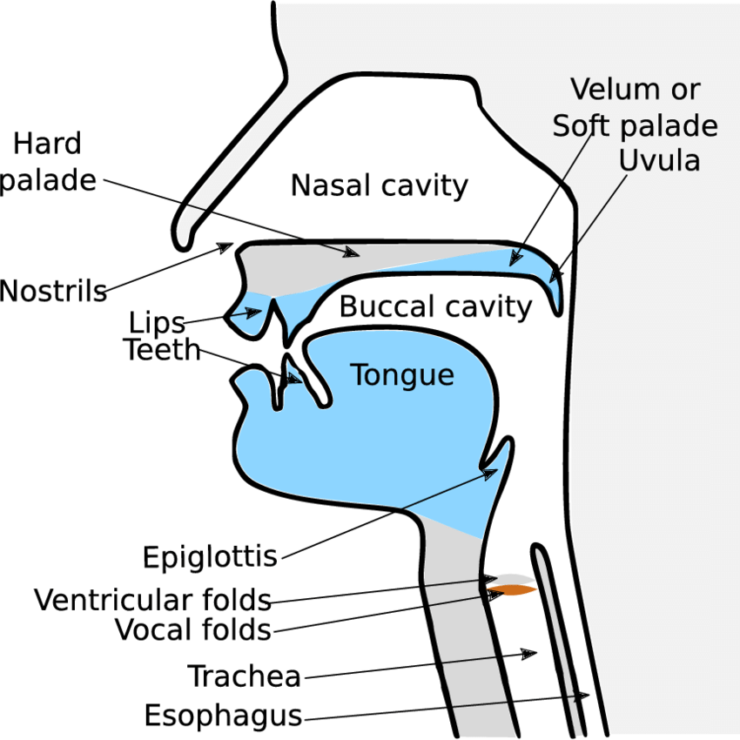

Slide 21
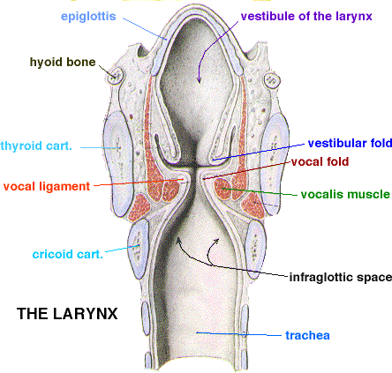
INTRINSIC MUSCLES
The function of intrinsic muscles of the larynx are
Adjust tension in the vocal ligaments
Open and close the rima glottidis,
Control the inner dimensions of the vestibule,
Close the rima vestibuli,
Open or close the laryngeal inlet.

Slide 22
INTRINSIC MUSCLES
Cricothyroid
Oblique arytenoid
Transverse arytenoid
Aryepiglotticus
Lateral cricoarytenoid
Posterior cricoarytenoid
Thyroarytenoid
Thyroepiglotticus

Slide 23
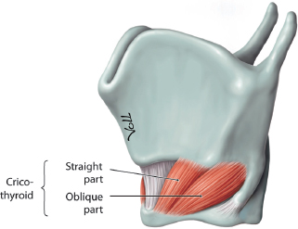
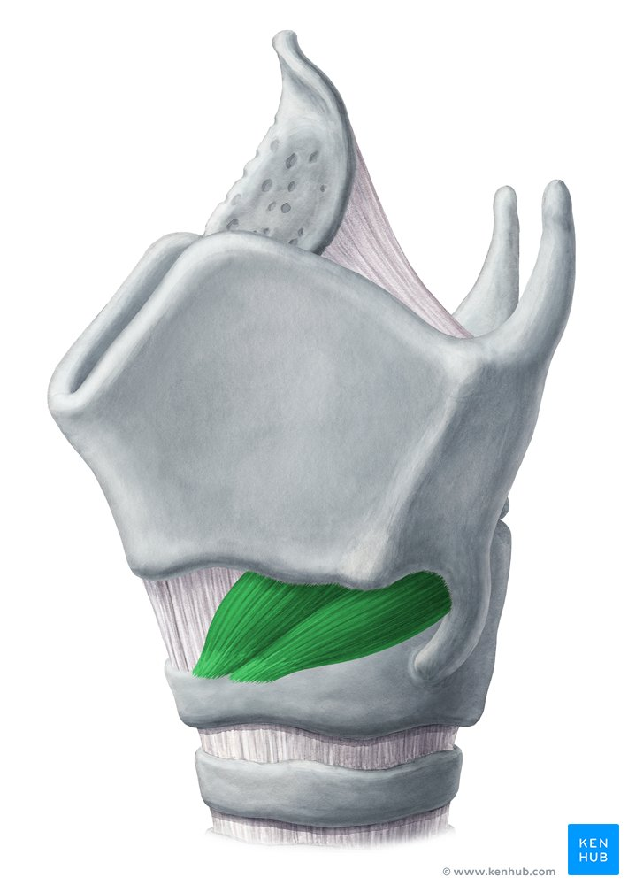
Cricothyroid
Origin -anterolateral part of arch of cricoid cartilage
Insertion – inferior cornua & adjacent part of lower border of lamina of thyroid cartilage
Nerve supply – external laryngeal nerve (branch of superior laryngeal nerve )

Slide 24
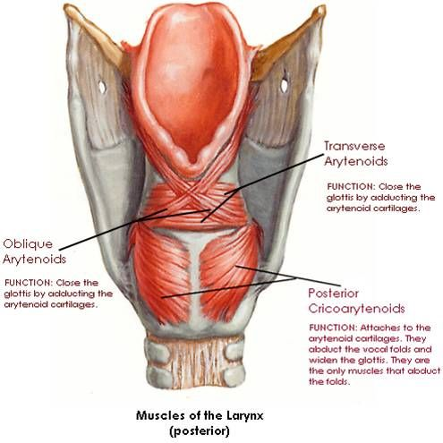
Oblique arytenoid
/aryepiglotticus
Origin –tip of the muscular process of one arytenoid
Insertion - apex of opposite arytenoid

Slide 25
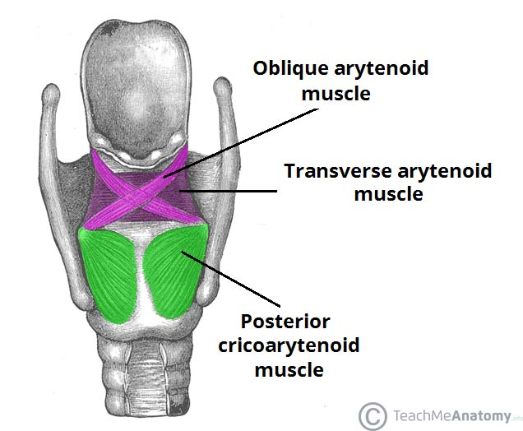
Oblique arytenoid
/aryepiglotticus
Actions
The oblique arytenoids and aryepiglottic muscles act as a sphincter of the laryngeal inlet.
• Closing of inlet by adducting the aryepiglottic folds and approximating the arytenoid cartilages to the tubercle of the epiglottis.

Slide 26
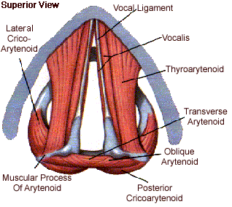
Transverse (inter)arytenoid
• It is a single, unpaired muscle
• It lies deep to the oblique inter-arytenoids.
• It bridges the gap at the back between the two arytenoid cartilages and fills their concave posterior surfaces.
It is attached to the back of themuscular process and adjacent lateralborder of both arytenoids.
Actions: It adducts the arytenoidcartilage.

Slide 27
Transverse arytenoid
Origin – posterior surface of one arytenoid
Insertion – posterior surface of other arytenoid

Slide 28
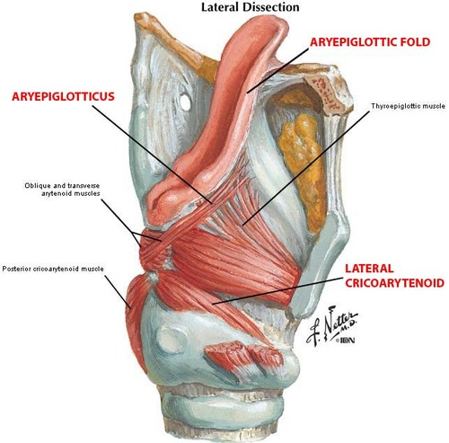
Lateral cricoarytenoid
Origin – lateral part of upper part of cricoid
Insertion –front of muscular process of arytenoid

Slide 29
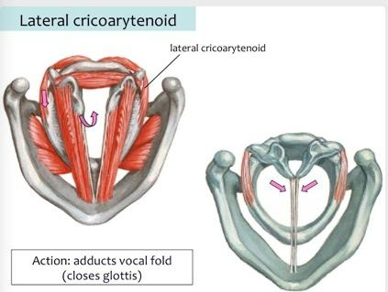

Slide 30
Posterior cricoarytenoid
Origin –posterior surface of cricoid lamina lateral to median ridge
Insertion – back of muscular process of arytenoid

Slide 31
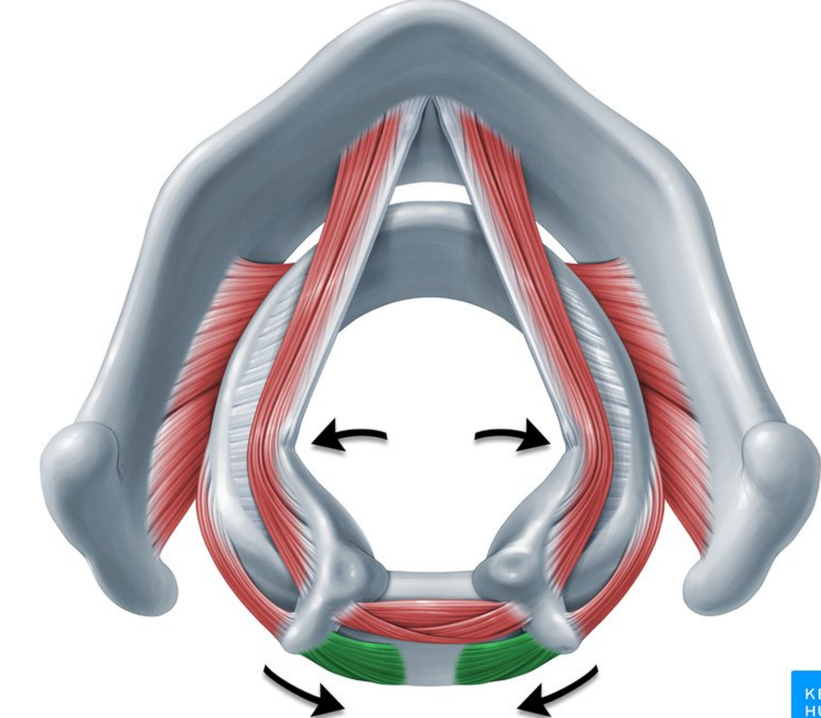

Slide 32
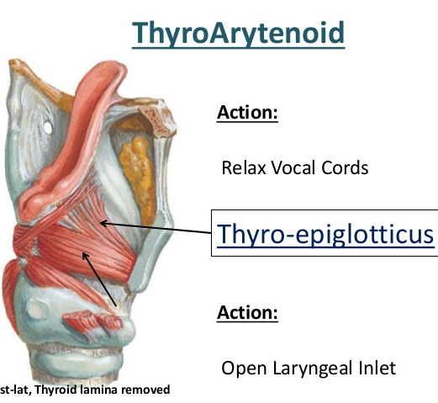
Thyroarytenoid
Origin – posterior aspect of angle of thyroid cartilage (Inner aspect of the throid cartilage )
Insertion - anterolateral surface of arytenoid cartilage
Actions: The thyroarytenoids draw the arytenoid cartilages towards the thyroid cartilage, thereby shortening and relaxing the vocal ligaments.

Slide 33
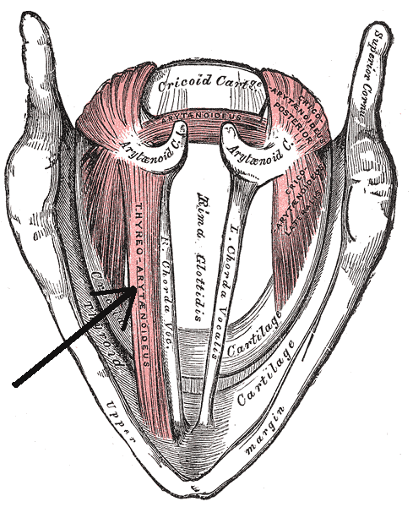

Slide 34
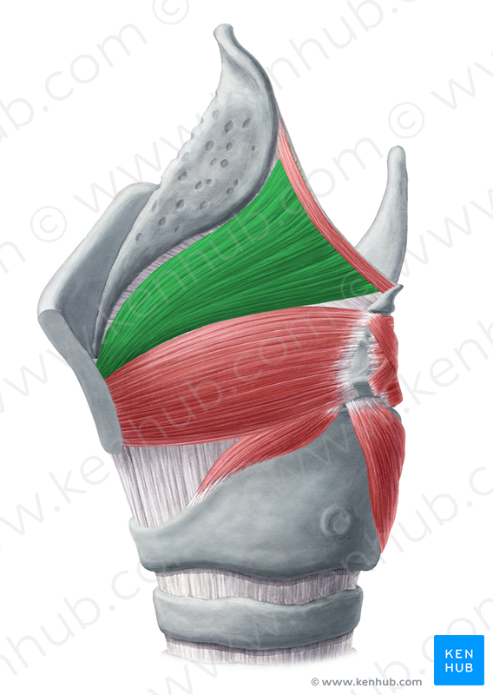
Thyroepiglotticus
Origin – posterior aspect of angle of thyroid
Insertion - margin of epiglottis

Slide 35
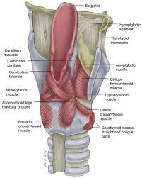

Slide 36
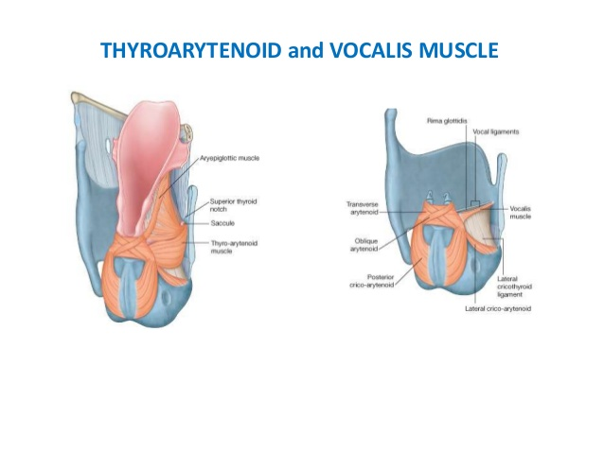

Slide 37
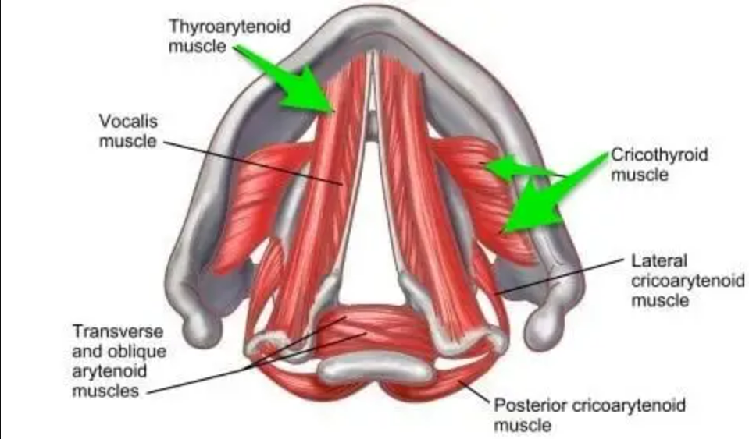
VOCALIS
It is the detached medial part of the thyro-arytenoid.)
It lies within the vocal fold just lateral to the vocal ligament.
Posterior attachment: to the lateral surface of the vocal process and anterolateral surface of the arytenoid cartilage.
• Anteriorly insert along the length of the vocal ligament to the thyroid angle.

Slide 38
According to their actions, intrinsic muscles of the larynx are arranged into the three groups:
1. Open or Close the Laryngeal Inlet (Sphincter)The oblique arytenoids, ary-epiglottic and thyro-epiglottic muscles.
2. Abduct or Adduct the Vocal Cords/change thedimensions and the degree of opening of the rimaglottidis.
The posterior and lateral cricoarytenoids and oblique and transverse arytenoids.
3. Increase or Decrease the Tension of Vocal Cords --The cricothyroids, thyroarytenoids and vocalis.

Slide 39
Laryngeal cavity

Slide 40
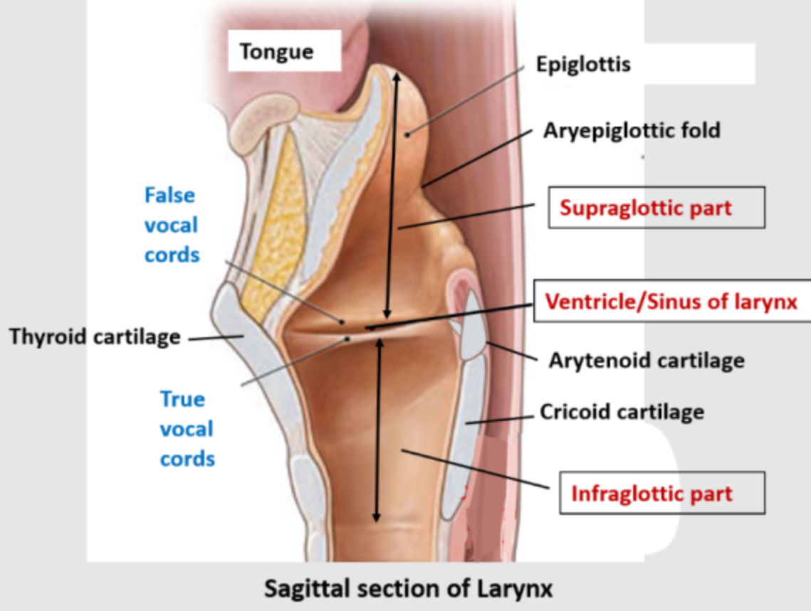
Boundries of laryngeal cavity
Boundaries
Anterior – epiglottis
Posterior - interarytenoid fold of mucous membrane
Lateral - aryepiglottic fold of mucous membrane

Slide 41

Cavity of larynx
Extends from inlet of larynx to lower border of cricoid cartilage .anterior wall longer than posterior wall
Laryngeal inlet is obliquely placed ,sloping downwards and backwards , opening into laryngopharynx

Slide 42
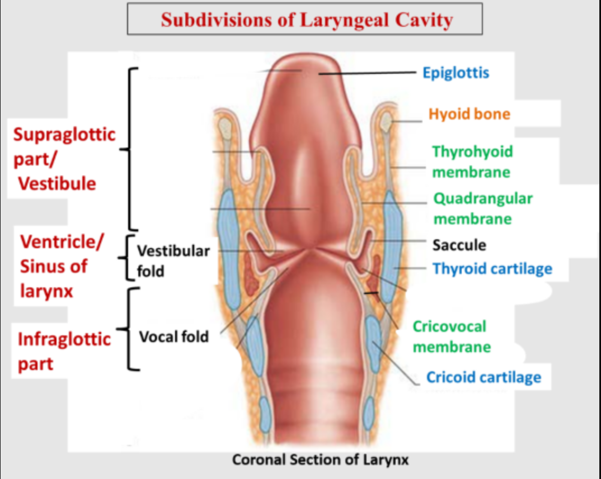
Parts of the laryngeal cavity
The folds project into the cavity of the larynx and divide the cavity into
Upper part
Middle part
Lower part

Slide 43
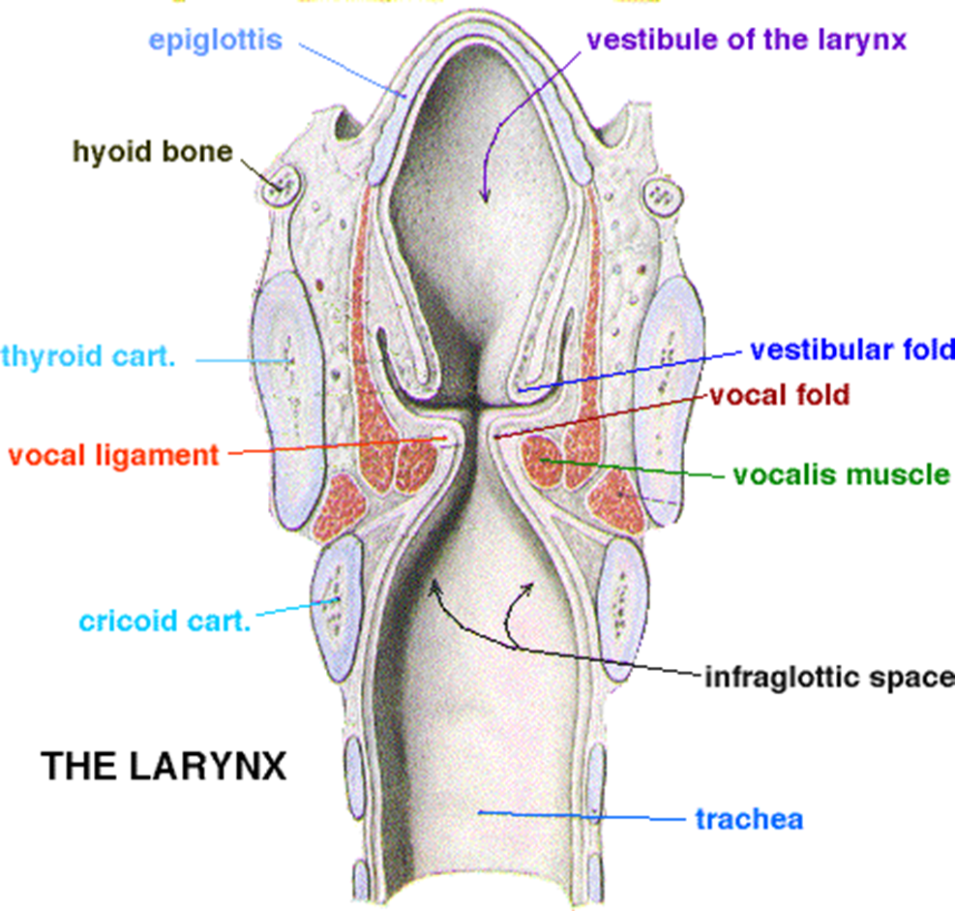
Structures in the upper part of the cavity
The upper part of the laryngeal cavity consists of:
The laryngeal inlet (aditus)
The aryepiglottic fold and
The laryngeal vestibule.

Slide 44
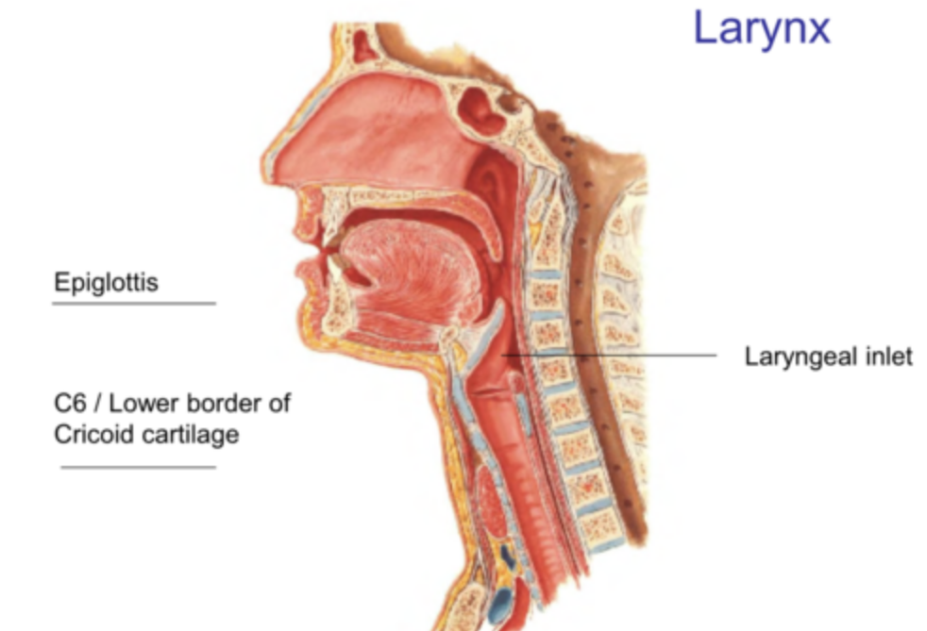
laryngeal inlet (aditus)
The upper part of the laryngeal cavity is entered by the laryngeal inlet (aditus laryngis).
It is an aperture between the larynx and pharynx.
• This faces backwards and somewhat upwards.
Because the anterior wall of the larynx is much longer than the posterior.

Slide 45
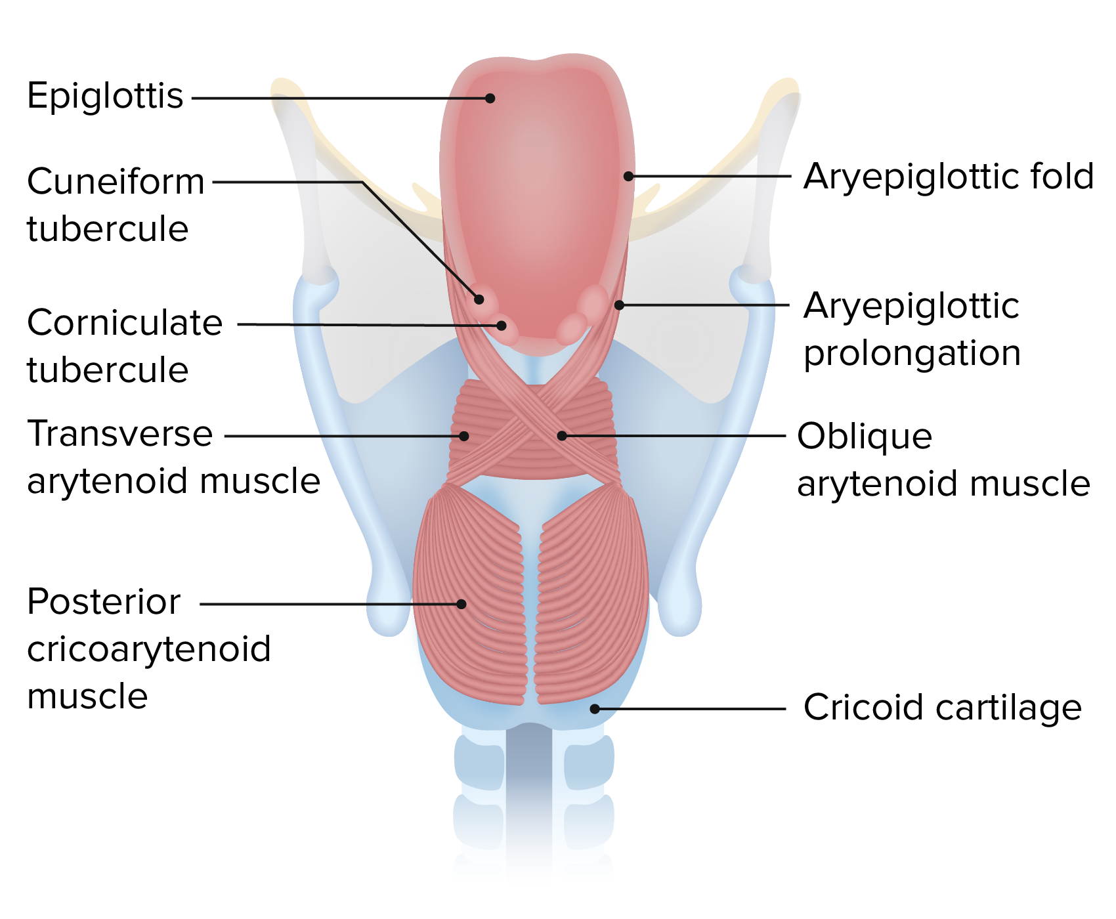
Boundaries of laryngeal inlet
The inlet is bounded:>
Anteriorly by the upper edge of the epiglottis,
Posteriorly by the transversemucosal fold between the two arytenoids (posterior commissure),and
On each side, by the edge of a mucosal ridge, called the aryepiglottic fold.

Slide 46
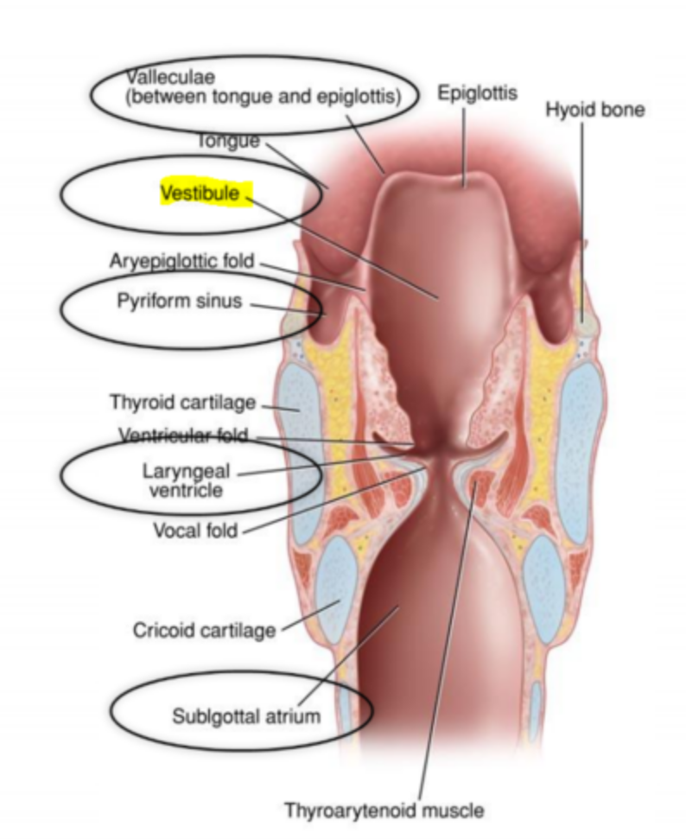
VESTIBULE OF LARYNX
The laryngeal vestibule is the region between the laryngeal inlet and vestibular folds.
It is wide above, narrow below.
• The anterior wall is formed by the posterior surface of the epiglottis, the lower part of which (epiglottic tubercle) bulges backwards a little.
• The lateral walls, higher in front and shallow behind, are formed by the medial surfaces of the aryepiglotticfolds.
The posterior wall consists of the inter- arytenoid mucosa above the ventricular folds.

Slide 47
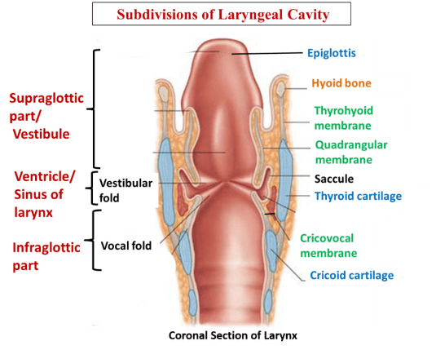

Slide 48
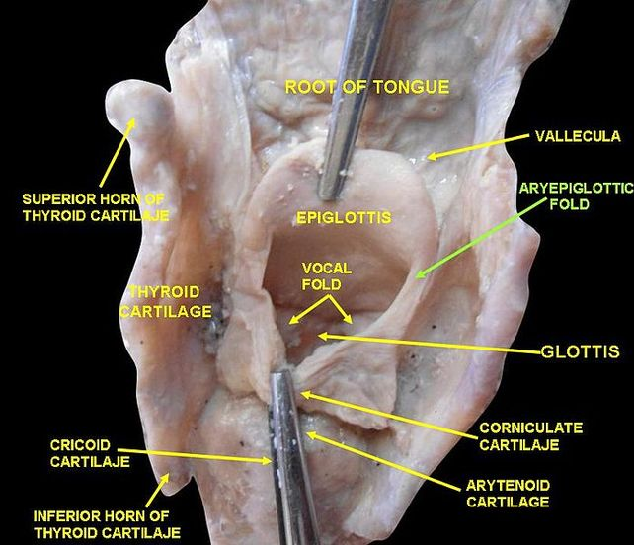
ARYEPIGLOTTIC FOLD
The aryepiglottic fold contains ligamentous and muscular fibres.
The ligamentous fibres represent the free upper border of thequadrangular membrane.
The muscle fibres are continuations of the oblique arytenoids.
The posterior part of the aryepiglottic fold contains two oval swellings, cuneiform andcorniculate cartilages.

Slide 49
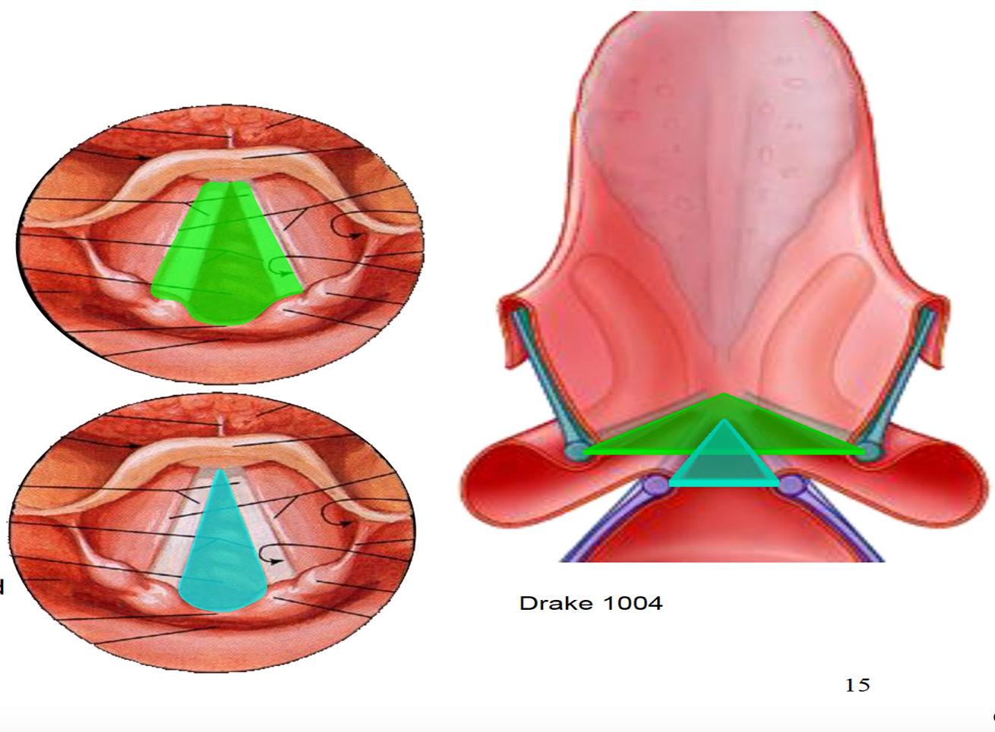
Middle part of the laryngeal cavity
• The middle part of the laryngeal cavity is the smallest.
• It extends from the rima vestibuli above to the rima glottidis below
.• On each side it contains:
The vestibular folds,
The ventricle and
The saccule of the larynx.

Slide 50
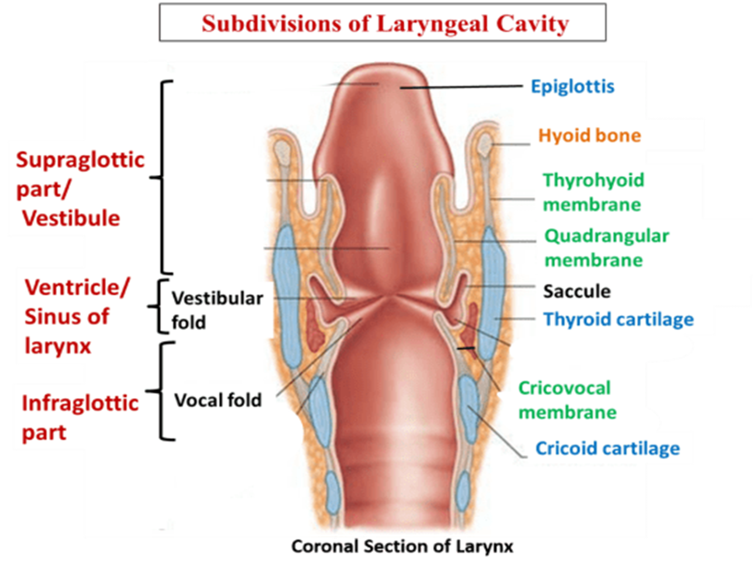
Ventricle
Deep elliptical space between vestibular & vocal folds
On each side , a narrow blind diverticulum of mucous membrane extends posterosuperiorly between vestibular fold and lamina of thyroid cartilage ,saccule of larynx .
It is provided with mucous glands which lubricate the vocal cords ,hence called oil can of larynx .

Slide 51
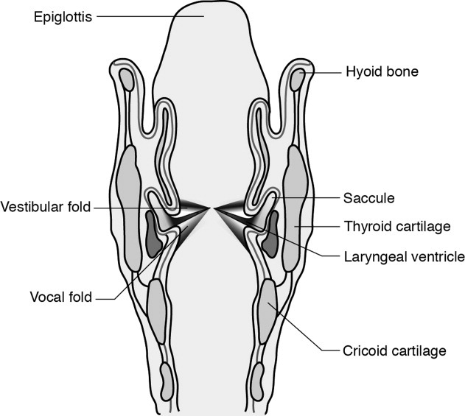
SACCULE OF THE LARYNX
The saccule is a pouch of variable size that ascends forwards from the anterior end of the ventricle.
It lies between the vestibular fold and thyroid cartilage.
• It contains mucous glands in the submucosa.
• The orifice of the saccule lies lateral to the vestibular fold.
• It opens anteriorly in middle part of laynx

Slide 52
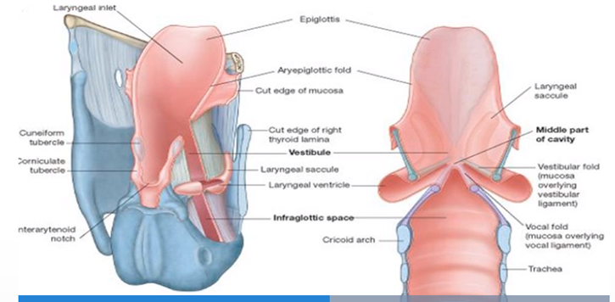

Slide 53
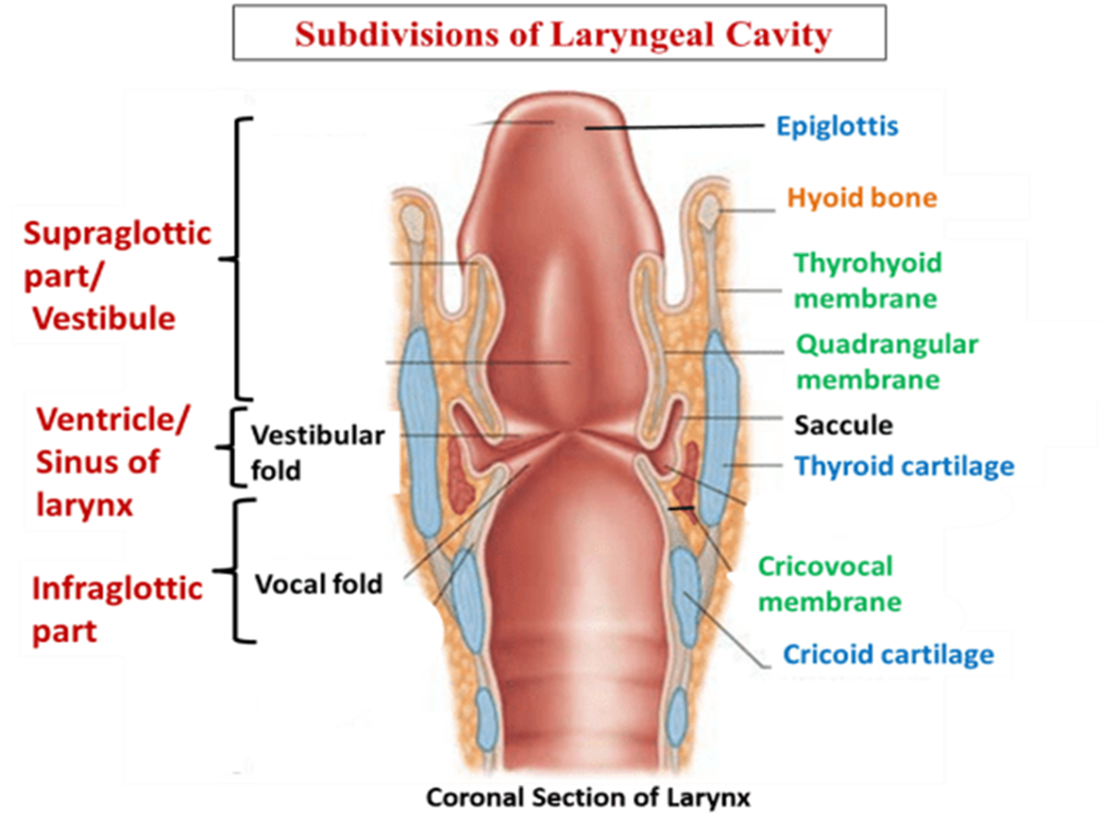
Infraglottic part
It is also knownas subglottic cavity
From vocal folds to lower border of cricoid cartilage

Slide 54
Summary
Two pairs of mucous folds divide the cavity into 3 regions
Upper fold – vestibular ligament-vestibular folds –false vocal cords
Lower folds - vocal ligament ,vocalis muscle – vocal cords
Space between vestibular folds – rima vestibuli
Space between vocal folds - rima glottidis
Rima glottidis is the narrowest part of laryngeal cavity

Slide 55

Mucous membrane of larynx
Anterior surface & upper half of posterior surface of epiglottis ,upper part of aryepiglottic fold & vocal folds –lined by stratified squamous epithelium
The rest of mucosa is covered by ciliated columnar epithelium

Slide 56
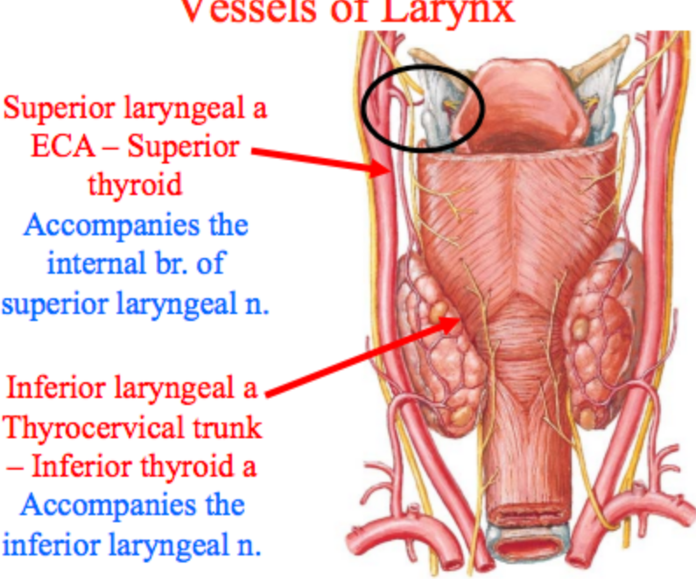
Blood supply
Up to vocal folds
By superior laryngeal artery
By superior laryngeal vein -to superior thyroid vein
Below vocal folds
By inferior laryngeal artery
Inferior laryngeal vein –to inferior thyroid vein

Slide 57
Nerve supply
Recurrent laryngeal nerve supplies all intrinsic muscles except cricothyroid
Cricothyroid is supplied by external laryngeal nerve

Slide 58
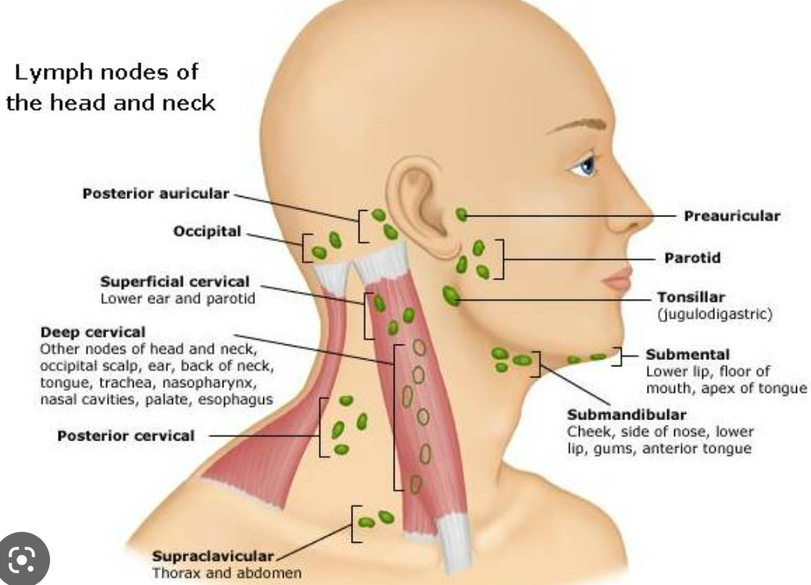
Lymphatic drainage
Part above vocal folds –along superior thyroid vessels – deep cervical nodes
Below vocal folds - deep cervical nodes
Few drain into prelaryngeal nodes

