Slide 1
Intestines

Slide 2
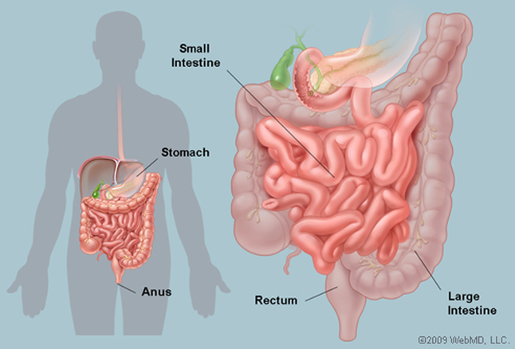
Intestine, which is the longest part of the digestive tube, is divided into long, less distensible, small intestine, and shorter, more distensible large intestine.

Slide 3
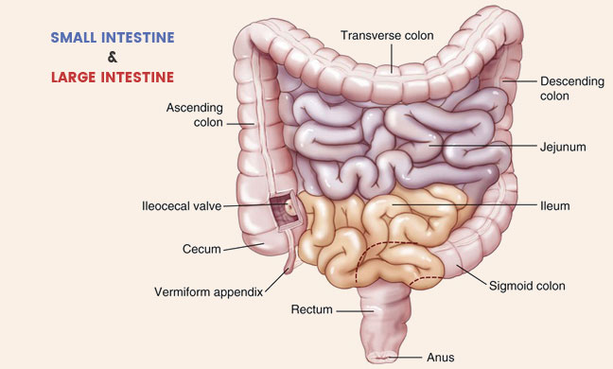
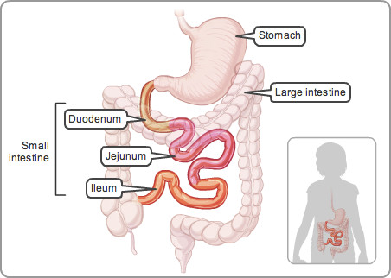
Parts of the
Intestines

Slide 4
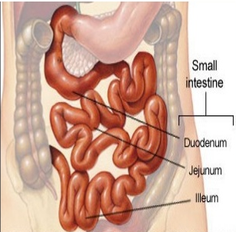
SMALL INTESTINE __________
Extent -small intestine extends from the pylorus to the ileocaecal junction .
Length-6 m long.

Slide 5
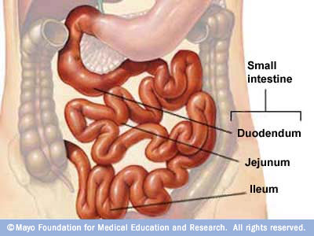
It is divided into (a) an upper, fixed part, called the duodenum, which measures about 25 cm in length; and (b) a lower, mobile part, forming a very long convoluted tube.
The upper two-fifths of the mobile intestine are known as the jejunum, and the lower three-fifths are known as the ileum.
The structure of the small intestine is adapted for digestion and absorption.

Slide 6
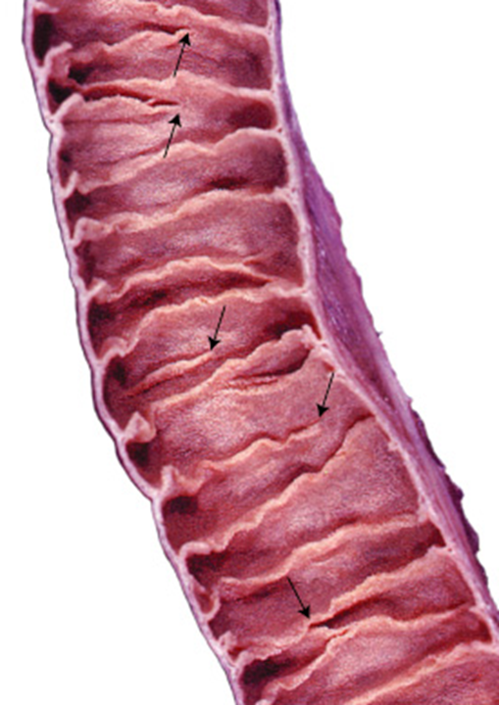
Features of small intestines
1. Large surface area for absorption of digested food.
Circular folds of mucous membrane, plicae circulares, or valves of Kerkring form complete /incomplete circles.
Folds are permanent, are not obliterated by distension. They begin in the second part of the duodenum, diminish progressively in size and number
Are almost absent in the distal half of the ileum

Slide 7
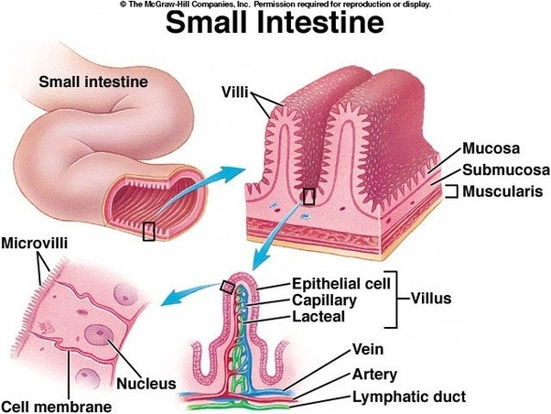
The intestinal villi are finger-like projections of mucous membrane.
Give the surface of the intestinal mucosa a velvety appearance.
They are large and numerous in the duodenum and jejunum, but are smaller and fewer in the ileum. They vary in density from 10 to 40 per square millimetre, and are about 1 to 2 mm long. They increase the surface area of the small intestine about eight times.

Slide 8
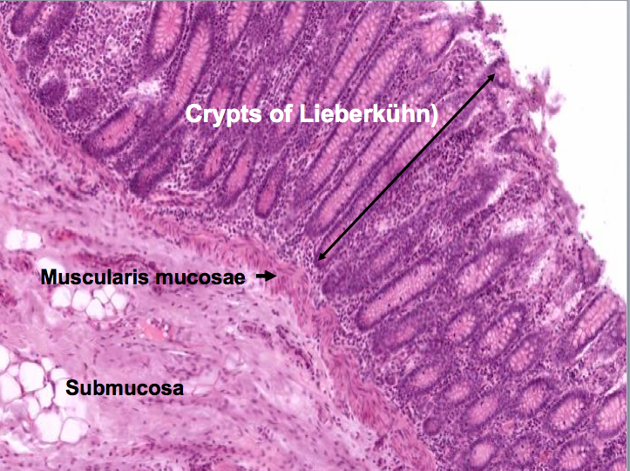
Intestinal glands or crypts of Lieberkuhn: These are simple tubular glands distributed over the entire mucous membrane of the jejunum and ileum. They open by small circular apertures on the surface of mucous membrane between the villi. They secrete digestive enzymes and mucus.

Slide 9
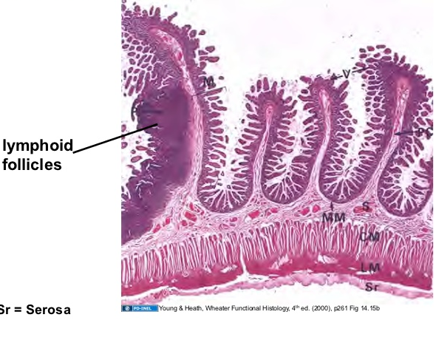
Lymphatic follicles: The mucous membrane of the small intestine contains two types of lymphatic follicles. The solitary lymphatic follicles are 1 to 2 mm in diameter, and are distributed throughout the small and large intestines.

Slide 10
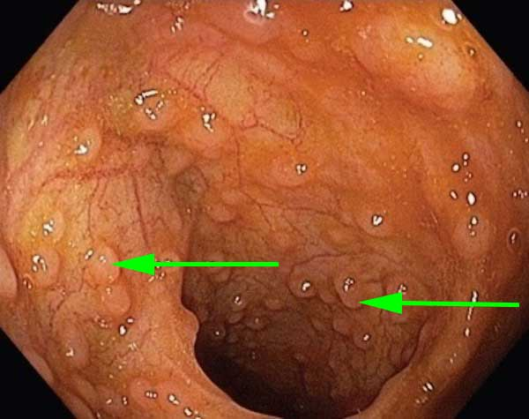
Peyer's patches
The aggregated lymphatic follicles or Peyer's patches form circular or oval patches, varying in length from 2 to 10 cm and containing 10 to over 200 follicles. They are largest and most numerous in the ileum, and are small, circular and fewer in the distal jejunum

Slide 11
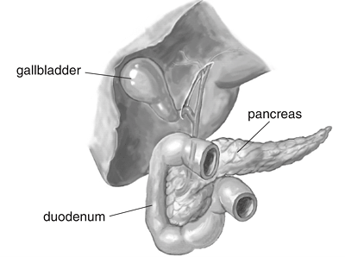
THE DUODENUM
Term -The term duodenum is a Latin corruption of the Greek word, dudekadaktulos, meaning twelve fingers.

Slide 12
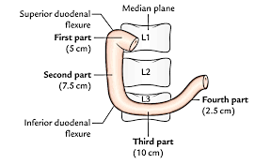
Definition and Location
The duodenum is the shortest, widest and most fixed part of the small intestine.
Extent-from the pylorus to the duodenojejunal flexure.
Location- The duodenum lies above the level of the umbilicus, opposite first, second and third lumbar vertebrae.

Slide 13
Length and Parts
Duodenum is 25 cm long and is divided into the i following four parts.
1. First or superior part, 5 cm long.
2. Second or descending part, 7.5 cm long.
3. Third or horizontal part, 10 cm long.
4. Fourth or ascending part, 2.5 cm long

Slide 14
Peritoneal Relations
The duodenum is mostly retroperitoneal and fixed, except as its two ends where it is suspended by folds of peritoneum, and is therefore, mobile. Anteriorly, the duodenum is only partly covered with peritoneum

Slide 15
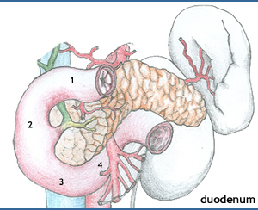
First Part
The first part begins at the pylorus, and passes backwards, upwards and to the right to meet the second part at the superior duodenal flexure

Slide 16
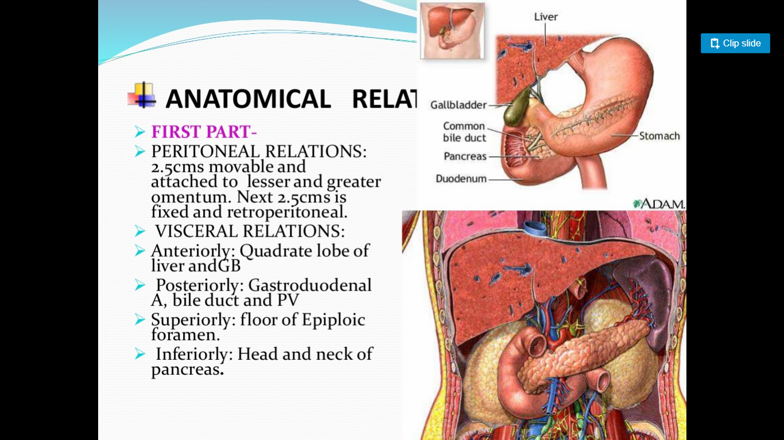
Peritoneal Relations
1. The proximal 2.5 cm is movable. It is attached to the lesser omentum above, and to the greater omentum below.
2. The distal 2.5 cm is fixed. It is retroperitoneal. It is covered with peritoneum only on its anterior aspect.

Slide 17
Visceral Relations
Anteriorly: Quadrate lobe of liver, and gall bladder .
Posterior. Gastroduodenal artery, bile duct and portal vein .
Superiorly : Epiploic foramen
Inferiorly : Head and neck of the pancreas

Slide 18
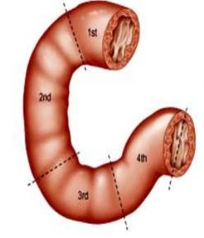
Second Part
This part is about 7.5 cm long. It begins at the superior duodenal flexure, passes downwards to become continuous with the third part

Slide 19
Peritoneal Relations
2nd part
It is retroperitoneal and fixed. Its anterior surface is covered with peritoneum, except near the middle, where it is directly related to the colon

Slide 20
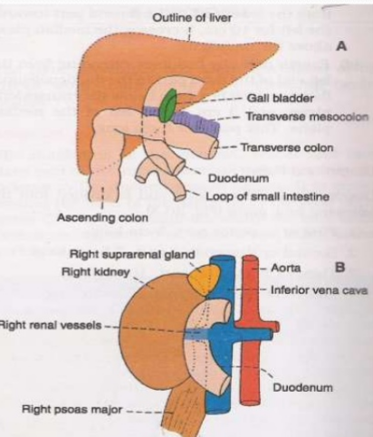
Visceral Relations
2nd part
Anteriorly : (a) Right lobe of the liver; (b) transverse colon, (c) root of the transverse mesocolon, (d) small intestine
Posteriorly: (a) Anterior surface of the right kidney near the medial border, (b) right renal vessels, (c) right edge of the inferior vena cava, (d) right psoas major .
Medially : (a) Head of the pancreas and (b) the bile duct .
Laterally : Right colic flexure

Slide 21
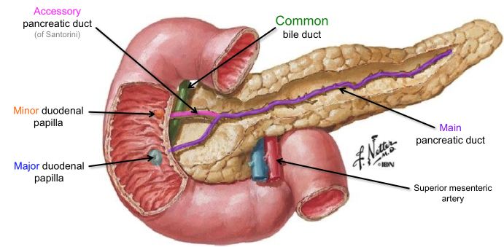
Duodenal papilla
1. The major duodenal papilla is an elevation present posteromedially, 8 to 10 cm distal to the pylorus. The hepatopancreatic ampulla opens at the summit of the papilla.
2. The minor duodenal papilla is present 6 to 8 cm distal to the pylorus, and presents the opening of the accessory pancreatic duct

Slide 22
Third part
This part is about 10 cm long. It begins at the ! inferior duodenal flexure,
It passes almost horizontally and slightly upwards in front of the inferior vena cava, and ends by joining the fourth part

Slide 23
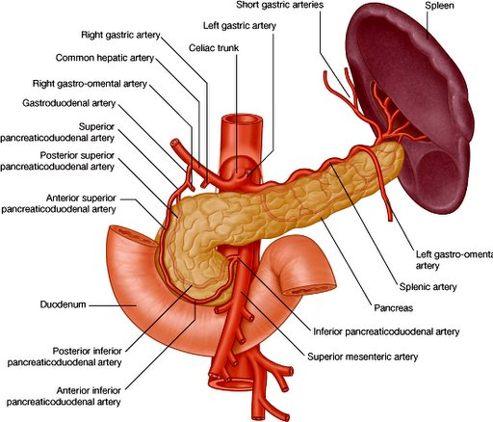
It is retroperitoneal and fixed. Its anterior surface is covered with peritoneum, except in the median plane, where it is crossed by the superior mesenteric vessels and by the root of the mesentery

Slide 24
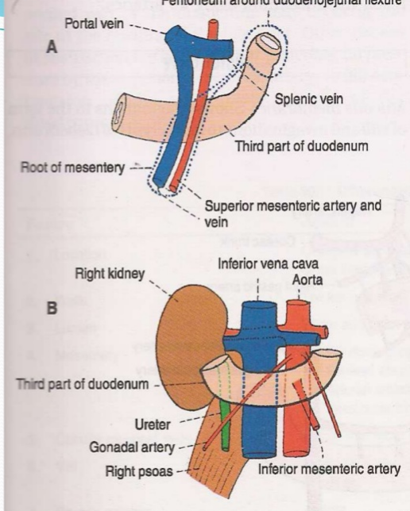
Visceral Relations
3rd part
Anteriorly : (a) Superior mesenteric vessels and b) root of mesentery
Posteriorly: (a) Right ureter, (b) right psoas major,
(c) right testicular or ovarian vessels, (d) inferior vena cava, and (e) abdominal aorta with origin of inferior msenteric artery
Superiorly : Head of the pancreas with uncinate process .
Inferiorly : Coils of jejunum

Slide 25
Fourth Part
Course
This part is 2.5 cm long. It runs upwards on or immediately to the left of the aorta, up to the upper border of the second lumbar vertebra, where it turns forwards to become continuous with the jejunum at the duodenojejunal flexure.

Slide 26
Peritoneal Relations
It is mostly retroperitoneal, and covered with peritoneum only anteriorly. The terminal part is suspended by the uppermost part of the mesentery, and is mobile.

Slide 27
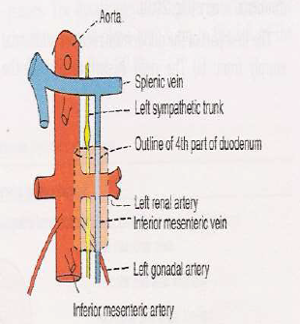
Visceral Relations
Anteriorly : (a) Transverse colon, (b) transverse mesocolon, (c) lesser sac, and (d) stomach.
Posteriorly : (a) Left sympathetic chain, (b) left psoas major, (c) left renal vessels, (d) left testicular vessels, and (e) inferior mesenteric vein.
To the right: Attachment of the upper part of the root of the mesentery.
To the left: (a) Left kidney and (b) left ureter.
Superiorly : Body of pancreas .

Slide 28
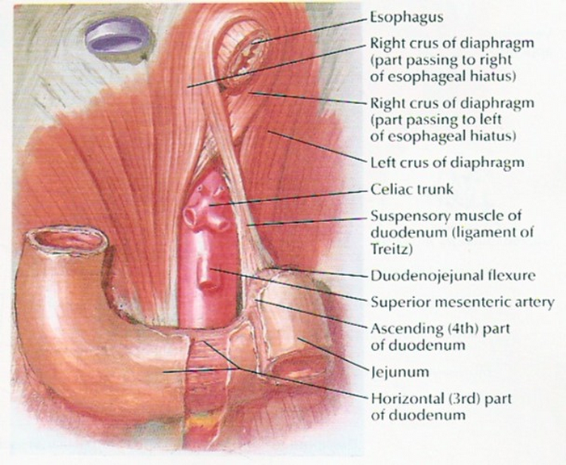
Suspensory muscle of Duodenum or Ligament of Treitz
This is a fibromuscular band which suspends and supports the duodenal flexure.
It arises from the right crus of diaphragm
Close to the right side of oesophagus passes downwards behind the pancreas and is attached to the posterior surface of the Duodenal flexure

Slide 29
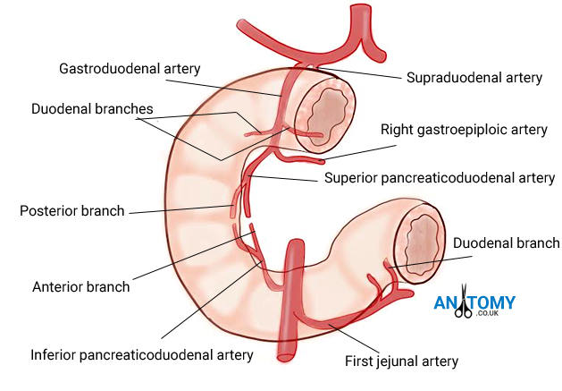
Arterial Supply
The opening of the bile duct into the second part of the duodenum
Upto the level of the opening, the duodenum is supplied by the superior pancreaticoduodenal artery, and below it by the inferior pancreaticoduodenal artery
The first part of the duodenum receives additional supply from: (a) The right gastric artery; (b) the supraduodenal artery, retroduodenal artery

Slide 30
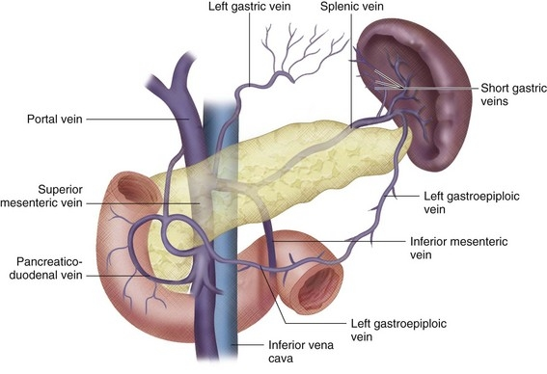
Venous Drainage
The veins of the duodenum drain into the splenic, superior mesenteric and portal veins.

Slide 31
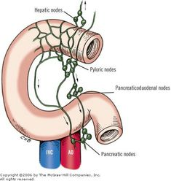
Lymphatic Drainage
Most of the lymph vessels from the duodenum end in the pancreaticoduodenal nodes present along the inside of the curve of the duodenum, i.e. at the junction of the pancreas and the duodenum.
From here the lymph passes partly to the hepatic nodes, and through them to the coeliac nodes; and partly to the superior mesenteric nodes and ultimately via intestinal lymph trunk into the cisterna chyli.

Slide 32
Nerve Supply
Sympathetic nerves from thoracic ninth and tenth spinal segments and parasympathetic nerves from the vagus,

Slide 33
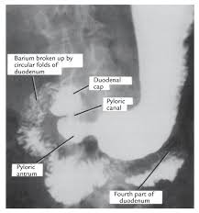
Clinical anatomy
1. In the x-rays taken after giving a barium meal, the first part of the duodenum is seen as a triangular shadow called the duodenal cap

Slide 34
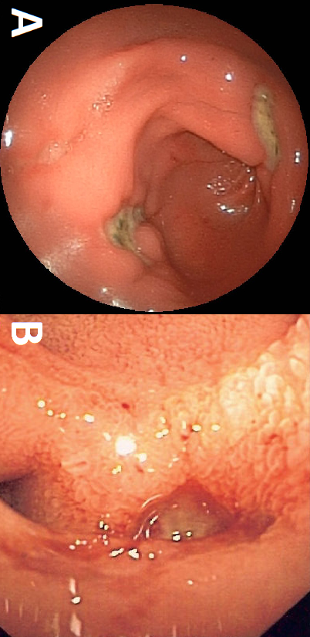
2. The first part of the duodenum is one of the commonest sites for peptic ulcer, possibly because of direct exposure of this part to the acidic contents reaching it from the stomach

Slide 35
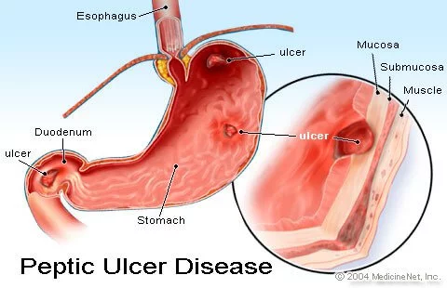
3. The first part of duodenum is overlapped by the liver and gall bladder, either of which may become adherent to, or even ulcerated by a duodenal ulcer.

Slide 36
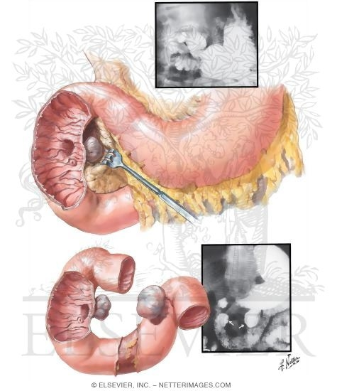
4. Duodenal diverticula are fairly frequent. They are seen along its concave border, generally at points where arteries enter the duodenal wall.

Slide 37
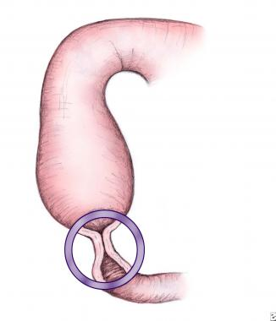
5. Congenital stenosis and obstruction of the second part of the duodenum may occur at the site of the opening of the bile duct.

Slide 38
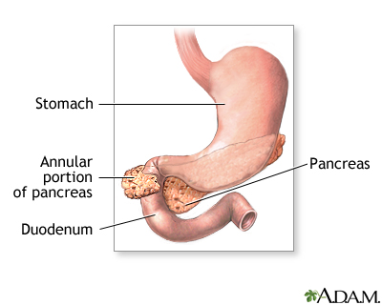
Other causes of obstruction are (i) an annular pancreas; (ii) pressure by the superior mesenteric artery; or (Hi) contraction of the suspensory muscle of the duodenum.

Slide 39
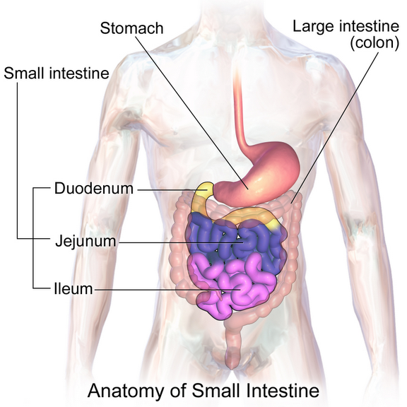

Slide 40
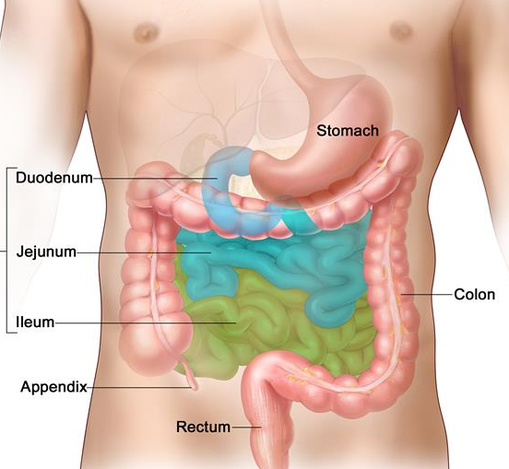
JEJUNUM AND ILEUM ____________
Jejunum and ileum are suspended from the posterior abdominal wall by the mesentery and, therefore, enjoy considerable mobility.
The jejunum constitutes the upper two-fifths of the mobile part of the small intestine, while the ileum constitutes the lower three-fifths.
The jejunum begins at the duodenojejunal flexure. The ileum terminates at the ileocaecal junction.

Slide 41
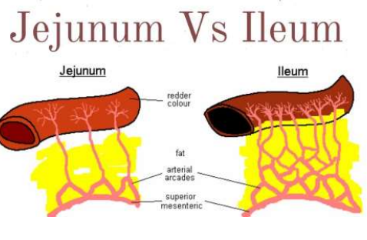
Mesentery

Slide 42
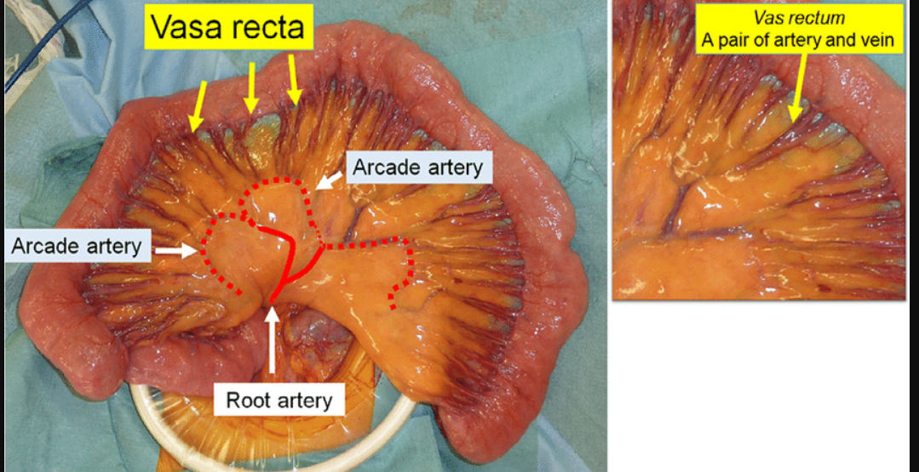
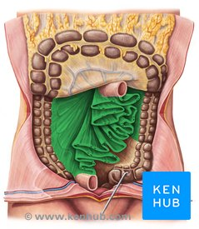
Difference between jejunum and ileum

Slide 43
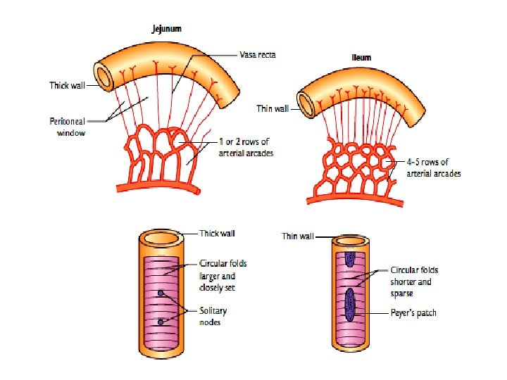

Slide 44
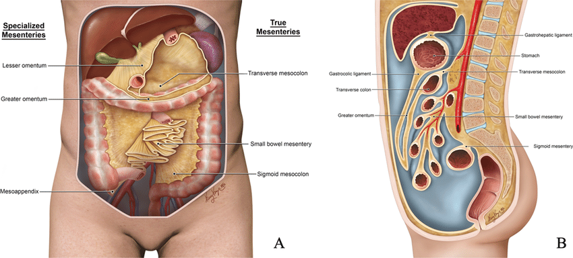

Slide 45
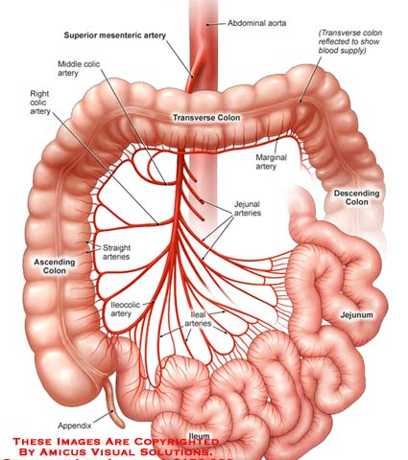
Blood supply and venous drainage
superior mesenteric artery, and are drained by corresponding veins.

Slide 46
Nerve supply
Sympathetic nerves arrive from the T5 to the T9 spinal cord segments
parasympathetic system- by vagus nerve

Slide 47
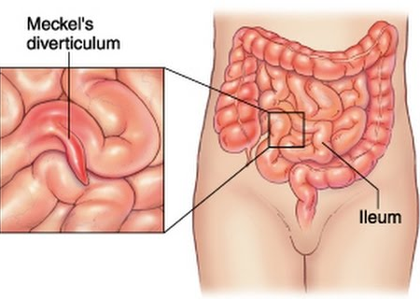
Meckel's Diverticulum
Meckel's diverticulum is the persistent proximal part of the vitellointestinal duct which is present in the embryo, and which normally disappears during the 6th week of intrauterine life.

Slide 48
Features of Meckel's Diverticulum
1. It occurs in 2% subjects.
2. Usually it is 2 inches or 5 cm long.
3. It is situated about 2 feet or 60 cm proximal to the ileocaecal valve, attached to antimesenteric border of the ileum.
4. Its calibre is equal to that of the ileum.
5. Its apex may be free or may be attached to the umbilicus, to the mesentery, or to any other abdominal structure by a fibrous hand.

Slide 49
CLINICAL ANATOMY
1. Meckel's diverticulum may cause intestinal obstruction.
2. Occasionally it may have small regions of gastric mucosa.
3. Acute inflammation of the diverticulum may produce symptoms that resemble those of appendicitis.
4. It may be involved in other diseases similar to those of the intestine

Slide 50
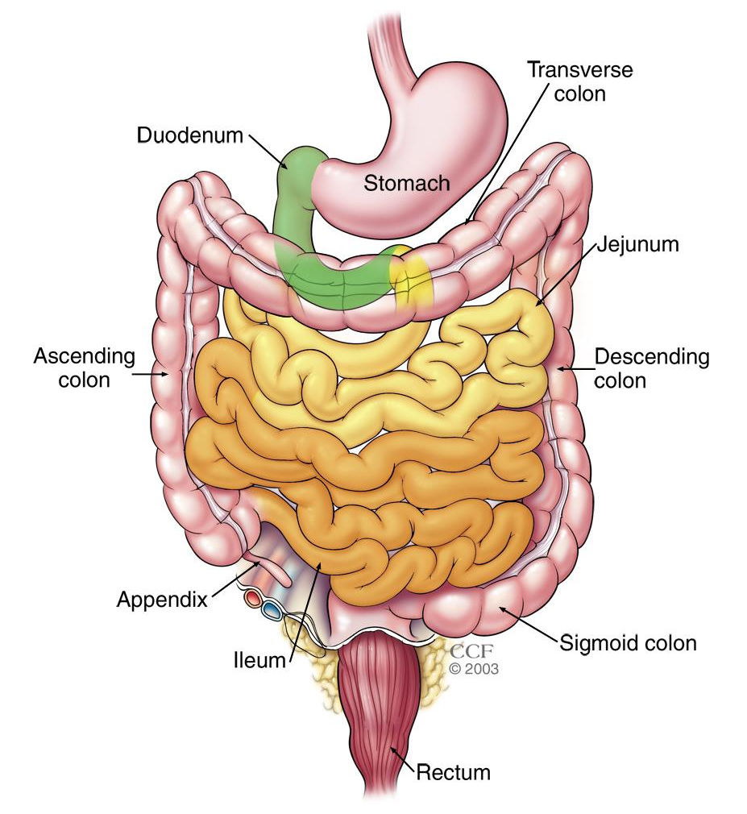
Features of small intestine

Slide 51
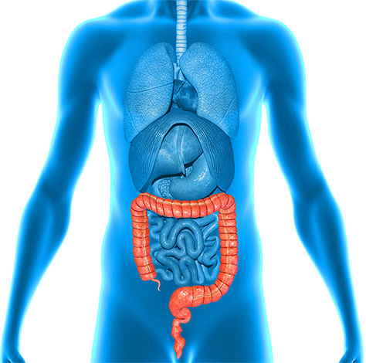
____________ LARGE INTESTINE
Extent- The large intestine extends from the ileocaeca junction to the anus.
Length- It is about 1.5 m long

Slide 52
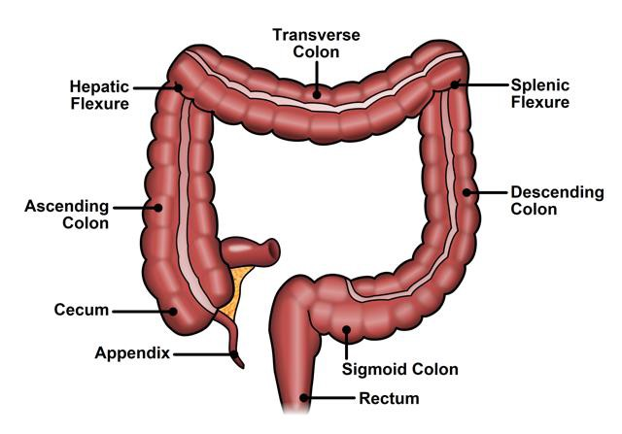
Parts of the large intestine
Caecum,
Ascending Colon,
Transverse Colon,
Descending Colon
Sigmoic Colon,
Rectum
Anal Canal.
Between the caecum and the terminal part of the ileum there is a narrow diverticulum called the vermiform appendix.

Slide 53
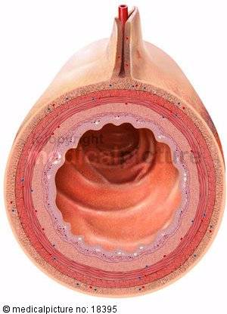
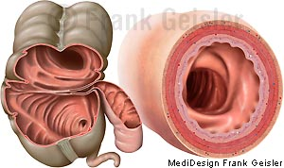
Features of the large intestine
1. The large intestine is wider in calibre than the small intestine.

Slide 54
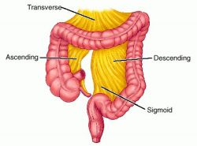
2. The greater part of the large intestine is fixed, except for the appendix, the transverse colon and the sigmoid colon.

Slide 55
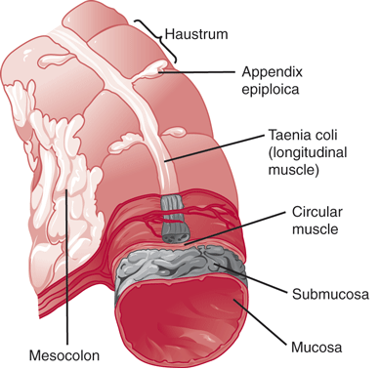
Taeniae coli
The longitudinal muscle coat forms only a thin layer in this part of the gut. The greater part of it forms three ribbon-like bands, called the taeniae coli

Slide 56
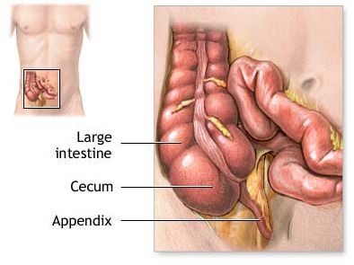
Taeniae coli
Proximally the taeniae converge at the base of the appendix, and distally they spread out on the terminal part of the sigmoid colon to become continuous with the longitudinal muscle coat of the rectum

Slide 57
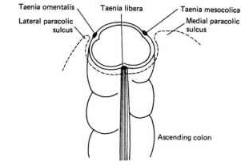
Position of taenia colli
One taenia, taenia libera, is placed anteriorly in the caecum, ascending, descending and sigmoid colon, but is placed inferiorly in the transverse colon.

Slide 58
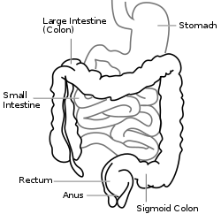
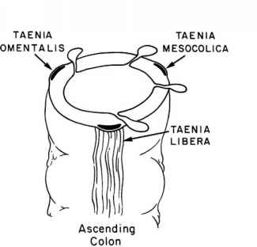
Second taenia, taenia mesocolica is present on the posteromedial surface of caecum, ascending, descending and sigmoid colon, but is placed posteriorly on the transverse colon

Slide 59

Third taenia, taenia omentalis, is situated postero-laterally in caecum, ascending, descending and sigmoid colon, but is situated on the anterosuperior surface of transverse colon

Slide 60

Features of large intestine cont..
4. Since the taeniae are shorter than the circular muscle coat, the colon is puckered and sacculated.

Slide 61


Appendices epiploicae
Small bags of peritoneum filled with fat, and called the appendices epiploicae,
They are scattered over the surface of the large intestine, except for the appendix, the caecum and the rectum.
These are most numerous on the sides of the sigmoid colon and on the posterior surface of the transverse colon.

Slide 62

Blood supply of large intestines
The blood supply to the colon is derived from the marginal artery
Terminal branches from the marginal artery are distributed to the intestine as long and short vessels, vasa longa and vasa brevia.
They gradually pierce the muscular coat and reach the submucosa.

Slide 63

Venous drainage

Slide 64

Lymphatic drainage
7. Lymph from the large intestine passes through four sets of lymph nodes :
Epicolic lymph nodes, lying on the wall of the gut;
(b) Paracolic nodes, on the medial side of the ascending and descending colon and near the mesocolic border of the transverse and sigmoid colon;
(c) Intermediate nodes, on the main branches of the vessels;
(d) Terminal nodes, on the superior and inferior mesenteric vessels.

Slide 65
Nerve supply
The nerve supply of the large intestine, barring the lower half of the anal canal, is both sympathetic and parasympathetic.
Sympathetic from T1 to L1
Parasympathetic by vagus

Slide 66
Functions of the Colon
(a) Lubrication of faeces by mucus,
(b) Absorption of water, salts and other solutes,
(c) Bacterial flora of colon synthetizes vitamin B.
(d) Mucoid secretion of colon is rich in antibodies of IgA group, which protect it from invasion by microorganisms,
(e) The microvilli (apical tufts) of some columnar cells serve a sensory function.

Slide 67

Caecum
Caecum is a large blind sac forming the startingof the large intestine.
Location- right iliac fossa, above the lateral half of the inguinal ligament.

Slide 68
Communications
It communicates superiorly with the ascending colon, medially at the level of the caecocolic junction with the ileum, and postero-medially with the appendix

Slide 69
Dimensions
6 cm long and 7.5 cm broad.

Slide 70

External features of the caecum
Taenia coli
Sacculations
Appendices epiploicae

Slide 71

Relations
Anterior: Coils of intestine and anterior abdominal wall.
Posterior :
(a) Muscles: Right psoas and iliacus.
(b) Nerves: Genitofemoral, femoral and lateral cutaneous nerve of thigh (all of the right side).
(c) Vessels: Testicular or ovarian, and often the external iliac (of the right side),
(d) Appendix in the retrocaecal recess

Slide 72



Slide 73

PERITONEAL RELATIONS
In about 90% individuals, the caecum is almost completely surrounded by the peritoneum.

Slide 74

Types based on
1. Conical type (13%), where the appendix arises from the apex of the caecum
2. Intermediate type (9%), where the right and left caecal pouches are equal in size, and the appendix arises from a depression between them
3. Ampullary type (78%), where the right caeca] pouch is much larger than the left, and the appendix arises from the medial side

Slide 75


Slide 76

COMMUNICATION OF CAECUM
It communicates:
A. Superiorly with ascending colon at trans-tubercular plane.
B. Medially with ileum. The ileo-cecal orifice lies at thelevel of ceco-colic junction/ trans-tubercular plane.
Postero-medially with the appendix.

Slide 77

Ileocaecal Valve
lower end of the ileum opens on the postero medial aspect of the caecocolic junction.
Ileocaecal opening is guarded by the ileocaecal valve

Slide 78

Functions of illeocaecal valve
Preventing reflux from the cecum to the ileum
2. Regulating the passage of contents from the ileum to the cecum.

Slide 79

APPENDICULAR ORIFICE
orifice lies 2 cms inferior to the ileo-cecal orifice.
The orifice is guarded by insignificant semicircular fold of mucous membrane called valve of Gerlach

Slide 80

Vessels and Nerves
Arterial supply - caecal branches of the ileocolic artery.
The veins drain into the superior mesenteric vein.
The nerve supply is same as that of the midgut (T 11 toL1
parasympathetic, vagus).

Slide 81

CLINICAL ANATOMY
(1) Amoebiasis, causing amoebic dysentry;
(2) intestinal tuberculosis (ileocaecal tuberculosis)
(3) carcinoma.
(4)Inflammation of caecum is known as caecitis or typhlitis.

Slide 82
Functions of Ileocaecal Valve
1. It prevents reflux from caecum to ileum.
2. It regulates the passage of ileal contents into the caecum, and prevents them from passing too quickly.

Slide 83

VERMIFORM APPENDIX
Definition
This is a worm-like diverticulum arising from the posteromedial wall, of the caecum, about 2 cm below the ileocaecal orifice

Slide 84

Dimensions
Dimensions
The length varies from 2 to 20 cm with an average of 9 cm.
It is longer in children than in adults. The diameter is about 5 mm. The lumen is quite narrow and may be obliterated after mid-adult life.

Slide 85

Positions
The appendix lies in the right iliac fossa. Although the base of the appendix is fixed, the tip can point in any direction.
Positions are often compared to those of the hour hand of a clock

Slide 86
Positions
The appendix lies in the right iliac fossa. Although the base of the appendix is fixed, the tip can point in any direction.
Positions are often compared to those of the hour hand of a clock

Slide 87

1. The appendix may pass upwards and to the right. This is the paracolic or 11 O'clock position.
2. It may lie behind the caecum or colon, known as retrocaecal or 12 O'clock position. This is the commonest position of the appendix, about 65%.
3. The appendix may pass upwards and to the left. It points towards the spleen. This is the splenic or 2 O'clock position. The appendix may lie in front of the ileum (preileal) or behind the ileum (postileal).
4. It may pass horizontally to the left (as if pointing to the sacral promontory called promontoric or 3 O'clock position.

Slide 88
4. It may pass horizontally to the left (as if pointing to the sacral promontory called promontoric or 3 O'clock position.
5. It may descend into the pelvis called pelvic or 4 O'clock position. This is the second most common position about 30%.
6. It may lie below the caecum (subcaecal) and may point towards the inguinal ligament called as midinguinal or 6 O'clock position

Slide 89

Appendicular Orifice
Appendicular orifice is occasionally guarded by an indistinct semilunar fold of mucous membrane, known as 'valve of Gerlacti.
LUMEN OF APPENDIX
It is quite small and may be partially or completely obliterated after mid-adult life

Slide 90

3. The orifice is marked on the surface by a point situated 2 cm below the junction of the trans-tubercular and right lateral planes

Slide 91

McBurney's point
The site of maximum tenderness in appendicitis. The point lies at the junction of lateral one-third and medial two-thirds of the line joining the right anterior superior iliac spine to the umbilicus

Slide 92

Peritoneal Relations
Appendix is suspended by a small, triangular fold of peritoneum, called the mesoappendix, or appendicular mesentery.

Slide 93
Blood Supply
Blood supply by appendicular artery which is a branch of the lower division of the ileocolic artery .
Blood from the appendix is drained by the appendicular, ileocolic and superior mesenteric veins, to the portal

Slide 94

Nerve supply
Sympathetic by T9 toT10.
Parasympathetic by vagus
Referred pain of appendix is felt at umbilicus,

Slide 95

Lymphatic Drainage
Most of the lymphatics pass directly to the ileocolic nodes, but a few of them pass indirectly through the appendicular nodes situated in the mesoappendix.

Slide 96

Appendicitis
Appendicitis will result in para-umbilical pain initially
Pain becomes localized after 6-8hours to theright lower quadrant
Inflammation of parietal peritoneum leads to rigidity and tenderness of the overlying muscles.• Also associated with nausea, vomiting, anorexia.
Also associated with nausea, vomiting, anorexia.
There will is a tenderness on McBurney's point.

Slide 97

ASCENDING COLON
Extent- caecum to the inferior surface of the right lobe of the liver.
Length - 12.5 cm long
Usually Retroperitonial Rarely, it may possess an ascending mesocolon.

Slide 98

Relations
Anteriorly- coils of small intestine, right edge of the greater omentum, anterior abdominal wall.
Posteriorly - iliacus, the iliolumbar ligament, the quadratus lumborum, the transversus abdominis, the diaphragm at the tip of the last rib; the lateral cutaneous, ilioinguinal, and iliohypogastric nerves; the iliac branches of the iliolumbar vessels, the fourth lumbar artery; and the right kidney.

Slide 99



Slide 100

RIGHT COLIC FLEXURE (HEPATIC FLEXURE)
Right colic flexure lies at the junction of the ascending colon and transverse colon.
The colon bends forwards, downwards and to the left.
The flexure lies on the lower part of the right kidney.
Anterosuperiorly, it is related to the colic impression on the inferior surface of the right lobe of the liver

Slide 101

TRANSVERSE COLON
Extend- across the abdomen from the right colic flexure to the left colic flexure.
Length – 50 cm
It is suspended by the transverse mesocolon attached to the anterior border of pancreas, and has a wide range of mobility

Slide 102
Relations
Anteriorly- greater omentum , anterior abdominal wall
Posteriorly -second part of the duodenum, the head of the pancreas, and to coils of small intestine.

Slide 103
LEFT COLIC FLEXURE (SPLENIC FLEXURE
Left colic flexure lies at the junction of the transverse colon and the descending colon. Here the colon bends downwards, and backwards.
Flexure lies on the lower part of the left kidney and diaphragm, behind the stomach, and below the anterior end of the spleen

Slide 104
DESCENDING COLON
Extent - left colic flexure to the sigmoid colon.
Length- 25 cm

Slide 105
Relations
Anteriorly, it is related to the coils of small intestine.
Posteriorly, it is related to the transversus abdominis, quadratus lumborum, iliacus, psoas muscles;
iliohypogastric,
ilioinguinal,
lateral cutaneous,
femoral and genitofemoral nerves;
iliac branches of the iliolumbar vessels; and the testicular and external iliac vessels

Slide 106

SIGMOID COLON (PELVIC COLON
Extend - pelvic brim to the third piece of the sacrum, where it becomes the rectum.
Length – 37cm
It is suspended by the sigmoid mesocolon and is covered by the coils of small intestine.

Slide 107


CLINICAL ANATOMY
Inflammation of the appendix is known as appendicitis. In this condition, it is usually necessary to remove the appendix. The operation for removal of the appendix is called appendicectomy

Slide 108

Intestinal obstruction can affect the small or the large intestine. It occurs when an area of the bowels becomes twisted, blocked by food or stops working altogether. Symptoms include pain, vomiting, abdominal distension and constipation.

Slide 109

Colitis is the inflammation of the walls of the colon

Slide 110


Diverticulosis
Diverticulosis occurs when certains areas of the colon’s muscular wall become weak and the intestinal lining protrudes, forming little pouches, which can be subject to bleeding or inflammation.

