Slide 1
Female reproductive system

Slide 2
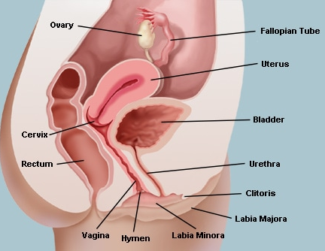
introduction
Produce sex hormones Estrogen, Progesterone
Produce egg (ova)
Support & protect developing embryo
Give birth to new baby
So these are organs which are responsible for copulation , fertilization,growth & development of fetus and its exit to the outside world

Slide 3
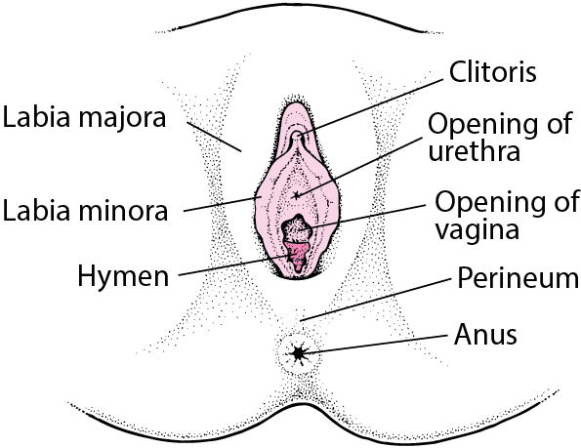
Divisions of the female genitalia
External genitalia
Internal genitalia
Accessory organs
Female external genitalia or vulva include
the mons pubis,
labia majora,
labia minora,
clitoris,
vestibule,
vestibular bulb
and the greater vestibular glands

Slide 4
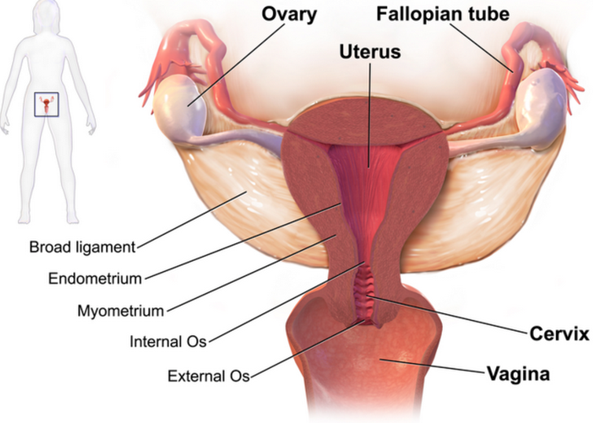
Divisions of the female genitalia
INTERNAL GENITALIA
It consists of a pair of
ovaries
A pair of ovarian tubes fallopian tubes
A uterus
Vagina

Slide 5
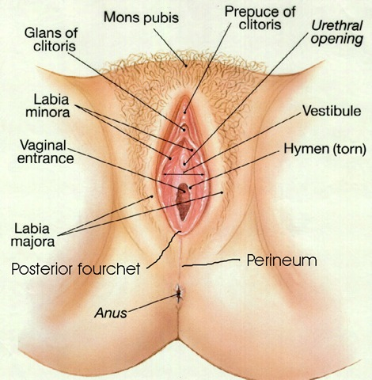
External genitalia
It is also known as the vulva
Mons pubis – it is a rounded cutaneous elevation formed by the accumulation of subcutaneous fat
With the onset of puberty coarse hairs grow over the area

Slide 6
External genitalia
Labia majora – it is pair of longitudinally placed thick folds of skin seperated from each other by the pudental cleft
When traced anteriorly it is continous with the mons pubis and meets each other to form the anterior commissure
Posterior end of labia is known as the posterior commissure

Slide 7
External genitalia
Labia minora- they are also a pair of cutaneous folds medial to the labia majora
Cleft between the labia minora is known as the vestibule
Vestibule presents the external orifices of urethra and vagina
Anteriorly labia minus splits into upper and lower layers
Upper layer covers the upper surface of the glans clitoiris and forms the prepuce of clitoris
The lower layers of labia minora meet each other below the glans clitoris to form the frenulum of clitoris

Slide 8
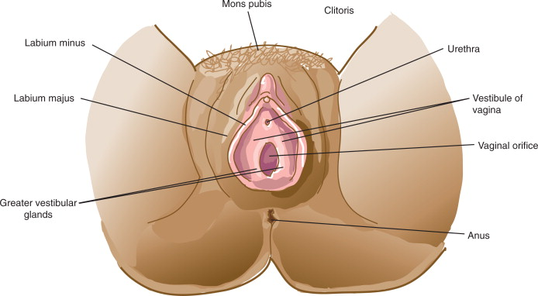
Vestibule
Vestibule of vagina is the area between the two folds of labia minora .
It extends from the frenulun of the clitoris to the frenulum of vestibule

Slide 9
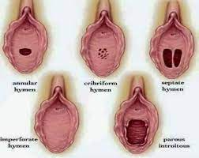
Features of vestibule
Theses are found in the vestibule
External urethral opening- lies 2.5 cm behind the clitoris
Vaginal orifice is presented here as a H shaped slit partly closed in a virgin called hymen
Hymen gets fissured during coitus so margins of fissured hymen is known as caruncula hymanalis
3.Orifices of the duct of greater vestibular glands –lies on both sides of the vaginal orifice
4. Numerous small mucous glands

Slide 10
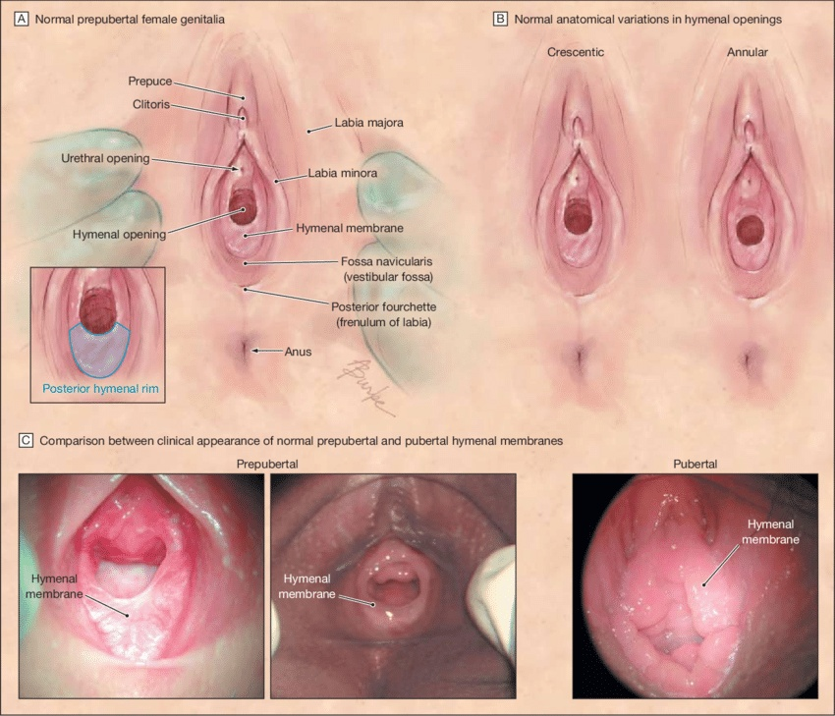
Vestibular fossa
It is a depression between the frenulum of vestibule and vaginal orifice

Slide 11
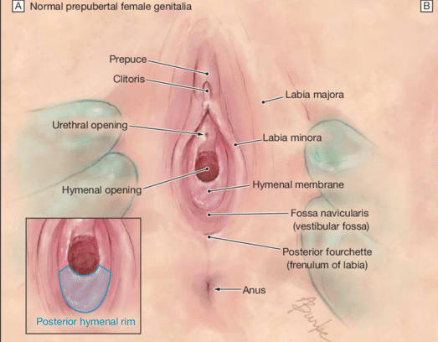
Clitoris
It is the structure which is homologous to the penis only difference here is it is not trversed by urethra
It consists of two erectile tissues , copus cavernosa each of which diverges behind to form crus which is attached to the pubic arch
The tip of the clitoris highly sensitive known as the glans clitoris

Slide 12
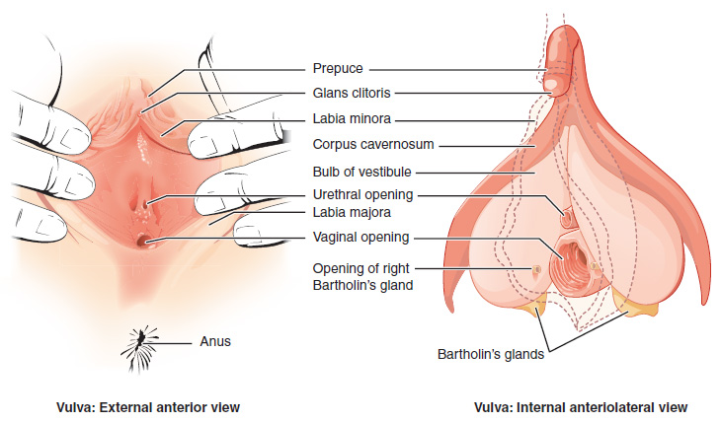
Bulbs of vestibule
These are a pair of oval shaped erectile tissues situated on either sides of the vaginal orifice and is continous with the glans clitoridis
They are covered with bulbo spongiousis muscle

Slide 13
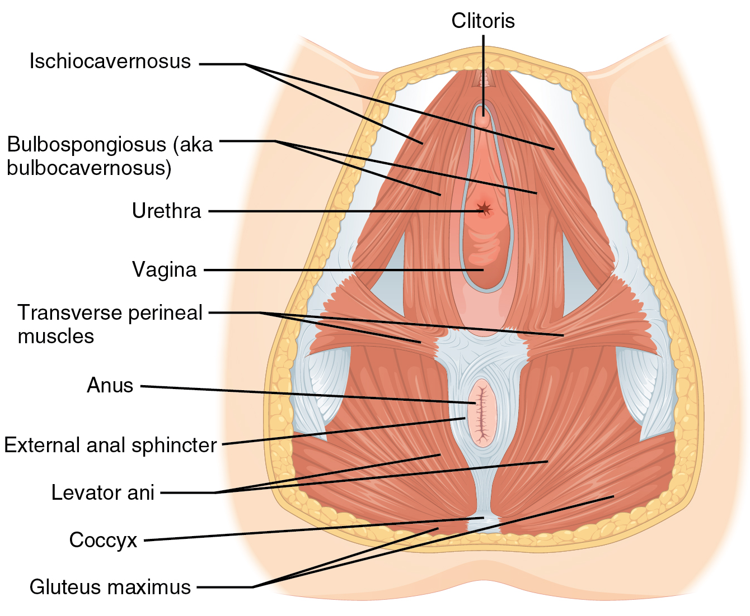

Slide 14
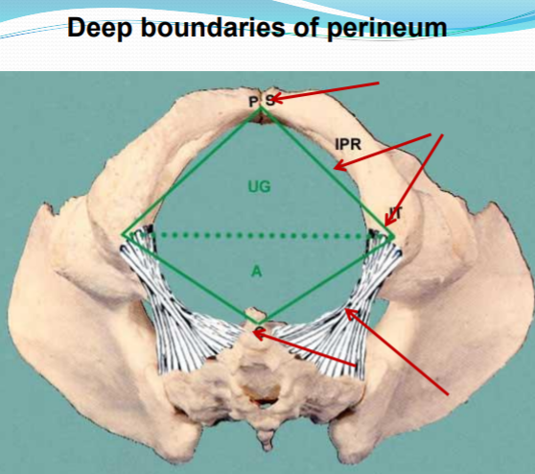

Slide 15
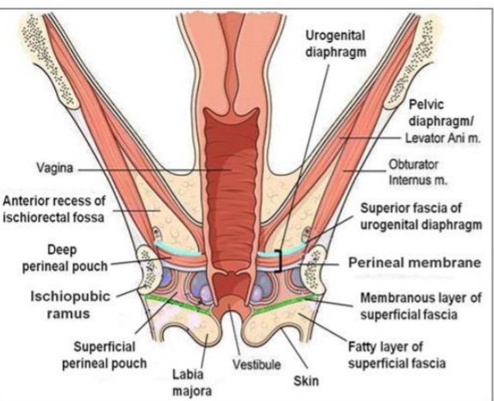

Slide 16
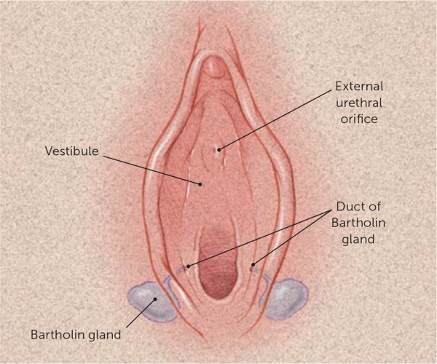
Greater vestibular glands /bartholin’s glands
Theses are mucous secreating glands which are located in the superficial perineal pouch.
Homologous with the cowpers gland in male
Ducts from these glands open on each side in the vaginal orifice below the hymen

Slide 17
Internal genitalia

Slide 18
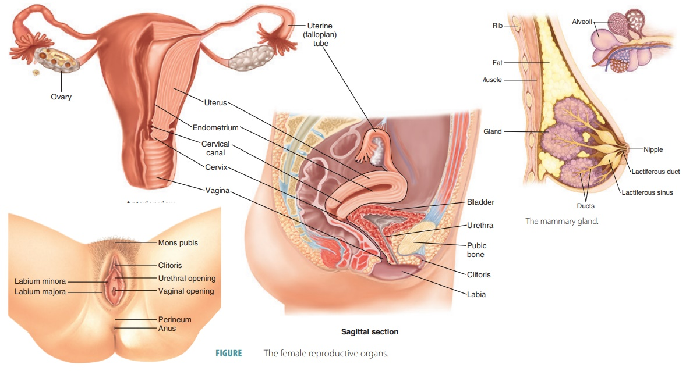
Introduction
The internal genitalis of the female consists of
ovaries
A pair of ovarian tubes fallopian tubes
A uterus
Vagina

Slide 19
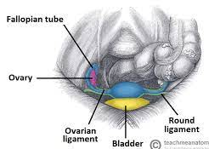
Ovaries
They are a pair of female reproductive glands or the female gonads
Location :- situated in the lesser pelvis on each side of the uterus in the ovarian fossa
And is attached to the posterior layer of the broad ligament

Slide 20
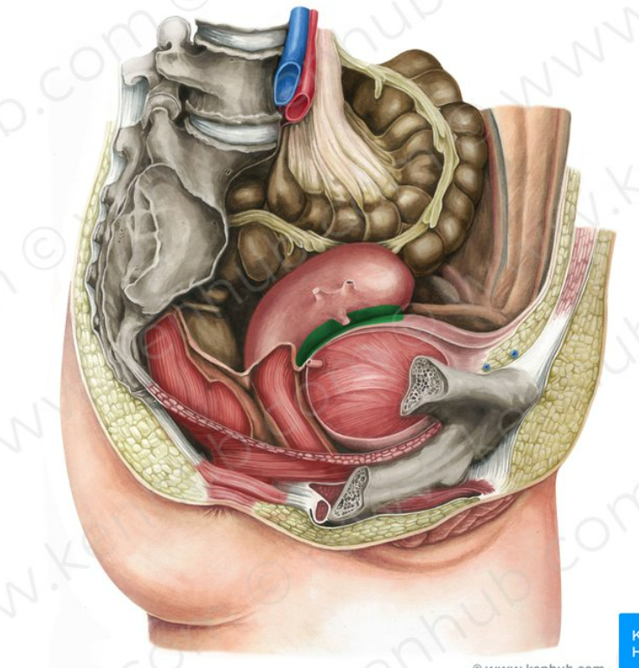
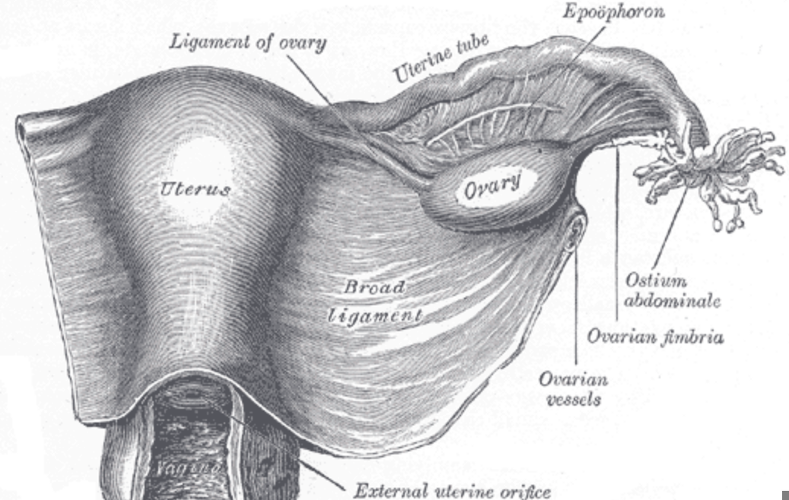

Slide 21
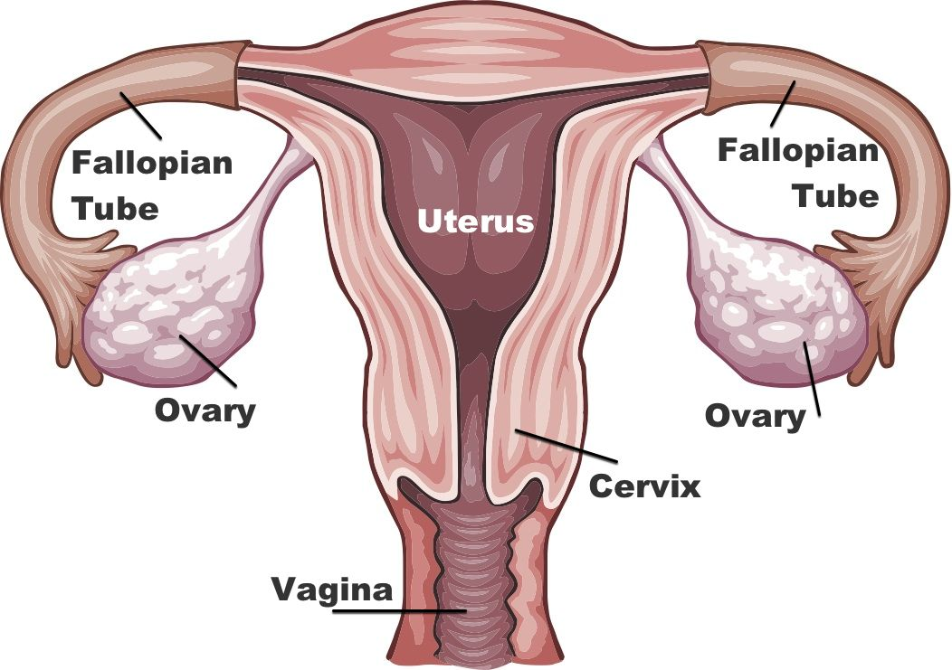
Shape and size
Each ovary is almond shaped and has the following measurements
Vertical- 3cm
Antero-posterior – 1.5cm
Transverse – 1cm
It is an infra – peritonial organs which is dull grey inn colour
Before puberty surface of the ovary is smooth after that the surface becomes irregular due to repeated ovulations

Slide 22
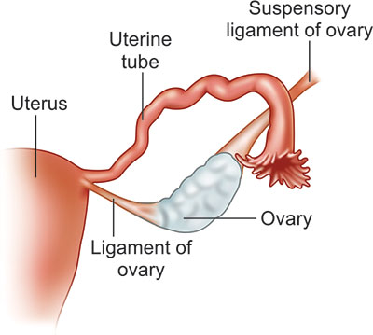
Features and position
Each ovary has two poles or extremities
Position and axis
In nulliparous adult, it lies in the ovarian fossa and its long axis is nearly vertical
• In the newborn, ovary is situated above the pelvic brim.
• After repeated pregnancies, then long axis may become horizontal
it may be prolapsed in the recto-uterine pouch.
On very rare occasions ectopic ovary may be found in the inguinal canal or labium majus due to errors of descent.

Slide 23
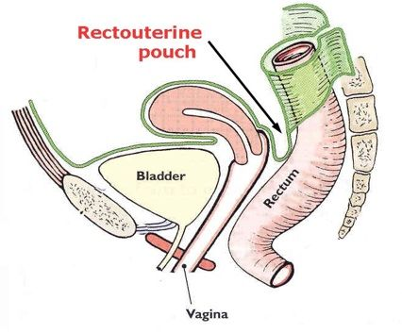

Slide 24
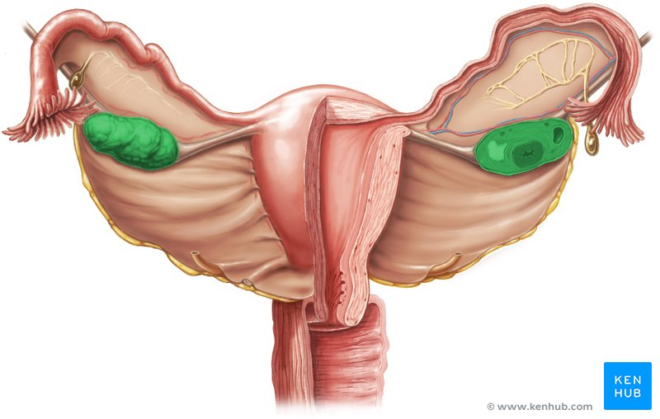
Presenting parts of ovary
Each ovary has two ends
Tubal end /tubal pole/upper end
Lower or uterine pole
Two borders
Anterior or mesoovarian border
Posterior or free border
Two surfaces
Medial
Lateral

Slide 25
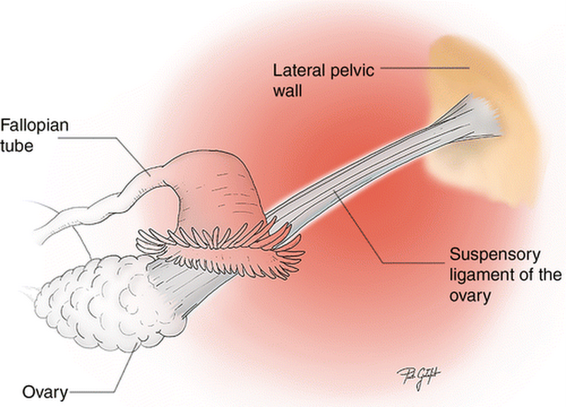
Tubal pole- it is directed upwards and is broader than the lower pole . Uterine tube arches over it and is attached to the ovarian fimbria.
The suspensory ligaments of the ovary is attached to this pole

Slide 26
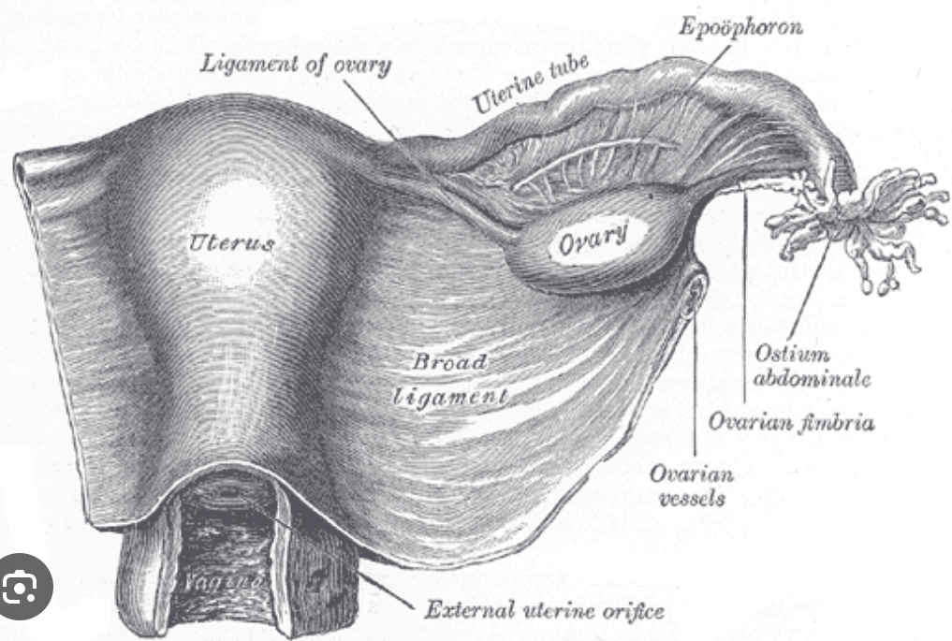
Lower or uterine pole
It is narrower than the upper pole and
directed downwards and is connected to the lateral angle of uterus by the ligament of ovary

Slide 27
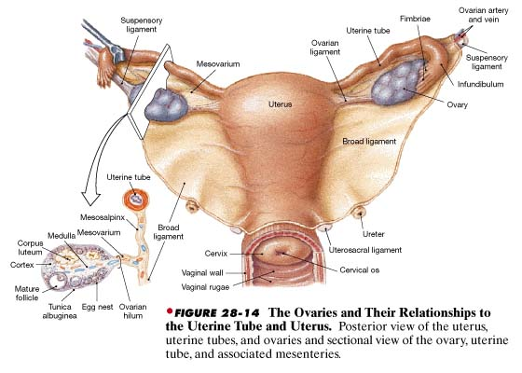

Slide 28
Anterior or Mesovarian border
It is attached to the posterior layer of the broad ligament by a fold which acts as the hilum of the ovary and conveys ovarian vessels and nerves.
A white line known as the line of Furre is observed along this border due to a transition between the flattened mesothelium of the broad ligament and germinal epithelium of the ovary.

Slide 29
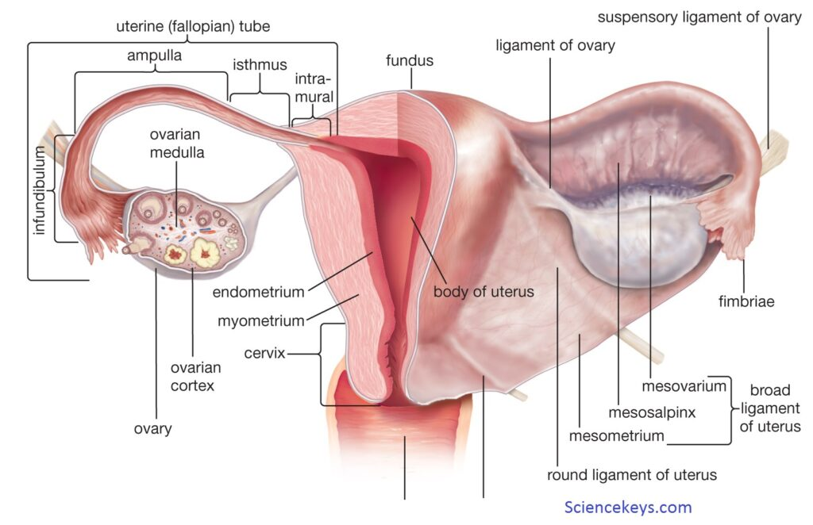

Slide 30
Posterior or free border
It is convex and related with the uterine tube in the upper part. Further behind, it is related to the ureter and internal iliac vessels beneath the peritoneum.

Slide 31
Medial surface
Medial surface of the ovary is related to the terminal part of the uterine tube separated by the bursa ovarica, which is a recess between the mesosalpinx (containing the tube) and the ovary

Slide 32
Lateral surface
It is convex and rests on a peritoneal depression of the lateral pelvic wall known as the ovarian fossa,

Slide 33
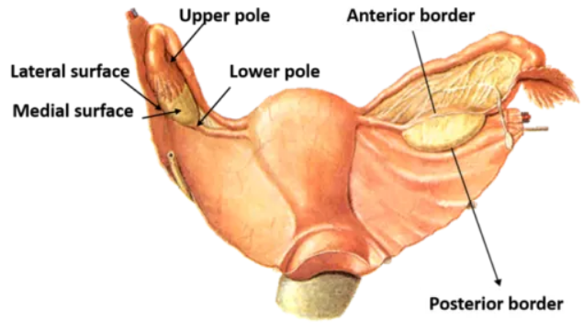
RELATIONS OF THE OVARY

Slide 34
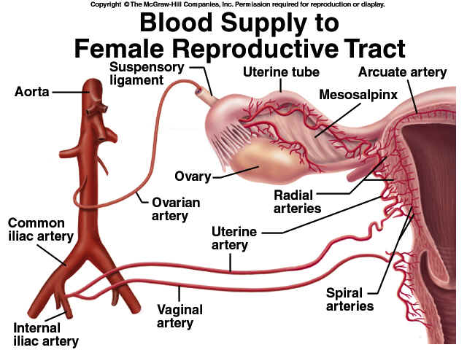
BLOOD SUPPLY
Ovary is mainly supplied by the ovarian artery which is a branch of abdominal aorta.
Artery reaches the organ after passing successively through the suspen sory ligament of ovary, mesosalpinx, and mesovarium of the broad ligament.
It is partly supplied by a branch from the Uterine Artery

Slide 35
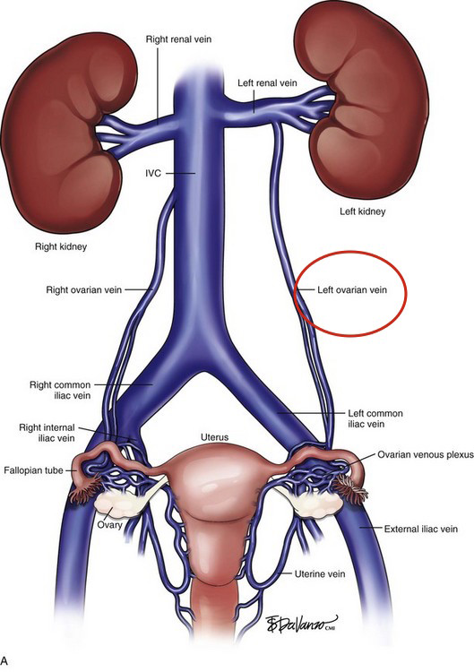
Venous drainage
The veins form a pampiniform plexus which joinsfurther to form a single vein in the suspensory ligament of ovary.
Right ovarian vein drains into inferior vena cava at an acute angle;
Left vein drains into left renal vein almost at a right angle.

Slide 36
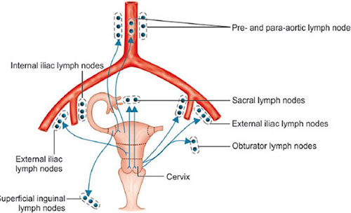
Lymphatic drainage
Lymphatics drain into pre-aortic and lateral aortic lymph nodes following ovarian blood vessels.

Slide 37
Nerve supply
Ovaries are predominantly supplied by the sympathetic nerves;
the sympathetic fibres are derived from T10and T11segments of the spinal cord.
Parasympathetic is derived from S2toS4

Slide 38
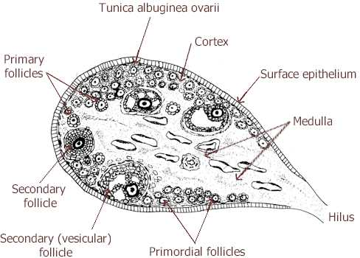
Structure of ovary
Medulla is composed of loose connective tissue, unstriped muscles, blood vessels, lymphatics and nerves.
Small numbers of chromaffin cells, similar to the interstitial cells of Leydig in the testis are also present in the medulla;
They may be the source of androgen secretion.

Slide 39
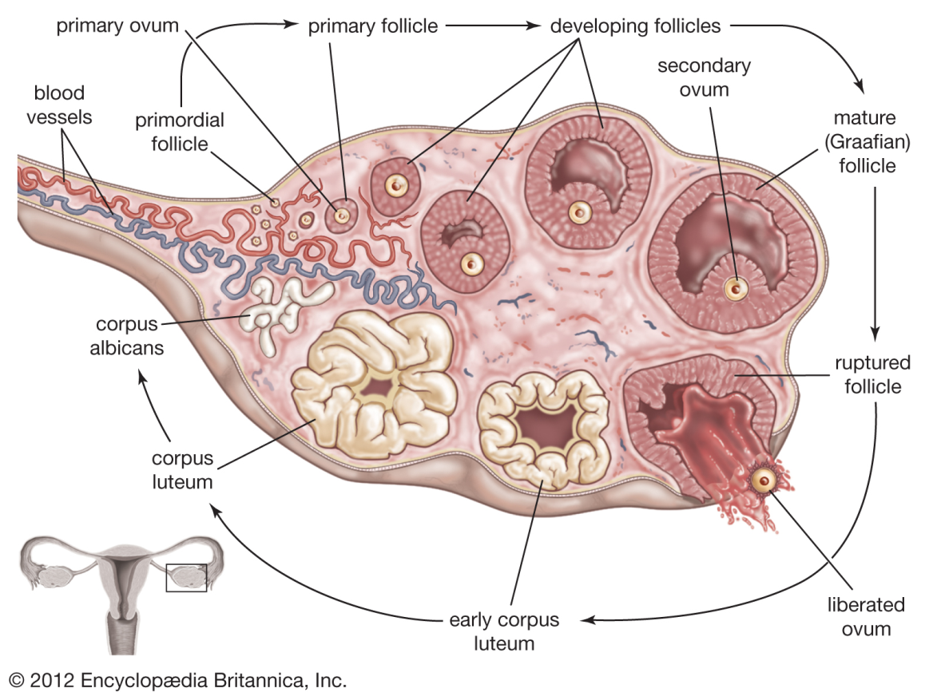
Structure of ovary
Cortex consists of stroma cells, some of which are thickly arranged beneath the germinal epithelium to form the tunic albuginea.
The cortex also contains ovarian follicles which are different in different periods of life. Or different stages of development

Slide 40
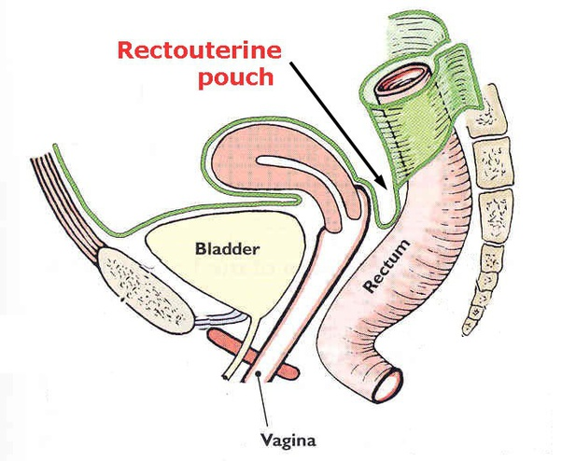
Applied anatomy of ovary
Prolapse of ovaries: Ovaries are frequently displaced to the pouch of Douglas where they can be palpated by a PV or per vaginal examination.

Slide 41
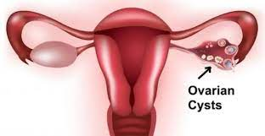
Ovarian cysts: The developmental arrest of the ovarian follicles may result in the formation of one or more small ovarian cysts.
Multiple small theca lutein cysts involve both the ovaries in cases with Stein-Leventhal syndrome.
The syndrome is characterised by mild hirsutism, deep voice, secondary amenorrhoea, and cystic enlargement of both the ovaries.

Slide 42
Carcinoma of ovary is common, and accounts for 15% of all cancers and 20% of gynaecological cancers. • Ovaries are the commonest site in the abdomenfor endometriosis. The endometrial cysts in the ovary are called the chocolate cysts.

Slide 43
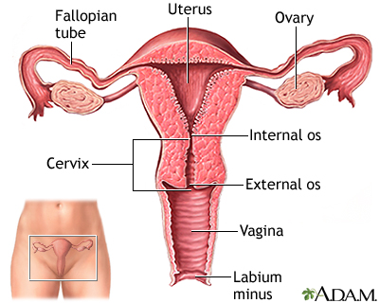
Uterus
Uterus is shaped like an inverted pear (pyriform).
Location-
It is a thick-walled hollow muscular organ, situated obliquely in the lesser pelvis between the urinary bladder below and in front, and the rectum and sigmoid colon above and behind.

Slide 44
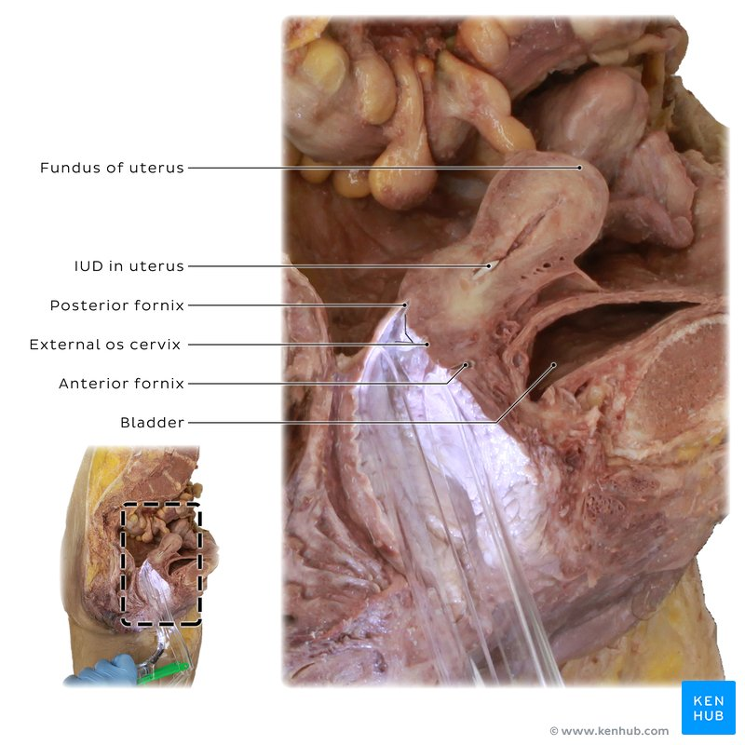
Primary function of uterus
It is primarily concerned with the embedding of the fertilized ovum and retaining the product of conception until the foetus undergoes sufficient maturity for independent existence.

Slide 45
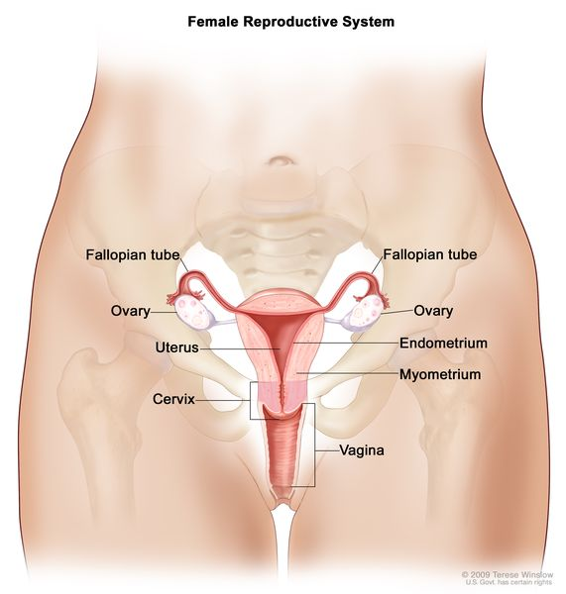
Communications of uterus
On each side the uterus receives the opening of the uterine tube at the supero-lateral angle (cornu), and
communicates below with the vagina through the external os of the cervix.

Slide 46
ZMeasurements of the uterus
The average measurements of the nulliparous uterus are as follows:
Total length : 7.5cm
Breath :5cm
Thickness :2.5cm
Wt – 50-70gm

Slide 47
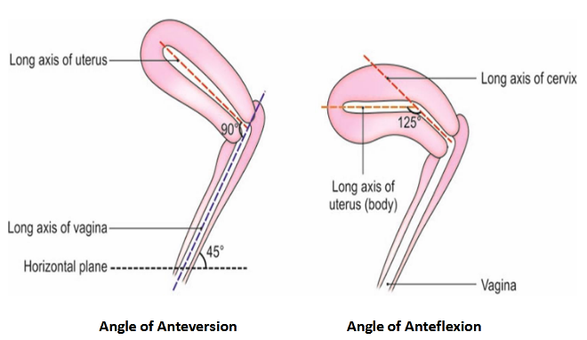
Normal Axes of Uterus
Normally the uterus lies in anteversion and anteflexion
Anteversion is a forward angle between the axis of the cervix and that of the vagina measuring about 90°, provided the urinary bladder and rectum are empty.
Anteflexion is a forward angle between the body and cervix at the isthmus measuring about 125°, provi ded the bladder and rectum are empty.

Slide 48
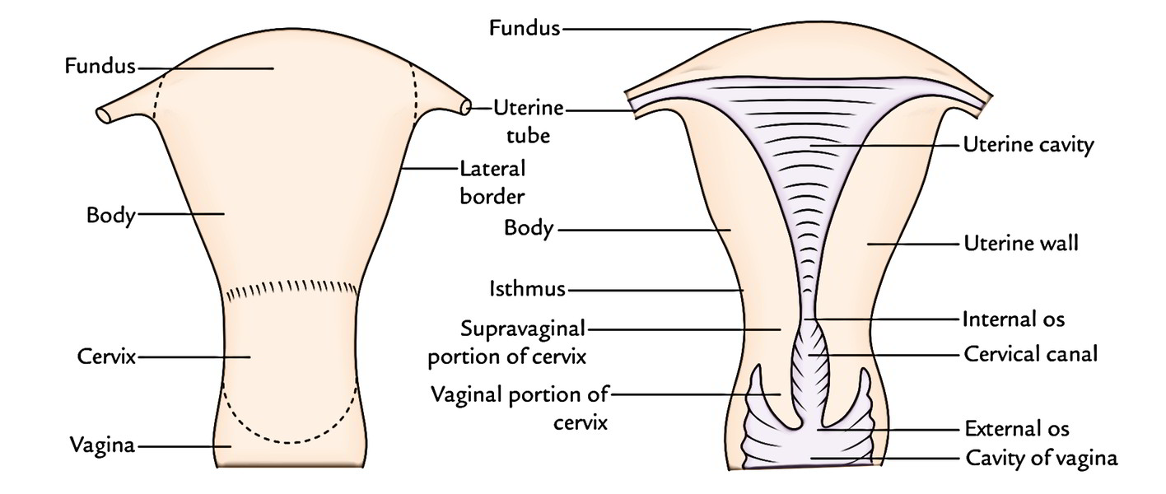
Subdivisions of uterus
uterus is subdivided into three parts from above downwards-fundus, body, and cervix.

Slide 49
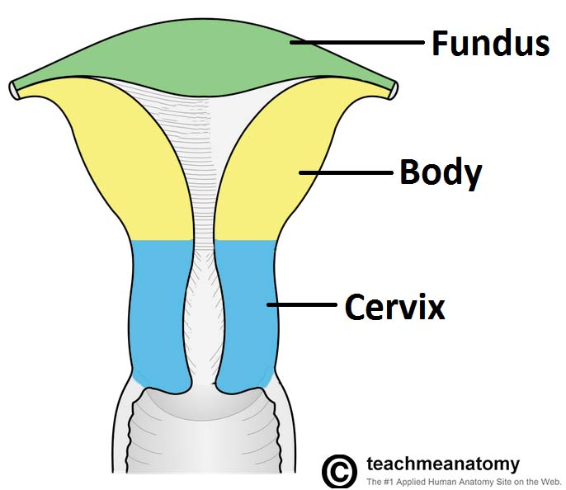
Parts of uterus
The presenting parts of uterus are the
Fundus
Body
Cervix

Slide 50
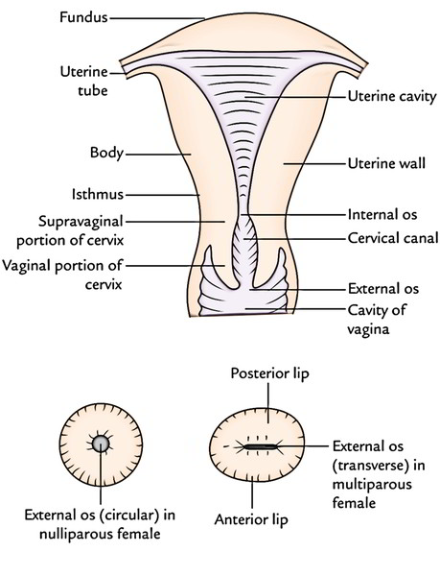
Fundus is that part of the body which lies above the entrance of the two uterine tubes.
Body extends from the fundus to a constriction known as the isthmus which corresponds with the internal os of the cervical canal.
Cervix of uterus lies below the isthmus and is subdivided by the vaginal wall into supra-vaginal and vaginal parts.

Slide 51
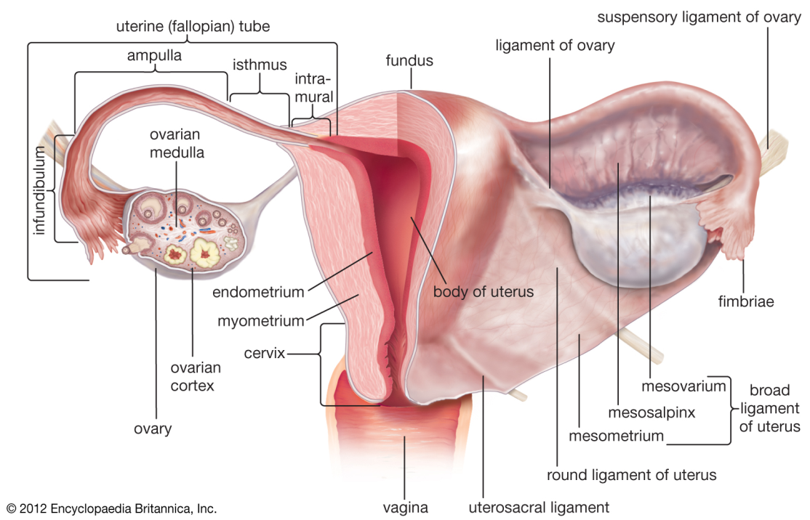
Fundus
It is the expanded end of the body which is situated above an imaginary horizontal plane passing through the entrance of the two uterine tubes.
The fundus is some shaped and is directed forwards, convex on all sides, covered with peritoneum, and does not contain the uterine cavity.
Fertilized ovum is implanted in its posterior wall

Slide 52
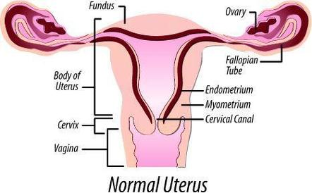
BODY
It extends from the fundus to the isthmus, is flattened antero-posteriorly, wider in the upper part, and contains the uterine cavity.
Features of the body
2 surfaces – anterior surface and posterior surface
2 lateral borders

Slide 53
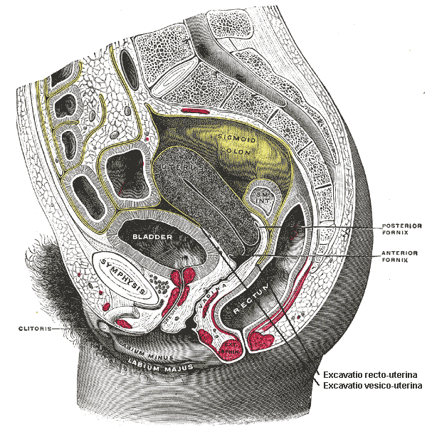
Anterior surface of uterus
Anterior or vesical surface is flat, directed downwards and forwards, and
covered with peritoneum upto the isthmus, where the peritoneum is reflected onto the upper surface of the urinary bladder forming the utero-vesical pouch.

Slide 54
Posterior surface of uterus
posterior or intestinal surface is convex, directed upwards and backwards and covered with peritoneum which extends upto the posterior fornix of the vagina; therefrom the peritoneum is reflected to the rectum forming the recto-uterine pouch of Douglas. The posterior surface is related to the sigmoid colon and small intestine.

Slide 55
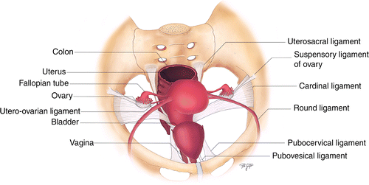
Borders of uterus
Each lateral border is rounded and non-peritoneal for the attachment of the broad ligament of uterus.
Broad ligament attaches the uterus to the lateral pelvic wall
The border is related to the tortuous uterine vessels.

Slide 57

Lateral angle of uterus
lateral angles or cornua of the uterus project outwards from the junction of the fundus and the body. Each angle presents the attachments of three structures
:(1) Uterine tube, the uppermost structure piercing the musculature of uterus;
(ii) Proximal part of the round ligament of uterus,below and in front of the tube;
(iii) Ligament of ovary, below and behind the tube.

Slide 58
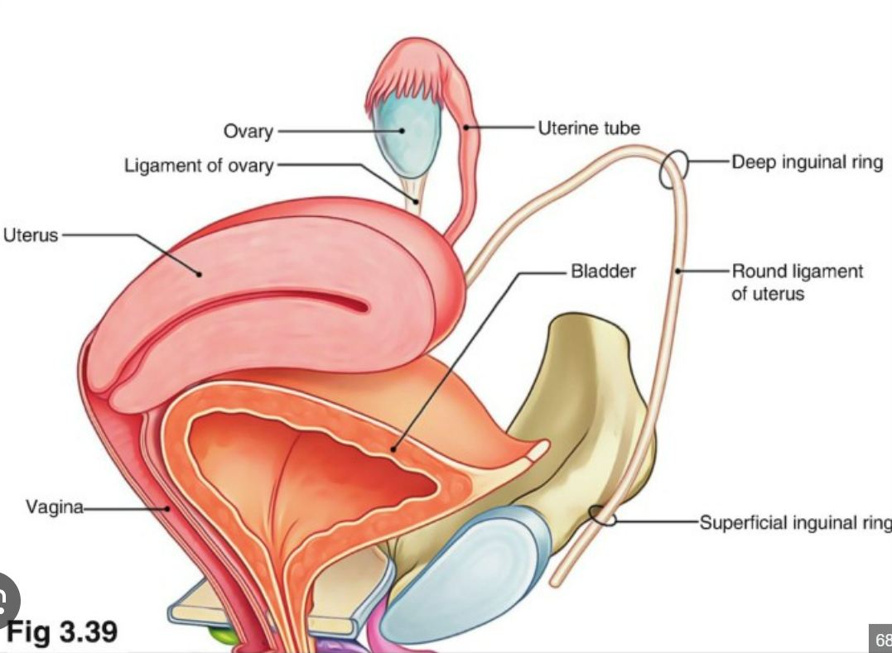
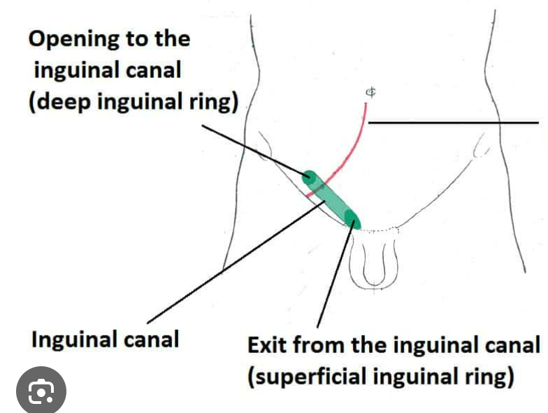

Slide 59
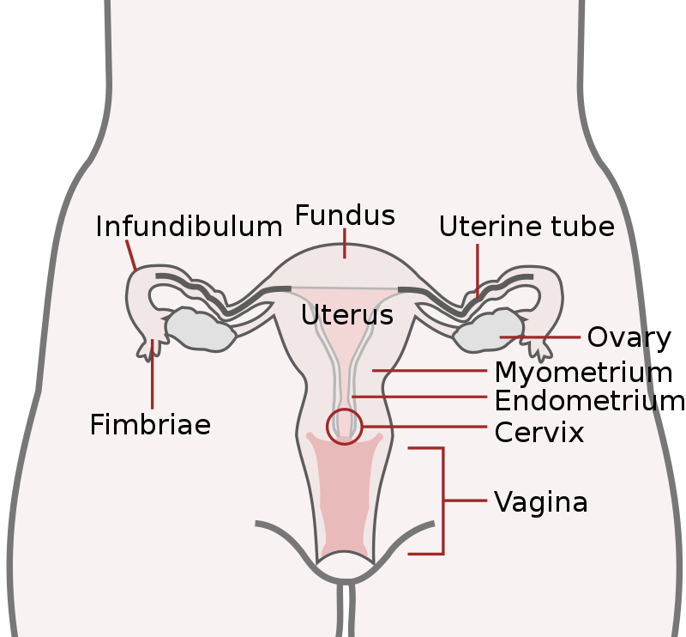
Uterine cavity
Uterine cavity is a vertical slit on sagittal section, and a transverse slit on cross section.
The cavity is triangular on coronal section;
its base is formed by the fundus and its apex by the internal os through which the uterine cavity communicates with the cervical canal.
The mucous membrane of the uterine cavity is known as the endometrium which is changed into decidua during pregnancy.

Slide 60

Structure of the fundus and body
From within outwards the uterus presents
Endometrium,
Myometrium, and
Perimetrium.

Slide 61
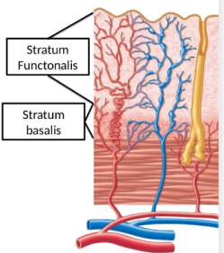
Endometrium
Functionally, the endometrium consists of outer basal layer and inner functional layer. The functional layer undergoes changes during the menstrual cycle and is cast off in each month with uterine bleeding.
The basal layer remains practically unaltered and helps in regeneration of the epithelial f lining over the denuded endometrium from the basal ends of the uterine glands.

Slide 62
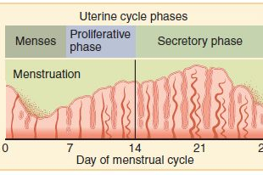
Changes in endometrium while mensturation
endometrial changes in menstrual cycle may be subdivided into the following phases
Menstrual,
Regenerative,
Proliferative,
Secretory and
Pre-menstrual.

Slide 63
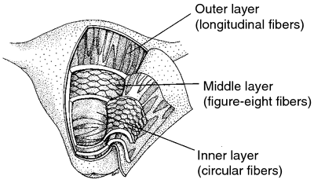
Myometrium
myometrium or muscle of uterus consists of three ill-defined layers of smooth muscles-
Outer longitudinal,
Middle circular, and
Inner reticular;
Longitudinal Muscles are continuous with the corresponding muscles of the uterine tubes.
Longitudinal muscles help in the anchorage of uterus and expel the uterine contents to the exterior.

Slide 64

Myometrium
Middle layer contains a vascular bed, the stratum vasculare, where the uterine vessels ramify.
Circular muscles of this layer form a sort of sphincter close to the internal os and help to retain the uterine contents (products of conception).
The muscles of the inner layer are reticular in arrangements, and the endometrial vessels pass through the interstices between them. On contraction, the muscles stop the uterine bleeding in menstruation or during the separation of the placenta. Thus the inner layer acts as the 'living ligature of the uterus'.

Slide 65

Perimetrium
Perimetrium or serous coat is derived from the peritoneum which covers the entire organ
except the two lateral borders, anterior surface of the supravaginal part of the cervix, and the vaginal part of the cervix.
On the posterior surface of uterus the peritoneum is intimately adherent to the underlying muscle.

Slide 66

Cervix
cervix is the part of uterus below the level of internal os.
It is more fixed and more cylindrical than the body.
The cervix is separated in front from the body by a constriction known as the isthmus and behind by a transverse ridge known as The Torus Uterinus.
It contains a cervical canal which communicates the uterine cavity with the vagina..

Slide 67


Slide 68
Measurements of cervix
Length :2.5 cm
PARTS OF CERVIX
Lower part of the cervix projects into the anterior wall of the vagina which divides it into
supravaginal and
vaginal parts.

Slide 69
Relations of supravaginal part of cervix
In front - It is non-peritoneal, and related to the base of the bladder separated by loose parametric tissue.
Behind-It is covered with peritoneum of the pouch of Douglas, and related to sigmoid colon and small intestine which separate the cervix from the rectum.
Laterally
Ureter lies about 2 cm lateral to the cervix;
Uterine artery

Slide 70

Vaginal part of cervix
It is conical in shape and the blunt tip rests on the posterior vaginal wall.
Spaces between it and vaginal wall are called the vaginal fornices
Cervical canal opens into vagina by an opening called the external os
In nulliparous women the external os is smaller campared to multiparous women

Slide 71

Cervical canal
It is fusiform on coronal section and communicates above with the uterine cavity through the interal os.
The canal is flattened from before backwards so that it comes to have anterior and posterior walls.
These walls show mucosal folds which resemble the branches of a tree called the arbor vitae uteri.
The folds in the anterior and posterior walls interlock with each other and close the canal.

Slide 72


Slide 73

Ligaments of uterus
There are two kinds of peritonial ligament
Peritonial ligament
Fibromuscular ligaments
Peritonial ligaments – these are those ligaments that does give any support to uterus
They are
Anterior ligament
Posterior ligament
broad ligament

Slide 74

Supports of uterus
Primary Supports Muscular or active supports
1 Pelvic diaphragm
2 Perineal body
3 Distal urethral sphincter mechanism
Fibromuscular or mechanical supports
1 Uterine axis
2 Pubocervical ligaments
3 Transverse cervical ligaments of Mackenrodt
4 Uterosacral ligaments
5 Round ligaments of uterus

Slide 75


Slide 76


Slide 77


Slide 78


Slide 79

Contents of broad ligament
Uterine tubes
Round ligament
Ligaments of ovary
Uterine and ovarian vessels
Utero vaginal & ovarian nerve plexus
Epoophoron
Paraphoron
Lymph nodes and vessels

Slide 80

Arterial supply of uterus
Uterus is mostly supplied by the uterine arteries, and partly by the ovarian arteries.
uterine arteries are the branches of the anterior division of the internal iliac arteries,
ovarian arteries are the branches of the abdominal aorta.

Slide 81

Venous Drainage
The veins correspond to the arteries and drain into systemic vein via the uterine and ovarian veins.
Beneath the peritoneum of the recto-uterine pouch, the uterine veins communicate with the superior rectal vein establishing a porta-caval anastomosis.

Slide 82
Lymphatic drainage of uterus
Lymphatics of the uterus begin at three intercommuni cating networks-
Endometrial,
Myometrial and
Subperitoneal.

Slide 83
Lymphatic drainage of uterus
From the Fundus and Upper Part of the Body:(a) Most of the vessels drain into pre-aortic and lateral aortic lymph nodes
The middle lymphatics from the lower part of body drain into the external iliac nodes
The lower lymphatics from the cervix drain into the internal iliac and sacral nodes.

Slide 84

Nerve supply of uterus
Sympathetic supply from T12 –L1 segments of the spinal cord and they produces vasoconstriction and uterine contractions
Parasympathetic fibres of the uterus are derived from the pelvic splanchnic nerves (S2-S4).
They inhibit vasoconstriction and produces uterine inhibitions

Slide 85
Changes in uterus
At the time of birth, the cervix of the uterus is large and the body is small. Thereafter, the body grows more thanthe cervix so that by puberty the uterus acquires its normal piriform shape.
At the time of menstruation, the uterus undergoes slight enlargement.
During pregnancy, it undergoes great enlargement, when its upper end reaches the epigastrium. After the delivery, the uterus gradually approaches near its normal size by 6 weeks but the size of its cavity and the thickness of its muscle wall remain larger than they were before pregnancy.
The external os also becomes more prominent.
The uterus undergoes atrophy in old age

Slide 86

Applied anatomy of uterus
Congenital anomalies: The uterus may be duplicated, may be divided by a septum, or may be absent.
Only one half of the uterus (and one uterine tube) may be present (unicornuate uterus).
Sometimes the cervix is absent. There may be atresiaof the lumen. The uterus may remain rudimentary.

Slide 87


Prolapse of uterus
Weakening of the pelvic diaphragm can lead to prolapse of uterus.
Retroversion also predisposes to prolapse (as the uterus comes in line with the vagina).

Slide 88

Neoplasms may occur in the uterus; these may be benign or malignant.
The most common growth is a fibroma (fibroid)which can be multiple.
It is benign in nature. Carcinoma Is more common in the cervix.

Slide 89

Caesarean section
The most common surgical procedures performed on the uterus is a caesarean section. It is done in cases where normal birth of a baby is not possible and delivery is done by opening the uterus.

Slide 90

A hysterectomy is a surgical procedure that removes the uterus, and may also include the fallopian tubes and ovaries

Slide 91


Slide 92

Instruments may be passed into the uterus after dilating the cervix for termination of pregnancy, or for curetting(scraping) of the endometrium to study the pathology.

Slide 93


Intrauterine contraceptive devices (IUCD) made of metal or plastic may be inserted into the uterus to prevent implantation of a fertilised ovum, which is one of the common methods followed for temporary sterilisation.

Slide 94

Uterine tubes
Other names: Fallopian tube (named after the 16th century Italian anatomist Gabriele Fallopius), oviduct, salpinx, tuba uterine.
The uterine tubes (oviducts, Fallopian tubes) are a pair of ducts which convey the ova from the ovary to the uterine cavity.

Slide 95

Length of the uterine tube
Each tube is about 10 cm (4 inches) long, and situated in the medial three-fourth of the upper free margin of the broad ligament of uterus.
The transport of ova into the uterine tube is facilitated by the longitudinal grooves on the inner aspect of the ovarian fimbria, by the suction created by the ciliary beats of the tube, and by the peristalsis of the tubal musculature.

Slide 96

Course of the uterine tube
At first the tube passes laterally from the angle of uterus upto the uterine end of the ovary.
Then it passes upwards along the mesovarian border and arches backwards around the tubal end of the ovary.
Finally the tube turns downwards and comes in contact with the posterior border and medial surface of the ovary.

Slide 98

Course of the uterine tube
Uterine tube undergoes the following successive changes of direction lateralwards, upwards, arches backwards, and downwards

Slide 99

Parts of the uterine tube
Each tube presents two openings (ostia) and four parts
uterine ostium
Pelvic or abdominal ostia
Parts :
Pars uterina tubae (intra-mural part)
Isthmus
Ampulla
Infundibulum

Slide 100
Parts of the uterine tube
Medial most part of the uterine tube which is embedded in the muscle wall of the uterus at the junction of the fundus and body of the uterus is the intra-mural part of the tube. It is 1 cm long.
Next 3 cm is thick-walled and has a narrow lumen so that it is cord like; this part is called the isthmus.
Next 5 cm is thin walled and has a much larger lumen than the rest of the tube. This dilated part is called the ampulla. Fertilization of the ovum takes place in this part.
Lateral end of the uterine tube is funnel shaped and is called the infundibulum. The wall of the infundibulum are prolonged into a number of irregular processes called the fimbriae. One of the fimbriae is larger than the others and is in close contact with the ovary. It is called the ovarian fimbria. The infundibular end presents with the abdominal ostium.

Slide 101

Blood supply of the uterine tube
The tube gets nutrition from two sources: ovarian artery from the abdominal aorta, and uterine artery from the anterior division of the internal iliac. Both arteries anastomose close to the angle of the uterus.

Slide 102

venous drainage of the uterine tube
The venous blood is drained by the ovarian and uterine veins.
Right ovarian vein terminates into the inferior vena cava,
and the left vein drains into left renal vein.

Slide 103

Lymphatic drainage of the fallopian tube
Most of the tube is drained into pre-aortic and lateral aortic lymph nodes following ovarian blood
Intra-mural part drains into superficial inguinal lymph nodes following the round ligaments of the uterus.

Slide 104

Nerve supply of the uterine tubes
The tubes are supplied by both sympathetic and parasympathetic nerves which accompany the blood vessels.
The sympathetic nerves are derived from the ovarian and superior hypogastric plexuses; the pre-ganglionic fibres are derived from T₁-L2, segments of the spinal 10 cord.
The parasympathetic fibres for the lateral part of the tube are derived from the vagus, and for the medial part of the tube from the pelvic splanchnic nerves.

Slide 105

Applied anatomy of uterine tubes
Tubal pregnancy (ectopio pregnancy) is a condition when the fertilized ovum fails to migrate in the uterine cavity and may produce subsequent rupture of the tube with alarming haemorrhage. This requires immediate surgical interference.

Slide 106


Sometimes the tube is filled with a bag of pus (Pyosalpinx) due to infection of the tube.
Ligations of both tubes are employed as one ofthe methods of the family planning,

Slide 107

hystero-salpingography
Patency of both uterine tubes is tested in investigation of sterility by injecting a radio-opaque dye (or air) into the uterine cavity and subsequently following the course of the dye. This is known as the hystero-salpingography

Slide 108

Vagina (colpos=hollow)Greek*
Vagina is the female organ of copulation and forms the lower part of the birth canal.
It extends from the vestibule (cleft between the labia minora) upwards and backwards upto the vaginal part of the cervix,
Vagina forms four fornices around the cervix-anterior, posterior, and two lateral.

Slide 109

Lumen of Vagina
vagina is wider in the upper part, and its anterior wall falls short of the posterior wall because the cervix protrudes through the anterior vaginal wall.
The anterior wall is about 7.5 cm, whereas the posterior wall is about 9 cm.
vagina corresponds with the axis of the pelvic outlet, and meets the cervix at a forward angle of about 90° (anteversion), provided the bladder and rectumare empty.

Slide 110

Relations of vagina
It has an
Anterior wall
Posterior wall
Two lateral walls

Slide 111


Slide 112
Structure of vagina
From outside inwards the vagina presents
Serous,
Fascial,
Muscular, and
Mucous coats

Slide 113

Serous coat is derived from the peritoneum and covers only the posterior fornix of vagina.
Fascial coat is derived from the visceral layer of the pelvic fascia (endopelvic fascia).
Muscular coat consists of outer longitudinal and inner circular layers of smooth muscle.
Mucous membrane consists of lamina propria and surface epithelium.The lamina propria is composed of loose connective tissue and contains plexuses of blood vessels, lymphatics and nerves

Slide 114

Relations of vagina
Anterior Wall : It is entirely non-peritoneal. In the upper part, it is related to the base of the urinary bladder and terminal parts of ureters separated by loose areolar tissue
In the lower part, the urethra is embedded in the anterior vaginal wall.

Slide 115


Posterior Wall
In upper one-fourth, the vagina is covered with the peritoneum of recto-uterine pouch, and related to the sigmoid colon and small intestine.
In middle two-fourths, it is related to the ampulla ofthe rectum separated by the recto-vaginal fascia
; In lower one-fourth, the vagina related to the anal canal separated by the perineal body.

Slide 116

Lateral Walls
Each lateral wall is related to the following from above downwards
1) Crossing of the ureter and the uterine artery;
(ii) Attachment of the Mackenrodt's ligament;
(iii) Embraced by the levator ani which acts as the sphincter vaginae;
(iv) Muscles and fasciae of the urogenital diaphragm;
(v) Bulb of the vestibule, greater vestibular gland, and bulbo-spongiosus muscle.

Slide 117

Structure of vagina
From outside inwards the vagina presents serous, fascial, muscular, and mucous coats.
Serous coat is derived from the peritoneum andcovers only the posterior fornix of vagina.The fascial coat is derived from the visceral layer ofthe pelvic fascia (endopelvic fascia).
Muscular coat consists of outer longitudinaland inner circular layers of smooth muscle
.Mucous membrane consists of lamina propria and surface epithelium. Lamina propria is composed of loose connective tissue and contains plexuses of blood vessels, lymphatics and nerves.

Slide 118

Interior of vagina
The hymen is an incomplete mucous fold which is situated close to the external orifice of vagina.
It is of various shapes annular, crescentic or cribriform.
Sometimes the hymen is congenitally absent or it may remain imperforate.
During coitus the margin of the hymen becomes fissured producing tags of mucous membrane, the caruncle.

Slide 119

Interior of vagina
Median longitudinal folds known as the columns of vagina are present along the anterior and posterior vaginal walls. From the sides of each column numerous horizontal folds arise and make the lumen irregular.

Slide 120
Arterial Supply of vagina
Vagina is supplied by the branches of the uterine, vaginal, internal pudendal and middle rectal arteries.
.

Slide 121

Lymphatic Drainage of Vagina
Lymphatics of vagina are arranged in three groups
1. From the upper third, the lymph vessels accompany the uterine artery and drain into internal and external iliac lymph nodes.
2. From the middle third (above the hymen), the lymphatics accompany the vaginal artery and drain
into internal iliac nodes.
3. From the lower third below the hymen, the vessels drain into the superficial inguinal lymph nodes.

Slide 122

Nerve supply to vagina
Parasympathetic and sympathetic nerves arise from the uterovaginal nerve plexus (in turn a subsidiary of the inferior hypogastric plexus).
Only the inferior 1/5 of the vagina receives somatic innervation. This is via a branch of the pudendal nerve, the deep perineal nerve.

Slide 123


Applied anatomy of vagina
Congenital anomalies: The vagina may be duplicated, may be subdivided by a septum, or may be absent. The hymen may be imperforate Abnormal communications may exist with the rectum (rectovaginal fistula) or with the urinary bladder (vesicovaginal fistula).

Slide 124

Vaginal examination:
Most of the structures related to the vagina can be palpated through fingers introduced into the vagina.
On the anterior side, the pubic symphysis, urinary bladder and the urethra are felt. Posteriorly, the rectum and any structure lying in the rectouterine pouch may be felt. The

Slide 125

Papanicolaou test

Slide 126

Colposcopy
The cervix can also be visualised for macroscopic changes through the vagina by a procedue called colposcopy.
Colposcope is an endoscopic instrument, which when introduced into the vagina will magnify the cells of the vagina and cervix thus permitting direct examination of these structures.

