Slide 1
duodenum

Slide 2
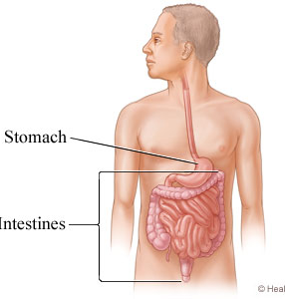
Introduction
The intestine, which is the longest part of the digestive tube, is divided into long, less distensible, small intestine, and
shorter, more distensible large intestine.
Food has to be digested, metabolised and stored for expulsion in the intestines.

Slide 3
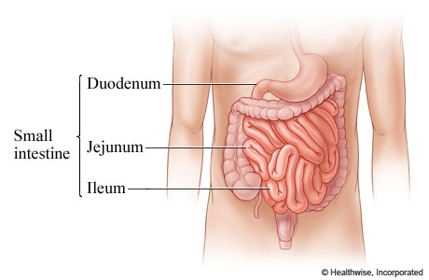
THE SMALL INTESTINES
The small gut extends from the pyloric end of the stomach to the ileo-caecal junction.
It consists of the proximal fixed part, the duodenum, and the remaining mobile part which includes the jejunum and the ileum.
The total length of the small intestine is about 6.5 metres.
The small gut is essential for life, because most of the digestion and absorption takes place in the small gut.

Slide 4
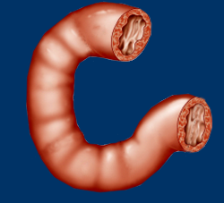
THE DUODENUM
It is a latin corruption of Greek word ‘Do-dekadactulos’, which means that the length of the duodenum is equal to the breadth of twelve fingers.
The name was first used by Hirophilus in 300 BC

Slide 5
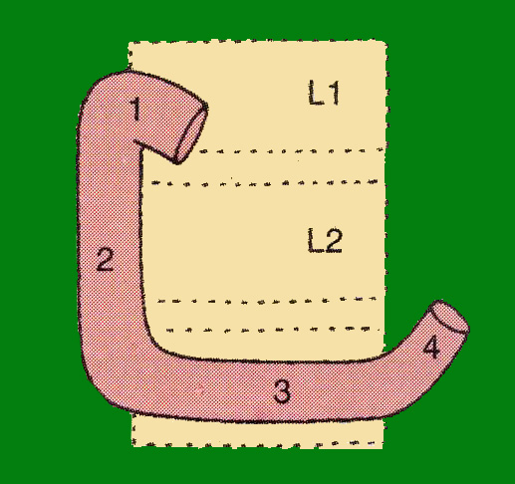
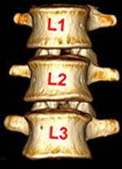
Definition and Location
The duodenum is the shortest, widest and most fixed part of the small intestine.
It extends from the pylorus to duodenojejunal flexure.
It is curved around the head of pancreas in the form of letter ’C’.
The duodenum lies above the level of umbilicus, opposite first, second and third lumbar vertebrae.

Slide 6
Length and Parts
Duodenum is 25 cm long and is divided into the following four parts.
First or superior part, 5 cm or 2 inches long.
Second or descending part, 7.5 cm or 3 inches long.
Third or horizontal part, 10 cm or 4 inches long.
Fourth or ascending part, 2.5 cm or 1 inch long.

Slide 7
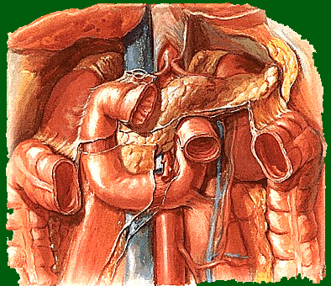
Duodenum – peritoneal relations
Duodenum is mostly
retroperitoneal and
Fixed except at its
two ends where
it is suspended by
folds of peritoneum.
Anteriorly the duodenum
is partly Covered with peritoneum.

Slide 8
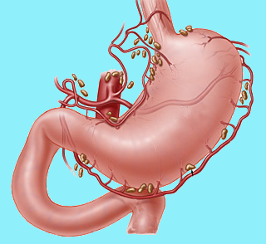
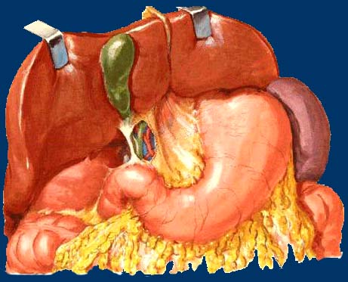
Duodenum 1st part (5 cm)
Extends from pylorus to
Sup. Duodenal flexure,
directed upwards, backwards &
to Right
Length – 5 cm
(Surface projection 2.5 cm)
Peritoneal relations:
prox. 2.5 cm movable.
Attached to lesser omentum above and
to greater omentum below.
Distal 2.5 cm is fixed. Retroperitoneal.
Covered with peritoneum only on anterior aspect.

Slide 9
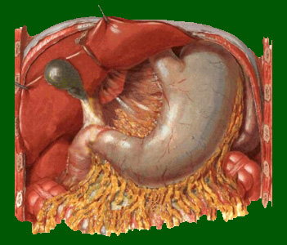
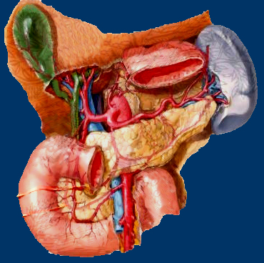
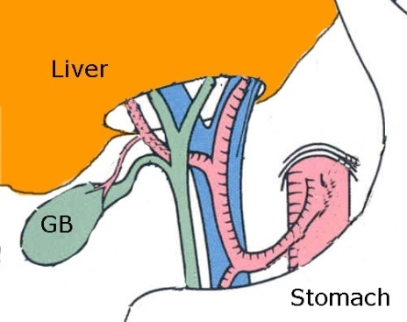

Duodenum 1st part
Visceral relations:
Anteriorly : Quadrate lobe of liver,
and gall bladder.
Posteriorly : Gastroduodenal art.,
bile duct, and portal vein.
Superiorly : Epiploic foramen.
Inferiorly : Head & neck of pancreas.

Slide 10
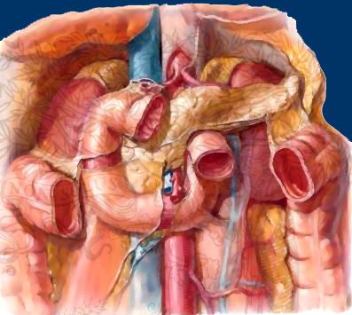
Duodenum – second part (7.5 cm)
Begins at superior duodenal flexure opp. L1 vertebra
passes vertically downwards
- in front of hilum of Rt. Kidney
- along Rt. Side of vertebral column
in para vertebral gutter
- Within Rt. Lateral plane
- ends in inferior duodenal flexure
opp. Lower border of L3
- continues with 3rd part
Rt. Lat. Plane

Slide 11
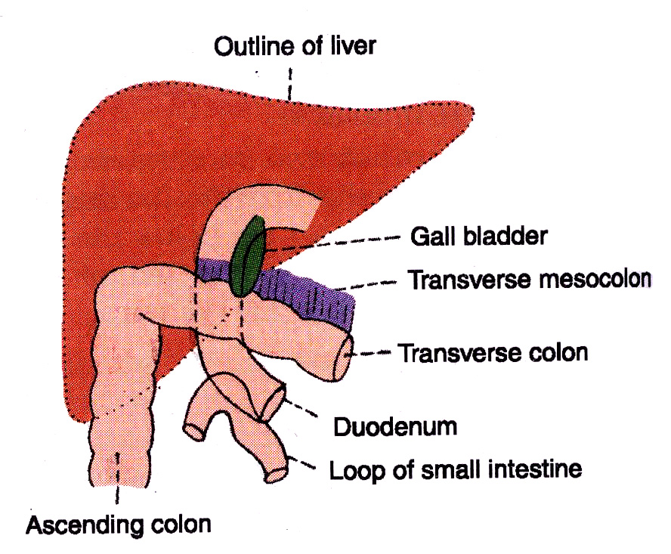
Duodenum – second part
Peritoneal relations:
It is retroperitoneal and fixed.
Ant. Surface is covered with
peritoneum , except near the
middle where it is directly
related to colon.
Visceral relations:
Anteriorly: Right lobe of liver,
Transverse colon,
Root of transverse mesocolon,
Small intestine.

Slide 12
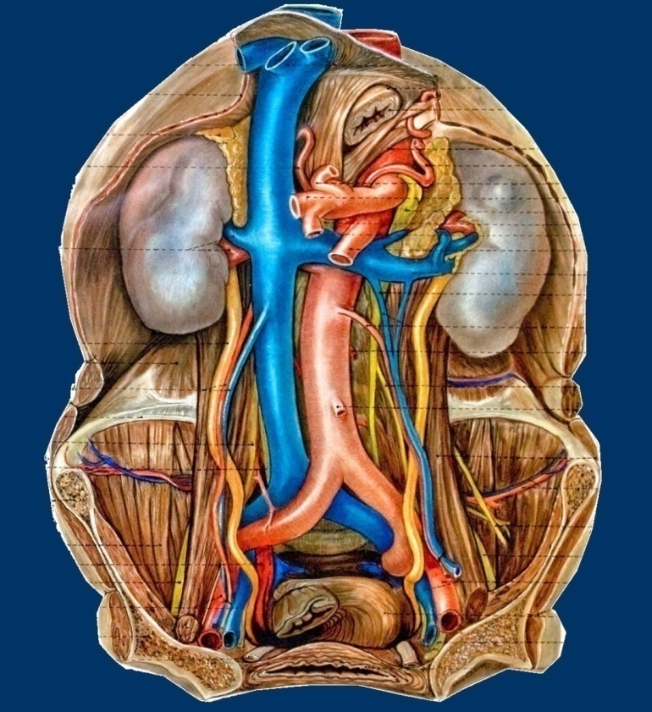
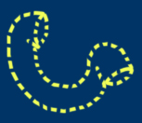
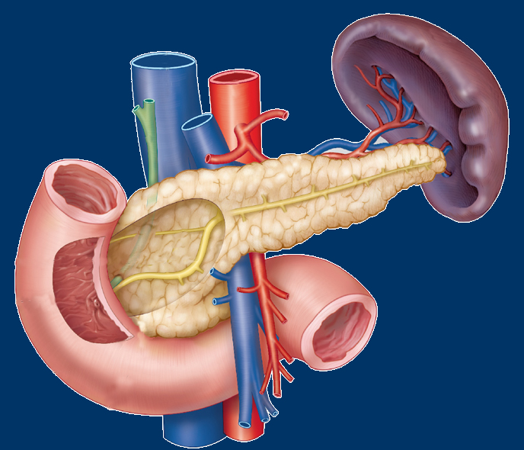
Duodenum – second part
Posteriorly :
Entirely non-peritoneal
Ant. Surface of Rt. Kidney close to hilum
Rt. Renal vessels, pelvis of Rt. Ureter
Rt. Psoas major muscle
Rt. Edge of inferior vena cava
Sometimes part of Rt. Supra renal

Slide 13
First Part
The first part begins at the pylorus, and passes backwards, upwards and to the right to meet the second part at the superior duodenal flexure.
Peritoneal Relations
1 The proximal 2.5 cm is movable. It is attached to the
lesser omentum above, and to the greater omentum below
2 The distal 2.5 cm is fixed. It is retroperitoneal. It is covered with peritoneum only on its anterior aspect.
Visceral Relations
Anteriorly: Quadrate lobe of liver, and gallbladder (Fig. 20.8a).
Posteriorly: Gastroduodenal artery, bile duct and portal vein (Fig. 20.8b).
Superiorly: Epiploic foramen (Fig. 20.8a). lnferiorly: Head and neck of the pancreas.

Slide 14
Second Part Course
This part is about 7.5 cm long. It begins at the superior duodenal flexure, passes downwards to reach the lower border of the third lumbar vertebra, where it curves towards the left at the inferior duodenal flexure, to
become continuous with the third part. Its relations are as follows.
Peritoneal Relations
It is retroperitoneal and fixed. Its anterior surface is covered with peritoneum, except near the middle, where it is directly related to the colon.
Visceral Relations
Anteriorly 1 Right lobe of the liver
2 Transverse colon 3 Root of the transverse mesocolon
4 Small intestine (Fig. 20.9a).
Posteriorly 1 Anterior surface of the right kidney near the medial
border 2 Right renal vessels 3 Right edge of the inferior vena cava
4 Right psoas major (Fig. 20.9b).
Medially 1 Head of the pancreas 2 The bile duct (Fig. 20.6).
Laterally: Right colic flexure (Fig. 20.9a).

Slide 15
The interior of the second part of the duodenum
shows the following special features.
a. The major duodenal papilla is an elevation present posteromedially, 8 to 10 cm distal to the pylorus. The hepatopancreatic ampulla opens at the summit of the papilla.
b. The minor duodenal papilla is present 6 to 8 cm distal to the pylorus, and presents the opening of the accessory pancreatic duct (see Fig. 23.16).
c. Below major duodenal papilla, a longitudinal fold called plica longitudinalis is seen

Slide 16
Third Part Course
This part is about 10 cm long. It begins at the inferior duodenal flexure, on the right side of the lower border of the third lumbar vertebra. It passes almost horizontally and slightly upwards in front of the inferior vena cava, and ends by joining the fourth part in front of the abdominal aorta. Its relations (Fig. 20.10) are as follows.
Peritoneal Relations
It is retroperitoneal and fixed. Its anterior surface is covered with peritoneum, except in the median plane, where it is crossed by the superior mesenteric vessels and by the root of the mesentery.
Visceral Relations Anteriorly
1 Superior mesenteric vessels 2 Root of mesentery (Fig. 20.1051).
3 Right testicular or ovarian vessels 4 Inferior vena cava
Inferiorly: Coils of jejunum.

Slide 17
Fourth Part Course
:Thls part is 2.5 cm long. It runs upwards on or immedlately to the left of the aorta, up to the upper border of the second lumbar vertebra, where it turns forwards to become continuous with the jejunum at the duodenojejunal flexure. Its relations are as follows.
Peritoneal Relations
It is mostly retroperitoneal, and covered with peritoneum only anteriorly. The terminal part is suspended by the uppermost part of the mesentery, and
is mobile.
Visceral Relations
Anteriorly
1 Transverse colon,
2 Transverse mesocolon, 3 Lesser sac, and
4 Stomach.
Posteriorly
1 Left sympathetic chain,
2 Left renal artery,
3 Left gonadal artery, and
4 Inferior mesenteric vein (Fig. 20.11).
To the right: Attachment of the upper part of the root of the mesentery (Fig. 20.10).
To the left
1 Left kidney and 2 Left ureter.
Superiorly: Body of pancreas (Fig. 20.6).

Slide 18
SUSPENSORY MUSCLE OF DUODENUM OR LIGAMENT OF TREITZ
This is a fibromuscular band which suspends and supports the duodenojejunal flexure. It arises from the left crus of the diaphragm, close to the right side of the oesophagus, passes downwards behind the pancreas, and is attached to the posterior surface of the
duodenojejunal flexure and the third and fourth parts of the duodenum (Fig. 20.12).
It is made up of:
a. Striped muscle fibres in its upper part b. Elastic fibres in its middle part c. Plain muscle fibres in its lower part.
Normally its contraction increases the angle of the duodenojejunal flexure. Sometimes it is attached only to the flexure, and then its contraction may narrow the angle of the flexure, causing partial obstruction of the
gut.

Slide 19
Arterial Supply
The duodenum develops partly from the foregut and partly from the midgut. The opening of the bile duct into the second part of the duodenum represents the junction of the foregut and the midgut. Up to the level of the opening, the duodenum is supplied by the superior pancreaticoduodenal artery, and below it by the inferior pancreaticoduodenal artery (Fig. 20.13).
The first part of the duodenum receives additional supply from: a. The right gastric artery.
b. The supraduodenal artery of Wilkie, which i5 usually a branch of the common hepatic artery.
c. The retroduodenal branches of the gastroduodenal artery.
d. Some branches from the right gastroepiploic artery.

Slide 20
Venous Drainage
The veins of the duodenum drain into the splenic, superior mesenteric and portal veins

Slide 21
Lymphatic Drainage
Most of the lymph vessels from the duodenum end in the pancreaticoduodenal nodes present along the inside of the curve of the duodenum, i.e. at the junction of the pancreas and the duodenum. From here the lymph passes partly to the hepatic nodes, and through them to the coeliac nodes; and partly to the superior mesenteric nodes and ultimately via intestinal lymph trunk into the cisterna chylz'.
Some vessels from the first part of the duodenum drain into the pyloric nodes, and through them to the hepatic nodes. All the lymph reaching the hepatic nodes drains into the coeliac nodes.

Slide 22
Nerve Supply
Sympathetic nerves from thoracic ninth and tenth spinal segments and parasympathetic nerves from the vagus, pass through the coeliac plexus and reach the duodenum along its arteries.

Slide 23
HlSTOLOGY
Mucous membrane: Shows evaginations in the form of villi and invaginations to form crypts of Lieberkuhn. Lining of villi is of columnar cells with microvilli. Muscularis mucosae comprises two layers.
Submacosa is full of mucus-secreting Brunner’s glands.
The muscularz's externa comprises outer longitudinal and inner circular layer of muscle fibres.
Outermost layer is mostly connective tissue.

