Slide 1
Applied aspects of larynx

Slide 2
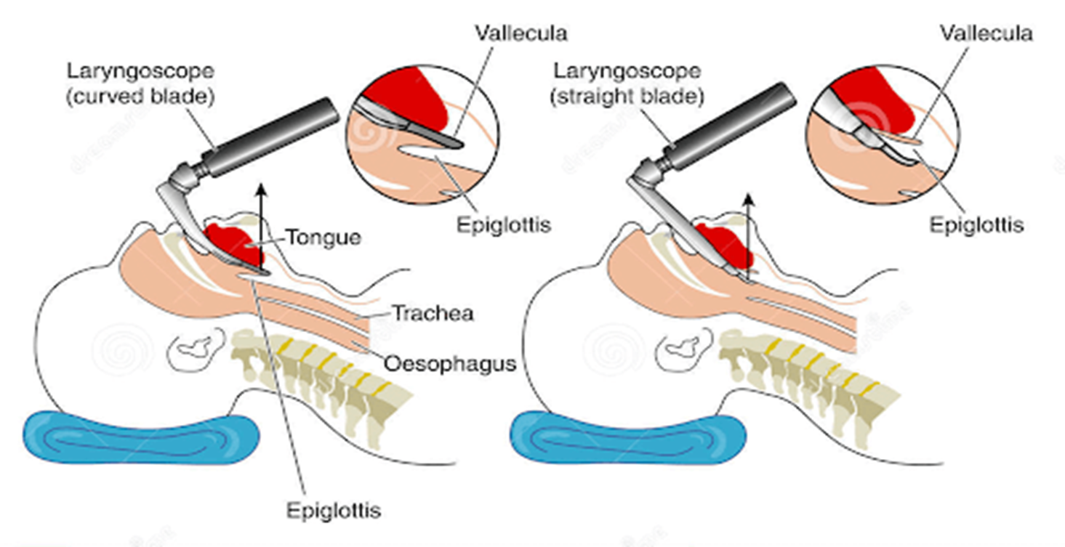
Laryngoscopy
The interior of larynx can be inspected directly by laryngoscope (direct laryngoscopy ) or indirectly through a laryngeal mirror ( indirect laryngoscopy )
Structures visible are
Base of tongue
Vallecula ,
Epiglottis,aryepiglottic folds
Piriform fossa
True & false vocal cords
Sinus of larynx

Slide 3
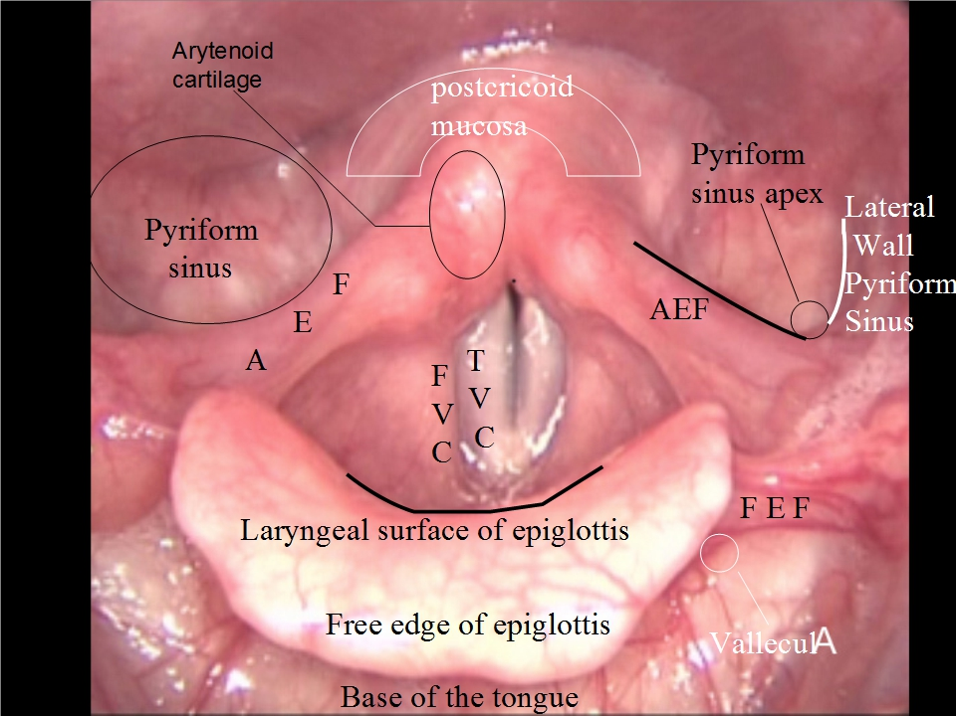
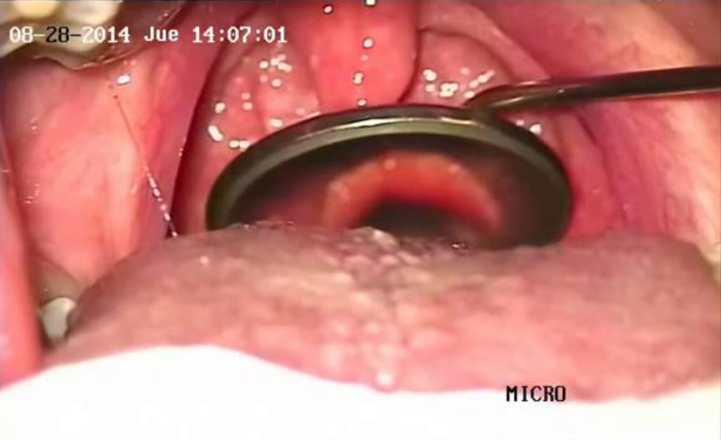

Slide 4
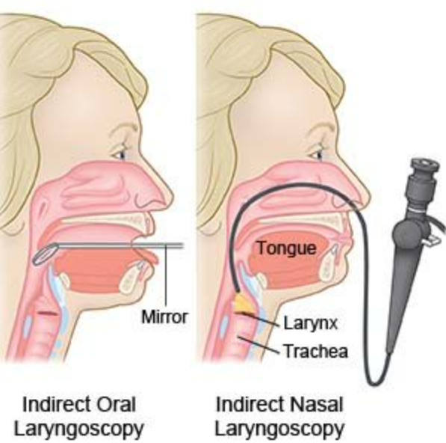

Slide 5
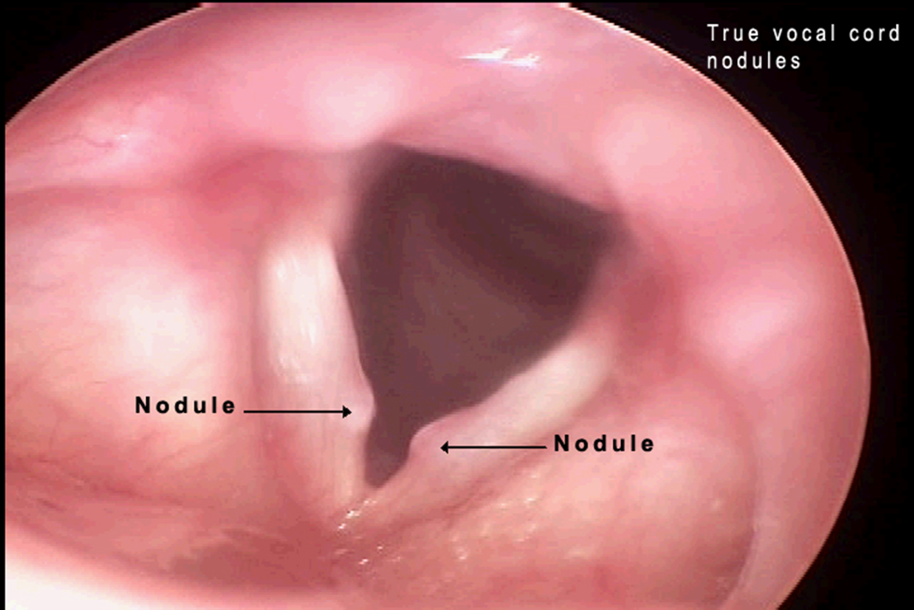
Vocal nodules (singer’s nodules or screamer’s nodules )
During vibration, the area of maximum contact between vocal cords is at the junction of their 1/3rd & posterior 2/3rd and is subjected to maximum friction .Hence in individuals who overuse their voice such as teachers ,singers etc. inflammatory nodules develop at these sites called vocal nodules . They vary in size from that of a pin head to a split pea .

Slide 6
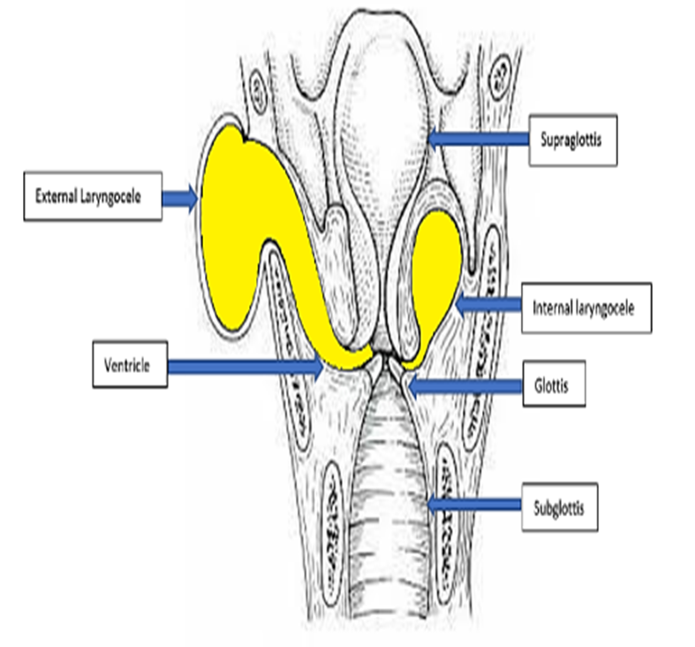
laryngocele
If air pressure in the laryngeal sinus is raised too much as in trumpet players ,glass blowers or weight lifters ,the saccule dilates to produce an air filled cystic swelling called laryngocele
The laryngocele may be internal ,when it is located within the larynx or external when distended saccule herniates through the thyrohyoid membrane and comes outside the larynx

Slide 7
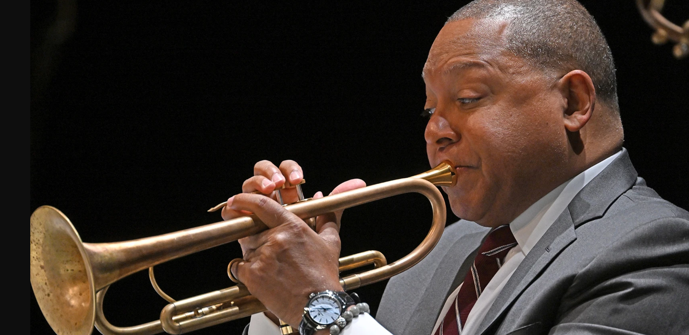
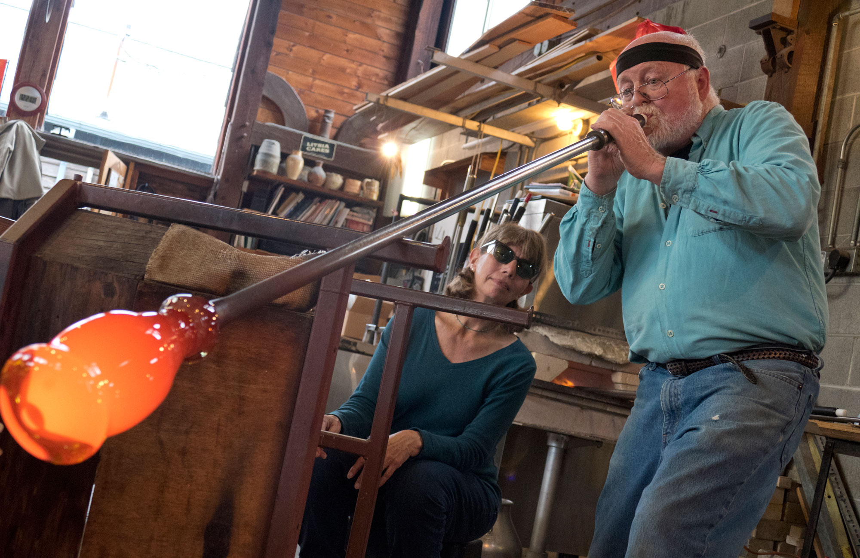

Slide 8
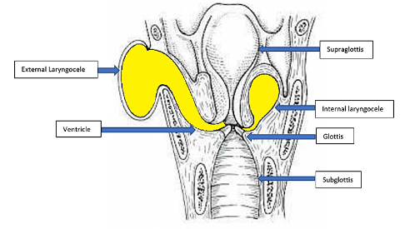
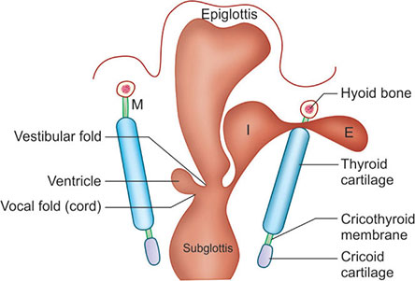

Slide 9
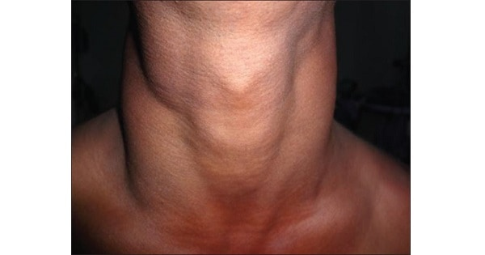
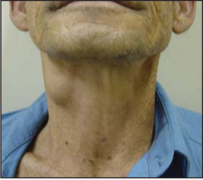
External laryngocele

Slide 10
Laryngeal obstruction
The mucous membrane of superior part of larynx is very sensitive. When a foreign body enters into laryngeal inlet ,it causes immediate explosive coughing & the foreign body is expelled out .
If the reflex is slowed or absent as in neurological lesion ,the foreign body may enter the laryngeal cavity and cause obstruction .
Heimlich manoeuver can be performed for expelling the foreign body .

Slide 11
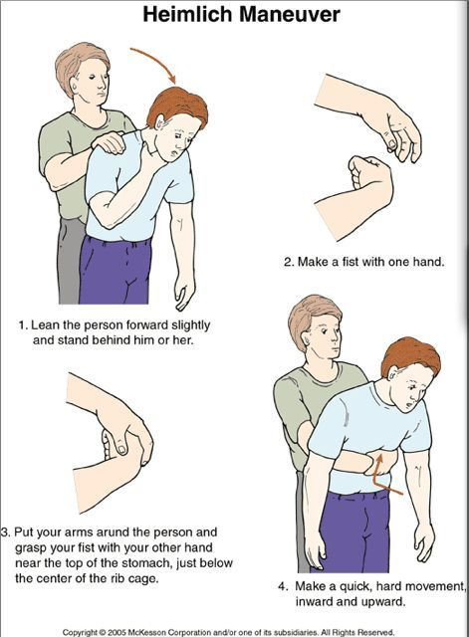
Heimlich manoeuver

Slide 12
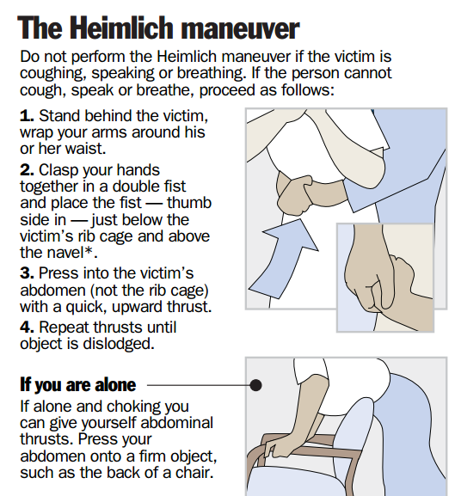

Slide 13
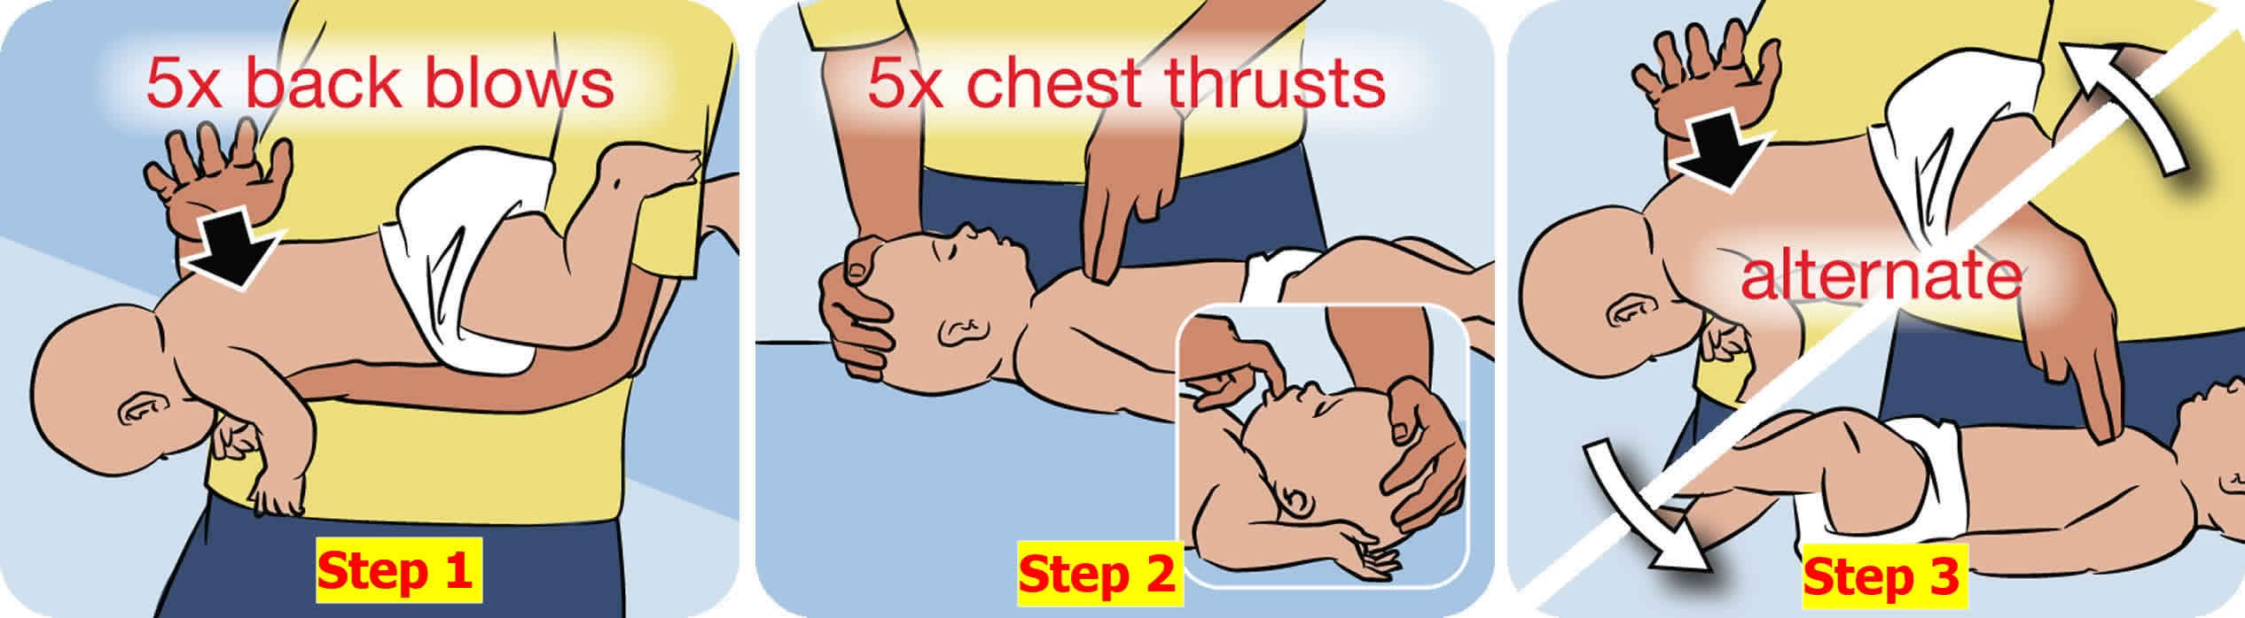
For infants below one year

Slide 14
Tuning fork of larynx
Cricothyroid is an important muscle for tone and pitch of voice .When sound is about to be produced ,it tenses the vocal cord and makes it ready to vibrate like a tuning fork . Hence it is known as tuning fork of larynx .

Slide 15
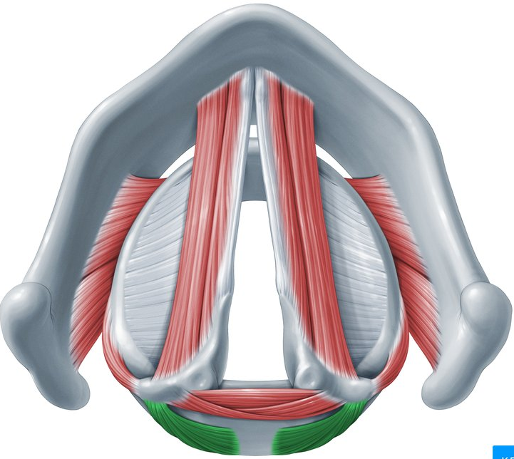
Safety muscle of larynx
Posterior cricoarytenoid muscles are the only intrinsic muscles which abduct the vocal cords to allow entry of air through rima glottidis .
If they are paralysed the adductor muscles take the upper hand and the person may die due to lack of air .Hence they are known as the safety muscles of larynx .

Slide 16
The mucosa lining the vocal cords is firmly adhered to the vocal ligaments & there is no intervening submucosa .This accounts for the pearly white avascular appearance of vocal cords. The oedema of larynx does not involve the true vocal cords since there is no submucous tissue

Slide 17
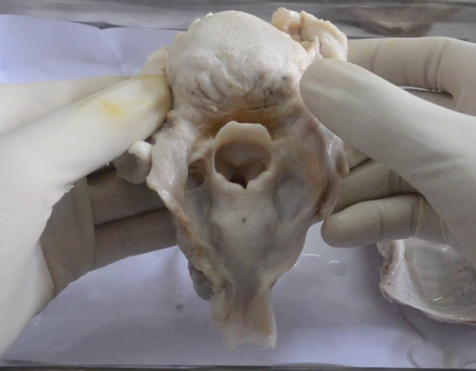
Infection of larynx is called laryngitis .It is characterized by hoarseness of voice.
Smuggler’s fossa –( piriform fossa )
smuggler’s use this area to smuggle small items
Food particles also get trapped in this space

Slide 18
The mucous membrane of larynx is supplied by 10th nerve through superior laryngeal or recurrent laryngeal nerves .So laryngeal tumours may also cause referred pain in the ear partly supplied by auricular branch of 10th nerve .

Slide 19
Thank you

