Slide 1
ANAL CANAL

Slide 2
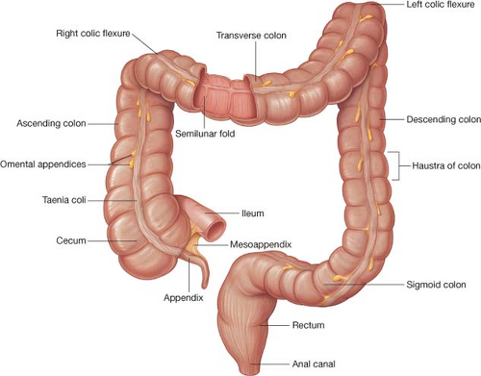
Definition
Anal canal is the terminal part of the large intestine.

Slide 3
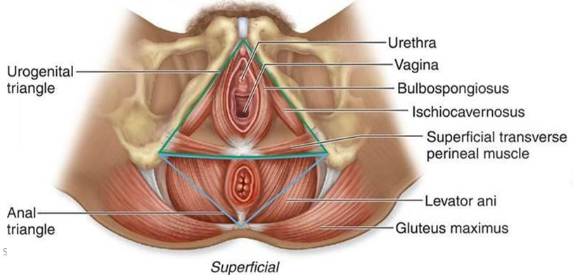
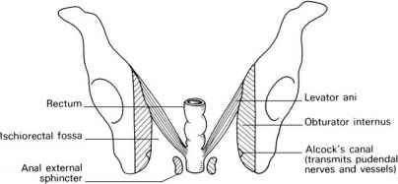
Situation
Anal canal is situated below the level of the pelvic diaphragm.
It lies in the anal triangle of perineum in between the right and left ischiorectal fossae, which allow its expansion during passage of the faeces

Slide 4
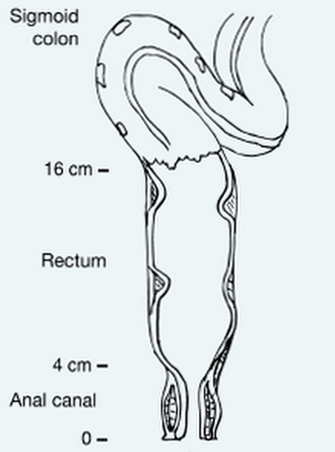
Length - 3.8 cm long.
Extent - Anorectal junction to the anus

Slide 5
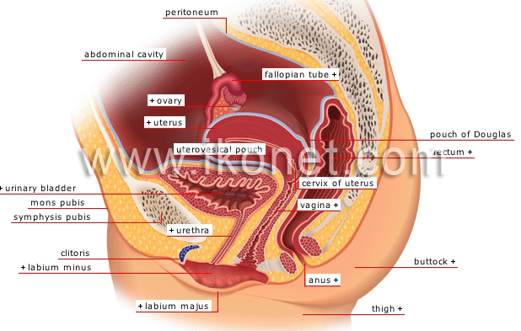
Direction or course
It is directed downwards and backwards.
The anal canal is surrounded by inner involuntary and outer voluntary sphincters which keep the lumen closed in the form of an anteroposterior slit.

Slide 6
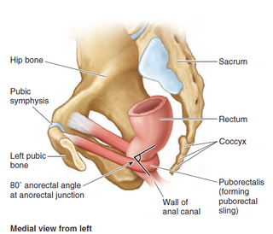

Slide 7
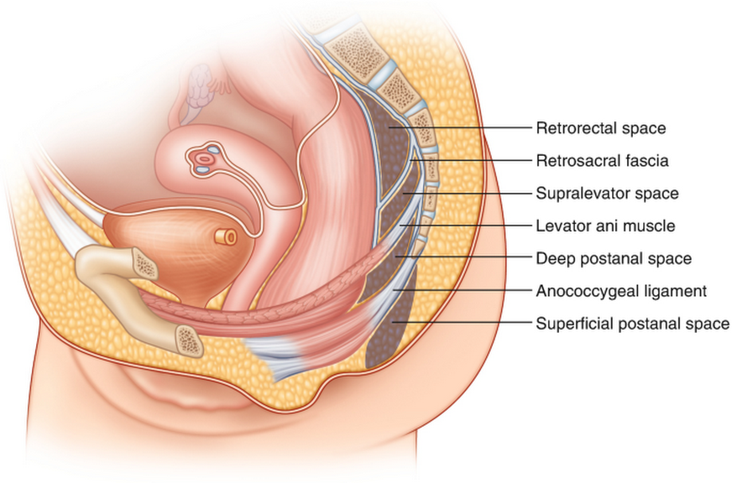

Slide 8
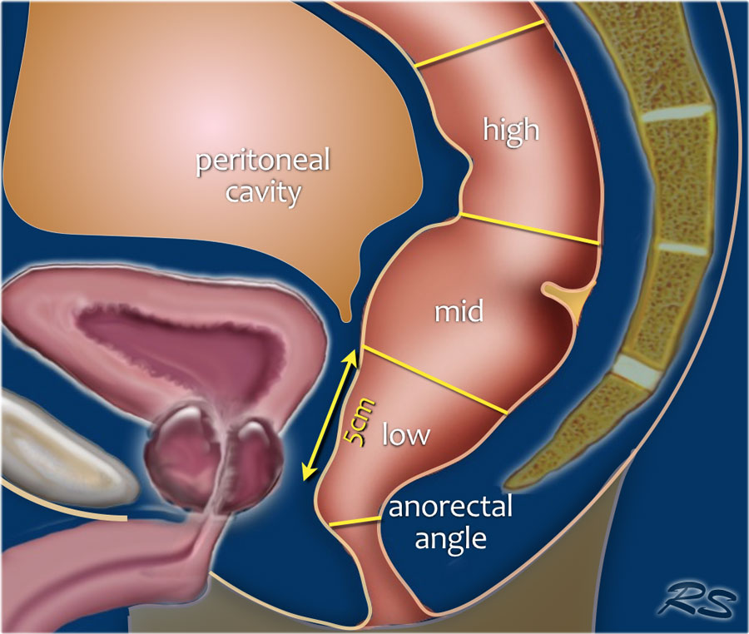
Anorectal junction
Anorectal junction is marked by the forward convexity of the perineal flexure of the rectum and lies 2-3 cm in front of and slightly below the tip of the coccyx.

Slide 9
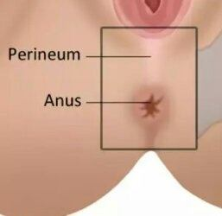
Anus
Anus is the surface opening of the anal canal,
Situated about 4 cm below and in front of the tip of the coccyx in the cleft between the two buttocks.
Surrounding skin is pigmented and thrown into radiating folds, and contains a ring of large apocrine glands

Slide 10
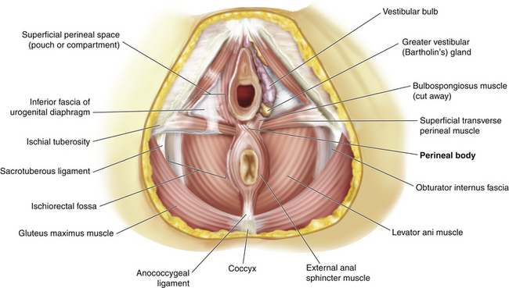
Relations of the Anal Canal
Anteriorly: (a) In both sexes : perineal body, (b) In males : membranous urethra and bulb of penis,
(c) In females : lower end of the vagina

Slide 11
Posteriorly:
(1) Anococcygeal ligament; and (2) tip of the coccyx
Laterally : Ischiorectal fossae

Slide 12
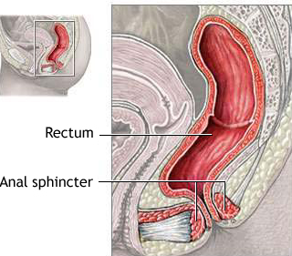
All round : Anal canal is surrounded by the sphincter muscles, the tone of which keeps the canal closed.

Slide 13
Parts of the anal canal

Slide 14
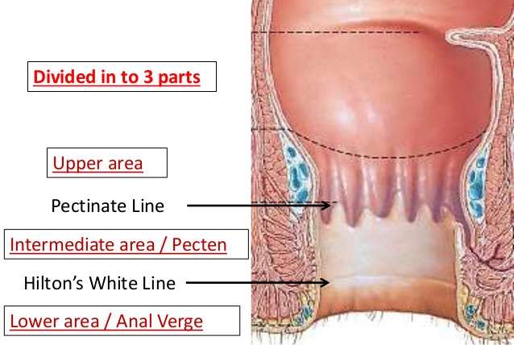
Interior of the Anal Canal
Interior of the anal canal shows many important features and can be divided into three parts:
Upper part, -15 mm
Middle part -15 mm long;
Lower part- 8 mm

Slide 15
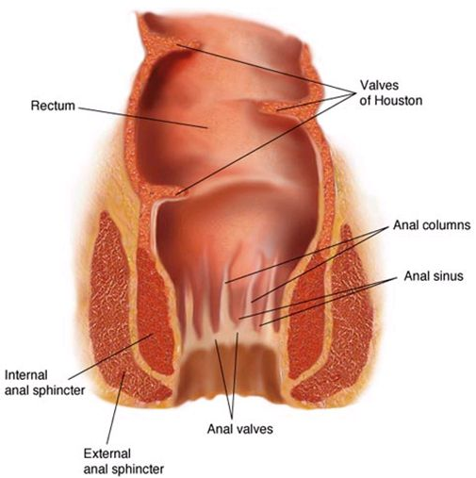
Upper Mucous Part features
1. This part is about 15 mm long. It is lined by mucous membrane
2. The mucous membrane shows (a) 6 to 10 vertical folds; these folds are called the Anal columns of morgagni.
(b) The lower ends of the anal columns are united to each other by short transverse folds of mucous membrane; these folds are called the anal valves,

Slide 16
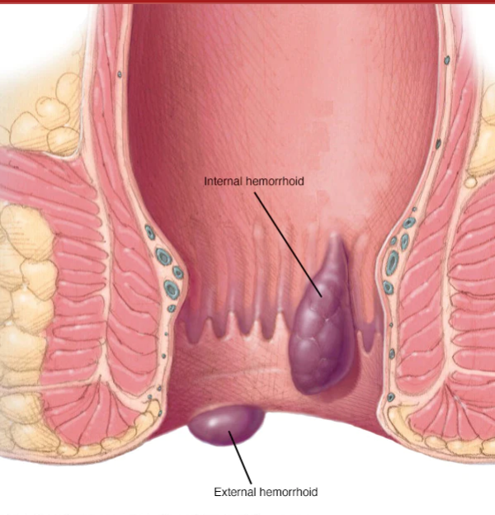

Slide 17
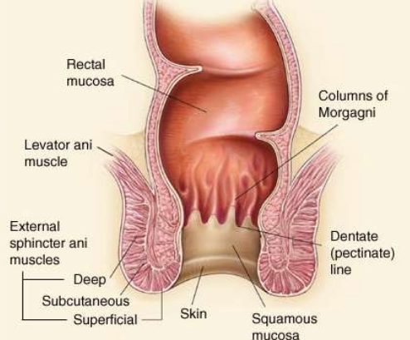
Above each valve there is a depression in the mucosa which is called the anal sinus,
(d) The anal valves together form a transverse line that runs all round the anal canal. This is THE PECTINATE LINE

Slide 18
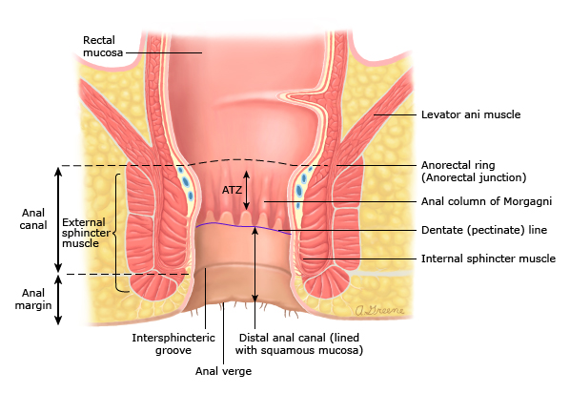
PECTINATELINE

Slide 19
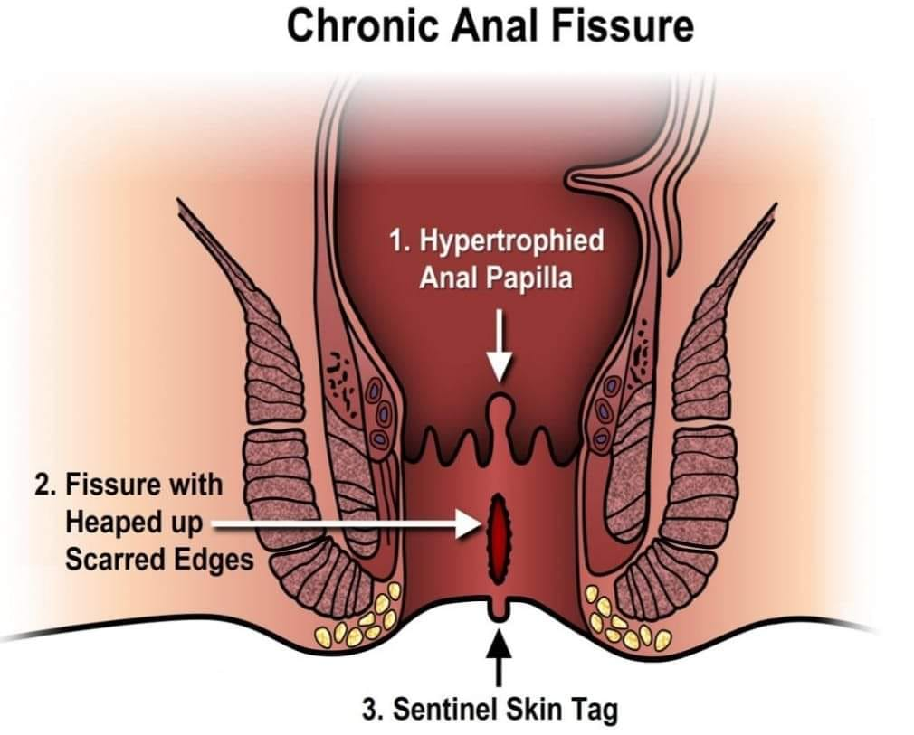
Features of Upper Mucous Part cont
Anal papillae: Occasionally, the free margins of anal valves show epithelial projections called anal papillae. These represent remnants of anal membrane.F.

Slide 20
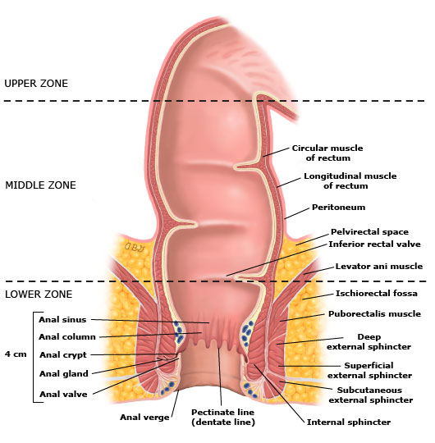
Features of Upper Mucous Part cont
Anal glands: The anal sinus contains anal glands. The secretion of these glands produces peculiar smell which is important in lower animals to attract.• The infected anal glands become the source of abscess.

Slide 21
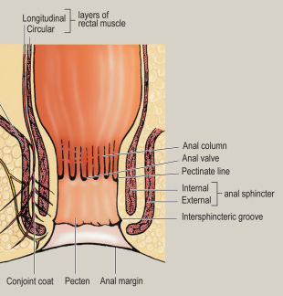
Middle Part or Transitional Zone or Pecten
The next 15 mm of the anal canal is also lined by mucous membrane, but anal columns are not present here.
The mucosa has a bluish appearance because of a dense venous plexus that lies betweem it and the muscle coat.
Mucosa is less mobile than in the upper part of the anal canal. This region is referred to as the pecten or transitional zone.

Slide 22
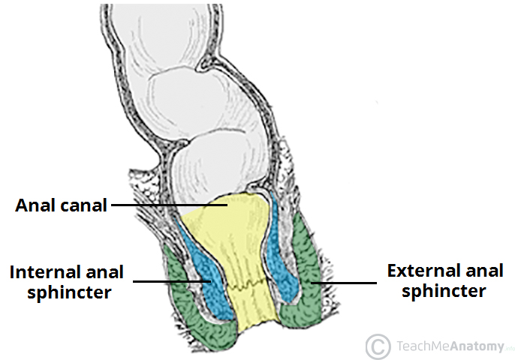
white line of Hilton
The lower limit of the pecten often has a whitish appearance because of which it is referred to as the white line of Hilton.
Hilton's line is situated at the level of the interval between the subcutaneous part of external anal sphincter and the lower border of internal anal sphincter

Slide 23
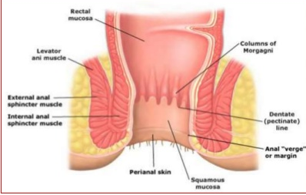
Lower Cutaneous Part
It is about 8 mm long and is lined by true skin containing sweat and sebaceous glands. The epithelium of the lower part resembles that of true skin in which sebaceous and sweat glands are present.

Slide 24
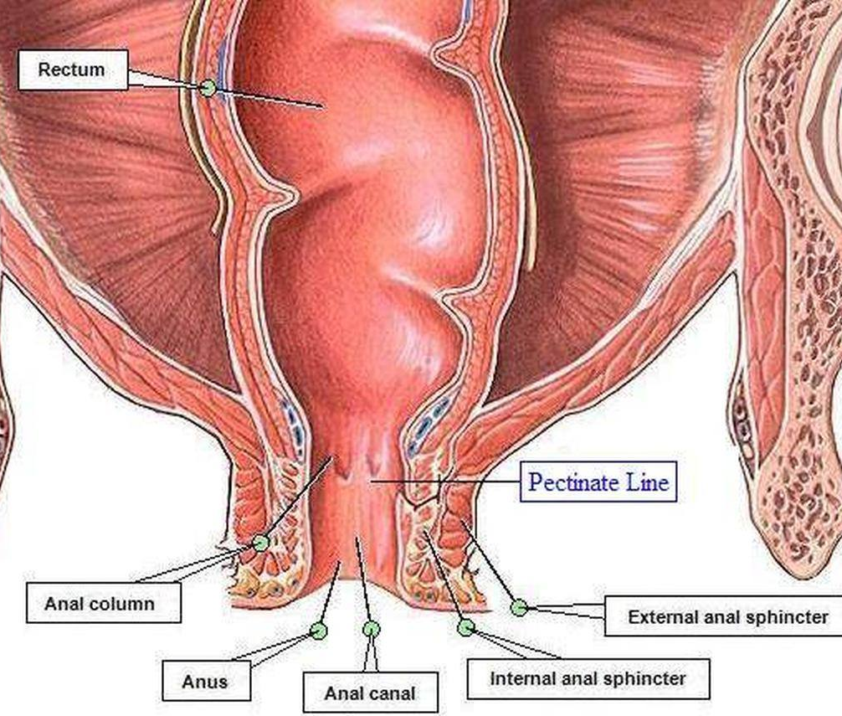
Musculature of the Anal Canal
Anal Sphincters
The internal anal sphincter is involuntary in nature. It is formed by the thickened circular muscle coat of this part of the gut. It surrounds the upper three-fourths, extending from the upper end of the canal to the white line of Hilton

Slide 25
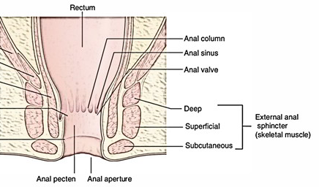
external anal sphincter
It is under voluntary control. It is made up of a striated muscle and is supplied by the inferior rectal nerve and the perineal branch of the fourth sacral nerve.
It surrounds the whole length of the anal canal and has three parts, subcutaneous, superficial and deep

Slide 26
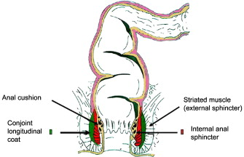
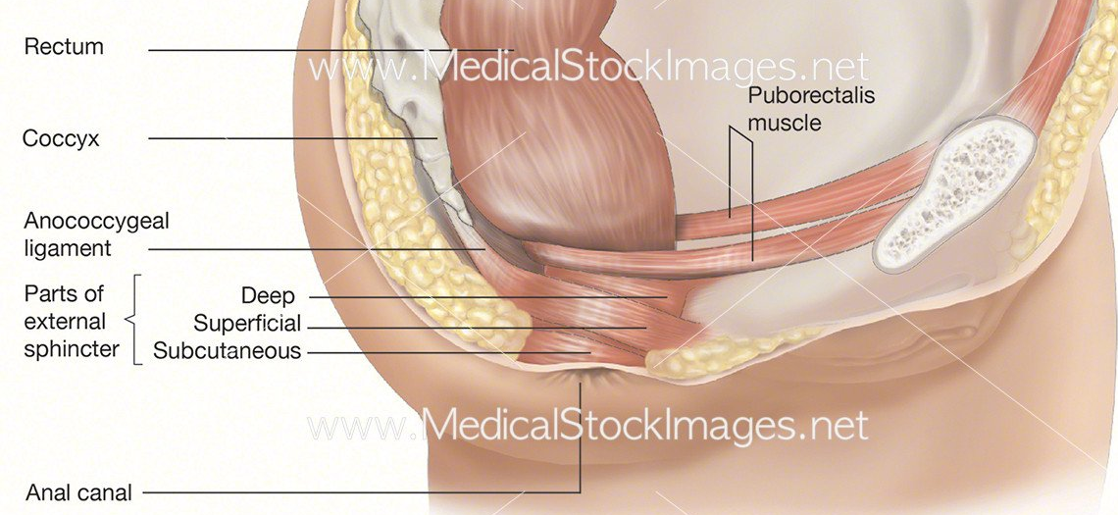
Conjoint Longitudinal Coat
It is formed by fusion of the puborectalis with the longitudinal muscle coat of the rectum at the anorectal junction. It lies between the external and internal sphincters

Slide 27
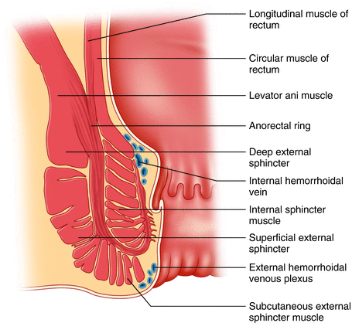
Anorectal Ring
This is a muscular ring present at the anorectal junction.
It is formed by the fusion of the puborectalis, deep external sphincter and the internal sphincter.
It is easily felt by a finger in the anal canal.
Surgical division of this ring results in rectal incontinence. The ring is less marked anteriorly where the fibres of the puborectalis are absent.

Slide 28
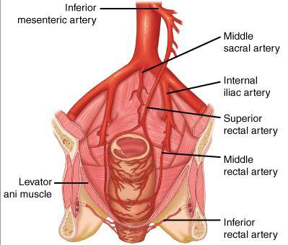
Arterial Supply
1. The part of the anal canal above the pectinate line is supplied by the superior rectal artery.
2. The part below the pectinate line is supplied by the inferior rectal artery.

Slide 29
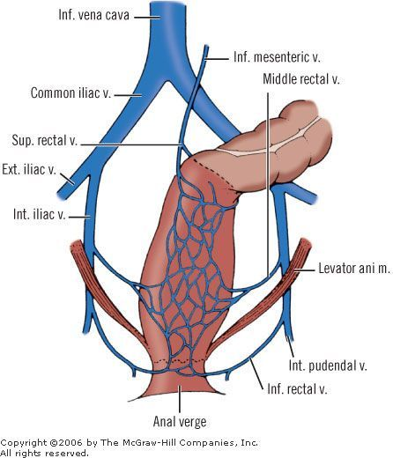
Venous Drainage
1. The internal rectal venous plexus or haemorrhoidal plexus lies in the submucosa of the anal canal. It drains mainly into the superior rectal vein but communicates freely with the external plexus and thus with the middle and inferior rectal veins.

Slide 30
External venous plexus
. The external rectal venous plexus lies outside the muscular coat of the rectum and anal canal, and communicates freely with the internal plexus.
The lower part of the external plexus is drained by the inferior rectal vein into the internal pudendal vein; the middle part by the middle rectal vein into the internal iliac vein; and the upper part by the superior rectal vein which continues as the inferior mesenteric vein.

Slide 31
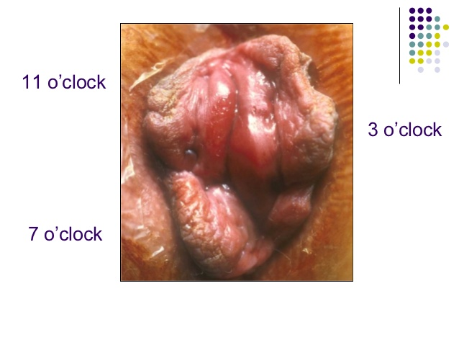
Veins present in the three anal columns situated at 3, 7 and 11 O'clock positions as seen in the lithotomy position are large and constitute potential sites for the formation of primary internal piles.

Slide 32
Lymphatic Drainage
Lymph vessels from the part above the pectinate line, drain with those of the rectum into the internal iliac nodes.
Vessels from the part below the pectinate line drain into the medial group of the superficial inguinal nodes

Slide 33
Nerve Supply
1. Above the pectinate line, the anal canal is supplied by autonomic nerves, both sympathetic (inferior hypogastric plexus; LI, L2) and parasympathetic (pelvic splanchnic, S2, S3, S4)..
2. Below the pectinate line, it is supplied by somatic (inferior rectal, S2, S3, S4) nerves.
3. Sphincters : The internal sphincter is caused to contract by sympathetic nerves and is relaxed by parasympathetic nerves. The external sphincter is supplied by the inferior rectal nerve and by the perineal branch of the fourth sacral nerve.

Slide 34
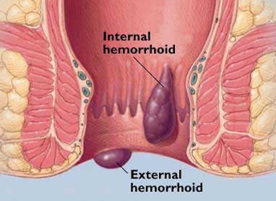
CLINICAL ANATOMY
Piles /Haemorrhoids
Internal piles or true piles are saccular dilatations of the internal rectal venous plexus.
External piles or false piles occur below the pectinate line and are, therefore, very painful. They do not bleed on straining at stool.

Slide 35
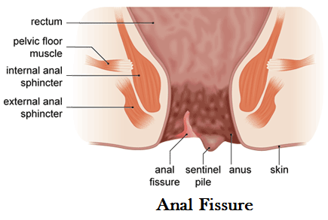
Anal Fissure/Fissure in Ano
Anal fissure is caused by the rupture of one of the anal valves, usually by the passage of dry hard stool in a constipated person

Slide 36
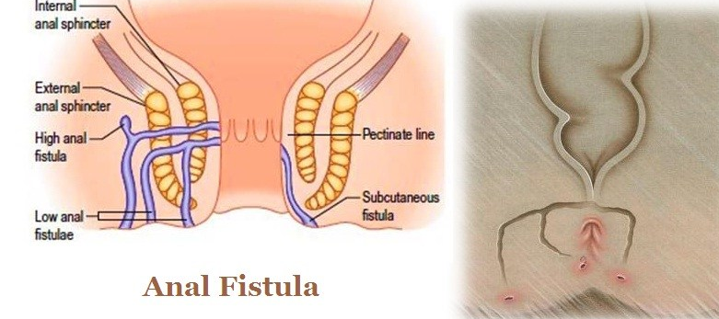
Fistula in Ano
A fistula is an abnormal epithelialised track connecting two cavities, or one cavity with the exterior.

