Slide 1
SODHANA OF POISONOUS PLANTS
DR. ANURAG MISHRA
ASSISTANT PROFESSOR
DEPT. OF ATVV
RAMCH, BAREILLY.

Slide 2
CONTENTS

Slide 3
INTRODUCTION
CONCEPT OF VISHA
CLASSIFICATION OF VISHA
CONCEPT OF SHODHANA
IMPORTANCE OF SHODHAN
PROCEDURES
MEDIA FOR SHODHANA
LIST OF POISONOUS SUBSTANCE UNDER THE AYURVEDIC SYSTEM OF MEDICINE
SHODHANA OF VISHA DRAVYA IN AYURVEDA
DISCUSSION
CONCLUSION

Slide 4
INTRODUCTION

Slide 5
Ayurveda involves the use of drugs obtained from plants, animals, and mineral origin. All the three sources of drugs can be divided under poisonous and non-poisonous category. There are various crude drugs, which generally possess unwanted impurities and toxic substances, which can lead to harmful health problems. Śodhana (detoxification/purification) is the process, which involves the conversion of any poisonous drug into beneficial, non-poisonous / non-toxic ones.
Plants are the prime source of medicine in Ayurveda. Several compounds have been isolated from medicinal plants and introduced for the service of mankind ; however most of these medicines containing isolated compounds have been withdrawn due to their toxicity or side effects. Traditionally, plants having various classes of phytochemicals are still in use either in their crude form or after proper processing. Though most of the plant drugs are safe, yet few are toxic for human health.

Slide 6
The detoxification or purification process of any toxic material used for medicinal purposes is termed as “Śodhana”. In Ayurveda, śodhana is in practice since the times of Caraka Saṃhitā , but it’s use expanded with the development of Rasaśāstra since 8th century.
Śodhana process is specially designed for the drugs from mineral origin; however, it is recommended for all kinds of drugs to remove their doṣās (impurities or toxic content).
It is cited in the charak samhita that by the use of proper method of processing, viṣa can be converted into amṛta (nectar) and on other hand by adoption of inappropriate methods, non-toxic materials become a toxic.

Slide 7
Vatsanābha (Aconitum species), Bhallataka(Semecarpus anacardium), Kupilu (Strychnos nux-vomica), Gunja (Abrus precatorius) etc., are some of the interesting examples of toxic plants, which are still used in the Indian system of medicine. Aconite, bhilawanols, strychnine, abrin are some of the toxic components present in these plants and are relatively toxic in nature.
Śodhana process involves the purification as well as reduction in the levels of toxic principles which sometimes results in an enhanced therapeutic efficacy. This presentation is designed to extensively discuss and understand the scientific basis of the use of toxic plants as a medicine after their purification process.

Slide 8
CONCEPT OF VISA

Slide 9
The substance immediately after entering in to the body causes the vitiation of the healthy dhatus or killing of the healthy person is defined as Visha.
A substance which causes sadness to the world is also called as visha. (S.SU.38/37)
Visha dravyas (poisonous drugs) are used in various Ayurvedic formulations, in spite of their reported side effects, due to their quick effectiveness and in relatively smaller dose. A vivid but scattered description of this can be traced in different texts of Ayurveda and particularly in Agadatantra .
Hence , visha dravya may be defined as a substance which is life threatening or produces many other complications and brings about sadness. The synonyms used for poison are Visha, Halahal, Darada, Kakola, Souktikeya, Ahichhatra, Meshshringi, Kustha, Haimavata, Pippala, Patala, Malina & Kambala.

Slide 10
In spite of their fatal effect many visha dravyas (poisonous substances) are used as medicines. Many of the poisonous plants as well as rasaushadhis which are reported for their toxic nature but they are used, after proper processing, widely in the treatment without any adverse effects as they are effective in small doses to cure the diseases . ( Rasavagbhat)
Visha dravyas , along with their undesirable properties, are also incorporated with certain desirable properties, by which they act faster than other medicines or plants. Further, to make these properties therapeutically effective certain shodhana (detoxification technique) procedures are explained in the classical texts, which may be helpful for diminution of toxic properties of the poisonous substances.

Slide 11
CLASSIFICATION OF VISHA

Slide 12
Visha , basing upon its origin, has been classified into two categories viz. Jangama visha (animal poison) and Sthavara visha (plant and mineral poisons) and has been recited as ten and sixteen respectively. [S.S.K. 2/3-6]
Further, basing upon origin it is classified as Akritrima visha (natural poison) and kritrima visha /Gara visha (artificial or chemically prepared poison) where Akritrima visha is again sub divided into two i.e. sthavara and jangama. [A.H.UT35/5]
Certain texts of Rasashastra and Dravyaguna classified visha in various categories like mahavisha - upavisha ,etc
[R.T 24/7-8&24/163-164]

Slide 13
CONCEPT OF SHODHANA

Slide 14
Definition: - Shodhana is a process by which unwanted impurities are separated from the substance by various pharmaceutical methods like grinding, washing,etc. With specific drugs (media) thereby minimizing the toxicity of the substance.
The various meaning of shodhana word in various context are as follows:
TO CLEANSE | TO DISTIL | TO SORT | TO PEEL
TO CLARIFY | TO DEHYDRATE | TO STREAM | TO DEHUSK
TO PURIFY | TOSHIFT | TO FILTER | TO WASH

Slide 15
Shodhana is a combination of process which removes unwanted part from the drug , which control the unwanted effect or toxic effect or remove those effect and enhances the properties of drug which make the drug suitable for desired action.
Types of shodhana: - Shodhana process is grossly subdivided into two major categories as samanya and vishesha.
Samanya Shodhana (Common purification/ processing): Samanya shodhana means general method of purification of all poisonous drugs of a particular group.
Vishesha shodhana (Specific purification/ processing): Vishesha shodhana means specific method of purification for the particular drug. Vishesa Sodhana is performed, to remove the impurities peculiar to the substance which can not be removed by Samanya Sodhana.

Slide 16
IMPORTANCE OF SHODHANA

Slide 17
Poisons when used incautiously, readily spread throughout body and cause deleterious effect which may cause even death. This is due to the qualities of Visas like ‘Vyavayi’, ‘Tiksna’, ‘Asu’, etc. The cautious utilization of Visa in small quantity after proper purification acts as “Amrta” that is, it has very good clinical efficacy.
Rasa Vagbhatta and Rasa Madhava have clearly mentioned the detrimental effects of impurities of Swarnadi Lohas.
However, in Rasendra Cudamani and Rasa Prakasa Sudhakar, it has been mentioned that pure gold does not require to undergo Sodhana process.

Slide 18
Sodhana was that much important since ages that, a complete detail of the characteristics of the impure substance is given. How the impurities are removed is also described fully . The effect on body of the pure form of the substance is also described to the fullest extent. So in this way a Rasasastri can never fail in his endeavor of Sodhana.
As told earlier Sodhana of Ayurveda does not literally means purification of modern chemistry. It means something more than mere purification. ‘Sendriyatva’ is brought about after Sodhana and this quality is of utmost importance for it is to be utilized internally as medicine. And that is why though now a days we are having 99.9% pure metals from the market, still they can not be utilized without Sodhana . Sodhana is an essential process as far as ayurvedic pharmaceutical preparations are concerned.

Slide 19
Aim of Sodhana :
There are so many aims of Sodhana and is different from substance to substance, some of them are given below:
DRUGS | AIM OF SHODHANA
BHALLATAKA | TO MAKE IT NIRMALA
KANKSHI | TO MAKE IT NIRJALA
BHANGA | TO MAKE IT NIRMADA
GUNJA | TO MAKE IT NIRVISHA
LASHUNA | TO REDUCE UGRATA
GUGGULU | TO REDUCE STICKINESS

Slide 20
PROCEDURES

Slide 21
Classical texts of Ayurveda recommend different techniques /procedures for shodhana of a specific visa dravyas .
Achushana (Absorption)
Oily content of certain toxic materials are minimized through different absorption means, e.g. Bhallataka Shodhana with brick powder.
Bharjana (Frying or Roasting)
The drug is fried with specific liquid media on Mandagni (mild heat), e.g. Hingu shodhana, kupilu shodhana with cow's ghee.
Bhavana (Levigation)
The drug is triturated with prescribed liquid media for specific time period. e.g. Ahiphena Shodhana with ginger juice.

Slide 22
Nimajjana (Dipping)
The drug is kept immersed in the prescribed liquid media for specific time period, e.g. Vatsanabha shodhana with cow's urine.
Parishravana (Straining)
The solid drug is dissolved in suitable liquid media and separated from insoluble impurities through straining, e.g. Guggulu with triphala decoction.
Prakshalana (Washing)
The drug is washed with prescribed liquid to remove its physical impurities, e.g. tuber of vidarikanda after collection Shodhana with water.
Prithakikarana (Separation)
Physical impurities are removed, e.g. Kampillaka Shodhana
Swedana (Boiling under liquid bath)
The drug is boiled in prescribed liquid media through Dola Yantra method ,e.g. nux-vomica Shodhana with cow's milk.

Slide 23
SL.NO. | PROCEDURE | HERBAL DRUGS
1 | Bhavana (Trituration) | : eg. Ahiphena
2 | Bharjana (Frying) | : eg. Hingu
3 | Swedana (Boiling) | : eg. Vacha
4 | Mardana (Pounding) | : eg. Jayapala
5 | Nimajjana (Soaking) | :eg. Vatsanabha
6 | Prakshalana (Washing) | :eg. Kampillaka
7 | Prithakkarana (Separating) | :eg. Guggulu
8 | Achushana (Absorption) : | Oily content of certain toxic materials is minimized through different absorption means, e.g. Bhallataka Shodhana
9 | Parishravana (Straining): | The solid material is dissolved in suitable liquid media and separated from insoluble impurities through straining, e.g. Guggulu

Slide 24
MEDIA FOR SODHANA

Slide 25
In Ayurveda , a series of phamaceutical procedures /methods which converts a poisonous drug into a therapeutically very effective medicine for various ailments is termed as shodhana. Various medias are being used for processing the herbal poisonous drugs, are quite interesting to understand with modern scientific technology.
The media used in the process of shodhana has very important role in either breaking down or destroying the chemical constituent that is not required.

Slide 26
Sometimes media acts like solvent, to dissolve the material for easy separation from the insoluble impurities like in Guggulu.
All the procedures adopted under the head shodhana can be analyzed under the light of modern chemistry. It is important to evaluate the drug before and after the shodhana Samskara.

Slide 27
LIST OF POISONOUS SUBSTANCES UNDER THE AYURVEDIC SYSTEM OF MEDICINE

Slide 28
Drugs of vegetable origin
Ahiphena - Papaver somniferum ,
Arka - Calotropis gigantea ,
Bhallataka - Semecarpus anacardium,
Bhanga - Cannabis sativa,
Danti - Baliospermum monatanum,
Dhattura - Datura metal,
Gunja - Abrus precatorius
Jayapala - Croton tiglium.,
Karaveera - Nerium indicum
Langali - Gloriosa superba
Parasika Yavani - Hyoscyanamus niger
Snuhi - Euphorbia neriifolia
Vatsanabha - Acontium ferox
Vishamushti - Strychnox nuxvomica
Shringivisha - Acontium chasmanthum ,etc.

Slide 29
List of poisonous substances under the Ayurvedic System of Medicine
Drugs of Animal Origin
Drugs of Mineral Origin
Sarpa Visha ,
Vruschika Visha,
Alarka Visha,
Luta Visha,
Kita Visha ,etc
Gauripashana - Arsenic
Hartala - Arseno sulphide
Parada - Mercury
Tuttha - Copper sulphate
Hingula - Cinnabar
Sindura - Red oxide of lead
Girisindura - Red oxide of mercury , etc.

Slide 30
SHODHANA OF VISHA DRAVYA IN AYURVEDA

Slide 31
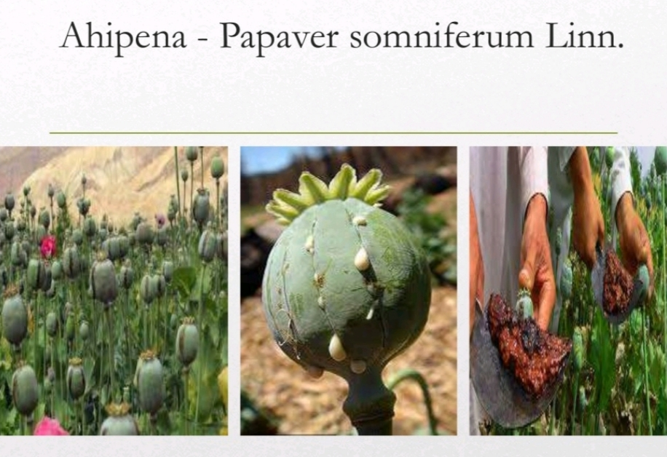

Slide 32
Ahiphena - Papaver somniferum Linn.- (except seeds)
Dissolved in water then filtered with cloth. After that mixed with Godugdha (cow’s milk), heated in mild heat. This paste is triturated with ginger juice for 7 - 21 times, dried under shade ¹ .

Slide 33
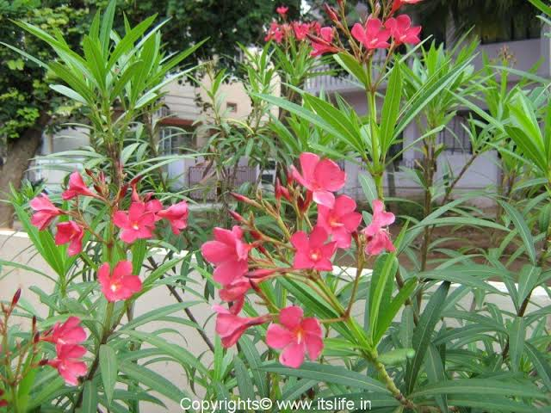

Slide 34
Karavira - Nerium indicum
Roots are purified by Swedana process in Dola Yantra using Godugdha for 3 hours, then washed with water and dried. After shodhana , Oleandrin decreases.

Slide 35
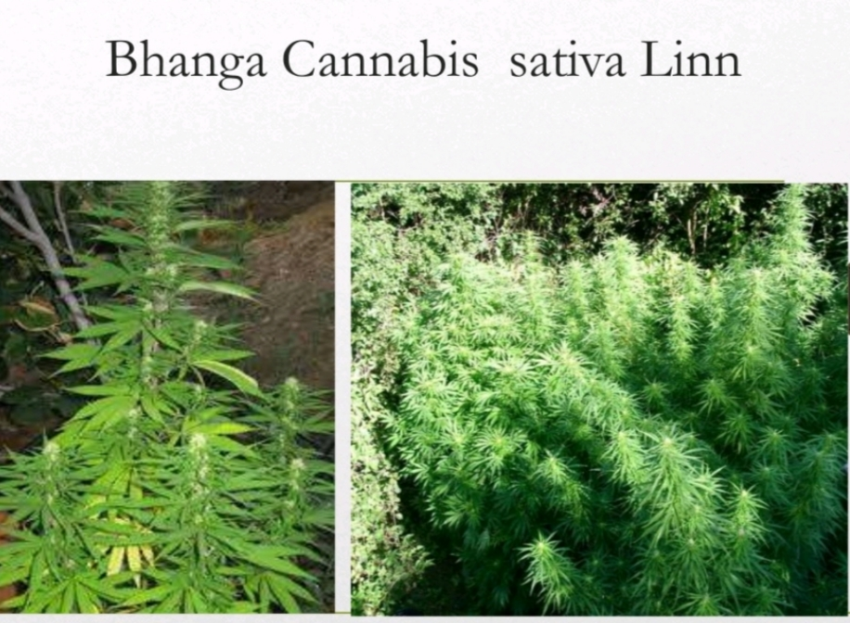

Slide 36
Bhanga - Cannabis sativa Linn. {(Except seeds)}
1st Method: The leaves are tied in a cloth and soaked with water. This procedure has to be continued until the greenish colour stops discharge from the leaves. After this the leaves are dried under the shade, thereafter it should be fried in Goghrita (Cow’s ghee) on mild fire and used for therapeutic purpose.
2nd Method: Swedana (fomentation) in Godugdha (cow’s milk) for 3 hours with mild heat then washed with water. After getting it dried, it is being fried in Goghrita.
3rd Method: The Bhanga leaves are to be fomented in decoction of Babbul Tvak (Bark of Acacia catechu) for 25- 30 minutes with moderate heat and then subjected to drying under direct sunlight. Further they are triturated with Godudha, dried and used ³.

Slide 37
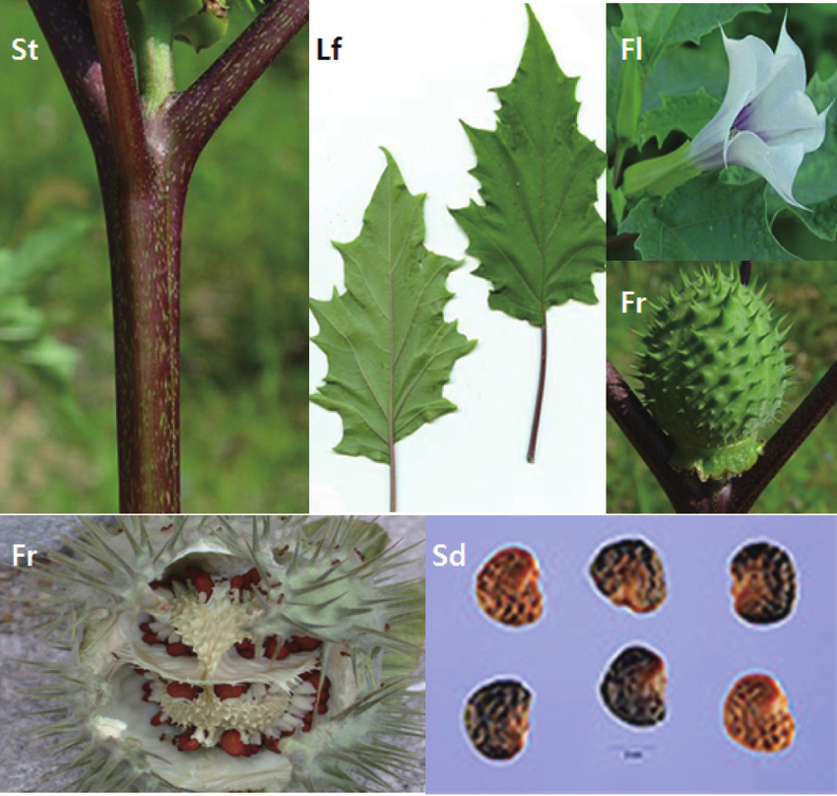

Slide 38
Dhattura –Datura metel Linn.
1st Method: Seeds are kept in a Potali, it should be Swedana (Fomented) in a Dolayantra by adding Godugdha (Cow’s milk) or Gomutra (Cow’s urine) for 3 hrs. Then after seeds should be washed with warm water and dried in the sun. The seeds are used after removing the seed coat ⁴.
2nd Method: Seeds should be kept in Dolayantra & Swedana is done using cow’s urine for 3 hrs after that it is triturated in Khalvayantra & filtered through cloth ⁵.

Slide 39
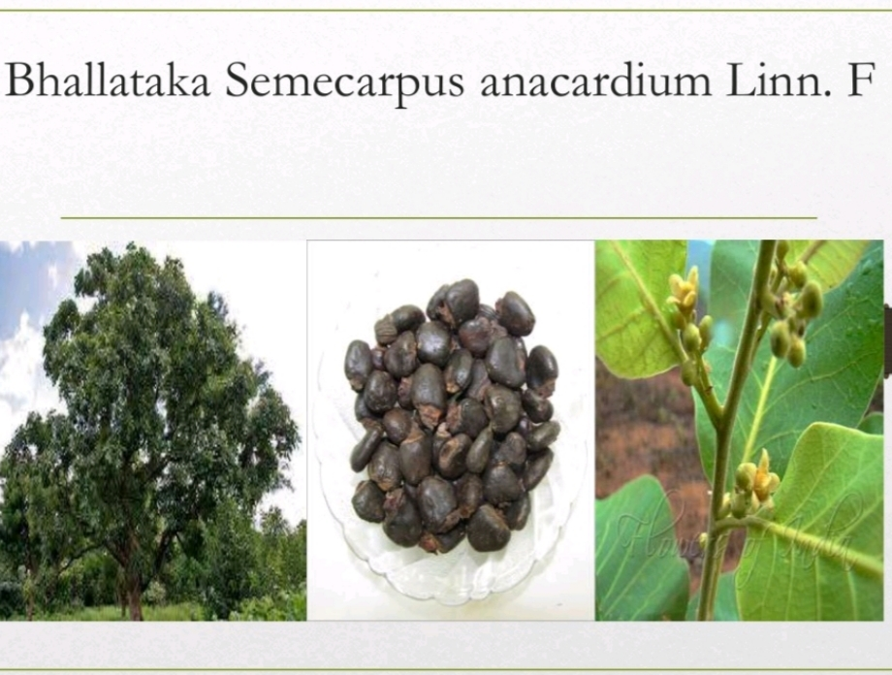

Slide 40
Bhallataka - Semecarpus anacardium Linn.-(Seed)
1st Method: Top portion of Bhallataka fruits should be
removed with knife and mixed with brick powder (ishtika churna) and are kept in a Pottali ( bag ) and tie its mouth with a strong thread. This is rubbed gently by hands. When brick powder become wet with oil and skin of Bhallataka is unwrapped , it is washed with hot water. Obtain Shuddha (purified) ⁶.
2nd Method: After removing top part and cut it into two parts are placed in a Pottali . Swedana is done by filling it with coconut water for 1 to 2 hr. in Dolayantra (swing apparatus). In this process it becomes Shuddha ⁷.

Slide 41
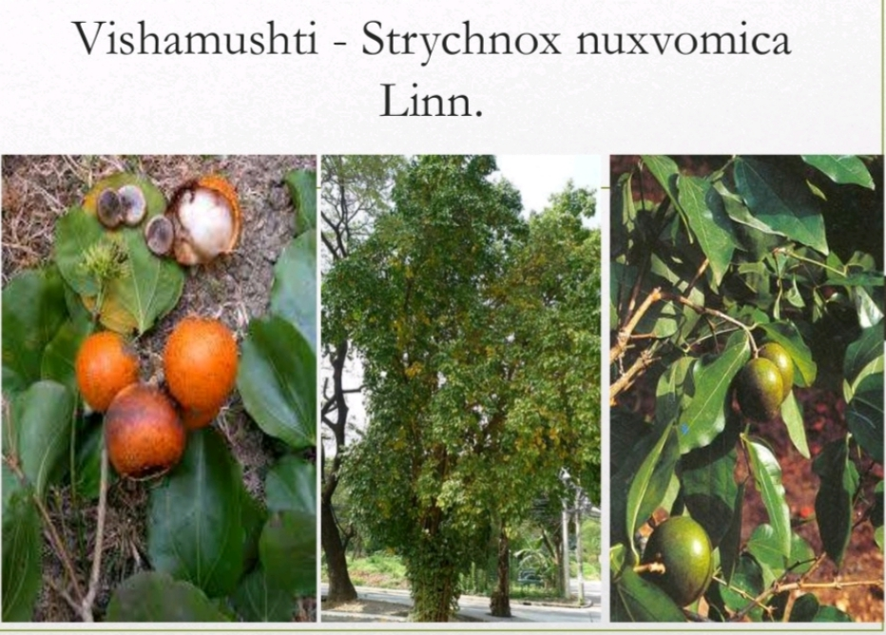

Slide 42
Kuchila - Strychnos nuxvomica Linn.
Kuchila seeds shall be immersed in Gomutra (cow’s urine) for 7 nights; fresh Gomutra is to be replaced every night. Thereafter, it is removed and washed with water. Seeds shall be further detoxified by Swedhana boiling with Godugdha (cow’s milk) in Dolayantra for 3 days. Then the seed coat and embryo are removed. The cotyledon shall be fried in cow’s ghee and powdered well ⁸.

Slide 43
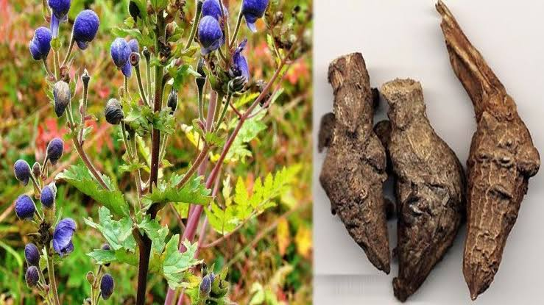

Slide 44
Vatsanabha (Aconitum ferox)
The roots of Vatsnabha were cut into small pea-sized pieces and tie in a Pottali. It can be detoxified by placing it in cow’s urine for three consecutive days, or by Swedana it in cow’s milk or goat’s milk in Dolayantra for three to six hours. After that pieces of Vatsnabha is washed with warm water and used for therapeutic purpose ⁹.

Slide 45
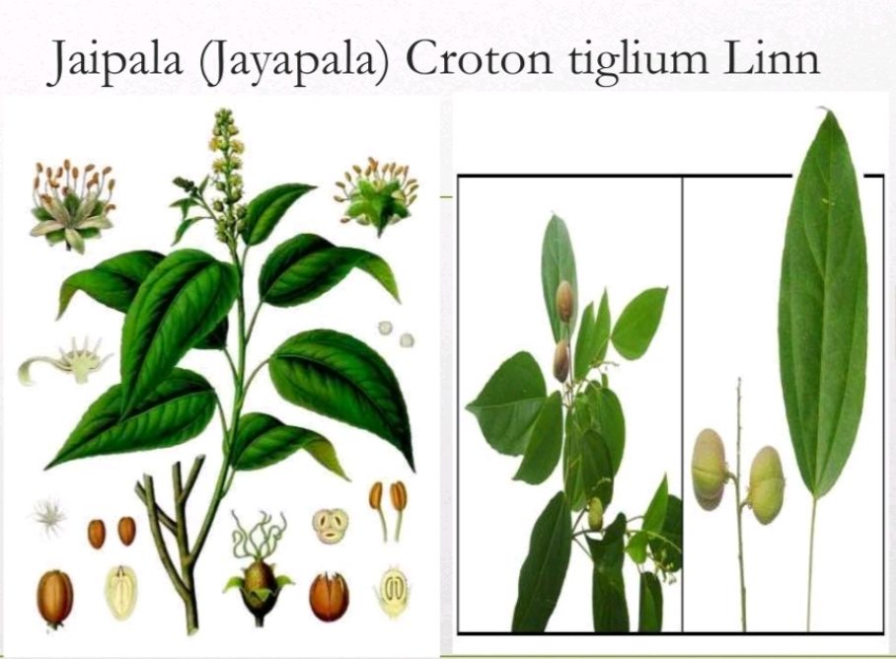

Slide 46
Jaypala (Croton tiglium)
Seeds should be soaked in water for one night , then outer covering is removed. The seeds are taken and cut into two along the ridges. Then the seed are boiled in cow’s milk for about 3 hours and are dried under sunlight. By keeping the seeds in an earthen plate. The earthen plate absorbs the oil content from the seeds ,thus reducing its toxicity level ¹⁰.

Slide 47
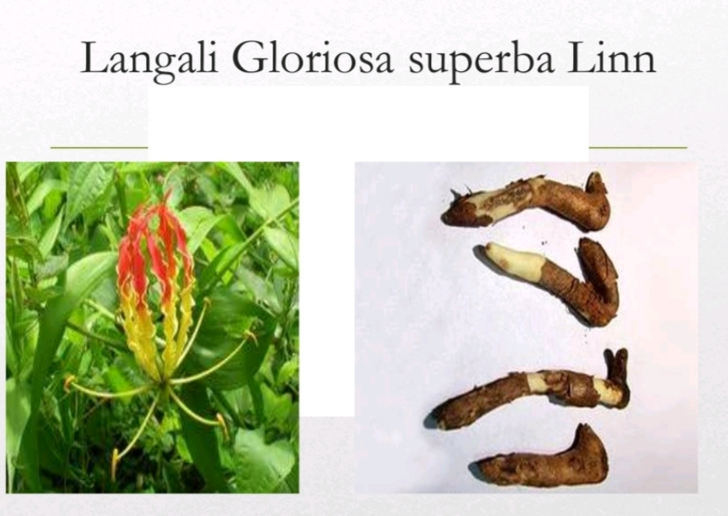

Slide 48
Langali - Gloriosa superba Linn.
1st Method: Fresh Langali roots and seeds are immersed in Gomutra (cow’s urine) for 24 hour and washed with lukewarm water , by this process it is detoxified.
2nd Method: Firstly cut small pieces of Langali and then kept it in sour buttermilk for seven days in earthen pot and then dried in sun, after that collected in glass jar and used for medicinal purpose ¹¹.

Slide 49
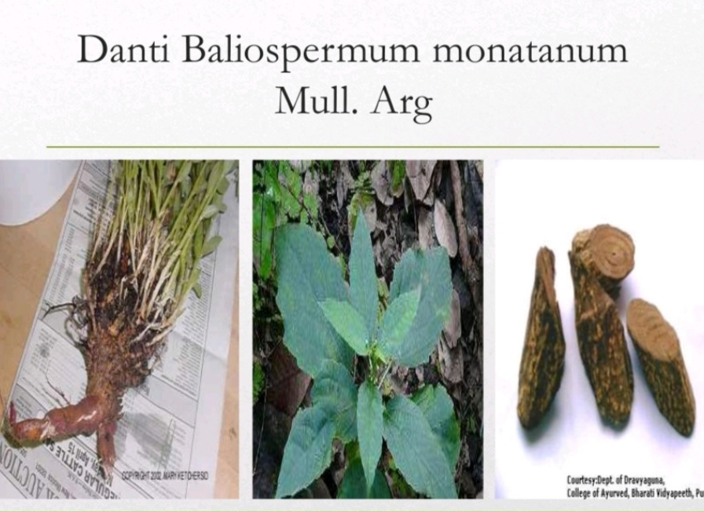

Slide 50
Danti - Baliospermum montanum
Danti root is washed properly with water. It is smeared with a thin layer of paste prepared from a powder of Pippali ( Piper longum Linn.) and honey , then wrapped in the leaves of Kusha ( Desmostachya bipinnata ) . The resultant was coated with mud and go for Swedana in dolayantra for 3 hours and after that the procured can be used for medicinal purpose ¹².

Slide 51
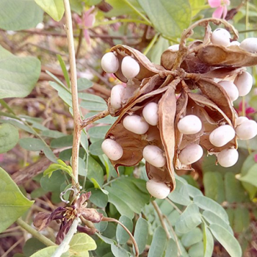

Slide 52
Gunja – Abrus Precatorius Linn.
Newly collected seeds of gunja are tied in two layered cloth , kept suspended in cow’s milk / kanji taken in a pot(Dolayantra). The milk is then boiled with the gunja seed pack (potali) suspended for 3 hrs. After this the seeds are taken out, washed in hot water , dried and preserved ¹³.

Slide 53
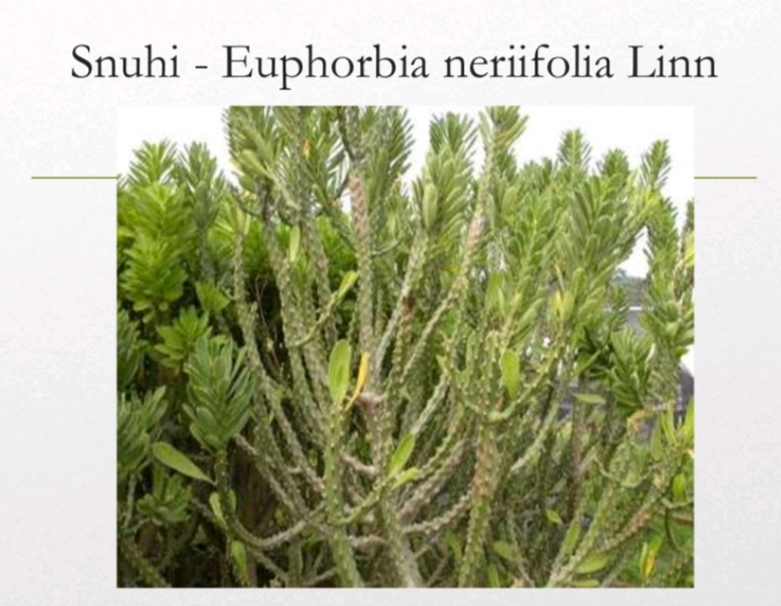

Slide 54
Snuhi – Euphorbia Nerifolia Linn.
Equal quantity of snuhi latex with 1/4th of chincha patra ( tamarind leaves ) added and dried under sunlight ( mixing & drying principle) ¹⁴.

Slide 55
DISCUSSION

Slide 56
Ahiphena synonyms are Aaphuc , Nagfen , Ahiphena , Nifena , etc. Major constituents of Opium are Morphine and Papavarine . It is triturated with ginger juice to reduce its toxicity . Toxic effects of opium can be reduced by steeping in cold water for 5-6 hours ^{15,16}.

Slide 57
Karveera synonyms are Hyamar, Ashwmar, Aswantak, Ashwaghna. It contains a mixture of toxic cardiac glycosides, the cardinolides particularly, Oleandrin and Nerilin. Roots are purified by Swedana process in Dola Yantra using Godugdha for 3 hours, then washed with water and dried. After shodhana , Oleandrin decreases¹⁷.

Slide 58
Adverse effects of dhatura are dryness, excessive thirst, cramps, unconsciousness and giddiness. It is due to anti-cholinergic property of alkaloids present in this plant. After shodhana, reduction in total alkaloid content and increase in total protein content was found. Complete removal of Scopolamine and partial removal of hyoscyamine reflects the importance of shodhana in Dhatura seeds¹⁸.

Slide 59
Impure Bhallataka causes blisters, glossitis, diarrhoea, menorrhagia, ulcers, oedema, and burning sensation. Weight loss observed after shodhana may be due to the reduction of the oil content of the fruits. Due to the decarboxylation of the oil, anacardic acid gets converted into the less toxic anacardol. It is possible that a greater percentage of oil might get reduced by soaking the fruits in Gomutra or Godugdha. Brick powder has adsorbent property because of which it absorbs irritant oil in the fruit¹⁹.

Slide 60
Detoxification of Kupilu might be due to the chemical changes that causes N-oxidation and conversion of Strychnine and brucine into less toxic derivations as iso-strychnine , iso-brucine , strychnine N-Oxide , brucine N- oxide and reduced level ofloganic acid content of the seeds. Larger doses of Strychnine are known to be lethal, but lower doses are stimulator. It has been reported that Shodhana processes of Kupilu enhances its hepato-protective potency^{20,21}.

Slide 61
The synonym of the Vatsanabha is Vatsanaga, Kshveda, Visha & Amrita.The purification process includes swedana in dola yantra using Godugdha for 3 hrs daily for 3 consecutive days. If there is no tingling sensation and numbness of the tongue means it is free from toxicity. After shodhana process the total alkaloid content decreases. It has been reported that Gomutra converts Aconite to a compound with a cardiac stimulant property, whereas raw Aconite showed cardiac depressant properties. Both type of Shodhana, either by Godugdha or Gomutra makes Aconite devoid of cardiac & neuro muscular toxic effects without affecting its antipyretic activity^{22,23}.

Slide 62
Langali also known as Halini, Kaliharika, Agni Jiwha, Bahni Shikha, Garbhpatini ,etc. It is a semi-wooden herbaceous climber which is used in inflammation, Gout, Rheumatoid Arthritis, Gonorrhoea and fever. The detoxification process involves soaking of roots and seeds in Gomutra for 24 hours and washing with warm water. Colchicine and Gloriosine is present as an Alkaloid in this plant. The level of the Alkaloids reduces significantly after shodhana²⁴.

Slide 63
Gunja synonyms are Raktika , Rakta , Tamrika , Shitapaki , Bhilla , etc. It’s leaves and roots are non toxic, but seeds are toxic. Since ancient times it been used as fish poison, arrow poison and for criminal purposes of poisoning ( both humans and cattle ) . It contains a toxic lectin, Abrin, a fat splitting enzyme, urease, abarnin and steroidal oil.

Slide 64
During the shodhana process, color of the media changes due to the removal of colored material from the endosperm of the seeds and there is loss in weight. A major part of Hypaphorine might have undergone transformation into abrin , by reduction of its tertiary amino group into primary Amino Glycemic Response % of protein and also reduces after shodhana process ²⁵.

Slide 65
CONCLUSION

Slide 66
As we know poison can be converted into excellent medicine if processed and administered properly but if hand inaccurately it may become dangerous. It is good to admit shodhana process mentioned in ancient text with modern technology to assess its safety and efficacy. Bhavana dravya also plays an important role in making drug without side-effect. In Ayurveda , there are lots of media used for shodhana. Cow’s urine and cow’s milk are common media for shodhana of Vishadravya (poisonous plants).

Slide 67
Thus, I can say that it is matter of discussion and research that after purification how many dreadful qualities of poison are diminished to make it useful therapeutically. Poisons are highly potent and fast acting drugs; they can be used as a catalyst to enhance the drug with which it is used , for which media also plays an important role. But, before using poison they should be purified to reduce its fatality. So , it causes the drug to become nectar if method of shodhana is appropriate .

Slide 68
REFERENCES :
Sadananda Sharma, Pt. Kashinath Shastri, Rasataringini of Sadanand Sharma, Delhi; Motilal Banarsidas Publisher, Reprinted., 2000; 692.
Dikshit Manisha, poisonous plants as medicine after shodhana: a review, unique journal of ayurvedic and herbal medicines, issn 2347-2375.
Sadananda Sharma, Pt. Kashinath Shastri, Rasataringini of Sadanand Sharma, Delhi; Motilal Banarsidas Publisher, Reprint ed., 2000; 720.
Sadananda Sharma. Rasa Tarangini, Kasinath sastri, editor. 11th ed. New Delhi: Motilal Banarasidas, 2004; 346-349.
Parikh Gopinath, Vanousadhi Ratnakara, 1st ed. Vijaygath: Sudhanidhi karyalaya, 1999; 5: 87.
Sadananda Sharma, Pt. Kashinath Shastri, Rasataringini of Sadanand Sharma, Delhi; Motilal Banarsidas Publisher, Reprint ed., 2000; 735.
Ambikadatta shastri, Bhaishajyaratnavali of Vd. Rajeshwar data, 17th ed., Chaukhambha Sanskrit sansthan, Varanasi; Ch-2/180, shodhanamarana prakaran, 2004; 25.
Sadananda Sharma, Pt. Kashinath Shastri, Rasataringini of Sadanand Sharma, Delhi; Motilal Banarsidas Publisher, Reprint ed., 2000; 679.
Sadananda Sharma, Pt. Kashinath Shastri, Rasataringini of Sadanand Sharma, Delhi; Motilal Banarsidas Publisher, Reprint ed., 2000; 652.

Slide 69
REFERENCES :
11. Dikshit Manisha, poisonous plants as medicine after shodhana: a review, unique journal of ayurvedic and herbal medicines, issn 2347-2375.
12. Dahegaonkar Yogesh Anand, concept of mahavisha- upvisha shodhana in agadtantra, international ayurvedic medical journal, issn: 2320 5091.
13. Pravesh kumar, sodhan process of various visha and upvisha in Ayurveda, world journal of pharmaceutical research, ISSN 2277– 7105.
14. Sadananda Sharma, Pt. Kashinath Shastri, Rasataringini of Sadanand Sharma, Delhi; Motilal Banarsidas Publisher, Reprint ed., 2000; shloka no. 24/443-444.
15. Mishra BS. Yogratnakar.Varanasi: Chaukhmba Prakashan;2010, p.167-169
16. Shastri K. Sadanand Sharma:Rastarangini.11 ed. New Delhi:Motilal Banarsi Das Publications:2012.p651-52.
17. Kant C., Sanwariya A., Meena I. Acute cardiac toxicity of Nerium Oliander-Indicum Poisoning (Kaner). Poisoning heart views 2010:11:p115-6

Slide 70
REFERENCES :
18. Patel Y, Bhat SD., Rabinarayan A., Ashok BK, Shukla V.J. Role of Shodhan on analytical parameters of Dhatura innoxia mill and Dhatura metel Linn. Seeds. International Journal Research Ayurved Pharma 2010; 1:249-54
19. Ilan Chezhian R. Joseph CR., Rabinarayan A.Induced contact dermatitis caused during shodhan (purificatory measures) of Bhallataka(S. Anacardium Linn.) fruit.Ayu 2012;33:270-3
20. J.Ethnopharmacol.2004:93:109-12 ,Choiyh, Sohn YM., Onky, Kim J., Analysis of Strychnine from detoxified S. Nux vomica(corrected) seeds using liquid chromatography electrospray mass spectrometry..
21. Cai B.C.,Yang WX., Zhu WY, Lu JC., Ye DJ., Effect of processing on the extraction of alkaloids from strychnine. Zhon Gguo Zhong Yao Za Zhi, 1993:
22. Rastogi SA., Review of Aconite (Vatsanabh) Uses in Ayurvedic Formulations: Traditional views and their references. Spatula D.D. 2011:1:233-44
23.Singh IB, Poisonous plants in Ayurveda. 2nd ed. Varanasi:Chaukhmba Sanskrit Bhawan:2003
24.Neber MP., Mahaske PN. Pimpalagoankar PB.Laddha KS. Gloriosa Superva Roots:Content Change of Colcicine during shodhan (detoxification) process. Indian J.Trad.Knowl. 2013: 12: 277-80
25.Singh JD., Banerji R., Mehrotra S. Effect of Shodhan on the toxicity of Abrus precatorious. Ancient Science Life 1998:18:127-9.

Slide 71


