Slide 1

NCISM
DR. ANURAG MISHRA
DEPT. OF AGADTANTRA

Slide 2
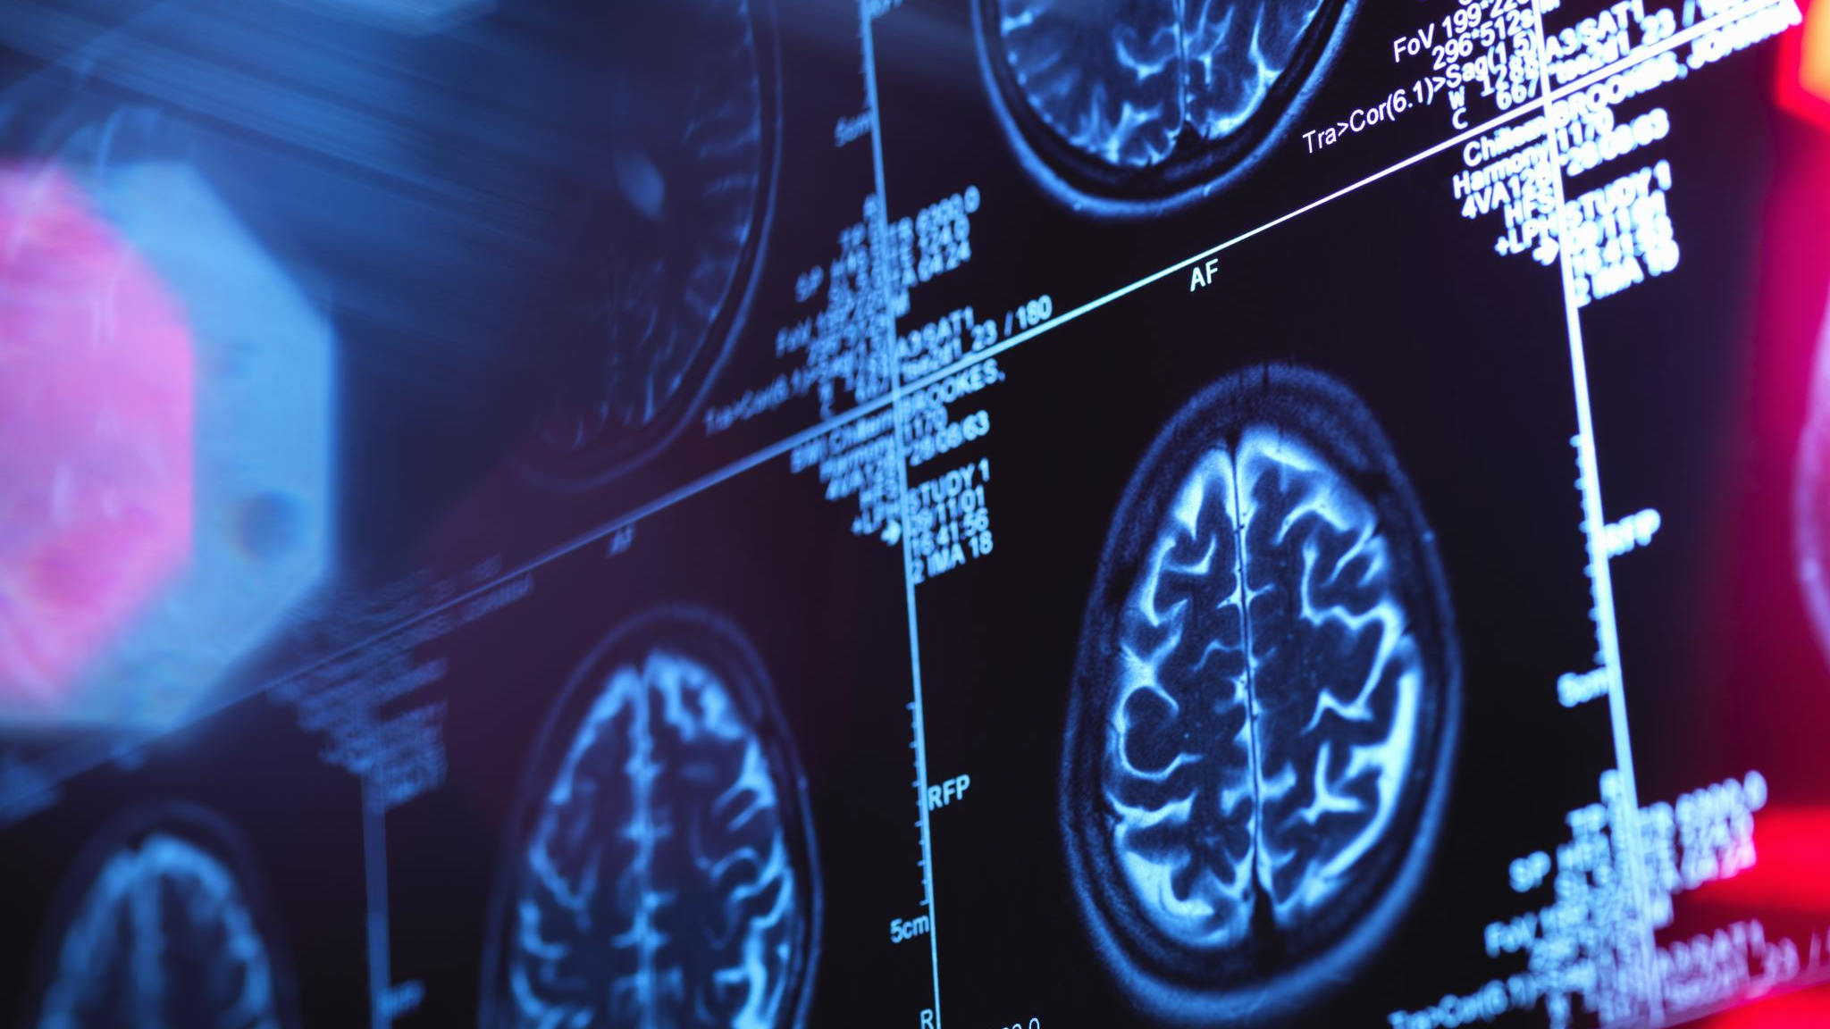
INTRODUCTION
The National Commission for Indian System of Medicine (NCISM) is a statutory body that regulates medical education and medical professionals. The NCISM was formed by the Government of India under the NCISM Act, 2020.

Slide 3

INTRODUCTION
(contd…)
In pursuance of the provisions of National Commission for Indian System of Medicine (NCISM) Act 2020 (14 of 2020), the Indian Medicine Central Council (IMCC) Act 1970 (48 of 1970) has been repealed and all the provisions of the National Commission for Indian System of Medicine (NCISM) has been come into force with effect from the 11th day of June 2021.
Under the provisions of section 59 (2) of NCISM Act 2020 the Central Government has constituted the Commission and four Autonomous boards on the same day. Medical standards, requirements and other provisions of the IMCC Act 1970 and the rules and regulations made thereunder shall continue to be in force and operate till new standards or requirements as specified under new act or rules and regulations made thereunder come into force.
However, the provisions of concerned regulations which are inconsistent with the provisions of NCISM Act 2020 shall not be applicable.

Slide 4
INTRODUCTION
(contd…)
The National Commission For Indian System Of Medicine is the statutory body constituted under NCISM Act, 2020 vide gazette notification extraordinary part (ii) section 3 (ii) dated 21.09.2020.

Slide 5

Constitution of the National Commission for Indian System of Medicine
The NCISM will consist of 29 members, appointed by the central government. A Search Committee will recommend names to the central government for the post of Chairperson, part time members, and presidents of the four autonomous boards set up under the NCISM. These posts will have a maximum term of four years. The Search Committee will consist of five members including the Cabinet Secretary and three experts nominated by the central government (of which two should have experience in any of the fields of Indian System of Medicine).

Slide 6
Constitution of the National Commission for Indian System of Medicine
(contd…)
Members of the NCISM will include:
the Chairperson,
the President of the Board of Ayurveda,
the President of the Board of Unani, Siddha, and Sowa-Rigpa,
the President of the Medical Assessment and Rating Board for Indian System of Medicine,
Advisor or Joint Secretary in-charge of Ayurveda, Ministry of AYUSH, and
three members (part-time) to be elected by the registered medical practitioners of Ayurveda, and one member each by the respective registered medical practitioners of Siddha, Unani, and SowaRigpa from amongst themselves from the prescribed regional constituencies under the Bill.

Slide 7

Autonomous boards
The autonomous boards under the supervision of the NCISM.
These boards are:
(i) the Board of Ayurveda (BOA) and the Board of Unani, Siddha, and Sowa-Rigpa (BUSS) : They will be responsible for formulating standards, curriculum, guidelines for setting up of medical institutions, and granting recognition to medical qualifications at the undergraduate and post graduate levels in their respective disciplines,

Slide 8

Autonomous boards (contd…)
(ii) Medical Assessment and Rating Board for Indian System of Mediciene (MARBISM) : It determine the process of rating and assessment of medical institutions and have the power to levy monetary penalties on institutions which fail to maintain the minimum standards It will also grant permission for establishing a new medical institution, and
(iii) Board of Ethics and Registration for Indian System of Medicine (BERISM) : It will maintain a National Register of all licensed medical practitioners of Indian System of Medicine, and regulate their professional conduct.
Only those included in the Register will be allowed to practice Indian System of Medicine.

Slide 9

Ayurveda
Ayurveda means "the science of life" (ayur means "life" and veda means "science" in Sanskrit). Ayurveda is a discipline of the upaveda or "auxiliary knowledge" in Vedic tradition.Ayurveda has its prime origin from Atharva-Veda and apart as a supplement of the Rig-Veda. Dhanvantari is worshipped as the God of Ayurveda.
The aim of this system is to prevent illness¸ heal the sick and preserve life. The Ayurveda has its origins from the India and extended its wings in various parts of the world. Ayurveda was taught in Gurukula system in ancient days, which is now been evolved in to under graduate & post graduate courses from Institutions.

Slide 10
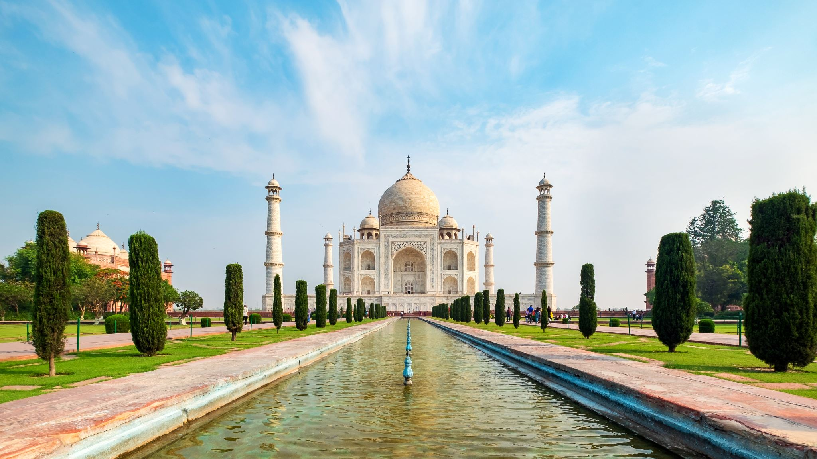
Unani
Unani-tibb or Unani Medicine also spelled Yunani Medicine (Arabic, Hindustani, Pashto and Persian) is a form of traditional medicine practiced in middle-east & south-Asian countries. It refers to a tradition of Graeco-Arabic medicine, which is based on the teachings of Greek physician Hippocrates and Roman physician Galen, and developed into an elaborate medical system in middle age era by Arabian and Persian physicians, such as Rhazes (al-Razi), Avicenna (Ibn Sena), Al-Zahrawi, and Ibn Nafis.
Unani medicine first arrived in India around 12th or 13th century with establishment of Delhi Sultanate (1206–1527) and Islamic rule over North India and subsequently flourished under Mughal Empire. An outstanding physician and scholar of Unani Medicine, Hakim Ajmal Khan (1868 – 1927) championed the cause of the Unani system in India. The Unani System of Medicine is included in the Central Council of Indian Medicine as per IMCC, Act 1970.

Slide 11

Siddha
"Siddhargal" or Siddhars were the premier scientists of ancient days. Siddhars, mainly from Southern India, in the state of Tamil Nadu laid the foundation for Siddha system of medicine. Siddhars were spiritual adepts who possessed the ashta siddhis. Agastyar or Agasthya, is believed to be the founding father of Siddha medicine.
Eighteen Siddhars are considered to be important in the Siddha Medicine. Siddha medicine is claimed to revitalize and rejuvenate dysfunctional organs that cause the disease and to maintain the ratio of Dosha. Kayakarpam (special combination of medicine and life style) and Muppu (the universal Salt) are speciality of Siddha system of medicine

Slide 12
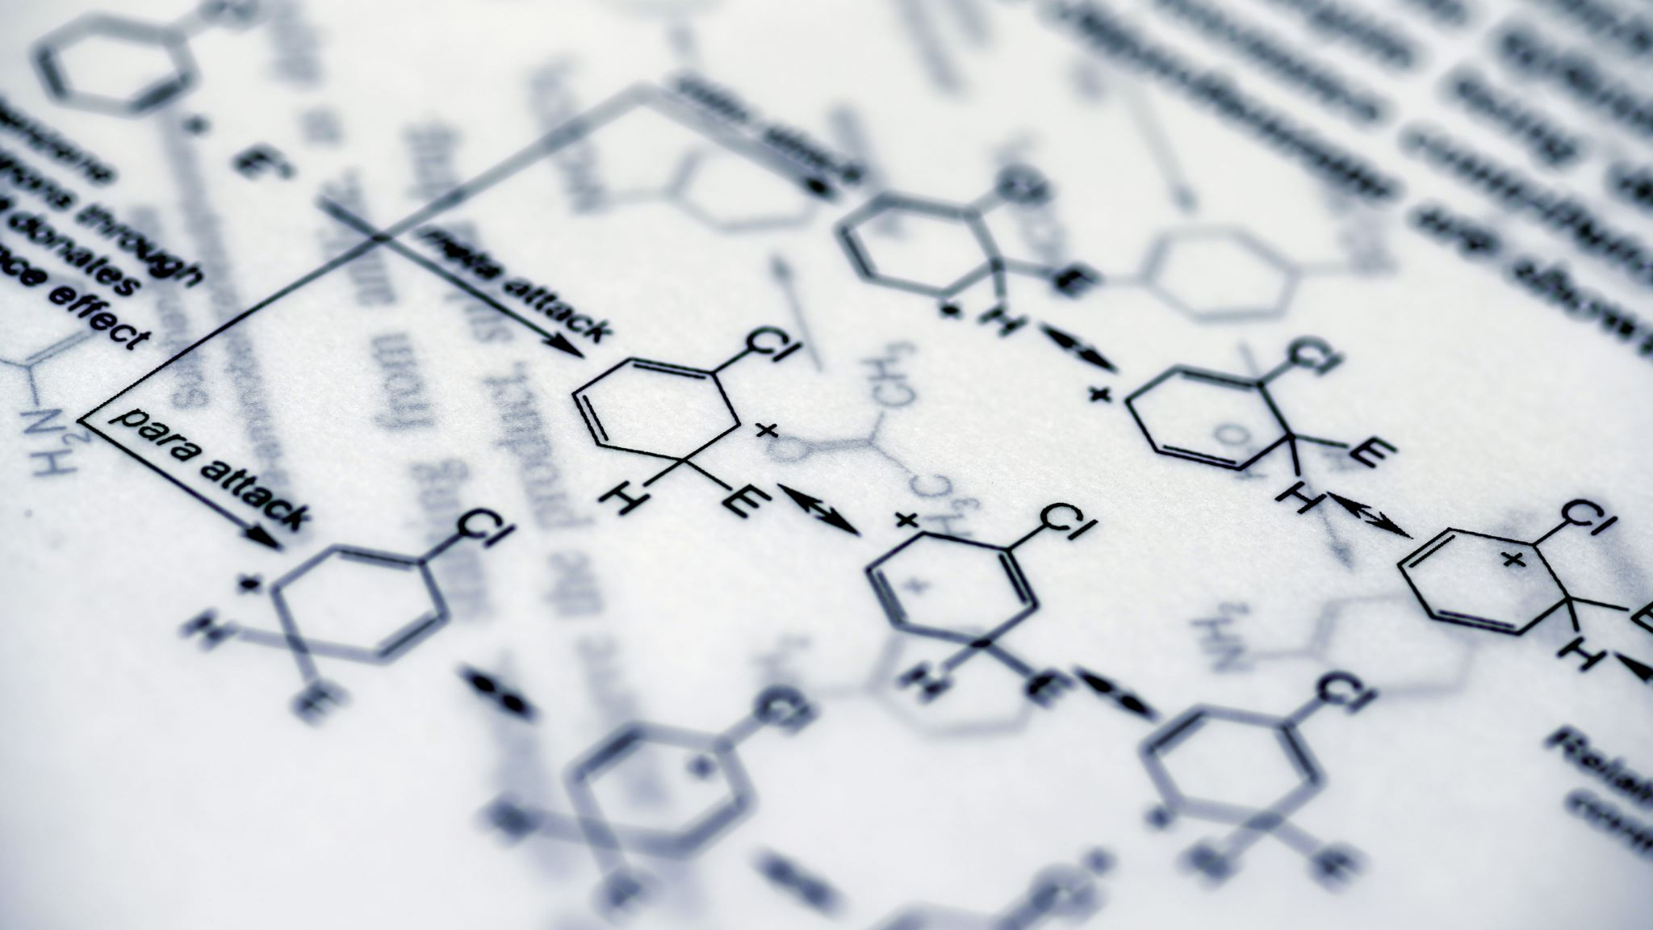
Sowa Rigpa
Sowa Rigpa is a centuries-old traditional medical system that employs a complex approach to diagnosis, incorporating techniques such as pulse analysis and urinalysis, and utilizes behaviour and dietary modification, medicines composed of natural materials (e.g., herbs and minerals) and physical therapies to treat illness.
The Four Tantras (Gyushi, rGyu-bzhi) are native Tibetan texts incorporating Indian, Chinese and Greco-Arab medical systems. The Four Tantras is the common name for the text of the Secret Tantra Instruction on the Eight Branches, the Immortality Elixir essence. The four Tantras are as follows, Root Tantra - Exegetical Tantra - Instructional Tantra - Subsequent Tantra Although there is clear written instruction in the Four Tantra, the oral transmission of medical knowledge still remained a strong element in Tibetan Medicine. The Sowa Rigpa System of Medicine is included in the Central Council of Indian Medicine from the year 2012 as per Gazette Notification No. 2345 dated 16.12.2011

Slide 13
VISION AND MISSION
Improve access to quality and affordable Ayurveda, Unani, Siddha and Sowa-Rigpa (AUS&SR) medical education
Ensure availability of adequate and high quality AUS&SR medical professionals in all parts of the country;
Promote equitable and universal healthcare that encourages community health perspective and makes services of AUS&SR medical professionals accessible to all the citizens;
Encourage medical professionals to adopt latest medical research in their work and to contribute to research;

Slide 14
VISION AND MISSION (contd…)
objectively assess and rate medical institutions periodically in a transparent manner;
Maintain a National AUS&SR medical register for India;
Enforce high ethical standards in all aspects of AUS&SR medical services;
Have an effective.e grievance redressal mechanism

Slide 15
OBJECTIVES
An Act to provide for a medical education system that improves access to quality and affordable medical education, ensures availability of adequate and high quality medical professionals of Indian System of Medicine in all parts of the country;
  that promotes equitable and universal healthcare that encourages community health perspective and makes services of such medical professionals accessible and affordable to all the citizens;

Slide 16
OBJECTIVES
(contd…)
  that promotes national health goals; that encourages such medical professionals to adopt latest medical research in their work and to contribute to research;
  that has an objective periodic and transparent assessment of medical institutions and facilitates maintenance of a medical register of Indian System of Medicine for India and enforces high ethical standards in all aspects of medical services;
  that is flexible to adapt to the changing needs and has an effective grievance redressal mechanism and for matters connected therewith or incidental thereto.

Slide 17
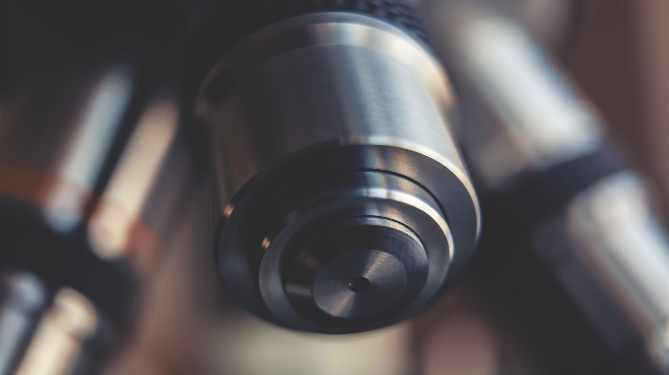
FUNCTIONS
The NCISM and the Central Council for Research in Ayurvedic Sciences (CCRAS) are both under the Ministry of Ayush.
The NCISM's functions include:
  (i) framing policies for regulating medical institutions and medical professionals of Indian System of Medicine, (ii) assessing the requirements of healthcare related human resources and infrastructure,
  (iii) ensuring compliance by the State Medical Councils of Indian System of Medicine of the regulations, and
  (iv) ensuring coordination among the autonomous boards

Slide 18
functions
(contd…)
To provide medical education system that improves access to quality and affordable medical education,
To ensure availability of adequate and high-quality medical professionals of Indian System of Medicine in all parts of the country;
To promote equitable and universal healthcare that encourages community health perspective and makes services of such medical professionals accessible and affordable to all the citizens;
To promote national health goals;

Slide 19
functions
(contd…)
To encourage such medical professionals to adopt latest medical research in their work and to contribute to research;
To carry out Periodic and transparent assessment of medical institutions
To facilitate maintenance of a medical register of Indian System of Medicine for India and enforce high ethical standards in all aspects of medical services;
To provide Medical Education System that is flexible to adapt to the changing needs and has an effective grievance redressal mechanism and for matters connected therewith or incidental thereto

Slide 20

LOCATION
The NCISM is located at Jawahar Lal Nehru Bhartiya Chikitsa Avam Homoeopathy Anusandhan Bhawan, 61-65, Institutional Area, Janakpuri "D" Block, New Delhi-110058.

Slide 21

Thank you ..!

