Slide 1


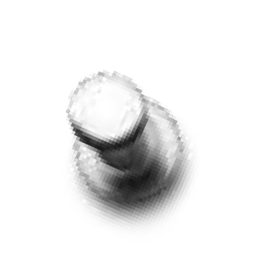
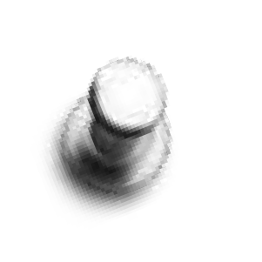


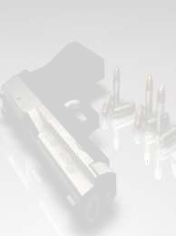
FIREARM INJURIES
Rifled and Smooth-bore
firearm injury
DR. ANURAG MISHRA
ASSISTANT PROFESSOR
DEPT. OF AGADATANTRA

Slide 2

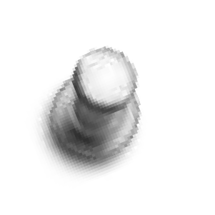



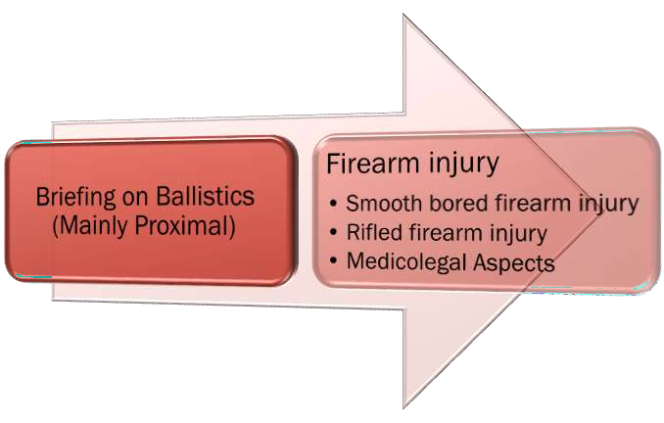
LETS TALK ABOUT

Slide 3







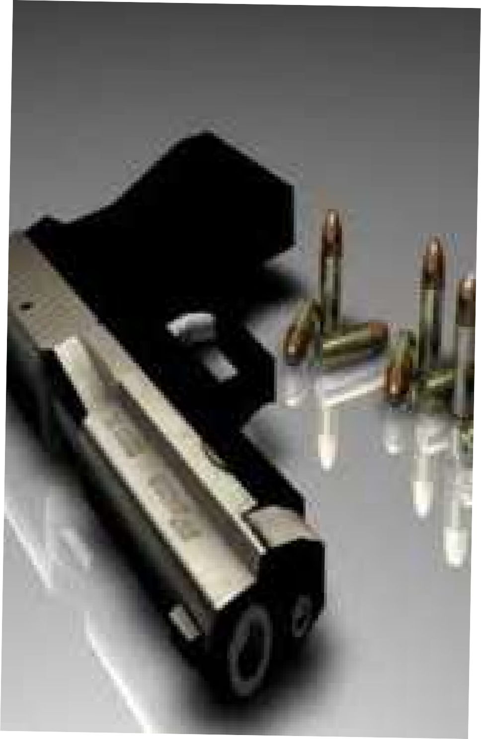


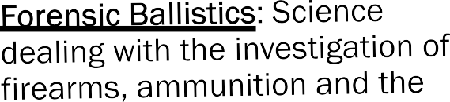


Slide 4



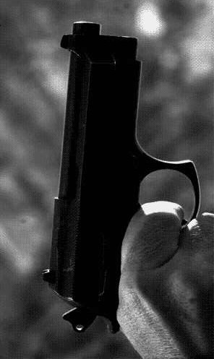



Slide 5


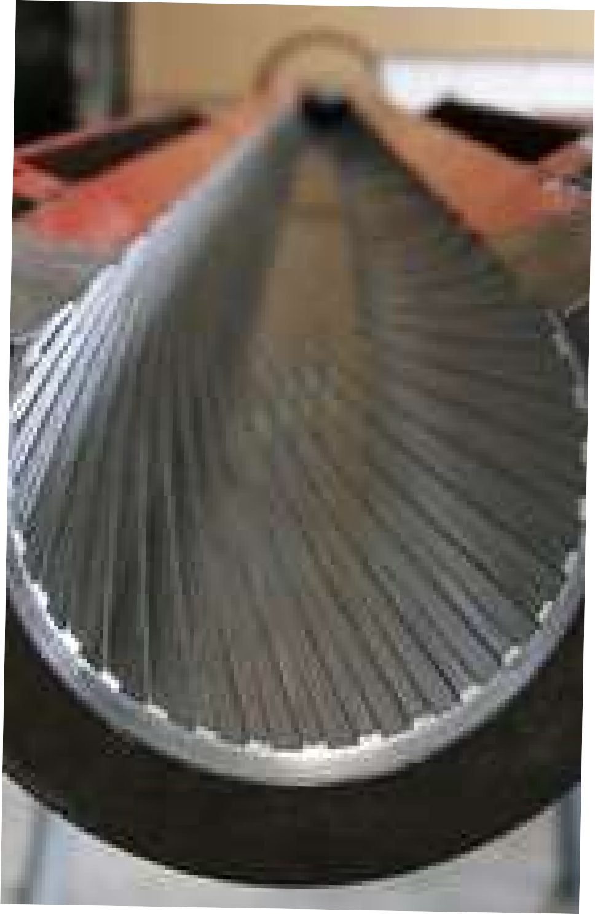



Slide 6


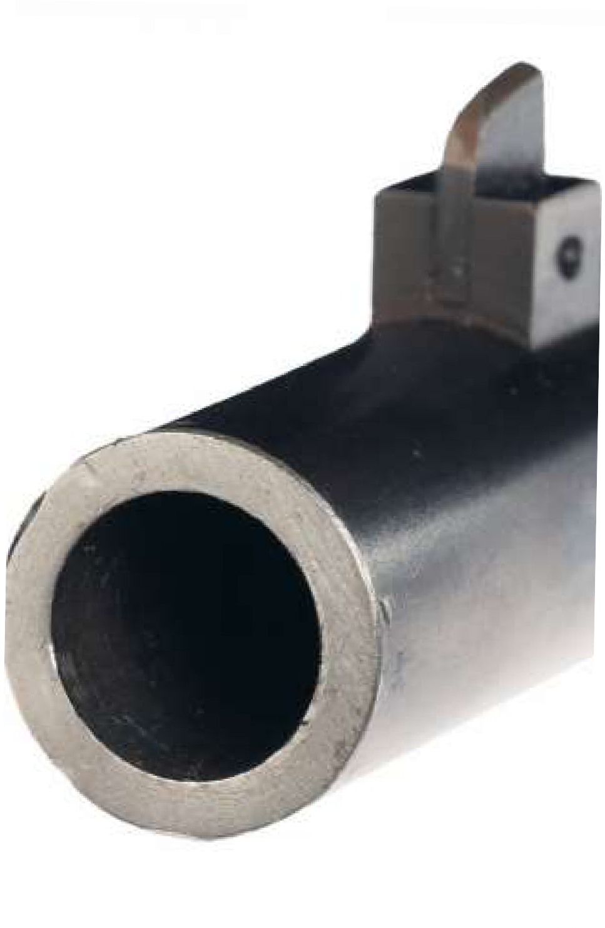


Slide 7
Quick Briefing
Proximal Ballistics

Slide 8
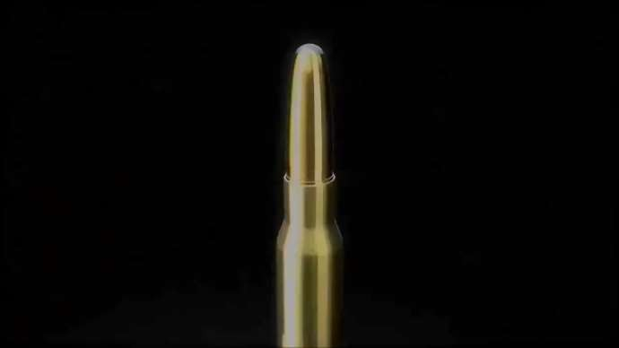
Quick Briefing on Forensic Ballistics-Rifled

Slide 9
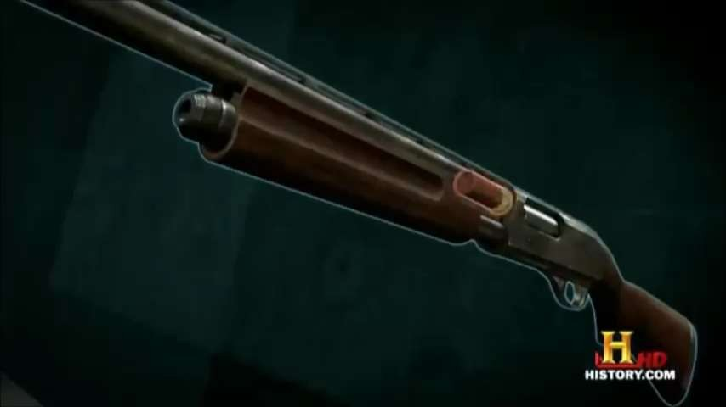
Quick Briefing on Proximal Ballistics-Shotgun

Slide 10
Firearm Injury
General Aspects

Slide 11

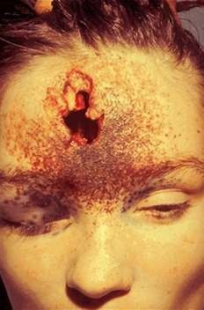
Firearm injury-General Aspects
Tattooing (peppering/stippling):
Small, descrete, black specks which can’t be wiped off
Caused due to grains of gunpowder driven into skin

Slide 12
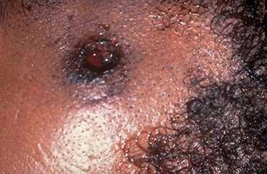
Firearm injury-General Aspects
Blackening/Smudging:
Carbonaceous deposition on skin which can be easily wiped off.
Caused by deposition of smoke on skin

Slide 13
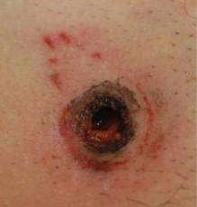
Firearm injury-General Aspects
Lead ring/Metal ring:
Deposition of very small quantity of lead deposition at site of entry of projectile

Slide 14
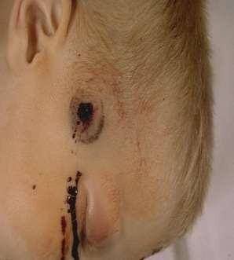
Firearm injury-General Aspects
Grease collar/Dirt collar:
Carried lubricant from the barrel of firearm on the projectile

Slide 15
Firearm injury-General Aspects
Entity | Distance travelled |  | Injuries/Features exhibited on wound
 | Revolver/ Pistol | Rifles
Flame | 7.5cm | 15cm | Scorching, singeing(burning)
Unburnt gunpowder grains | 60cm | 75cm, 90cm max | Tattooing
Partially burnt gunpowder grains | Var | Var | Tattooing
Smoke | 15cm | 20-40cm | Blackening/Smudging
Projectile | Var | Var | Abrasion collar, contusion collar, grease collar

Slide 16
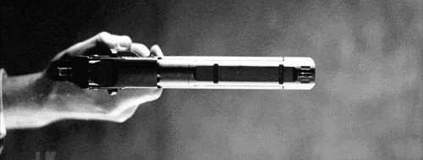
Firearm injury-General Aspects
Position of target
Flame
Gun powder
RANGE
of shooting
Contact
Close
Near
Distant

Slide 17
Rifled-firearm injury
Entry wound and exit wound

Slide 18
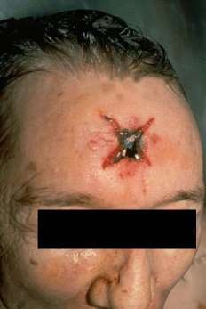
Entry wound-Contact shot
Point blank shot
Cruciate/stellate/star shaped when over a dense area like cranial vault (explosive effects of gases
Circular when over thin bone/abdomen with abrasion or contusion collar

Slide 19
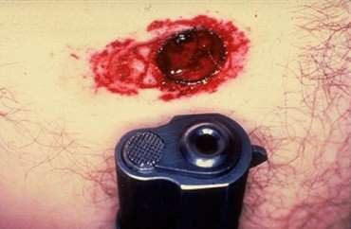
Entry wound-Contact shot
Burning, blackening and tattooing are slight or absent (driven into the wound)
Surrounding hair are singed
Imprint of muzzle end may be found stamped on skin

Slide 20

Entry wound-Contact shot
Tissues saturated with CO and show cherry red color
Diameter of hole + collar = Approx. diameter of the bullet

Slide 21
Entry wound-Close contact
Circular hole surrounded by scorching, singeing and smudging
Abrasion collar, grease collar and tattooing present

Slide 22
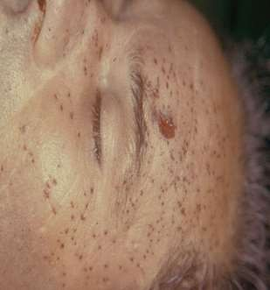
Entry wound-Near shot
Circular or oval
Singeing of hair and scorching
absent
Smudging not seen beyond 30cm
Grease collar and abrasion collar present

Slide 23
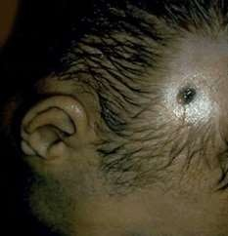
Entry wound-Distant shot
Circular with inverted margins
Scorching, tattooing and smudging
are all absent
Grease collar and abrasion collar present

Slide 24
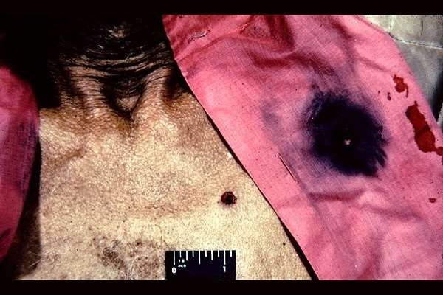
Possibilities are endless…

Slide 25
Entry wound-Summary
Shot | Shape | Scorching | Singeing | Smudging | Tatooing | Abrasion collar | Grease collar
Contact | Cruciate (dense), circular (thin bone,ab domen |  |  |  |  |  | Not comme -nted
Close | Circular
Near | Circular or oval |  |  | Upto 30 cm | Upto 90 cm max
Distant | Circular

Slide 26
Exit wound
Vary greatly in size, shape and configuration
Usually larger than the corresponding wound of entry Scorching, blackening, and tattooing absent Abrasion collar and grease collar also absent
Edges invariably everted
Outward beveling in case of skull

Slide 27
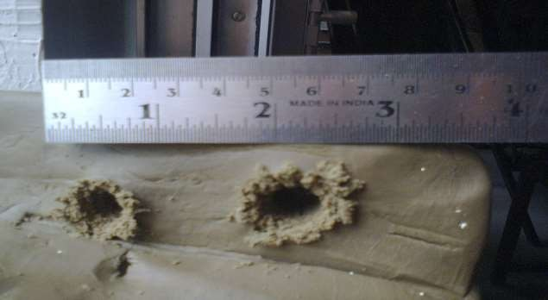
Exit wound
Demonstrating Exit wound by experimenting air rifle

Slide 28
Exit wound-Summary
Shape | Scorching | Singeing | Smudging | Tatooing | Abrasion collar | Grease collar
Variable, usually larger than correspo nding entry wound

Slide 29
Difference between Entry wound and Exit wound

Slide 30
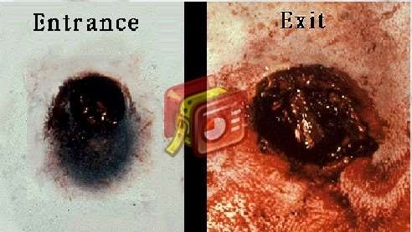
Entry and Exit wound gross appearance

Slide 31
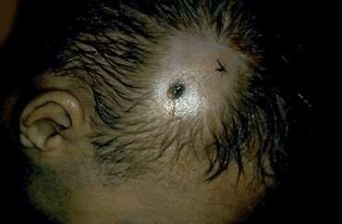
Case of close entry and exit wound

Slide 32
Differentiating entry from exit
Characteristics | Entry wound | Exit wound
Size | Smaller than diameter of bullet | Larger
Edges | Inverted | Everted
Abrasion and grease collar | Present | Absent
Burning, blackening, tattooing | May be present | Absent
Bleeding | Less | More
Fat extrusion | Absent | May be present
Cherry red | May be present | Absent
Lead ring | May be present | Absent

Slide 33
Smooth-bore firearm injury
Entry wound and Exit wound

Slide 34
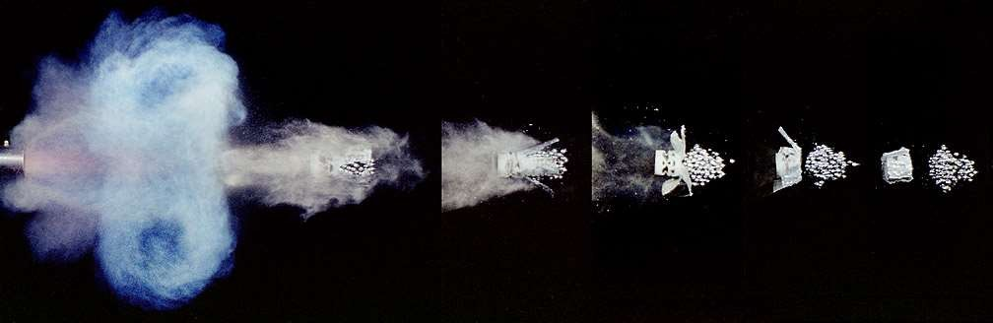
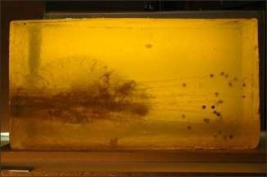
It’s different from bullets-It’s pellets

Slide 35
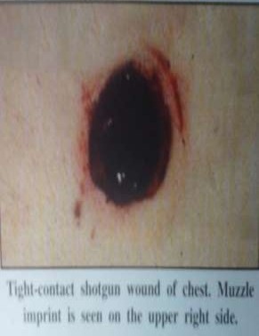
Entry wound-Contact shot
Large irregular hole (Explosive blast effect)
Scorching, tattooing and blackening present
Imprint abrasion may be present Shot enters as a solid mass

Slide 36
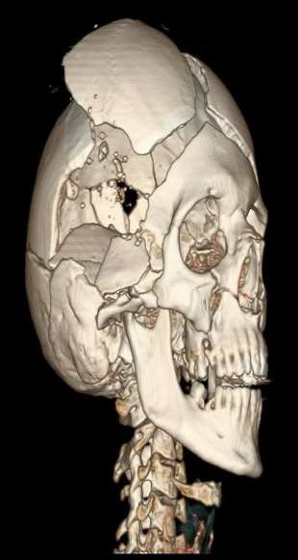
Entry wound-Contact shot
Cherry red colored injured tissue
In cranium, large and irregular wound with fissured fractures radiating outwards from the margin

Slide 37
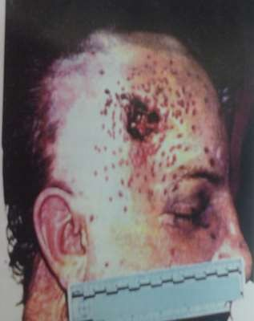
Entry wound-Close shot
Circular defect with irregular inverted borders
Edges show scorching and blackening
Fairly wide zone of tattooing

Slide 38
Entry wound-Close shot
Cherry red appearance of tissues
Pellets enter enmasse
Wads and cartridge parts may contribute to the wound

Slide 39
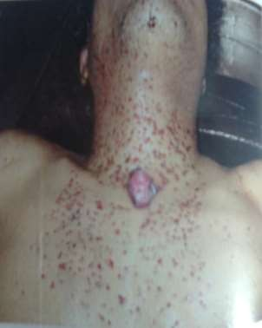
Entry wound-Near shot
Circular or oval
Smudging not beyond 30cm
Wads may produce mild abrasions (upto 30cm only)
Wide area of tattooing

Slide 40
Entry wound-Distant shot
Beyond 2m, no burning or blackening
Tattooing is rare
Wads may contribute upto 5m

Slide 41
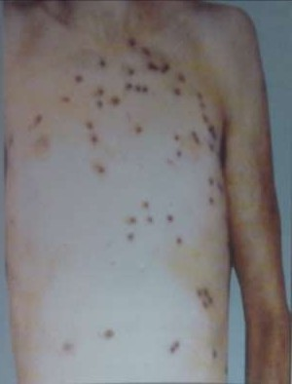
Entry wound-Distant shot
Significant dispersion of pellets beyond 2m and increases progressively
Old thumb rule: Diameter of spread in inches is roughly equal to range in yards x 1.5
Beyond 6m central defect diminishes to nothing and lethality is very less

Slide 42
Medicolegal aspects
Firearm injuries

Slide 43
MLA Firearm injuries
1
Nature of firearm
2
Range of fire
3
Direction of fire
4
Place from where firing took place
5
Cause of death
6
Manner of death-Accidental, suicidal or homicidal

Slide 44
Putting Forensic science to use
Feature Accidental Suicidal Homicidal
Site of entry Any part Head/Chest Any part wound
Range Close Contact/Close Any range
Direction Any direction Upward/backward Usually upward No. of wounds One Usually one One or multiple
Firearm residue Present Present Absent
on hand
Weapon at scene Present Present Usually absent
Location Anywhere Usually home Anywhere Sex Usually males Usually males Either sex
Motive Absent
Depression, Robbery, revenge mental illness

Slide 45
Ballistic Trivia
Just fun to know…

Slide 46
Types of
lead shot
Bird shot- Consists of lead pellets of average diameter 3.5mm, used for small game hunting
Buck shot- Consists of large pellets of average diameter 6-8mm, used for big game hunting
Dust shot- Consists of extremely fine particles

Slide 47
Unusual Ballistic effects
O Billiard ball effect

Slide 48

Unusual Ballistic effects
O Tandem bullet:

Slide 49
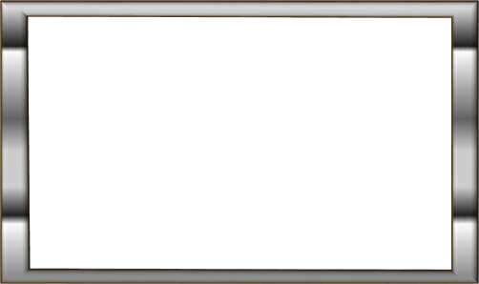
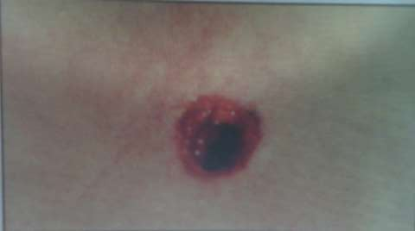
Unusual Ballistic effects
O Shored exit wound

Slide 50
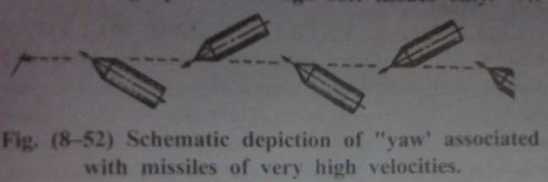
Unusual Ballistic effects
O Yawing bullet

Slide 51
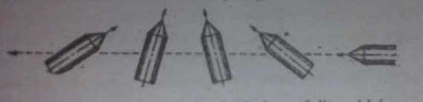
Unusual Ballistic effects
O Tumbling bullet:

Slide 52
Unusual Ballistic effects
O Souvenir bullet: A bullet remaining from a long time in the body without invoking any certain discomfort or visible damage.

Slide 53
Unusual Ballistic effects
O Kennedy phenomenon: Alteration of firearm wound due to surgical intervention

Slide 54
He fired a GUN, I’m sure
O Dermal Nitrate test:
O Cloth dipped in molten paraffin is wrapped on the hands of the accused
O Then, cloth is removed and is treated with
diphenylamine reagent on its internal surface
O Appearance of blue color indicates positive test
O More specific and sensitive tests: Harrison and Gilroy’s test, Neutron activation analysis and atomic absorption spectroscopy

