Slide 1
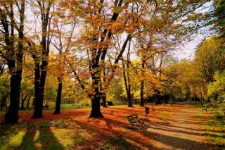
Rtucarya – A way to prevent seasonal Disorders
By
Dr. Sivajothy S
Associate Professor,
Department of Samhita Siddhanta & Sanskrit
Rohilkhand Ayurvedic Medical College & Hospital
Bareilly

Slide 2
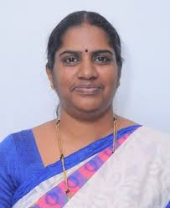
Late Dr. Mallika K.J

Slide 3
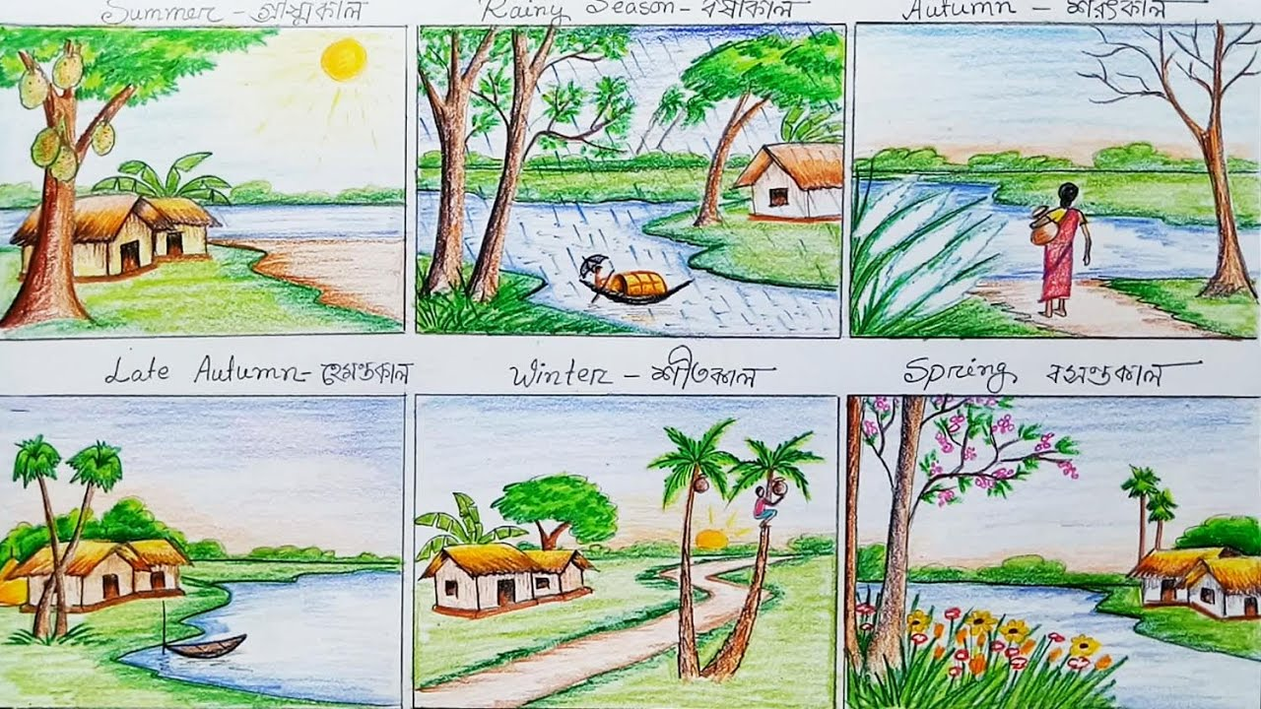
Living thing
The entity used to differentiate Animals and plants from other inorganic materials is life.
Living things are made up of cell or cells
They require energy for survival
They have an unique ability to reproduce, grow, metabolize, respond to stimuli, adapt to the environment, ability to respire.

Slide 4
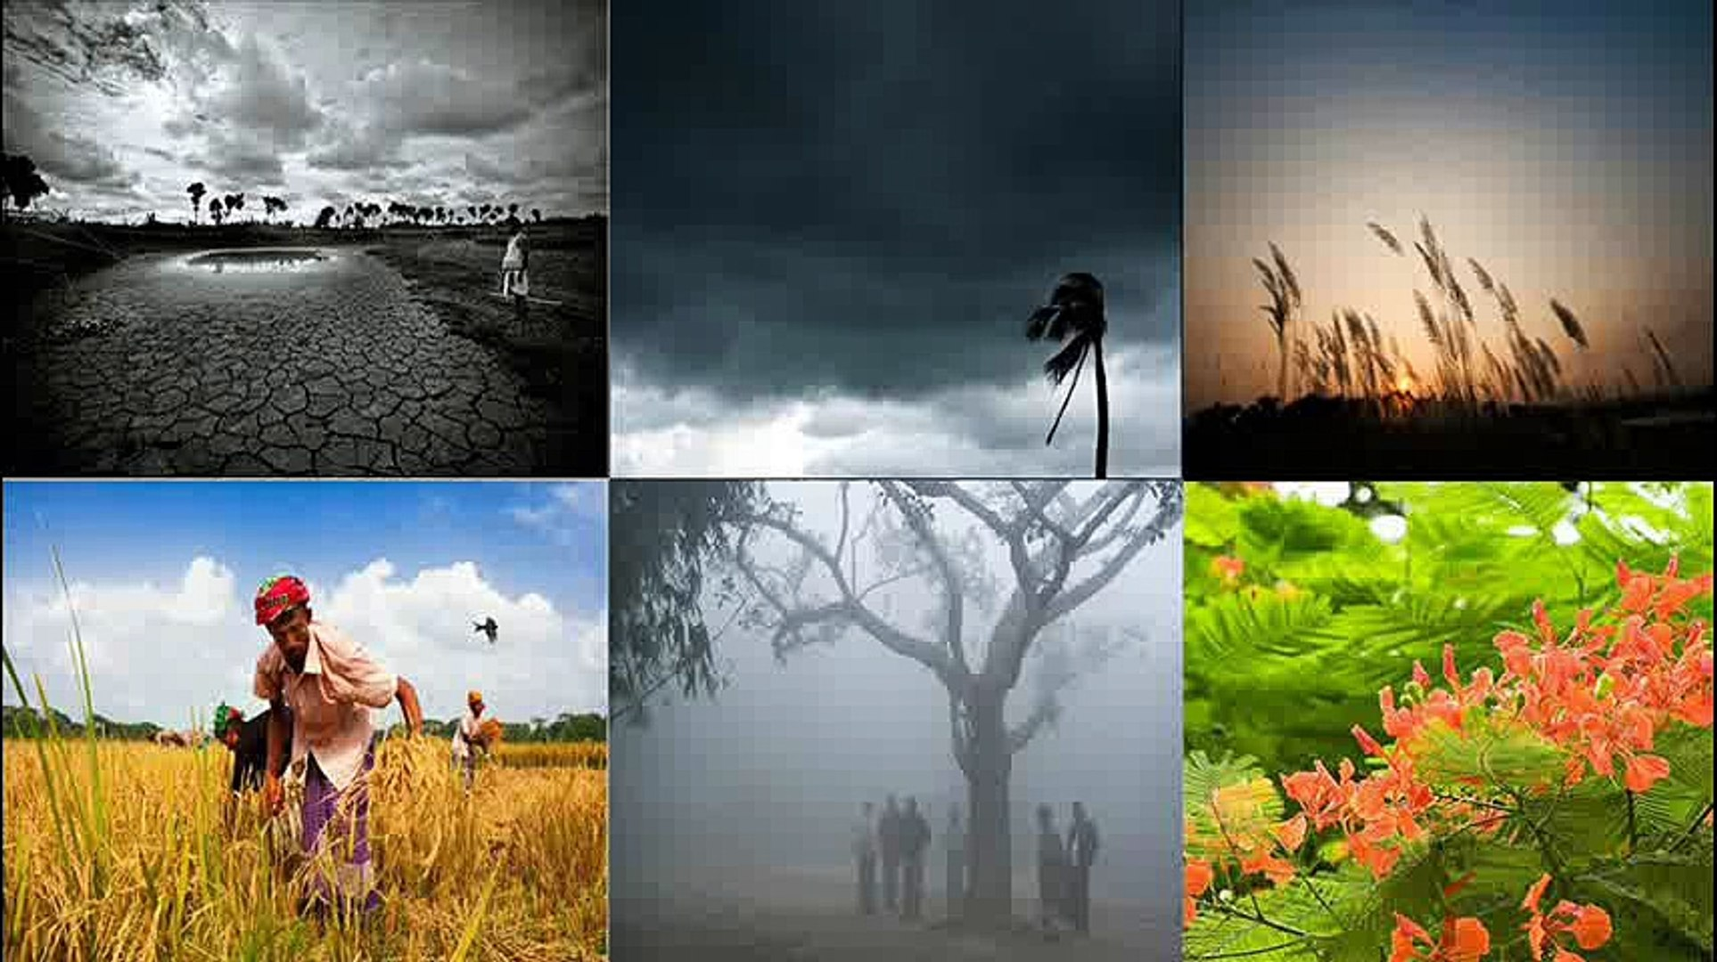
Contd…
The property or quality that distinguishes living organisms from dead organisms and inanimate matter, manifested in functions such as metabolism, growth, reproduction and response to stimuli or adaptation to the environment originating from within the organism.

Slide 5
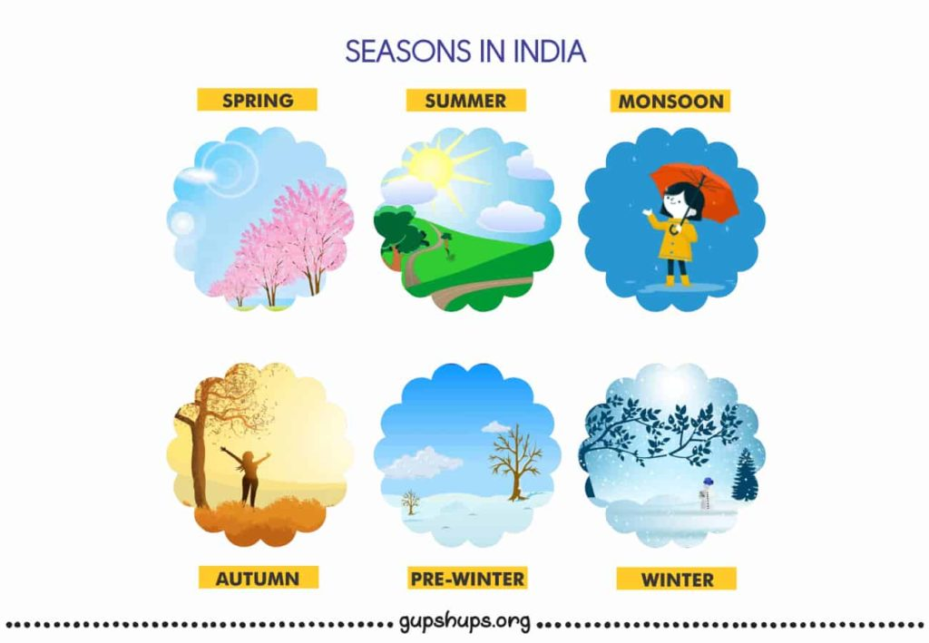
Life is considered a characteristic of something that preserves, furthers or reinforces its existence in the given environment. This characteristic exhibits all or most of the following traits:
Homeostasis: regulation of the internal environment to maintain a constant state; for example, sweating to reduce temperature
Organization: being structurally composed of one or more cells – the basic units of life
Metabolism: transformation of energy by converting chemicals and energy into cellular components (anabolism) and decomposing organic matter (catabolism). Living things require energy to maintain internal organization (homeostasis) and to produce the other phenomena associated with life.
Growth: maintenance of a higher rate of anabolism than catabolism. A growing organism increases in size in all of its parts, rather than simply accumulating matter.
Adaptation: the ability to change over time in response to the environment. This ability is fundamental to the process of evolution and is determined by the organism's heredity, diet, and external factors.
Response to stimuli: a response can take many forms, from the contraction of a unicellular organism to external chemicals, to complex reactions involving all the senses of multicellular organisms. A response is often expressed by motion; for example, the leaves of a plant turning toward the sun (phototropism), and chemotaxis.
Reproduction: the ability to produce new individual organisms, either asexually from a single parent organism or sexually from two parent organisms

Slide 6
Operational definition of Health by WHO
“Condition or quality of the human organism expressing the adequate functioning of the organism in a given condition, genetic or environmental” in a broad sense.

Slide 7
Time - MüÉsÉ
ÌlÉirÉaÉ – AÉuÉÎxjÉMü
ÌlÉirÉaÉ – GiÉÑ
AÉuÉÎxjÉMü – urÉÉkrÉuÉxjÉÉ
ÌlÉirÉaÉ – EwhÉ, zÉÏiÉ, uÉwÉï sÉ¤ÉhÉ
ÌuÉ±ÉiÉç, MüÉsÉxiÉÑ zÉÏiÉÉåwhÉuÉwÉÉïpÉåSÉiÉç | (A WØû 12/38)

Slide 8
GiÉÑ pÉåS
E¨ÉUÉrÉhÉ/ AÉSÉlÉ MüÉsÉ
ÍzÉUÍzÉU
uÉxÉliÉ
SÍ¤ÉhÉÉrÉlÉ/ ÌuÉxÉaÉï MüÉsÉ
uÉwÉï
zÉUSè
aÉëÏwqÉ
WåûqÉliÉ

Slide 9
NAME OF RTU | GUNA PREDOMINANT | MAHABHUTA PREDOMINANT | RASA PREDOMINANT | DOSHA CONDITION
SHISHIRA | zÉÏiÉ, Ã¤É, sÉbÉÑ, zsÉ¤ÉhÉ, qÉ×SÒ | AÉMüzÉ + uÉÉrÉÑ | ÌiÉ£ü | MüTü cÉrÉ
VASANTA | EwhÉ + cÉrÉ MüTü Ã¤É, sÉbÉÑ | mÉ×ÎjuÉ + AÌlÉsÉ | MüwÉÉrÉ | MüTü mÉëMüÉåmÉ
GREESHMA | EwhÉ+ Ã¤É, iÉÏ¤hÉ, sÉbÉÑ, ZÉU, xÉÔ¤qÉ, cÉsÉ | AÎalÉ + AÌlÉsÉ | MüOÒû | MüTü zÉqÉlÉ uÉÉiÉ cÉrÉ
VARSHA | zÉÏiÉ + cÉrÉ uÉÉiÉ zÉÏiÉ + ÎzlÉakÉ, SìuÉ, xÉU, sÉbÉÑ | AmÉ + mÉ×ÎjuÉ | AqsÉ | uÉÉiÉ mÉëMüÉåmÉ ÌmÉ¨ÉcÉrÉ Ì§ÉSÉåwÉ mÉëMüÉåmÉ
SARAD | EwhÉ + cÉrÉ ÌmÉ¨É EwhÉ, ÎxlÉakÉ, aÉÑÂ, zsÉ¤hÉ, ÎxjÉU | AÎalÉ + eÉsÉ | sÉuÉhÉ | ÌmÉ¨É mÉëMüÉåmÉ uÉÉiÉ zÉqÉlÉ
HEMANTA | zÉÏiÉ, ÎxlÉakÉ, qÉlS, aÉÑÂ, zsÉ¤ÉhÉ, qÉ×SÒ, ÎxjÉU | mÉ×ÎjuÉ + AmÉ | qÉkÉÑU | ÌmÉ¨É zÉqÉlÉ MüTü cÉrÉ

Slide 10
How Day – night and season influence us?
Circadian Rhythm
DNA’s

Slide 11
What are seasonal disorders?
Seasonal affect us in the same time every year
Due influence of change in season
Change in our hormonal secretion, fertility, metabolism, immune function
Change in our Doshic predominance influenced by seasonal/ climatic change in the environment leading to symptoms of ill health occurring every year in a particular time.

Slide 12
Fundamental
SåzÉÉlÉÉqÉÉqÉrÉÉlÉÉÇ cÉ ÌuÉmÉUÏiÉaÉÑhÉÇ aÉÑhÉæ: |
xÉÉiqrÉÍqÉcNûÎliÉ xÉÉiqrÉ¥ÉÉ¶ÉåÌ¹iÉÇ cÉÉ±qÉåuÉ cÉ ||
(cÉ xÉÔ 6/50)

Slide 13
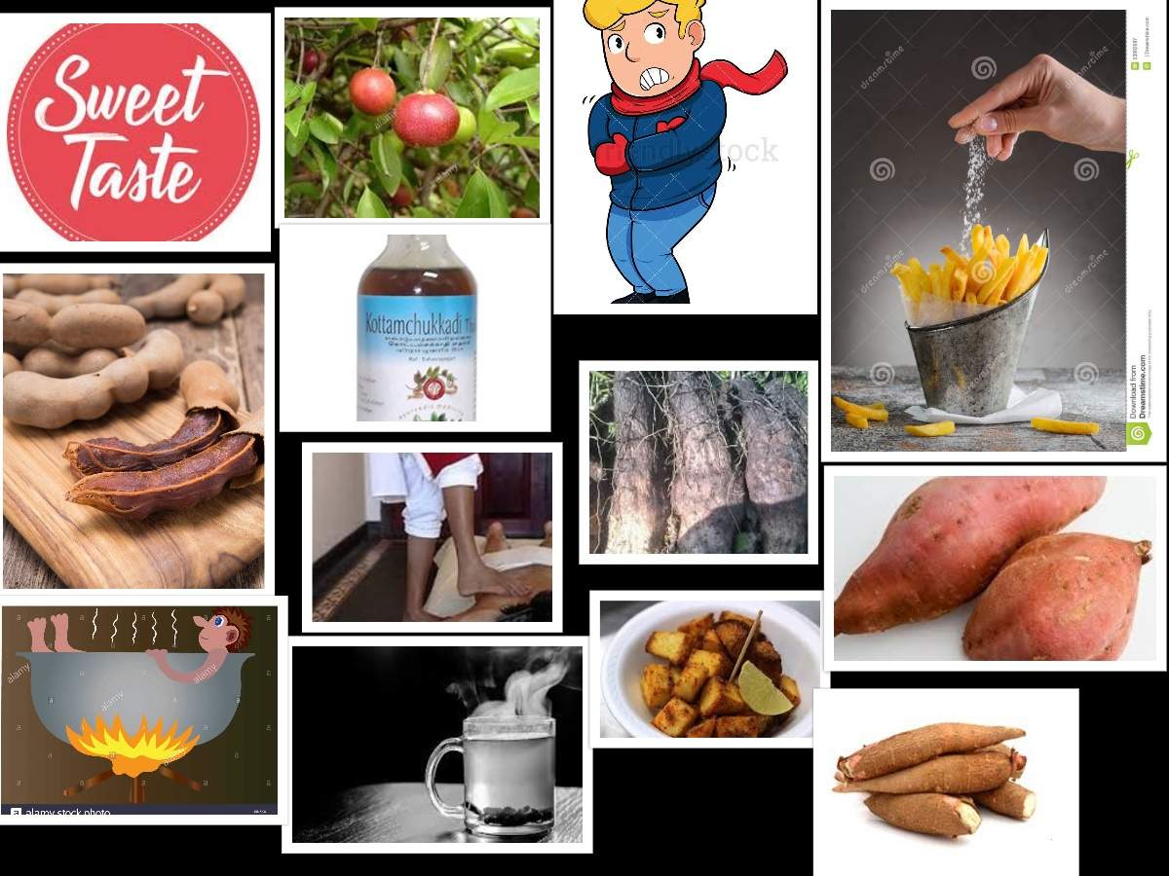
WåûqÉliÉ GiÉÑ
zÉÏiÉ mÉëkÉÉlÉ
AÎalÉ – E¨ÉqÉ
SÉåwÉ – MüTü xÉÇcÉrÉ – ÌmÉ¨É mÉëzÉqÉlÉ
EwhÉ EmÉcÉÉU
EmÉrÉÉåÌaÉ UxÉ – xuÉÉSÒ, AqsÉ, sÉÉuÉhÉ
ÌSlÉcÉrÉÉï –
  uÉÉiÉWûUiÉæsÉ AprÉ…¡û, qÉÔkÉïiÉæsÉ, mÉÉSÉbÉÉiÉ
  MüwÉÉrÉ UxÉ cÉÔhÉï E²iÉïlÉ, xlÉÉlÉ

Slide 14
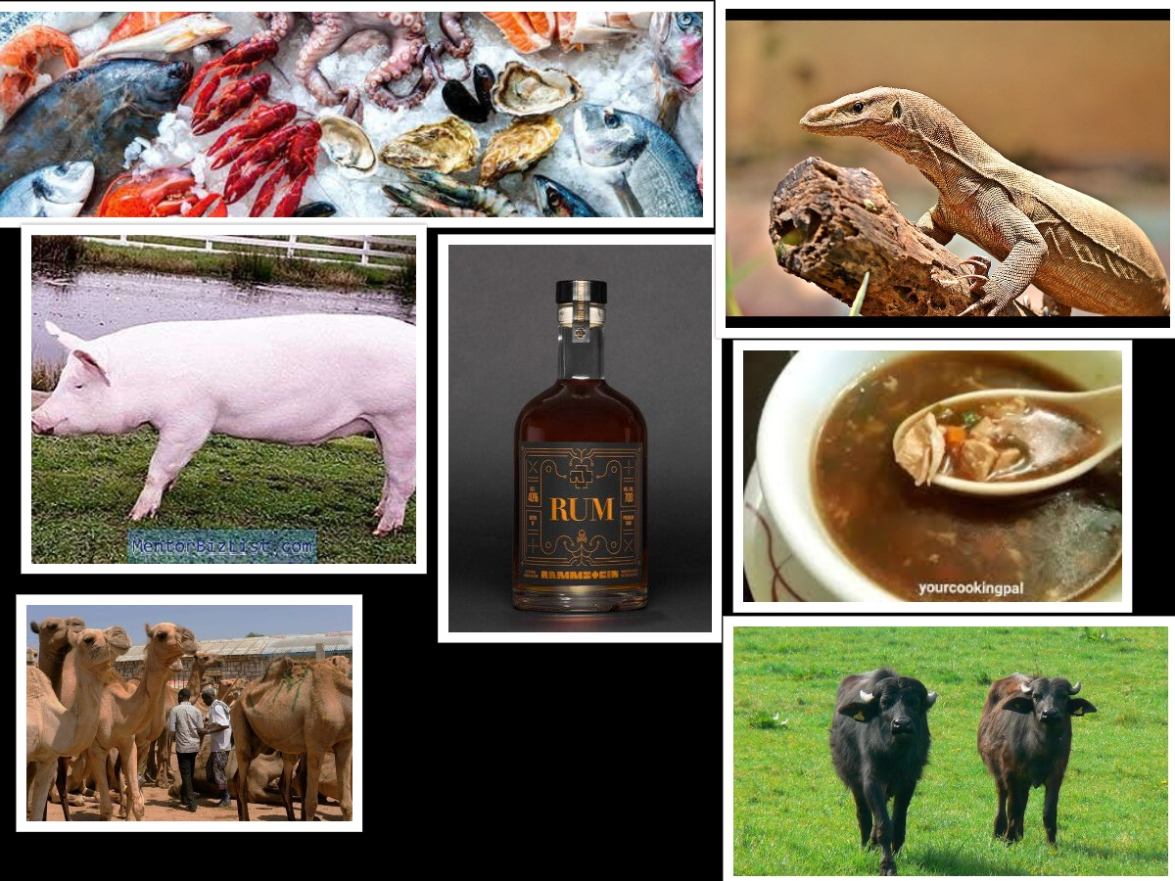
WåûqÉliÉ GiÉÑ
AÉWûÉU
  xlÉåWûrÉÑ£ü qÉÉÇxÉ UxÉ, AÉæSMü (fish, crab,lobster), AÉlÉÔmÉ qÉÉÇxÉ (pork, buffalo), qÉå± qÉÉÇxÉ, ÌoÉsÉåzÉrÉ (frog, snake, monitor lizard, mongoose), mÉëxÉWû qÉÉÇxÉ (cow, camel, dog
  qÉÌSUÉ (uÉÉiÉWûU), xÉÏkÉÑ (made from molasses/ Rum)
Notes:
Mrigyam vaiskirikam kinca praatudam ca bileshayam| praasahaM ca mahaamrugyam apcaram maatsyam ashtadaa|
Aadyantaa jaangalaanupa madhyou saadharanou smritou|
Mriga, vishkira, pratuda – jaangala. Mahaamrga, apcara, matsya – aanupa. Bileshaya, prasahaa – saadhaarana

Slide 15
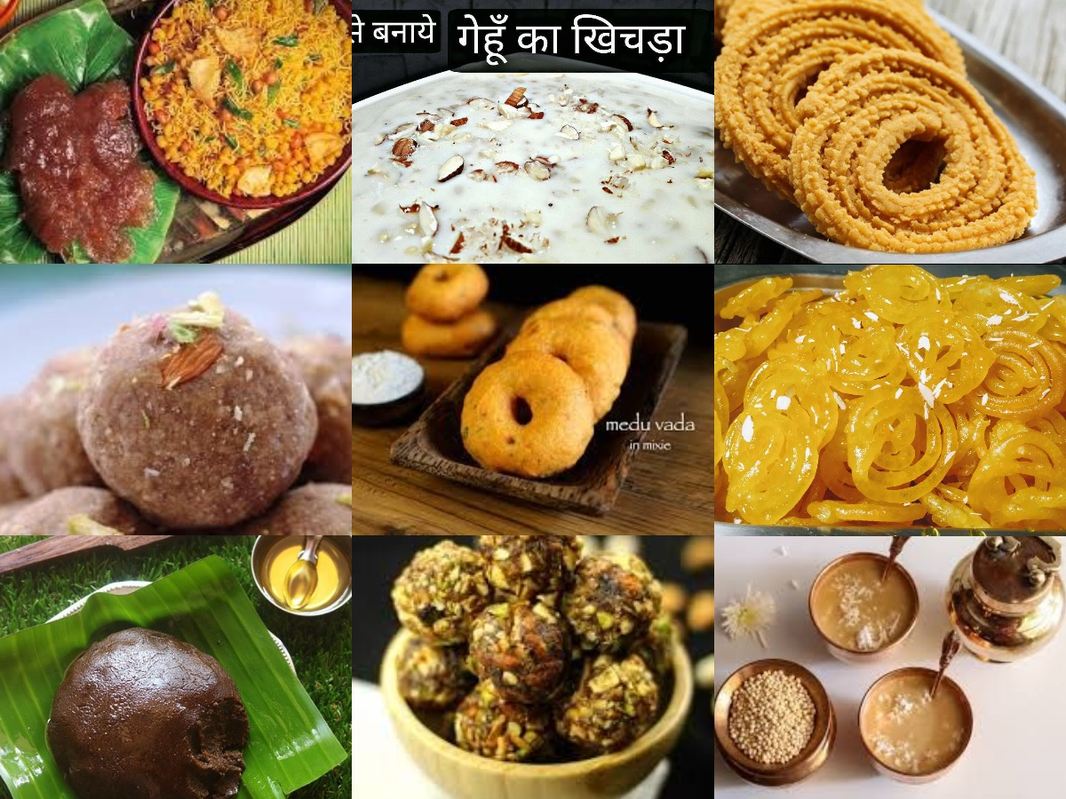
WåûqÉliÉ GiÉÑ
aÉÉåkÉÔqÉ (WûsuÉÉhttps://www.youtube.com/watch?v=Gu6WmKmeOiY, sÉŒÖû https://www.youtube.com/watch?v=lm4i03V0GPo MüÎqosÉ, ZÉÏcÉQûÉ https://www.youtube.com/watch?v=K8ak5jQde0k),
zÉÉÍsÉ (cÉÎYsÉ, https://www.youtube.com/watch?v=wa3xjdUvhzw)
qÉÉwÉ (porridge https://www.youtube.com/watch?v=jf-VyTIiSso)
dry fruit laddoo (https://www.youtube.com/watch?v=7LX-mq4hM1Y)
Mudde (https://www.youtube.com/watch?v=xtwwHVJjmt8)
Vada (https://www.youtube.com/watch?v=qgYTSsxe7W4)
lÉuÉÉ³É (Pongal, Smkranti khichada)
uÉxÉÉ, iÉæsÉ (iÉæsÉ mÉÉlÉ in Rajasthan)

Slide 16
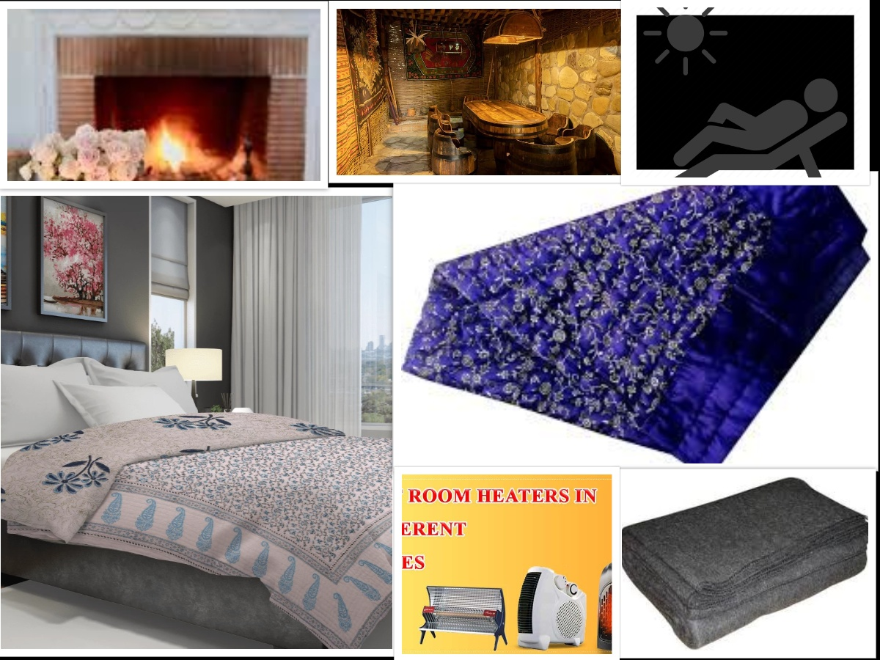
WåûqÉliÉ GiÉÑ – Living place
mÉëÉuÉÉU, AÎeÉlÉ, MüÉæzÉårÉ, mÉëuÉåhÉÏ, MüÉæjÉuÉ
Sun bath, Sveda, Padatraana
A…¡ûÉUiÉÉmÉxÉliÉmiÉ aÉpÉïpÉÔuÉåzqÉcÉÉËUhÉ: |
ÍzÉÍzÉU GiÉÑ – zÉÏiÉqÉÍkÉMÇü, UÉæ¤rÉÇ AÍkÉMüqÉç.
  zÉÏiÉÇ qÉåbÉqÉÉÂiÉuÉwÉïeÉqÉç | (cÉ xÉÔ 6/19)
ArÉqÉåuÉ ÌuÉÍkÉ – ÌuÉzÉåwÉiÉ:
To avoid
  MüOÒû, ÌiÉ£ü, MüwÉÉrÉ
  uÉÉiÉsÉ AÉWûÉU ÌuÉWûÉU, sÉbÉÑ AÉWûÉU
  zÉÏiÉ AÉWûÉU

Slide 17
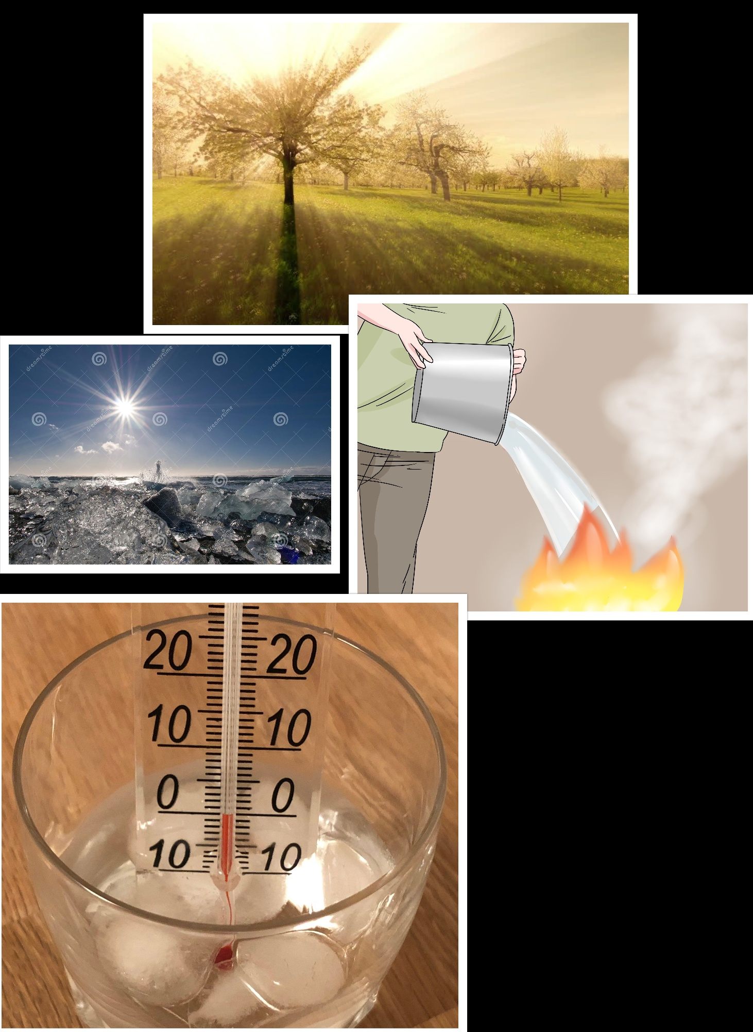
uÉxÉliÉ GiÉÑ
GiÉÑ sÉ¤ÉhÉ - xÉÔrÉï ÌMüUhÉ – EwhÉ after continuous winter
WåûqÉliÉ ÌlÉÍcÉiÉ MüTü – SìuÉÏMüUhÉ
WûiuÉÉ AÎalÉÇ
ÎxlÉakÉ: zÉÏiÉÉå aÉÑÂqÉïlS: zsÉ¤hÉÉå qÉ×ixlÉ:ÎxjÉU: MüTü: |

Slide 18
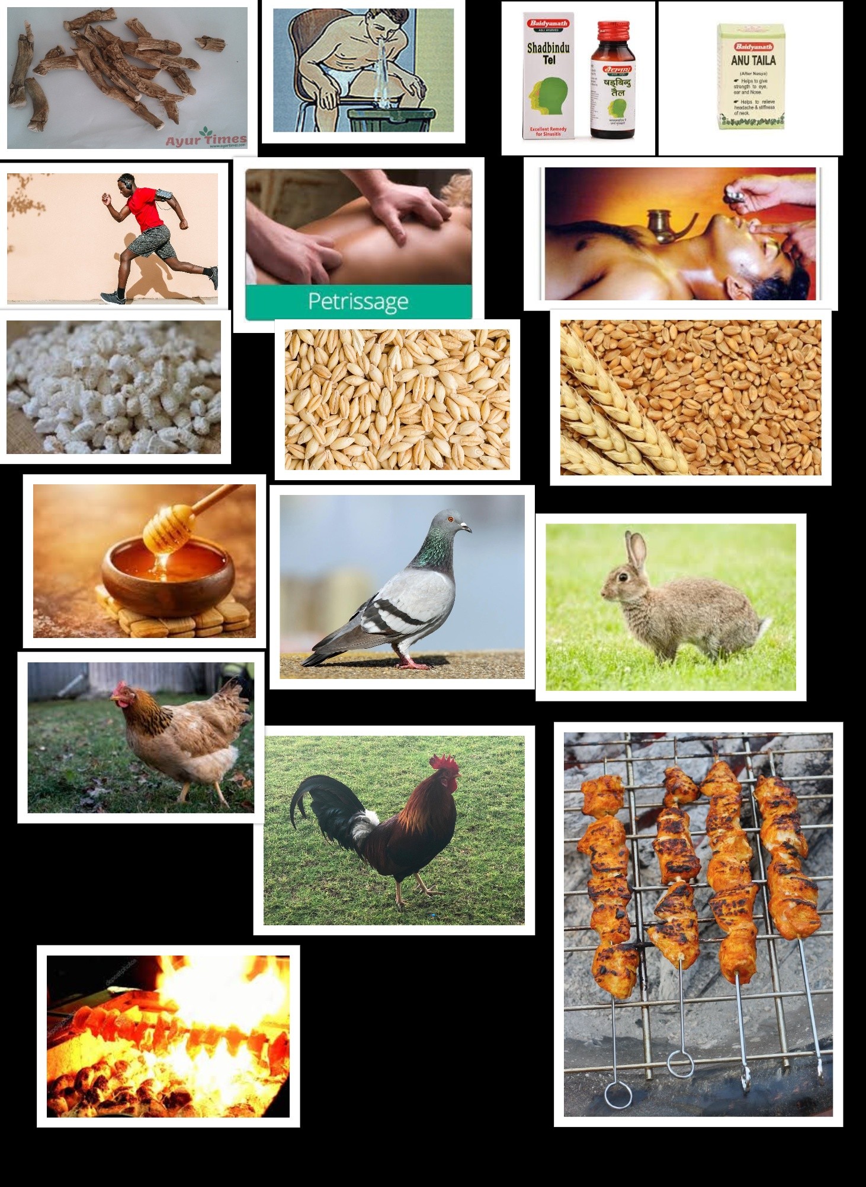
uÉxÉliÉ GiÉÑ
EmÉcÉÉU – Ã¤É EwhÉ
iÉÏ¤hÉ uÉqÉlÉ lÉxrÉ, AgeÉlÉ, kÉÔqÉ, MüuÉsÉ
ÌuÉWûÉU
  urÉÉrÉqÉ, E²iÉïlÉ, AÉbÉÉiÉ
AÉWûÉU – sÉbÉÑ, Ã¤É
  mÉÑUÉhÉ rÉuÉ, aÉÉåkÉÔqÉ, qÉkÉÑ
  eÉÉ…¡ûsÉ qÉÉÇxÉ, zÉÔsrÉ qÉÉÇxÉ (qÉ×aÉ, ÌuÉÎwMüU, mÉëiÉÑSÉ)

Slide 19
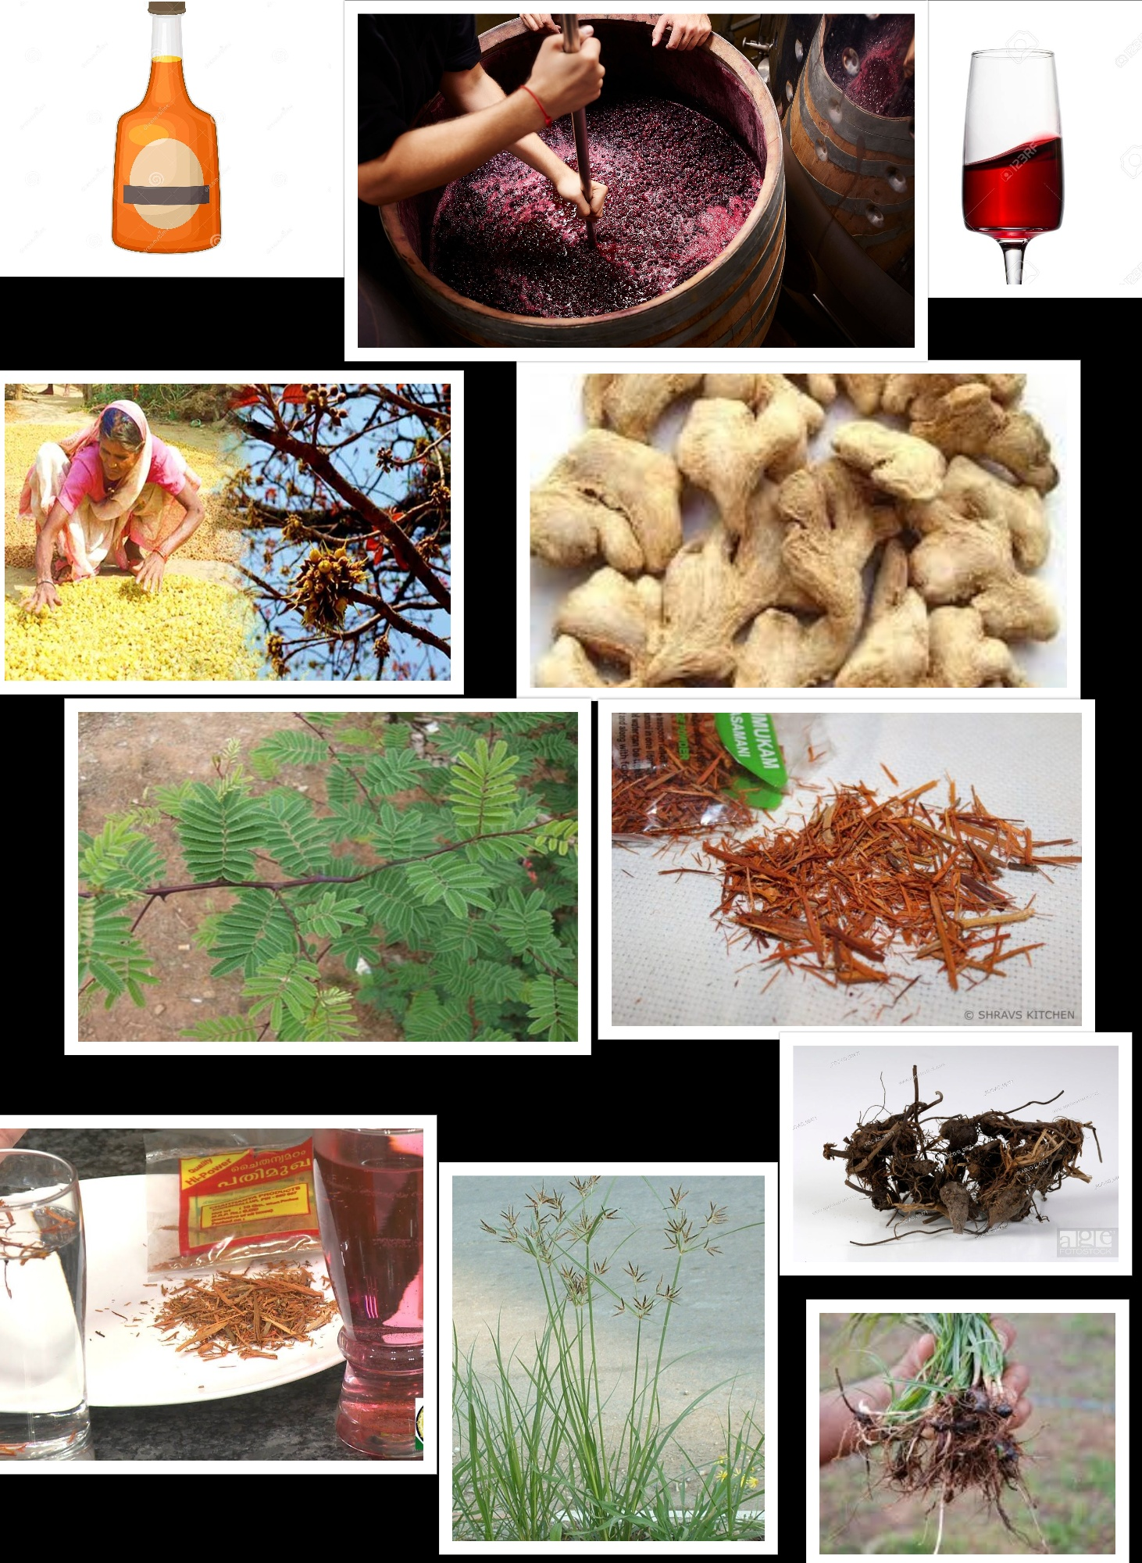
uÉxÉliÉ GiÉÑ
ÌlÉaÉïS - ÌlÉSÉåïwÉ
xÉÏkÉÑ (C¤ÉÑ UxÉålÉ ÌlÉÍqÉïiÉ)
qÉÉ²ÏïMü (SìÉ¤ÉÉ)
qÉÉkÉuÉ (qÉÉæuÉÉ)
zÉ×…¡ûuÉåUÉqoÉÑ
xÉÉUÉqoÉÑ
qÉkuÉÉqoÉÑ
eÉsÉSÉqoÉÑ

Slide 20
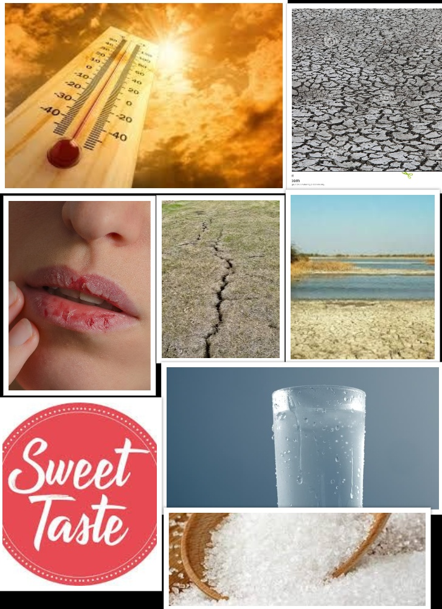
aÉëÏwqÉ GiÉÑ
GiÉÑ sÉ¤ÉhÉ – AirÉÑwhÉ, Ã¤É
SÉåwÉ ÌuÉMüsmÉ – MüTü ¤ÉrÉ, uÉÉiÉ uÉ×Î®
AÎalÉ – qÉlS
EmÉcÉÉU – zÉÏiÉ
EmÉrÉÉåÌaÉ UxÉ aÉÑhÉ– qÉkÉÑU, zÉÏiÉ, sÉbÉÑ, ÎxlÉakÉ AÉWûÉU

Slide 21
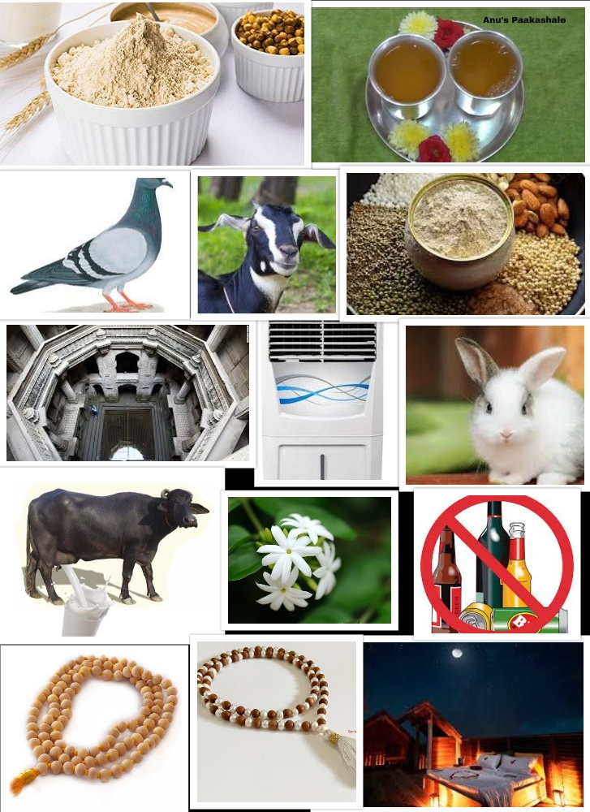
aÉëÏwqÉ GiÉÑ
xÉ£Ñü + zÉMïüUÉ – sÉåWû
xÉ£Ñü + zÉMïüUÉ + ¤ÉÏU + bÉ×iÉ – qÉljÉÇ
MÑülSålSÒkÉuÉsÉÇ zÉÉsÉÏqzlÉÏrÉÉiÉç (light)
eÉÉ…¡ûsÉ qÉÉÇxÉ UxÉ sizzled with ghee
mÉÉlÉMü (https://www.youtube.com/watch?v=l0dDxkNTGfA, Aam panna), UxÉÉsÉ (curd mixed with sugar and spices, ca su 27/278)
Fanning with large leaves (A/C, Air coolers)
qÉÌWûwÉÏ ¤ÉÏU –UÉÌ§É
Spending day time in dense forests or kÉÉUÉaÉ×Wû
MümÉÔïUqÉÎssÉMüÉqÉÉsÉÉ WûÉUÉ: xÉWûËU cÉlSlÉÉ: |

Slide 22
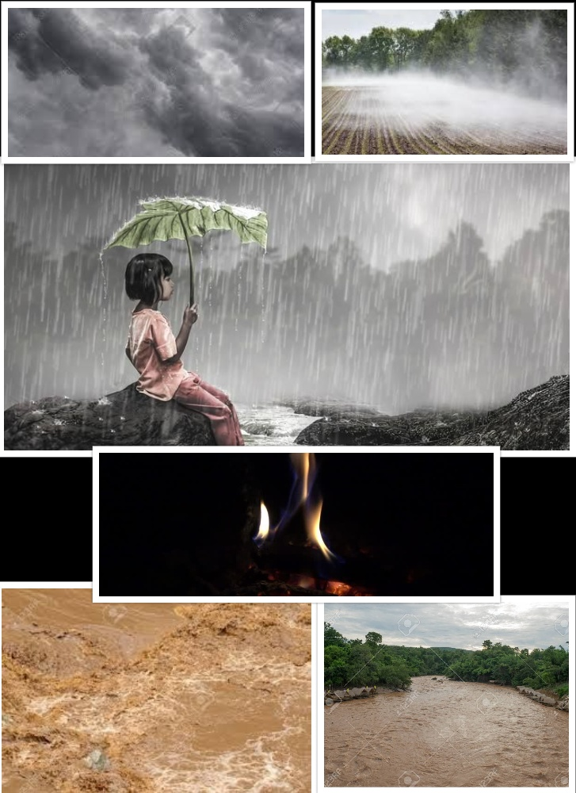
uÉwÉï GiÉÑ
GiÉÑ sÉ¤ÉhÉ – uÉwÉï, zÉÏiÉ, SìuÉ, ÎxlÉakÉ
pÉÔoÉÉwmÉ, AqsÉÌuÉmÉÉMü, AÎalÉqÉÉl±-SÉåwÉ mÉëMüÉåmÉ
uÉÉiÉ mÉëkÉÉlÉ ÌmÉ¨ÉÉlÉÑoÉlkÉ Ì§ÉSÉåwÉ SÒÌ¹
EmÉcÉÉU – xÉÉkÉÉUhÉ, EwhÉ
AÎalÉ - qÉlS

Slide 23
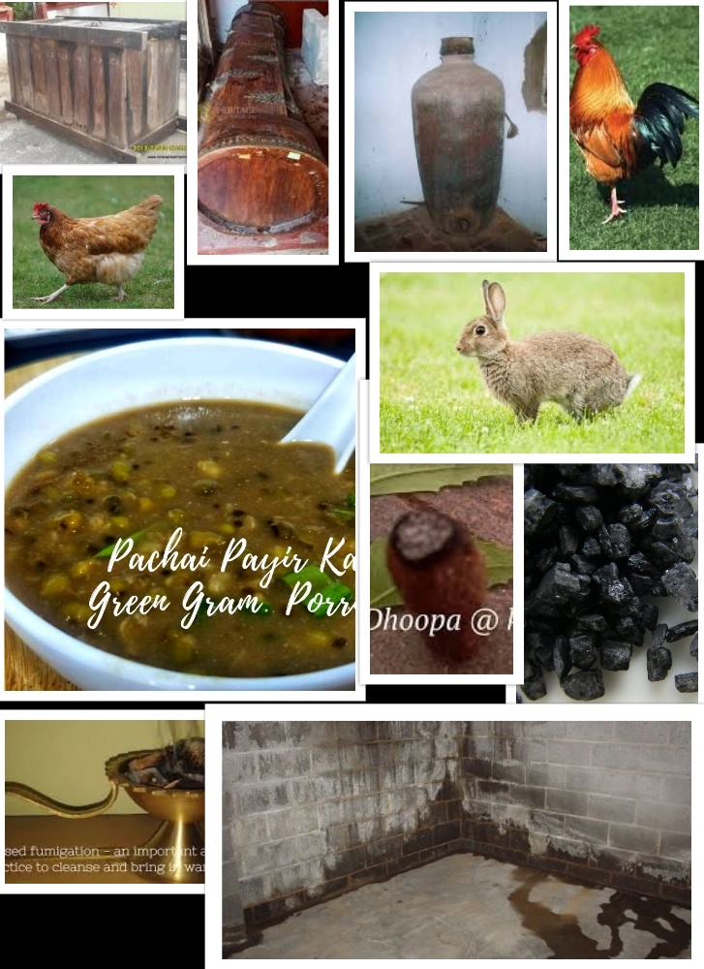
uÉwÉï GiÉÑ
AÉWûÉU – mÉÑUÉhÉ kÉÉlrÉ (rÉuÉ, aÉÉåkÉÔqÉ, zÉÉÍsÉ)
eÉÉ…¡ûsÉ qÉÉÇxÉ
rÉÔwÉ
qÉkuÉËU¹, qÉxiÉÑ + xÉÉæuÉcÉïsÉ/ mÉgcÉMüÉåsÉ cÉÔhÉï
zÉ×iÉÇ cÉ AqpÉÉå
pÉÉåeÉlÉÇ iÉÑ AÌiÉSÒÌSïlÉå urÉ£üÉqsÉsÉuÉhÉxlÉåWÇû xÉÇzÉÑwMÇü ¤ÉÉæSìuÉssÉbÉÑ |
xÉiÉiÉÇ kÉÔÌmÉiÉÉqoÉU: |
WûqrÉïmÉ×¸å uÉxÉå¯ÉwmÉzÉÏiÉzÉÏMüUuÉÎeÉïiÉå |

Slide 24
zÉUSè GiÉÑ
sÉ¤ÉhÉ - EwhÉ
AÎalÉ - qÉlS
cÉrÉ ÌmÉ¨É (Sheeta in previous Rtu opposing Pitta Prakopa) + EwhÉ = ÌmÉ¨É mÉëMüÉåmÉ (SìuÉ aÉÑhÉ)
1. ÌiÉ£ü bÉ×iÉ 2. ÌuÉUåcÉlÉ 3. U£üqÉÉå¤ÉhÉ
AÉWûÉU – ÌiÉ£ü, qÉkÉÑU, MüwÉÉrÉ (ZÉÉuÉÉrÉÑ, ¤qÉÉqpÉÉå, aÉÉåÅÌlÉsÉ)
zÉÉÍsÉ, rÉuÉ, aÉÉåkÉÔqÉ, qÉÑª, ÍxÉiÉÉ, kÉÉ§ÉÏ, mÉOûÉåsÉ, qÉkÉÑ, eÉÉ…¡ûsÉ qÉÉÇxÉ (EUpÉë)

Slide 25
zÉUSè GiÉÑ
EAT WHEN HUNGRY -¤ÉÑÌSiÉÉåÅ³ÉÇ pÉeÉåssÉbÉÑ | qÉÉ§ÉrÉÉ mÉëMüÉÎXç¤ÉiÉæ: |
WÇûxÉÉåSMü
uÉeÉïrÉåiÉç-
  uÉxÉÉ, ¤ÉÉU, iÉæsÉ, ÌSuÉÉxuÉmlÉ, AuÉzrÉÉrÉ, AÉæSMüÉlÉÔmÉ qÉÉÇxÉ, SÍkÉ, mÉëÉauÉÉiÉ

Slide 26
Some interesting facts
Night-time levels of melatonin are at least 10-fold higher than daytime concentrations.
In addition to its circadian rhythm, melatonin levels also have a seasonal (or circannual) rhythm, with higher levels in the autumn and winter, when nights are longer, and lower levels in the spring and summer.
Does buffalo milk increases melatonin secretion?

Slide 27
Contd…
For instance, it is believed that the cold temperatures may cause the pituitary gland to produce more thyroid stimulating hormone (TSH) >> T3, T4^^
Increased gastric secretion - Increased metabolism (increased BMR) BMR is a flexible trait (it can be reversibly adjusted within individuals), with, for example, lower temperatures generally resulting in higher basal metabolic rates for both birds^{[7]} and rodents.^{[8]}

Slide 28
Contd…
Although testosterone levels are within normal limits in both seasons, its level in cold months is lower than the hot months. Testosterone levels can change according to the season. The impact of cold seasons in particular should be taken into account when evaluating testosterone levels and sexual status, as well as the other influences (social, cultural).
https://www.ncbi.nlm.nih.gov/pmc/articles/PMC5057046/#:~:text=affect%20our%20results.-,CONCLUSIONS,change%20according%20to%20the%20season.

Slide 29
Conclusion
The seasonal changes are the stimuli bringing changes in our metabolism, hormones, immune system, etc.
We need to adopt and adapt to specific changes in the environment which is the inherent nature of every living being.
Our adoption of various food and activities are based on the attribute (Guna) predominant in the season.

Slide 30
Contd….
Apart from the predominant seasonal attribute its influence/ response by the host are also taken on deciding what are the specific do’s and don'ts for the given season.
Condition of Agni, Pradhana Dosha, Anubandha Dosha need to be considered.
Seasonal foods practices are part of ethno –medical practices.
Observation of nature, changes happening in it, the process involved in the change and the response by the host will help us in clear understanding of our guiding principles.

Slide 31
THANK YOU

