Slide 1
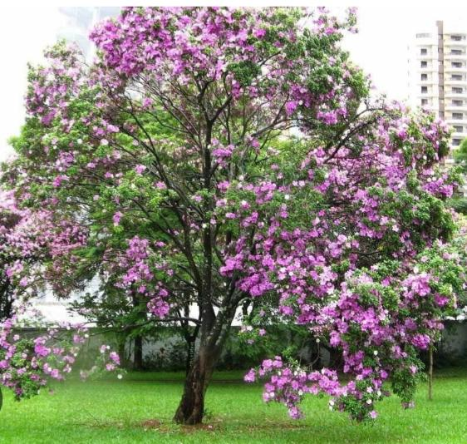
KANCHANARA
Dr Kavita Tiwari
Asst proff
Dept.of dravyaguna

Slide 2
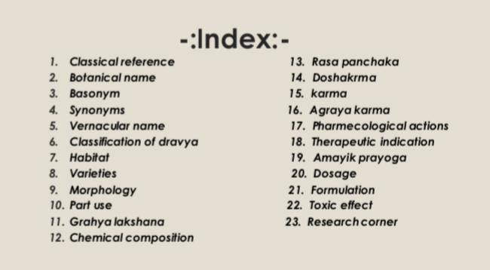

Slide 3
KANCHANARA
काञ्चनारः काञ्चनको गण्डारिः शोणपुष्पकः । कोविदारश्च मरिकः कुद्दालो युगपत्रकः ॥ कुण्डली ताम्रपुष्पश्चाश्मन्तकः स्वल्पकेशरी । (भा.प्र. गुडूच्यादि वर्ग 101-102)

Slide 4
Basonym
काञ्चनं तद्वर्ण ऋच्छति पुष्पैः ।
The flower of Kancanara (Bauhinia variegata) is golden yellow in colour.
Synonyms
1 युग्मपत्रकः- । Leaf of Kancanara is emarginated.
2. चमरिक- । Kancanara has smooth and beautiful bark.
3 पुष्पं अस्यास्तीति । The flower of Kancanara is coppery red coloured.
4. स्वल्पकेसरी- Flowers contain very few stamen

Slide 5
Botanical Name : Bauhinia variegata
Family : Caesalpinaceae
Vernacular Name
English : Mountain Ebony, Camel Foot
Hindi : Kachnar
Sanskrit: Kanchanara , Gandhari , Yugmpatraka

Slide 6
Classical Categorization
Charak : Vamanopaga Varga
Sushrut Samhita : Kashaya Varga
Bh.Pr.Ni : Gudcyadi Varga 101- 104

Slide 7
VARIETIES
Kai. Ni & Pri. Ni – Two types
1. Kancanara
2. Kovidāra

Slide 8
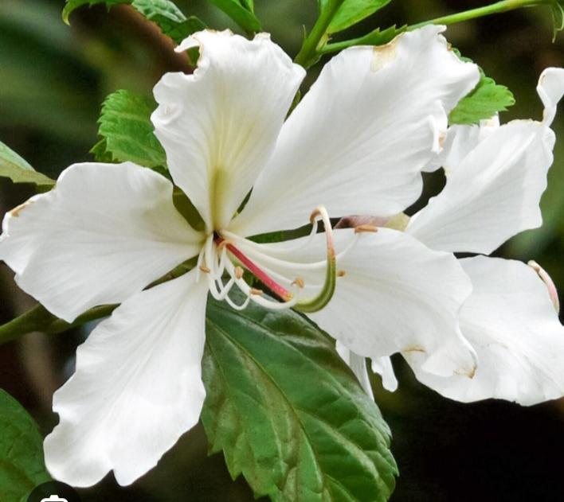
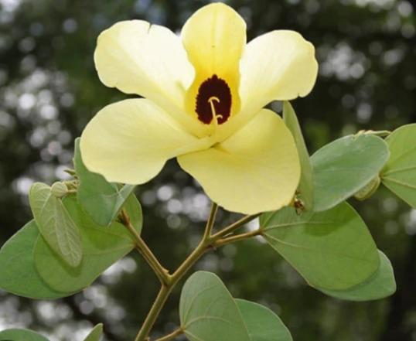
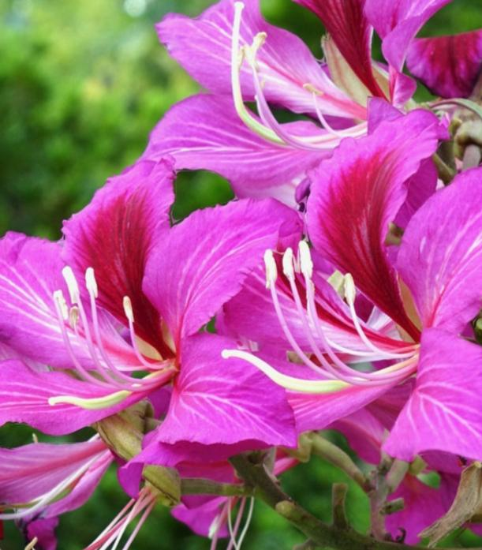
SPECIES
White : Bauhinia Variegata
Red : Bauhinia Purpurea
Yellow:. Bauhinia Tomentosa

Slide 9
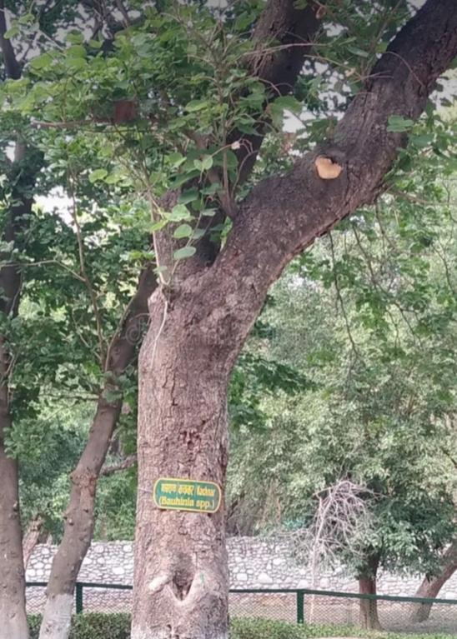
Habitat
Kanchanar is very Common throughout India As it gives Shade Commonly Planted by Road Side.
MORPHOLOGY
Habit
Shrub or Small Tree
Stem
Woody Aerial Erect Branched, Solid , Cylindrical and Rough

Slide 10
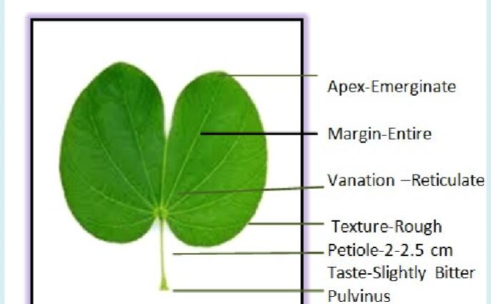
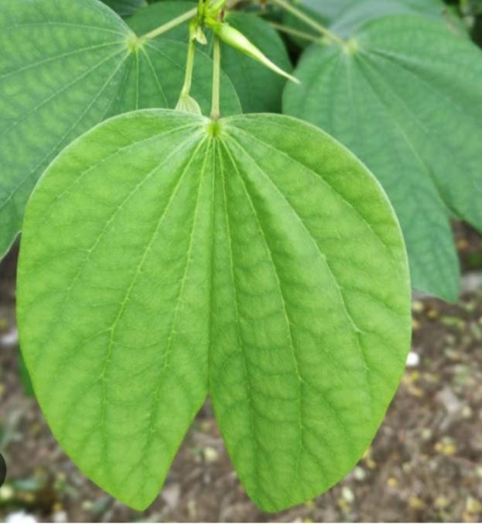
Leaf
Alternate Simple, Stipulate, Cordate entire Emarginate ,Long Wide and Containing Several Seeds Divergent Minute Hairy , Unicostate, Gynoecium Reticulate Venation

Slide 11
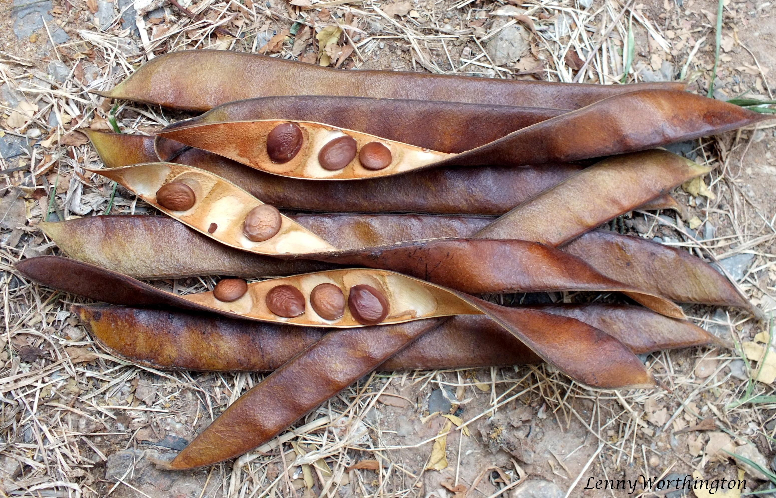
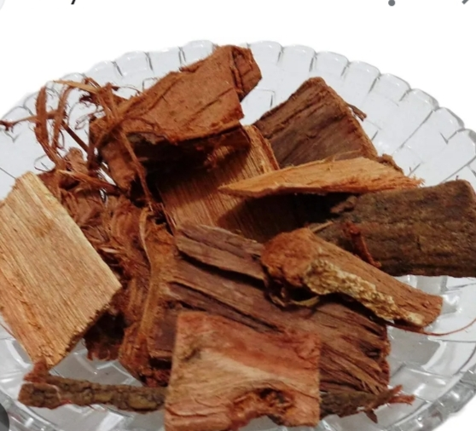
Seed 10-15 Seeded
Inflorescence
Panicle Chyme
Useful Part
Kaanda Twak ( Stem bark)

Slide 12
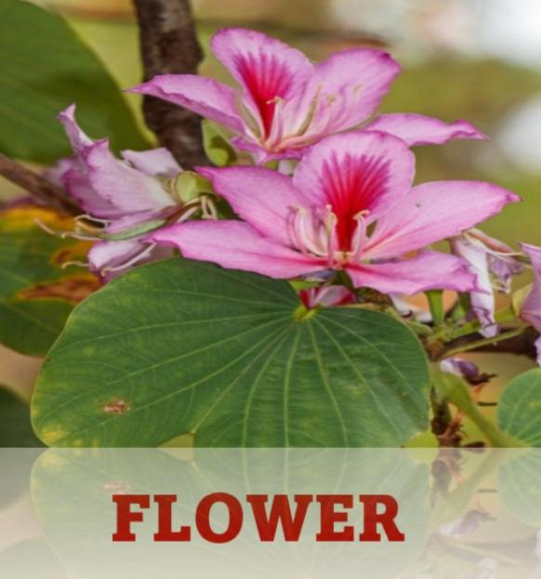
Flower
Complete bisexual, zygomorphic, pink colourd with prominent red veins, 5 petals and 5 sepals, stamens are 5 in number, monocarpellary gynoecium

Slide 13
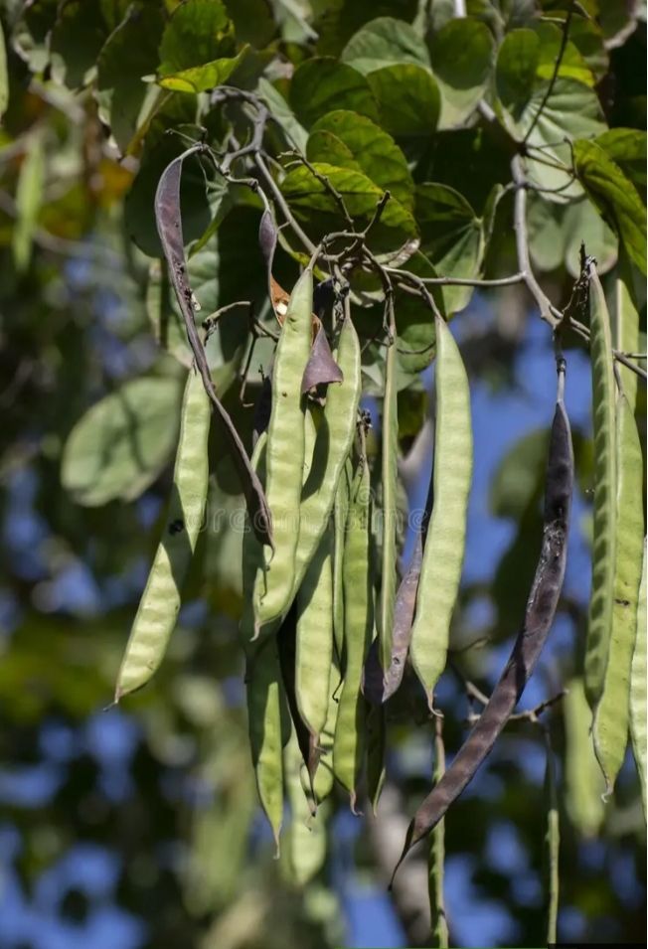
FRUIT
Fruit-Legume or Pod, 15 to 30 cm long and containing several seeds.

Slide 14
CHEMICAL COMPOSITION
Stem bark yielded Hentriacontane, Octacosanol, b-Sitosterol and stigmasterol
Stem contains lupeol & aminoacids
Seeds consist myricetol glycosides flowers have hentriacontane, octacosanol, b-Sitosterol & stigma sterol.

Slide 15
RAS PANCHAK
RAS Kasaya
GUNA Ruksa, Laghu
VEERYA Sita
VIPAK Katu
PRABHV Gandmala hara

Slide 16
DOSH KARMA (Action on Dosa)
Kaphapitta Šamaka, Pittahara due to Sit vīrya and Kaşaya rasa and Kaphahara because of Katu vipāka and Kaşāya
KARMA Action
Kancanara twak – Grāhi, Krimighna, Kuşthaghna, Gandamālahara, Vrnahara,
Kovidara twak – Gandamālāhara, Kuşthaghna, Krimighna, Dīpana.
Kancanara puspa – Sangrāhī, Rocaka, Pradara nāśaka, Kāsahara.
Kovidara Puspa – PRADARANĀSAKA, Raktapittahara

Slide 17
Pharmacological Action
Astringent, Anthelminitc, Haemostatic, Anti-inflammatory
THERAPEUTIC INDICATION
Twak – Gandamala, Krimi , Kuştha, Käsa, Vranavikara,
Atisara, Apaci
Pushpa - Pradara, Raktapitta, Kasa, Swaso

Slide 18
Amayika Prayoga
1 Gandamala (Goitre)
काञ्चनारत्वचः क्वाथः शुण्ठीचूर्णेन नाशयेत् । गण्डमालां. काना ..........((शा.स. 2/2/125)
Kwath(decoction)of Kanchanara (Bauhinia variegata) is prepared and Shunti (Zingiber officinale) powder is added,and then administerd it is very effacious in Gandmala( Goitre)
2 Masurika (Pox)
काञ्चनारत्वचःक्वाथस्ताप्य चूर्णाव चूर्णित ।। (भा.प्र.चि. 60/49)
In case of Masurika (Pox) the decoction prepared from bark of Kancanara added with Swarna mākşika (Copper pyrite) powder is beneficial

Slide 19
3 Shweta pradara – bark decoction is useful to treat leucorrhea with rice gruel.
4 Atisara Decoction with jeerak powder is useful to treat diarrhea.
Matra(Dose)
Kwath(Decoction) | 40-80ml
Churna(Powder) | 3-6 grm
Pushpa rasa (Juice) | 10 -20 ml

Slide 20
YOGA (Formulation)
S. No | Formulation | Indication
1 | Kancanara Guggulu | Galaganda, Apaci , Arbuda
2 | Kancanara Gutika | Galaganda , Nadivranga
3 | Kancanara Varuna Kwath | Gandmala
4 | Kancanara Kwath | Masurica

Slide 21
Toxic Effects
Kanchnar guggulu exhibited a cytotoxic effect by inhibiting cell division (antimitotic) and reducing cell proliferation
CONTROVERSY
Kovidara and Kanchanara
2) Kovidara and Uddalaka

Slide 22
Research Update
1) Antidiabetic
2) Anticarcinogenic & Antimutagenic
3) Antiarthritic
4 )Anti-helmintic
5) Anti-oxidant
6) Nephroprotective effect

Slide 23


