Slide 1
HARITAKI
DR.KAVITA TIWARI
ASST.PROFF
DEPT OF DRAVYAGUNA

Slide 2
Index
Shloka
Basonym
Synonyms
Vernacular name
Botanical name & family
Classical categorization
Varieties
Habitat
Morphology
Grahya-Agrahya
Chemical composition
Raspanchak
13. Karma
14. Pharmacological action
15. Therapeutic indication
16. Aamayik prayog
17. Matra
18. Useful part
19.Formulations
20.Adulteration
21.Controversy
22. Reseach update

Slide 3
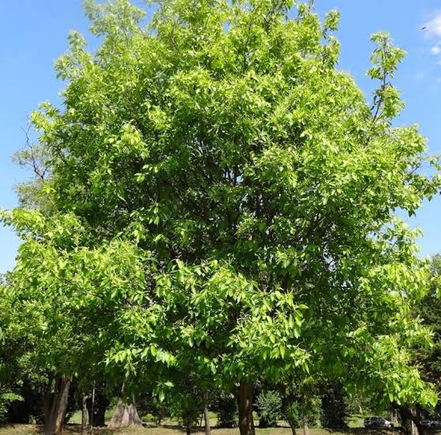
HARITAKI
हरीतक्यभया पथ्या कायस्था पूतनाऽमृता ।
हैमवत्यव्यथा चापि चेतकी श्रेयसी शिवा ।।
वयस्था विजया चापि जीवन्ती रोहिणीति च ।।
(भा.प्र. हरीतक्यादि वर्ग 6-7)

Slide 4
Basonym
हरस्य भवने जाता, हरिता च स्वभावतः ।
हरते सर्व रोगांश्च ततः प्रोक्ता हरीतकी ।
Haritaki is very auspicious drug which cures all the disease.
Synonym
Haritak - It eliminates the impurities of the body.
Abhaya- It removes fear of disease.
Pathya -It cleanses the body channels.
Kasyatha- It promote health and postpones old age.
Putana – It cleanses the body.

Slide 5
Amrita – It also act as rasayana.
Hemvati- It commanly growing in Himalaya.
Chetaki- Haritaki sharpense the mind.
Shreyasi- Haritaki is best and auspicious drug.
Shiva- It always done well to the person who consume it.
Vaystha- It promotes longevity.
Vijaya – It overcomes the disease from its root.
Jeevanti – Its brings back normalcy and longevity.
Rohini – Haritaki has healing power and nourishes the tissues because of its rejuvenating qualities.

Slide 6
Vernacular name
Hindi - Harad
English - Chebulic myrobalan
Sanskrit - Haritaki
Botanical name
Terminalia chebula Retz.
Family
Combretaceae
Classical categorization

Slide 7
Charaka | Sushruta | B.P.N
Kasahara varga | Amalakyadi gana | Haritakyadi varga
Virechanopaga varga | Parushakadi gana
Arshoghna varga | Vachadi gana
Vayasthapana varga | Mustadi gana
Kusthaghna varga | Triphala
Prajasthapana vrga
Jwarahara varga

Slide 8
विजया रोहिणी चैव पूतना चामृताऽभया |
जीवन्ती चेतकी चेति पथ्यायाः सप्तजातयः ||७||(BP)
Vijaya
Rohini
Putana
Amrita
Abhaya
Jeevanti
Chetaki

Slide 9
“अलाबुवृत्ता विजया वृत्ता सा रोहिणी स्मृता । पूतनास्थिमती सूक्ष्मा कथिता मांसलाऽमृता ॥८॥ पञ्चरेखाऽभया प्रोक्ता जीवन्ती स्वर्णवर्णिनी। त्रिरेखा चेतकी ज्ञेया सप्तानामियमाकृतिः ||९||”
Variety | Habitat | Textual characters | Presumed characters
Vijaya | Vindhya | Alabuvritta | Elongated shape without ridges
Rohini | Prati sthana (Everywhere) | Vritta | Circular, without ridges yellow colour
Putana | Sindhu | Asthimati and Sukshama | Very small size with <4 gm weight with stony mesocarp and large seed
Amrita | Champa (Bhagalpur) | Mamnsal | Mesocarp is more and fleshy with small seed < 7 gm
Abhaya | Champa | Pancha rekha | Fruit having 5 ridges and weight 7-9 gm
Jeevanti | Saurashtra | Swarna varna | Fruit s golden yellow
Chetaki |  | Tri rekha

Slide 10
Habitat- Haritaki is found all over India specially in forest of North India,also occurs in Bihar, West Bengal,Assam Central India and South India.
“विन्ध्याद्रौ विजया हिमाचलभवा स्याच्चेतकी पूतना
सिन्धो स्यादथ रोहिणी निगदिता जाता प्रतिस्थानके ।
चम्पायाममृताभया च जनिता देशे सुराष्ट्राह्वये।
जीवन्तीति हरीतकी निगदिता सप्त प्रभेदा बुधैः” (१) ॥७॥
Name | Variety
Vijya | Vindhya mountain
2. Rohini | Found everywhere
3. Putan | Sindh region
4. Abhya | Champa region
5. Amrita | Champa region
6. Jivanti | Saurashtra region
7. Chetaki | Himalayan region

Slide 11
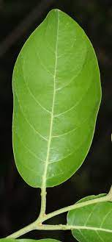
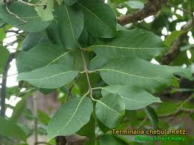
Morphology
Leaves:
8-20 cm long
Mostly subopposite.
Distant
Ovate or oblong-ovate in shape.
Deciduous in cold season.
Inferior aspect of the leaves shows two small nodules near its attachment with the stalk.

Slide 12
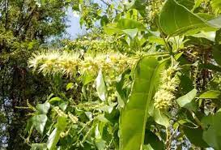
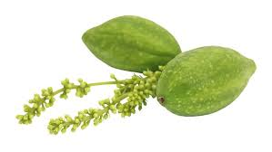
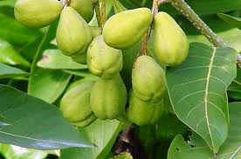
Flower
Dull white or yellowish.
With strong offensive smell in spike.
April-May.
Fruit
Drupe like
Ovoid or ellipsoidal from a broad base.
Glaborous
More or less than 5 ribbed when dry.
November-January.

Slide 13
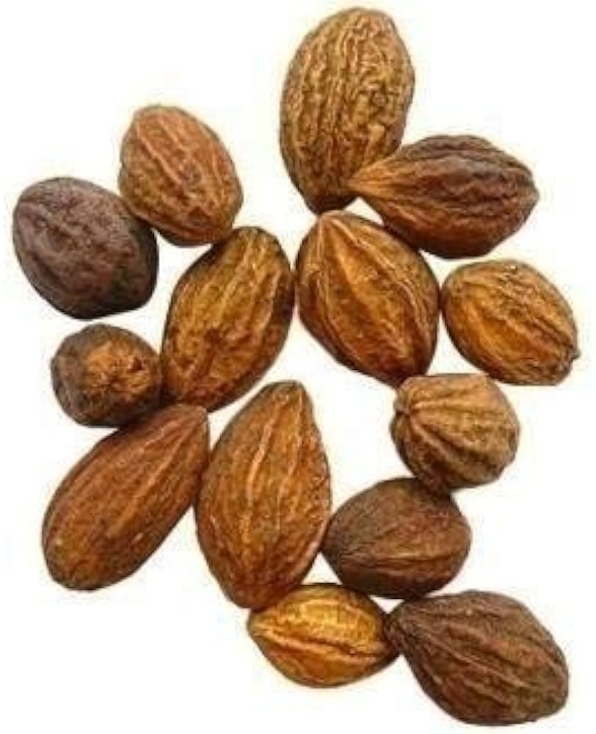
Seeds
Each fruit contain one seed, oval and hard.
On breaking the shell of the seed than oval shaped pulp is obtained.

Slide 14
Grahya
Large sized fruits consisting of semi-mature fruits which are upto 8 cm long and 2.5 cm in diameter at the thickest part. These are oblong, ovoid or club shaped, with a longi- tudinally wrinkled surface of greenish yellow or golden brown colour, having five ribs running from apex to the base. The fruit contains a single stony seed or light yellow colour.The small sized variety of young immature fruits are upto 2.5 cm long and 8 mm broad at the thickest part, Ovoid or often dorsally compressed with a longitudinally wrinkled surface and dark brown to black colour. It doesn't have any odour and has astringent taste.

Slide 15
Chemical composition
Fruit – Tannic acid, chebulinic acid, Anthraquinone glycoside, terchebin, vit. C
Fruit kernel- Arachidic acid, behenic acid, lindeic, oleic, palmiticacid, stearic acid.
Flower- Chebulin
Rasapanchak
Rasa Kashaya rasa pradhan lavana varjita Pancharasa
Virya Usna
Vipaka Madhura
Guna Ruksha, Laghu
Prabhava Tridoshahara

Slide 16
Part | Rasa
Haritaki Majja | Madhura rasa
Snayu | Amla rasa
Vrinta | Tikta rasa
Twacha | Katu rasa
Asthi | Kashaya rasa

Slide 17
Karma
Doshakarma
Madhur,Tikta, kashaya - Pitta shamaka
Katu, tikta, kashaya - Kapha shamaka
Amla, madhur - Vata shamaka
Anya karma
Pachansansthan - Dipana, Pachana, Anulomana, Mradu virechana
Twacha – kusthaghna
Mutrasansthan – Mutral
Swasansansthan - kaphaghna

Slide 18
Agra karma
हरीतकी पथ्यानाम् । (च.सू. 25/40)
Haritaki is highly conductive.
Pharmacological action
Antimicrobial
Antifungal
Antispasmodic
Cytoprotective
Purgative
Cardiotonic
Hypotensive

Slide 19
Therapeutic indication
Vibandha
Swasa
Kasa
Kustha
Prameha
Arsh
Netra roga
Pravahika
Ajeerna
Amlapitta

Slide 20
Aamayik pragog
Prameha - Haritaki churna with madhu.
Parinamasula – Haritaki takes with jaggery and sugar.
Vatavyadhi – Regular use of haritaki with cow’s urine cures vatavyadhi.
Arsh roga – Haritaki is kept in cow’s urine then mixed with jaggery.
Vibandha – Haritaki takes with jaggery relieves constipation.
Matra
churna - 3 - 6 gm
kwatha - 30 - 50 ml
Useful part
fruit

Slide 21
Formulations
Name | Indication
Haritakyadi churna | Udavarta
Haritakyadi Kwatha | Vibandha, Mutrakricchra
Hariakyadi pralepa | Vaivarnya
Triphala ghrita | Kamla
Abhayarista | Arsh
Triphala guggula | Shotha, Arsh
Danti Haritaki | Anah, Grahani

Slide 22
Ritu | Anupana
Shishir | Pipalli
Vasant | Madhu
Grishma | Guda
Varsa | Saidhava
Sarad | Sharkara
Hemant | Shunthi
Adulteration
Terminalia citrina Roxb in Assam
and Bengal and T. pallida in South India
Ritu Haritaki
To achieve rasayana karma one has
to consume Haritaki with different
anupana is different Ritu.

Slide 23
Controversy- There is no controversy in the identity of its botanical source , in South India it is being adulterated with T. pallida while in Bengal and Assam another species T. citrina Roxb. Is being used as a variety of Haritaki.
Contra indication- Due to Kashaya pradhana and Usna virya Haritaki is contra indicated in
बलवर्जितश्च रूक्षः कृशो लङ्घन कर्शितश्च ।
पित्ताधिको गर्भवती च नारी विमुक्तरक्तस्त्वभयां न खादेत ।।
(भा.प्र. हरीतक्यादि वर्ग 35)
Malnourished peron
Severe debility
While fasting
Mental depression
Pregnant woman

Slide 24
Research update
Anticarcinogenic property
A group of researchers have reported the inhibitory action on cancer cells growth by the phenolics of T. chebula Retz fruit and found that chebulinic acid, tannic acid, ellagic acid were the most growth inhibitory phenolics of T.chebulic . Ethanol extract of T.chebula fruit inhibited cell proliferation and induced cell death ia dose depandent manner in several malignant cell lines including human and mouse breast cancer cell line, human prostate cancer cell and a non tumerogenic immortalised human prostate cell lines. Beside , acetone extract of bark and fruit powder of T. chebula harbors constituents with promising anticarcinogenic property.(Bag A. et al.,2013)

Slide 25
Antidiabetic and renoprotective activity
T. chebula fruit and seeds exhibited dose dependent reduction in blood glucose of sreptozotocin induced diabetic rats both in short term and long term study and also had renoprotective activity. (Bag A. et al.,2013)
Hypolipidemic and hypocholesterolemia activity
Hypolipidemic activity of T. chebula extract against experimentally induced atherosclerosis have been documented. It also possesed hypocholestrenomicactivity against cholesterol induced hypocholesterolemia and atherosclerosis in rabbits. (Bag A. et al.,2013)

Slide 26
Anti inflammatory and analgesic activity
Aqueous extract of dried fruit of T. chebula showed anti inflammatory by inhibiting nitric oxide synthesis. Chebulagic acid from immature seed of T. chebula significantly suppressed the onset and progression of collagen induced arthritis in mice. T.chebula ina polyherbal formulation exhibited a dose dependent anti inflammatory effect against Freud adjuvant induced arthritis in rats. (Bag A. et al.,2013)
46 children with diarrhoea wee given T. chebula and T. vulgare decoction. 57.17% children were cured within 3 days of treatment (Sharma et al., 1984).

Slide 27
Thank you

