Slide 1






ADVERSE DRUG REACTIONS : IDENTIFICATION, MANAGEMENT AND REPORTING SYSTEM
Prof. Rakesh Kumar Tewari, M.D.(Ay.) I.M.S.(BHU),
Head, Deptt Of Dravyaguna,
R.A.M.C.H, Bareilly (UP).
E mail : vdrakesh.tiwari@gmail.com

Slide 2



IMPORTANCE OF KNOWING ADRs
Although in public opinion ASU Drugs are considered to be natural, safe, harmless, risk free, can be used without medical supervision, virtually for effective and safe drug therapy it is important to know :-
Nature and severity of ADR.
Whether treatment has to be stopped or not?
How safe the drug is?
How it may be made more safe and acceptable to patient?

Slide 3
MEASURE OF SAFETY: THERAPEUTIC INDEX (T. I.)
T.I. =
LD 50 (Median lethal dose ) ED 50 ( Median effective dose )
Drugs with a T.I. of : 10 or more - safe.
3 or 4
< 3
must be used cautiously.
cannot be used safely .
Note: - clinical
T.I. for same drug may be different in different situation e.g. T.I. for Aspirin in headache is more
than its T.I. for Antiarthritic and Antirheumatic uses (dose 0.3 to 1g / day as compared to 5 to 10g/day respectively).

Slide 4

SITES OF UNWANTED EFFECTS
LOCAL - At the site of contact- e.g. –nausea, vomiting, dia. with many oral drugs.
FOCAL - At a particular organ e.g. - Cardio toxicity of emetine, nasal stuffiness due to Jatamansi Fant.
GENERAL-Widespread e.g. – body ache, fatigue, fever, allergic rashes etc.

Slide 5
TYPES OF UNWANTED EFFECTS
SIDE EFFECTS
TOXIC EFFECTS
SECONDARY EFFECTS
INTOLERANCE
IDIOSYNCRASY OR PHARMACOGENETIC EFFECT
HYPER SENSITIVITY
SPECIAL TOXICITIES

Slide 6
SIDE EFFECTS
Normal pharmacological effects in therapeutic doses. Can occur in all.
Undesirable but unavoidable.
Usually do not need withdrawal of drug.
e.g.- Phenobarb in epilepsy – drowsiness.
Atropine & parsik yavani for abd. colic – dryness of mouth. Isoprenaline & somalata churna for br. asthma – palpitation. Diuretics – postural hypotension & hypokalemia.
S/E can be used as therapeutic effects in some conditions.
Mild constipating effect of Ashwagandha in IBS improves its adaptogenic action.

Slide 7
TOXIC EFFECTS
Dose related undesirable pharmacological actions or due to therapeutic dose in an intolerant person or due to prolonged use of cumulative drugs.
May need –
•Absolute:
Dose reduction / Withdrawal of the drug. due to real excess/ accumulation of drug.
•Relative: (i) decreased biotransformation/ excretion.
(ii) Excess response in normal dose due to abnormal physiological variables.
e.g. Digitalis toxicity in hypokalemia.
(iii) Therapeutic dose in an intolerant person.
e.g.
Hepatotoxicity by some steroids, i.v. Tetracyclines, Nephro/ototxicity by Amino glycosides, cardio toxicity by emetine etc.

Slide 8

INTOLERANCE/ HYPER-REACTIVITY
Excessive but expected pharmacological response due to biological variation.
e.g. Sedative dose of pnenobarb leading to severe CNS depression.

Slide 9
IDIOSYNCRASY or PHARMACO – GENETIC EFFECT
Unexpected & abnormal pharmacological response due to Genetic peculiarity.
Example:
Haemolysis with primaquine, sulfones & sulphonamides ( G-6-PD deficiency )
Succinylcholine Apnoea (due to atypical pseudo cholinesterase)
➢
➢
Cinchonism with Quinine & quinidine Salicylism with salicylates.
Note : Therapy may have to be stopped or dose to be titrated.

Slide 10
HYPERSENSITIVITY REACTIONS or ALLERGIC REACTIONS
Qualitatively abnormal response
Not related to pharmacological response Not related to dose
Based on Antigen Antibody Reaction Requires prior sensitization to drug
(Direct exposure or indirectly through food or environmental factors)
Drugs act as partial antigens (HAPTENs) which combine with body proteins & become complete antigens.
Contd.

Slide 11
HYPERSENSITIVITY REACTIONS or ALLERGIC REACTIONS
Antigen or Allergen may be – 1. Drug itself
Metabolite of drug.
Preservative / vehicle.
contaminant/adulterant Classification: (on the basis of +ve skin tests with antigens)
•Immediate Type – Type I, II & III.
•Delayed Type – Type IV.

Slide 12
TYPE – I HYPERSENSITIVITY REACTION : ANAPHYLAXIS
IgE (Reaginic Ab) fixed on mast cell surface react with Ag and release mediators without cell injury.
Symptoms appear within minutes & last for 1-2 hr.
Mild forms – Urticaria & Agio-neurotic oedema with food allergens & several drugs. Asthma & Rhinitis with Aspirin, Sulphonamides & Penicillins etc.
Severe Form: ANAPHYLACTIC SHOCK – rare life threatening reaction seen with penicillins , vaccines/ sera etc. Leading to Bronchospasm, Laryngeal oedema, hypotension and shock.
Treatment – Airway patency, Adrenaline, Corticosteroids, Pressure Agents & management of shock.

Slide 13
TYPE II: CYTOTOXIC HYPERSENSITIVITY / AUTO – ALLERGY
Failure of recognition of own tissue is lost due to partial antigenic action of drugs
Antibodies formed against body tissues activate surface bound COMPLEMENT SYSTEM leading to PHAGOCYTOSIS of
target cells.
e.g.- Thrombocytopenic purpura – by Allopurinol , pbz, quinidine, sulfa drugs.
•Haemolytic Anaemia – Alpha – M- DOPA , L-DOPA , Penicillin, Quinidine.
•Agranulocytosis – Chloramphenicol , Sulforamides, Pbz, Alpha-M-DOPA
•Collagen Diseases (SLE, RA) –Hydralazine, Phenytion , INH etc.

Slide 14
TYPE III – IMMUNE COMPLEX MEDIATED HYPERSENSITIVITY
COMPLEMENT , IgG & IgM react with Antigen - Liberate vaso-active substances and Lysozymes leading to cell damage.
•Arthus Reaction – Localised tissue necrosis due to Acute Immune complex Vasculitis at the site of entry of antigen
•Serum Sickness –
Fever, skin rash, Lymphadenopathy and Arthralgia Onset is delayed.
Treatment may have to be stopped.
Drug Fever – Sudden high grade fever, 7 to 21 days after administration of drug.
•e.g. –from Antivenom /sera, Penicillins, Phenytoin, Sulfonamides etc.

Slide 15
TYPE – IV CELL MEDIATED HYPERSENSITIVITY
Reaction is initiated by exposure of sensitized T cells to specific Antigen.
•Delayed type hypersensitivity-
Activated Memory T cell recruits other cells ( Macrophages ) which phagocytose & destroy the target cell bearing Antigen.
T cell mediated cytotoxicity-
Sensitized CYTOTOXIC T Lymphocytes kill Ag bearing
target cells directly. e.g. Cutaneous Reactions ( Dermatitis ) from Penicillins & topical sulphonamides.
Aplastic Anaemia from chloramphenicol, Phenylbutazone.
Hepatotoxicity -Hepatitis type – by INH, Pyrazinamide, Halothane.
Cholestatic type – by Phenothizines.

Slide 16
FACTORS FAVOURING ADRs
Non drug Factors
  Intrinsic to patient – Age , sex, personality, habits, genetic factors, Immune status.
  Extrinsic to patient
Environment
Prescriber
Inappropriate choice of drug.
Unskilled administration
Drug Factors
  Intrinsic to drug – Unwanted effects
  Drug Interactions

Slide 17
ADVERSE EVENT / ADVERSE EXPERIENCE
Any untoward occurrence (clinical phenomenon) that may present during treatment with a pharmaceutical product but which does not necessarily have causal relationship with this treatment.
SIGNAL / ALERT
Reported more than one adverse event may lead to generate a signal depending upon the seriousness of event & quality of information.

Slide 18
ADVERSE REACTION
A response to drug which is noxious and unintended and which occurs at doses normally used in man for prophylaxis, diagnosis or therapy of disease or for the modification of physiological function. (WHO Technical Report No. 498 (1972))
UNEXPECTED ADRs – nature & severity is not consistent.
SERIOUS ADR
Results in death/disability/incapacity.
Is life threatening?
Requires hospitalisation or prolongation of existing hospitalisation.

Slide 19
AIMS OF ADR REPORTING
To identify, quantify & document drug related problems.
To increase knowledge & minimise such episodes. WHAT TO REPORT
  All suspected ADRs
  Lack of efficacy
  Counterfeiting
  Resistance
  Interactions
  Dependence & Abuse.

Slide 20
REPORTING OF ADVERSE DRUG REACTIONS
Notifier
Reporter - any healthcare professional.
Where to report? –
Peripheral phamacovigilance centre Regional pharmacovigilance centre National pharmacovigilance resource centre
  How to report- in Reporting form for suspected ADRs
•What happens to information submitted – information is handled confidentially. PPC forwards the form to RPC who will carry out causality analysis. Information forwarded to NPRC will be analyzed & forwarded to Deptt. Of AYUSH, Govt of India.

Slide 21
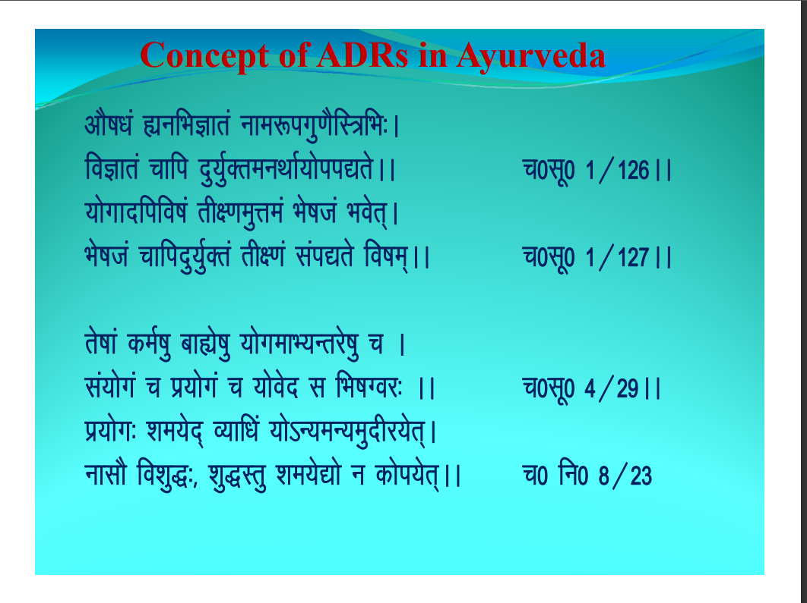

foKtr˙ ptfi n¸¸;¸¸'DreuFtt';t’ii4r’jj
;t’xtnfifoet˙ rी{.te¸Ùte˙ Ht’ett˙ Hto’r,j Ht’ett˙ ptfin¸;¸'Dr˙ rी{.t˙ l˙i4r’ foete,jj
p0l˛˛0 1/126jj
p0l˛0 1/127jj
rett weet¸ atáet¸ ;txetH;:rjet¸ p j l˙;t’x˙ p iz;t’x˙ p ;t’o’n l fHtetXoj: jj iz;t’x: ‘te;’n, O;tf/t ;t’s:;e:;e¸nीj;’r,j
utlt“ fo’t¸):, ‘t¸)Lr¸ ‘te;’4t’ u wt’i;’r,jj
’ ˙ ' ’ ’
p0l˛0 4/29jj
’ ’ ˙ ’ ’
p0 fu0 8/23

Slide 22
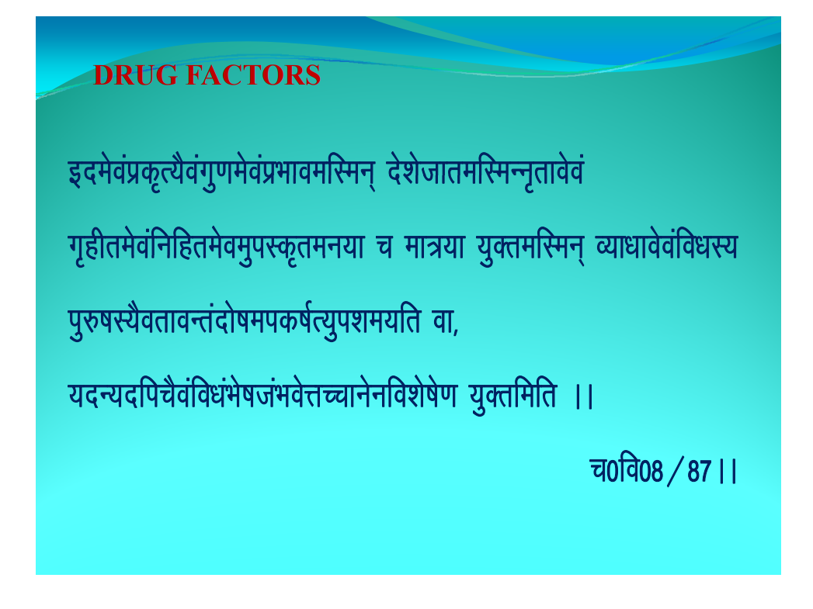
bne’o˙izw`i;“o˙x¸.te’o˙izHttoefLeu, n’’t’ttrefLe:u`rto’o˙ x`gीre’o˙fufgre’oe¸iLw`reu;t p et=;t ;DrefLeu, O;t/tto’o˙fo/tL; i¸#etL;“orto:r˙nt’eteiwet'i;¸i’te;fr ot,
;n:;nfip“o˙fo/t˙Ht’ett˙Hto’ÙtPptu’ufo’t’et’.t ;¸Drfefr jj
p0fo08/87jj

Slide 23
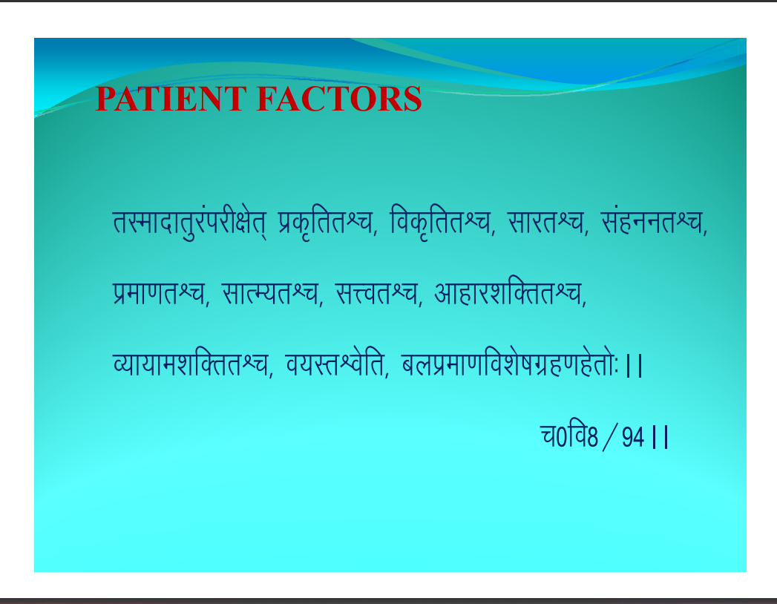
rLetntr¸j˙ijी{t’r, izw`frrÜp, fow`frrÜp, ltjrÜp, l˙guurÜp, izet.trÜp, ltiE;rÜp, lÙorÜp, vtgtj’tfDrrÜp,
O;t;te’tfDrrÜp, o;LrÜo’fr, ayizet.tfo’t’etxzg.tg’rt’:jj
p0fo8/94jj

Slide 24
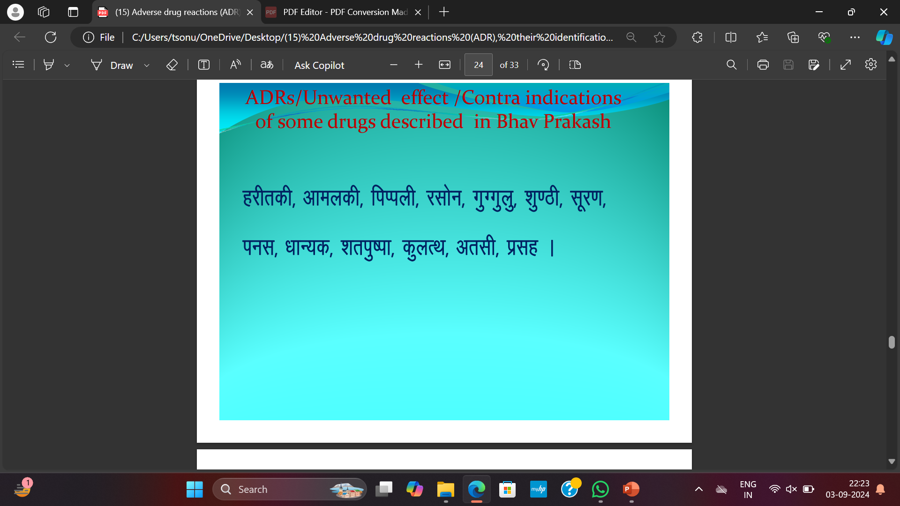

gjीrwी, vteywी, fiIiyी, jlt’u, x¸Xx¸y¸, ‘t¸.Bी, l˛j.t, iul, /tt:;w, ‘tri¸eit, w¸yiFt, vrlी, izlg j

Slide 25

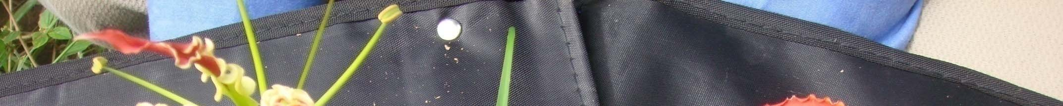
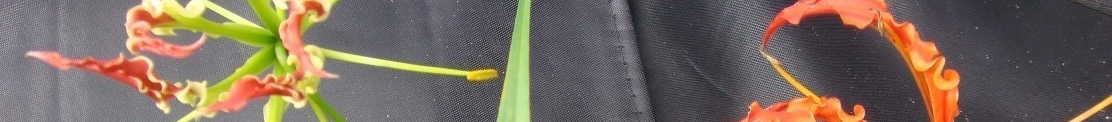



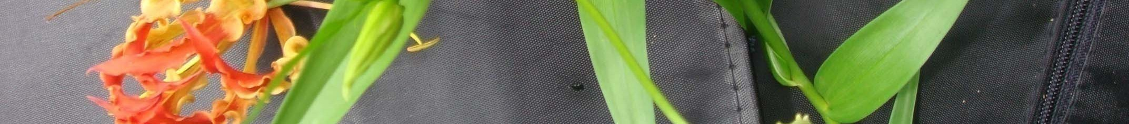

Slide 26






Slide 27






Slide 28






Slide 29







Slide 30






Slide 31
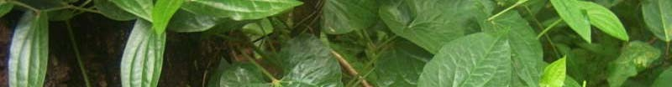


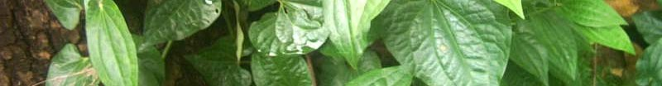
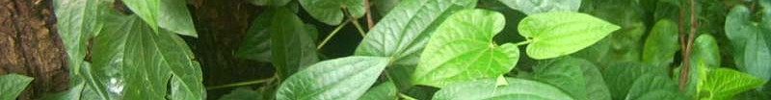

Slide 32




Conclusion
Hospitalization due to drugs is about 6-7 % of total admissions.
It is very expensive.
Do not force govt. physician to prescribe particular medicine (e.g. kaishor guggulu in place of kanchnar guggulu.)
Minimize multi drug prescription.
Please listen to your patient.

