Slide 1

UNIT-: 07
REFERRAL SERVICES

Slide 2

INTRODUCTION
In India health services are provides at 3 levels considering the 3 levels of prevention. At each level the facilities for health services are organized as per planning to cater the specific type of health needs of the client.

Slide 3

INTRODUCTION
WHO has identified the provision of referral system as one of the major supportive activities for primary health care, so the referral system has been established in such a way that cases can be referred from primary level of care to secondary level of care, to tertiary level of care according to the clients health needs.

Slide 4
INTRODUCTION
TERTIARY LEVELCARE
STATE LEVEL HOSPITAL
PRIMARY HEALTH CENTER
SUBCENTER LEVEL
VILLAGE LEVEL
DISTRIC LEVEL HOSPITAL
COMMUNITY HEALTH CENTER
SECONDARY LEVEL OF CARE
FIRST REFERRAL UNIT
PRIMARY LEVEL OF CARE
VILLAGE HEALHTH GUIDE

Slide 5
PURPOSES
For early diagnosis and treatment of the case under the specialist care.
Cost effective system.
Reduce the duration of stay of the patient in hospital .
Limits the progress of the disease.
Prevents complications by starting appropriate timely care.
Teaching the nursing personnel for reviewing of patients sent for referral.

Slide 6

FACTORS AFFECTING REFERRALS
Availability of qualified consultants.
Physician specialty
Length of training
Unexplained findings
Patients characteristics.

Slide 7
FUNCTION OF FRU
Surgical function
Medical treatment function
Blood transfusion function
Manual functioning
Anesthetic function
Obstetric and neonatal care function

Slide 8


STEPS IN REFERRAL PROCESS
8.
7.
6.
5.
4.
3.
2.
1.
Establish a good relationship with the patient.
Establish the need for a referral
Set objectives for the referral
Explore resources availability
Patient decides to use or not use
Make pre-referral treatment
Facilitate, coordinate referral
Evaluate and follow up

Slide 9


REFERRAL FORM
All the units have printed referral forms which is filled by the referring doctors with patients particular brief history of case treatment given and reason for referring.

Slide 10
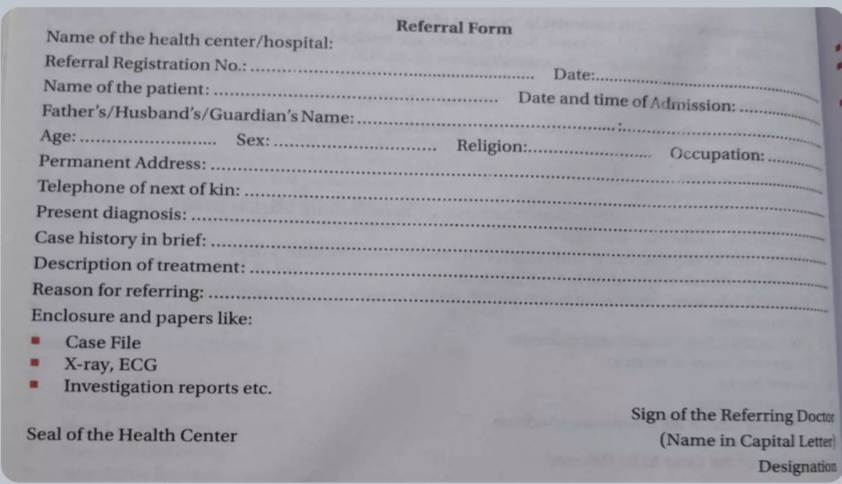
REFERRAL FORM

Slide 11
BENEFITS OF REFERRAL
FOR THE PATIENTS
Prompt diagnosis and management
Save time , money and effort
Better outcome
FOR THE FAMILY PHYSICIAN
Learning and training
Gaining self confidence
Increase communication between the health care staff

Slide 12

Conti…
FOR THE CONSULTANT
Improve the quality of the patients managements.
Increase communication between the health care staff

Slide 13
ROLES AND RESPONSIBILITY OF CHN
Observe and collect the information.
Nurses should be aware of their limitations and responsibilities in referral system.
In case of emergency, they should attempt to save the life of the patient before referral.
While sending serious patients, life-saving equipments/ medicines should be arranged.

Slide 14
Conti…
Nurses should explore and use the available resources for transportation.
Explain about the seriousness of the situation/ problem.
Maintain the record and reports.

Slide 15
SUMMERY
In public system health care , the health care services are provided at three levels. Primary level of health care is the setting health care which provide first level of contact between the community and the health care at grass root level. At this level most of the health problem are solved with some guidance, education and assistance and treatment by the team of health personnel. This care is provided by the Sub center and PHC , Secondary level of care by the CHC and the tertiary level of care is provided by the state level multi- speciality hospital.

Slide 16
Thank you !

